Slide 1
Advance Python Packages

Slide 2
Working with NumPy

Slide 3
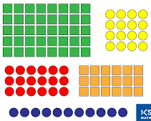
Introduction to Array
What is
Array?
Common
Applications
Scientific Computing
Data Analysis
Machine learning

Slide 4

Introduction to NumPy
Some Key features:
Library of mathematical functions & operations
Fast and efficient computation
Multi-dimensional arrays & matrices
Scientific computing packages such as SciPy & Pandas
What is
NumPy?

Slide 5
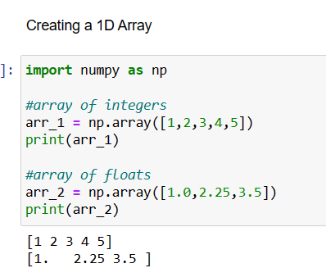
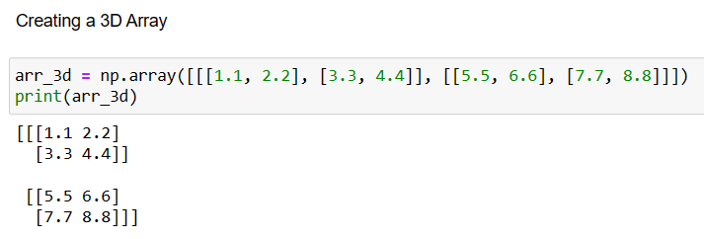
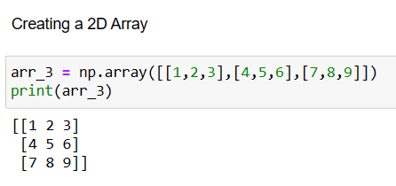
Creating Arrays

Slide 6
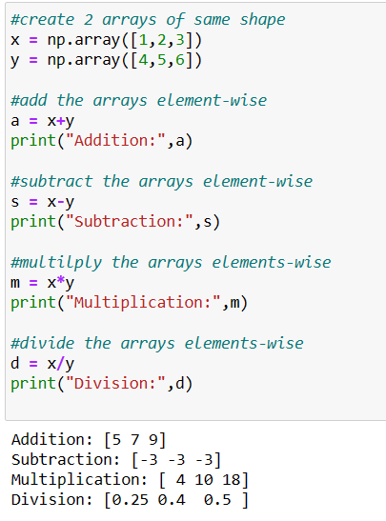
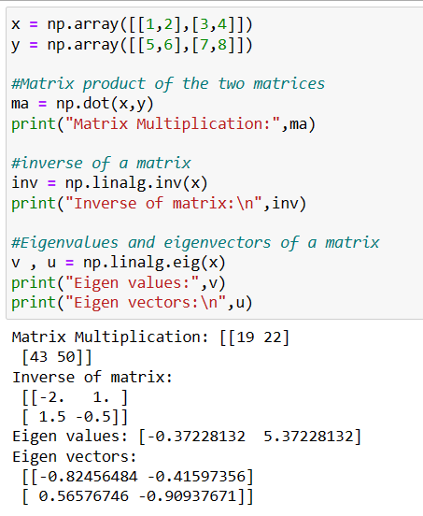
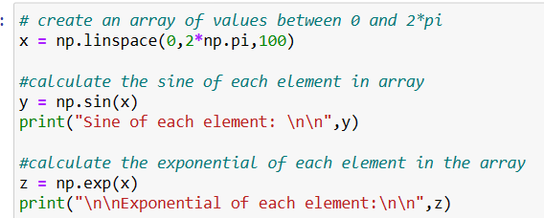
Common Operations
Mathematical
Basic Arithmetic
Linear Algebra

Slide 7
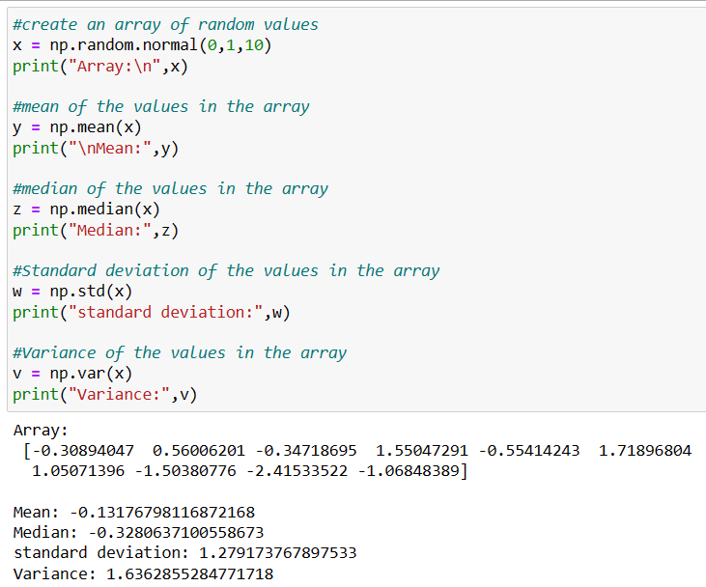
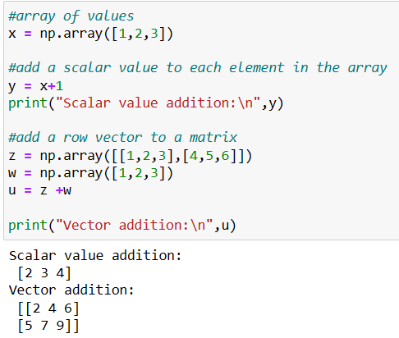
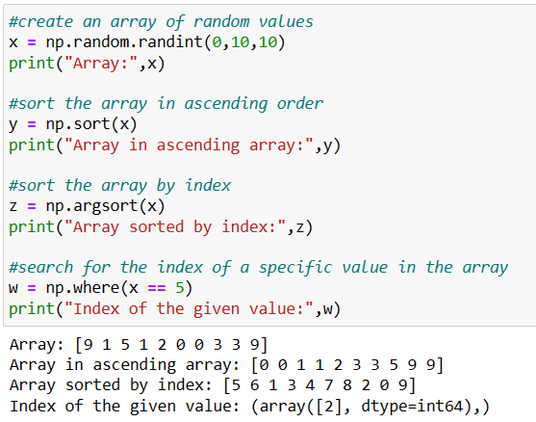
Common Operations
Braodcasting
Statistical
Sorting & Searching

Slide 8

Q
&
A

Slide 9
Working with Pandas

Slide 10

Overview Of Pandas
Series
Data Frames
What is
Pandas?
Range of functions
Filtering
Merging
Grouping
Pivoting
Key data structures

Slide 11
Forms in Pandas
Series
DataFrame
One – dimensional array-like object
Can hold any data type
Has an associated index label
Two-dimensional table-like data structure
Each column in a DataFrame is a Series object and columns are aligned by their index labels

Slide 12
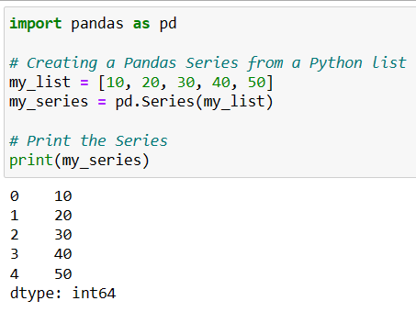
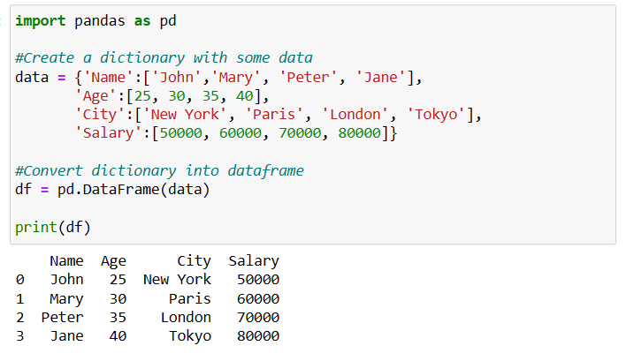
Creating a Series and DataFrame
Series
DataFrame

Slide 13
Pandas Functions
read_csv()
Reads a CSV file into a data frame.
head()
Returns first n rows of a data frame
Computes summary statistics for each column in a data frame
tail()
Returns last n rows of a data frame
info()
Provides information about a data frame
describe()
shape
Returns the number of rows & columns in a data frame
isnull()
Returns a Boolean mask indicating which values in a data frame are null
Creates a pivot table from , aggregate data according to specified rows and columns
fillna()
Fills null values in a Data frame with a specified value
groupby()
pivot_table()
Groups by one or more columns and perform aggregation on each group

Slide 14
Pandas Demo

Slide 15
Q
&
A

Slide 16
Data Wrangling

Slide 17
Data Wrangling
Deleting missing values
Imputing missing values
Creating a separate category for missing values
Using machine learning algorithm
Data Cleaning
Missing values handling
Purpose
Transforming & preparing
Identifying & correcting errors
Common tasks
Remove duplicate data
Filling missing values
Correcting data formats
Incorrect Conclusions
Standardizing data
Handling outliers
Consequences
Misleading insights
Flawed decisions

Slide 18
Handling categorical & numerical features
Categorical features
Numerical features
Label encoding
Frequency encoding
One-hot encoding
Standardization
Min-max scaling
Log transformation

Slide 19
Outlier detection & Imputation
Outlier detection
Imputation
Z-score
Interquartile Range
Visualization
Winsorizing
Median imputation
Machine learning algorithms

Slide 20
EDA & Suitable algorithms
Exploratory data analysis
Decide suitable algorithms
Summary statistics
Data visualization
Principal Component Analysis
K-means clustering
Support Vector Machines
Decision Trees
Regression Analysis
Correlation analysis
Hypothesis testing

Slide 21
Sampling & Data Diagnostics
Sampling
Data Diagnostics
Simple random Sampling
Startified Sampling
Cluster Sampling
Systematic Sampling
Model Selection
Train-test split
Confusion matrix
Standard scaler
Normalization
Transformations

Slide 22
Demo using Titanic dataset

Slide 23
Q
&
A

Slide 24
Data analysis Using Python

Slide 25

Introduction to matplotlib
Open-source
Wide range of customizable plots
Most widely used library for visualization
Flexible & powerful API
Range of built-in style & themes

Slide 26
Basic plots
plt.plot()
Used to create line plots
plt.scatter()
Used to create scatter plots
plt.box()
Used to create box plots
plt.bar()
Used to create bar plots
plt.imshow()
Used to create image plots
plt.pie()
Used to create pie charts
plt.hist()
Used to create histograms

Slide 27

Seaborn
Integration with Pandas
Beautiful default styles
Support for complex plots
Flexible customization for plots
Powerful statistical function

Slide 28
Basic used plots
sns.lineplot()
Line plots
sns.scatterplot()
Scatter plots
sns.barplot()
Bar plots
Heatmaps
sns.histplot()
histograms
sns.boxplot()
Bar plots
sns.heatmap
sns.pairplot()
Matrix of scatter plots

Slide 29
Demo using Iris dataset

Slide 30
Q
&
A

Slide 31
Thank You

