Slide 1

BIKE SHARING CASE STUDY
Group 4

Slide 2

Mentor Name :-
Mr. Saurabh Singh
Team Members :-
Miss. Sneha Chogale
Mrs. Ankita Todkar
Mr. Ganesh Kumbhar

Slide 3

INTRODUCTION
A bike-sharing system is a service that makes bikes available to people for short-term, shared use that can be paid for or provided for free.

Slide 4

Problem Statement
What factors are important for predicting demand for shared bikes ?
Acceptance Criteria
To build the best model which gives the maximum performance, and need to deploy the model with stream lit.

Slide 5
Technical Parameters
Software
Python
Libraries
Pandas
Models
Linear Regression
Spyder
Seaborn
Scikitlearn
Numpy
Random Forest
Deployment
Streamlit

Slide 6
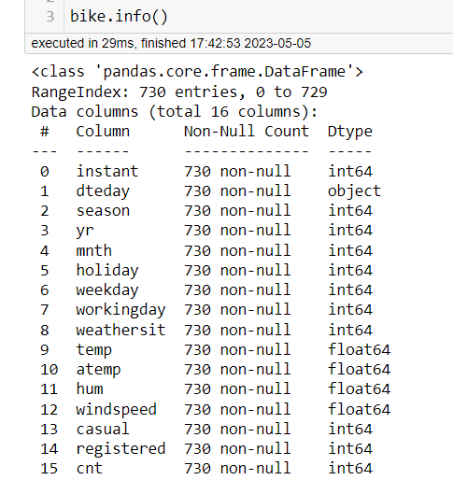
Dataset Details
There are 730 records and 16 features in the given dataset.
In Bike sharing dataset, all values are numerical except date. It contains 2 years of data for all season, weekdays, weather sit also temperature and windspeed.
There is no any null value in given dataset.

Slide 7
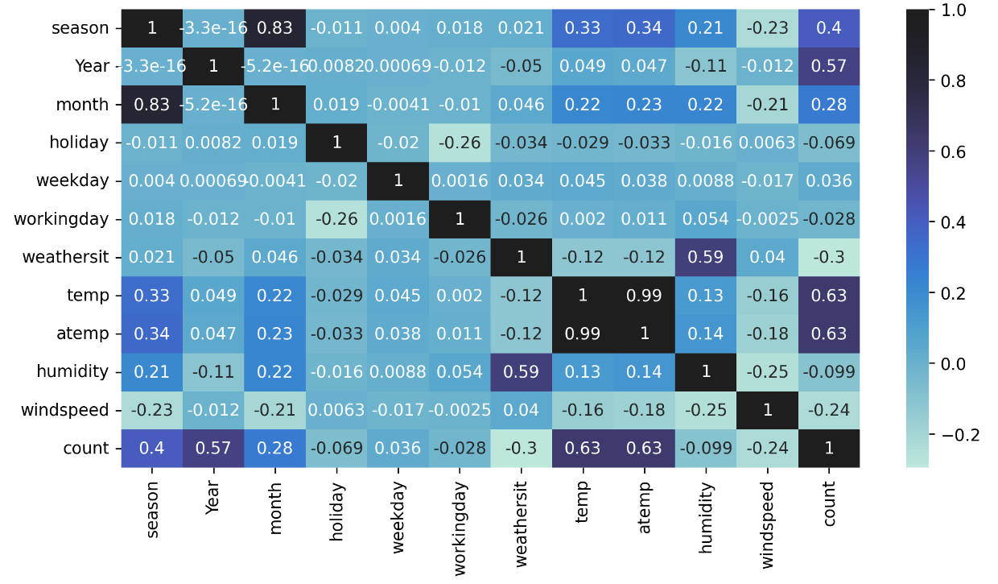
EDA
First we dropped some unwanted features like instant, dtedate.
Also sum of Casual and registered feature gives count feature so we dropped casual and registered feature.
There is very high correlation in temp and atemp so we dropped atemp from the dataset.

Slide 8
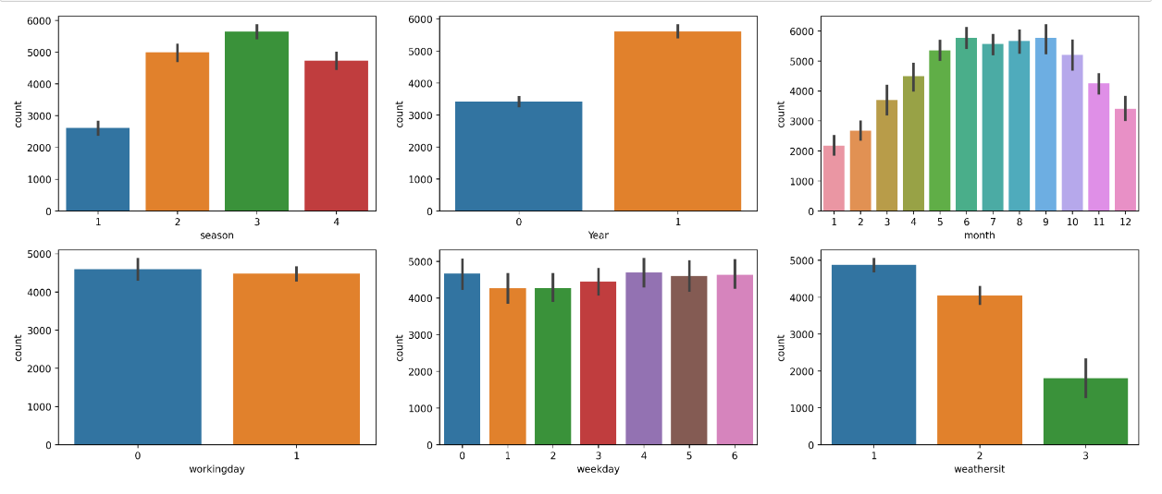
Data Visualization
From the above bar plot, We can see maximum bikes rentals are from season 3 and year 1.
The count of bikes is reduced in bad weather.
Bikes are in high demand from June to September compared to other months.

Slide 9
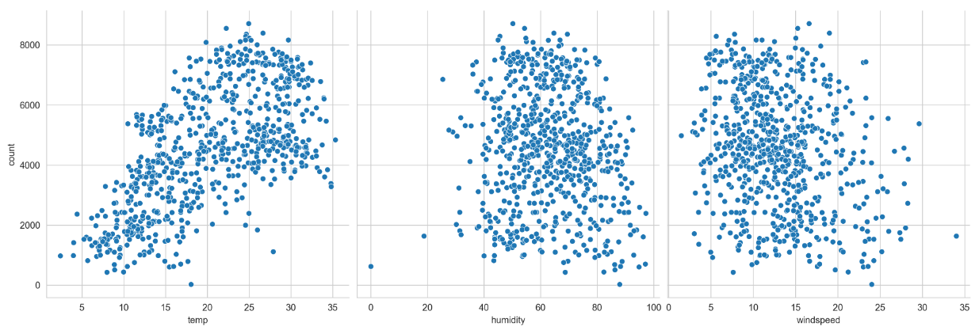
Dealing with Outliers
In humidity, there is outlier from below 20 also in the second graph, there is one outlier lies in near 35 windspeed.
By simple imputer, we put mean value in outlier points.

Slide 10

Model Training
We divided the data into two parts one for training (80%) and (20%) for testing data by using train test split (sklearn).

Slide 11
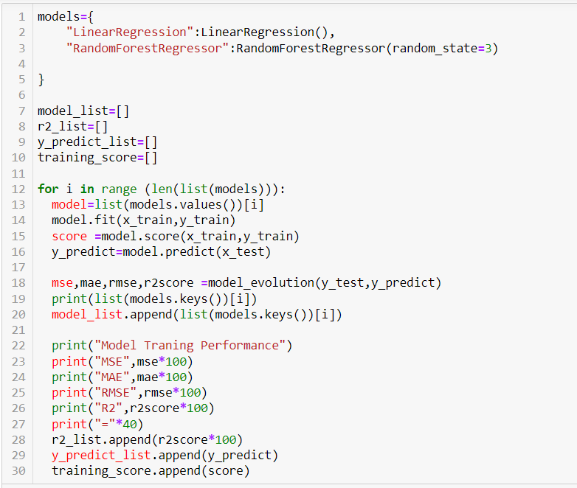
Model Building
We train our model in linear regression and
random forest regression.
Training performance :-
LinearRegression Model Traning Performance
MSE 63444216.28229355 MAE 61312.02939040634 RMSE 79651.87774452876 R2 81.46446231710543
RandomForestRegressor Model Traning Performance
MSE 37125653.9689041
MAE 44716.0
RMSE 60930.824685789456
R2 89.15355885111975

Slide 12
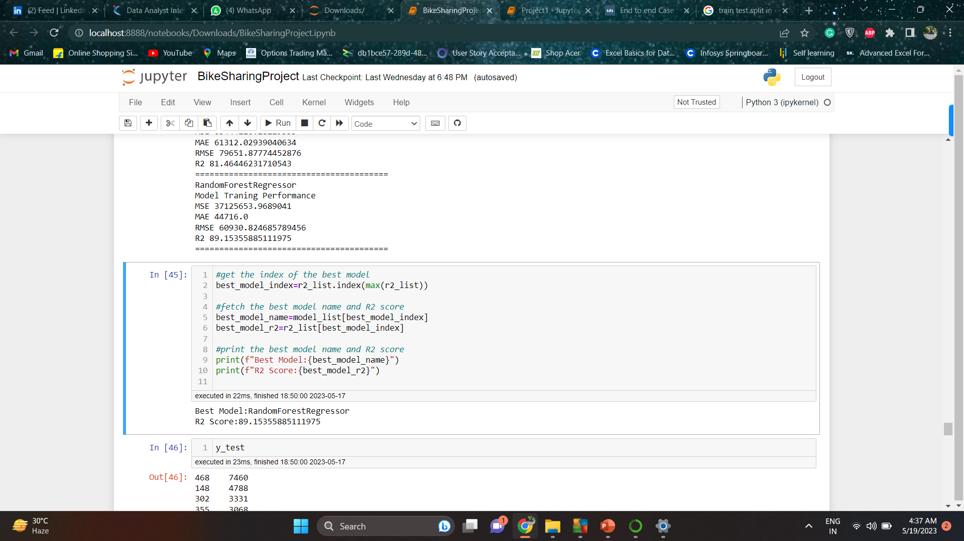
Model Finaliazation
Comparing with all models, we are finalizing the Random Forest Model

Slide 13
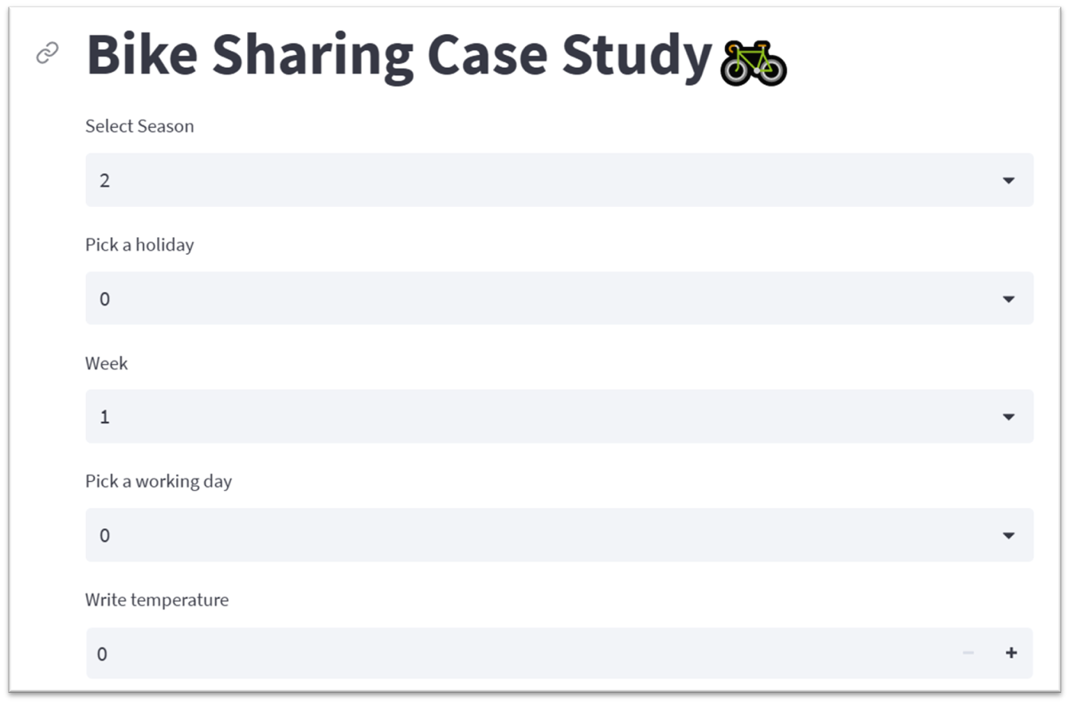
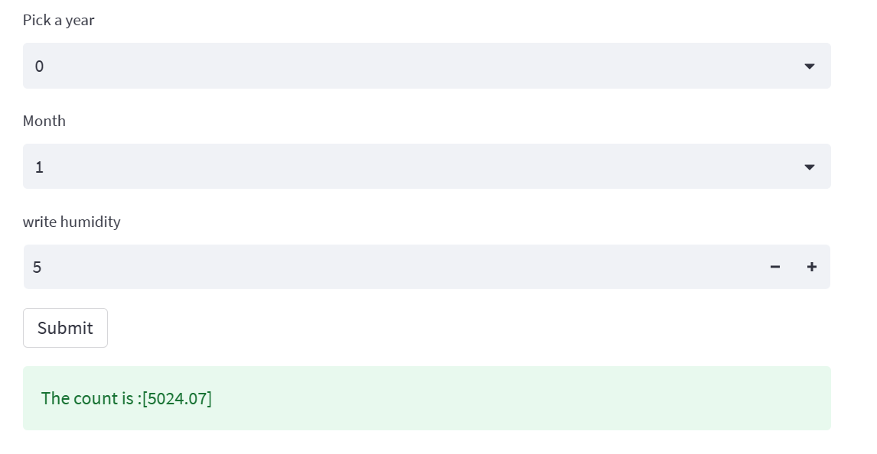
Model Deployment by Streamlit

Slide 14
Challenges:
Data cleaning
Unnecessary features
Highly coreelated features (multicollinerity)
Dealing with Outliers
Overfitting issue

Slide 15
Conclusion
Based on the final model below features contributing significant towards the demand :-
Season
Year
Month
Week
Working days
Humidity
Holidays
Temperature

Slide 16
Suggestion
With an increase in temperature the demand also increases, hence it should keep track of the weather conditions.
During the Spring season the demand rises, hence it should be well prepared to meet high demand.

Slide 17

Thank You

