Slide 1
Vue.js Framework
Web Programming
Spring 2020
Pooya Parsa
Professor: Bahador Bakhshi
CE Department, Amirkabir University of Technology

Slide 2
Outline
Introduction to Vue.js
The Vue instance
Declarative Rendering
Event Listeners & Input handling
v-if and v-for Directives
Computed Props
Components

Slide 3

What is Vue.js
A progressive framework for building user interfaces.
Created by evan you when he was working at Google Creative Labs in 2013.
Pronounced /vjuː/, like view!

Slide 4
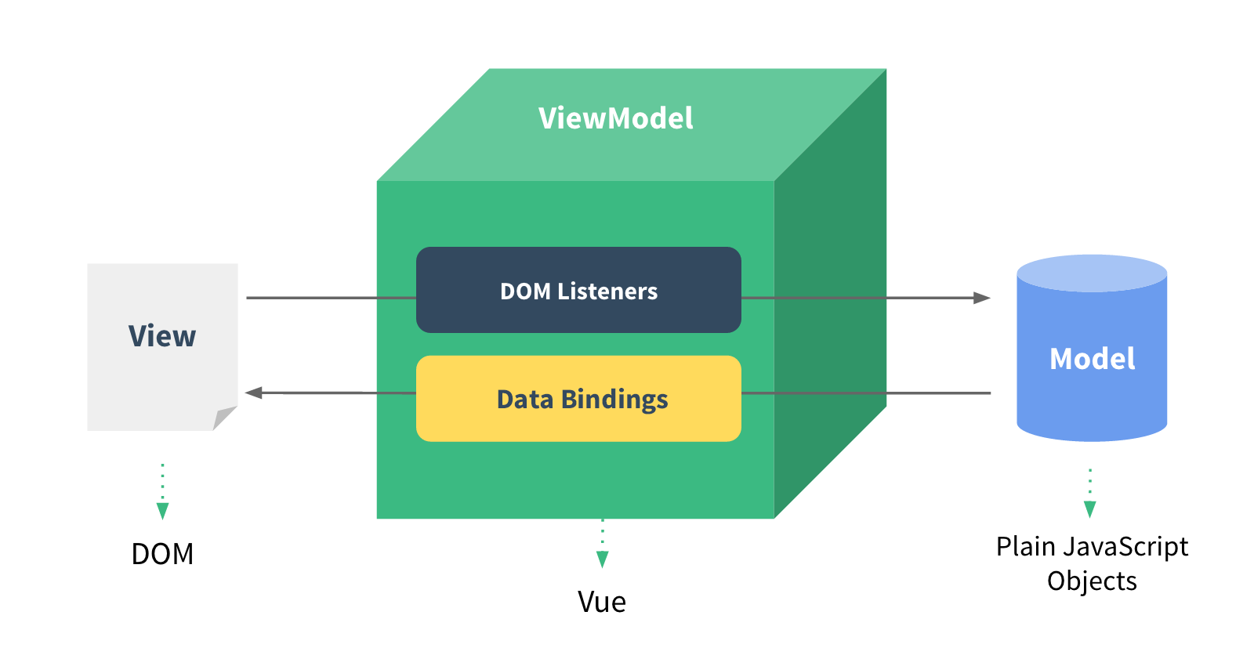
MVVM Architecture Pattern

Slide 5
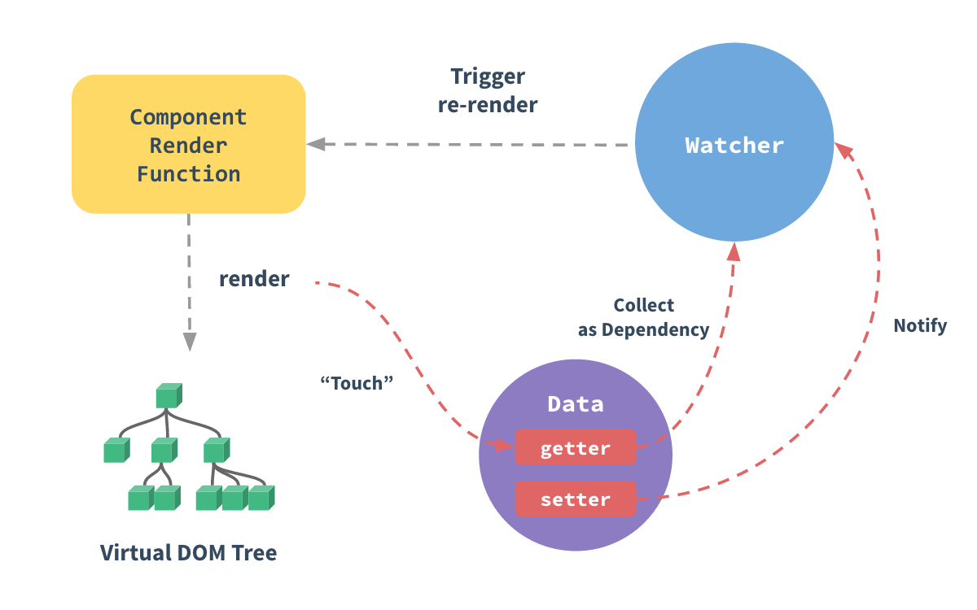
Reactivity

Slide 6
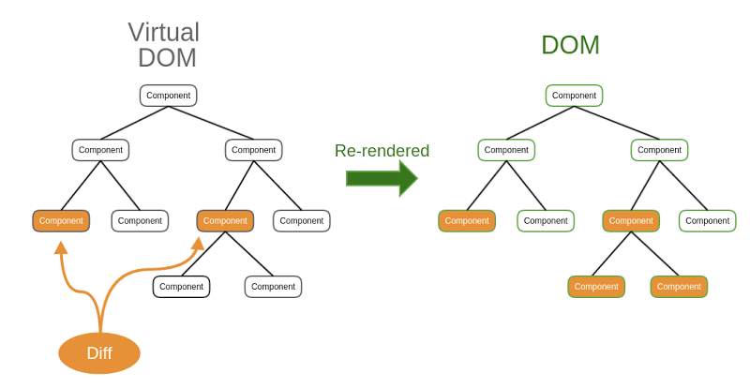
Virtual DOM

Slide 7
Outline
Introduction to Vue.js
The Vue instance
Declarative Rendering
Event Listeners & Input handling
v-if and v-for Directives
Computed Props
Components

Slide 8
The Vue Instance
Every Vue application starts by creating a new Vue instance with the Vue function:
<script>
var vm = new Vue({
// options
})
</script>
As a convention, we often use the variable vm (short for ViewModel) to refer to our Vue instance.
A Vue application consists of a root Vue instance created with new Vue, optionally organized into a tree of nested, reusable components.

Slide 9
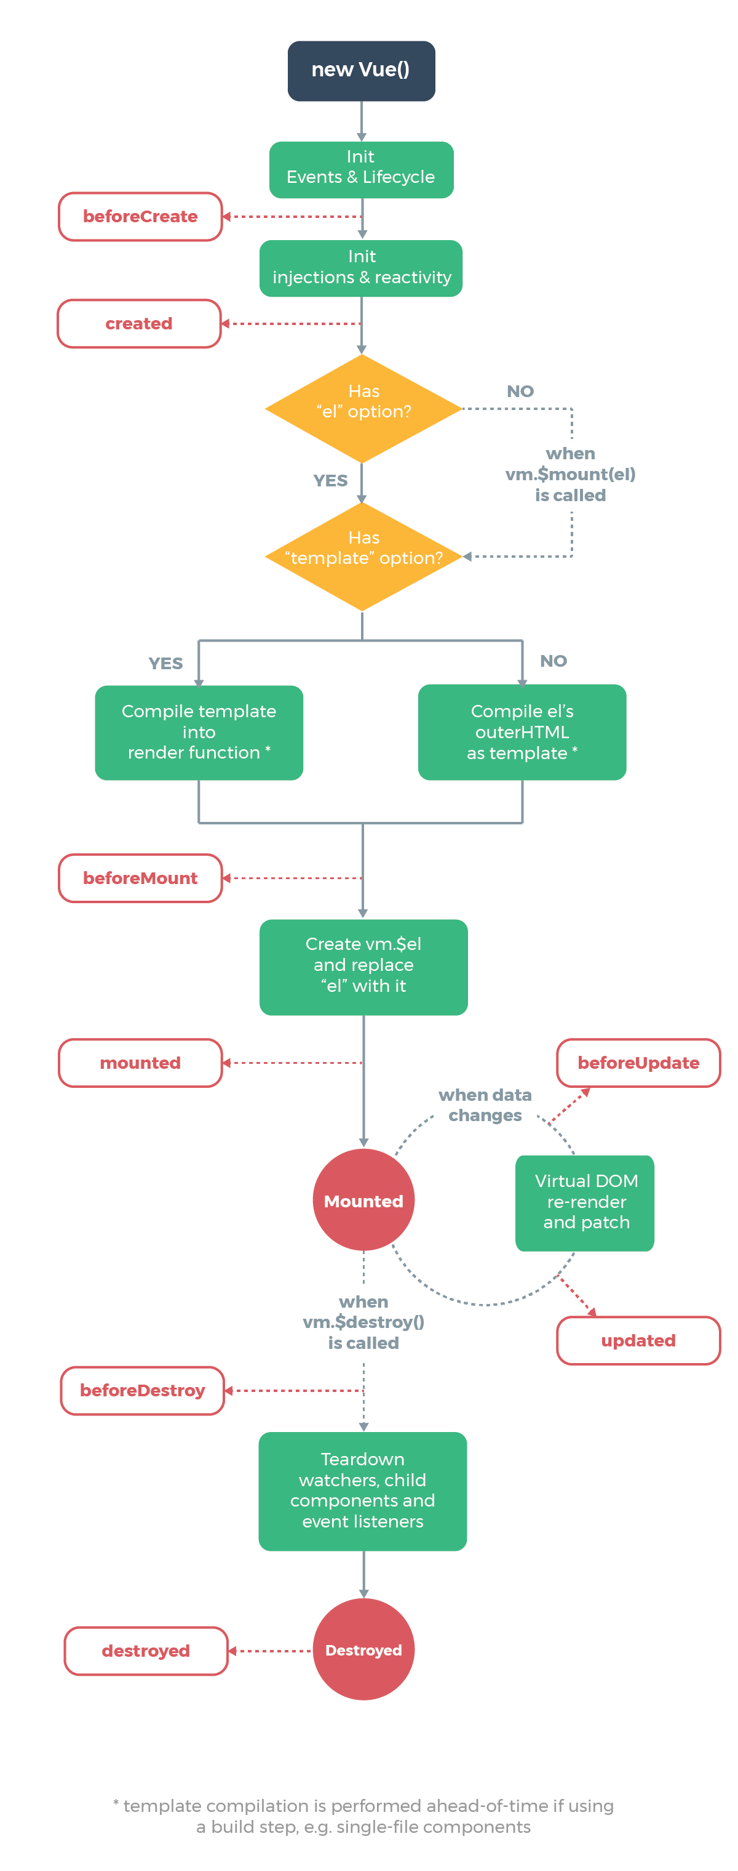
Vue Lifecycle Diagram

Slide 10
Vue Lifecycle Diagram

Slide 11
Outline
Introduction to Vue.js
The Vue instance
Declarative Rendering
Event Listeners & Input handling
v-if and v-for Directives
Computed Props
Components

Slide 12
Declarative Rendering
Render template with data

Slide 13
Data Bindings

Slide 14
Data Bindings
<div id="app">
{{ message }}
</div>
<script>
new Vue({
el: '#app',
data: {
message: 'Hello World!'
}
})
</script>
https://codepen.io/pi0/pen/pdKxKZ

Slide 15
Binding attributes
<div id="app">
<img :src="imageSrc" />
</div>
<script>
new Vue({
el: '#app',
data: {
imageSrc: 'https://lorempixel.com/300/150'
}
})
</script>
https://codepen.io/pi0/pen/mqKzgm

Slide 16
Outline
Introduction to Vue.js
The Vue instance
Declarative Rendering
Event Listeners & Input handling
v-if and v-for Directives
Computed Props
Components

Slide 17
DOM Listeners

Slide 18
DOM Listeners
<div id="app">
<button @click="clicked">Click Me</button>
</div>
<script>
new Vue({
el: '#app',
methods: {
clicked () {
alert("HEEY!")
}
}
})
</script>
https://codepen.io/pi0/pen/aVKRPo

Slide 19
Why using listeners in HTML?
All Vue handler functions and expressions are strictly bound to the ViewModel.
It’s easier to locate the handler function implementations within your JS code.
ViewModel code can be pure logic and DOM-free. This makes it easier to test.
When a ViewModel is destroyed, all event listeners are automatically removed. You don’t need to worry about cleaning it up.

Slide 20
Handling User Input
<div id="app">
Your name: <input @input="onInput"></input>
Welcome {{ name }}!
</div>
<script>
new Vue({
el: '#app',
data: {
name: ’Guest User'
},
methods: {
onInput(e) {
this.name = e.target.value
}
}
})
</script>
https://codepen.io/pi0/pen/rYKqEE

Slide 21
Handling User Input (v-model)
<div id="app">
Your name: <input v-model="name"></input>
Welcome {{ name }}!
</div>
<script>
new Vue({
el: '#app',
data: {
name: 'Guest User'
}
})
</script>
https://codepen.io/pi0/pen/xPzQZZ

Slide 22
Outline
Introduction to Vue.js
The Vue instance
Declarative Rendering
Event Listeners & Input handling
v-if and v-for Directives
Computed Props
Components

Slide 23
Conditional Rendering Conditional rendering (v-if)
<div id="app">
<input type="checkbox" id="accept" v-model="accepted">
<label for="accept">I accept terms of use</label>
<p v-if="!accepted">Please accept terms!</p>
<p v-else>Thank you!</p>
</div>
<script>
new Vue({
el: '#app',
data: {
accepted: false
}
})
</script>
https://codepen.io/pi0/pen/LOrXWx

Slide 24
List rendering (v-for)
<div id="app">
<ul>
<li v-for="course in courses">
<input type="checkbox" v-model="selectedCourses" :value="course" />{{ course }}
</li>
</ul>
{{ selectedCourses }}
</div>
<script>
new Vue({
el: '#app',
data: {
selectedCourses: [],
courses: ['IE', 'ML', 'BP', 'AP']
}
})
</script>
https://codepen.io/pi0/pen/xPzQLE

Slide 25
Outline
Introduction to Vue.js
The Vue instance
Declarative Rendering
Event Listeners & Input handling
v-if and v-for Directives
Computed Props
Components

Slide 26
Computed props
Putting too much logic in your templates can make them bloated and hard to maintain and not declarative.
Computed props are being cached.
Dependencies will be auto tracked.

Slide 27
Computed props
<div id="app">
<input v-model="a"> * <input v-model="b"> = {{ result }}
</div>
<script>
new Vue({
el: '#app',
data: {
a: 10,
b: 10
},
computed: {
result() {
return this.a * this.b
}
}
})
</script>
https://codepen.io/pi0/pen/xPzQYR

Slide 28
Outline
Introduction to Vue.js
The Vue instance
Declarative Rendering
Event Listeners & Input handling
v-if and v-for Directives
Computed Props
Components

Slide 29
Vue Components
In Vue, a component is essentially a Vue instance with pre-defined options.
They help you extend basic HTML elements to encapsulate reusable code.
Components are one of the most powerful features of Vue.

Slide 30
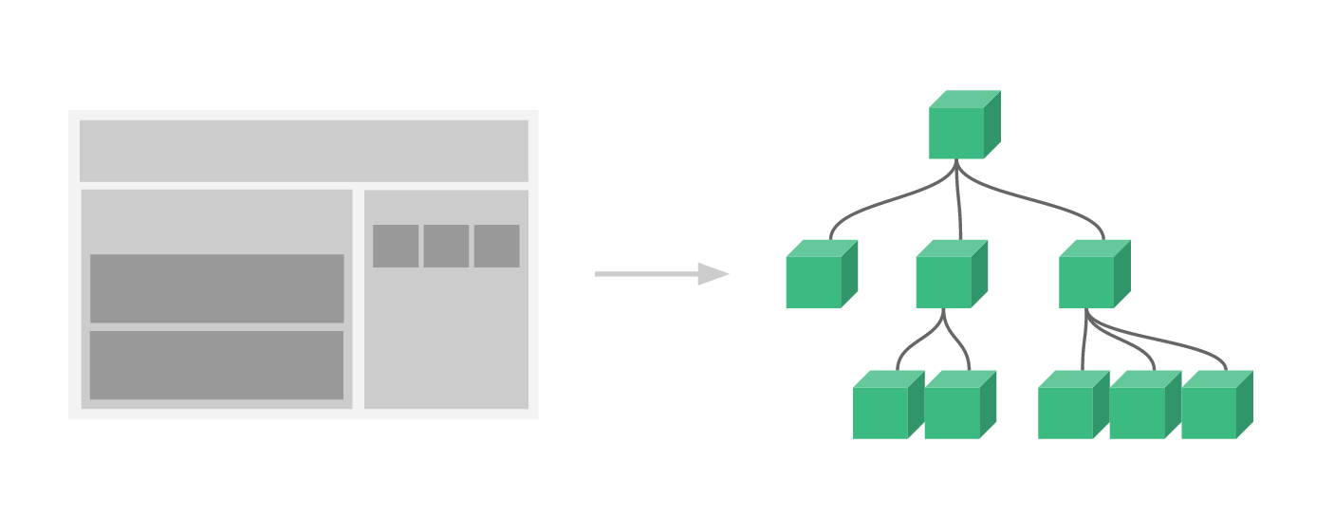
Composing with Components
Component are an abstraction that allows us to build large-scale applications composed of small, self-contained, and often reusable components.

Slide 31
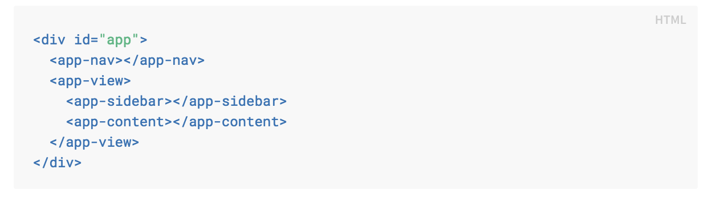
Components for large scale apps
An (imaginary) example of what an app’s template might look like with components:

Slide 32
Composing Components
Components are meant to be used together, most commonly in parent-child relationships.
In Vue, the parent-child component relationship can be summarized as props down, events up.
This prevents child components from accidentally mutating the parent’s state, which can make your app’s data flow harder to understand.

Slide 33
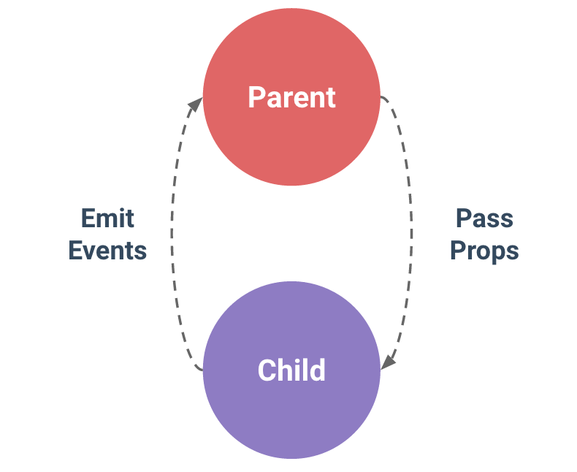
One-Way Data Flow
Parent passes data down to the child via props, and the child sends messages to the parent via events.

Slide 34
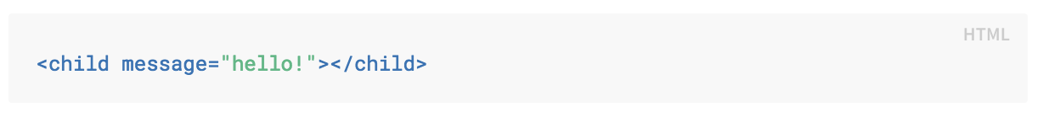
Component Props
Every component instance has its own isolated scope.
Data can be passed down to child components using props.
A prop is a custom attribute for passing information from parent components.

Slide 35
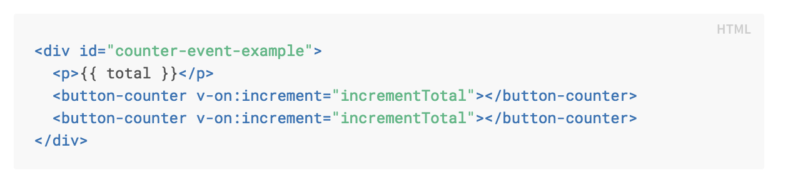
Custom Events
Every Vue instance implements an events interface, which means it can:
Trigger an event using $emit(eventName)
Listen to an event using
$on(eventName)
v-on:eventName
@eventName

Slide 36
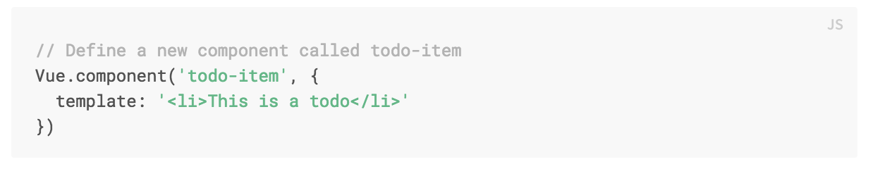
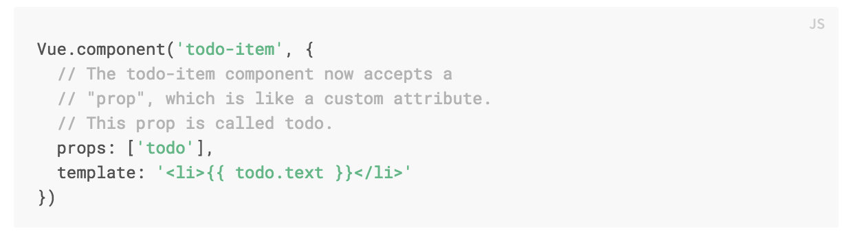
Declare a component
In Vue, a component is essentially a Vue instance with pre-defined options:

Slide 37
Declare a component
In more complex projects or when your frontend is entirely driven by JavaScript, these disadvantages become apparent:
Global definitions
Force unique names for every component
String templates
Lack syntax highlighting and require ugly slashes for multiline HTML
No CSS support
While HTML and JavaScript are modularized into components, CSS is conspicuously left out

Slide 38
Single File Components
In modern UI development, we have found that instead of dividing the codebase into three huge layers (HTML/CSS/JS) that interweave with one another, it makes much more sense to divide them into loosely-coupled components and compose them.
This is possible using single-file components with a .vue extension.

Slide 39
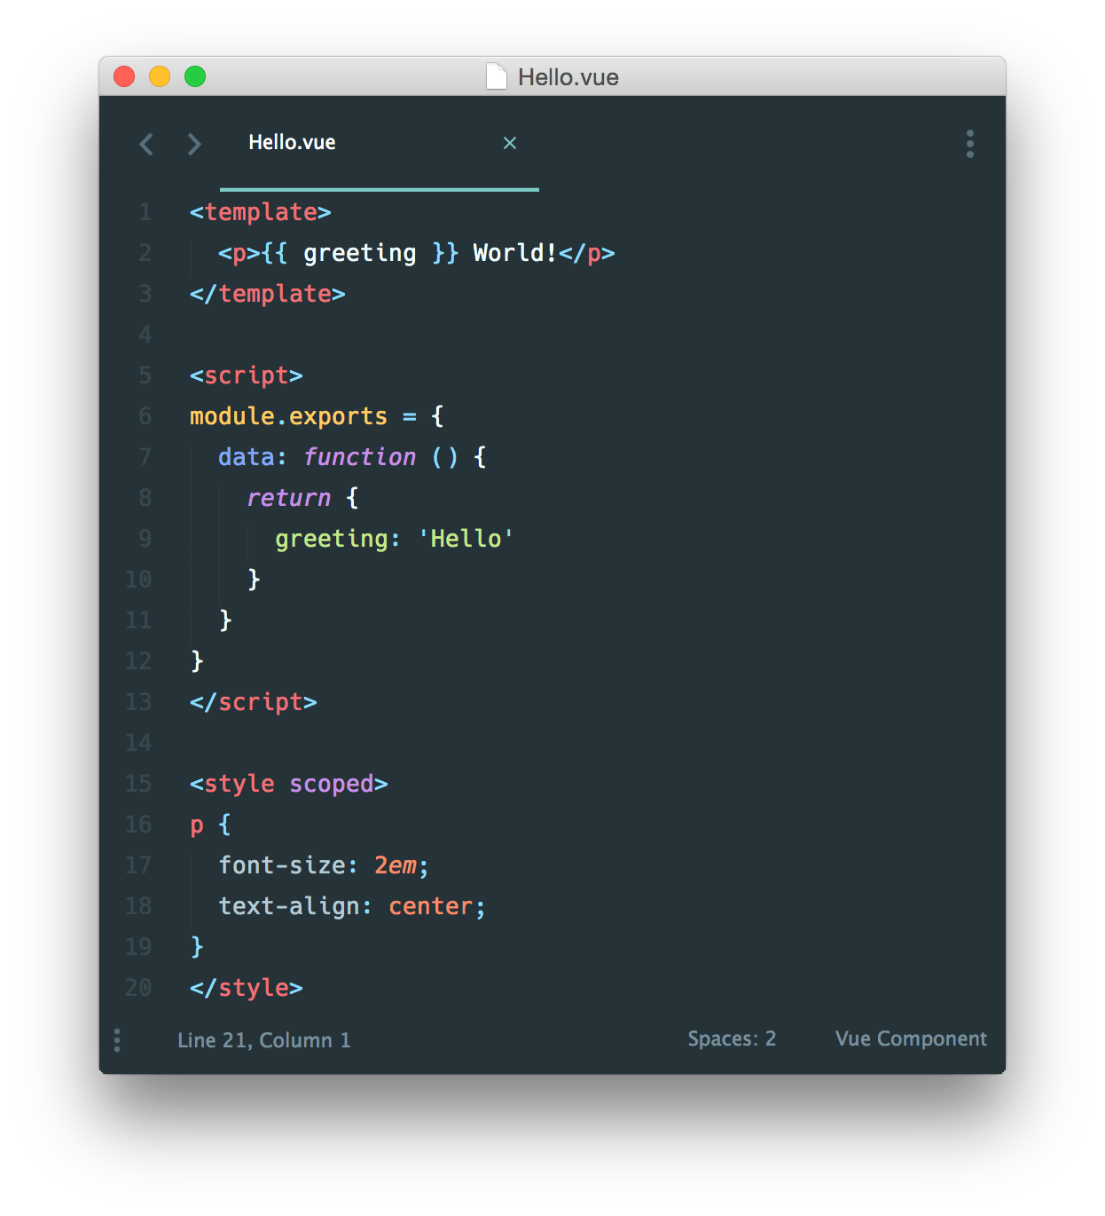
Single File Components

Slide 40
References
http://singlepageappbook.com (2013 - Mikito Takada)
The Majesty of Vue.js 2 (2017- Alex Kyriakidis, Kostas Maniatis and Evan You)
https://developers.google.com/web/fundamentals/web-components/customelements
https://developers.google.com/web/fundamentals/web-components/shadowdom

