Slide 1

Introduction to NoSQL and MongoDB
Principles of Database Design
Ehsan Edalat
Parham Alvani

Slide 2
Outline
Introduction to NoSQL
Architecture
NoSQL Assumptions and CAP Theorem
Strengths and weaknesses of NoSQL
MongoDB
Functionality
Examples

Slide 3






Taxonomy of NoSQL
Key-Value
Graph Database
Document Oriented
Column Family

Slide 4
NoSQL Architecture [Data Model]
Data and query model: Is your data represented as rows, objects, data structures, or documents? Can you ask the database to calculate aggregates over multiple records?
It’s hard to model data into proper relations, and most applications are not as relational as we hope.

Slide 5
NoSQL Architecture [Scalability]
Scalability: Does your data fit on a single server? Do the amount of reads and writes require multiple disks to handle the workload?
RDBMSs not very good at scaling, and their distributed applications introduce signiﬁcant delay and network trafﬁc.

Slide 6
NoSQL Architecture [Transactions]
Transactional semantics: When you run a series of operations, some databases allow you to wrap them in a transaction, which provides some subset of ACID (Atomicity, Consistency, Isolation, and Durability) guarantees on the transaction and all others currently running. Does your business logic require these guarantees, which often come with performance tradeoffs?

Slide 7
CAP Theorem of NoSQL
What the CAP theorem really says:
If you cannot limit the number of faults and requests can be directed to any server and you insist on serving every request you receive then you possibly be consistent
How it is interpreted
You must always give something up:
Consistency
Availability
Tolerance to failure and reconfiguration

Slide 8
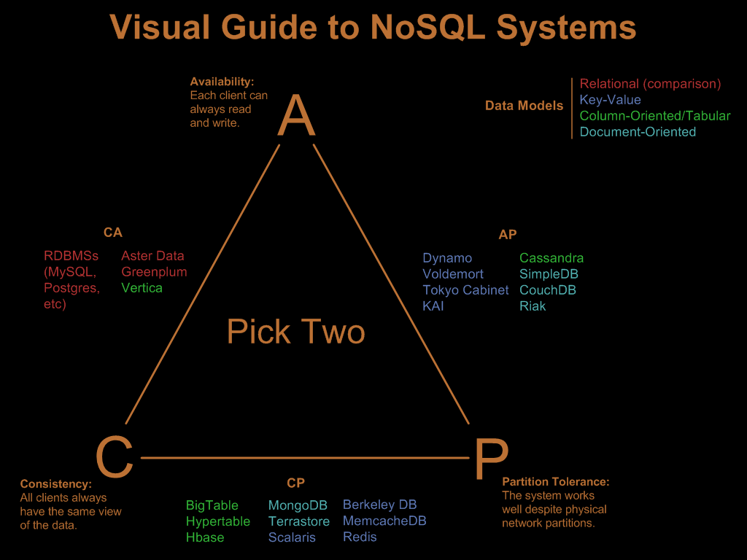

Slide 9
Sharding of data
Distributes a single logical database system across a cluster of machines
Uses range-based partitioning to distribute documents based on specific shard key
Automatically balances the data associated with each shard
Can be turned on and off per collection

Slide 10
Replica Sets
Redundancy and Failover
Zero downtime for updates and maintenance
Master-slave replication
Strong Consistency
The protocol is said to support strong consistency if: All accesses are seen by all parallel processes (or nodes, processors, etc.) in the same order (sequentially)
Delayed Consistency

Slide 11
Outline
Introduction to NoSQL
Architecture
NoSQL Assumptions and CAP Theorem
Strengths and weaknesses of NoSQL
MongoDB
Functionality
Examples

Slide 12
What is MongoDB
Developed by 10gen
Founded in 2007
A document-oriented, NoSQL database
Hash-based, schema-less database
No Data Definition Language
In practice, this means you can store hashes with any keys and values that you choose
Keys are a basic data type but in reality stored as strings
Document Identifiers (_id) will be created for each document, field name reserved by system

Slide 13
What is MongoDB
Application tracks the schema and mapping
Uses BSON format
Based on JSON – B stands for Binary
Written in C++
Supports APIs (drivers) in many computer languages

Slide 14
Functionality of MongoDB
Dynamic schema
No DDL
Document-based database
Secondary indexes
Query language via an API
Atomic writes and fully-consistent reads
If system configured that way
Master-slave replication with automated failover (replica sets)

Slide 15
Functionality of MongoDB
Built-in horizontal scaling via automated range-based partitioning of data (sharding)
No joins nor transactions

Slide 16
Why use MongoDB
Simple queries
Functionality provided applicable to most web applications
Easy and fast integration of data
No ERD diagram
Not well suited for heavy and complex transaction systems

Slide 17
MongoDB: Hierarchical Objects
A MongoDB instance may have zero or more databases
A database may have zero or more collections
A collection may have zero or more documents
A document may have one or more fields
MongoDB indexes function much like their RDBMS counterparts

Slide 18
RDB Concepts to NoSQL
RDBMS |  | MongoDB
Database |  | Database
Table, View |  | Collection
Row |  | Document (BSON)
Column |  | Field
Index |  | Index
Join |  | Embedded Document
Foreign Key |  | Reference

Slide 19
MongoDB Processes and configuration
Mongod – Database instance
Mongos – Sharding proceses
Analogous to a database router
Process all requests
Decides how many and which mongods should receive the query
Mongos collects the results, and sends it back to the client

Slide 20
MongoDB Processes and configuration
Mongo – an interactive shell (a client)
Fully functional JavaScript environment for use with a MongoDB

Slide 21
Schema Free
MongoDB does not need any pre-defined data schema
Every document in a collection could have different data

Slide 22
Schema Free
MongoDB is a JSON-style data store.
The documents stored in the database can have varying sets of fields, with different types for each field.
One could have the following objects in a single collection:
{ name : “Joe”, x : 3.3, y : [1,2,3] }
{ name : “Kate”, x : “abc” }
{ q : 456 }

Slide 23

JSON Format
Data is name/value pairs
A name/value pair consists of a field name followed by colon, followed by a value:
Example: “name”: “R2-D2”
Data is separated by commas
Example: “name”: “R2-D2”, “race”: “Droid”

Slide 24
JSON Format
Curly braces hold objects
Example: {“name”: “R2-D2”, “race”: “Droid”, “affiliation”: “rebels”}
An array is stored is brackets []
Example: [{“name”: “R2-D2”, race : “Droid”, affiliation: “rebels”}, {“name”: “Yoda”, affiliation: “rebels”}]

Slide 25


Mongoose, The ODM

Slide 26
Mongoose, The ODM
Mongoose provides a straight-forward, schema-based solution to model your application data.
It includes built-in type casting, validation, query building, business logic hooks and more, out of the box.

Slide 27
CRUD Operations
Create
db.collection.insert( <document> )
db.collection.save( <document> )
db.collection.update( <query>, <update>, { upsert: true } )
Read
db.collection.find( <query>, <projection> )
db.collection.findOne( <query>, <projection> )
Update
db.collection.update( <query>, <update>, <options> )
Delete
db.collection.remove( <query>, <justOne> )

Slide 28
Why use MongoDB in IoT ?
Diversity of devices and data
Data generated from an exponentially growing number of diverse sensors, applications, and things will be accompanied by a growing diversity in the structure and scale of that data
Flexible and agile systems
As the Internet of Things becomes a more open system where new sensors, devices and applications and things are added the supporting databases and applications will need to remain flexible and agile

Slide 29
Why use MongoDB in IoT ?
Sophisticated analytics
Where simple alerts and notifications were the backbone of M2M systems, analytics becomes the cornerstone of Internet of Things, requiring enhanced and multiple analytical approaches to address the requirements of the applications.

Slide 30

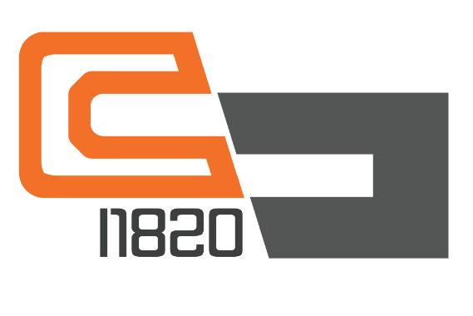
NoSQL IoT Platforms
Kaa
Mongodb
Apache Cassandra
MySQL
…
I1820
InfluxDB

Slide 31
References
The NoSQL Ecosystem
Adam Marcus
http://www.aosabook.org/en/nosql.html
Introduction to NoSQL and MongoDB
Kathleen Durant
Lesson 20 CS 3200
Northeastern University

Slide 32
References
6 Rules of Thumb for MongoDB Schema Design
William Zola
http://blog.mongodb.org/post/87200945828/6-rules-of-thumb-for-mongodb-schema-design-part-1
NoSQL Databases and MongoDB
Pooria Azimi

