Slide 1
Hardware Description Languages
Basic Concepts

Slide 2
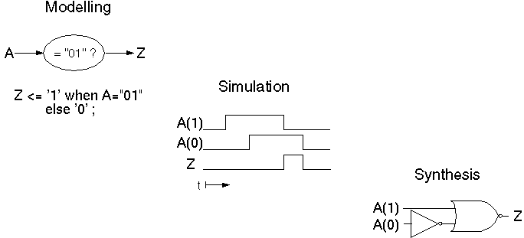
Application of HDLs
VHDL به عنوان زبان مستندسازي (توصيف فرمال و بدون ابهام).
سنتز: تبديل (اتوماتيك يا دستي) يك توصيف به توصيفي با جزئيات بيشتر

Slide 3
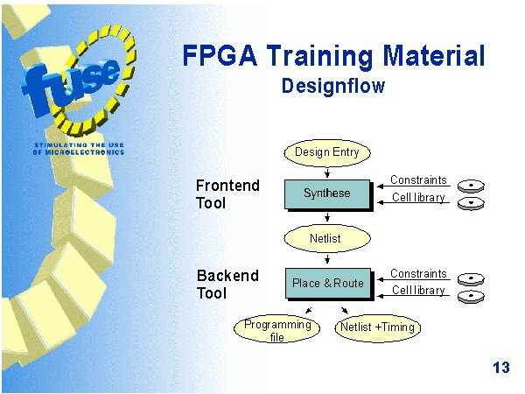
A digital system design process

Slide 4
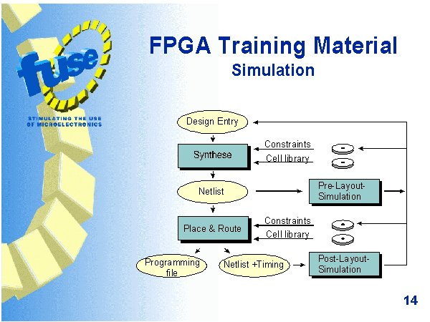
Simulation

Slide 5
VHDL - Overview
Very High Speed Integrated Circuit Hardware Description Language
Modeling of digital systems
Concurrent and sequential statements
Design lifetime > Designer lifetime
Man- and machine-readable documentation
International Standards
IEEE Std 1076-1987
IEEE Std 1076-1993, 2000, 2002, …

Slide 6
VHDL - History
2003: VHDL-200X by VASG (VHDL Analysis and Standardization Group)
Responsible for maintaining and extending the VHDL standard (IEEE 1076).
2005: Accellera VHDL TSC took over.
2006: Accellera VHDL-2006-D3.0 approved
DATE 2007: date_vhdl_tutorial.pdf
Pure definition of language in the LRM (Language Reference Manual)
No standards for application or methodology

Slide 7
VHDL Standards
علاوه بر استانداردهاي خالص, تلاشهايي براي استاندارد كردن عوامل مربوط به VHDL انجام گرفته است:
پكيج هاي
Std_logic_1164
Numeric_bit
Numeric_std
زيرمجموعة قابل سنتز: استاندارد 1076.6
VHDL-AMS 1076.1

Slide 8
VHDL - Overview
در حال حاضر براي VHDL-AMS فقط شبيه سازي امكان پذير است چون سنتز آنالوگ بسيار پيچيده است.
شبيه سازي Mixed Signal هم مسايل همگام سازي شبيه سازهاي ديجيتال و آنالوگ و الگوريتمهاي حل معادلات ديفرانسيل غيرخطي را دارد.

Slide 9
VHDL-Application Field
Hardware design
ASIC: technology mapping
توصيف به gate-level netlist تبديل مي شود و اجزا از كتابخانة ASIC انتخاب مي شوند.
FPGA, CPLD: LUT/PAL mapping
SPLD: smaller structures, hardly any use of VHDL

Slide 10
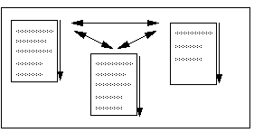
Concepts of VHDL
Execution of Statements:
Sequential
Concurrent
Methodologies:
Abstraction
Modularity
Hierarchy

Slide 11
Concepts of VHDL
Abstraction: طرح را مي توان در سطوح مختلفي از جزئيات توصيف كرد:
براي مدلسازي، سطوح بالا كافي است.
براي سنتز، ممكن است جزئيات بيشتري لازم باشد.

Slide 12
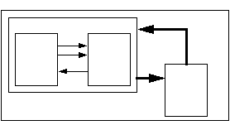
Concepts of VHDL
Modularity: مي توان بلوك بزرگ پيچيده را به بلوكهاي كوچكتر تقسيم كرد و براي هر بخش يك مدل نوشت.
Hierarchy: تشكيل يك درخت سلسله مراتبي
هر كدام از نودها ممكن است در سطح متفاوتي از abstraction توصيف شده باشد.

Slide 13
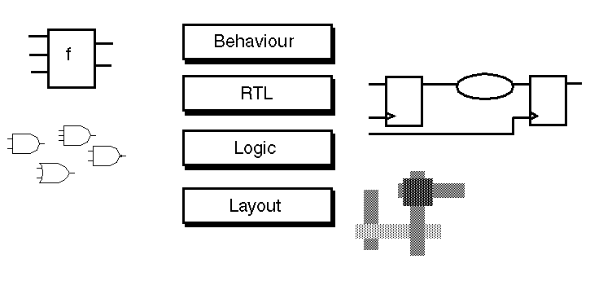
Abstraction Levels in IC Design
VHDL براي سطح layoutمناسب نيست.

Slide 14
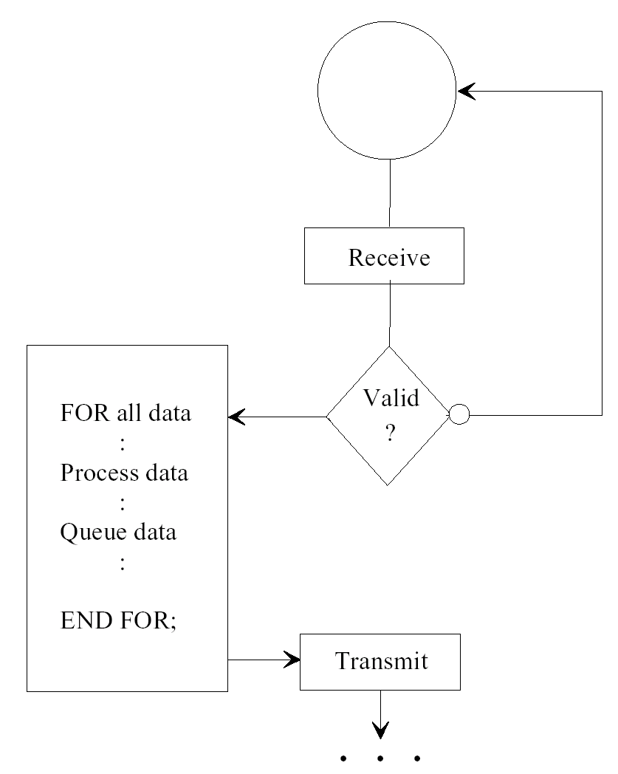
Behavioral Description in VHDL
در VHDL رفتار عملياتي با process مدل مي شود.

Slide 15
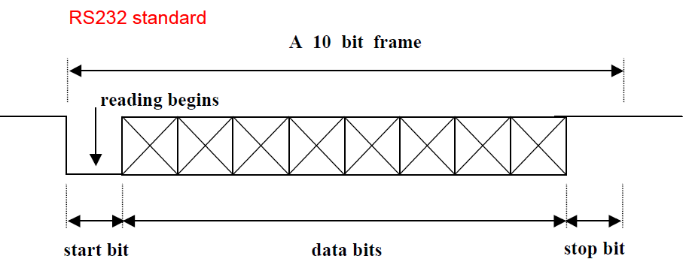
Behavioral Description
collect : PROCESS
BEGIN
WAIT UNTIL serial = '0';
WAIT FOR half_bit;
FOR count IN 0 TO 7 LOOP
WAIT FOR full_bit;
buff (count) := serial;
END LOOP;
WAIT FOR full_bit;
IF serial = '0' THEN
frame_error <= '1';
WAIT UNTIL serial = '1';
ELSE
frame_error <= '0';
dataready <= '1';
parallel_out <= buff;
WAIT UNTIL received = '1';
WAIT UNTIL received = '0';
dataready <= '0';
END IF;
END PROCESS collect;
constant half_bit : time := 50 ns;
constant full_bit : time := 100 ns;

Slide 16
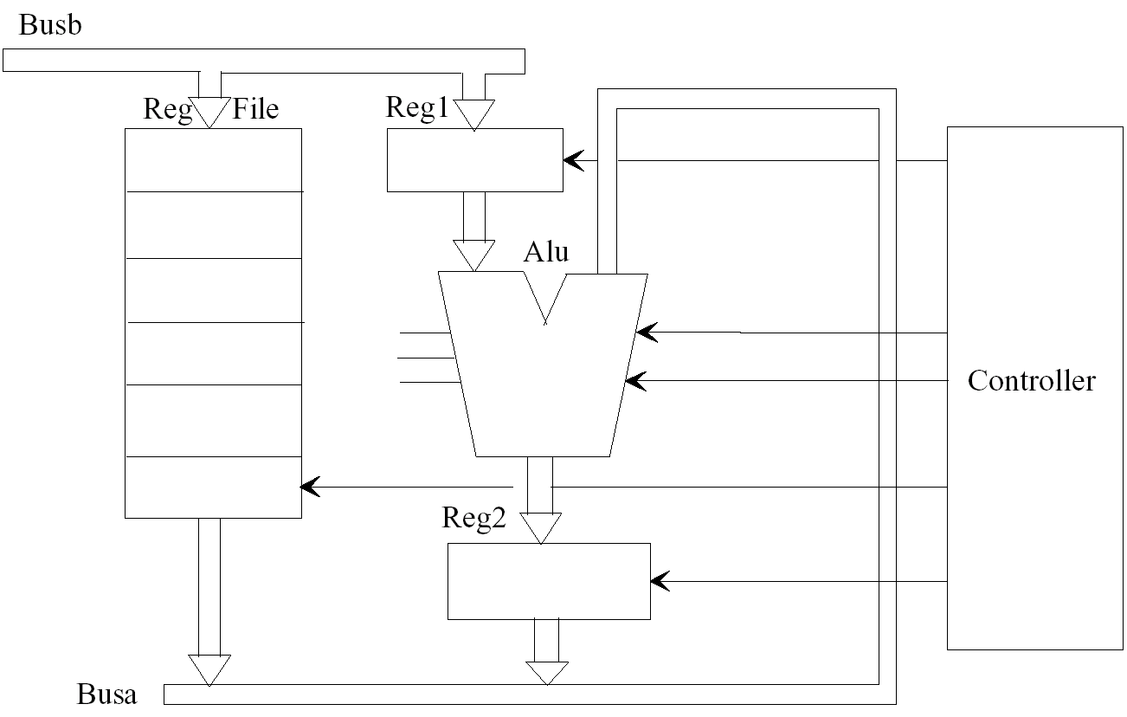
Dataflow (RTL) Description

Slide 17
Dataflow (RTL) Description
architecture RTL of MOORE_TEST is signal STATE,NEXTSTATE : STATE_TYPE ; begin REG: process (CLK, RESET) begin if RESET='1' then STATE <= START ; elsif CLK'event and CLK='1' then STATE <= NEXTSTATE ; end if ;
end process REG ;
OUTPUT_REG: process(CLK) begin if CLK'event and CLK='1' then Y <= S1 + S2; Z <= Z_I ; end if ; end process OUTPUT_REG ; end RTL ;

Slide 18
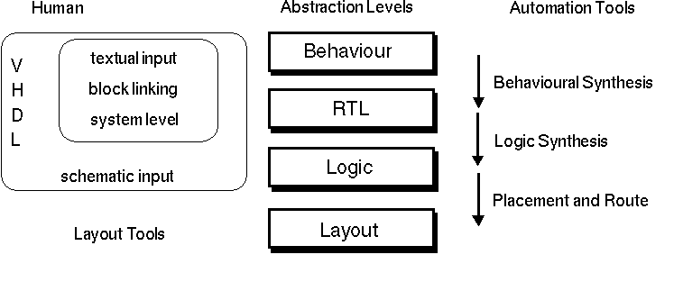
Abstraction Levels and VHDL

Slide 19
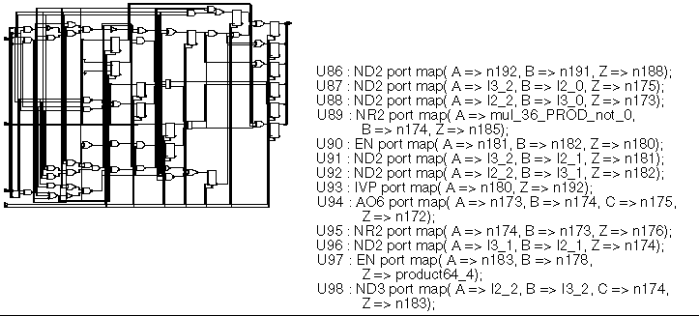
Structural Description
اجزا ممكن است گيت پيچيده باشند.

Slide 20
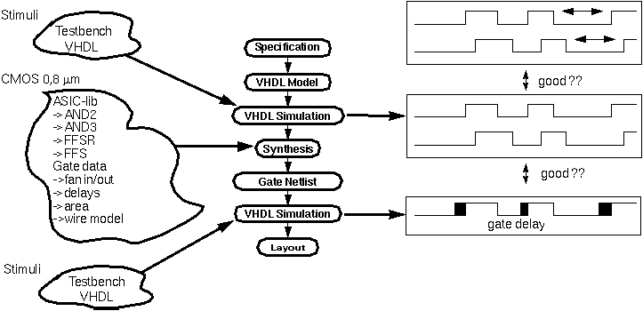
ASIC Development
CMOS 45 nm
Post-layout
simulation
بعد از شبيه سازي post-synthesis مي توان ماكزيمم فركانس كلاك را تخمين زد (بر اساس مسير بحراني موجود)
بعد از شبيه سازي post-layout مي توان ماكزيمم فركانس كلاك را به دست آورد

Slide 21
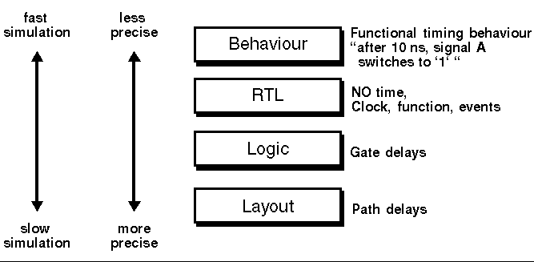
Information Content in Abstraction Levels

Slide 22
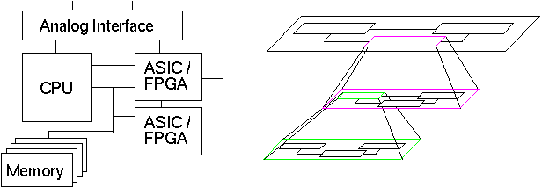
Modularity and Hierarchy
Partitioning in several partial designs
Restrict complexity
Enable teamwork
Study of alternative implementations
گاهي اوقات simulation model هايي از اجزا يا تراشه هاي استاندارد وجود دارند كه مي توان به طرح خود متصل كرد و نتايج شبيه سازي را در محيط واقعي مشاهده كرد.

Slide 23
Design Tools
Simulation

Slide 24
Tool Set
Synthesis
Place & Route
Simulation Tools
Timing Analysis
Power Analysis
Verification

Slide 25
Simulation Tools
Simulation Tools
Oblivious simulation
Event-driven logic simulation
Mixed-language simulation
Cycle-based simulation
Post-layout simulation

Slide 26
Simulation Tools
Types of Logic Simulators:
Oblivious:
Simple but inefficient
Event driven:
See the world as a series of discrete events
Cycle-based
Rough simulation for synchronous sequential designs

Slide 27
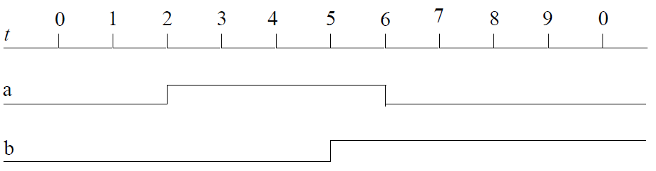
Simulation Concept

Slide 28
Oblivious Simualtor
Starts by a table and initial values
Evaluates periodically (even when no change in inputs)
Repeats until nothing is changed in a pass.

Slide 29
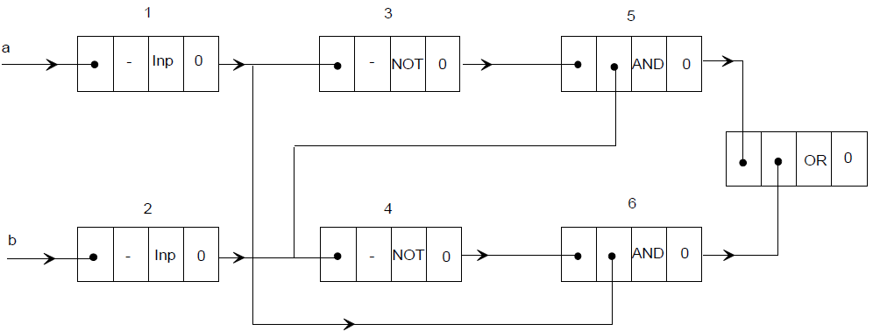
Event-Driven Simulator
Simulates when an event (change) at input(s) of a component
Only part of the design is evaluated

Slide 30
Event-Driven Simulator
When a gate input changes, it places a transaction (value, delay) on the driver of the delayed signal (e.g. gate output)
It will expire after delay
→ Changes its value
Repeats for other gates with changed inputs
Concurrency is handled.
Mostly used in industry

Slide 31
Cycle-based Simulation
RTL:
At the beginning of each cycle, propagate values from primary inputs and from register outputs into combinational blocks (CBs).
Compute the stable outputs of CBs, and store them in register inputs (they’ll move to outputs in the next cycle).
CB
RTL model
CB
CB

Slide 32
Zero-delay cycle-based simulation
Functionality and timing can be verified separately
Assumption:
Within each cycle, all signal changes occur in zero-delay
Only evaluate on the clock edge
First: evaluate all combinational logic
Next: latch values into state registers
Repeat on next clock edge
Assume ‘zero-delay’ (don’t care about the transient delays)
1
Steady state
Steady state
Steady state
0
t
Cycle 1
Cycle 2
Cycle 3

Slide 33
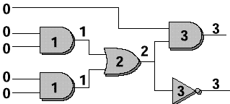
Levelizing the gates
Within each Combinational Block, gates can be levelized (sorted in topological order) for evaluation.
Going by level number, every gate will be evaluated after its inputs have been computed.
So: we order the gates by the flow of data, and we don’t care about the real delays → assume “0 delay”.
Combinational Feedbacks?
A levelized CB

Slide 34
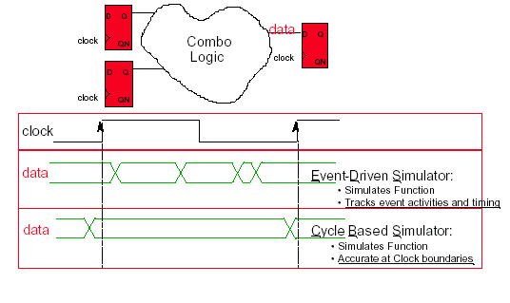
Event vs. Cycle-Based Simulation

Slide 35
Cycle-Based vs. Event-Driven
Event-driven:
Each internal node
Need scheduling and functions may be evaluated multiple times
Cycle-based:
Only boundary nodes
No delay information
Cycle-based does not detect glitches and setup/hold time violations, while event-driven does

Slide 36
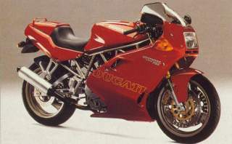
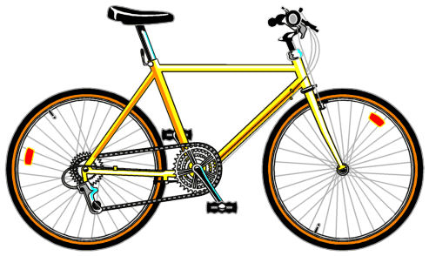

Simulation: Performance vs. Abstraction
Cycle-based
Simulator
Event-driven
Simulator
Abstraction
SPICE
.001x
1x
10x
Performance and Capacity

Slide 37
Why is it faster?
Node a has 5 transitions and b has 3 transitions.
Event-driven simulator reevaluates when inputs change
→ Gate A simulates 5 times,
Gate B: 9 times,
Gate C: 6 times
Total 20 times.
But for only these 3 gates
a
b
d
A
B
Z
c
FF
FF
C
FF
Conclusion:
Event-driven is faster if few transitions (typically less than 5% active nodes).
In practice, experiments confirm that a cycle-based simulator is almost always 5-10 times faster (and uses less memory)
Cycle-based simulator simulates the entire circuit only once (at the end of current cycle)
→ All Gates in the circuit are simulated regardless whether their inputs have been changed.

