Slide 1

Measuring Instruments
Prepared By : Garima Turan
Edited By: Anu Singla

Slide 2
“Without Measurement there is no control”
Measurement: Process of giving numbers to any quantity.
Measuring Instruments: An instrument is a device designed to collect data from an environment, or from a unit under test, and to display information to a user based on the collected data.
Electrical Measuring Instruments: Instruments which measures electrical quantities such as voltage, current, Power, energy etc.

Slide 3
Types of Measuring Instruments
Indicating Instruments
The quantity to be measured is merely indicated on a graduated scale.
Examples: Ammeter, Voltmeter, Wattmeter
Integrating Instruments
Such instruments give total amount of quantity being measured over a period of time. The summation given by such instrument is the product of time and an electrical quantity. E.g. Ampere-hour meter, energy meter
Recording Instruments
These instruments give a continuous record of the quantity being measured over a given period. E.g. ECG of a patient

Slide 4
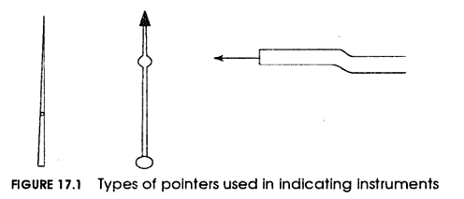
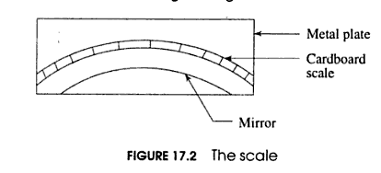
Requirements of Indicating Instruments
Pointer: Indicates the value of quantity , must be lighter in weight , available in different shapes , generally aluminium is preferred to make it.
Scale: Stiff Card board mounted on a metal sheet is used for making scales.

Slide 5
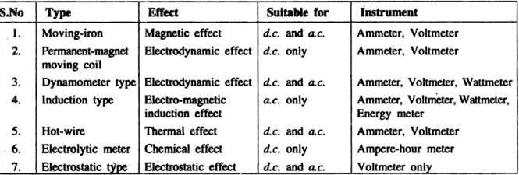
Principle of Operation

Slide 6
Essential features of Measuring Instruments
Moving (deflecting Mechanism for measuring deflection
Controlling system that controls the deflection of the moving mechanism.
Damping system to bring the deflection quickly to a steady state.

Slide 7
Deflecting Torque
A torque is required to move a pointer on a scale from zero to a value when the instrument is connected to a circuit to measure a quantity. That torque is called deflecting torque . Td α I
Controlling Torque
If deflecting torque were acting alone, the pointer would continue to move indefinitely and swing over to a maximum deflected position irrespective of the magnitude of current to be measured. So a opposing or controlling torque is needed to oppose the deflecting torque and must increase with the deflection of the moving system. The pointer will be at rest at that position when two opposite torques are equal.
Example: cycling where deflecting torque is peddling and surface friction is controlling torque.

Slide 8
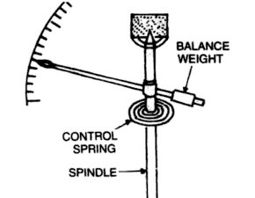
Ways to Produce Controlling Torque
Spring Control
A spring made of nonmagnetic material is attached to a moving system of instrument, with deflection of the pointer , a spring is twisted in opposite direction which provides the controlling torque.
With spring Control Tc α θ
Therefore θ α I

Slide 9
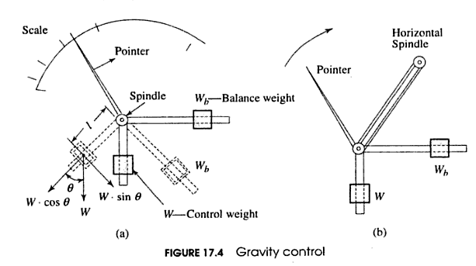
2. Gravity control
In gravity controlled instruments, a small weight is attached to the moving system in such a way that it produces a controlling torque, when the moving system is in deflected position.
Another adjustable weight is attached for zero adjustment and balancing purpose. This weight is called balancing weight.
T_{c} = W l sinθ
W – Control weight,
l – distance of control weight
from axis of rotation of
moving system.
T_{d} = T_{c}
Therefore: sinθ α I
Hence scale is not uniform . It is not suitable for use in portable instruments. It is very cheap ,has long life ,does not deteriorate with time.

Slide 10
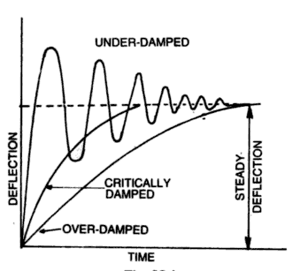
Damping Torque:
if there is only Td and Tc in the moving system then the pointer due to inertia will keep oscillating at the final position before coming to rest. Hence a torque is required to reduce these oscillations and make the pointer stationary with lesser time.
Under damped : the pointer will oscillate at the final position for some time.
Over damped : the pointer will become slow and lethargic.
Critically damped/Dead beat : the pointer will be stable quickly
Damping force increases with the angular velocity of the moving system, so that its effect is greatest when the rotation is rapid and zero when the system rotation is zero.

Slide 11
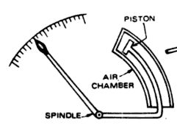
Damping Torque is provided by :
Air friction:
Small Al piston is attached to the spindle of moving system.
The piston moves in air chamber with one side open to air.
Damping of the moving system is brought about by compression and suction of air in chamber.
When the piston moves into the chamber, the air inside gets compressed.
The pressure created due to the compressed air opposes the motion of piston.
When piston moves out of the chamber, the motion is again opposed due to pressure being greater on open side than on the closed side of chamber.
Very simple and cheap method but not preferred as precise adjustment of the angle of the arm carrying piston is required so that movement of piston is not impaired.

Slide 12
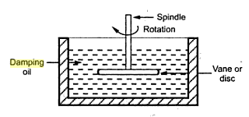
Damping Torque is provided by :
Fluid Friction:
A fluid is taken instead of air. The friction between disc and fluid opposes the movement of pointer.
More damping is provided by using more viscous liquid
Only can be used for instruments in vertical position

Slide 13
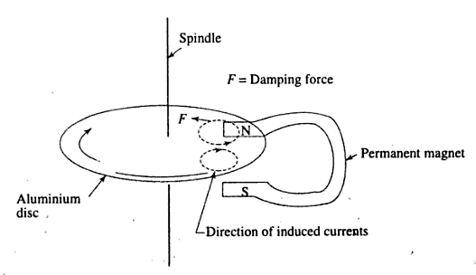

Eddy Currents:
Most effective way of providing damping.
An aluminum disc is mounted on the spindle when the spindle rotates then disc also rotates and currents induced in it.
According to Lenz’s Law, the disc moving in air gap in presence of permanent magnet will experience a force which opposes its rotation. This force is damping torque.

Slide 14
Advantages of Eddy Current Damping:
Most efficient form of damping
It is very convenient to use instrument where a metallic disc and permanent magnet already exist.
Disadvantages:
It cannot be used in instruments where eddy currents will distort the existing magnetic fields.

Slide 15
Voltmeter
To measure potential difference between two points of a circuit.
Connected in parallel with the circuit.
It must have enough resistance.
Ammeter
To measure the flow of current in a circuit.
Connected in series with the circuit or that part where current has to be calculated.
Ammeter should be capable of carrying current it is being measured and should have low resistance.

Slide 16
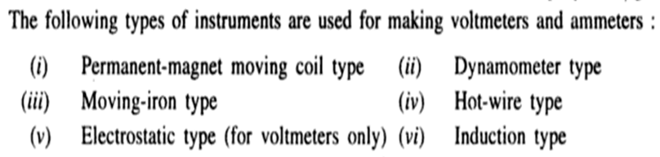
Permanent Magnet moving Coil Type instruments are for DC only
Induction Type instruments are for AC only
Others are both for AC and DC.

Slide 17
PERMANENT MAGNET MOVING COIL

Slide 18
Permanent Magnet Moving Coil Instrument
A permanent-magnet moving-coil movement is based upon a fixed U- shaped permanent magnet and light rectangular coil of several turns which is able to move.
When the switch is closed, current flows through the coil, the coil will have a magnetic field which will react to the magnetic field of the permanent magnet.
The coil is wound on an aluminum frame, or bobbin, and the bobbin is supported by jeweled bearings which allow it to move freely.

Slide 19
Permanent Magnet Moving Coil Instrument
The controlling system, which controls the movement of the coil, is constituted of two phosphor-bronze hair springs.
These springs also serve as terminals for passing current through coil.
The damping of the moving coil is achieved by eddy currents induced in the aluminium former.

Slide 20
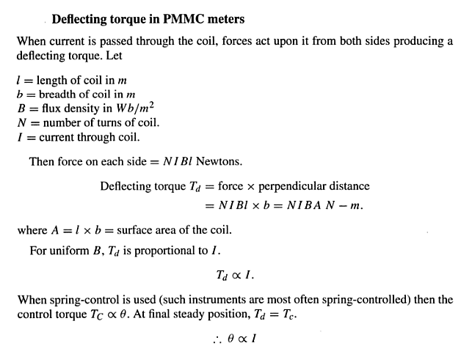


Slide 21
Advantages:
High Sensitivity. These instruments are not affected by stray magnetic fields since they are well shielded.
High torque to weight ratio as powerful magnet is used which does not contribute to the weight of moving system.
Disadvantages:
Can be used on DC. If alternating current is passed, the deflecting torque produced on the moving system will be alternating. Moving coil will oscillate around its zero position.
Cost is high compared with moving iron instrument.
Field strength of permanent magnet may be lost with time.

Slide 22
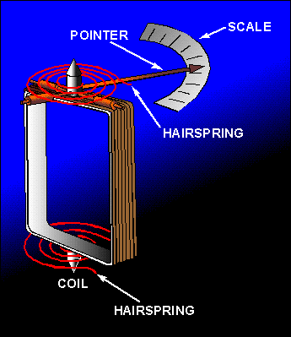
Applications
Ammeters
Voltmeters
Wattmeter
Multimeter

Slide 23
Moving Coil Dynamometer Type
Moving Coil dynamometer type consists of two coils :1. Moving Coil and Fixed Coil (permanent magnet is replaced by one or two fixed air-cored coils)
Moving Coil : Moving coil moves the pointer with the help of spring control instrument. A limited amount of current flows through the moving coil so as to avoid heating. So in order to limit the current , a high value resistor is connected in series with the moving coil.
Fixed Coil: The fixed coil is divided into two equal parts and these are connected in series with the load, therefore the load current will flow through these coils. Now the reason is very obvious of using two fixed coils instead of one, so that it can be constructed to carry considerable amount of electric current.

Slide 24
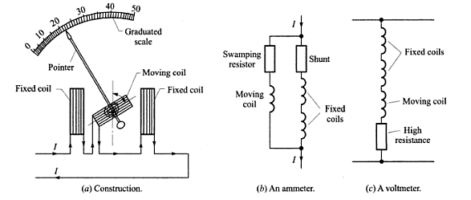
High resistance
Low resistance

Slide 25
The deflecting torque depends on the fields of both fixed and moving coils.
In ammeter:
T_{d} α I²
In Voltmeter:
T_{d} α I₁ I₂ α V²
I₁ is current flowing in fixed coil
I₂ is current flowing in moving coil
Hence deflection, θ α I² α V²
Advantages
Scale is uniform up to certain limit.
Can be used on both ac and dc systems
Ammeters up to 10 A and voltmeters up to 600 V can be measured with good accuracy.

Slide 26
Disadvantages:
Scale is non uniform
Since air cored coils are used, magnetic field produced is weak. Hence large number of ampere turns must be used on the moving coil to give necessary deflecting torque.
Heavy moving system gives more friction losses.
Lower sensitivity than that of PMMC instruments.
More expensive than the PMMC instruments
The dynamometer principle used in wattmeters.

Slide 27
Moving Iron Type
Moving iron type instruments are of mainly two types. Attraction type and repulsion type instrument.
Whenever a piece of iron is placed nearer to a magnet it would be attracted by the magnet. The force of this attraction depends upon the strength said magnetic field.
If the magnet is electromagnet then the magnetic field strength can easily be increased or decreased by increasing or decreasing current through its coil.
Accordingly the attraction force acting on the piece of iron would also be increased and decreased. Depending upon this simple phenomenon attraction type moving iron instrument was developed.

Slide 28
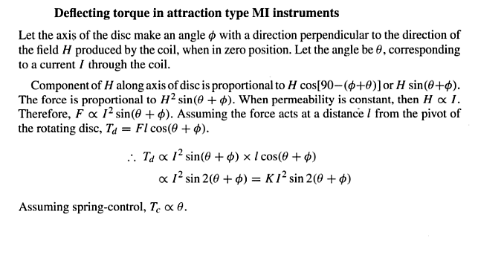
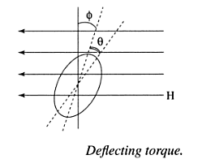

Slide 29
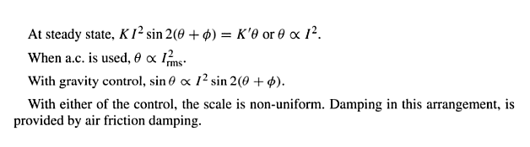
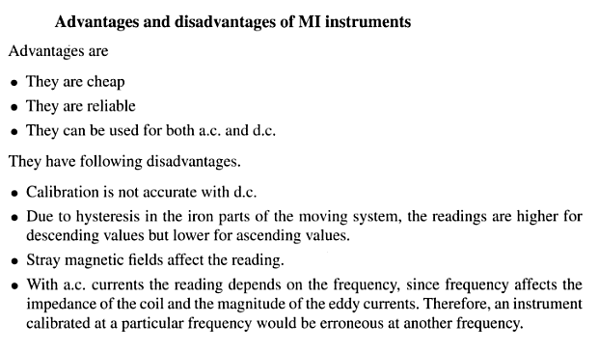
Since in steady state, Tc = Td

Slide 30
Measurement Errors
Human or Operator Errors
Instrument Errors
Environmental Errors
Random Errors

