Slide 1
https://economictimes.indiatimes.com/industry/banking/finance/banking/cosmos-banks-server-hacked-rs-94-crore-siphoned-off-in-2-days/articleshow/65399477.cms
https://www.pymnts.com/news/2015/how-100-banks-got-hacked-and-lost-900-million/
https://timesofindia.indiatimes.com/topic/bank-account-hacking/news
https://securitytrails.com/blog/why-does-web-software-get-hacked
https://en.wikipedia.org/wiki/List_of_security_hacking_incidents
https://cobweb-security.com/security_lessons/8-common-website-hacking-techniques-know/
https://www.guru99.com/how-to-hack-website.html

Slide 2
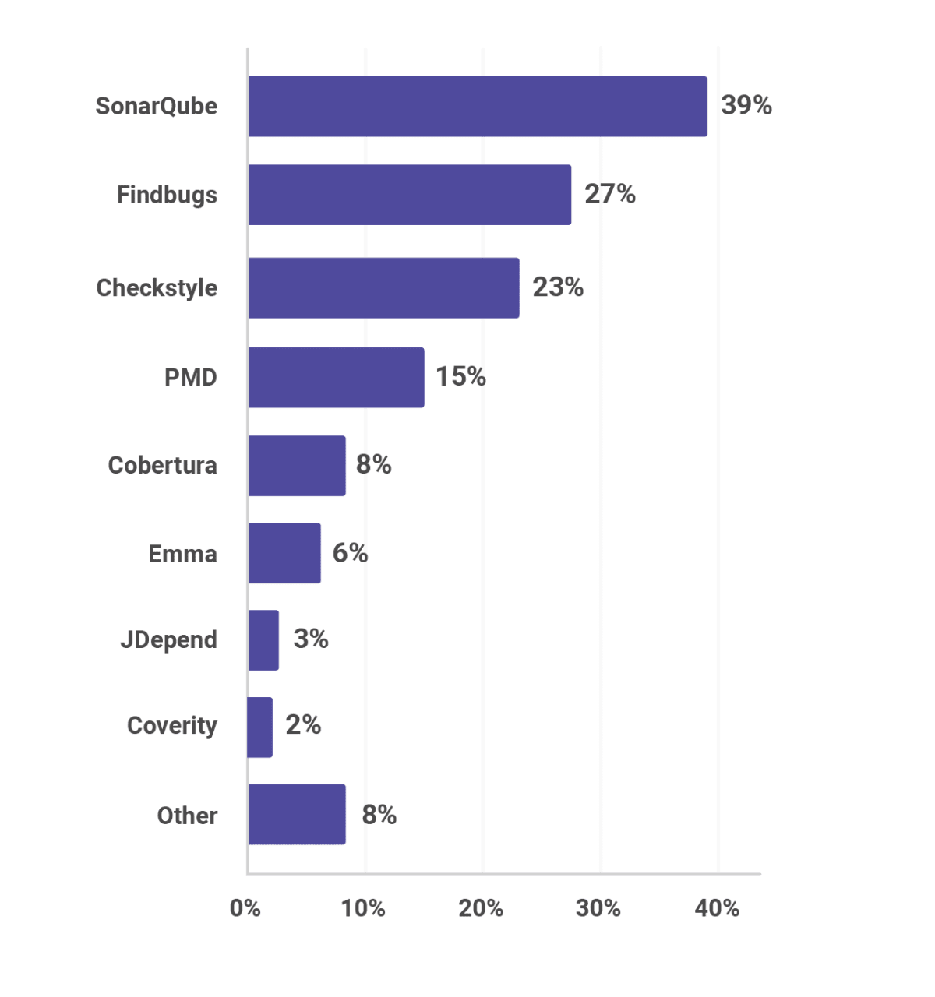

Slide 3


Slide 4
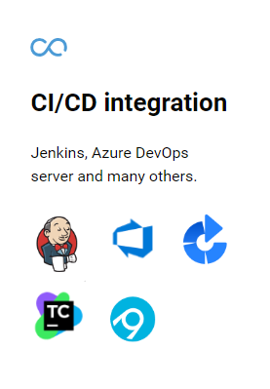
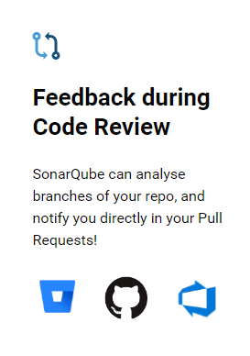
SonarQube Features:
Open Source
Code Inspection
Code Quality
Bugs Identifying
Code Duplication
Code Coverage
Unit Test Case
Supports 25+ Languages
Historical versioning
Feed Back During Code review
Integrate with Build Tools: Ant , Maven , Gradle
Integrate with Development Tools : Eclipse
Integrate with CI/CD Tools : Jenkins , Bamboo, Circle CI

Slide 5
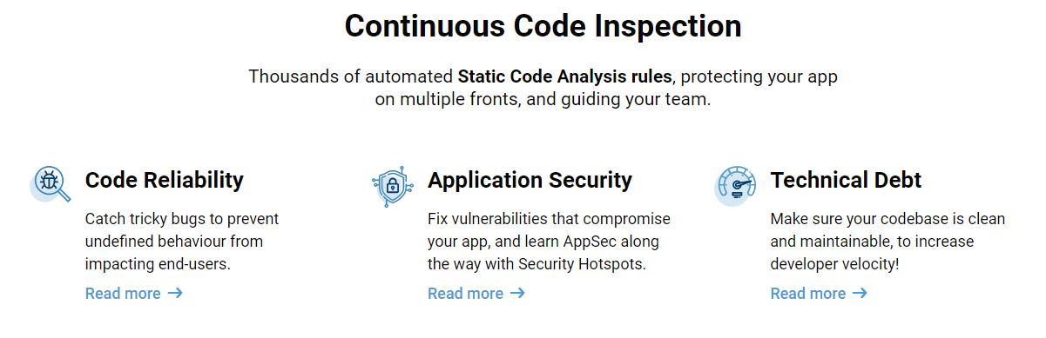

Slide 6
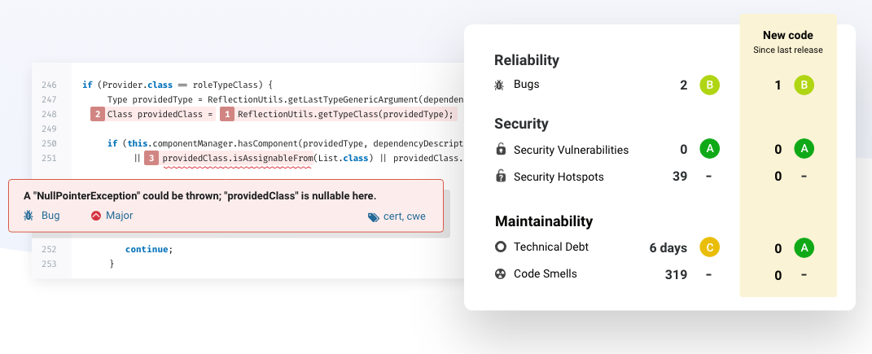

Slide 7
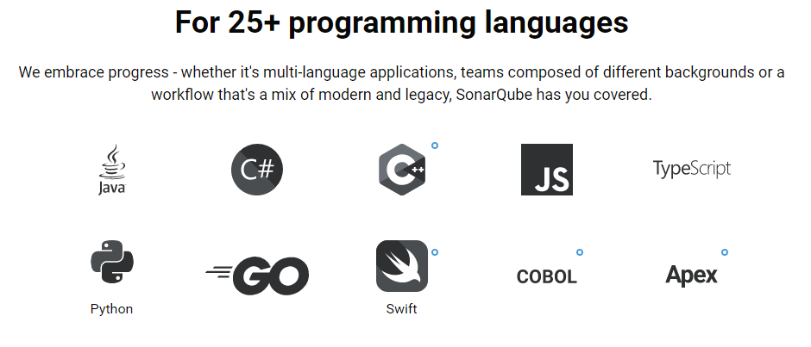

Slide 8
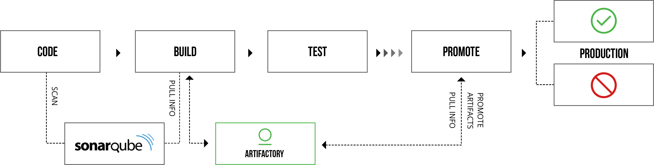

Slide 9
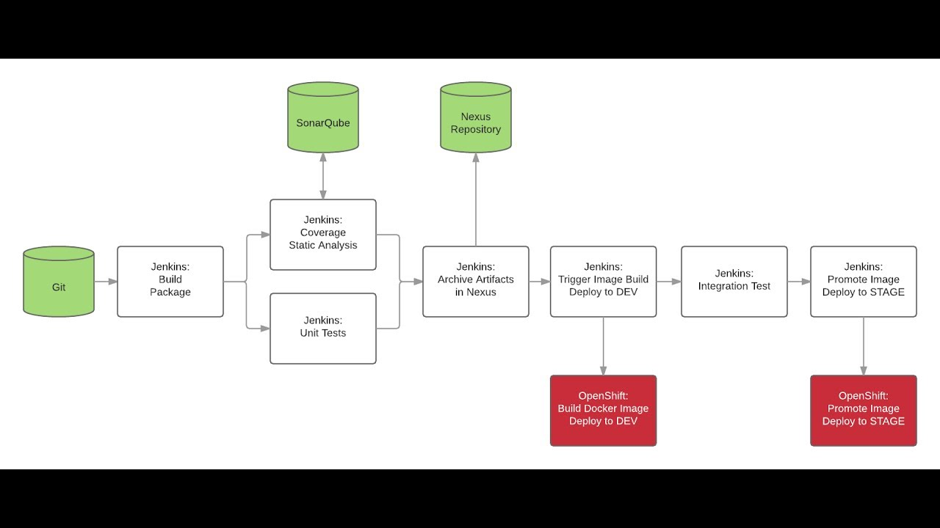

Slide 10
Installation Pre-requisites:
CentOS 7 with 8GB RAM and 2 Core CPU
MYSQL need to Install ( Will go with AWS RDS )
Packages Need to Install
Java , wget , unzip , mysql
Sonar Qube with analyzer
Follow the Installation Steps here :
https://github.com/learn-with-devops/devops/tree/master/SonarQube

Slide 11


Sonar Scanner
Sonar Qube Server
Jenkins Server
GitHub
UI Reports
Sonar Analyzer
AWS RDS - MYSQL

