Slide 1
Docker Agenda
Virtual Machine Introduction
Docker Introduction
Virtual Machine Vs Docker
Docker Version types & Architecture
Docker Installation
Docker Images
Docker Containers
Docker File
Docker Volume
DockerHub
Docker Networking
Docker Compose
Docker Swarm

Slide 2
Virtual Machines

Slide 3
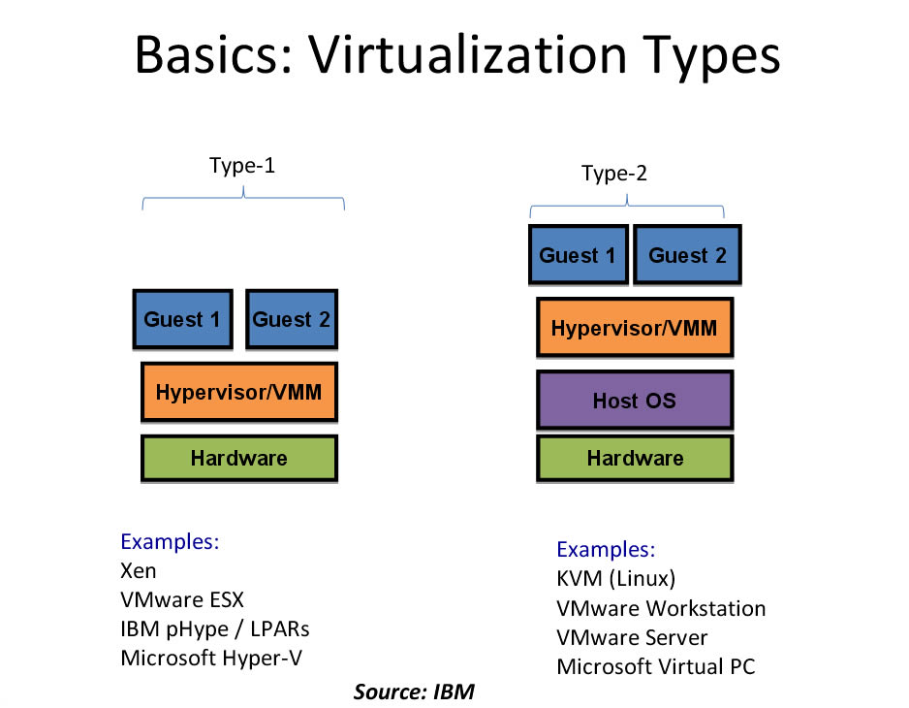

Slide 4
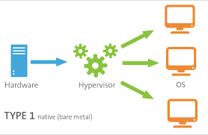
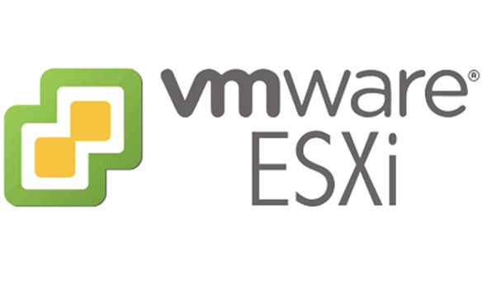
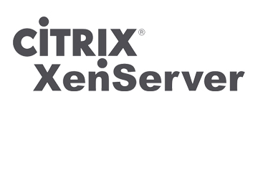
Type1 - Hypervisor
Hypervisors directly run on System Hardware.

Slide 5
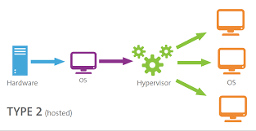
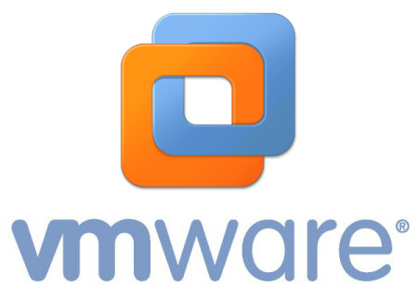
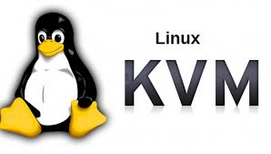
Type2 - Hypervisor
Hypervisors run on Host Operating Systems.

Slide 6
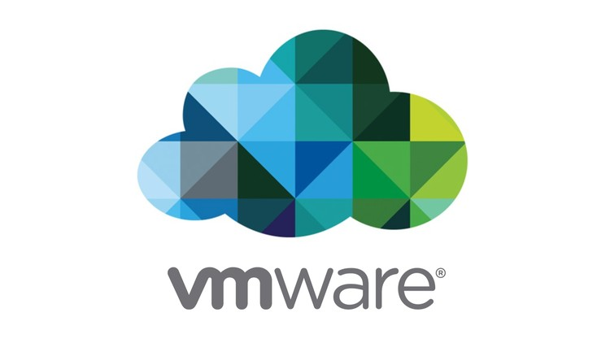

Slide 7
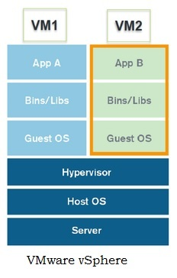
VM Ware

Slide 8
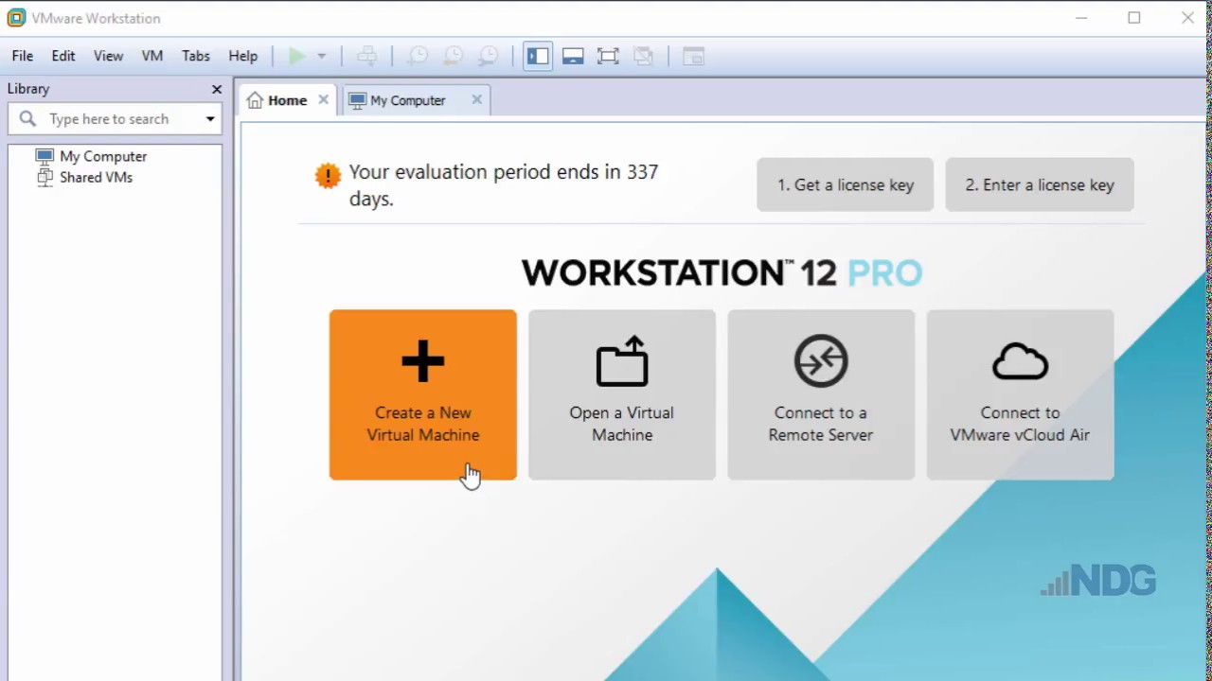

Slide 9
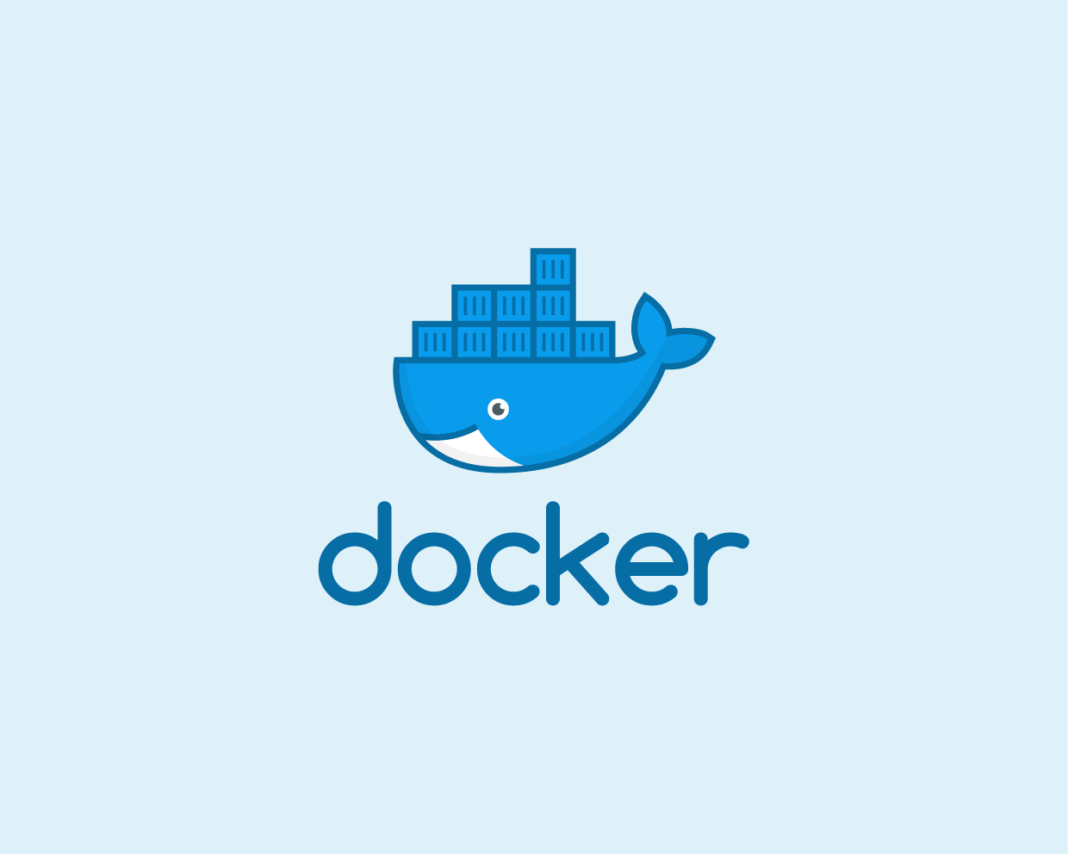

Slide 10
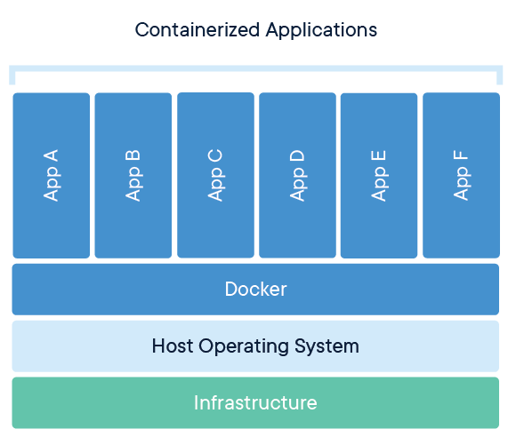

Slide 11
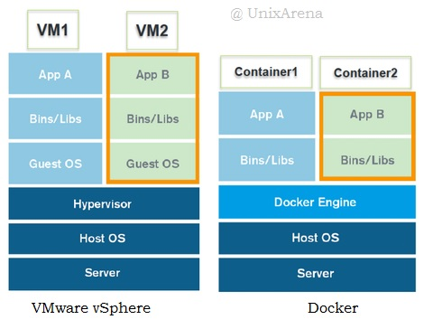

Slide 12
Drawback's Of VM Ware:
- Resources are Wasting in VM’s
Starting time long in VM’s
Integration / Spinning Up/Down the VM’s are very slow

Slide 13
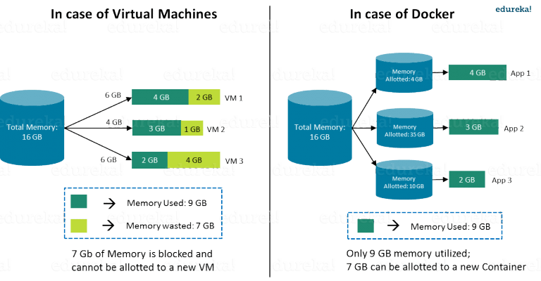
Resource Utilization:

Slide 14
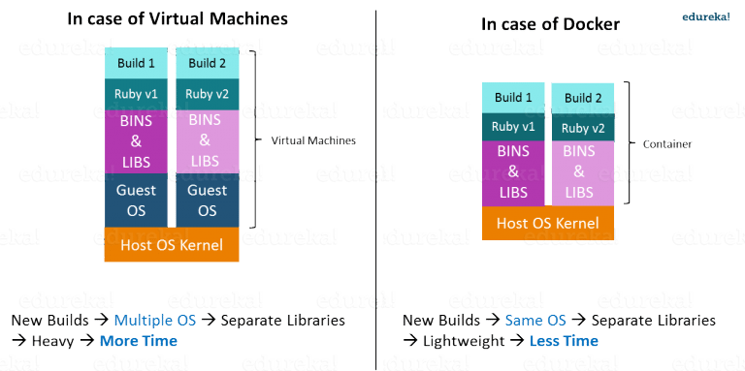
Reboot time:

Slide 15
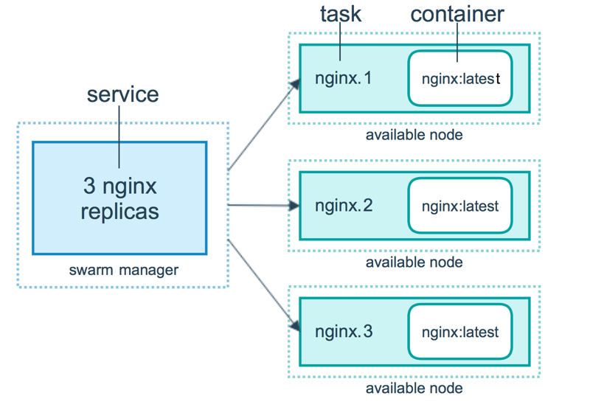
Scale Up/Down of VM’s/Containers:

Slide 16
Docker Architecture

Slide 17
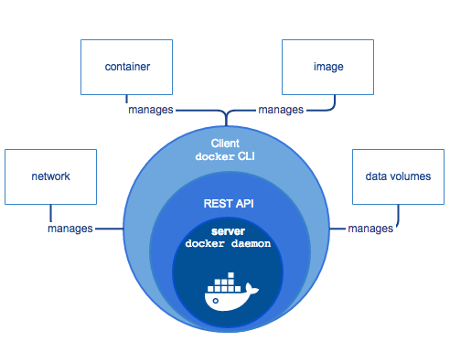

Slide 18
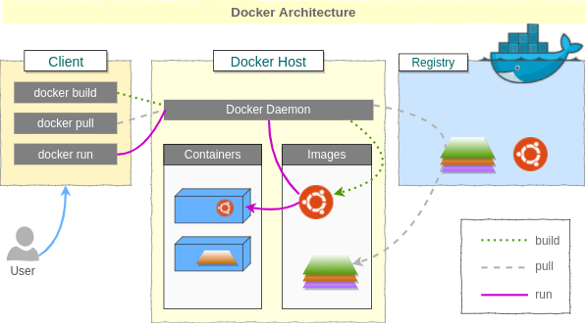

Slide 19
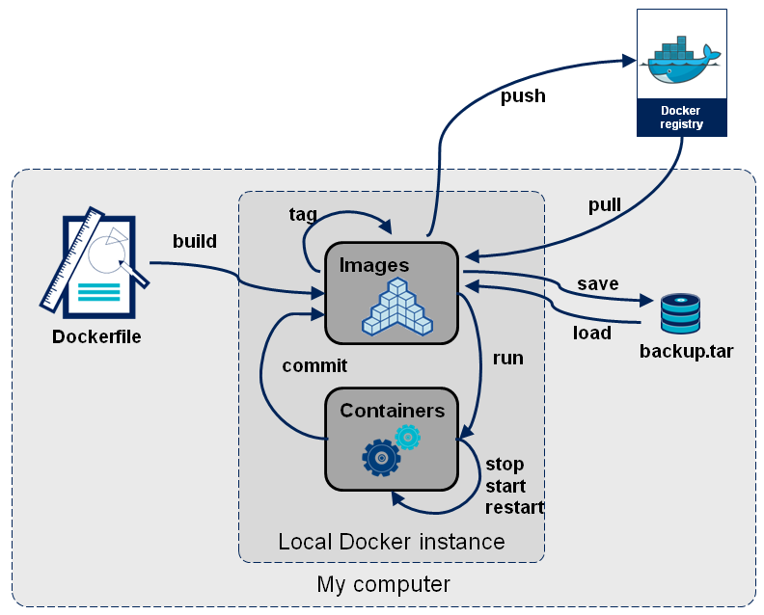
Docker Container Flow:

Slide 20
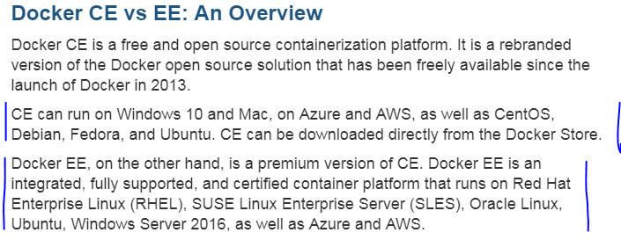
Docker Editions :
- Community Edition
- Stable ( Every Quarter release)
- Edge ( Every monthly release ) --testing
- Enterprise Edition
- Stable ( Every Quarter release)
- Edge ( Every monthly release ) --testing

Slide 21
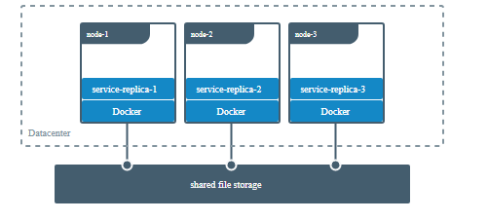
Docker Volume :

Slide 22
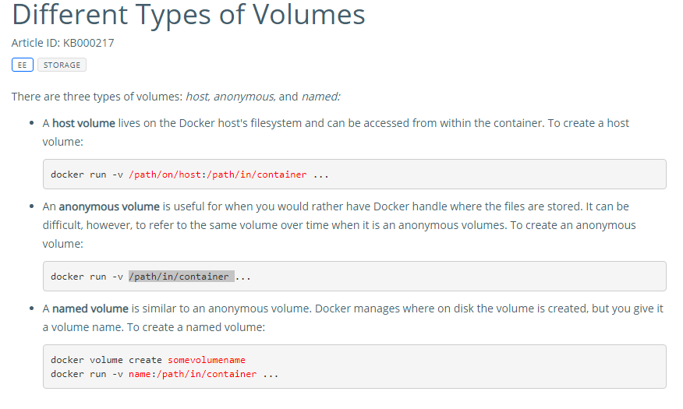
docker run -v volume-name:/path/in/container:ro my/image

Slide 23
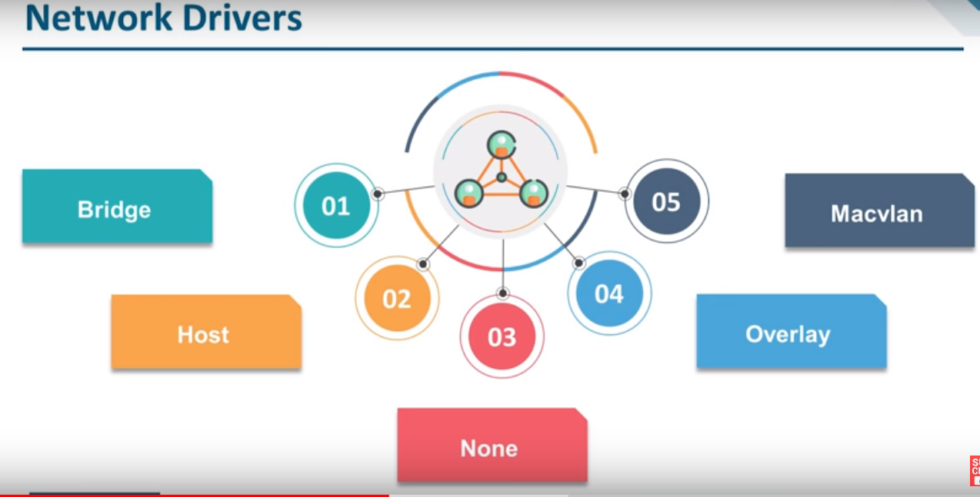
Docker Network Types

Slide 24
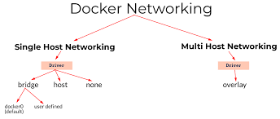
Macvlan

Slide 25
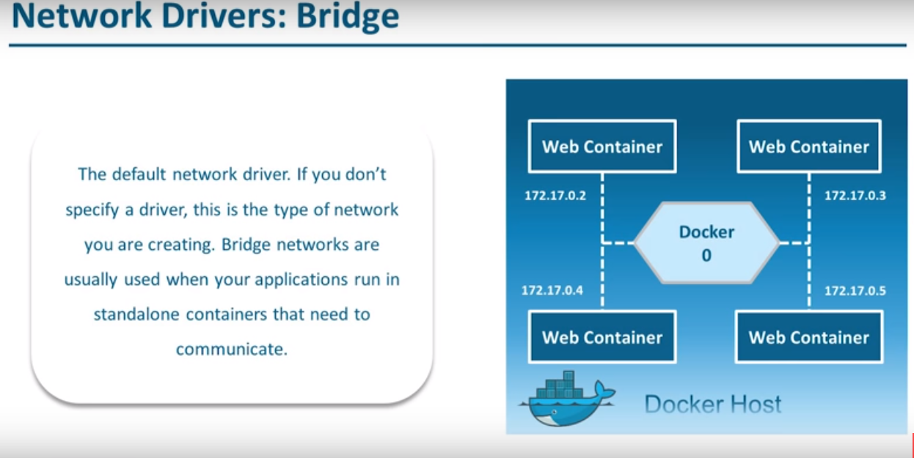

Slide 26
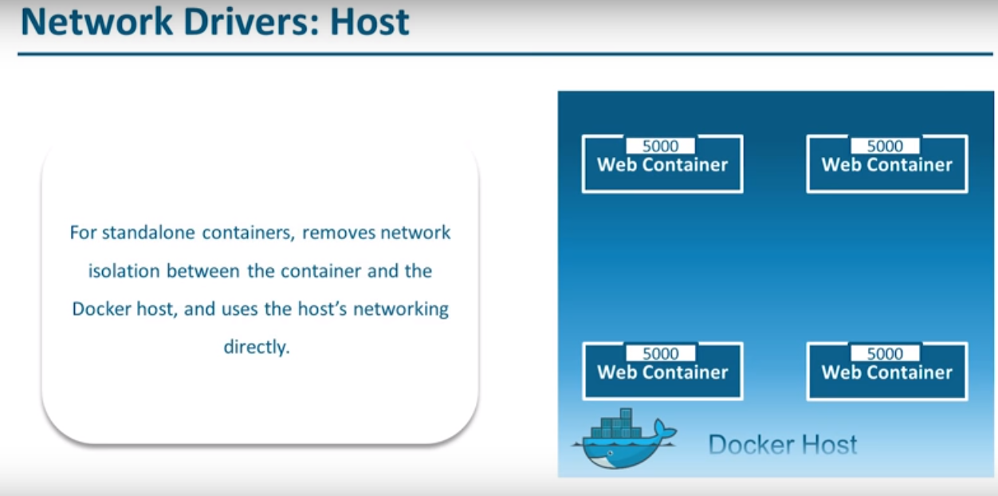

Slide 27
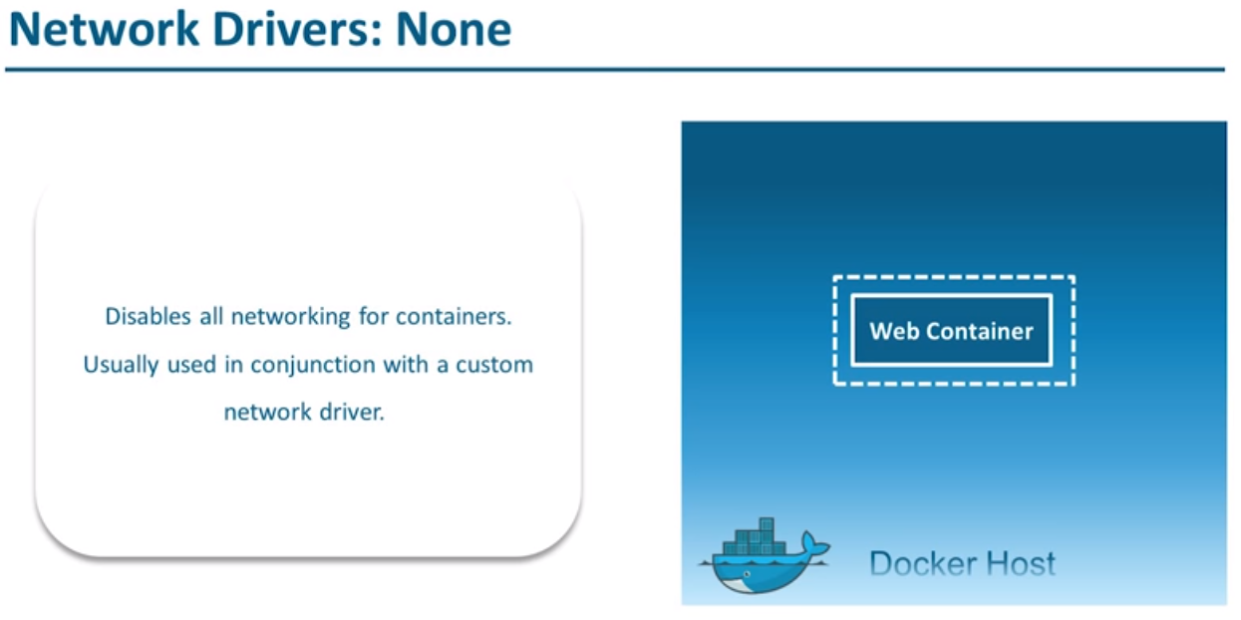

Slide 28
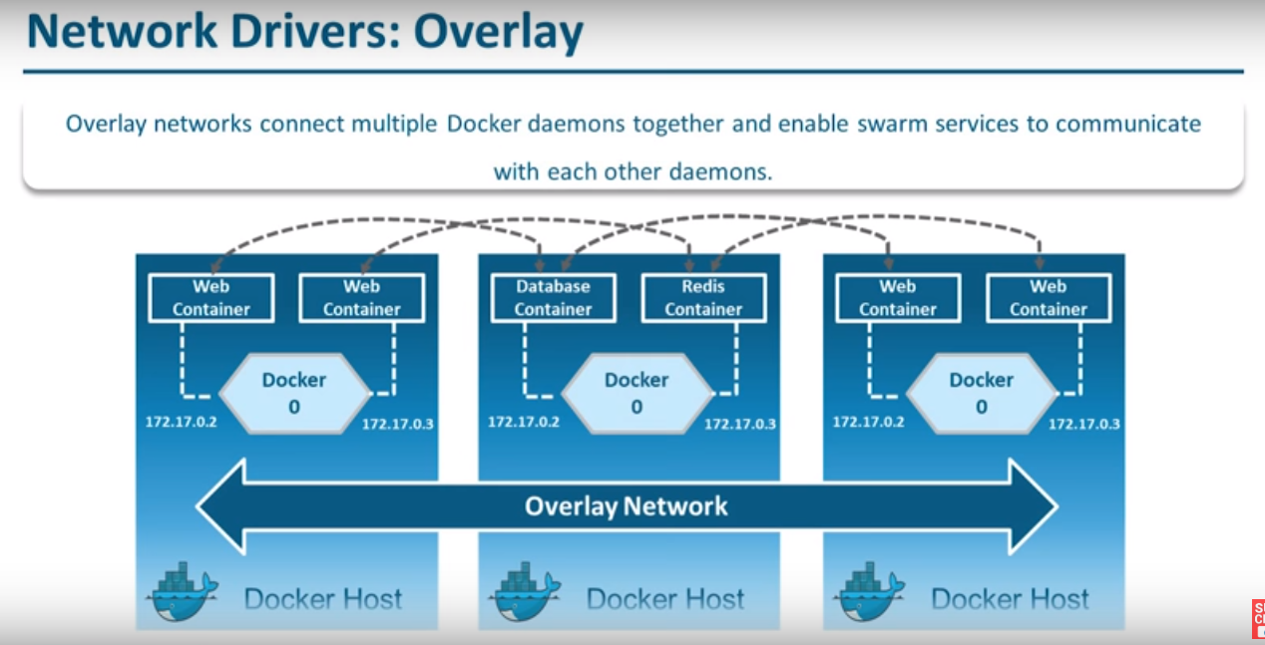

Slide 29
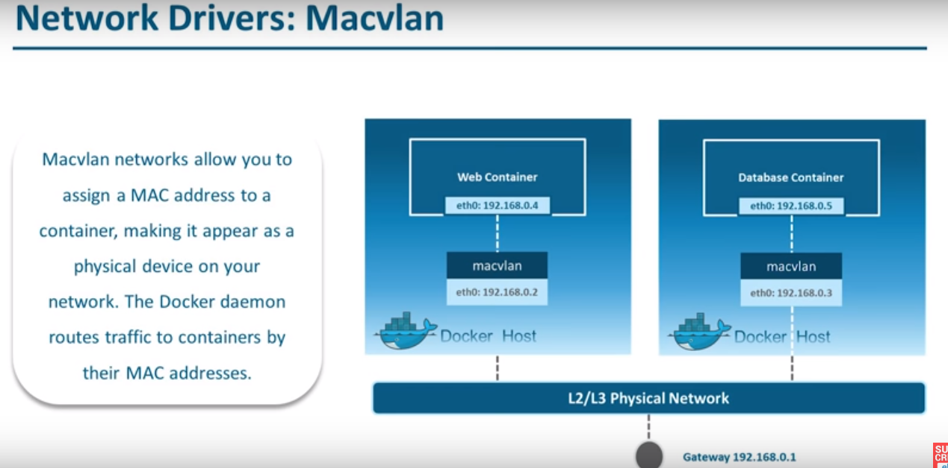

Slide 30
