Slide 1


2021
LeetCode
Speaker: Hewitt
PPT模板下载：www.1ppt.com/moban/ 行业PPT模板：www.1ppt.com/hangye/
节日PPT模板：www.1ppt.com/jieri/ PPT素材下载：www.1ppt.com/sucai/
PPT背景图片：www.1ppt.com/beijing/ PPT图表下载：www.1ppt.com/tubiao/
优秀PPT下载：www.1ppt.com/xiazai/ PPT教程： www.1ppt.com/powerpoint/
Word教程： www.1ppt.com/word/ Excel教程：www.1ppt.com/excel/
资料下载：www.1ppt.com/ziliao/ PPT课件下载：www.1ppt.com/kejian/
范文下载：www.1ppt.com/fanwen/ 试卷下载：www.1ppt.com/shiti/
教案下载：www.1ppt.com/jiaoan/
字体下载：www.1ppt.com/ziti/

Slide 2
Basic Introduction
Global
Online
IT Professional
Conprehensive

Slide 3
Brand Concept
Mission
Responsibility
Self-Driven
Trust
Persuit Of Perfection

Slide 4
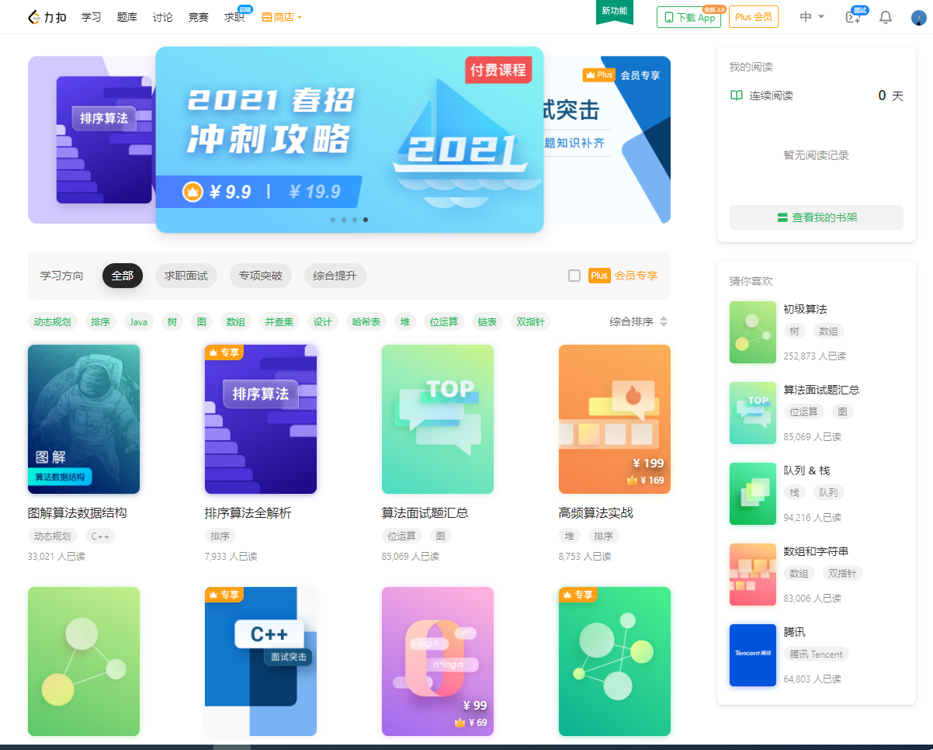
Core Function: Serch Card
Learning and sorting
tools.
Providing systematic and targeted special learning for users.
For example, graphic
algorithm data structure,
algorithm interview que-
stions summary.

Slide 5
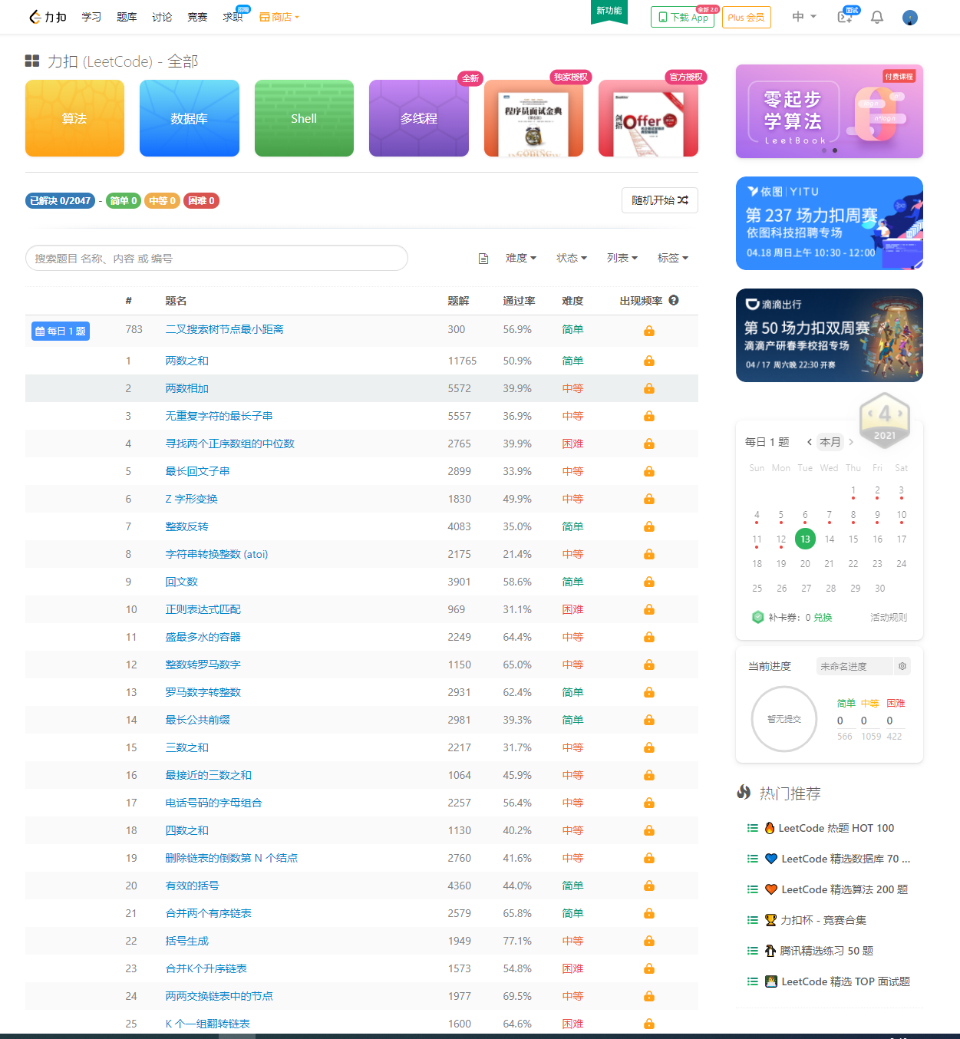
Function: Question Warehouse
Support more than 1000 prigramming languages such as C++, Java, Python,Rust,
Kotlin
Rich in variety
Diffficulty Classification

Slide 6
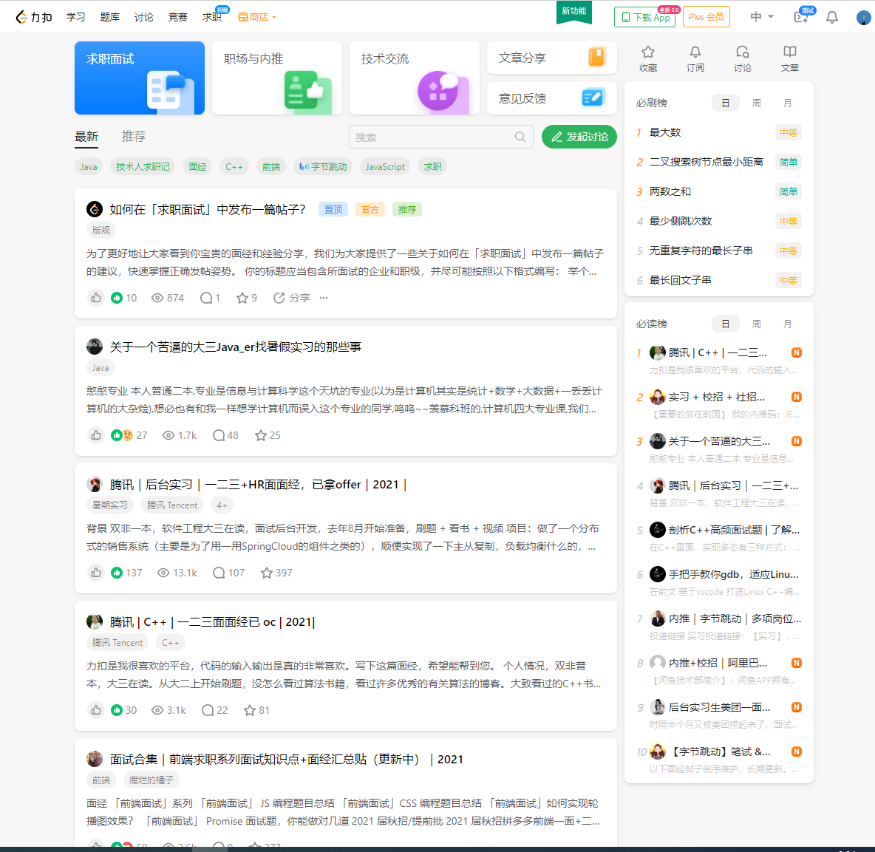
Function: Discussion Area
Users discussion area.
Covering technology learn-
ing, questions discussion,
workplace communication and
other topics.

Slide 7
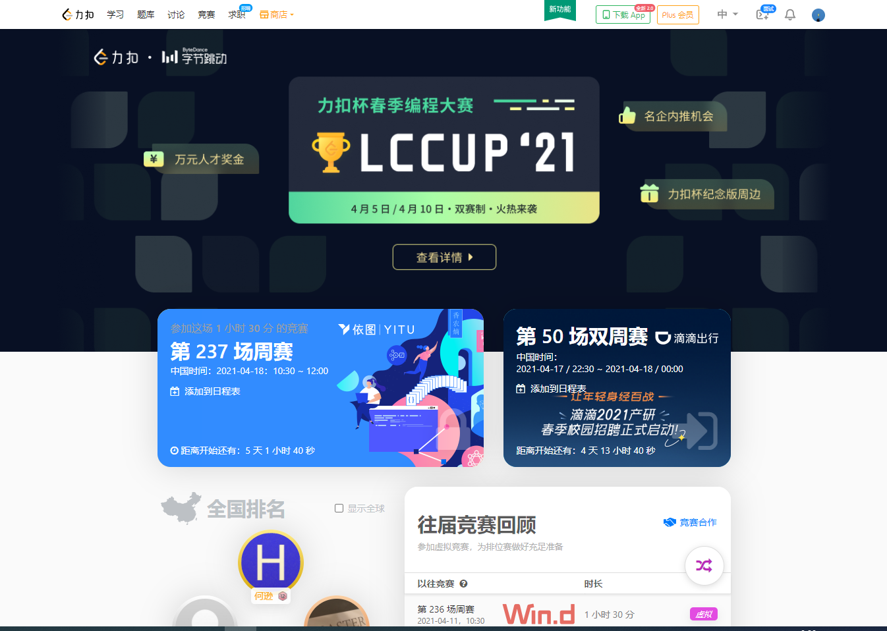
Function: Holding Competition
Regularly programming competitions.
One at every Sunday m-
orning, one at every ot-
her Saturday night.
Points and global ran-
kings.

Slide 8
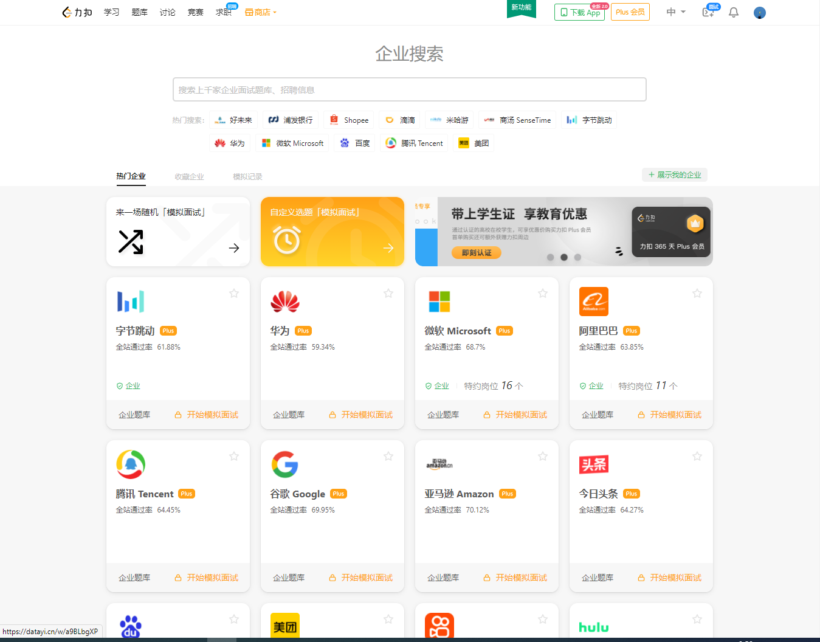
Function: Simulated Interview
Votes of millions of u-
sers.
1-3 interview questions
in 30-90 minutes, and ob-
tain detailed reports.

Slide 9
THANK YOU

