Slide 1
Vehicular Ad-hoc Network (VANET) based Control Systems for Smart Traffic Lights
Project Advisor: Ms.RADHIKA G
Assistant Professor
CSE

Slide 2

1
S.No | Reg.No | Name of the Student | Section
1 | CB.EN.U4CSE16105 | Aravind Raj | CSE-B
2 | CB.EN.U4CSE16117 | Gautam Ganesh | CSE-B
3 | CB.EN.U4CSE16120 | Haritha Jayan | CSE-B
4 | CB.EN.U4CSE16135 | Nishanth T | CSE-B
Date:9/10/2019
Group No:21

Slide 3

Introduction
3
VANETs which use vehicles as mobile nodes are a subclass of mobile ad hoc networks (MANETs) to provide communications among nearby vehicles and between vehicles and nearby roadside equipment with an aim of providing efficient and safe transportation.
Date:09/10/2019
Group No:21

Slide 4
Problem Statement
5
Rapid urbanization has put increasingly pressure on traffic management in urban areas. Conventional traffic signal with fixed or pre-defined variable cycles setting can slightly alleviate the increasing traffic problem, but cannot deal with continuously growing vehicular traffic in rapidly growing urban areas. Hence we propose a VANET based traffic control system, that helps to identify traffic density and control the traffic signal timers accordingly.
Date:09/10/2019
Group No:21

Slide 5
Comparative study of three base papers
6
Paper | Year | Parameters
Parisa Saraj Hamedani , Arshin Rezazadeh. "A New Two Level Cluster- Based Routing Protocol for Vehicular Ad Hoc NETwork (VANET)." | IEEE 2018 | QoL(quality of link), distance of the node, the velocity of the node, the direction of the node and the transmission power of the transmitted signal
Mohammed El Amine Fekair, Abderrahmane Lakas , Ahmed Korichi. "CBQoS- Vanet: Cluster-based Articial Bee Colony Algorithm for QoS Routing Protocol in VANET" | IEEE 2016 | Available bandwidth, end-to-end delay, jitter, and link expiration time and degree to determine QoS. Multipoint relays selection algorithm for inter cluster communication.
Wenxiao Dong , Fei Lin , Hongling Zhang , Yuping Yin. "A cluster-based re- cursive broadcast routing algorithm to propagate emergency messages in city VANETs." | IEEE 2017 | Traffic accident vehicle elected as cluster head. Next farthest message receiving node considered as next cluster head.
Date:14/08/2019
Group No:21

Slide 6
Proposed System
System Architecture
Our proposed system is going to be a combination of [1] and [2]. Here we
plan to implement a two level cluster based routing protocol. The rst level uses
QoS based Bee colony algorithm to elect a cluster head and to communicate between
cluster heads and cluster members. The next level uses a greedy method to choose
the nearest cluster head to communicate with.

Slide 7
Methodology
1. Cluster Head Election
The cluster head is responsible for selecting the appropriate path between
the source and destination by routing packets according to an Artificial Bee Colony
(ABC) algorithm based on specific QoS requirements.

Slide 8
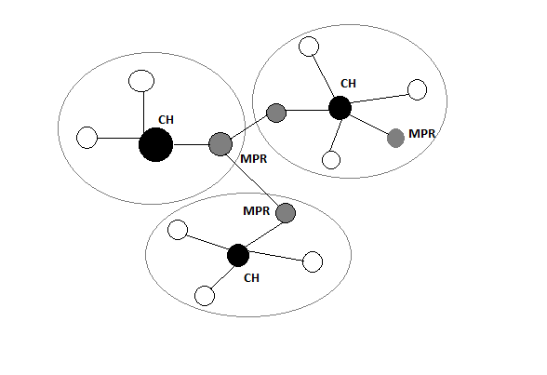
Fig: Cluster Head Election

Slide 9
Communication Principle
CBQoS-Vanet protocol is inspired by the way a swarm of bees communicate
and their forage for food. Here, the protocol uses two types of packets. The first type
of packets, called scout is used to discover route between the cluster head to a given
destination, a route that satises a certain QoS condition. Thus, the discovered
route should satisfy a combination of conditions based on the available bandwidth,
the end-to-end delay, jitter, and link stability. The second type of packets, called
forager is used to transmit the data between nodes.

Slide 10
Greedy Algorithm
The greedy algorithm performs the best choice according to the problem
conditions and determined criteria. It hopes optimization is done with continuing
the same procedure in every step. In a greedy way, the element that is best based
on a certain criterion is selected at each step.

Slide 11
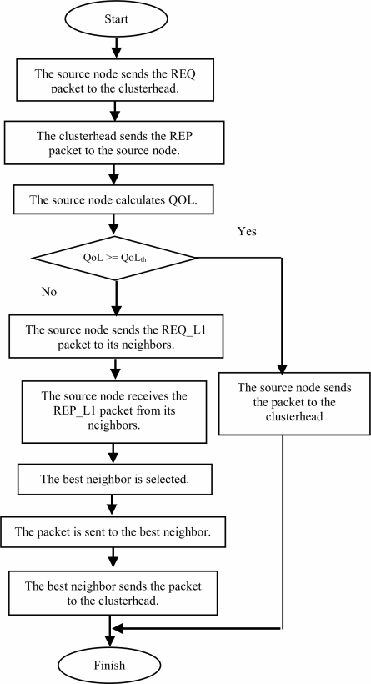

Slide 12
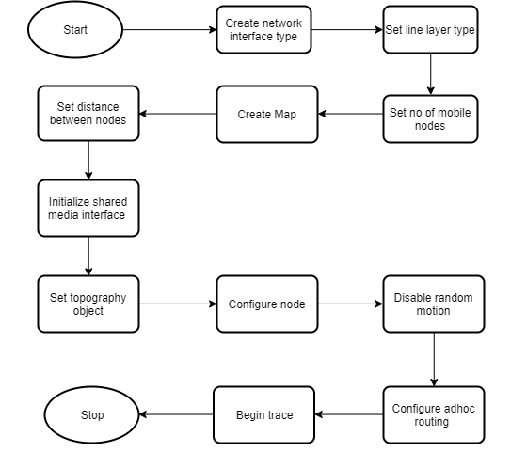
System flow
Fig: Creating VANETS

Slide 13
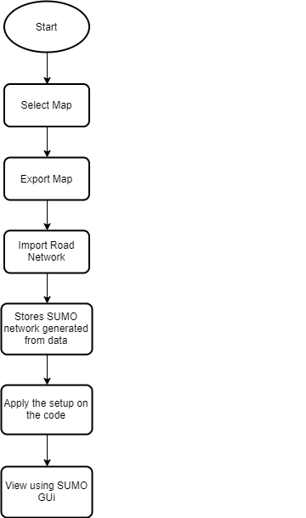


Slide 14
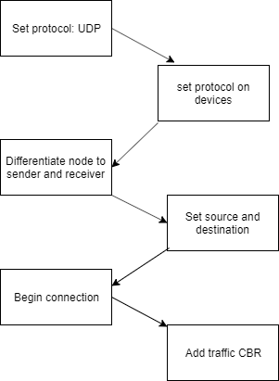
Fig: Message Broadcasting

Slide 15
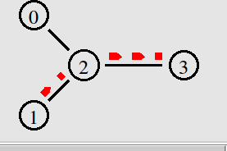
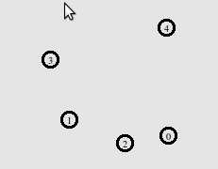
Output Screen Capture
Fig: Nodes in NS2
Fig: Nodes communicating with AODV while moving

Slide 16
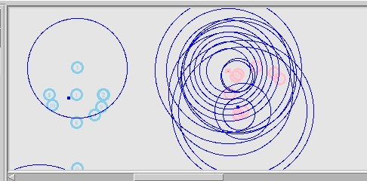
Fig: Formation of Clusters based on Clustering Algorithm

Slide 17
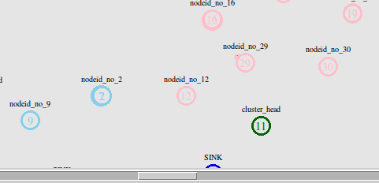
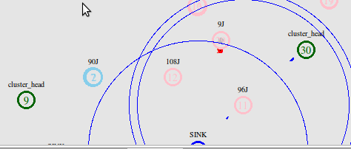
Fig: Cluster Adaptation
Fig: Post cluster formation

Slide 18
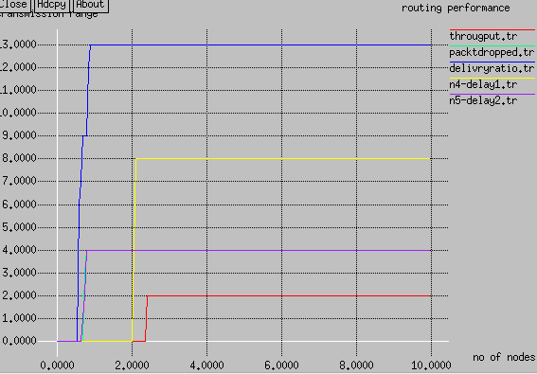
Fig: Routing Performance Analysis

Slide 19
References
12
Parisa Saraj Hamedani , Arshin Rezazadeh. "A New Two Level Cluster-Based Routing Protocol for Vehicular Ad Hoc NETwork (VANET)." IEEE2018
Mohammed El Amine Fekair, Abderrahmane Lakas , Ahmed Korichi. "CBQoS-Vanet: Cluster-based Artificial Bee ColonyAlgorithm for QoS Routing Protocol in VANET", 2016 International Conference on Selected Topics in Mobile & Wireless Networking (MoWNeT)
Wenxiao Dong , Fei Lin , Hongling Zhang , Yuping Yin. "A cluster-basedrecursive broadcast routing algorithm to propagate emergency messagesin city VANETs."IEEE 2017
Ganesh S. Khekare , Apeksha V. Sakhare. "A smart city framework for intelligent traffic system using VANET." IEEE 2013
R. Brendha , Dr.V.Sinthu Janita Prakash. "A Survey on Routing Protocols for Vehicular Ad Hoc Networks", 2017 International Conference on Advanced Computing and Communication Systems (ICACCS -2017)
Mohammad Fathian, Gholam Reza Shiran, Ahmad Reza Jafarian-Moghaddam, "Two New Clustering Algorithms for Vehicular Ad-Hoc Network Based on Ant Colony System", Springer Science+Business Media New York 2015
N. Maslekar , M. Boussedjra , J. Mouzna , H. Labiod. "VANET BasedAdaptive Trac Signal Control" IEEE 2011
Miao Wang , Hangguan Shan , Rongxing Lu , Ran Zhang , Xuemin Shen ,Fan Bai. "Real-Time Path Planning Based on Hybrid-VANET-EnhancedTransportation System." IEEE 2014
Date:09/10/2019
Group No:21

