Slide 1
FORECASTING CAR SALE PRICE

Slide 2




Our Team
Sowmya Reddy Product manager / Data Scientist
Saranya Reddy Front-end specialist
Triyogya
Data Engineer
Sai karthik
ML-Engineer / Team Lead

Slide 3
CONTENTS
Problem
Solution
Business Understanding’
Data Understanding
Data Preprocessing
Methodology
Technologies to be used
Project Pipeline
Future Scope
Conclusion
Result
Reference

Slide 4
3 Cs and why
Curiosity: Curiosity is essential for any data analysis and prediction task. In the context of car prices projection, curiosity drives the researcher or analyst to ask questions about the data, such as: What factors influence car prices? What is the relationship between a car's make, model, and year of manufacture and its price?
Connections: In the context of predictive car prices projection, connections refer to the relationships between various data points. For example, connections might exist between a car's make, model, and year of manufacture and its price.
Creating Value: Creating value refers to the process of generating insights and actionable recommendations from the data. In the context of predictive car prices projection, creating value involves using the insights generated from the data analysis to make informed decisions about buying, selling, or trading cars. For example, an accurate prediction of future car prices can help car dealerships make more informed decisions about their inventory, pricing, and marketing strategies.

Slide 5
What is the Problem?
Problem #1
Inaccurate Pricing
One common problem when selling a used car is figuring out how to price it accurately.
Problem #2
Negotiation Challenges
Even if both the buyer and seller have a good sense of the car's fair market value, negotiating a final price can still be difficult
Problem #3
Time Consuming valuation process
Determining the value of a used car can be a time-consuming process that involves lots of researching
01
02
03

Slide 6
How we are aiming to solve the problem
Solution #1
A car selling price prediction model can help by providing a data-driven estimate of the car's worth.
Solution #2
The model can help streamline the negotiation process and lead to a more satisfactory outcome for both parties.
Solution #3
A car selling price prediction model can provide a quick and easy way to get an estimate of a car's worth
01
02
03

Slide 7
Business Understanding
The main objective of this project would be to develop a machine learning model that can accurately predict the sale price of a car based on its attributes. Some of the key business questions that would need to be answered during this phase include
Main factors that influence the sale price of a car?
Target customers for this model?
Expected accuracy of the model?
Expected business benefits of the model?

Slide 8
Data Understanding
The dataset has been acquired from a car search venture website that helps users of the website purchase the cars.
The dataset that we collected has features that play a major role in helping us predicting the car’s market worth. For example, Odometer readings of the car, Fuel type, Number of previous owners etc.
We hope to perform Exploratory data analysis to handle any missing values, outliers, duplicates in the dataset.

Slide 9
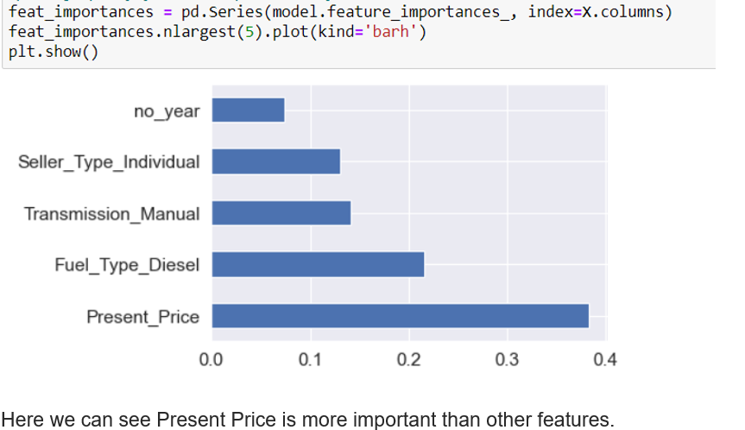
Data Preprocessing
Data Preprocessing is the process of transforming or encoding data so that it may be easily parsed by the machine. In other words, the algorithm can now easily interpret the data's features.
To produce an actual dummy encoding from a Data Frame, we need to pass drop first=True.
Feature Importance:- We are using Extra Tree-Regressor to get the important of the features in the dataset.

Slide 10
Methodology
For this project execution some past car data is used for which car pricing and other basic attributes are used. The cost of the car is the dependent variable, while the other characteristics are the independent variables.
Random Forest is a regression model that is based on ensemble learning. It employs a decision tree model to build the ensemble model, which, as the name implies, combines numerous decision trees to produce a forecast.

Slide 11
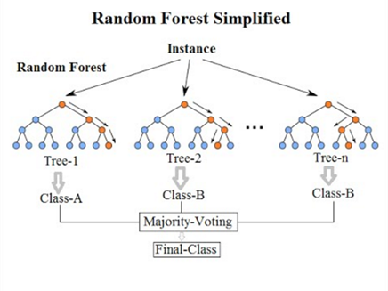

Slide 12






Technologies Deployed
Our Plan

Slide 13
Project Pipeline
Data Extraction
Feature Engineering
Data Cleaning & Visualizarion
Model Building
Model Deployment
Downloading Data from CarDekho website
Transforming the data to better represent the underlying problem
Selection and scaling of available features that are most relevant to the problem at hand
Performing EDA to carry out the data analysis
Checking null values, calculating sale price for all makes, models, market prices.
Building the model using random forest regression in sklearn
Using Python flask server to serve https request
A Website that permits users to input characteristics and obtain the projected selling price

Slide 14
FutureScope
Integration with real-time market data: Future models could incorporate real-time market data and trends to improve the accuracy of predictions.
Expansion to other markets: While car sale price predicting models currently exist for certain regions or markets, future models could expand to cover other regions and countries, providing a more comprehensive and global perspective on car pricing
Integration with blockchain technology: Future models could integrate blockchain technology to provide a secure, transparent, and decentralized platform for car pricing data. This could enable buyers and sellers to make more informed decisions based on trusted data and reduce the potential for fraud or manipulation in the pricing process.

Slide 15
CONCLUSION
It can be extreme to decide whether a utilized car is worth the promoted cost whereas looking at adverts. Mileage, make, demonstrate, year, and other characteristics can all have an affect on a car's genuine esteem. It may well be troublesome to cost a used car accurately from the point of view of a vender. Hence, the utilize of machine learning calculations will offer assistance in creating models for anticipating utilized car costs based on given highlights of car.

Slide 16
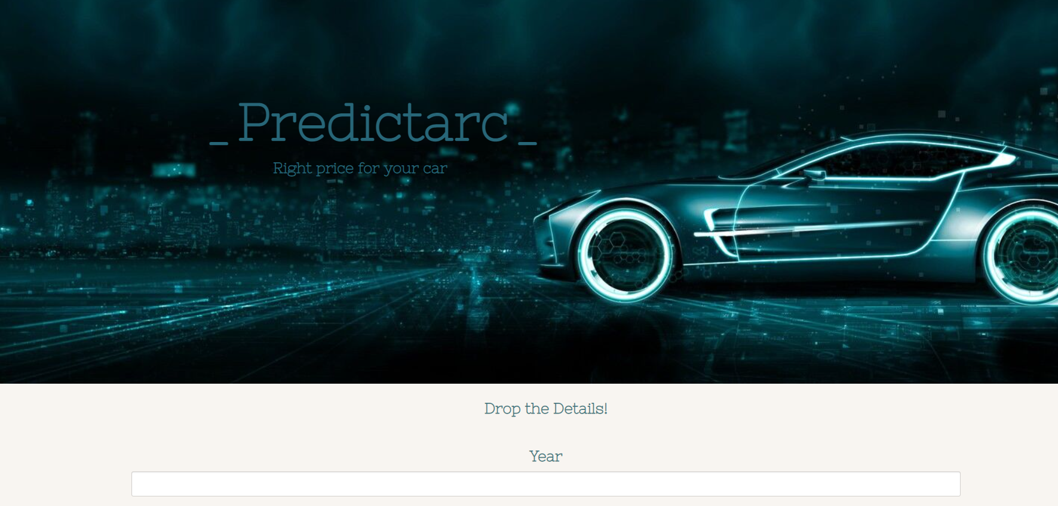
RESULT

Slide 17
REFERENCE
https://www.analyticsvidhya.com/blog/2021/07/car-price-prediction-machine-learning-vs-deep-learning/
https://towardsdatascience.com/predicting-car-price-using-machine-learning-8d2df3898f16
https://scholarworks.rit.edu/cgi/viewcontent.cgi?article=12220&context=theses
https://medium.com/geekculture/used-carprice-prediction-complete-machine-learning-project-d25559cf2d2a

Slide 18
THANK YOU

