Slide 1
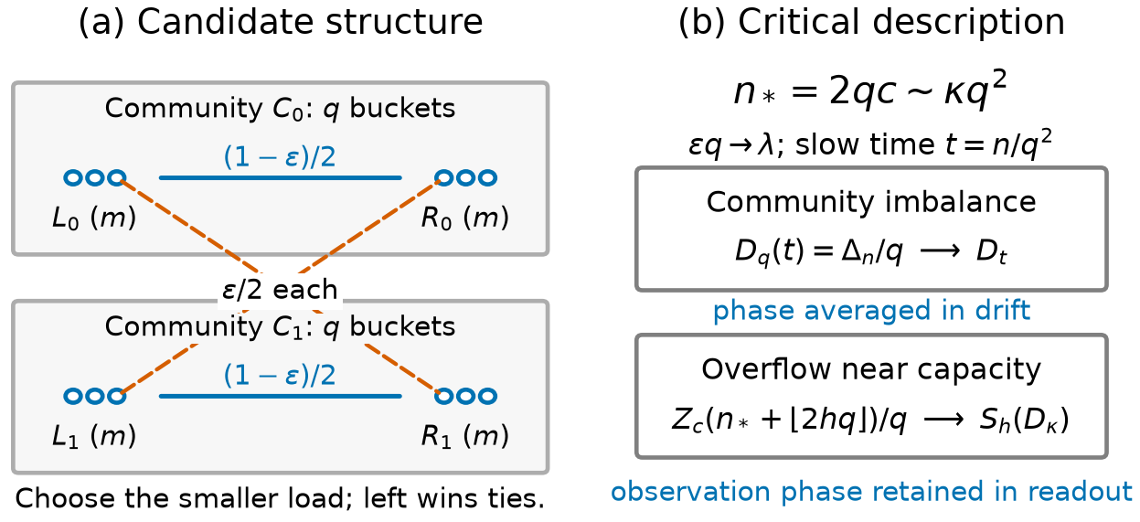
Capacity loss hidden by community totals
Silas Lu · Hongyi Dong · Xiaofeng Yu · Jin Shi
Two-choice allocation can leave overloaded buckets beside unused capacity.
Buckets carry assigned load.
Communities group the buckets.
Candidate edges limit comparisons.
Overflow counts load above c.
At critical fill, internal load variation contributes a positive order-q term beyond community excess.
Notes:
Source: main article, Introduction and Model and main results; Fig. 2 (model_scales). The model starts empty with two communities of q buckets, uniform complete-bipartite internal candidates, predetermined doubly stochastic cross kernels, and left-favored ties. The scaling is epsilon*q to lambda and 2*c_q/q to kappa. Corollary 2.4 identifies the positive leading internal contribution.

Slide 2
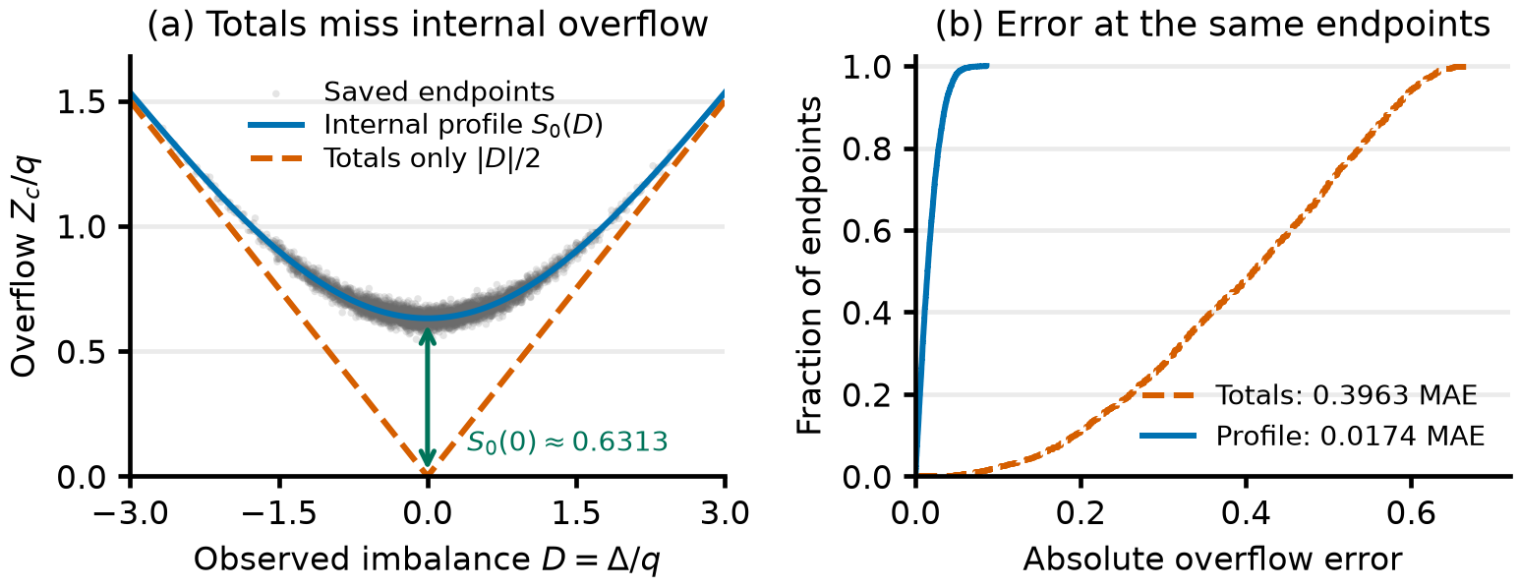
Internal overflow changes the leading capacity cost
A joint critical law retains community imbalance and the internal load profile.
Expected overflow is order q at nominal capacity.
At zero normalized imbalance, the profile readout is approximately 0.6313.
Notes:
Source: main article, Theorems 2.1-2.3, Corollaries 2.4-2.5, Numerical evaluation, and Fig. 1 (readout_teaser). The coefficient 0.6313 is the phase-zero, zero-imbalance limiting readout S_0(0). The figure uses 4096 saved endpoints at q=512, kappa=lambda=1 with matching crosses. It compares the profile and community-excess readouts at the same observed imbalance.

Slide 3
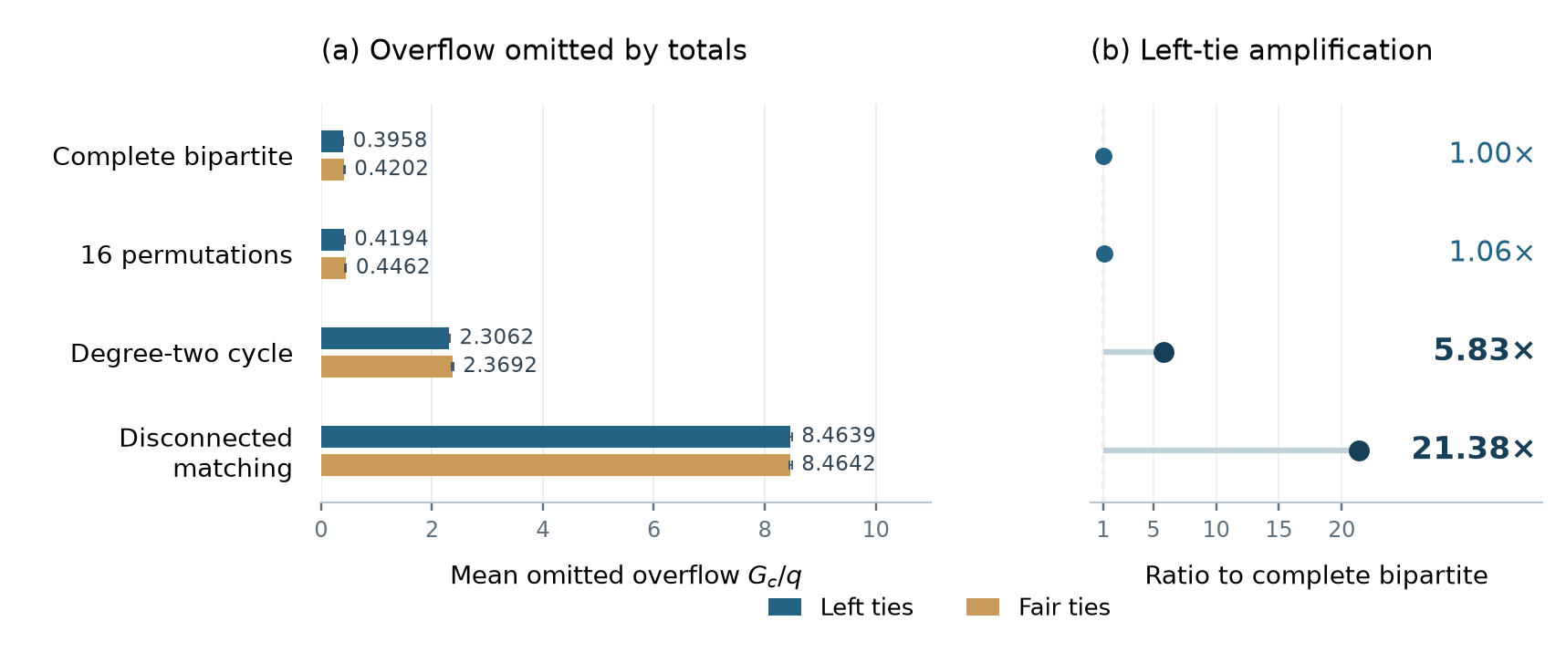
Topological amplification of internal overflow
Mean omitted overflow reaches 5.8× for cycles and 21.4× for matchings.
Complete-bipartite baseline. q=512, κ=λ=1, left ties. Each cell has 1024 trajectories.
Capacity monitoring can retain excess load and unused capacity together,
or preserve the bucket-load histogram.
Notes:
Source: main article, Section 6.5, Table 2, Fig. 5 (topology_amplification), and Section 7.3. The ratios compare unconditional sample means of G_c/q, with G_c=Z_c-|Delta|/2 at critical fill. For q=512, kappa=lambda=1 and left ties, the complete-bipartite, cycle, and matching means are 0.3958110809326172, 2.3062000274658203, and 8.463871002197266. The displayed ratios round 5.826517090 and 21.383613067. Error bars in the source figure show twice Monte Carlo standard error conditional on the fixed graphs. The monitoring statement follows from the aggregation identity G_c=sum_s min(E_s,U_s).

