Slide 1
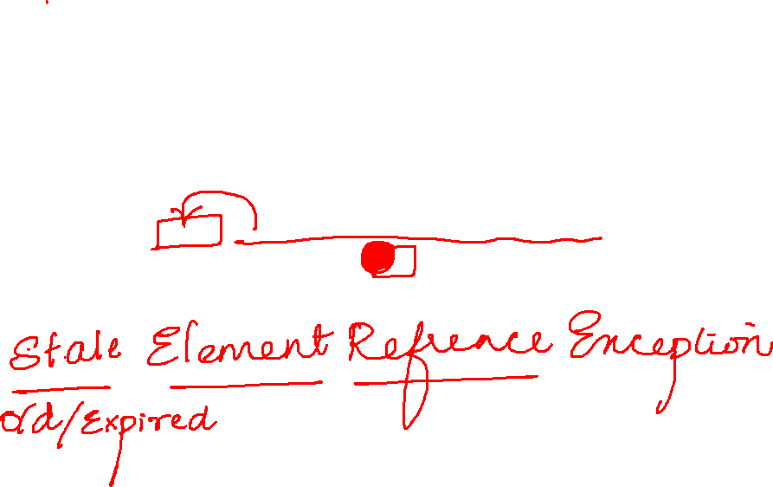
WebDriver driver=new ChromeDriver();
driver.manage().window().maximize();
driver.get("https://www.google.com/");
driver.manage().timeouts().implicitlyWait(Duration.ofSeconds(10));
WebElement ele = driver.findElement(By.name("q"));
driver.navigate().refresh();
ele.sendKeys("phone");

Slide 2
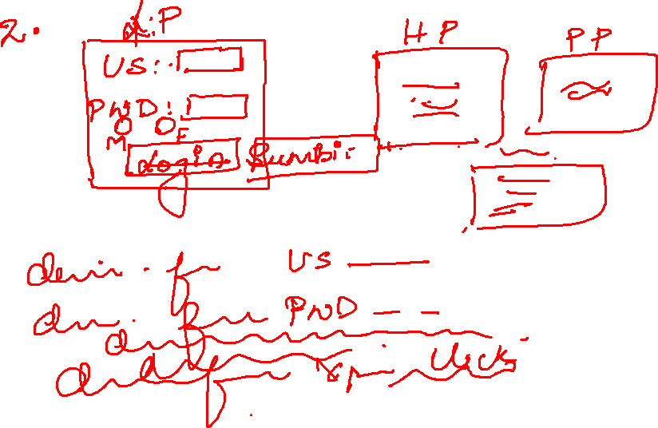

Slide 3
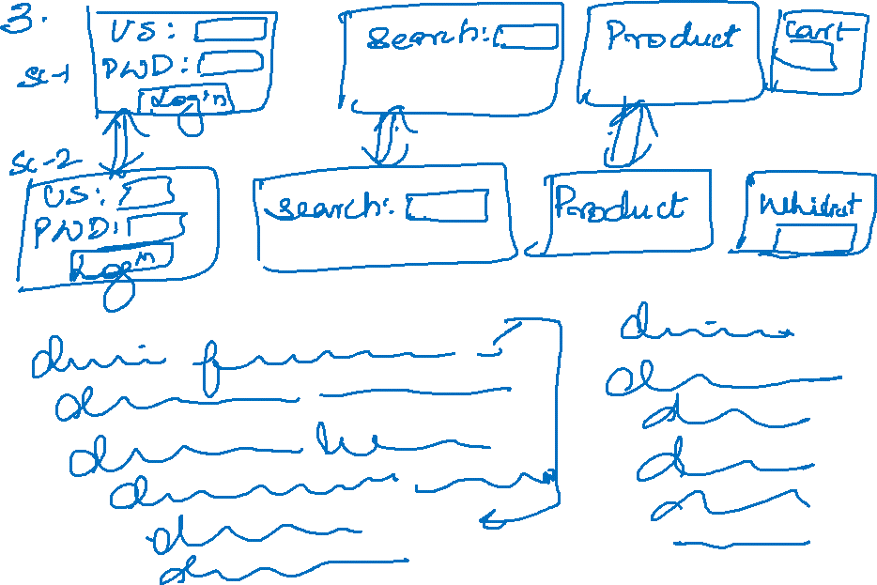

Slide 4
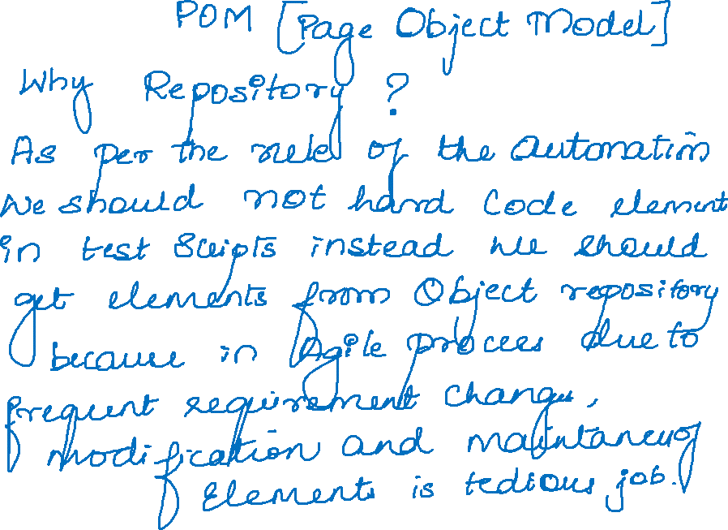

Slide 5
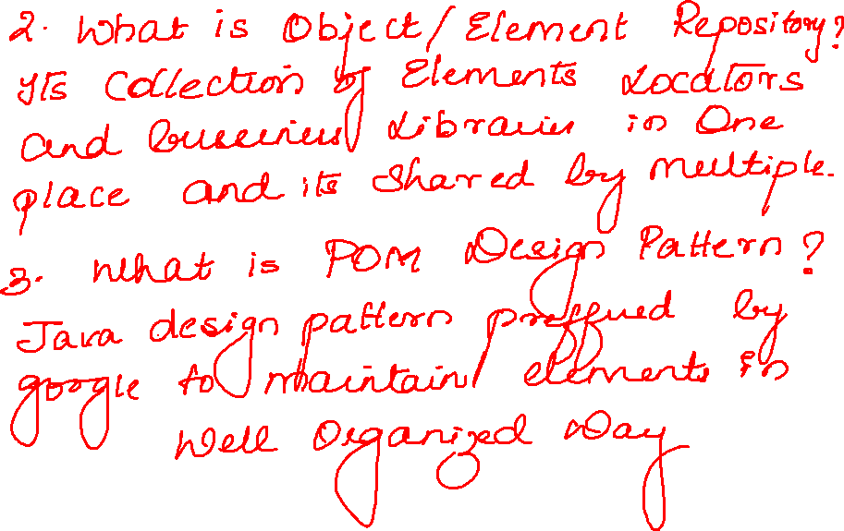

Slide 6
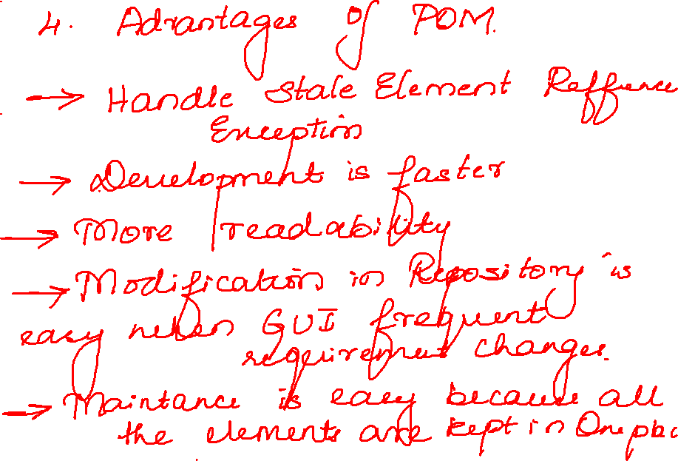

Slide 7
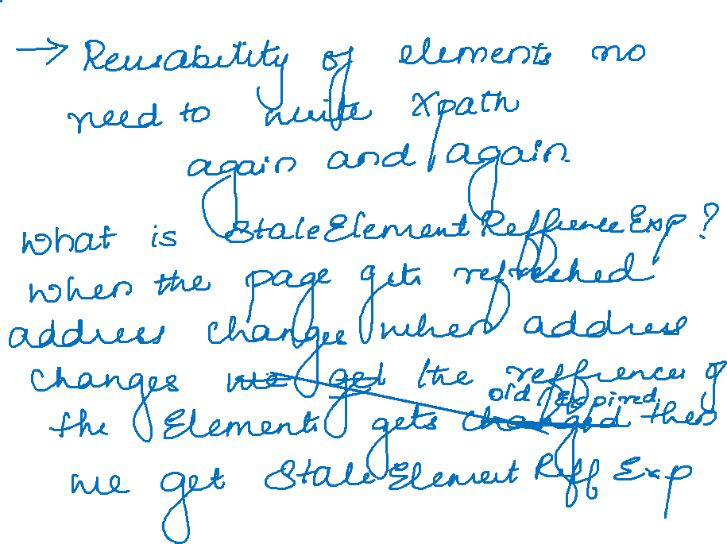

Slide 8
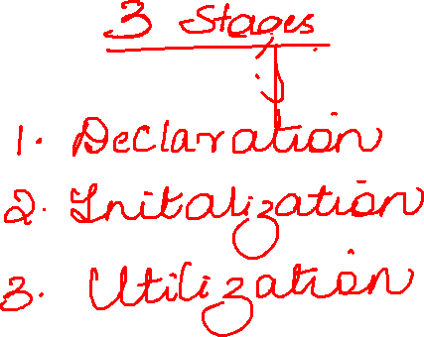

Slide 9
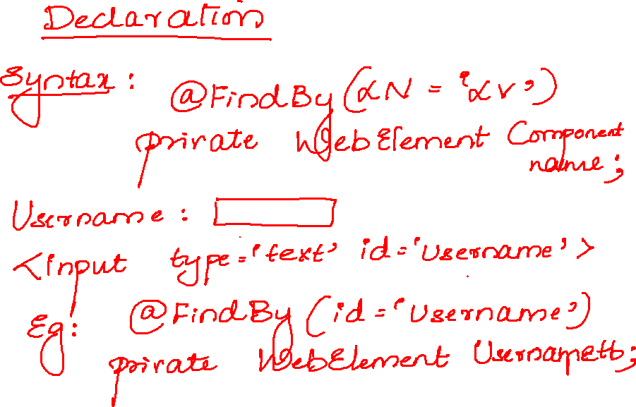

Slide 10
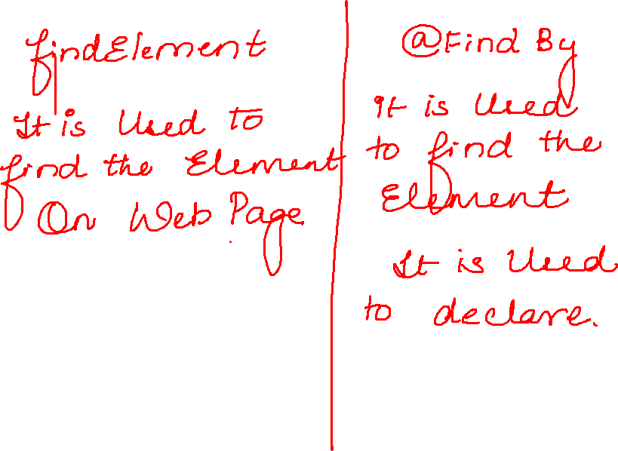

Slide 11
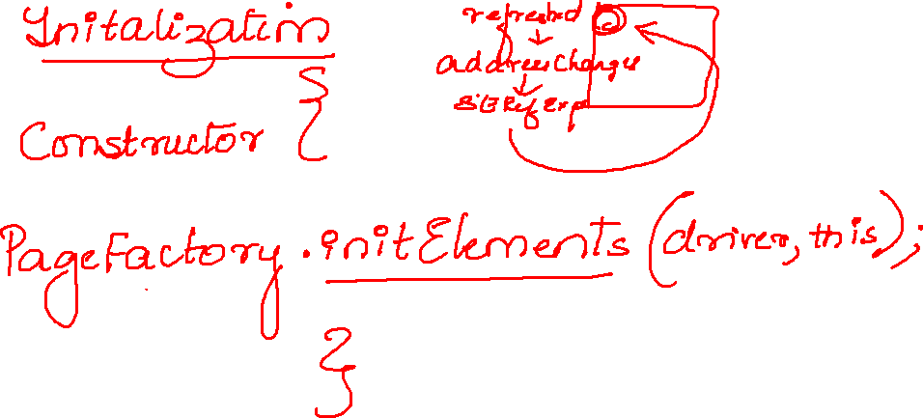

Slide 12
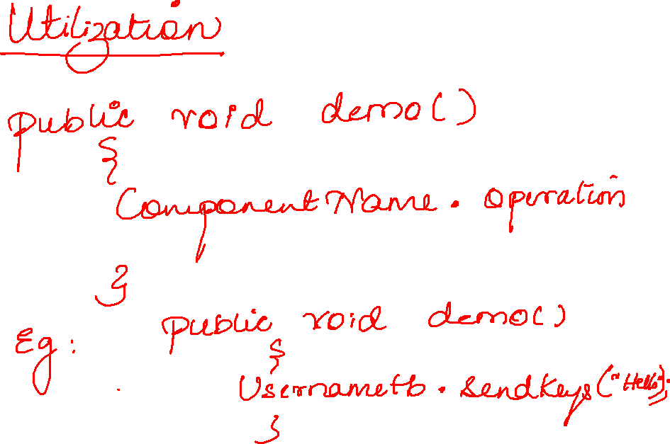

Slide 13
