Slide 1

Computer Algorithms
Unit-5
Backtracking

Slide 2
The General Method
Backtracking represents one of the most general techniques
Problems which deal with searching for a set of solutions or
which ask for an optimal solution satisfying some constraints
can be solved using backtracking formulation
Backtracking was first introduced by D. H. Lehmer in 1950

Slide 3
The General Method
In many applications of backtrack method, the desire solution is expressible as an n-tuple (x1, x2, ...,xn), where xi are chosen from some finite set Si.
Often the problem to be solved calls for finding one vector that, maximizes (or minimizes or satisfies) a criterion function P(x1,x2,…xn)
Sometimes it seeks all vectors that satisfy P
E.g. Sorting – Criteria function P is inequality

Slide 4
The General Method
Suppose mi is the size of set Si.
Then there are m = m1,m2,...,mn n-tuples
that are possible candidates for satisfying the function P.
The brute force approach would be to form all these n-tuples,
evaluate each one with P, and save those which yield the optimum

Slide 5
The General Method
The backtrack algorithm has as its virtue
the ability to yield the same answer with far fewer than m trials.
Its basic idea is to build up the solution vector one component at a time
and to use modified criterion functions
Pi (x1, . . . , xi) (sometimes called bounding functions)

Slide 6
The General Method
To test whether the vector being formed has any chance of success.
The major advantage of this method is this:
if it is realized that the partial vector (x1, x2, . . . , xi) can in no way lead to an optimal solution,
then mi+1 ... mn possible test vectors can be ignored entirely.

Slide 7
The General Method
Many of the problems we solve using backtracking require that
all the solutions satisfy a complex set of constraints.
For any problem these constraints can be divided into two categories:
explicit and
Implicit.

Slide 8
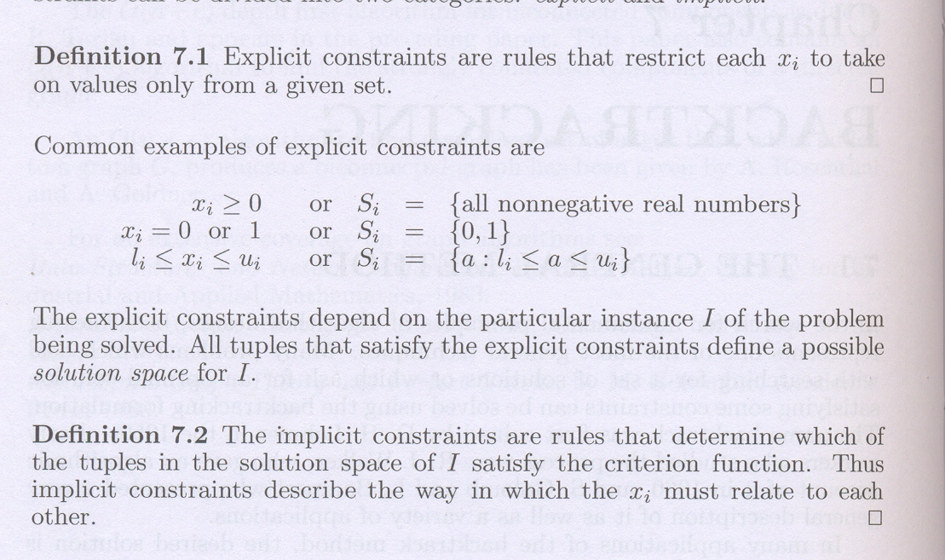

Slide 9
THE 8-QUEENS PROBLEM
Tackle the 8-queens problem via a backtracking solution.
Generalize the problem and consider an n x n chessboard
and try to find all ways to place n nonattacking queens.
Let (x1,…, Xn) represents a solution in which xi is the column of the ith row where ith queen is placed

Slide 10
THE 8-QUEENS PROBLEM
The 8-queens problem can be represented as 8-tuples (X1 . . , X8),
Si = {I, 2, 3, 4, 5, 6, 7, 8}, 1<=i<=8.
The solution space consists of 8⁸ 8-tuples.
The implicit constraints for this problem are that no two Xi‘s can be the same
(i.e. all queens must be on different columns)
and no two queens can be on the same diagonal.

Slide 11
THE 8-QUEENS PROBLEM
The first of these two constraints implies that
all solutions are permutations of the 8-tuple (1, 2, 3, 4, 5, 6, 7, 8).
This realization reduces the size of the solution space from 8⁸ tuples to 8! tuples.

Slide 12
THE 8-QUEENS PROBLEM
The xi's will all be distinct
since no two queens can be placed in the same column.
Now how do we test whether two queens are on the same diagonal?
Imagine the chessboard squares being numbered as
the indices of the two-dimensional array a[1 : n, 1 : n],

Slide 13
THE 8-QUEENS PROBLEM
Then observe that
every element on the same diagonal that runs from the upper left to the lower right
has the same row-column value.
For example, in Figure consider the queen at a[4,2].
The squares that are diagonal to this queen a[3, 1], a[5,3], a[6,4], a[7,5], and a[8,6].
All these squares have row-column value of 2

Slide 14
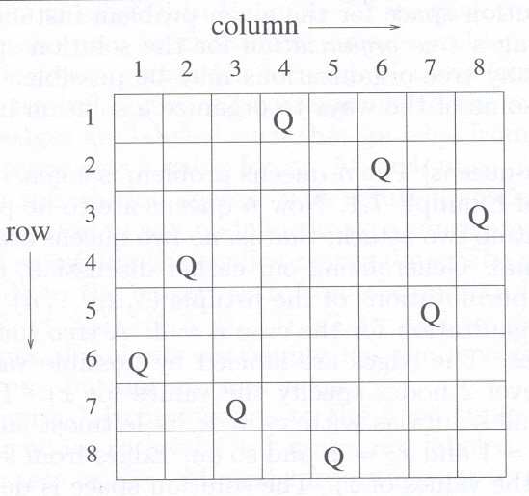
THE 8-QUEENS PROBLEM

Slide 15
THE 8-QUEENS PROBLEM
Also, every element on the same diagonal
that goes from the upper right to the lower left has the same row+column value.
Suppose two queens are placed at positions
(i, j) and (k, l).
Then by the above they are on the same diagonal only if

Slide 16
THE 8-QUEENS PROBLEM
i-j=k-l
Or i+j=k+l
The first equation implies
j-l=i-k
The second implies
j-l=k-i
Therefore two queens lie on the same diagonal if and only if |j – l| = |i – k|

Slide 17
THE 8-QUEENS PROBLEM
Algorithm Place(k, l)
//Return True if queen can be placed in k^{th} row and l^{th} column.
//X[ ] is global array whose (k-1) values have been set
//Abs(r) returns absolute value or r
{
For i=1 to k-1 do
if(x[i]=l) //Two queens in same column
OR
Abs(x[i]-l)=Abs(i-k) //Two queens on same diagonal
Then return false;
Return True;
}

Slide 18
THE 8-QUEENS PROBLEM
Place(k, l) returns a boolean value that is true if the kth queen can be placed in column l.
It tests both whether l is distinct from all previous values x[l],. . . , x[k - 1]
and whether there is no other queen on the same diagonal.
Its computing time is O(k - 1).

Slide 19
THE 8-QUEENS PROBLEM
Algorithm Nqueens(k, n)
//Using backtracking, this procedure prints all possible placements of n queens on an n x n chessboard so that they are nonattacking.
{
for l := 1 to n do
{ if Place(k, l) then
{ x[k] := l;
if (k = n) then write (x[1 : n]);
else Nqueens(k+1,n);
}
}
}

Slide 20
THE 8-QUEENS PROBLEM
At this point it is clear, how effective function NQueens is over the brute force approach.
For an 8 x 8 chessboard there are 16777216 possible ways to place 8 pieces,
However, by allowing only placements of queens on distinct rows and columns,
we require the examination of at most 8!, or only 40,320 8-tuples.

Slide 21
THE 8-QUEENS PROBLEM
Permutation Tree is used to show the solution space consisting of n! permutations of n-tuples (1,2,…n)
The edges are labeled by possible values of Xi
Edges from level 1 to level 2 nodes specify the values for x1
Leftmost subtree contains all solutions with x1=1, x2=2 and so on
Edges from level i to i+1 are lebeled with values of Xi

Slide 22
THE 8-QUEENS PROBLEM
The solution space is defined by all paths from the root node to a leaf node
There are 4!=24 leaf nodes

Slide 23
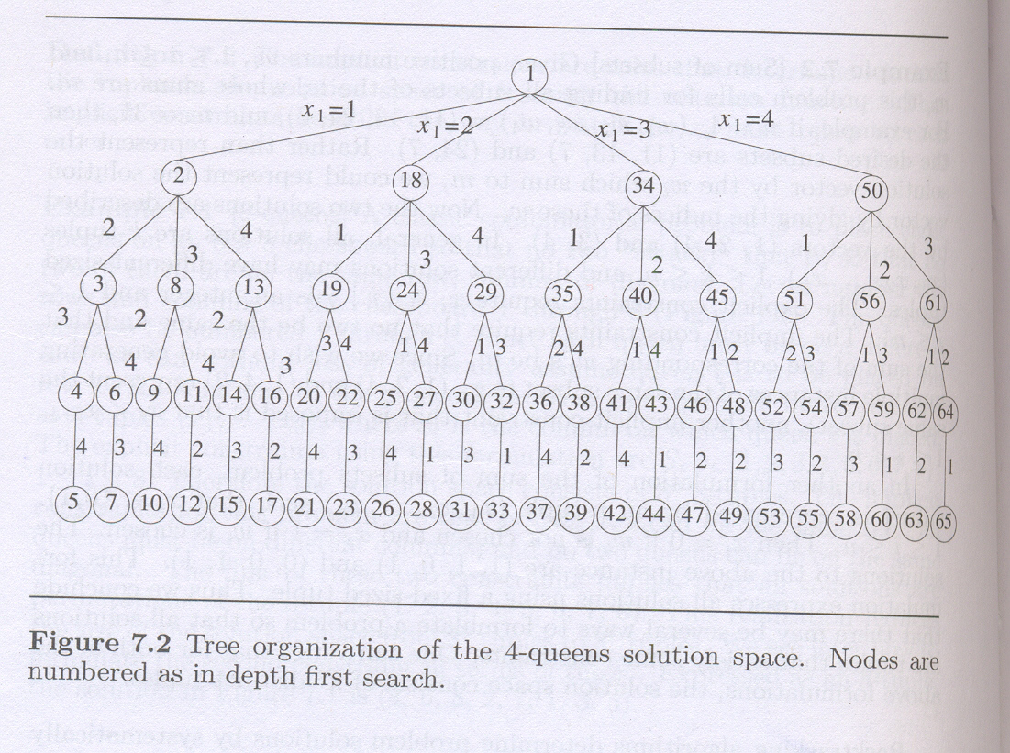

Slide 24
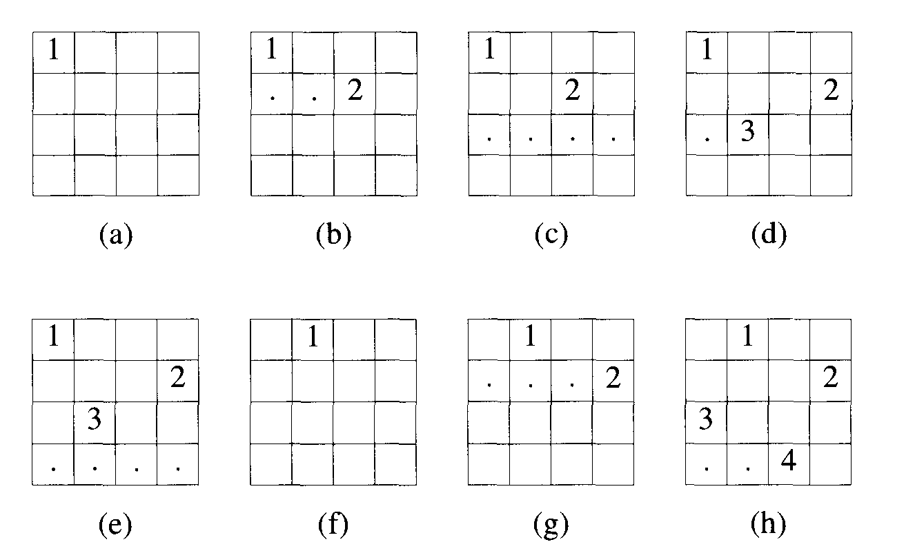

Slide 25
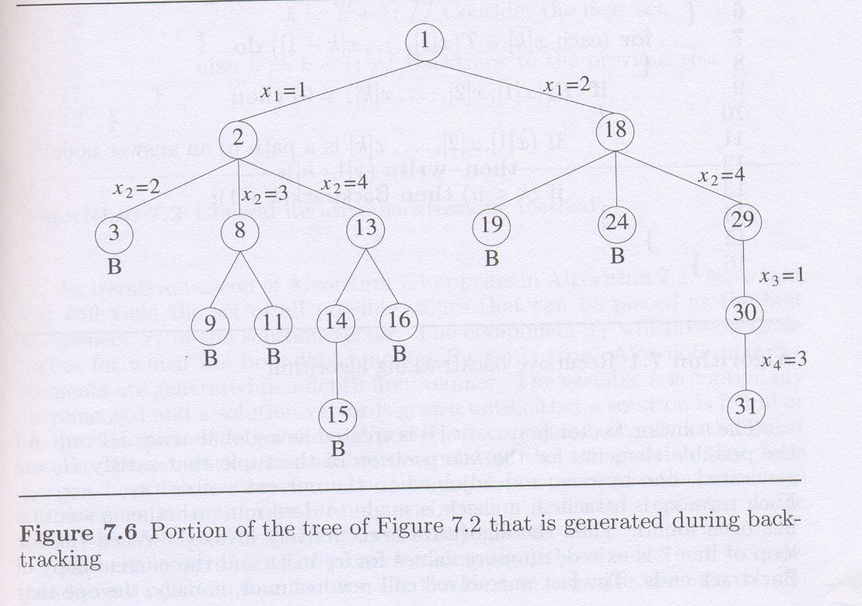

Slide 26
THE 8-QUEENS PROBLEM
As required, the placement of each queen on the chessboard was chosen randomly.
With each choice kept track of the number of columns a queen could legitimately be placed on.
These numbers are listed in the vector
The estimated number of unbounded nodes is only about 2.34% of the total number of nodes in the 8-queens state space tree.

Slide 27
SUM OF SUBSETS
Suppose we are given n distinct positive numbers (usually called weights)
we desire to find all combinations of these numbers whose sums are m.
This is called the sum of subsets problem.
consider a backtracking solution using the fixed tuple size strategy.

Slide 28
SUM OF SUBSETS
Given positive numbers Wi, 1<=i<=n and m,
this problem calls for finding all subsets of the Wi whose sums are m.
For example, if n = 4, (WI, W2, W3, W4) = (7, 11, 13, 24), and m = 31,
then the desired subsets are (11, 13, 7) and (24, 7). Rather than represent the solution vector by the Wi which sum to m,
we could represent the solution vector by giving the indices of these Wi. Now the two solutions are described by the vectors (1, 2, 3) and (1, 4).

Slide 29
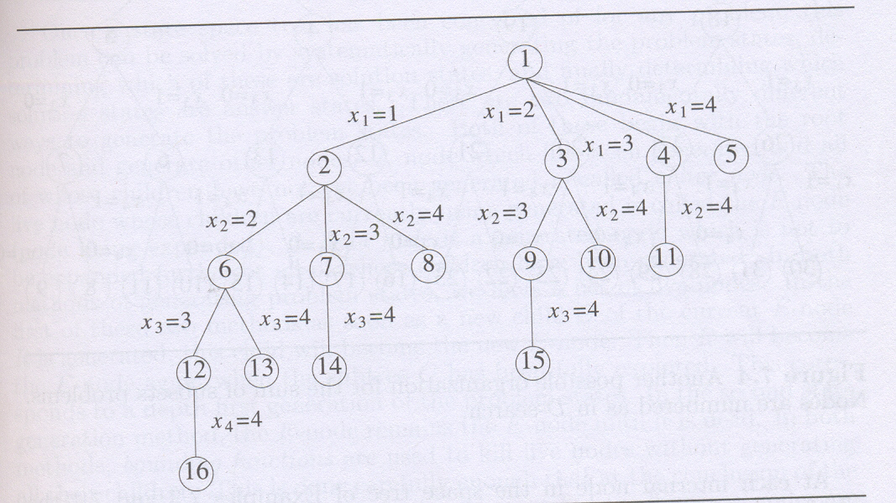

Slide 30
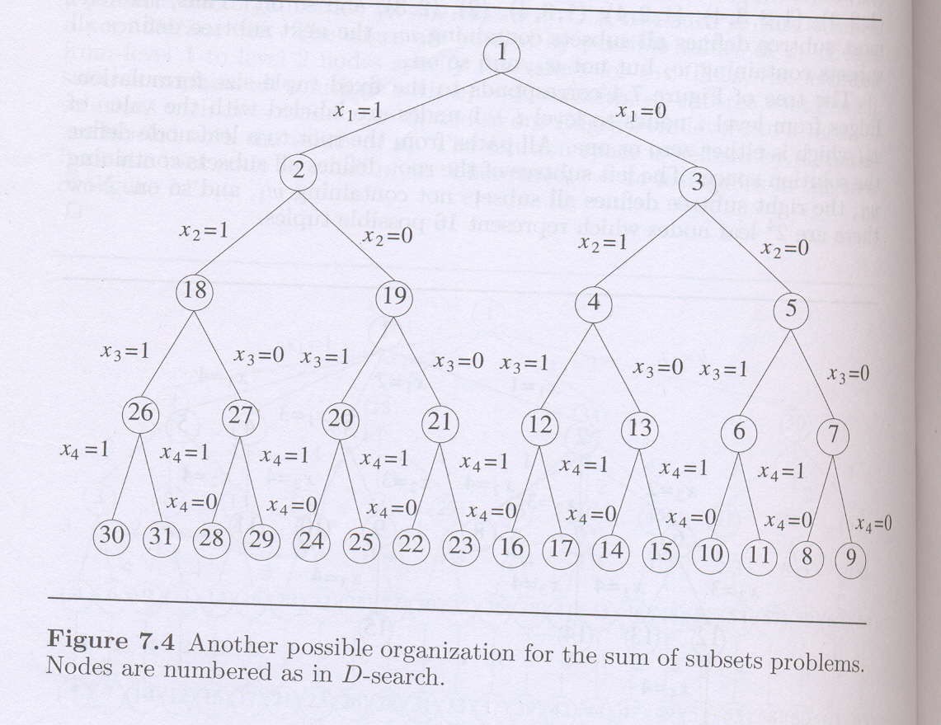

Slide 31
SUM OF SUBSETS
In this case the element Xi of the solution vector is either one or zero
depending on whether the weight Wi is included or not.
S= sum upto k-1 element
K=current element
R=sum from k to n

Slide 32
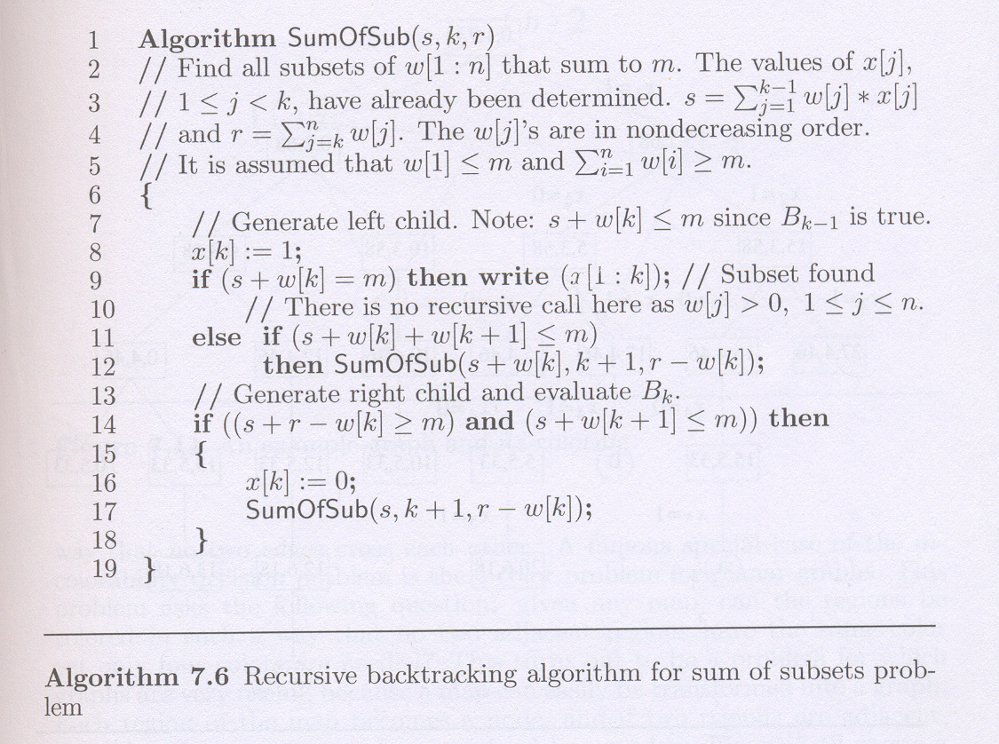

Slide 33
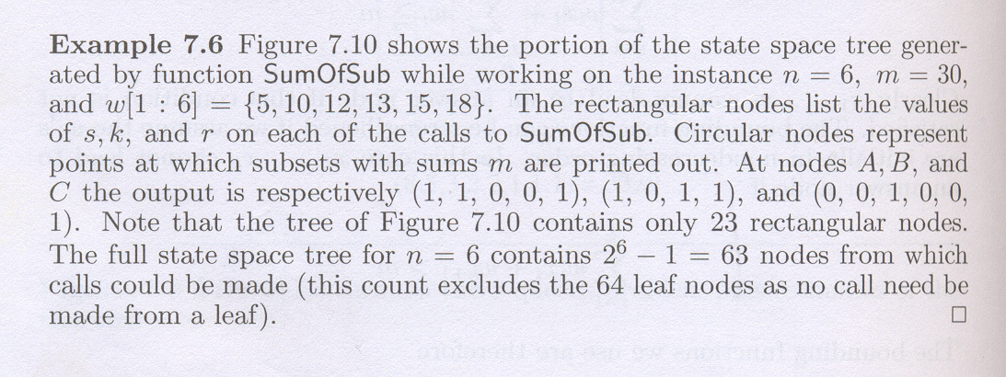

Slide 34
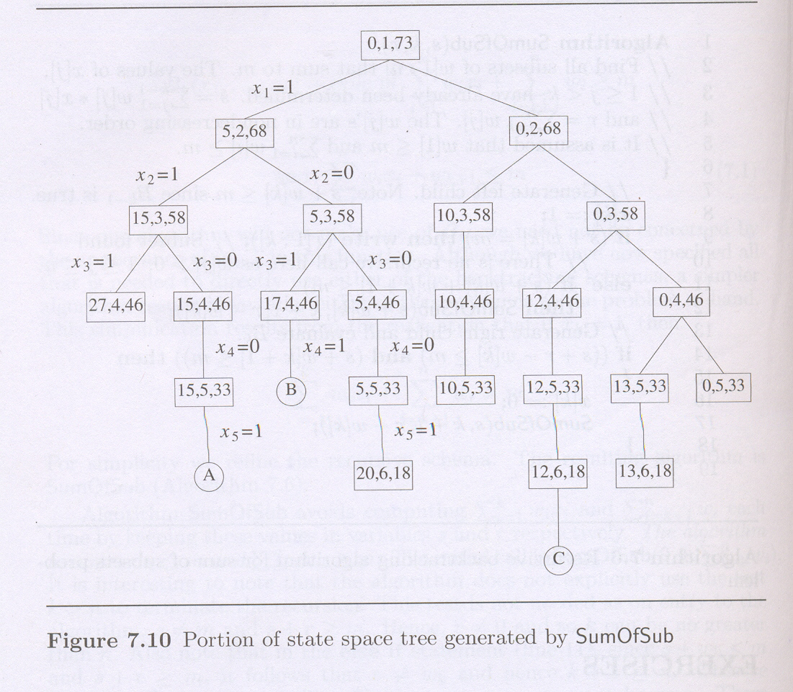

Slide 35
GRAPH COLORING
Let G be a graph and m be a given positive integer.
We want to discover whether the nodes of G can be colored
in such a way that no two adjacent nodes have the same color
yet only m colors are used.
This is termed the m-colorability decision problem

Slide 36
GRAPH COLORING
if d is the degree of the given graph,
then it can be colored with d + 1 colors.
the m-colorability optimization problem asks
For the smallest integer m for which the graph G can be coloreds
This integer is referred to as the chromatic number of the graph.

Slide 37
GRAPH COLORING
For example, the graph of Figure can be colored with three colors 1,2, and 3.
The color of each node is indicated next to it.
It can also be seen that three colors are needed to color this graph
and hence this graph's chromatic number is 3.

Slide 38
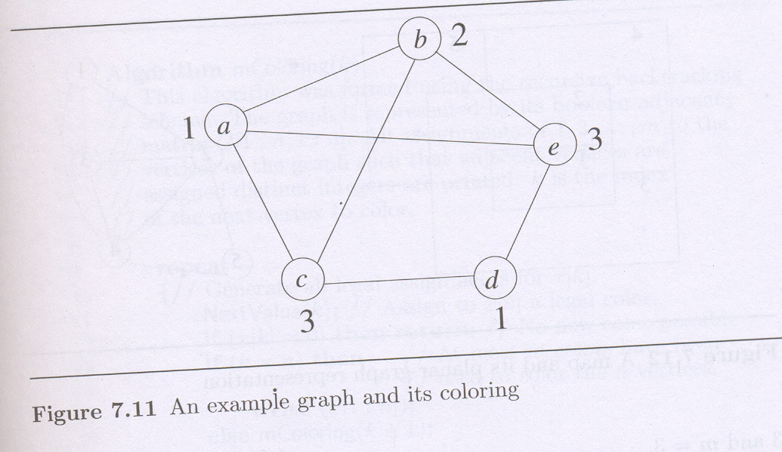
GRAPH COLORING

Slide 39
GRAPH COLORING
A graph is said to be planar iff
it can be drawn in a plane in such a way that no two edges cross each other.
A famous special case of the m-colorability decision problem is the 4-color problem for planar graphs.
This problem asks the following question

Slide 40
GRAPH COLORING
Given any map, can the regions be colored in such a way that
no two adjacent regions have the same color yet only four colors are needed?
This turns out to be a problem for which graphs are very useful,
because a map can easily be transformed into a graph.

Slide 41
GRAPH COLORING
Each region of the map becomes a node,
and if two regions are adjacent, then the corresponding nodes are joined by an edge.
Figure shows a map with five regions and its corresponding graph.
This map requires four colors.
For many years it was known that five colors were sufficient to color any map, but no map that required more than four colors had ever been found.

Slide 42
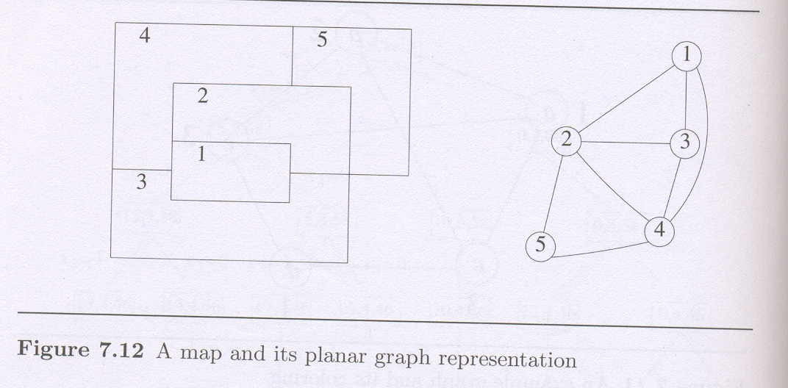
GRAPH COLORING

Slide 43
GRAPH COLORING
We are interested in determining
all the different ways in which a given graph
can be colored using at most m colors.
Suppose we represent a graph by its adjacency matrix G[1 : n, 1 : n],
where G[i, j] = 1 if (i, j) is an edge of G, and G[i, j] = 0 otherwise

Slide 44
GRAPH COLORING
The colors are represented by the integers 1,2,... , m
and the solutions are given by the n-tuple (X1,…, xn),
where Xi is the color of node i
Using the recursive backtracking formulation the resulting algorithm is mColoring

Slide 45
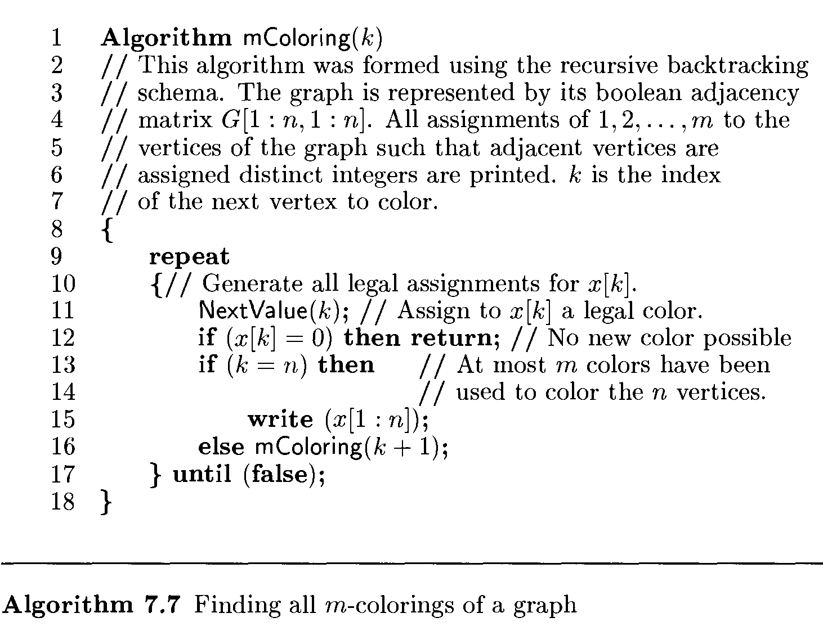

Slide 46
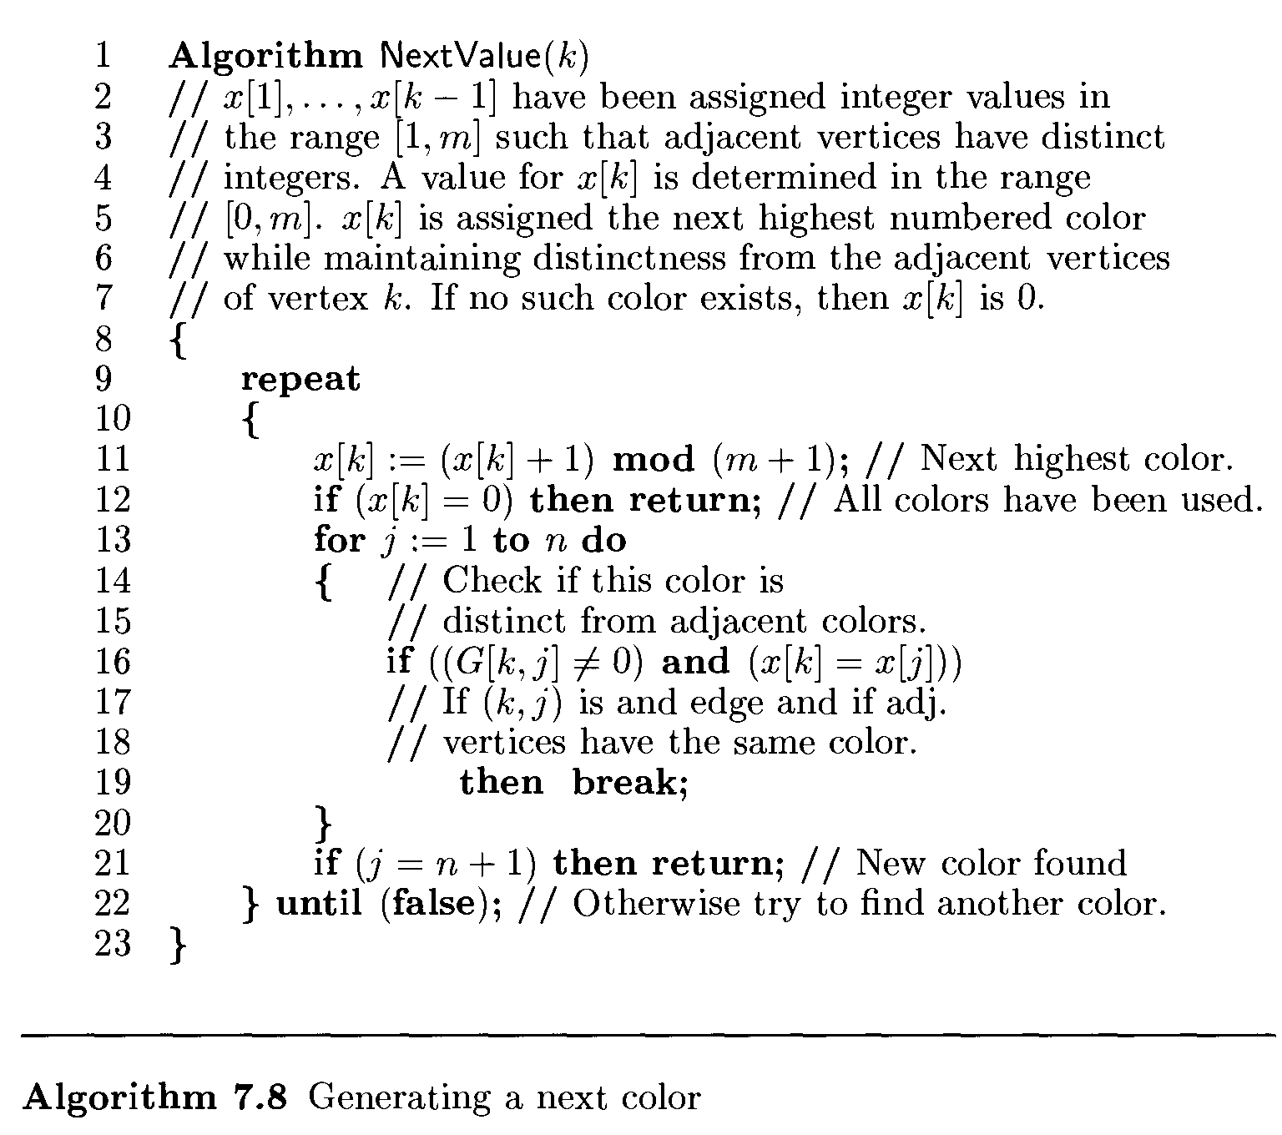

Slide 47
GRAPH COLORING
The underlying state space tree used is a tree of degree m and height n + 1.
Each node at level i has m children corresponding to the m possible assignments to Xi, 1 <= i <= n.
Nodes at level n + 1 are leaf nodes.
Figure shows the state space tree when n =3 and m = 3.
Computing Times is=O(n m^{n})

Slide 48
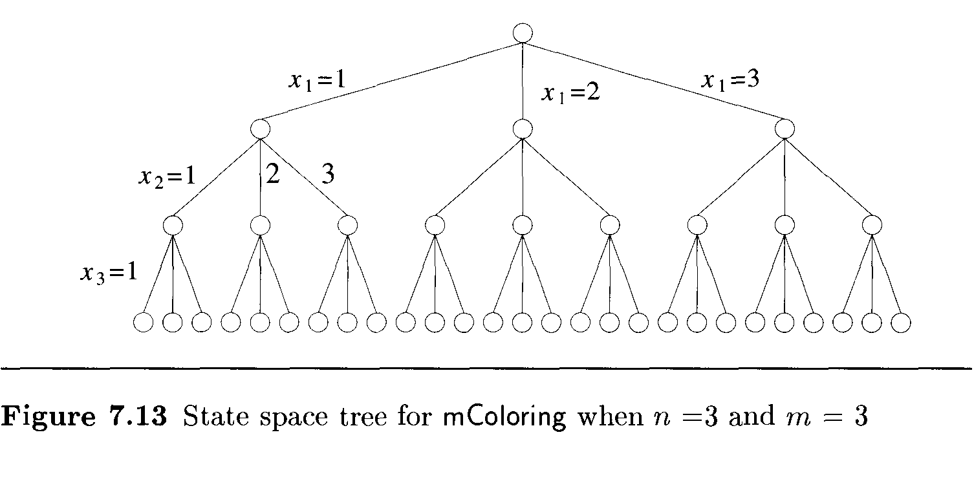

Slide 49
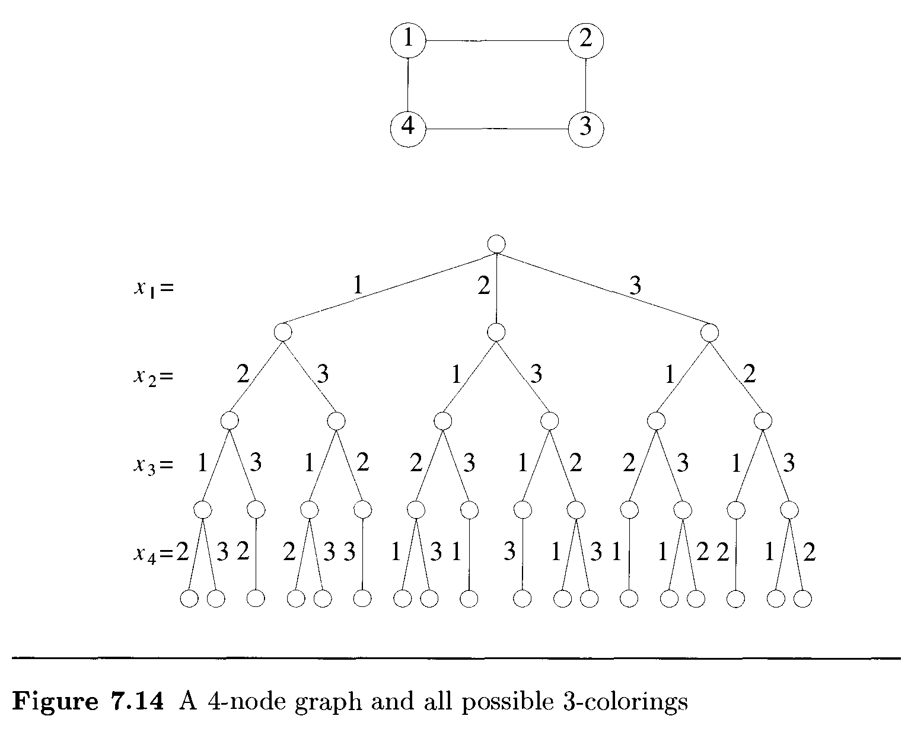

Slide 50
HAMILTONIAN CYCLES
Let G = (V, E) be a connected graph with n vertices.
A Hamiltonian cycle (suggested by Sir William Hamilton) is a
round-trip path along n edges of G
that visits every vertex once and returns to its starting position.

Slide 51

HAMILTONIAN CYCLES
In other words
if a Hamiltonian cycle begins at some vertex
and the vertices of G are visited in the order v₁, v₂, .. . , v_{n+1}
then the edges (v_{i}, v_{i+i}) are in E, 1 <i <n,
and the vi are distinct except for v₁ and v_{n+1}
which are equal.

Slide 52
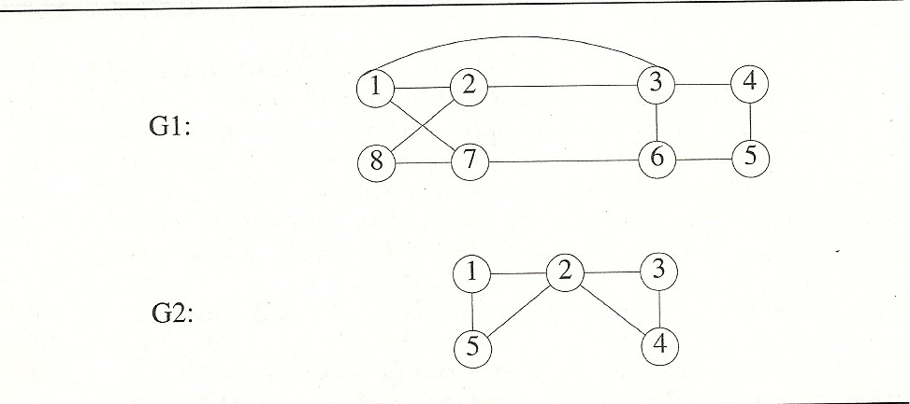
The graph G1 contains the Hamiltonian cycle 1, 2, 8, 7, 6, 5, 4, 3, 1.
The graph G2 contains no Hamiltonian cycle.

Slide 53
HAMILTONIAN CYCLES
There is no known easy way
to determine whether a given graph contains a Hamiltonian cycle.
backtracking algorithm can find all the Hamiltonian cycles in a graph.
The graph may be directed or undirected.
Only distinct cycles are output.

Slide 54
HAMILTONIAN CYCLES
The backtracking solution vector (x1,…,xn)
is defined so that xi represent the ith visited vertex of the proposed cycle.
Now all we need to do is determine how to compute the set of possible vertices
for xk if x1,..,xk-1 have already been chosen.

Slide 55
HAMILTONIAN CYCLES
To avoid printing the same cycle n times,
we require that x1=1. If 1 <k <n,
Then xk can be any vertex v that is distinct from x1,x2,... ,xk-1
and v is connected by an edge to xk-1.
The vertex xn can only be the one remaining vertex
and it must be connected to both xn-1 and x1

Slide 56
HAMILTONIAN CYCLESs
function NextValue(k) determines a possible next vertex for the proposed cycle.
Using NextValue particularize the recursive backtracking schema
to find all Hamiltonian cycles
This algorithm is started by first initializing the adjacency matrix G[1: n, 1 : n],
then setting x[2:n] to zero and x[1] to 1, and then executing Hamiltonian(2).

Slide 57
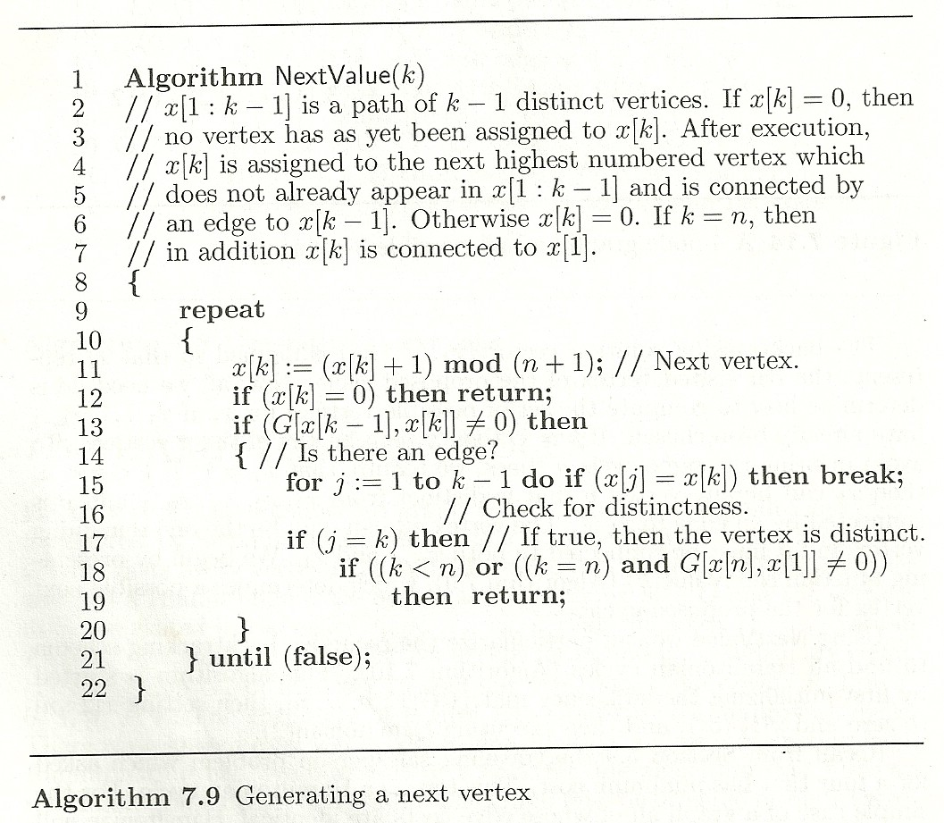

Slide 58
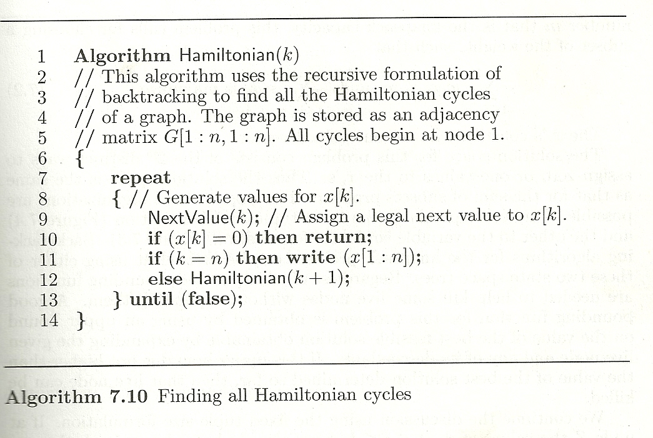

Slide 59
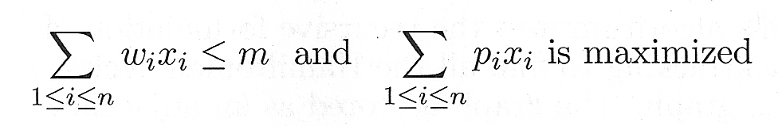
KNAPSACK PROBLEM
Reconsider 0/1 knapsack problem solved using dynamic programming approach
Given n positive weights wi,
n positive profits pi, and
positive number m that is a knapsack capacity
This problem calls for choosing a subset of weights such that

Slide 60
KNAPSACK PROBLEM
The xi’s constitute a zero-one-valued vector.
The solution space for this problem consists of the 2^{n} distinct ways to assign zero or one values to the xi’s.
Thus the solution space is the same as that for the sum of subsets problem.
Two possible tree organizations are possible.

Slide 61
KNAPSACK PROBLEM
Generate the sets S^{i} , 0 ≤ i ≤ 4, when
( w₁, w_{2,} w_{3,} w₄) = (10, 15, 6, 9) and
( p₁, p_{2,} p_{3,} p₄) = (2, 5, 8, 1)
m=25

Slide 62
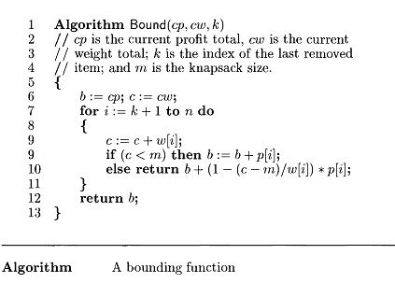
KNAPSACK PROBLEM

Slide 63
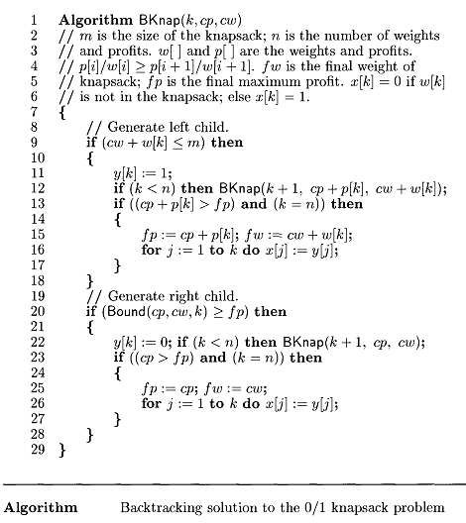

Slide 64
KNAPSACK PROBLEM
One corresponds to the fixed tuple size formulation

Slide 65
KNAPSACK PROBLEM
and the other to the variable tuple size formulation

Slide 66
Backtracking algorithms for the knapsack problem can be arrived at using either of these two state space trees.
Regardless of which is used,
bounding functions are needed to help kill some live nodes without expanding them.

Slide 67
Terminology
Bounding Function – modified Criteria Function
E.g. Sorting – comparison
Problem state is each node in the depth-first search tree
State space is the set of all paths from root node to other nodes

Slide 68
Terminology
Solution states are the problem states s for which the path from the root node to s defines a tuple in the solution space
In variable tuple size formulation tree, all nodes are solution states
In fixed tuple size formulation tree, only the leaf nodes are solution states
Partitioned into disjoint sub-solution spaces at each internal node

Slide 69
Answer states are those solution states s for which the path from root node to s defines a tuple that is a member of the set of solutions
– These states satisfy implicit constraints
State space tree is the tree organization of the solution space

Slide 70
Static trees are ones for which tree organizations are independent of the problem instance being solved
– Fixed tuple size formulation
– Tree organization is independent of the problem instance being solved

Slide 71
Dynamic trees are ones for which organization is dependent on problem instance
Live node is a generated node for which all of the children have not been generated yet
E-node is a live node whose children are currently being generated or explored

Slide 72
Dead node is a generated node that is not to be expanded any further
– All the children of a dead node are already generated
– Live nodes are killed using a bounding function to make them dead nodes
Backtracking is depth-first node generation with bounding functions

Slide 73
Thank You

