Slide 1

Computer Algorithms
Unit-4
Dynamic Programming

Slide 2
The General Method
An algorithm design method that can be used
When the solution to a problem can be viewed
as the result of a sequence of decisions.
Step wise decisions can be made for the problem like – knapsack problem, job sequencing with deadline, optimal merge pattern etc.
Which can be solved using Greedy Approach

Slide 3
The General Method
For some problems it is not possible to make a sequence of stepwise decisions, which will give optimal decision sequence.
Solution to such problems is – to try all possible decision sequences
Enumerate all decision sequences and then pick out best.
But the time and space requirement may be prohibitive.

Slide 4
The General Method
Dynamic Programming drastically reduces the amount of time and space required.
It avoids the enumeration of some decision sequences , that cannot possibly be optimal

Slide 5
Difference between Greedy Method and Dynamic Programming
In Greedy Method, only one decision sequence is generated.
In Dynamic Programming, many decision sequences can be generated
But sequences containing suboptimal subsequences can not be optimal
And so will not be generated

Slide 6
Multistage Graph
A multistage graph G=(V, E) is a directed graph, in which
The vertices are partitioned into k ≥ 2 disjoint sets V_{i,} 1≤i<k
Sets V₁ and V_{k} are such that │V₁│ = │V_{k}│ =1
Let s and t be the vertices in V₁ and V_{k} respectively.
s is source and t is sink (destination)

Slide 7
Multistage Graph
Let c(i, j) be the cost of edge (i, j)
The cost of a path from s to t is the sum of the costs of all the edges on the path
The multistage graph problem is to find a minimum-cost path from s to t
Each stage V_{i} defines a stage in the graph
Constraint is, every path from s to t starts in stage 1, goes to stage 2 and so on
And terminates in k stage

Slide 8
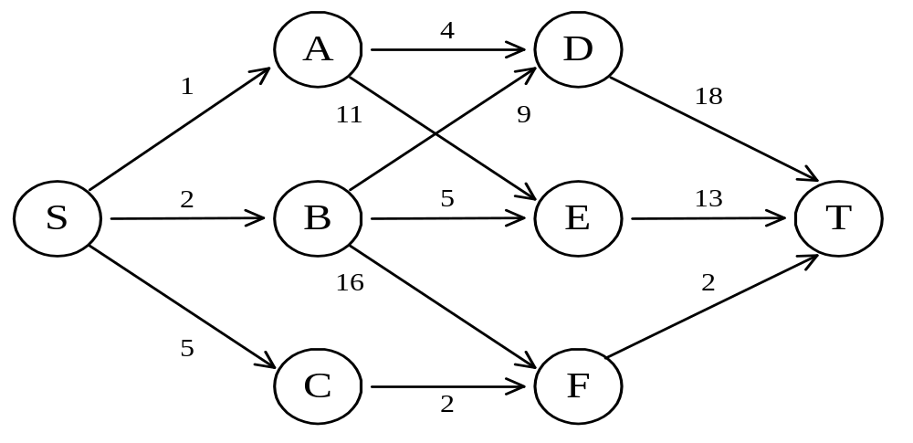
The shortest path in multistage graphs
e.g.
The greedy method can not be applied to this case: (S, A, D, T) 1+4+18 = 23.
The real shortest path is:
(S, C, F, T) 5+2+2 = 9.

Slide 9
Multistage Graph
Dynamic Programming Approach
Such problems can be solved using 2 approaches
Forward Approach
  Backward Reasoning
Backward Approach
  Forward Reasoning

Slide 10
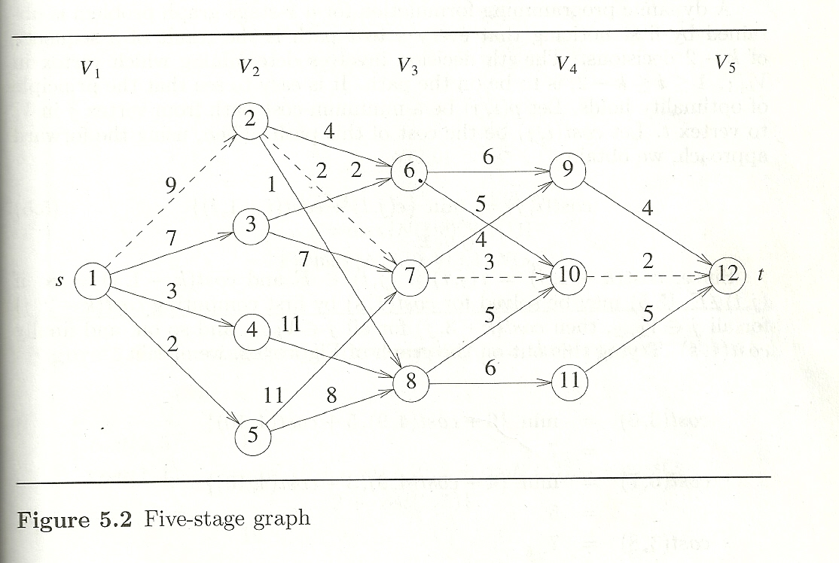
Multistage Graph- Example

Slide 11
Multistage Graph- Example
Every s to t path is the result of a sequence of k-2 decisions
i ^{th} decision involves determining which vertex in V_{i+1} is to be on the path
cost(i, j)=min {c(j, l) + cost (i+1, l)}
Cost(1,1)= min{9+cost(2,2), 7+cost(2,3), 3+cost(2,4), 2+cost(2,5)}
Forward Approach - backward reasoning.
Calculate Distance from Target as reference

Slide 12
Multistage Graph- Example
Cost(1,1)= min{9+cost(2,2), 7+cost(2,3), 3+cost(2,4), 2+cost(2,5)}
Cost(4,9)=c(9,12)+cost(5,12)
=4+0 = 4
Cost(4,10)=c(10,12)+cost(5,12)
=2+0 = 2
Cost(4,11)=c(11,12)+ cost(5,12)
=5+0 =5

Slide 13
Multistage Graph- Example
cost(3,6) = min{6+cost(4,9), 5+cost(4,10)}
=min(6+4, 5+2) = min( 10,7)=7
cost(3,7) = min{4+cost(4,9), 3+cost(4,10)}
=min(4+4, 3+2)=min(8,5)=5
cost(3,8) = min{5+cost(4,10), 6+cost(4,11)}
  =mint(5+2, 6+5)=min(7, 11)=7

Slide 14
Multistage Graph- Example
cost(2,2)
=min{4+cost(3,6), 2+cost(3,7), 1+cost(3,8)}
= min(4+7, 2+5, 1+7) = 7
cost(2,3)
=min{2+cost(3,6), 7+cost(3, 7)}
=min(2+7, 7+5)= 9

Slide 15
Multistage Graph- Example
cost(2,4)
=min{11+cost(3,8)}
=min(11+7)=18
cost(2,5)
=mint{11+cost(3,7), 8+cost(3,8)}
=min(11+5, 8+7)=15

Slide 16
Multistage Graph- Example

Slide 17
Multistage Graph- Example
Cost(1,1)
= min{9+cost(2,2), 7+cost(2,3), 3+cost(2,4), 2+cost(2,5)}
=min(9+7, 7+9, 3+18, 2+15)
=16
A minimum cost s to t path has a cost 16
This path can be determined easily if we record the decision made at each state (vertex)

Slide 18
Multistage Graph- Example
Let d(i, j) be the value of l (l is a node in next level) that minimizes {c(j, l) + cost (i+1, l)}
d(3,6)=10 d(3,7)=10 d(3,8)=10
d(2,2)=7 d(2,3)=6 d(2,4)=8
d(2,5)=8 d(1,1)=2 or 3

Slide 19
Multistage Graph- Example
Let the minimum-cost path be
s,v₂,v₃,..v_{k-1},t
V₂=d(1,1)=2 v₃=d(2,2)=7
v₄=d(3,7)=10
So the path is 1, 2, 7, 10, 12
Cost= 16

Slide 20
Multistage Graph- Example
Let the minimum-cost path be
s,v₂,v₃,..v_{k-1},t
V₂=d(1,1)=3 v₃=d(2,3)=6
v₄=d(3,6)=10
So the path is 1, 3, 6, 10, 12
Cost= 16

Slide 21
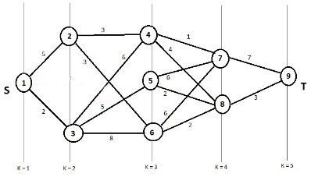
Multistage Graph- Example

Slide 22
Multistage Graph- Backward Approach
backward Approach - Forward reasoning.
Calculate Distance from Source as reference
bcost(i, j) = min(bcost(i-1, l)+c(l, j))
bcost(5,12)= min{4+cost(4,9), 2+cost(4,10), 5+cost(4,11)}

Slide 23
Multistage Graph- Example

Slide 24
Multistage Graph- Backward Approach
bcost(i, j) = min(bcost(i-1, l)+c(l, j))
bcost(2, 2)=9
bcost(2, 3)=7
bcost(2, 4)=3
bcost(2, 5)=2
bcost(3, 6)= min{ bcost(2, 2)+c(2, 6)
bcost(2, 3)+c(3, 6)}
=min{9+4, 7+2} = 9

Slide 25
Multistage Graph- Backward Approach
bcost(3, 7)=11
bcost(3, 8)=10
bcost(4, 9)=15
bcost(4, 10)=14
bcost(4, 11)=16
bcost(5, 12)=16

Slide 26
Multistage Graph
Example-
Consider a resource allocation problem
n units of resource are to be allocated to r projects
If j, 0≤ j ≤ n, units of the resource are allocated to project i,
Then the resulting net profit is N(i, j)

Slide 27
Resource allocation problem
The problem is to allocate the resource to the r projects
in such a way as to maximize total net profit
This problem can be formulated as an r+1 stage graph problem
Stage i, 1≤ i ≤ r represents project i
There are n+1 vertices V(i, j), 0≤ j ≤ n associated with stage i, 2≤ i ≤ r

Slide 28
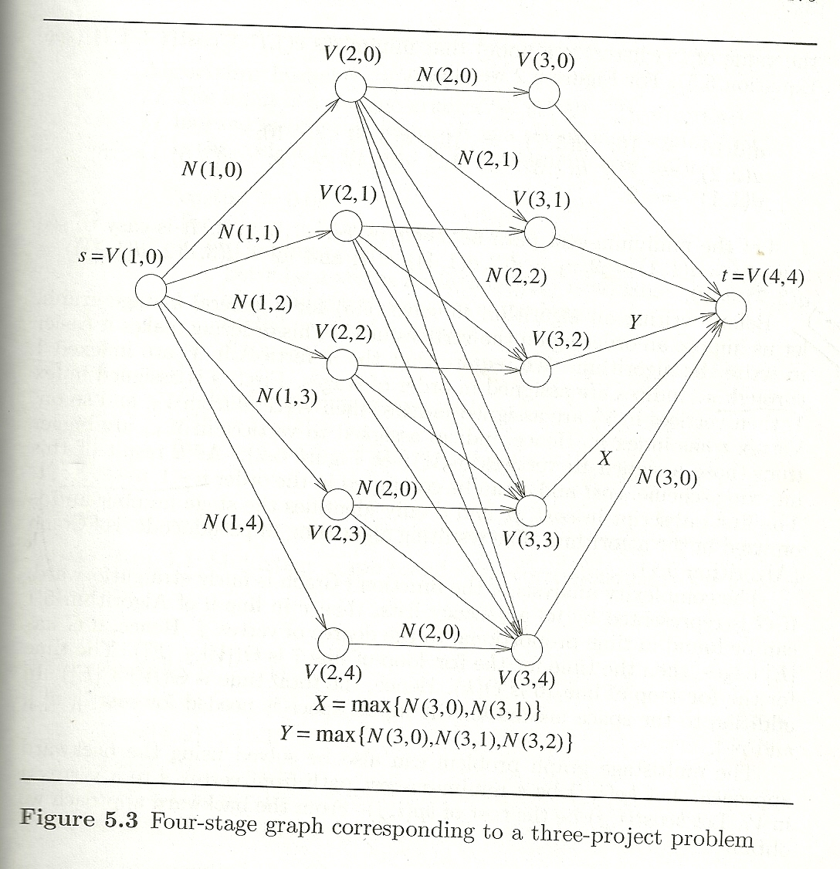
Resource allocation problem

Slide 29
All-Pairs Shortest Paths (APSP)
Let G=(V,E) be a directed graph with n vertices.
Let cost be a adjacency matrix for G, such that cost(i, i)=0 ,1≤ i ≤ n
cost(i, j) is the length (or cost) of edge (i,j) if (i, j) Є E(G)

Slide 30
All-Pairs Shortest Paths (APSP)
All pair shortest path problem is to determine a matrix A
such that A(i, j) is the length of shortest path from i to j.
A can be obtained by solving n Single source shortest path problems
– Complexity n*n² i.e. O(n³)

Slide 31
All-Pairs Shortest Paths (APSP)
Shortest path from i to j, i≠j
• Path may go through some intermediate vertex
• If k is the index of this intermediate vertex then path (i,k) and (k,j) must be shortest path
• If k is the intermediate vertex with highest index then
– i to k path is the shortest i to k path going through no vertex with index greater than k-1
– So is the k to j path
• We need to decide highest index intermediate vertex k

Slide 32
All-Pairs Shortest Paths (APSP)
Let A^{k}(i, j) be length of shortest path from i to j going through no vertex of index greater than k
A( i , j )=min{ min {A^{k-1}(i, k)+ A^{k-1}(k, j)}, cost(i,j)}
1≤k≤n
A shortest path from i to j may or may not go through highest index vertex
A^{k}( i , j )=min{ A^{k-1}(i, j), A^{k-1}(i, k)+A^{k-1}(k, j)}
K ≥ 1

Slide 33
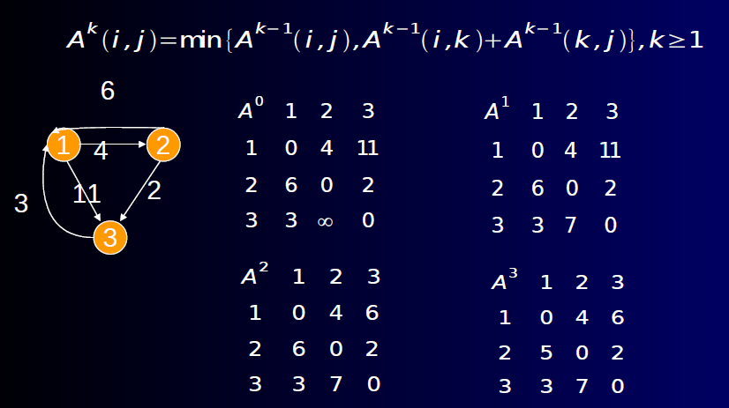

Slide 34
All-Pairs Shortest Paths (APSP)
6
1
2
4
2
3
11
4
4
3
17

Slide 35
All-Pairs Shortest Paths (APSP)
A⁰
1 2 3 4
1 0 4 11 ∞
2 6 0 ∞ 2
3 3 ∞ 0 17
4 ∞ ∞ 4 0

Slide 36
All-Pairs Shortest Paths (APSP)
A¹
1 2 3 4
1 0 4 11 ∞
2 6 0 17 2
3 3 7 0 17
4 ∞ ∞ 4 0

Slide 37
All-Pairs Shortest Paths (APSP)
A²
1 2 3 4
1 0 4 11 6
2 6 0 17 2
3 3 7 0 9
4 ∞ ∞ 4 0

Slide 38
All-Pairs Shortest Paths (APSP)
A³
1 2 3 4
1 0 4 11 6
2 6 0 17 2
3 3 7 0 9
4 7 11 4 0

Slide 39
All-Pairs Shortest Paths (APSP)
A⁴
1 2 3 4
1 0 4 10 6
2 6 0 6 2
3 3 7 0 9
4 7 11 4 0

Slide 40
Optimal Binary Search Tree
• Given set of identifiers, different binary trees
could be formed.
• Average number of comparisons needed for
finding the identifiers will be different for different trees.
• In the simplest form we assume
– Probability of search of each element is equal
– No unsuccessful searches made

Slide 41
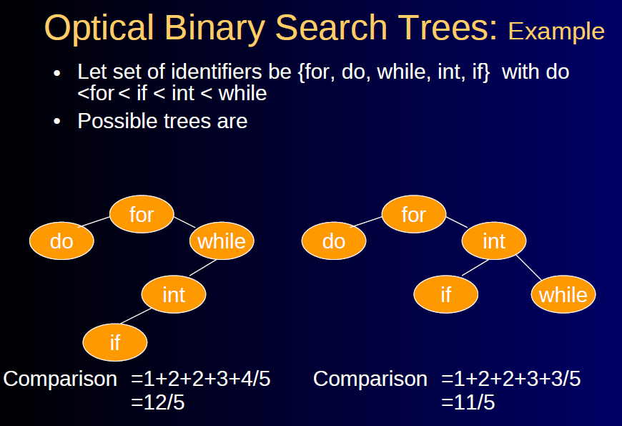
Optimal Binary Search Tree

Slide 42
Optimal Binary Search Tree
In general situation different identifiers can be searched with different probabilities
and unsuccessful searches can also be made
• Let set of identifiers be {a₁,a₂, ..,a_{n}} with a₁ <a₂ < .. < a_{n}
• Let p(i) be the probability with which we search a_{i}.

Slide 43
Optimal Binary Search Tree
• Let q(i) be the probability with which we search x such that a_{i} < x < a_{i+1}, , 0≤i≤n.
– Assume a₀= -∞ and a_{n+1} = ∞.
Then
Σ q(i) is the probability of unsuccessful search
0≤i≤n
Clearly
Σ p(i) + Σ q(i) =1
1≤i≤n 0≤i≤n

Slide 44
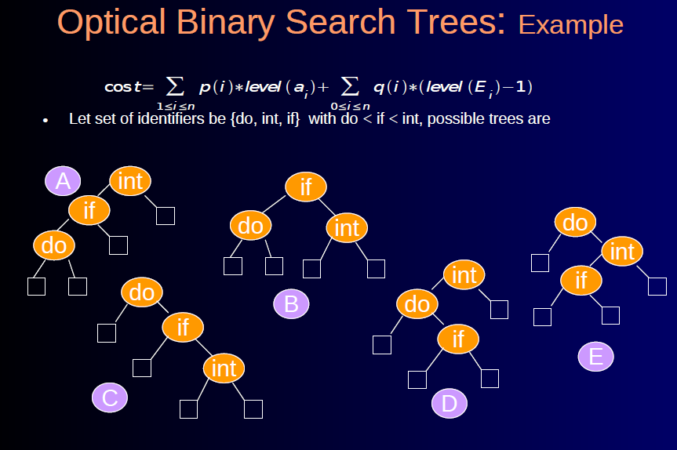
Optimal Binary Search Tree

Slide 45
Optimal Binary Search Tree
(a1, a2, a3) = (do, if, int)
If all searches (successful and un-successful)
equally probable (1/7)
the cost will be
Cost(tree A)=1/7+2/7+3/7+1/7+2/7+3/7+3/7
=15/7
Cost(B)=13/7
Cost(C)=15/7
Cost(D)=15/7
Cost(E)=15/7
Tree B is optimal

Slide 46
Optimal Binary Search Tree
(a1, a2, a3) = (do, if, int)
p(1)=0.5, p(2)=0.1, p(3)=0.05 and
q(0)=0.15, q(1)=0.1, q(2)=0.05, q(3)=0.05
the costs will be
cost(A)=((0.5 X 3) + (0.1 X 2)+ (0.05 X 1)) +
  ((0.15 X 3)+(0.1 X 3)+ (0.05 X2)+(0.05 X1))
= 1.5+0.2+0.05+0.45+0.3+0.1+0.05
= 2.65

Slide 47
Optimal Binary Search Tree
cost(B)=((0.5 X 2)+(0.1 X 1)+(0.05 X 2)) +
((0.15 X 2)+(0.1 X 2)+ (0.05 X2)+(0.05 X2))
  =1.0+0.1+0.1+0.30+0.2+0.1+0.1
  =1.9
cost(C)=((0.5 X 1)+(0.1 X 2)+(0.05 X 3)) +
((0.15 X1)+(0.1 X 2)+ (0.05 X3)+(0.05 X3))
  =0.5+0.2+0.15+0.15+0.2+0.15+0.15
  =1.5

Slide 48
Optimal Binary Search Tree
cost(D)=((0.5 X 2)+(0.1 X 3)+(0.05 X 1)) +
((0.15 X 2)+(0.1 X 3)+ (0.05 X3)+(0.05 X1))
  =1.0+0.3+0.05+0.30+0.3+0.15+0.05
  =2.15
cost(E)=((0.5 X 1)+(0.1 X 3)+(0.05 X 2)) +
((0.15 X1)+(0.1 X 3)+ (0.05 X3)+(0.05 X2))
  =0.5+0.3+0.10+0.15+0.3+0.15+0.10
  =1.6

Slide 49
Optimal Binary Search Tree
p(1)=0.5, p(2)=0.1, p(3)=0.05 and
q(0)=0.15, q(1)=0.1, q(2)=0.05, q(3)=0.05
the costs will be
cost(A)=2.65
cost(B)=1.9
cost(C)=1.5
cost(D)=2.15
cost(E)=1.6
Tree C is optimal

Slide 50
Applying Dynamic Programming Approach
Construct tree as a result of sequence of decisions
Make decision as to which of the a_{i} should be assigned to the root node of the tree
If we choose a_{k} as a root, then
Internal nodes a_{1,} a_{2,…,} a_{k-1} and external nodes E_{1,} E_{2,…,} E_{k-1} will lie in left sub-tree l of root
The remaining nodes will lie in right sub-tree r

Slide 51
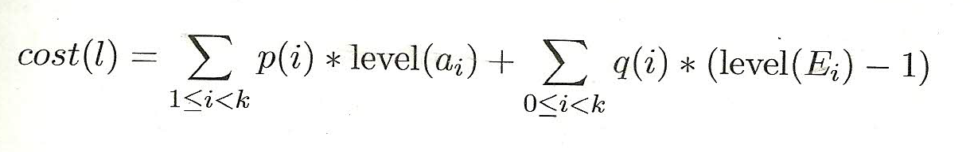
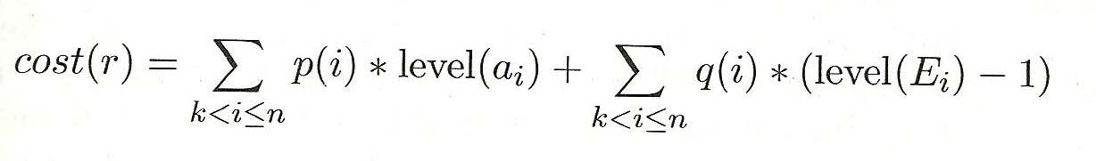
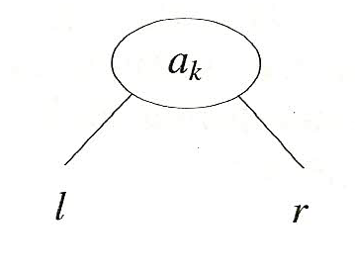
Applying Dynamic Programming Approach
Root of sub-tree is assumed to be present at level 1

Slide 52
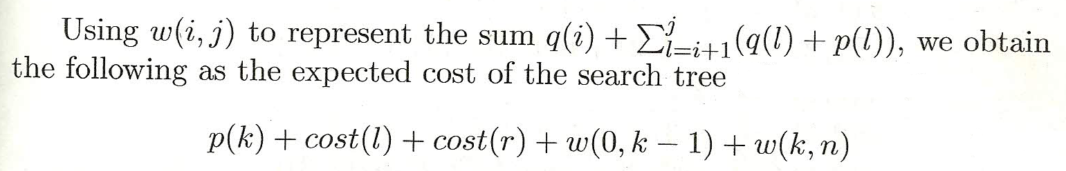
Applying Dynamic Programming Approach
If the tree is optimal, then this value must be minimum
Hence cost(l) and cost(r) must be minimum

Slide 53
Applying Dynamic Programming Approach
If we use c(i, j) to represent the cost of an optimal binary search tree t_{ij} containing a_{i+1,} a_{i+2,…,} a_{j} and E_{i,} E_{i+1,…,} E_{j}
Then for the tree to be optimal
cost(l)=c(0, k-1) and cost(r)=c(k, n)
k must be chosen such that
is minimum

Slide 54
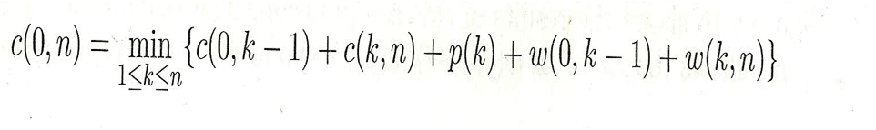
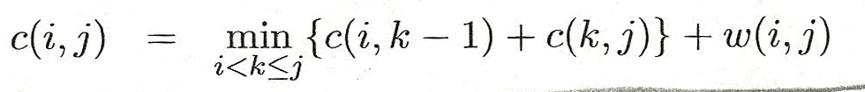
Applying Dynamic Programming Approach
Hence for c(0, n) we obtain
We can generalize it to obtain for any c(i, j)

Slide 55
Applying Dynamic Programming Approach
This equation can be solved for c(0, n)
By first computing all c(i, j), such that j-i =1
c(i, i)=0 w(i, i)=q(i) 0 ≤ i ≤ n
Next computing all c(i, j), such that j-i =2 and then computing all c(i, j), such that j-i =3 so on
During this computation we record the root r(i, j) of each tree t_{ij ,}
then optimal binary search tree can be constructed from these r(i, j)

Slide 56
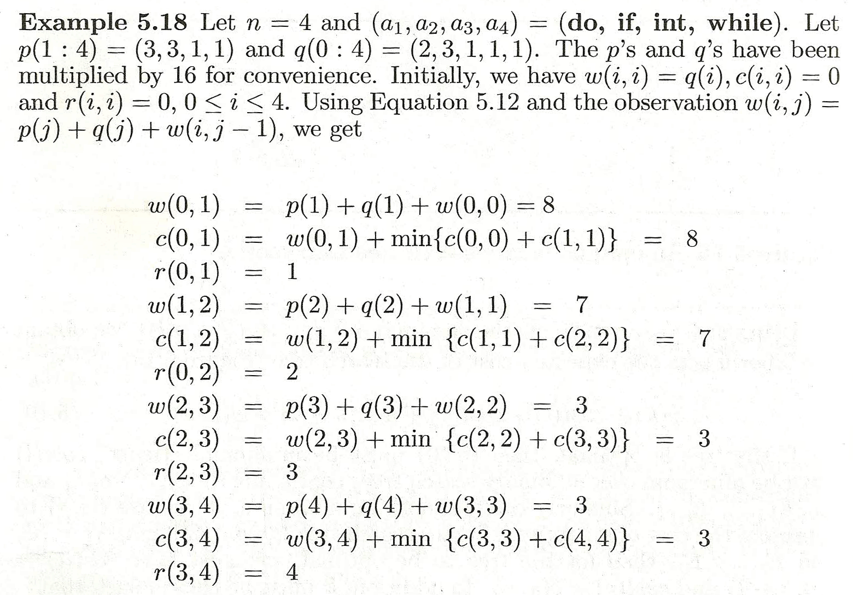

Slide 57
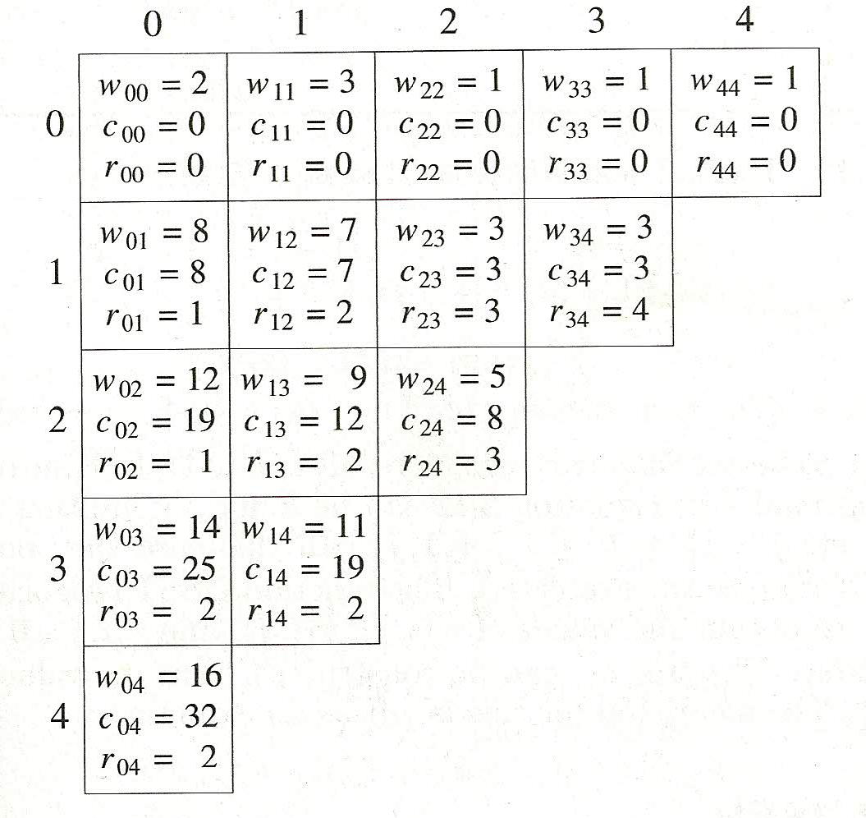

Slide 58
Applying Dynamic Programming Approach
w(i, j)= p(j)+q(j)+w(i, j-1)
w(0, 2) =p(2)+q(2)+w(0,1)
  =3+1+8
  =12
c(0,2)=min{c(0,0)+c(1,2), c(0,1)+c(2,2)}+w(0,2)
=min{0+3, 7+0}+12
=3+12= 15
r(0, 2) = 1;

Slide 59
Applying Dynamic Programming Approach
w(i, j)= p(j)+q(j)+w(i, j-1)
w(1, 3) =p(3)+q(3)+w(1,2)
  =1+1+7
  =9
c(1,3)=min{c(1,1)+c(2,3), c(1,2)+c(3,3)}+w(1,3)
=min{0+3, 7+0}+9
=3+9= 12
r(1, 3) = 2;

Slide 60
Applying Dynamic Programming Approach
w(i, j)= p(j)+q(j)+w(i, j-1)
w(2, 4) =p(4)+q(4)+w(2,3)
  =1+1+3
  =5
c(2,4)=min{c(2,2)+c(3,4), c(2,3)+c(4,4)}+w(2,4)
=min{0+3, 3+0}+5
=3+5= 8
r(2, 4) = 3;

Slide 61
Applying Dynamic Programming Approach
w(0, 3)=p(3)+q(3)+w(0,2)
  =1+1+12
  =14
c(0,3)=min{c(0,0)+c(1,3), c(0,1)+c(2,3), c(0,2)+c(3,3)} +w(0,3)
=min{0+12, 8+3, 19+0}+14
=11+14= 25
r(0, 3) = 2;

Slide 62
Applying Dynamic Programming Approach
w(1, 4)=p(4)+q(4)+w(1,3)
  =1+1+9
  =11
c(1,4)=min{c(1,1)+c(2,4), c(1,2)+c(3,4), c(1,3)+c(4,4)} +w(1,4)
=min{0+8, 7+3, 12+0}+11
=8+11= 19
r(1, 4) = 2;

Slide 63
Applying Dynamic Programming Approach
w(0, 4)=p(4)+q(4)+w(0,3)
  =1+1+14
  =16
r(0,4)=min{c(0,0)+c(1,4), c(0,1)+c(2,4), c(0,2)+c(3,4), c(0,3)+c(4,4)} +w(0,4)
=min{0+19, 8+8, 19+3, 25+0 }+16
=16+16= 32
r(0, 4) = 2;

Slide 65
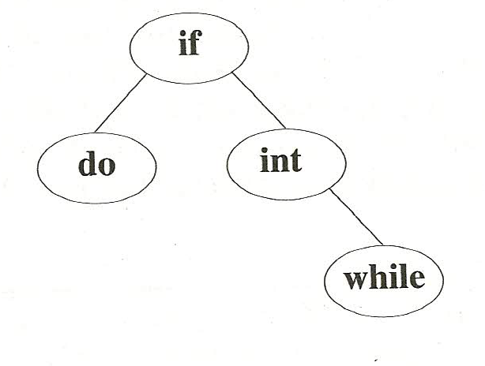
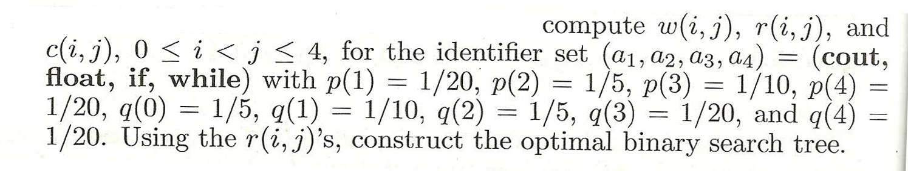

Slide 66
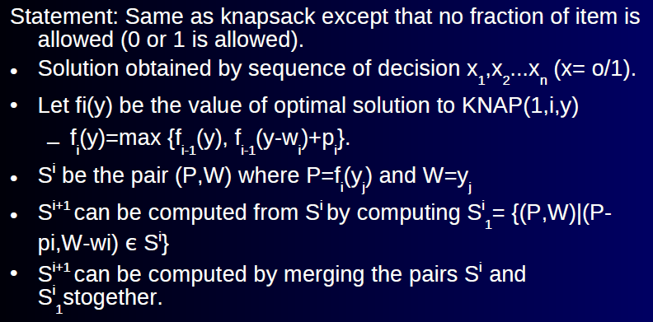
0 / 1 Knapsack

Slide 67
0 / 1 Knapsack
If S^{i+1} contains two pairs (P_{j}, W_{j}) and (P_{k}, W_{k}) with the values P_{j} ≤ P_{k} and W_{j} ≥ W_{k}
Then pair (P_{j}, W_{j}) can be discarded
It is called Dominance Rule/ Purging Rule.

Slide 68
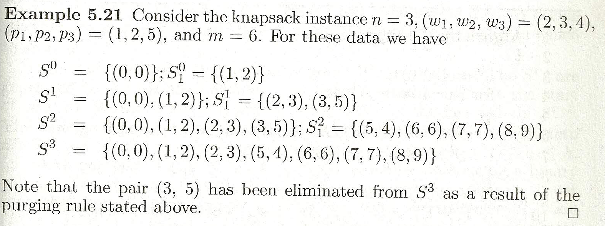

Slide 69
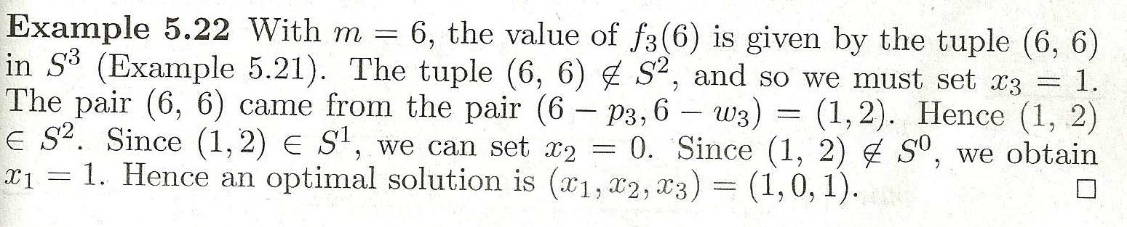
0 / 1 Knapsack
Generate the sets S^{i} , 0 ≤ i ≤ 4, when
( w₁, w_{2,} w_{3,} w₄) = (10, 15, 6, 9) and
( p₁, p_{2,} p_{3,} p₄) = (2, 5, 8, 1)
m=25

Slide 70
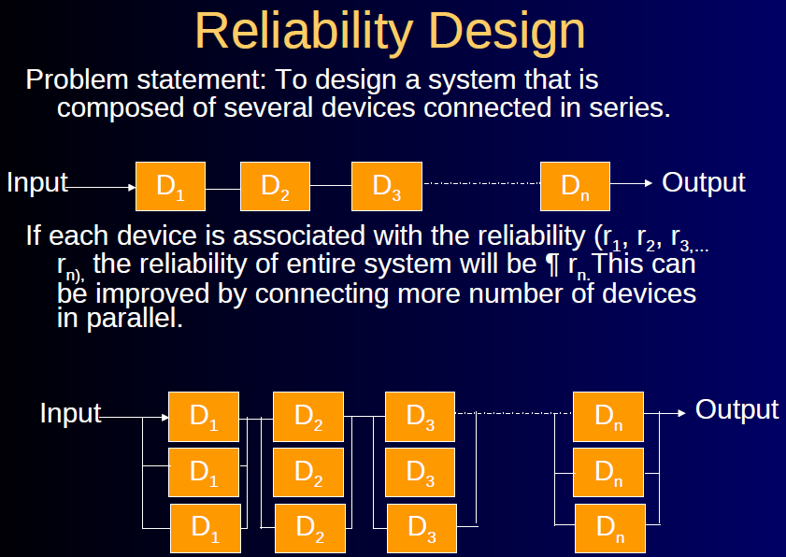

Slide 71
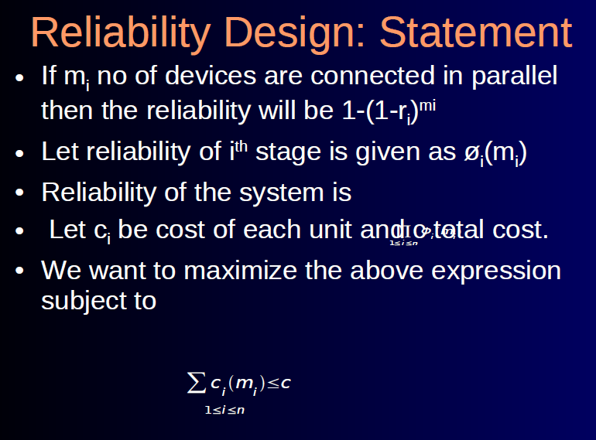

Slide 72
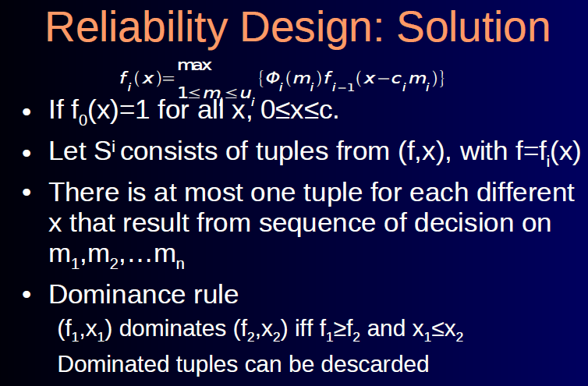

Slide 73
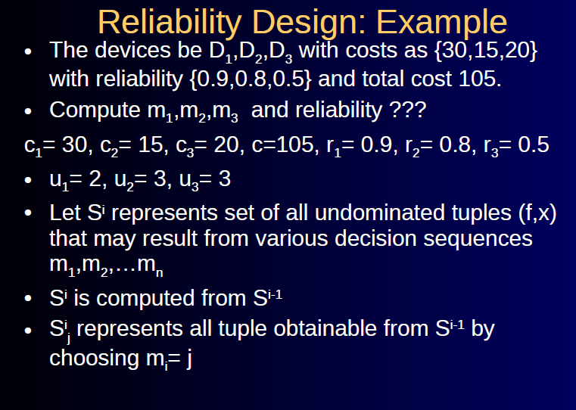

Slide 74
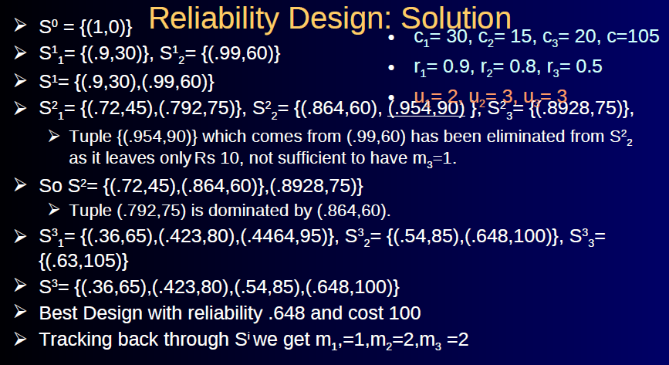

Slide 75
Reliability Design
s⁰ ={(1, 0)} – Initial Set Before adding any device
Add 1 device of type D1
s¹₁ ={(0.9, 30)}
Add 2 devices of type D1
Reliability of 2 devices of type D1 connected in parellel
1-(1-r)^{m} = 1-(1-0.9)² = 1- 0.1²= 0.99
s¹₂ ={(0.99, 60)}
s¹ ={(0.9, 30), (0.99, 60)}

Slide 76
Reliability Design
Add 1 device of type D2
s²₁ ={(0.72, 45), (0.792, 75)}
Add 2 devices of type D2
Reliability of 2 devices of type D2 connected in parellel
1-(1-r)^{m} = 1-(1-0.8)² = 1- 0.2²= 0.96
s²₂ ={(0.864, 60), (0.9504, 90)}

Slide 77
Reliability Design
Add 3 devices of type D2
Reliability of 3 devices of type D2 connected in parellel
1-(1-r)^{m} = 1-(1-0.8)³ = 1- 0.2³= 0.992
s²₃ ={ (0.8928, 75) }
s² ={ (0.72, 45), (0.792, 75), (0.864, 60), (0.9504, 90), (0.8928, 75) }
s² ={(0.72, 45), (0.864, 60), (0.8928, 75) }

Slide 78
Reliability Design
Add 1 device of type D3
s³₁ ={(0.36, 65), (0.432, 80), (0.4464, 95)}
Add 2 devices of type D3
Reliability of 2 devices of type D3 connected in parellel
1-(1-r)^{m} = 1-(1-0.5)² = 1- 0.5²= 0.75
s³₂ ={(0.54, 85), (0.648, 100)}

Slide 79
Reliability Design
Add 3 devices of type D3
Reliability of 3 devices of type D3 connected in parellel
1-(1-r)^{m} = 1-(1-0.5)³ = 1- 0.5³= 0.875
s³₃ ={ (0.63, 105) }
s³ ={(0.36, 65), (0.432, 80), (0.54, 85), (0.648, 100)}(0.63, 105) }
Optimal - (0.648, 100)
1,2,2

Slide 80
Reliability Design- Example 2
C1=40 c2=25 c3=35
r1=0.75 r2=0.85 r3=0.6
u1=3 u2=3 u3=2
c=175

Slide 81
• Till now we have seen how dynamic programming problem could be applicable to subset selection problem
Now will see some permutation problem with n! complexity

Slide 82
Traveling Salesperson Problem
Statement: Let G(V,E) be a directed graph with
edge cost c_{ij}.
• c_{ij} >0, and c_{ij} =∞ if <i, j> ɇ E.
• A tour of G is directed simple cycle that
includes every vertex in V.
• Cost of tour is sum of cost of edges on the
tour

Slide 83
Traveling Salesperson Problem
• Traveling salesman problem is to find tour of
minimum cost.
Traveling Salesman Problem: Applications
• Postal van picking mails from postal
mail boxes.

Slide 84
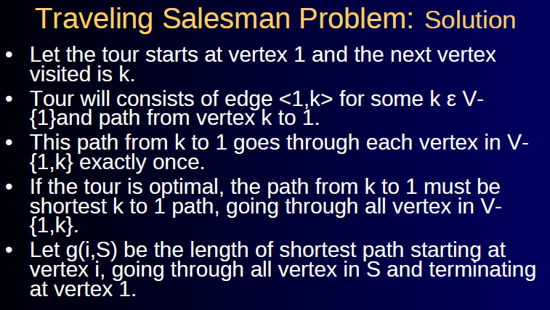

Slide 85
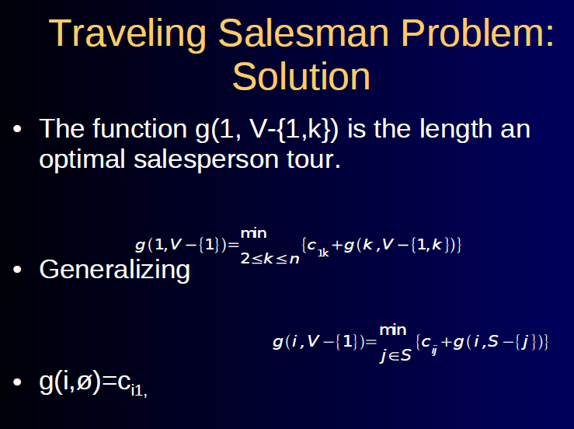

Slide 86
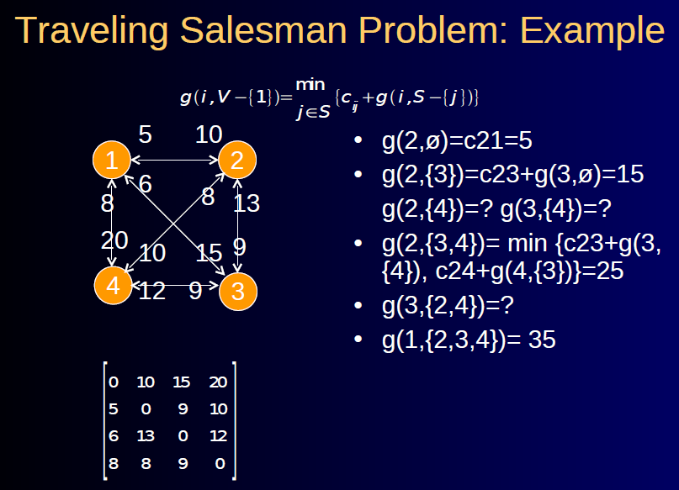

Slide 87
Traveling Salesman Problem
g(2,Φ)=C₂₁=5
g(3,Φ)=C₃₁=6
g(4,Φ)=C₄₁=8
g(2, {3})= C₂₃ + g(3,Φ) = 9+6=15
g(2, {4})= C₂₄ + g(4,Φ) = 10+8=18
g(3, {2})= C₃₂ + g(2,Φ) = 13+5=18
g(3, {4})= C₃₄ + g(4,Φ) = 12+8=20
g(4, {2})= C₄₂ + g(2,Φ) = 8+5=13
g(4, {3})= C₄₃ + g(3,Φ) = 9+6=15

Slide 88
Traveling Salesman Problem
g(2, {3, 4})=
= min {C₂₃ + g(3,{4}), C₂₄ + g(4,{3})}
= min {9+20, 10+15} = min{29, 25} =25
g(3, {2, 4})=
= min {C₃₂ + g(2,{4}), C₃₄ + g(4,{2})}
= min {13+18, 12+13} = min{31, 25} =25
g(4, {2, 3})=
= min {C₄₂ + g(2,{3}), C₄₃ + g(3,{2})}
= min {8+15, 9+18} = min{23, 27} =23

Slide 89
Traveling Salesman Problem
g(1, {2, 3, 4})=
= min {C₁₂ + g(2,{3, 4}),
C₁₃ + g(3,{2, 4}),
C₁₄ + g(4,{2, 3})}
= min {10+25, 15+25, 20+23}
= min{35, 40, 43}
=35
v1= 1 v2= 2 v3=4 v4= 3 v5=1
1,2,4,3,1

Slide 90
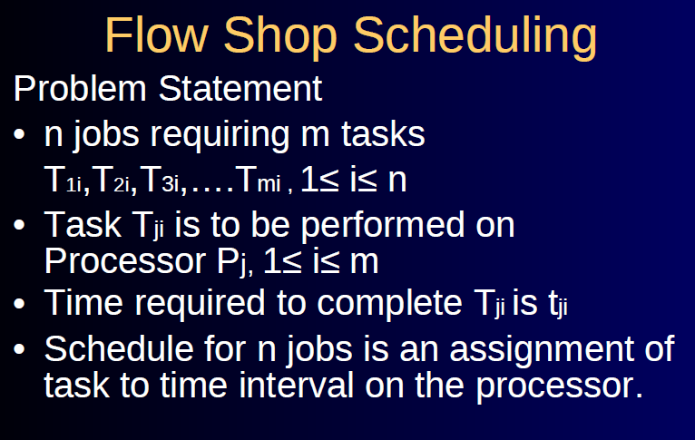

Slide 91
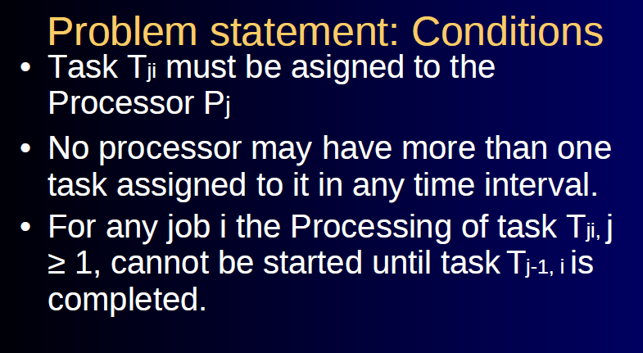

Slide 92
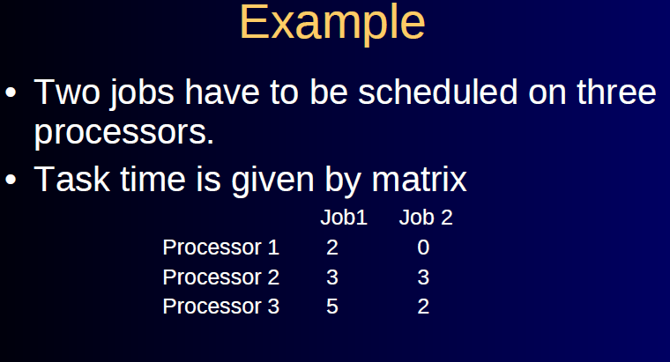

Slide 93
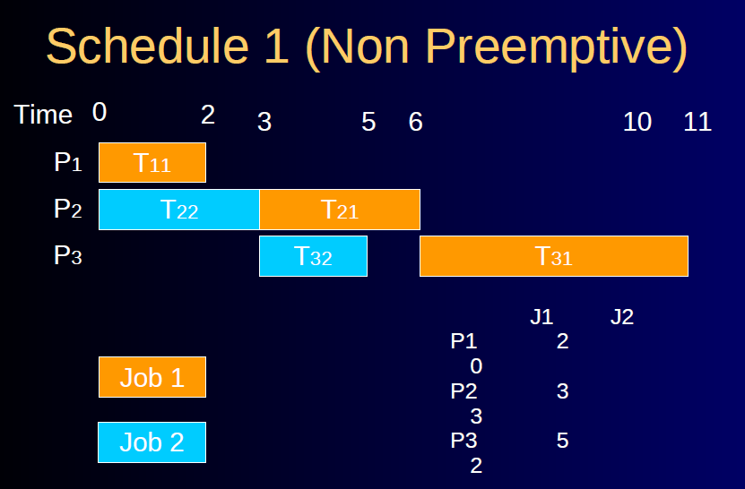

Slide 94
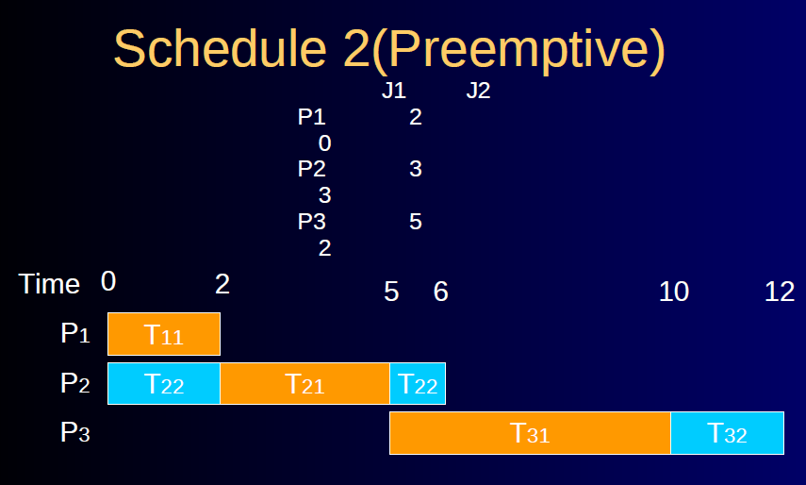

Slide 95
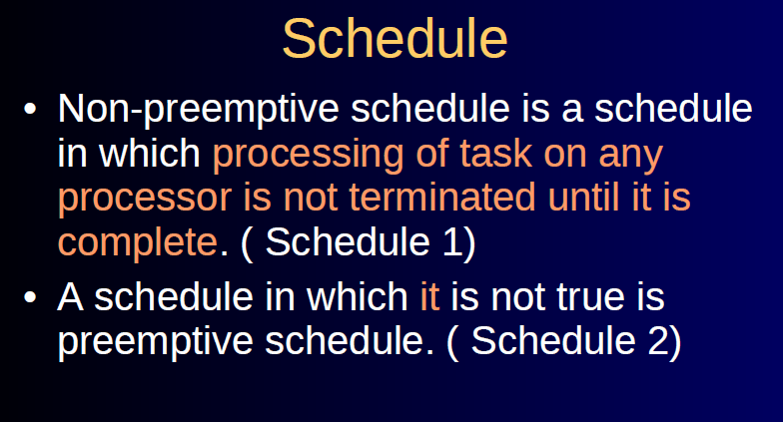

Slide 96
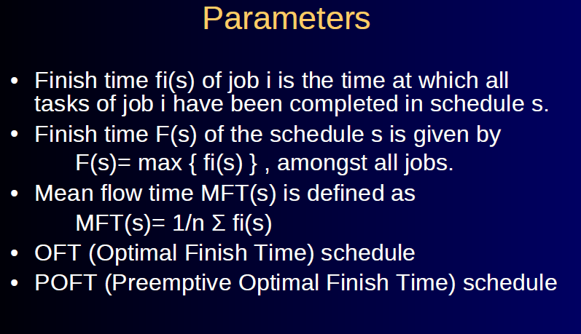

Slide 97
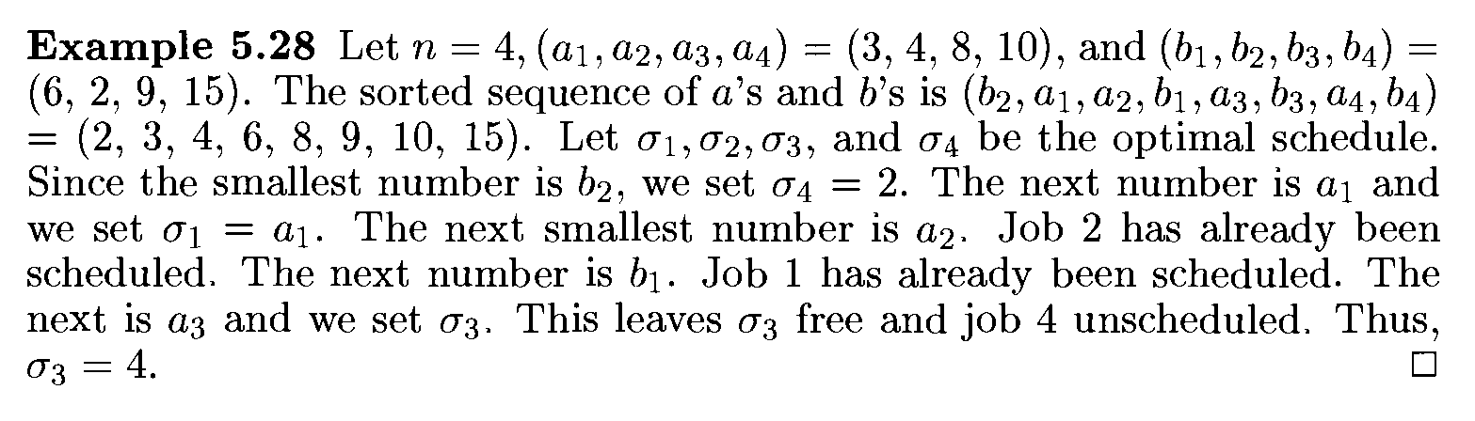
Flow Shop Scheduling

Slide 98
Thank You

