Slide 1

Computer Algorithms
Unit-6
NP Hard and
NP Complete Problems
‹#›
Notes:
‹#›

Slide 2
Basic Concepts
Problems that can be solved by a polynomial time algorithm
Sorting – O(n log n)
Searching – O(log n)
Problems for which no polynomial time algorithm is known
Traveling salesperson O(2^{n}n²)
No one has been able to develop a polynomial time algorithm for such problems.
‹#›

Slide 3
Deterministic and Non-deterministic Algorithms
Deterministic Algorithms:-
Result of every operation is uniquely defined
E.g. Normal Quick Sort
Non-deterministic Algorithms:-
Algorithm contains some operations whose outcomes are not uniquely defined
But limited to specified sets of possibilities
It is allowed to choose any one of these outcomes
E.g. Randomized Quick Sort
‹#›

Slide 4
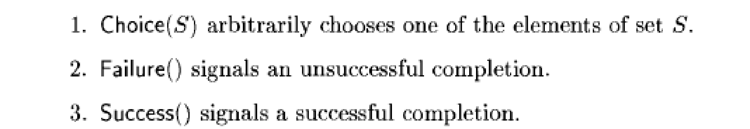
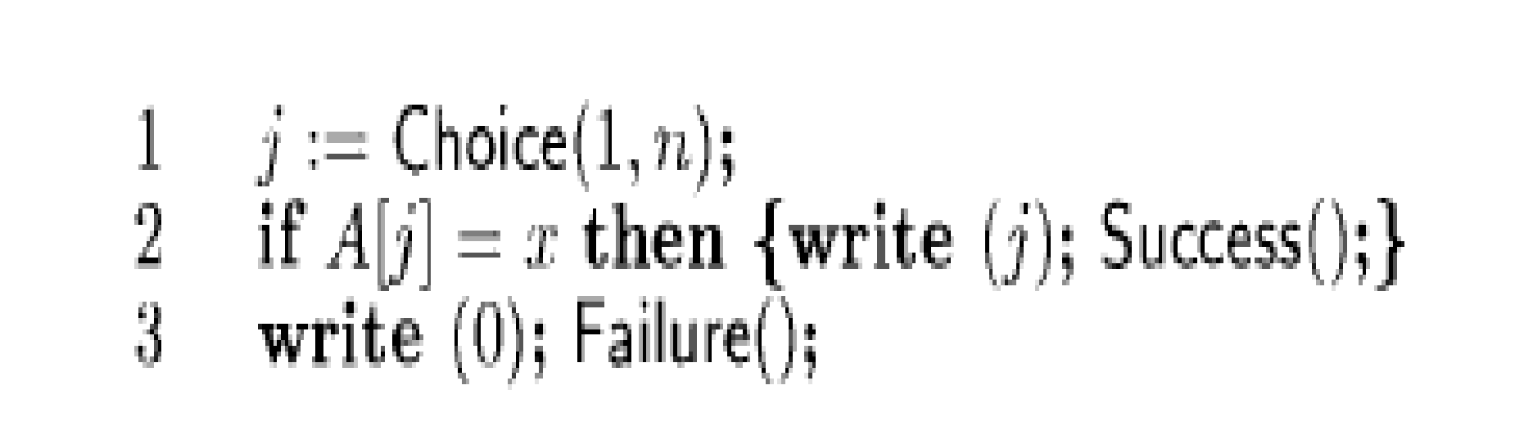
Non-deterministic Algorithms
Non-deterministic Search Algorithm:-
‹#›

Slide 5
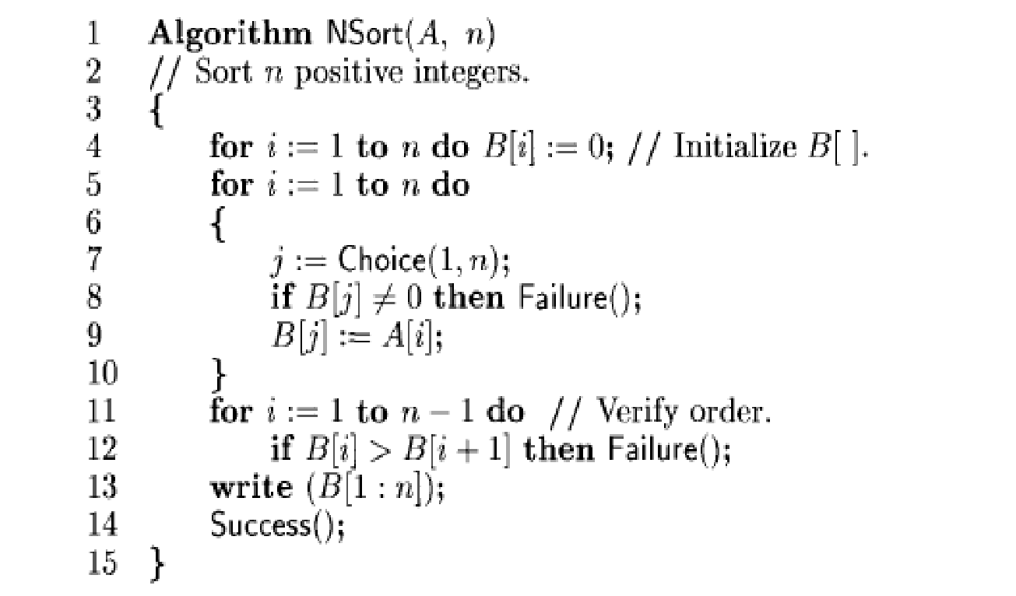
Non-deterministic Algorithms
Non-deterministic Sorting Algorithm:-
‹#›

Slide 6
Definitions
Decision Problem –
Any problem for which the answer is either 0 or 1
Optimization Problem –
Any problem that involves the identification of an optimal value of a given cost function
Decision Algorithms
Optimization Algorithms
‹#›

Slide 7
Definitions
P is the set of all the problems solvable by deterministic algorithms in polynomial time.
NP is the set of all the problems solvable by nondeterministic algorithms in polynomial time.
Since deterministic algorithms are just a special case of nondeterministic ones
conclude that P is subset of NP
Optimization problems are very complex.
Mostly, it is not possible to solve Optimization problems in polynomial time.
‹#›

Slide 8
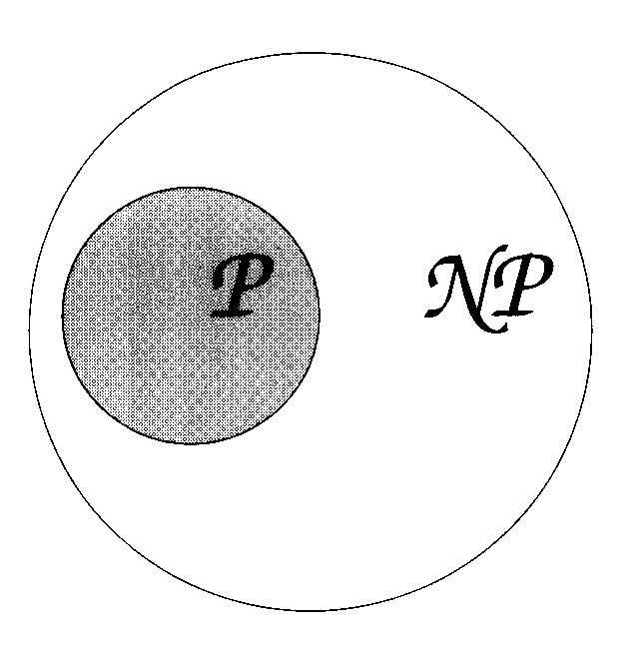
‹#›

Slide 9
Reducibility
Let L1 and L2 be problems.
Problem L1 reduces to L2 L1 α L2
if and only if there is a way to solve L1 by a deterministic polynomial time algorithm
using a deterministic algorithm that solves L2 in polynomial time.
This definition implies that
if we have a polynomial time algorithm for L2,
then we can solve L1 in polynomial time.
Reducibility is transitive
‹#›

Slide 10
To prove that problem P is NP-Hard –
Reduce that problem to known NP-Hard Problem.
Satisfiability (SAT) Problem is NP-Hard.
‹#›

Slide 11
Satisfiability
Let x₁, x₂, x₃,… denote Boolean variables
their value is either true or false
Let x_{i} denote the negation of x_{i}.
A literal is either a variable or its negation.
A formula in the propositional calculus is an expression that can be constructed using literals and the operations and / or.
Examples of such formulas are
The symbol V denotes or and Λ denotes and.
‹#›

Slide 12
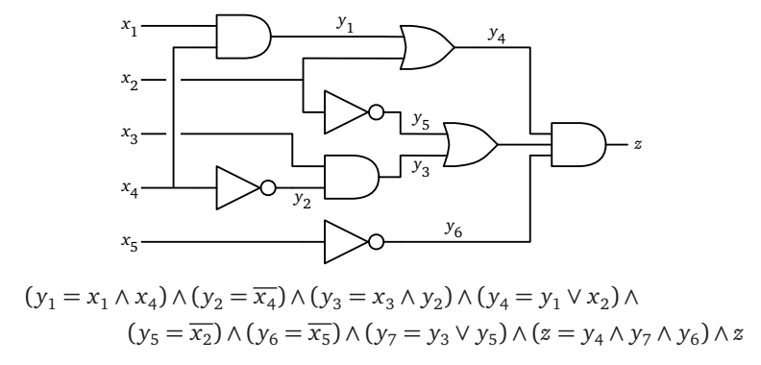
‹#›

Slide 13
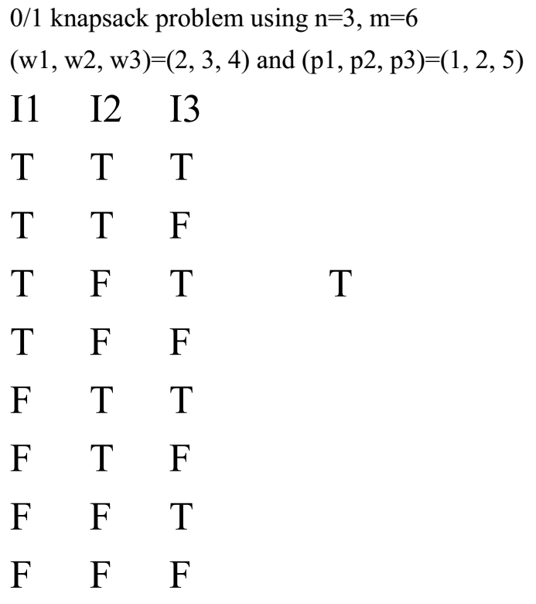
‹#›

Slide 14
Satisfiability
Propositional Calculus – Mathematical Logic
Satisfiability problem is
to determine whether a formula is true for some assignment of truth values to the variables.
‹#›

Slide 15
Satisfiability
It is easy to obtain a polynomial time nondeterministic algorithm that terminates successfully
if and only if a given propositional formula E(x1,...,xn) is satisfiable.
Such an algorithm could proceed by simply choosing (non-deterministically) one of the 2^{n} possible assignments of truth values to (x1,..., xn)
and verifying that E(x1,..., xn) is true for that assignment.
‹#›

Slide 16
Basic Concepts
Non-Polynomial – time needed is exponential
Requires vast amount of time
Even moderate-size problems can not be solved
Do not provide a method to obtain polynomial time algorithms for problems
many of the problems for which there are no known polynomial time algorithms are computationally related
Two classes of problems
NP – Hard NP – Complete
‹#›

Slide 17
A problem that is NP-complete has the property –
It can be solved in polynomial time
if and only if all other NP-complete problems can also be solved in polynomial time.
If an NP-hard problem can be solved in polynomial time
then all NP-complete problems can be solved in polynomial time.
All NP-complete problems are NP-hard,
But some NP-hard problems are not known to be NP-complete
‹#›

Slide 18
NP-Complete NP-Hard
A problem L is NP-hard
if and only if satisfiability reduces to L
A problem L is NP-hard
if and only if it can be reduced to satisfiability problem (SAT)
As Satisfiability Problem (SAT) is NP- Hard, Problem L is also NP-Hard
‹#›

Slide 19
NP-Complete NP-Hard
Set of very hard problems
If any NP Hard problem can be solved in polynomial time, then all NP-Complete problems can be solved in polynomial time.
It means, it is impossible to solve NP-Hard problem in polynomial time.
‹#›

Slide 20
NP-Complete NP-Hard
A problem L is NP-complete if and only if
L is NP-hard and L belongs to NP
NP-Complete problems are less hard than NP-Hard problems.
Smaller instance of NP-Hard problem can form NP-Complete Problem.
Up to certain extent, it can be solved in polynomial time.
E.g. Decision Problem instance of Optimization problem.
‹#›

Slide 21
Only Decision problems can be NP-complete. – 0 or 1
an optimization problem may be NP-hard.
if L1 is a decision problem and L2 an optimization problem,
L1 is reducible to L2
E.g. knapsack decision problem reduces to the knapsack optimization problem.
‹#›

Slide 22
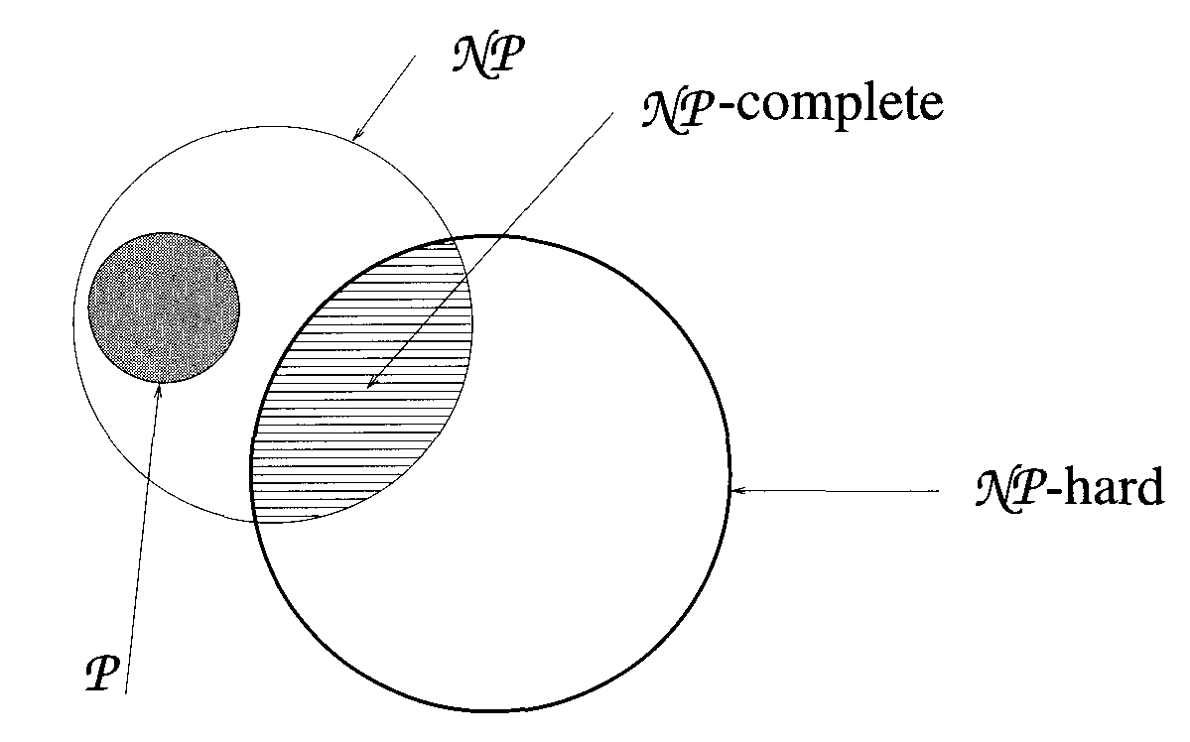
Commonly believed NP-complete, and NP-hard problems relationship among P, NP,
‹#›

Slide 23
How to prove the given problem is NP Hard and NP Complete?
Strategy is:
1. Pick a problem L2 already known to be NP-hard.
2. Show how to obtain an instance I’ of L2 from any instance I of L1
such that from the solution of I’ we can determine the solution to instance I of L1
3. Conclude from step (2) that L1 is reducible to L2.
4. Conclude from steps (1) and (3) and the transitivity of reducibility, that L1 is NP-hard.
5. To prove problem is NP Complete show that NP hard problem is also NP the is If a NP Hard problem can be solved using Non Deterministic Algorithm in Polynomial time then it is NP Complete
‹#›

Slide 24
Clique Decision Problem (CDP)
A maximum complete subgraph of a graph G=(V,E) is a clique –
Sets of elements where each pair of elements is connected.
The size of clique is the number of vertices in it
Max clique problem is an optimization problem that to determine the size of a largest clique in G
Decision problem is to determine whether G has a clique of size at least k for some given k
‹#›

Slide 25
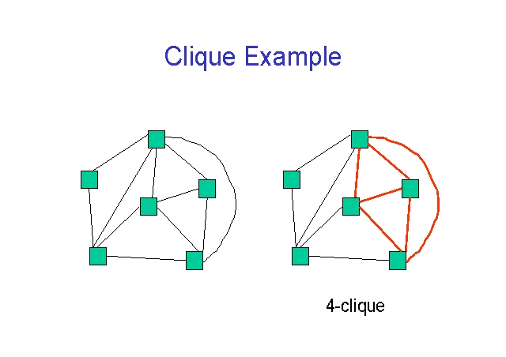
Clique Decision Problem (CDP)
A A
B C B C
D D
E F E F
‹#›

Slide 26
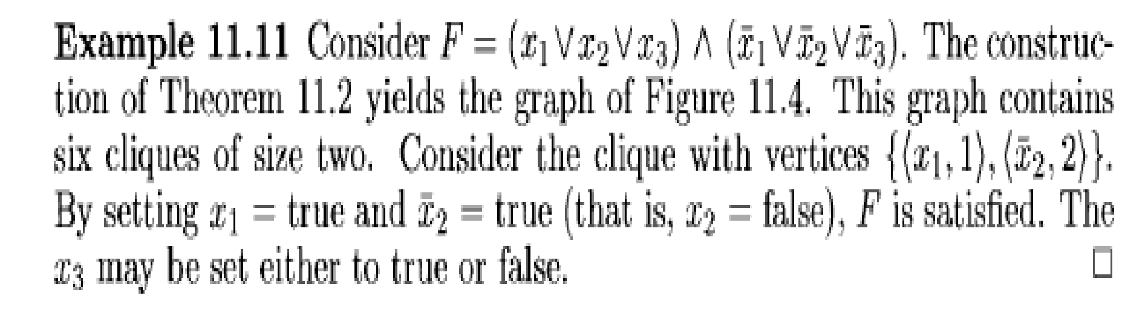
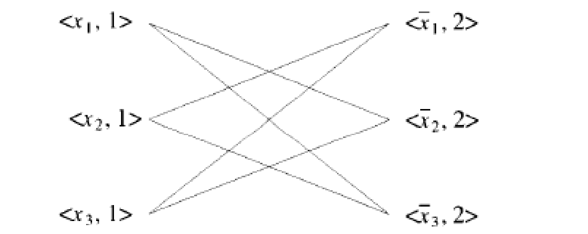
‹#›

Slide 27
Clique Decision Problem (CDP)
Max clique problem can be solved in polynomial time
if and only if the clique optimization problem can be solved in polynomial time
Satisfiability reduces to Clique Problem
Clique Problem is NP-Hard
Since CDP є NP, CDP is also NP-Complete
‹#›

Slide 28
Node Cover Decision Problem (NCDP)
A set S subset of V
is a node cover for a graph G = (V, E)
if and only if all edges in E are incident to at least one vertex in S.
The size |S| of the cover is the number of vertices in S.
Example –
Consider the graph of Figure
S = {2,4} is a node cover of size 2.
S = {1,3,5} is a node cover of size 3.
‹#›

Slide 29
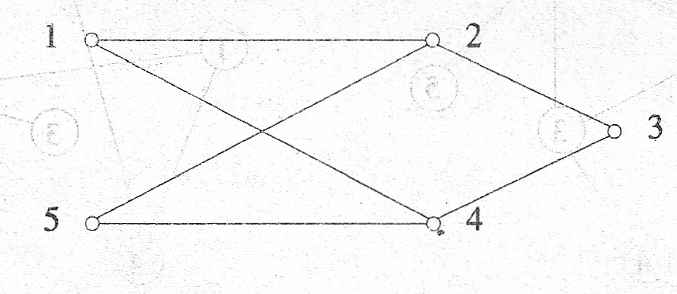
In the node cover decision problem
given a graph G and an integer k.
required to determine whether G has a node cover of size at most k
‹#›

Slide 30
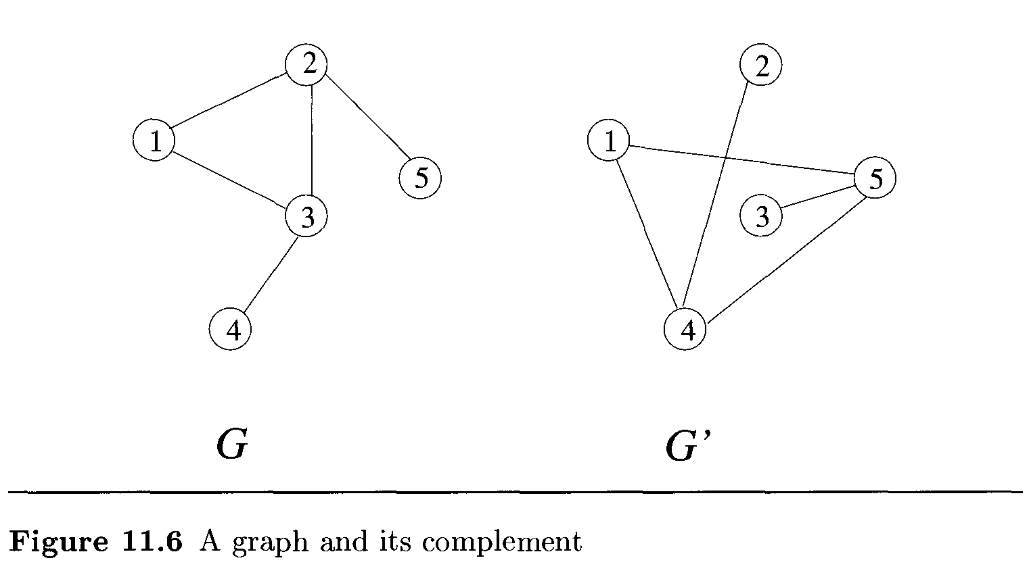
Theorem - The clique decision problem is reducible to the node cover decision problem.
‹#›

Slide 31
Proof
Let G = (V, E) and k define an instance of CDP.
Assume that |V| = n.
We construct a graph G’ such that G’ has a node cover of size at most n - k if and only if G has a clique of size at least k.
Graph G' is given
by G' = (V, E), where E = {{u,v) | u є V,v є V and (u,v) є E}.
The set G' is known as the complement of G.
‹#›

Slide 32
G’ has a node cover {4, 5} of size 2
since every edge of G’ is incident either on the node 4 or on the node 5.
G has a clique of size 5-2 = 3
consisting of the nodes 1,2, and 3.
‹#›

Slide 33
Chromatic Number Decision Problem (CNDP)
A coloring of a graph G = (V, E)
is a function f: V →{1, 2,... , k}
defined for all i є V.
If (u, v) є E, then f(u) ≠ f(v).
The chromatic number decision problem is to determine whether G has a coloring for a given k.
It is NP-Hard
‹#›

Slide 34
A possible 2-coloring of the graph of Figure is
f(1) = f(3) = f(5) =1.
and f(2) = f(4) = 2.
this graph has no 1-coloring possible.
‹#›

Slide 35
In proving CNDP to be NP-hard, we shall make use of the NP-hard problem SATY.
This is the CNF-satisfiability problem with the restriction that each clause has at most three literal
‹#›

Slide 36
To prove that the Chromatic Number Decision Problem (CNDP) is NP-hard, we typically reduce a known NP-hard problem to CNDP. One of the most commonly used NP-hard problems for such reductions is the Boolean satisfiability problem (SAT).
The Boolean satisfiability problem (SAT) asks whether there exists an assignment of truth values to variables in a Boolean formula such that the formula evaluates to true. SAT is NP-complete, meaning that any problem in NP can be reduced to SAT in polynomial time.
Here's a sketch of the reduction from SAT to CNDP:
Given a Boolean formula in conjunctive normal form (CNF), construct a graph where each variable corresponds to a vertex and each clause corresponds to a set of vertices.
For each clause, create a clique (complete subgraph) of size 3.
For each pair of vertices corresponding to complementary literals (i.e., variables and their negations), connect them with an edge.
Assign colors to the vertices in such a way that no two adjacent vertices have the same color.
The resulting graph can be colored with three colors if and only if the original Boolean formula is satisfiable.
This reduction can be done in polynomial time, and it shows that if we had a polynomial-time algorithm for solving CNDP, we could also solve SAT in polynomial time. Since SAT is NP-complete, this implies that CNDP is NP-hard.
Therefore, the Chromatic Number Decision Problem (CNDP) is NP-hard.
‹#›

Slide 37
Directed Hamiltonian Cycle (DHC)
A directed Hamiltonian cycle in a directed graph
G = (V, E)
is a directed cycle of length m = |V|
the cycle goes through every vertex exactly once and then returns to the starting vertex.
The DHC problem is to determine whether G has a directed Hamiltonian cycle
Satisfiability reduces to directed Hamiltonian Cycle
So it is NP-Hard problem
‹#›

Slide 38
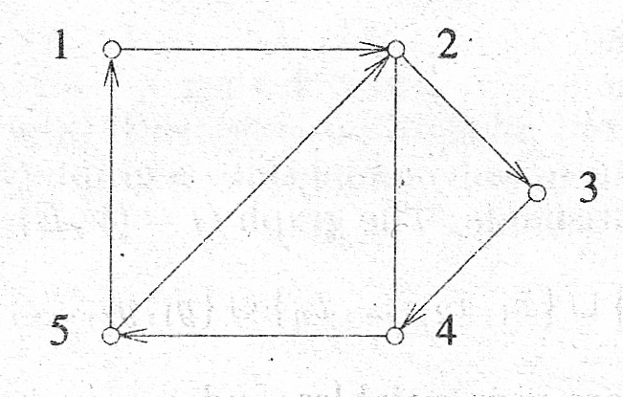
1, 2, 3, 4, 5, 1 is a directed Hamiltonian cycle in the graph
If the edge (5, 1) is deleted from this graph, then it has no directed Hamiltonian cycle.
‹#›

Slide 39
Traveling Salesperson Decision Problem (TSP)
Traveling salesperson decision problem is
to determine whether a complete directed graph G=(V, E)
with edge costs c(u, v) has a tour of cost at most M.
Theorem –
Directed Hamiltonian cycle (DHC) is reducible to the traveling salesperson decision problem (TSP)
‹#›

Slide 40
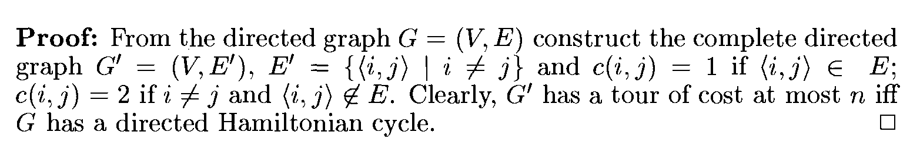
Traveling Salesperson Decision Problem (TSP)
Theorem –
Directed Hamiltonian cycle (DHC) is reducible to the traveling salesperson decision problem (TSP)
‹#›

Slide 41
AND/OR Graph Decision Problem (AOG)
complex problems can be broken down into a series of sub problems such that
the solution of all or some of these results in the solution of the original problem.
These sub problems can be broken down further into sub-sub-problems, and so on,
until the only problems remaining are sufficiently primitive as to be trivially solvable.
‹#›

Slide 42
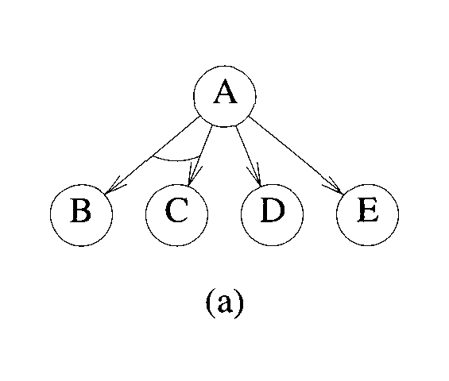
This breaking down of a complex problem into several subproblems can be represented by a directed graphlike structure
in which nodes represent problems and descendants of nodes represent the subproblems associated with them
problem can be solved by solving either both the sub-problems B and C
or the single subproblem D or E.
‹#›

Slide 43
Thank You
Email:- suhas.bhagate@gmail.com
‹#›

