Slide 1

Computer Algorithms
Unit-3
The Greedy method

Slide 2
The Greedy method
Straight forward design technique
It can be applied to wide variety of problems
Most of such problems have n inputs and required to obtain a subset that satisfies some constraints
Any subset that satisfies these constraints is called a feasible solution
Find feasible solution that either maximizes or minimizes a given objective function.
The feasible solution that do this, is called optimal solution

Slide 3
Subset Paradigm
Algorithm works in stages, considering one input at a time
At each stage decision is made regarding, whether a particular input is in an optimal solution
This is done by considering the inputs in an order determined by some selection procedure.
If inclusion of the next input into the partially constructed optimal solution will result in an infeasible solution,
then this input is not added to the partial solution, Otherwise it is added
Selection procedure is based on objective function

Slide 4
Ordering Paradigm
Do not call for the selection of an optimal subset
Make decisions by considering the inputs in some order
Each decision is made using an optimization criterion that can be computed using decisions already made

Slide 5
Knapsack Problem
• Given n items and a knapsack (or a bag) of capacity m.
• Associated with each item (i) is the weight (w_{i}) and the profit earned.
• If the fraction of item x_{i} is placed in knapsack
then profit of p_{i}x_{i} is earned. 0<=x_{i}<=1

Slide 6
Knapsack Problem
Objective is to obtain a filling of the knapsack that maximizes the total profit.
Formally the problem can be stated as
Maximize
∑ p_{i} x_{i}
1≤i≤n
  Subject to
  ∑ w_{i} x_{i} ≤ m
1≤i≤n
  And 0 ≤ x_{i} ≤ 1 1 ≤ i ≤ n

Slide 7
Greedy Approaches
•Sort items based on profit in decreasing order place items till knapsack is full.
•Sort items based on weight in increasing order place items till knapsack is full.
• Sort items based on profit/weight decreasing, place items till knapsack is full.
0/1 Knapsack

Slide 8
Example
Example 1
n=3 m=20
(p₁, p2, p3) = (25,24,15)
(w₁, w2, w3) = (18, 15, 10)
Example 2
  n=7 m=15
  (p1, p2, p3, p4, p5, p6, p7) = (10,5,15,7,6,18,3)
  (w₁, w₂, w₃, w₄, w₅, w₆, w₇) = (2,3,5,7,1,4,1)
(0,1,1/2) 20 31.5

Slide 9
Example
Example 3
n=4 m=25
(p₁, p2, p3, p₄ ) = (2, 5, 8, 1)
(w₁, w2, w3 , w₄) = (10, 15, 6, 9)
Example 4
  n=6 c=20
  (p1, p2, p3, p4, p5, p6) = (12,5,15,7,6,18)
  (w₁, w₂, w₃, w₄, w₅, w₆) = (2,3,5,7,1,5)

Slide 10
Example
Example 5
n=4 m=30
(p₁, p2, p3, p₄ ) = (27, 20, 24, 15)
(w₁, w2, w3 , w₄) = (15, 10, 18, 10)

Slide 11
Job Sequencing with Deadlines
• Given a set of n jobs
– Each job is associated with an integer deadline d_{i} ≥ 0 and profit p_{i} ≥0
– For any job profit p_{i} will be earned iff the job is completed by its deadline
– Each job takes unit time
– Only one machine (server) is available.

Slide 12
Job Sequencing with Deadlines
– Feasible solution:
subset J of jobs such that
each job in J is completed within its deadline
– Optimal solution:
Feasible solution with highest profit

Slide 13
Solution
• Greedy Method
– Sorting jobs based on profit ↓
– Sorting jobs based on deadlines ↑
• Implementation
– Using array

Slide 14
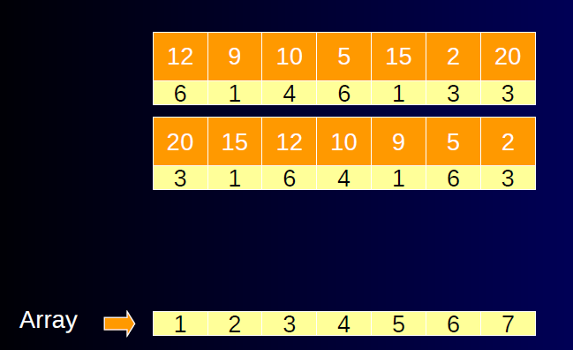
Example

Slide 15
Example
n=4 , (p₁, p₂, p₃, p₄) = (100,10,15,27)
(d₁, d₂, d₃ , d₄) = (2,1,2,1)
Feasible Solution Processing Sequence Value
(1,2) 2,1 110
(1,3) 1,3 or 3,1 115
(1,4) 4,1 127
(2,3) 2,3 25
(3,4) 4,3 42
(1) 1 100
(2) 2 10
(3) 3 15
(4) 4 27

Slide 16
Example
Example 1 n=5 ,
(p₁, p₂, p₃, p₄ , p₅) = (20,15,10,5,1)
(d₁, d₂, d₃ , d₄ , d₅) = (2,2,1,3,3)
  Example 2 n=7
  (p1, p2, p3, p4, p5, p6, p7) = (3,5,20,18,1,6,30)
  (d₁, d₂, d₃, d₄, d₅, d₆, d₇) = (1,3,4,3,2,1,2)
(1,2,4 ) 40

Slide 17
Example
Example 3 n=5 ,
(p₁, p₂, p₃, p₄ , p₅) = (45,15,20,7,65)
(d₁, d₂, d₃ , d₄ , d₅) = (1,3,2,1,2)
  Example 4 n=7
(p1, p2, p3, p4, p5, p6, p7) = (50,15,18,16,8,25,60)
(d₁, d₂, d₃, d₄, d₅, d₆, d₇) = (1,3,4,3,2,1,2)

Slide 18
Example
Example 5 n=5 ,
(p₁, p₂, p₃, p₄ , p₅) = (20,16,11,5,25)
(d₁, d₂, d₃ , d₄ , d₅) = (2,2,1,2,1)
  Example 6 n=7
  (p1, p2, p3, p4, p5, p6, p7) = (45,5,20,18,6,30,70)
  (d₁, d₂, d₃, d₄, d₅, d₆, d₇) = (1,3,4,3,2,1,2)
(1,2,4 ) 40

Slide 19
Job Sequencing with Deadlines
• Variants
– Processing time is different
– Multiple servers
– Profit factors different if executed on different server

Slide 20

Minimum Cost Spanning Tree
Spanning Tree-
Let G=(V,E) be undirected connected graph.
A sub-graph t=(V,E’) of G is spanning tree
iff t is tree.

Slide 21
Weighted graph:
    Weights assigned to edges.
Minimum Spanning Tree
• A spanning tree with minimum sum of weights
  It includes all vertices connected and sum of weight is minimum

Slide 22
Prim’s Algorithm
Steps
1. Select edge with smallest weight, include it in
subset.
2. Select next adjacent vertex with minimum weight.
3. Include it in the subset if it does not form cycle.
4. Go to step 2 if all vertices are not included in
subset.

Slide 23
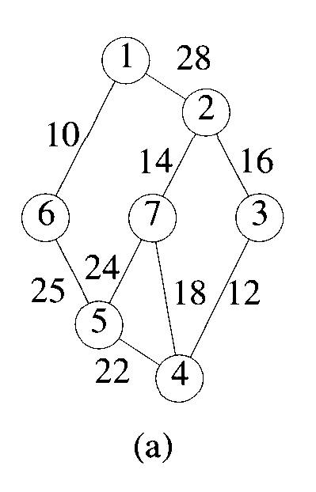
Prim’s Algorithm

Slide 24
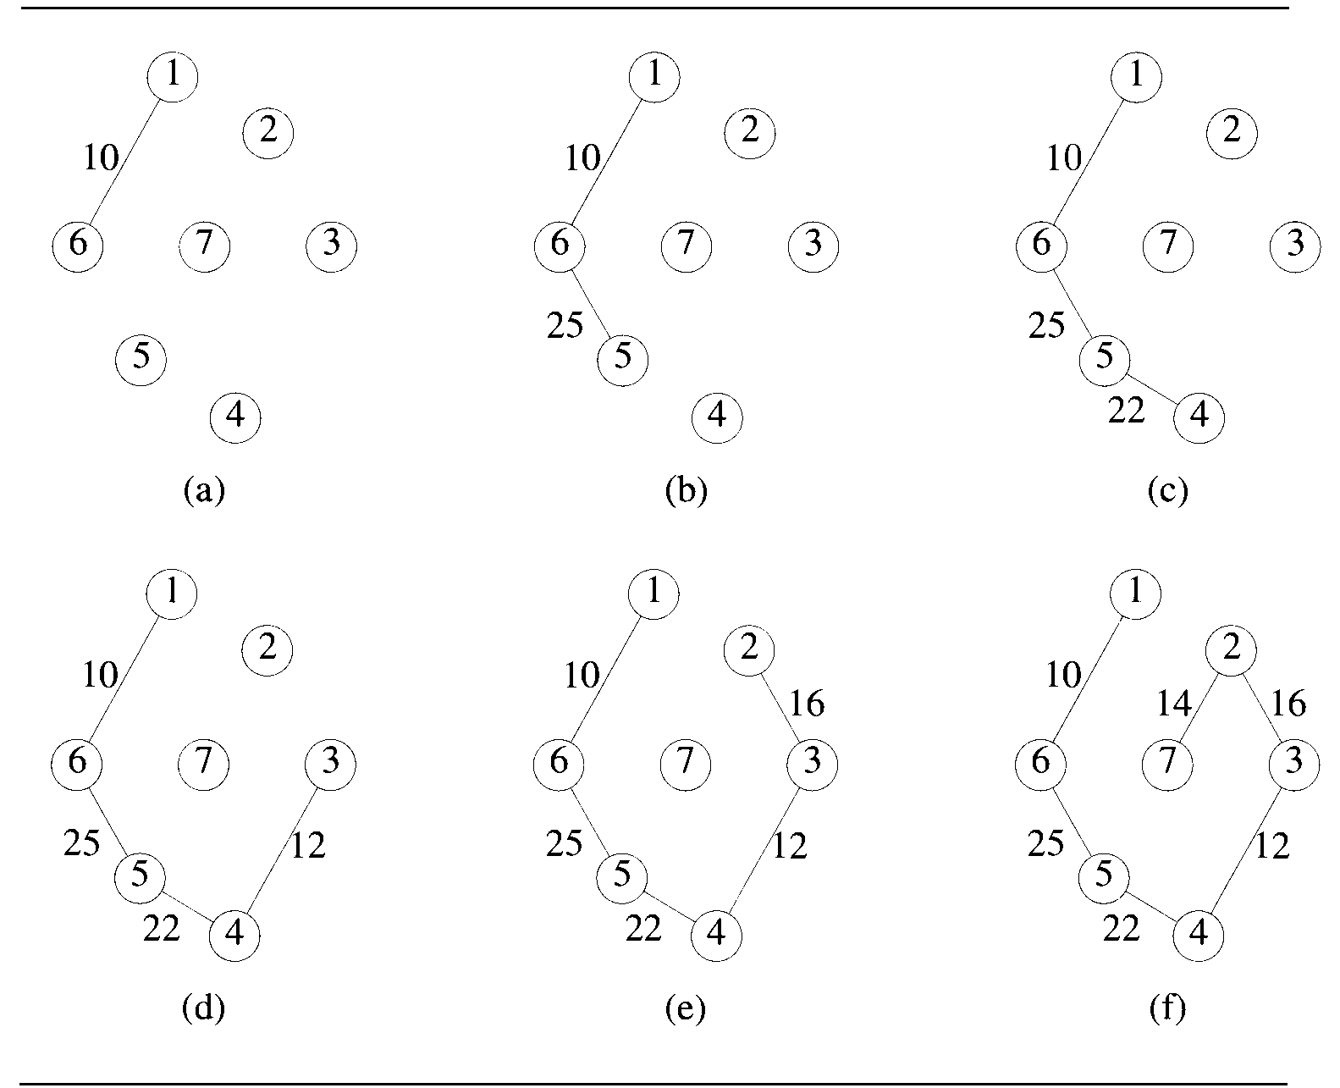

Slide 25
Prim’s Algorithm
After every step, graph we get is connected
Complexity – O(n²)

Slide 26
Kruskal’s Algorithm
Steps
1. Sort the edge list on weight in non decreasing order.
2. Select next edge and include it in the subset if it does not form cycle.
3. Go to step 2 if all vertices are not included in subset.

Slide 28
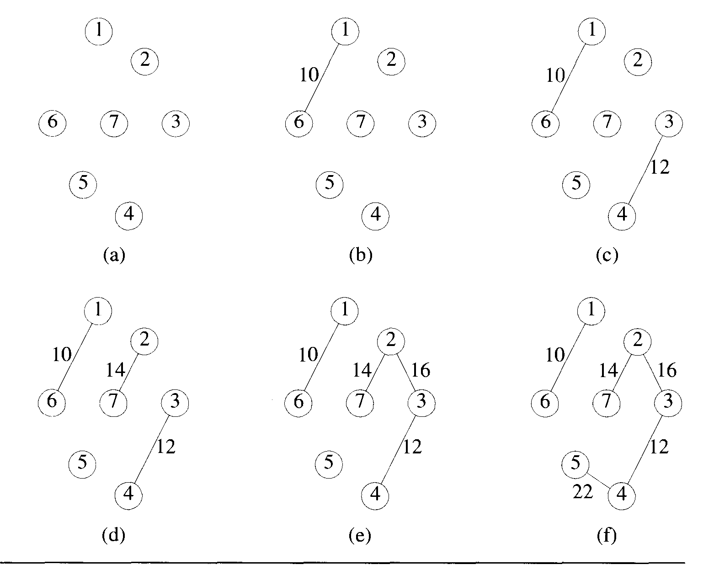

Slide 29
Kruskal’s Algorithm
After every step graph we get may not be connected graph
Complexity – O(E log E)

Slide 30
Application of MST
Network bandwidth management-
  Minimum bandwidth required to pass message from one node to another

Slide 31
Optimal Storage on Tapes
There are n programs that are to be stored on a computer tape of length l
Associated with each program i is a length l_{i}, 1 ≤ i ≤ n
All programs can be store on tape if and only if the sum of the length of the programs is at most l
Whenever a program is to be retrieved from this tape, the tape is initially positioned at the front.

Slide 32
Optimal Storage on Tapes
If the programs are stored in order
i₁,i₂,i₃,…i_{n}
The time t_{j} needed to retrieve the program i_{j} is proportional to
∑ l i_{k}
1≤k≤j
If all programs are retrieved equally often, then expected or mean retrieval time is (MRT) is
(1/n) ∑ t_{j}
1≤j≤n

Slide 33
Optimal Storage on Tapes
In the optimal storage on tape problem
We are required to find a permutation for the n programs so that
When they are stored on the tape in this order
MRT is minimized
This problem fits into Ordering Paradigm
Minimize d(I) = ∑ ∑ l i_{k}
1≤j≤n 1≤k≤j
O(n log n)
Sort in non-decreasing order

Slide 34
Example
n=3 (l1,l2,l3)=(5,10,3)
There are n! possible orderings
Ordering d(I)
1,2,3 =38
1,3,2 =31
2,1,3 =43
2,3,1 =41
3,1,2 =29
3,2,1 =34

Slide 35
Optimal Merge Pattern
• When two or more sorted files are to be merged together,
the merge can be accomplished by repeatedly merging sorted files in pairs.
• Approach
– Sort the files based on no of records
– Form pairs
– Merge pairs, Go to above step till complete
– Wrong results.

Slide 36
Optimal Merge Pattern
• Revised Approach
– Sort the files based on no of records
– Merge first two files, Go to above step till complete
– Wrong results.

Slide 37
Optimal Merge Pattern
• Re-revised Approach
1 Sort the files based on no of records
2 Select two smallest files,
3 merge them,
4 Place the resultant file at proper position in sorted list
5 repeat step 2 to 4 till all files are merged.
Example.
1 2 3 4 5
  10 5 9 6 12
Find an optimal binary merge pattern for ten files whose lengths are
28,32,12,5,84,53,91,35,3, and 11.

Slide 38
Optimal Merge Pattern
Find an optimal binary merge pattern for ten files whose lengths are
28,32,12,5,84,53,91,35,3, and 11.

Slide 39
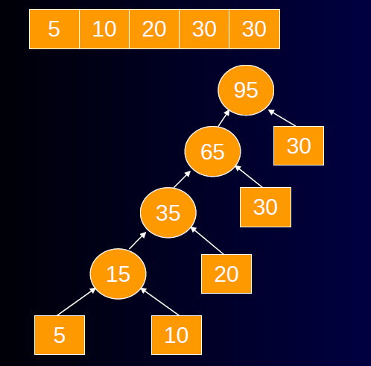
Optimal Merge Pattern

Slide 40
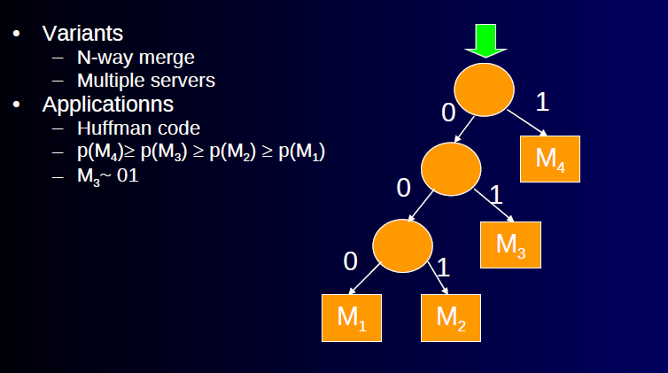
Optimal Merge Pattern

Slide 41
Huffman Code
Obtain a set of optimal Huffman codes for the messages (M1,..., M7) with relative frequencies
(q1,..., q7) = (4, 5,7,8,10,12, 20).
Draw the decode tree for this set of codes.

Slide 42
SINGLE-SOURCE SHORTEST PATHS
Graphs can be used to represent the highway structure of a state or country
vertices representing cities and edges representing roads
The edges can then be assigned weights
which may be either the distance between two cities connected by the edge or the average time to drive

Slide 43
SINGLE-SOURCE SHORTEST PATHS
A motorist wishing to drive from city A to B
would be interested in answers to the following questions:
Is there a path from A to B
If there is more than one path from A to B, which is the shortest path ?

Slide 44
SINGLE-SOURCE SHORTEST PATHS
The length of a path is defined to be the sum of the weights of the edges on that path.
The starting vertex of the path is referred to as the source, and the last vertex the destination.
The graphs are digraphs to allow for one-way streets.
In the problem we consider, we are given a directed graph G = (V,E),
a weighting function cost for the edges of G,
and a source vertex v₀.

Slide 45
SINGLE-SOURCE SHORTEST PATHS
The problem is to determine the shortest paths from v₀ to all the remaining vertices of G.
It is assumed that all the weights are positive.
The shortest path between v₀ and some other node v is an ordering among a subset of the edges.
Hence this problem fits the ordering paradigm.

Slide 46
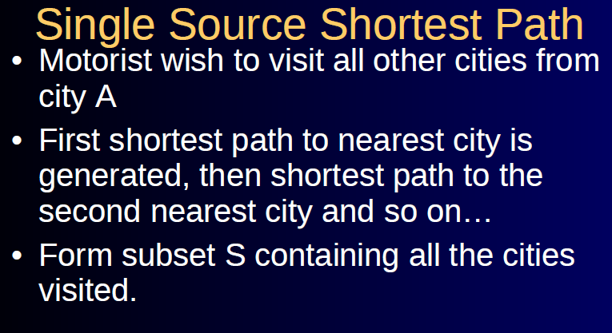

Slide 47
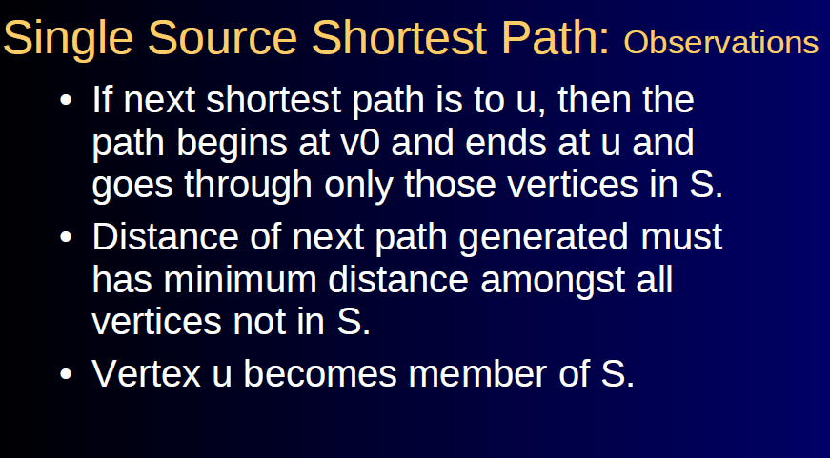

Slide 48
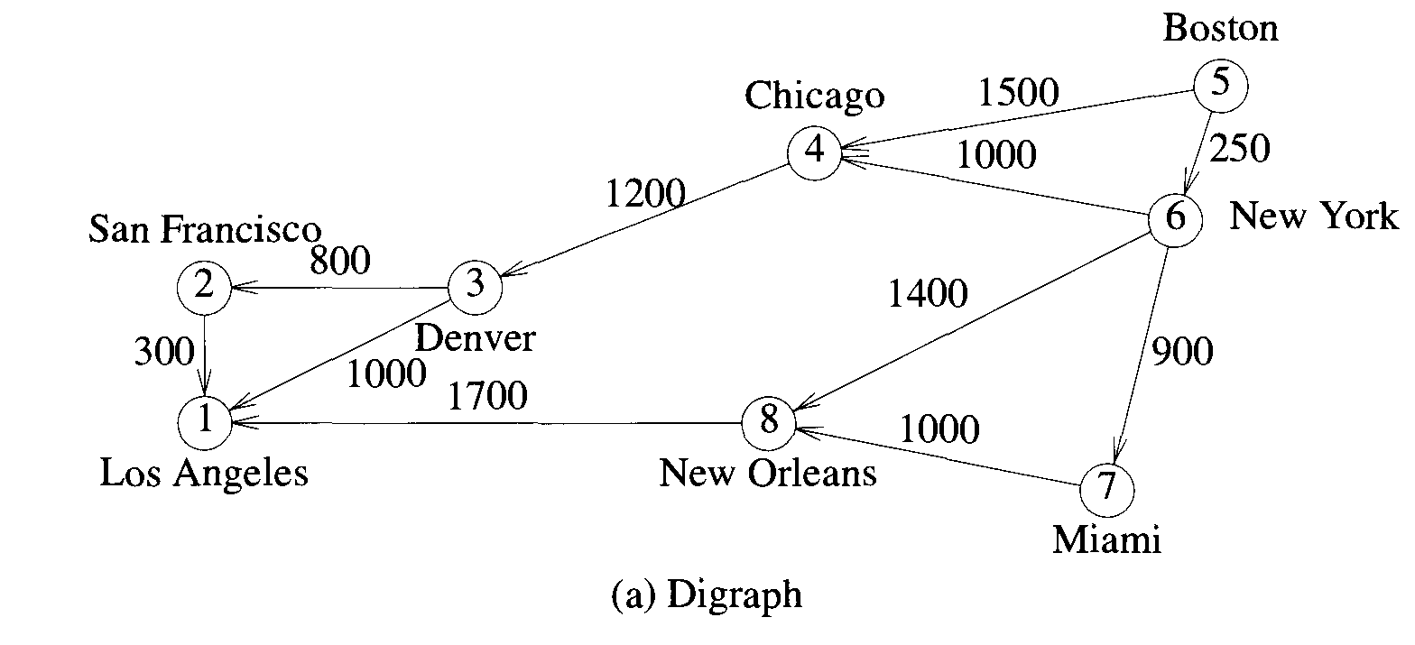
SINGLE-SOURCE SHORTEST PATHS

Slide 49
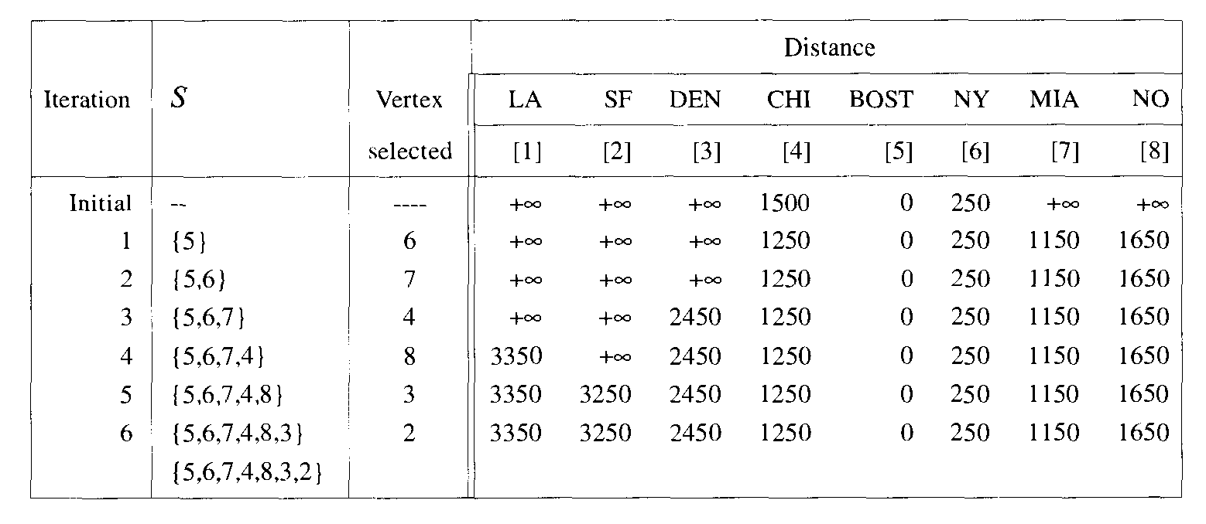
SINGLE-SOURCE SHORTEST PATHS

Slide 50
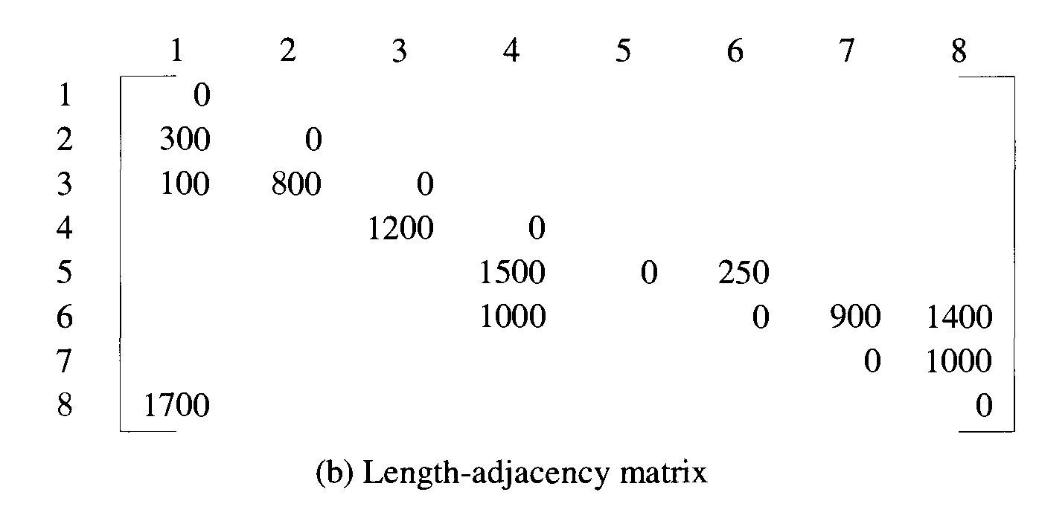
SINGLE-SOURCE SHORTEST PATHS

Slide 51
Thank You

