Slide 1

SmartCare
Sprint 2
Rob – Product Manger
Rodrigo & Micah - Lead Developers
James & George – Testers & Architecture Designers

Slide 2
Sprint 2 Backlog
Backend Model
Backend Controller
Additional
Login
New user
Delete
Login
Patient Controller
Book Appointment
Check Prescription
View Appointment
Make Payment
Staff Controller
View Appointment
Offer Prescription
Admin
Approve User
CRUD users/organisations/appointments
Manage Accounts
Report Service
Calculate Turn Over
Generate Surgery Invoice
Data Access Objects:
DynamicDAO (Allows access of DB for initial development)
SpecifcDAOs (Will be added once refactored)
List (patient)
Organisation (lists orgs)
Employee
Booking
Models Entity's
Patient
Organisation
Employee
Booking
Report
Model Service
Report
Booking
All required frontend functionality to test the backend development.
Unit tests throughout the project.
Create comprehensive system architecture diagrams.
Complete 7 (50%) required test cases.

Slide 3
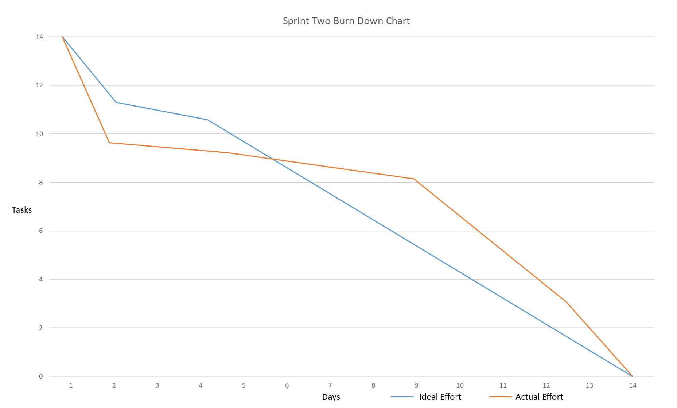
Sprint 2 Burndown chart

Slide 4
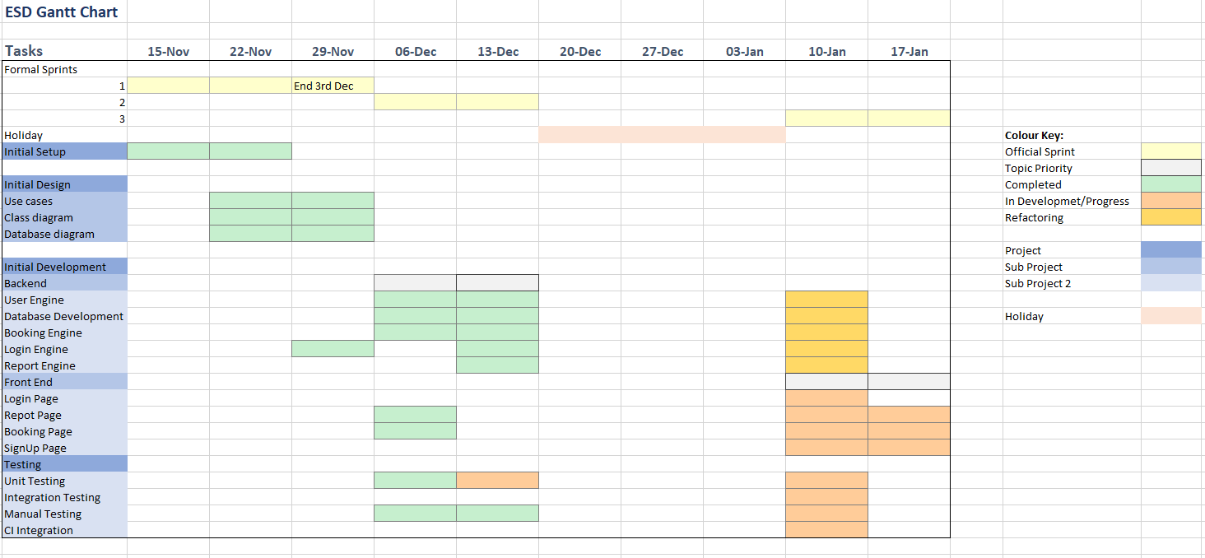
Updated Gantt Chart For Sprint 3

Slide 5
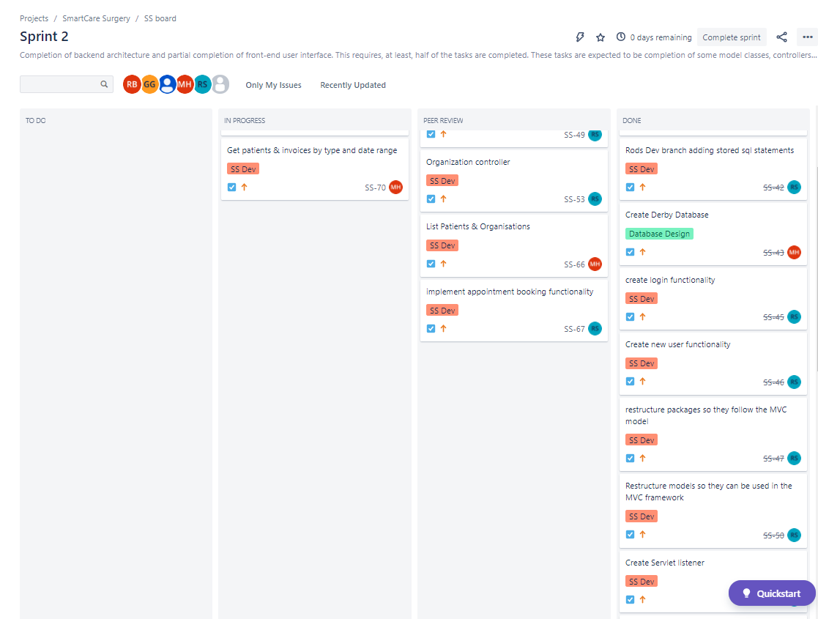
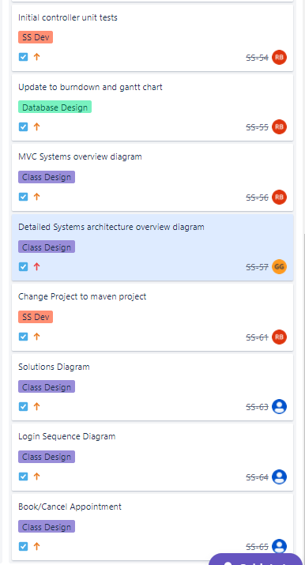
Kanban Board Showing Current Progress

Slide 6
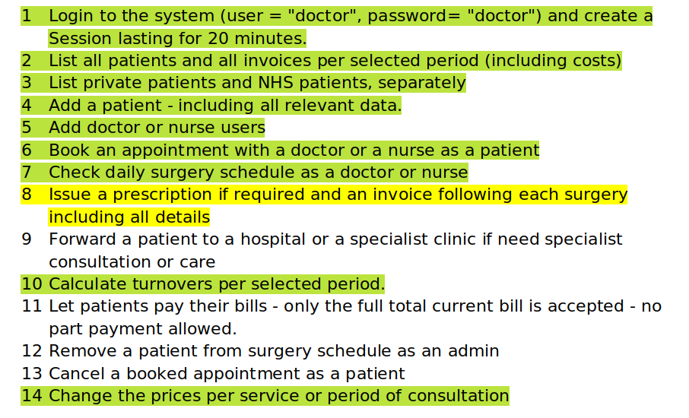
Completed Test Cases

Slide 7
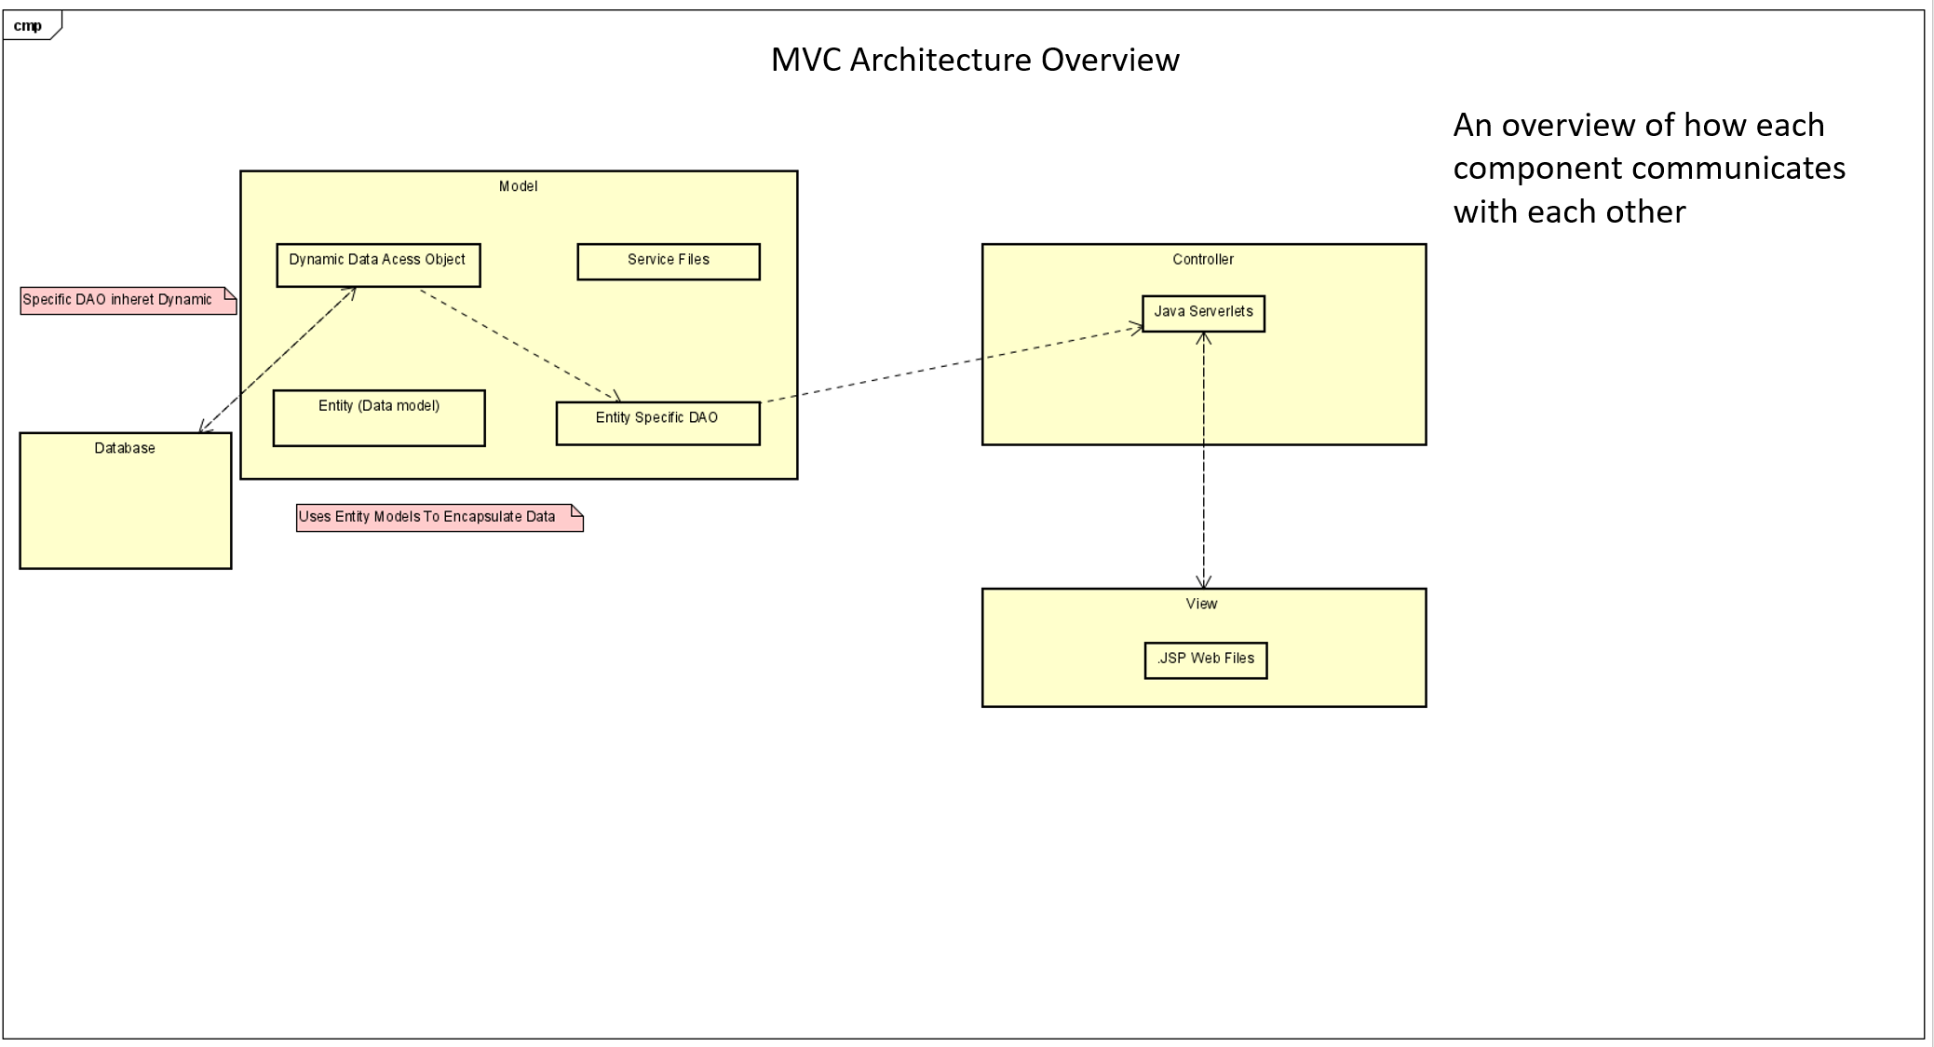
MVC Top Level Overview of Architecture
INSERT BEFORE MEETING

Slide 8
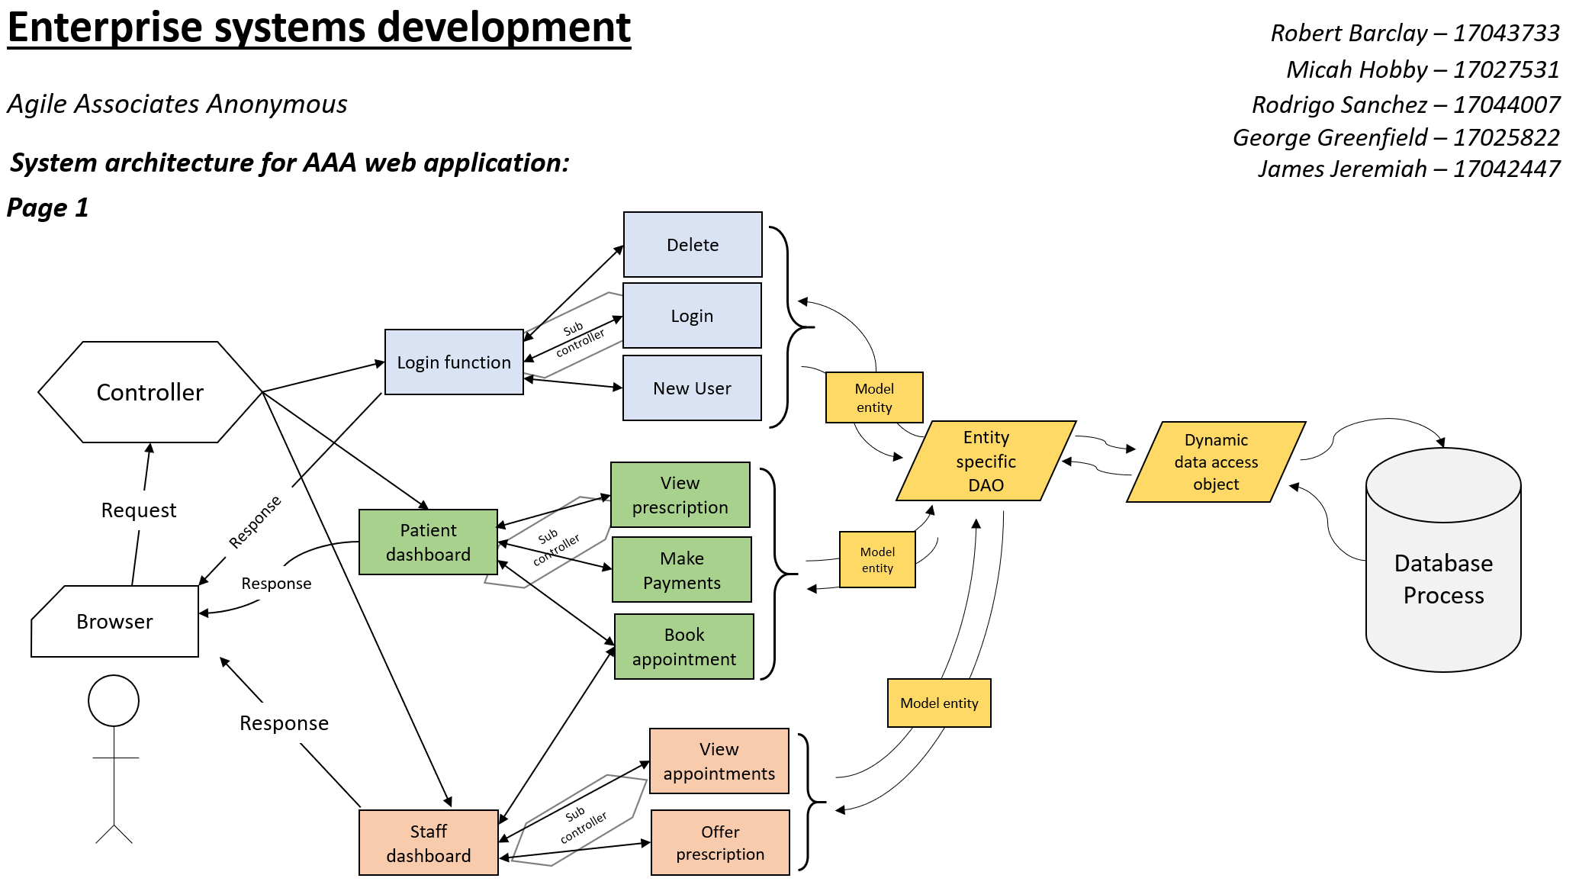
System Overview: Component Architecture

Slide 9
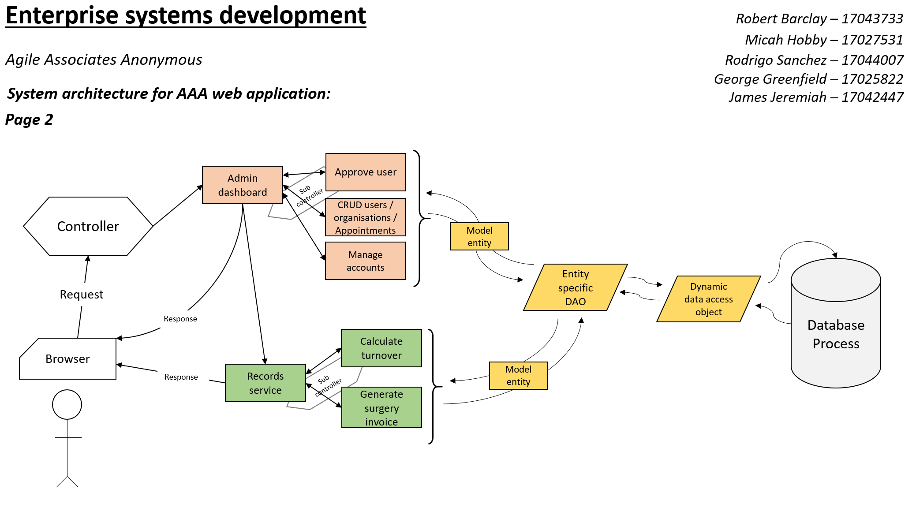
System Overview: Component Architecture

Slide 10
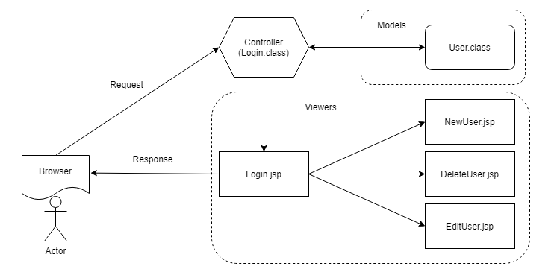
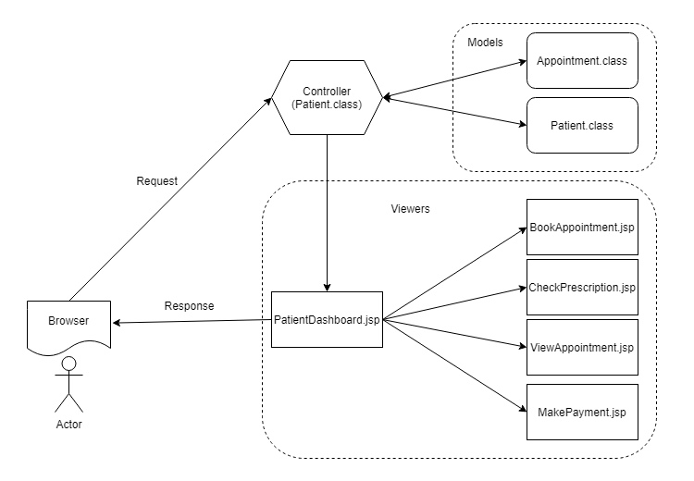
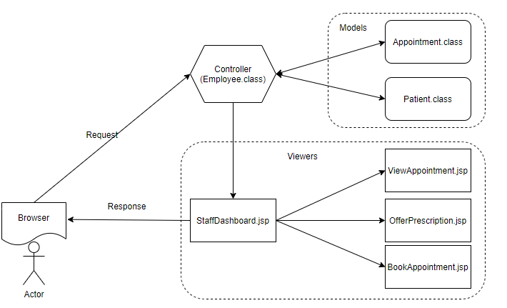
Solutions Architecture Diagrams
Login
Patient
Employee

Slide 11
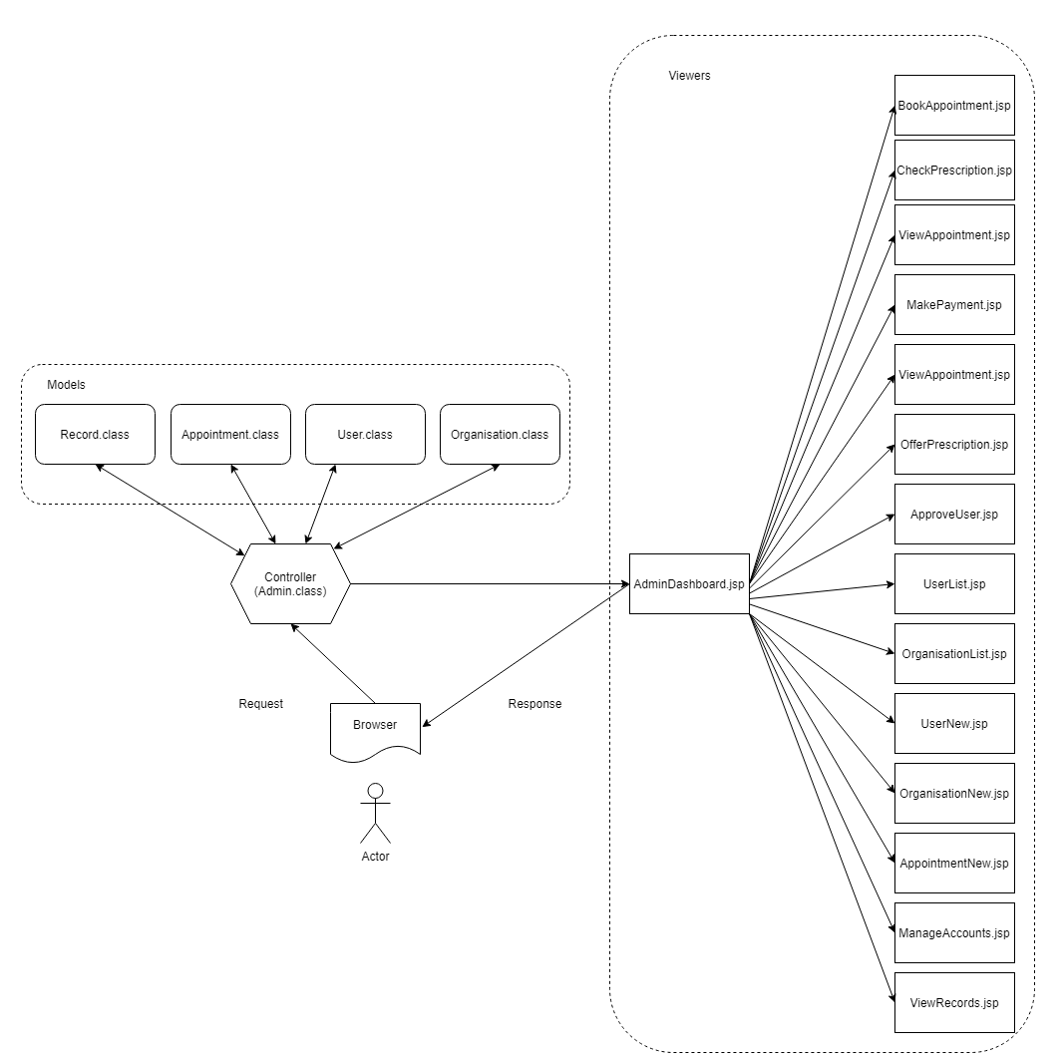
Solutions Architecture Diagrams
Admin

Slide 12
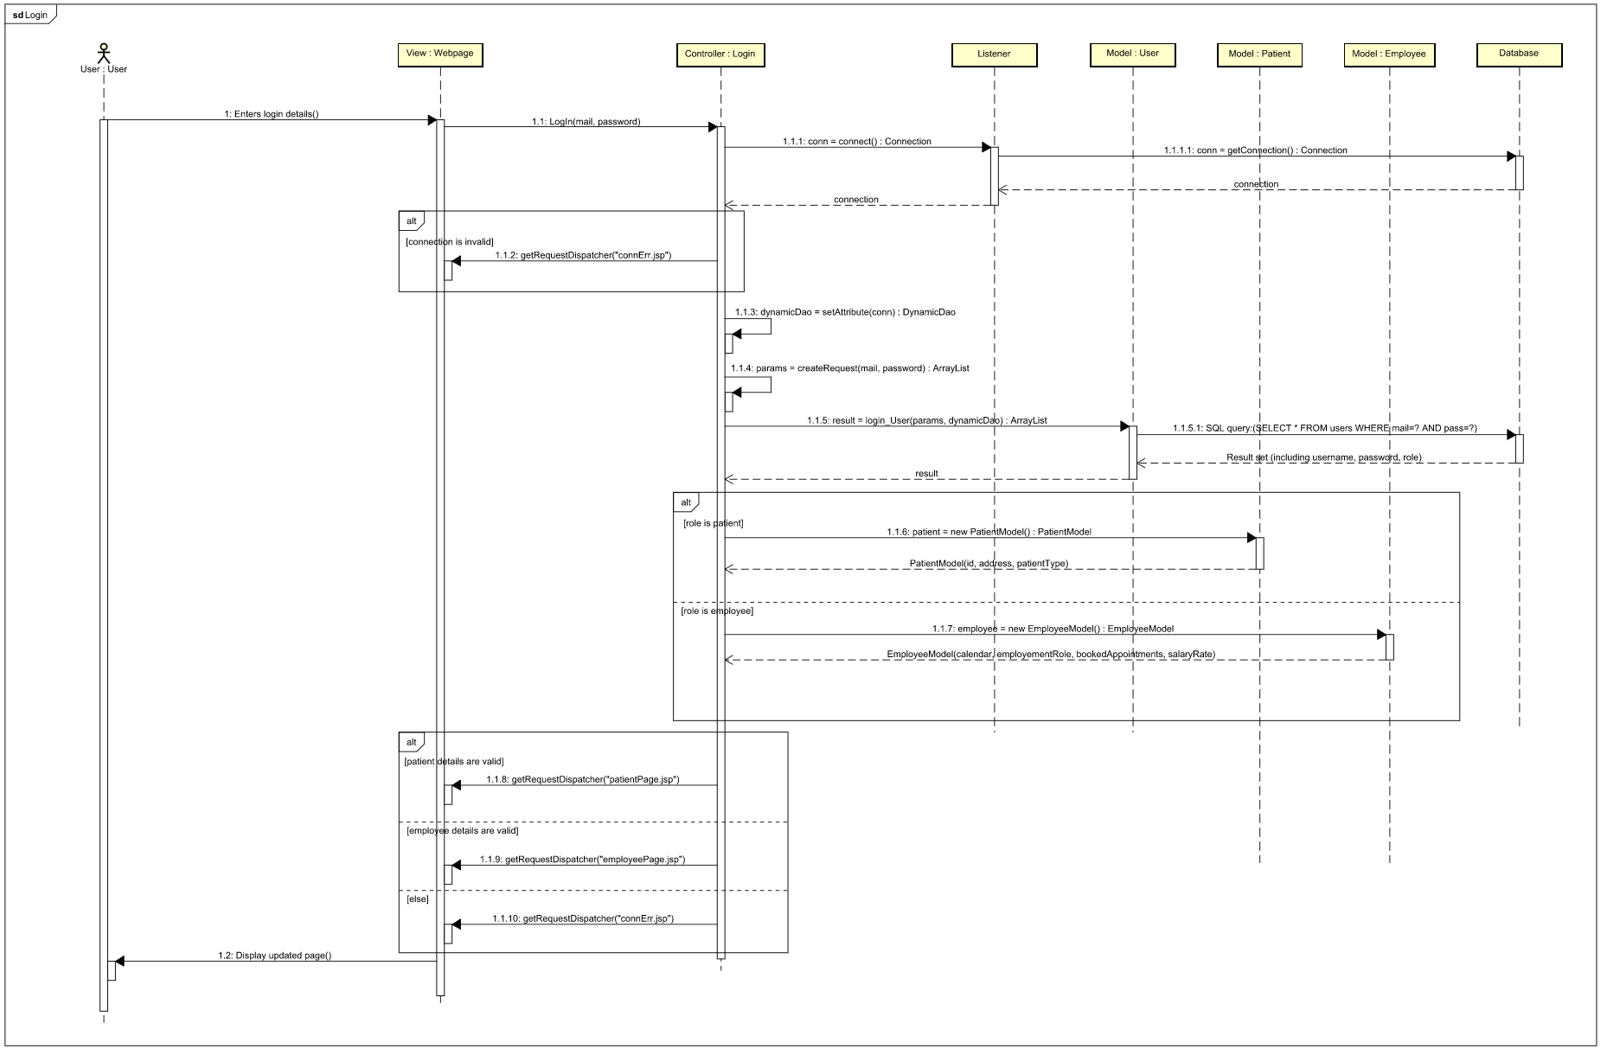
Sequence Diagram Example

Slide 13
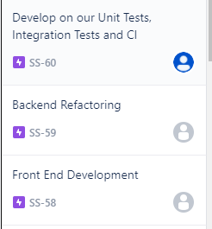
Uncompleted Tasks
Front End development
Extend on the current functionality increasing the UX. (Micah and George)
This includes development and refactoring of all the .jsp files mentioned in the solutions architecture diagram.
Refactoring of back end to encapsulate data into models. (Rob and Rodrigo)
Refactoring to have consistent variable names/formatting. (Rob and Rodrigo)
Create Integration tests (George, James and Rodrigo)
Develop on Unit Tests using features like mocking (George, James and Rob)
Implement CI (Rob and James)
The last 5-6/14 test cases completed (Completed 8-9/14).

Slide 14
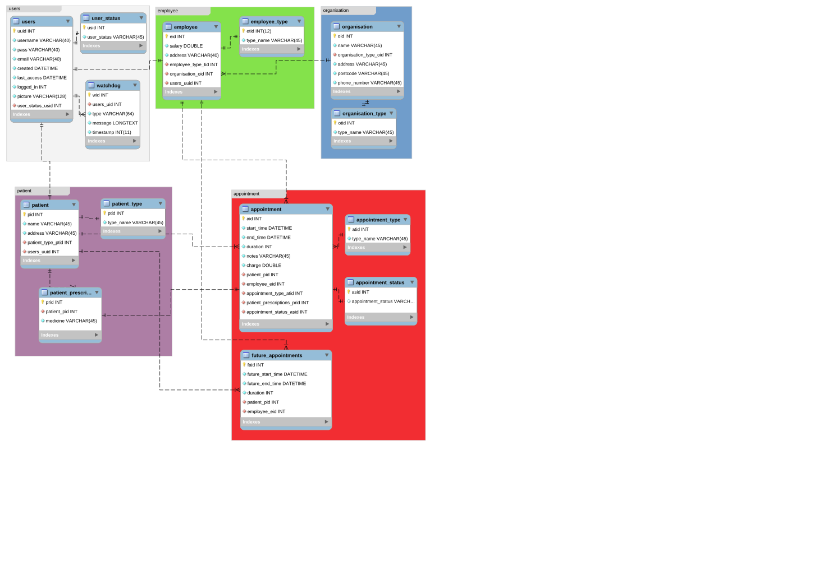
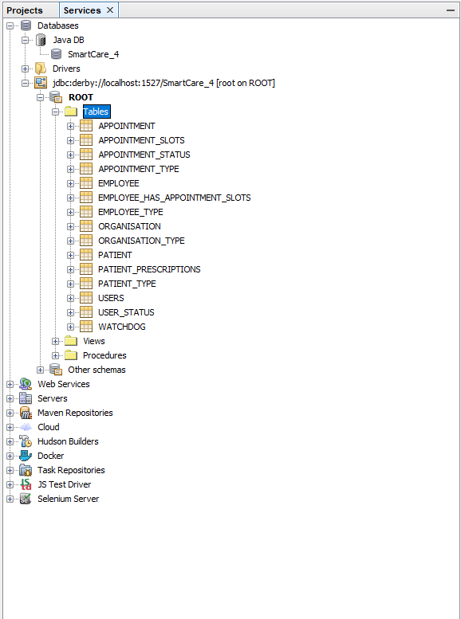
Updated Database Design

Slide 15


Project Link: https://github.com/19ATF72/AAA-project
Documentation Link:
https://github.com/19ATF72/AAA-documentation

