Slide 1
Bright Data Sciences
Analyst Interview Questions
Internal document - June 2020

Slide 2
Context for the Exercise
A Bright user typically 1-2 checking accounts (also called current accounts) and 5+ different credit cards with multiple other banks or credit card providers. They are typically $6-15k of debt (known as card balance) on their Credit Cards. And they have to make minimum-due payments of roughly $300 per month across cards
Bright Debt Manager is an automated A.I. financial management app. It automatically collects money from a user’s (checking) account and then automatically allocates payments to a user’s credit cards in order to pay their: 1) their minimum-dues on the credit cards, 2) pay down their balances to the best extent possible
The priority is always to pay minimum-dues if enough funds have been collected
For each credit card when it comes to ‘minimum dues’ case, there are 3 possible cases: a) the card is paid in full, b) the card is partially paid, c) the card was not paid at all (UNTOUCHED). In the events of b) or c)
A ‘surrender’ situation is when a card cannot be paid by Bright (so b or c) AND we do NOT see that the user has themselves paid the card already by themselves (as manual payment)
Unsubscribe means ‘Disconnecting the Debt Manager’ - like ‘Deleting the app’
Notes:
what is surrender situation?

Slide 3
Credit Card Min due payment analysis
Credit Cards Payment cases - for all valid credit cards
Note user:cards to is a one:many relationship
We couldn’t pay and user did it fast
X = Full paid
T = Untouched & Unsurrendered
Min dues contributed by Bright
U = Untouched & Surrendered
Y= Part paid + surrendered
V = Part paid + not surrendered
Untouched cards
Available data:
History of transactions and payments across all credit cards
History of transactions and payments across all checking accounts
History of connectivity with Bright of checking accounts and credit cards
Questions:
What metrics would you define to see the effectiveness of the Debt Manager system is doing? (Expect 2-5 answers)
For each of the metrics you define, if the metric is poor what data would you request specifically to analyse what is going on. What analysis would you do?

Slide 4
2) Product Exercise: Unsubscription rates
Use the data on the next 2 slides. Notice the y-axis scales are not labelled. You should look for patterns in the relative numbers.
What challenges and patterns do you notice in unsubscribe rates for the Debt Manager product?
What problem areas would you focus on?
What are your hypotheses on the types of problem?
What data would you collect to understand the problem and potential solutions?

Slide 5
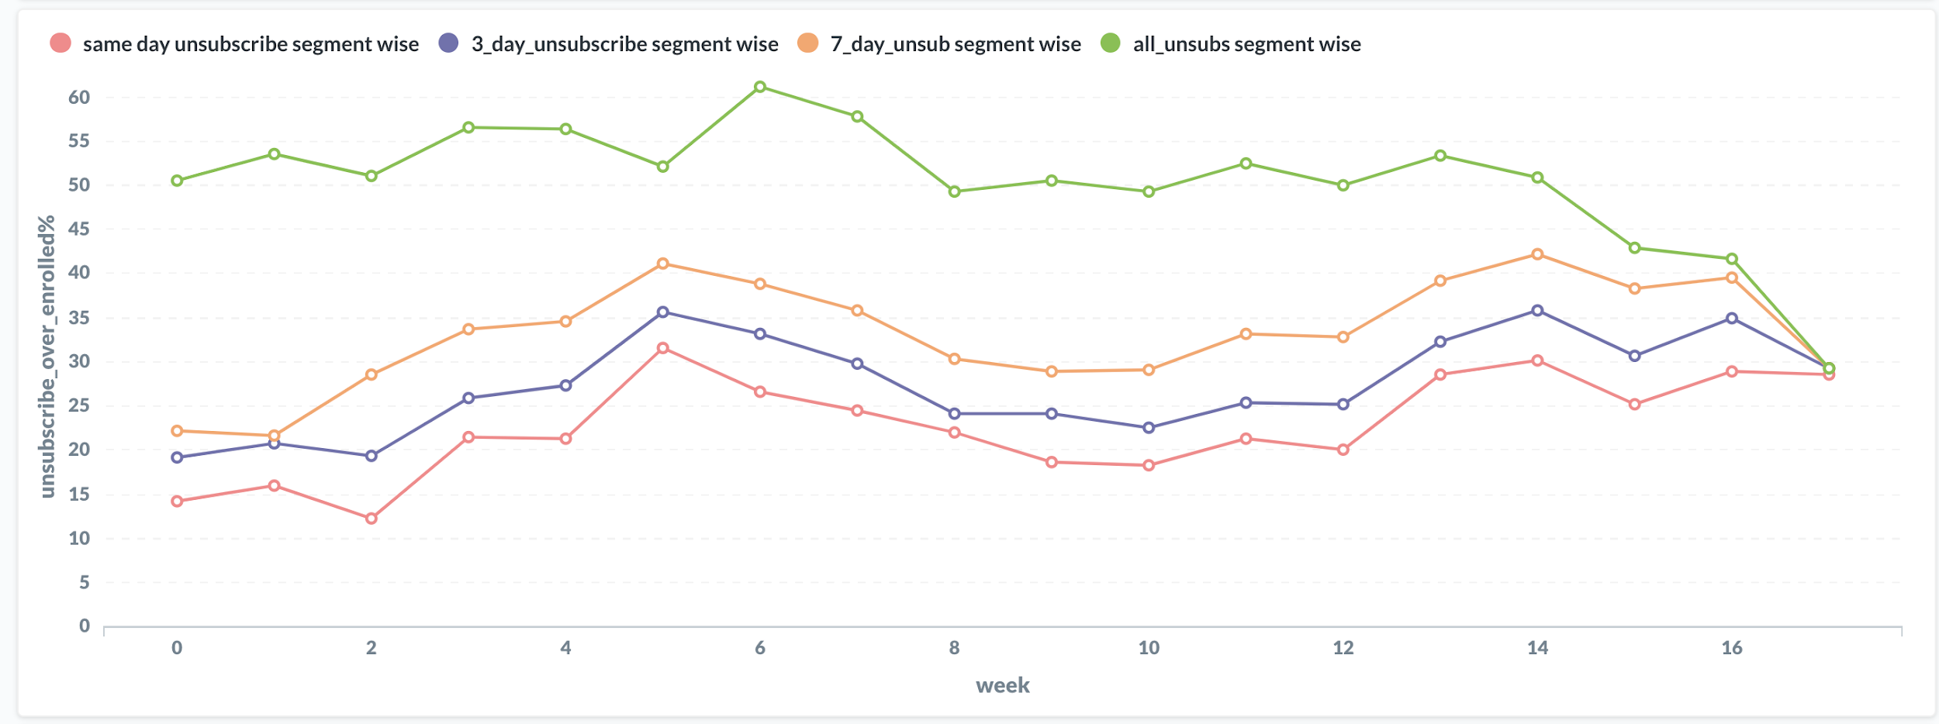
2) Unsubscribe levels - week on week
The curves crunch at the end because they have not had time to age. The users are still young in the system. So the green curve especially is not ‘fully aged’
Weeks denote the cohorts: tracking users who joined in this week

Slide 6
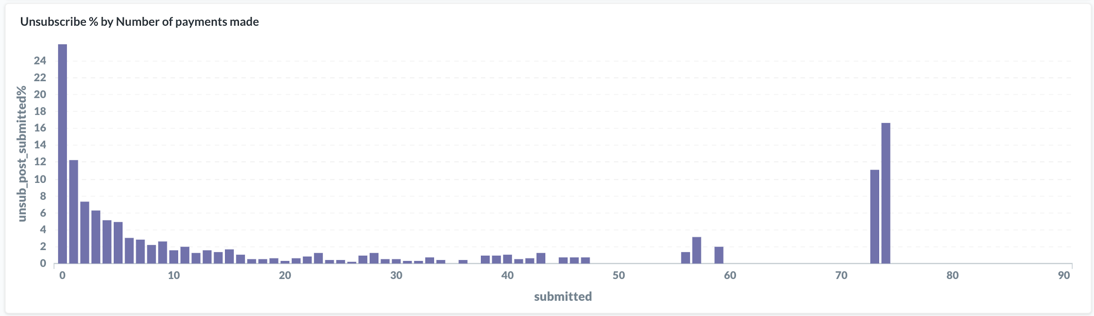
2) Unsubscribe % relative to no. of payments of a user
Ignore outliers because they are based on a small ‘n’
No. of payments the user has done

Slide 7
Write an email with your answers to Jaya + Avi
Email Jaya and Avi
jaya@brightmoney.co
avi@brightmoney.co
Treat this like a real work email you are writing having done this analysis for the Product Leader, which is Jaya.
Aim for good structure
Clear points
Well organized
Refer to data to make your points

