Slide 1
OHM Term Project 19IM30010
Gyanendra Behura

Slide 2
Bank Lending Problem

Slide 3
GA Summary
First I took a random number between 0 to 1024 as the no. of Loans we can choose from is 10. So, we have 2^10 permutations.
Then I converted those integers values to binary lists
e.g.[ 1 0 1 0 1 0 1 0 1 0 ]
I took Scalar dot product of interest, Loan and binary list to get the revenue and subtract bad debt from it.
Like that I calculated the net profit and added a penalty If the loan value increases from (1-K)*D values.
Then after that I did the fitness test using Proportionate selection method then did crossover and bit wise mutation to get the next generation.
Then I took graph of the for end generation and the no. of iterations and the value of the total profit.

Slide 4
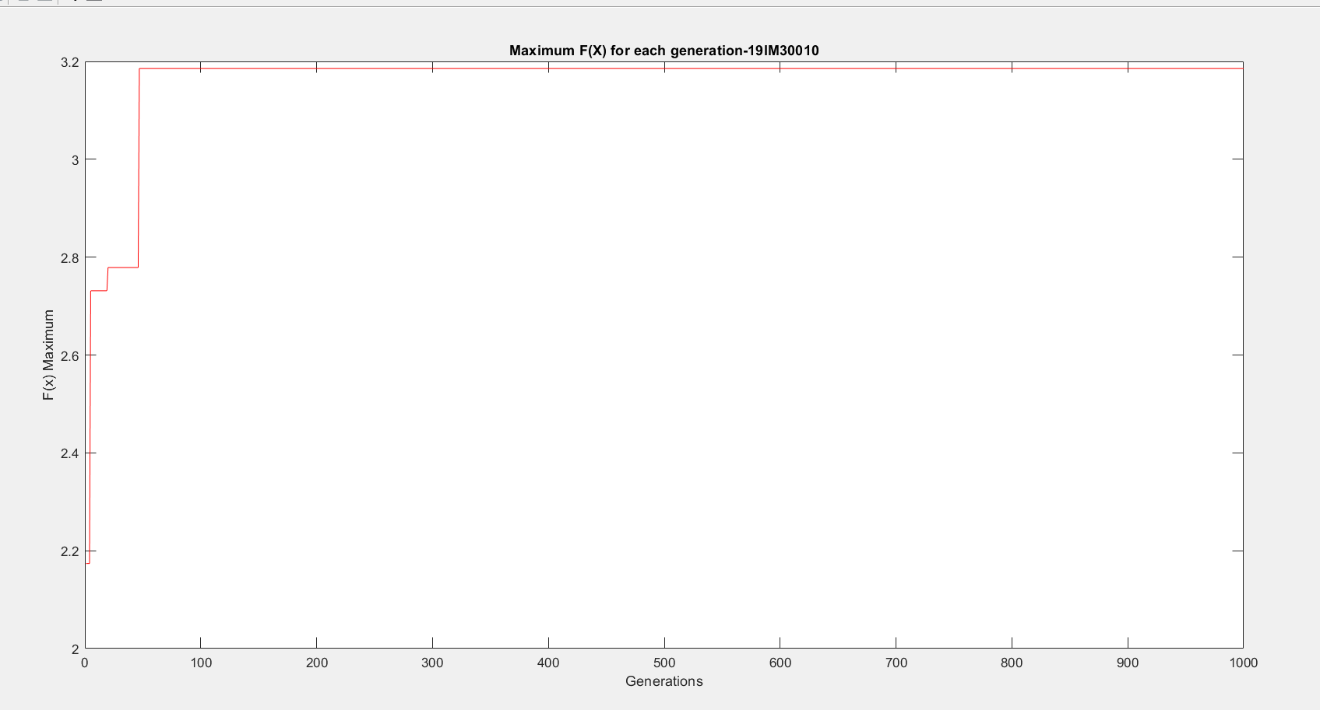
GA Code Results(fig-1)

Slide 5
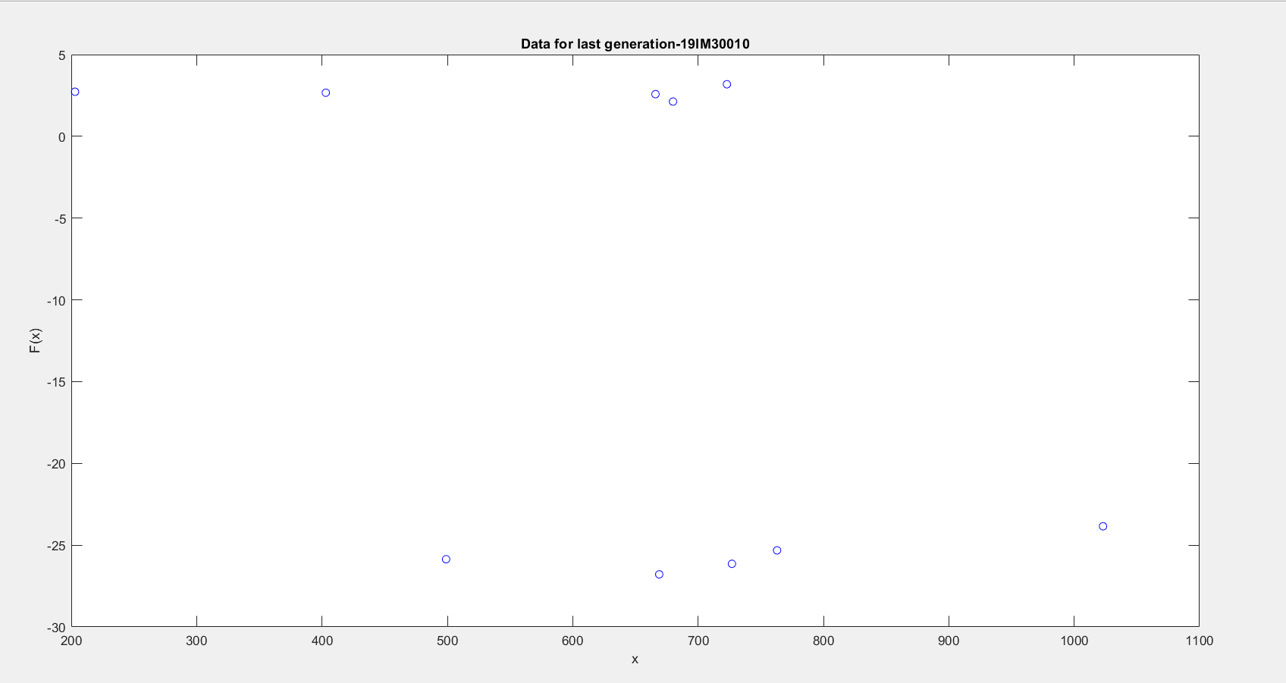
GA Code Results(fig-2)

Slide 6
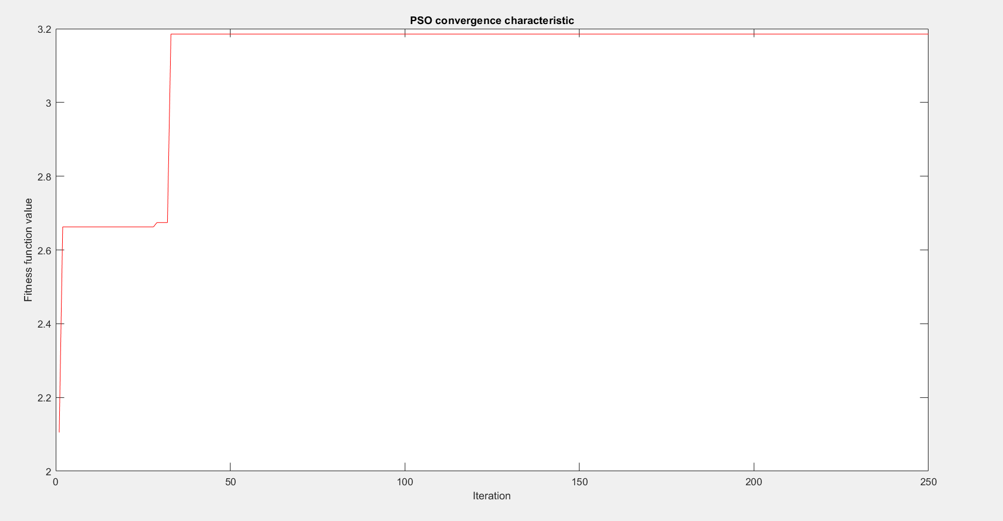
PSO Algorithm(fig-1)

Slide 7
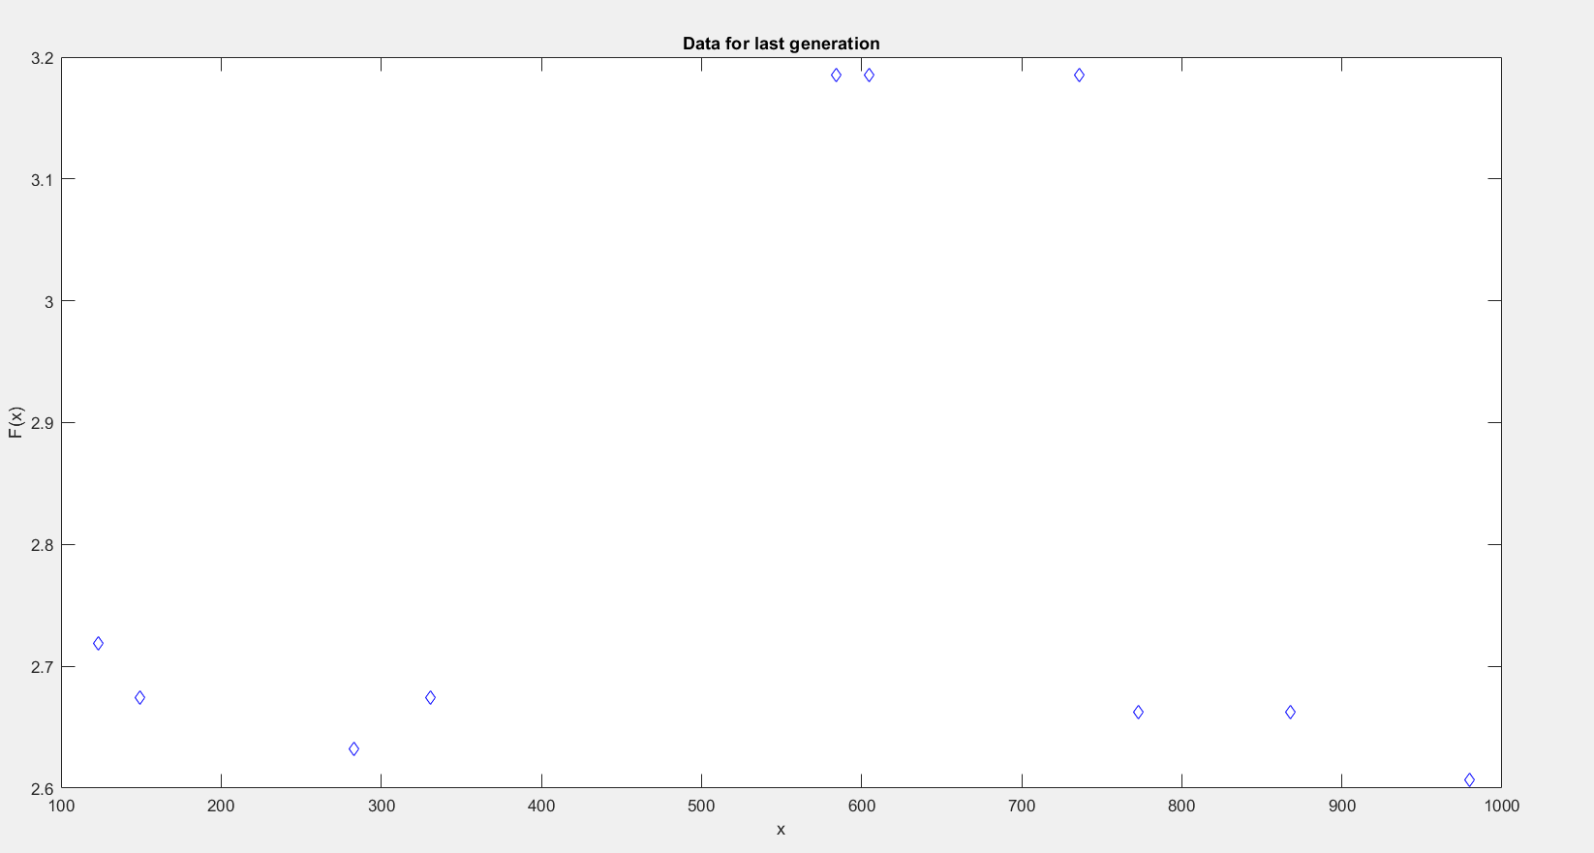
PSO Algorithm(Fig-2)

Slide 8
PSO Algorithm Summary
The function value is same as that of GA algorithm.
The total profit max value is 3.1854 also same as the GA algorithm.
But the PSO values have some decimal points but I rounded it to get the binary values.
Last generation Total profit Value
PSO Algorithm | 3.1854 | 2.6744 | 2.6068 | 3.1854 | 2.7192 | 2.6324 | 2.674 | 3.1854 | 2.6626 | 2.6626
GA Algorithm | 3.1854 | -25.978 | -25.916 | -25.364 | -25.743 | -27.127 | -26.57 | -24.622 | -26.635 | -26.652

Slide 9
Thank You

