Slide 1

IT258 SGP
STOCK PRICE PREDICTION USING MACHINE LEARNING
PROJECT REPORT
CONTRIBUTORS:
NAME | ID
VEDANT PATEL | 19IT113
KRUTARTH PUNJABI | 19IT122

Slide 2
ABSTRACT
Stock price forecasting is a popular and important topic in financial and academic studies. Stock Market is an untidy place for predicting since there are no significant rules to estimate or predict the price of share in the share market. Many methods like technical analysis, fundamental analysis, time series analysis and statistical analysis, etc. are all used to attempt to predict the price in the share market but none of these methods are proved as a consistently acceptable prediction tool. In this project we are using machine learning algorithms to predict stock market prices. With the help of historical data analysis. Although, stock market can never be predicted, due to its vague domain, this project aims at applying machine learning in forecasting the stock prices.

Slide 3
PROBLEM STATEMENT
Stock market is very vast and difficult to understand. It is considered too uncertain to be predictable due to huge fluctuation of the market. Stock market prediction task is interesting as well as divides researchers and academics into two groups, those who believe that we can devise mechanisms to predict the market and those who believe that the market is efficient and whenever new information comes up the market absorbs it by correcting itself, thus there is no space for prediction. Investing in a good stock but at a bad time can have disastrous result, while investing in a stock at the right time can bear profits

Slide 4
EXISTING SYSTEM
The existing system fails when there are rare outcomes or predictors, as the algorithm is based on bootstrap sampling. The previous results indicate that the stock price is unpredictable when the traditional classifier is used. The existence system reported highly predictive values, by selecting an appropriate time period for their experiment to obtain highly predictive scores. The existing system does not perform well when there is a change in the operating environment. It does not focus on external events in the environment, like news events or social media. It exploits only one data source, thus highly biased. The existing system needs some form of input interpretation, thus need of scaling

Slide 5
PROPOSED SYSTEM
In this proposed system, we focus on predicting the stock values using machine learning algorithms like Regression and LSTM models. Regression and LSTM models are engaged for this conjecture separately. Regression involves minimizing error and LSTM contributes to remembering the data and results for the long run. Finally, the graphs for the fluctuation of prices with the dates (in case of Regression based model) and between actual and predicted price (for the LSTM based model) are plotted.

Slide 6
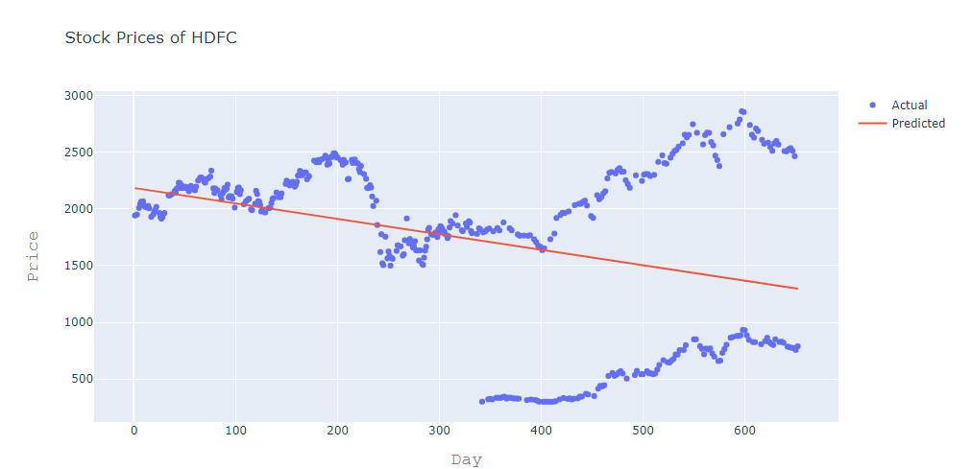
OUTPUTS-1

Slide 7
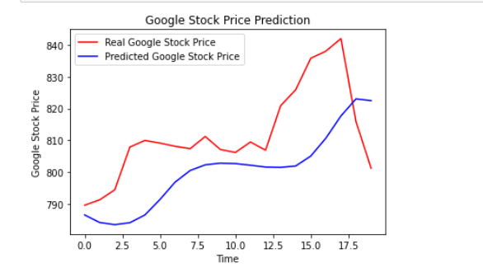
OUTPUT-2

Slide 8
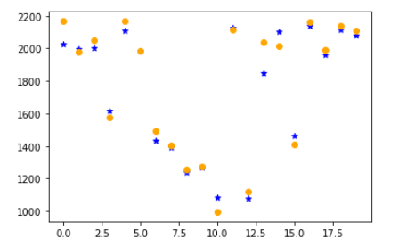
OUTPUT-3

Slide 9
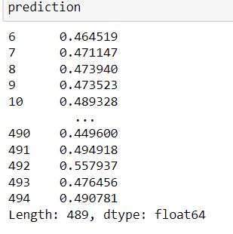
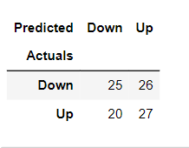
OUTPUT-4

Slide 10
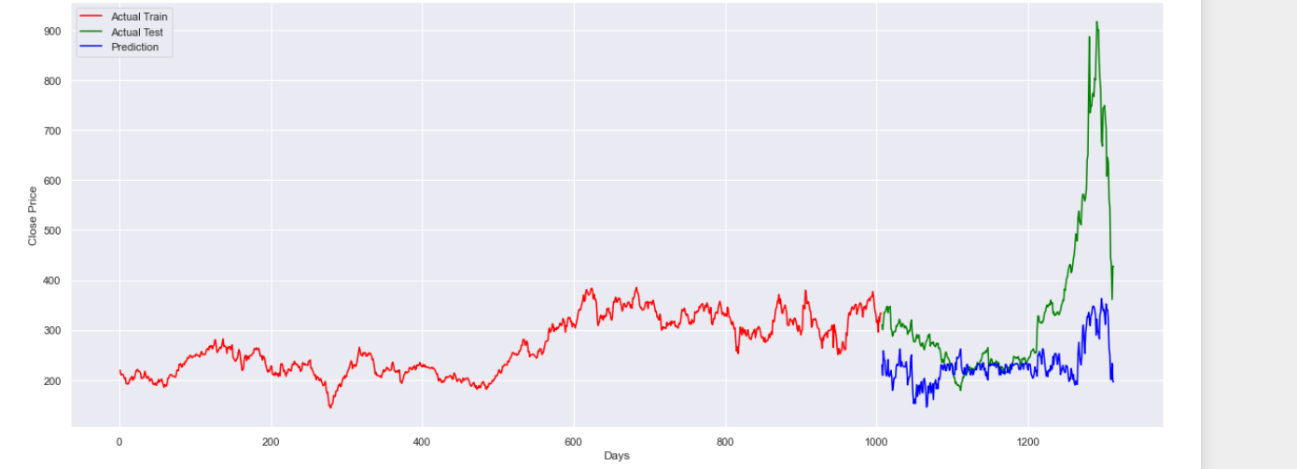
OUTPUT -5

