Slide 1
Sentiment based classification of the web texts
Klasifikacija spletnih besedil na osnovi izraženosti sentimenta
Novo mesto, 29th of September 2017 Adviser: Prof. Dr. Janez Povh
Jože Bučar Co-adviser: Asst. Prof. Dr. Martin Žnidaršič

Slide 2
[1] Outline
[1] Introduction & motivation
[2] Hypotheses
[3] Constructing annotated news corpora in Slovene
[4] Lexicon for sentiment analysis in Slovene
[5] Evaluation performance of sentiment based classification techniques
  [6] Estimating the proportion of positive, negative and neutral news in web media and evaluation
  [7] Monitoring the dynamics of sentiment
  [8] Scientific contributions
  [9] Conclusions & future work
/ 19

Slide 3
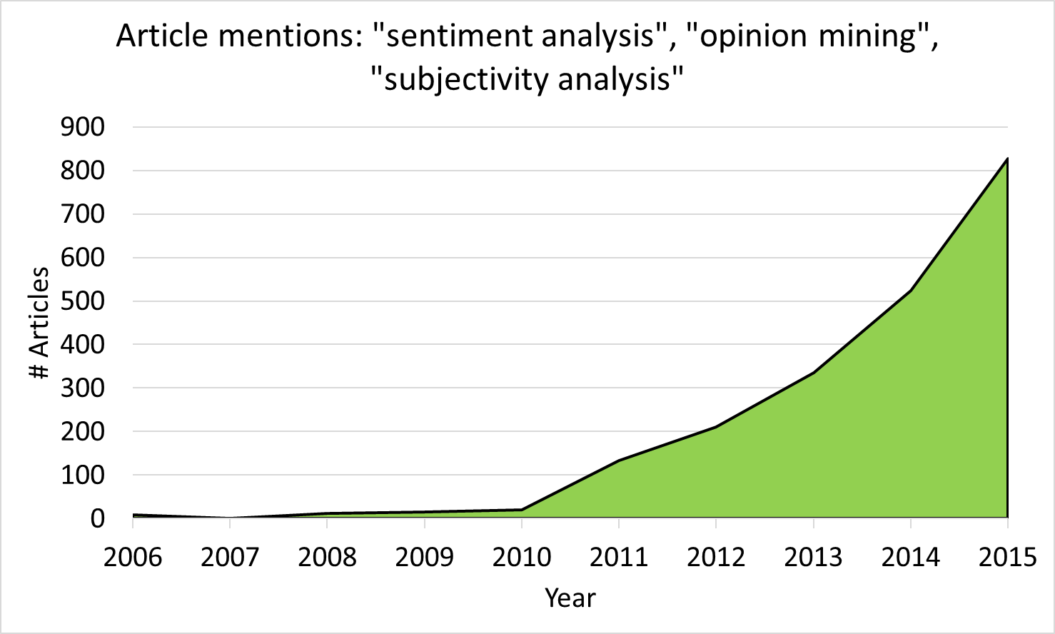
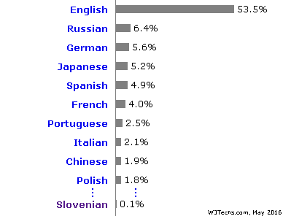
[1] Introduction & motivation
WWW:
– exponential growth of data and users
– main medium and an important source od data
– data repository (structure of data), computer processing
– big data, web crawlers, texts (blogs, soc. media) -> language scientists
– Web and content language
/ 70

Slide 4


[1] Introduction & motivation
Basic concepts
– textual information (facts vs. opinions)
– corpus
– text mining, sentiment analysis, sentiment classification
Motivation
– marketing, public relations, data mining (political analysis, analysing consumer habits, behaviour, trends, competitors, and market buzz);
– carrying out quality control to prevent negative viral effects;
– estimating and evaluating responses to company-related events and incidents in multiple languages;
– collecting and extracting user opinions of products and services;
– studies, contribution to better computer understanding of Slovene.
/ 19

Slide 5
[2] Hypotheses
H1: Appropriate selection of supervised machine-learning classifier and pre-processing settings can improve the classification performance.
H2: Granulation of a document to smaller segments, such as sentences, can improve the classification performance.
H3: The developed sentiment analysis tools, resources and methodology are applicable in real-life applications.
H4: In the retrieved news with political, business, economic and financial content from five Slovenian web media, the proportion of negative news is greater than the proportion of positive news for all web media.
/ 19

Slide 6

[3] Constructing annotated news corpora in Slovene
Web resources:
– Slovenian news texts with political, business, economic and finance content published between 1 September 2007 and 31 January 2016 retrieved from the digital archive of five web media (criteria)
Retrieved:
– 256,567 documents (Finance – 132,986, Dnevnik – 52,417, Žurnal24 – 47,735, Rtvslo – 13,420 and 24ur – 10,009);
– Web-crawlers: Automatization of procedures; fast, effective and comprehensive data retrieval (R programming language), HTML code retriever.
/ 19

Slide 7
[3] Constructing annotated news corpora in Slovene
Manual annotation process (1 year):
  6 annotators (10,427 documents) :
  „Please specify the sentiment from the perspective of an average Slovenian web user. How did you feel after reading the news?“
  Five-level Likert scale: 1 – very negative, 2 – negative, 3 – neutral, 4 – positive, and 5 – very positive;
  Levels of granulation: document, paragraph, and sentence-level;
  Sentiment allocation
    NEGATIVE (if average of scores ≤ 2.4)
    NEUTRAL (if average of scores is between 2.4 and 3.6)
    POSITIVE (average of annotated scores ≥ 3.6)
agreement between annotators, generation of an annotated corpora in Slovenian language for sentiment analysis (corpora statistics).
/ 19

Slide 8
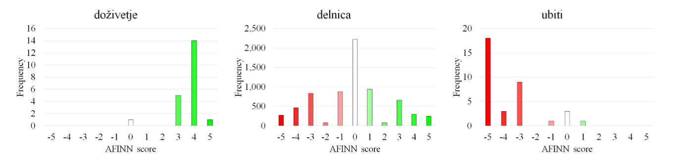
[4] Lexicon for sentiment analysis in Slovene
Basis:
  lemmatized version of the Manually sentiment annotated Slovenian (sentence-based) news corpus;
  List of Slovenian words – 354,205 different headwords from the Slovenian words data base; Fran Ramovš Institute of Slovenian Language ZRC SAZU)
AFINN model – allocation of AFINN score (from -5 to 5); 25,254 words with AFINN score (7,976 – positive, 7,898 – negative)
/ 69

Slide 9
[5] Evaluation performance of sentiment based classification techniques
Two-class and three-class document-level sentiment classification;
Software and hardware: Weka 3.6.11 (64-bit); 12 x (Intel® Core™ i7, 2.20GHz, 4 cores, 8GB RAM); running tests on HPC „Rudolf“ (700 cores, 4TB DDR3 RAM, 100 TB HDD, Faculty of Information Studies, Novo mesto)
9 Classifiers: KNN - k-Nearest Neighbour, NBM - Multinomial Naïve Bayes, SVM-polynomial - Support Vector Machines using Sequential Minimal Optimization with polynomial kernel, SVM-linear - Support Vector Machines with linear kerel, Random Forest, C4.5 - C4.5 algorithm, DT - Decision Table, SLR - Simple Logistic Regression, VP - Voted Perceptron (Neural Networks);
Validation technique: 10-fold CV (using the standard text mining pre-processing options (TF-IDF, to lower-case transformation, stopwords removal, unigrams+bigrams+trigrams; 30,000 features – „bag of words“) -> T-paired tests, Wilcoxon signed-ranks tests.
/ 19

Slide 10

[5] Evaluation performance of sentiment based classification techniques
2 classifiers (NBM, SVM); 80 pre-processing options (TF or TF-IDF, to lowercase, stopwords, Ngrams, lemmatization); validation technique: 5x 10-fold CV; balanced data set
Best performance (two-class Document-level): Best performance (three -class Document-level):
F1-score (and Accuracy) ± std. dev.: F1-score (and Accuracy) ± std. dev.:
Doc-level based on the average scores of documents
  NBM: 93.12%±1.65% (92.89%±1.65%) - NBM: 72.77%±3.44% (73.09%±2.28%)
  SVM: 92.48%±1.69% (92.55%±1.64%) - SVM: 67.71%±3.18% (67.94%±2.57%)
Doc-level based on the average scores of sentences
  NBM: 97.85%±0.97% (97.83%±0.98%) - NBM: 77.76%±3.13% (79.85%±1.93%)
  SVM: 96.28%±1.34% (96.27%±1.34%) - SVM: 74.61%±3.16% (76.20%±2.29%)
H1: Appropriate selection of supervised machine-learning classifier and pre-processing settings can improve the classification performance.
H2: Granulation of a document to smaller segments, such as sentences, can improve the classification performance.
/ 19

Slide 11
[6] Estimating the proportion of positive, negative and neutral news in web media and evaluation
Using the NBM and settings (TF-IDF, transforming upper-case letters to lower-case, with removal of stopwords, using complex combination of unigrams and bigrams, without lemmatization), F-measure : 77.76%±3.13% (Accuracy: 79.85%±1.93%).
Estimated proportion of negative, neutral and positive sentiment in news articles with political, business, economic and finance content published between 1 September 2007 and 31 January 2016 in five web media (n = 256,567; Finance – 132,986, Dnevnik – 52,417, Žurnal24 – 47,735, Rtvslo – 13,420 and 24ur – 10,009).
H4: In the retrieved news with political, business, economic and financial content from five Slovenian web media, the proportion of negative news is greater than the proportion of positive news for all web media. (except Finance)
 | 24UR | DNEVNIK | FINANCE | RTVSLO | ŽURNAL24
negative [%] | 42 | 33 | 20 | 37 | 34
neutral [%] | 38 | 47 | 43 | 49 | 51
positive [%] | 20 | 20 | 37 | 14 | 15
/ 19

Slide 12
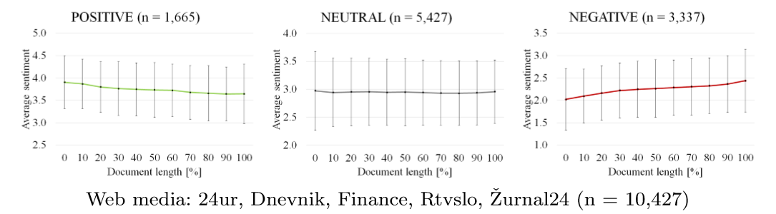
[7] Monitoring the dynamics of sentiment
within documents (documents annotated as positive, negative and neutral)
/ 19

Slide 13
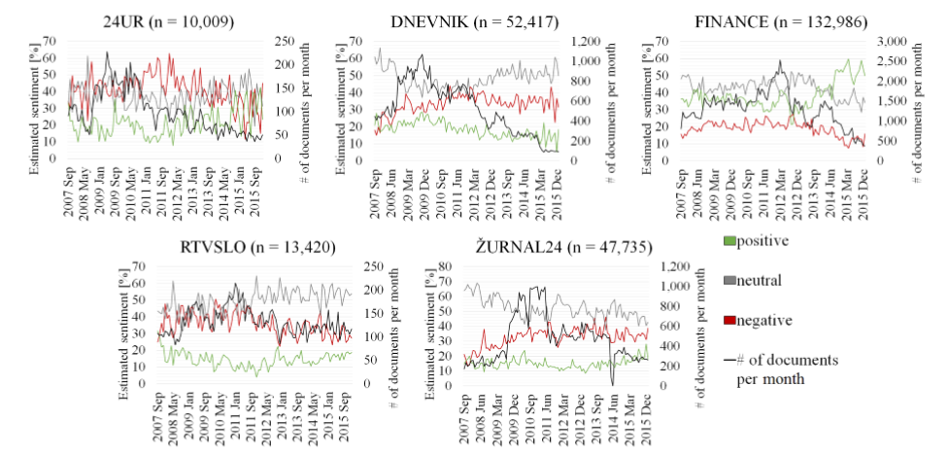
[7] Monitoring the dynamics of sentiment
over the time (web media)
/ 19

Slide 14
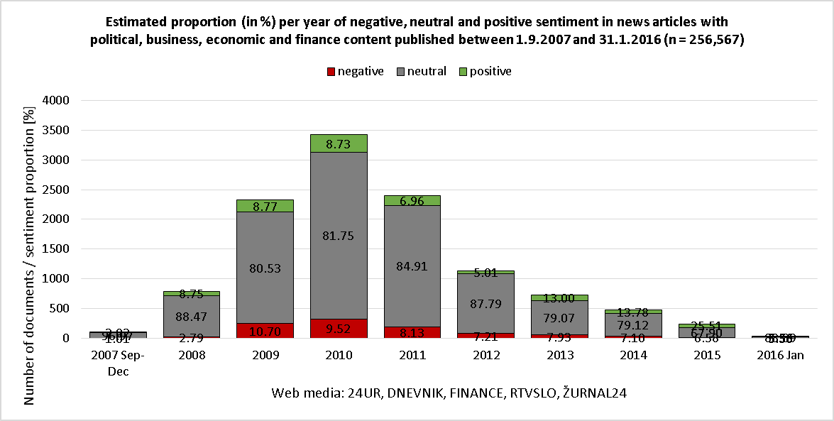
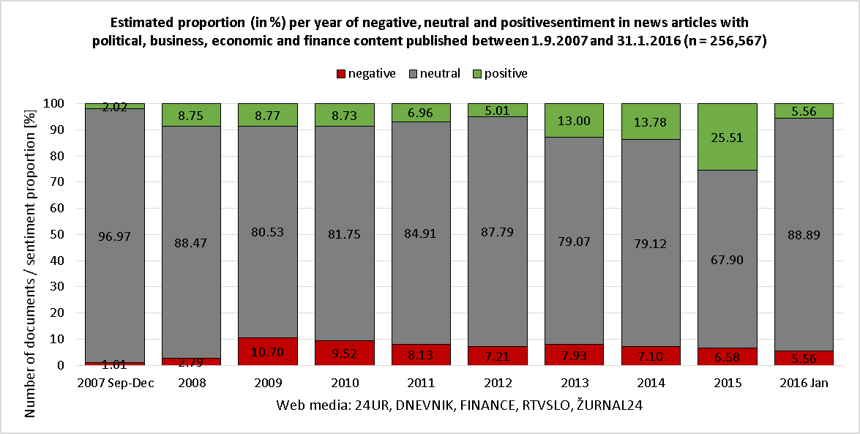
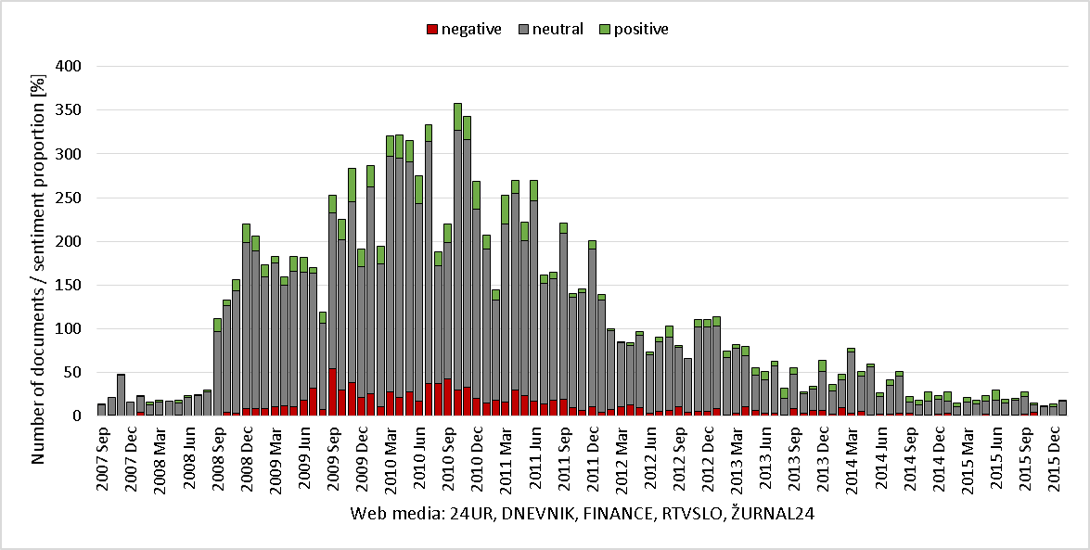
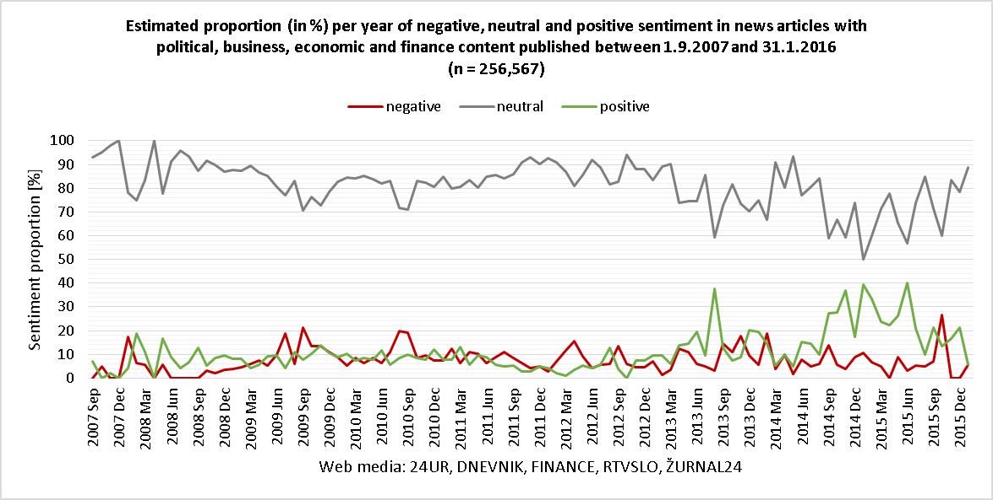
[7] Monitoring the dynamics of sentiment
within keywords (Borut Pahor – President of Slovenia [Dec 2012 – present])
/ 69

Slide 15
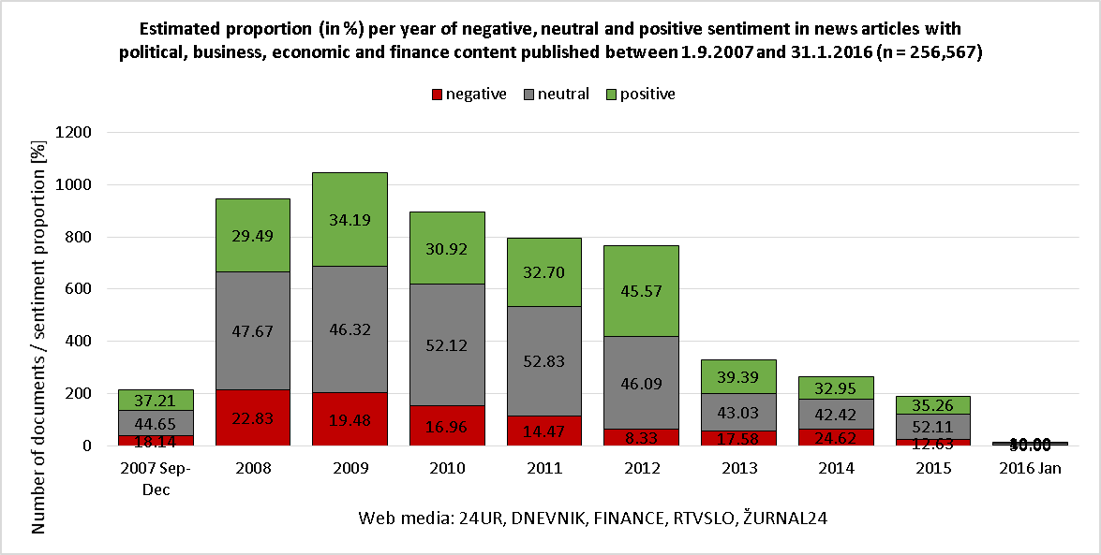
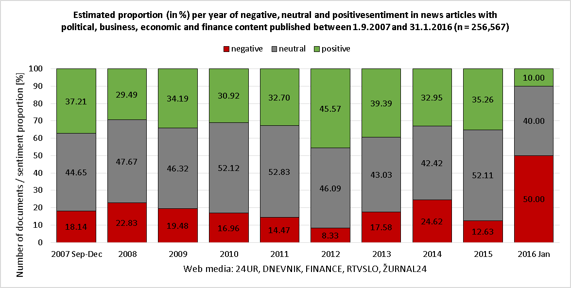
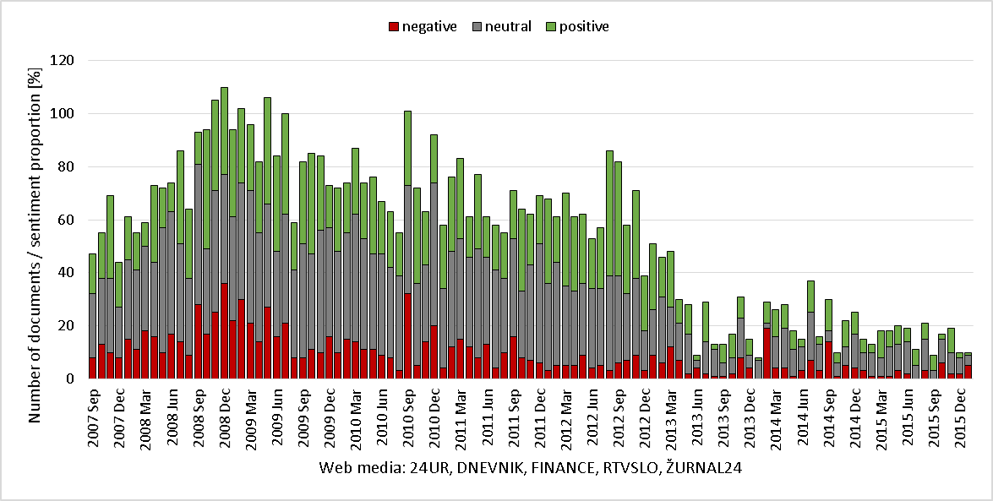
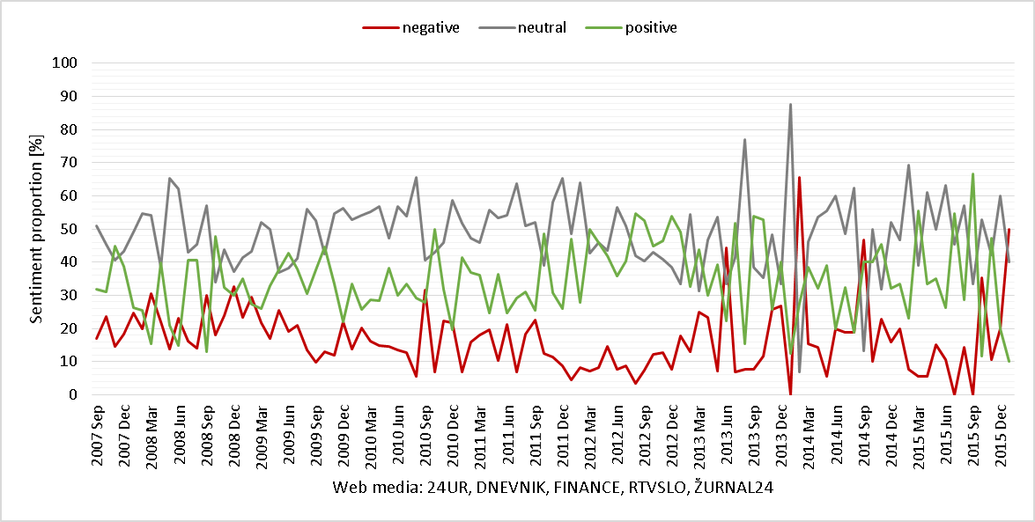
[7] Monitoring the dynamics of sentiment
within keywords (Krka – Pharmaceutical company)
/ 69

Slide 16
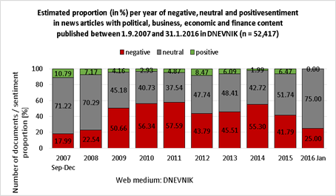
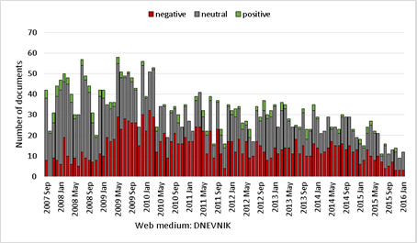
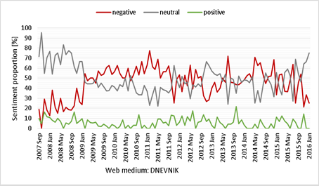
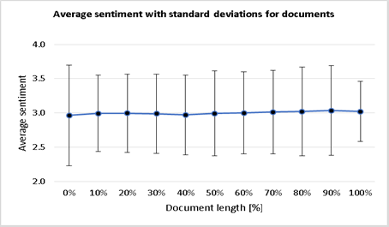
[7] Monitoring the dynamics of sentiment
within authors: DNEVNIK journalist
/ 69

Slide 17
[8] Scientific contributions
(Manually and automatically) annotated news corpora in Slovene (three levels, availability: CLARIN.si, GitGub).
Assessment of 9 machine-learning approaches to sentiment classification of Slovene texts into two and three classes and their performance (NBM sentiment classification, F1-score for two-class above 97%, for three-class above 77%; balanced training datasets and document sentiment scores based on sentence granularity).
Analysis of the within-the-document sentiment dynamics of manually annotated documents and indication that the sentiment is on average sharper at the beginning of documents and leans to neutrality towards the end of documents.
Applications of the developed tools and resources, useful in real-life applications.
H3: The developed sentiment analysis tools, resources and methodology are
applicable in real-life applications.
Analysis of sentiment expressed in Slovenian web media. Approximately half of the obtained news texts is neutral with negative news texts twice as much as positive.
/ 19

Slide 18
[9] Conclusions & future work
Rapid growth of web available information (customer feedback, competitor information, client emails, tweets, press releases, legal filings, product & engineering documents, etc.);
Growing interest in the analysis of informal, subjective, opinionated web content;
Language resources, encourage other researchers;
Further research: improve performance, topic detection, market-oriented projects;
Challenges: huge potential.
/ 19

Slide 19


Thank you
Questions?
/ 19

