Slide 1
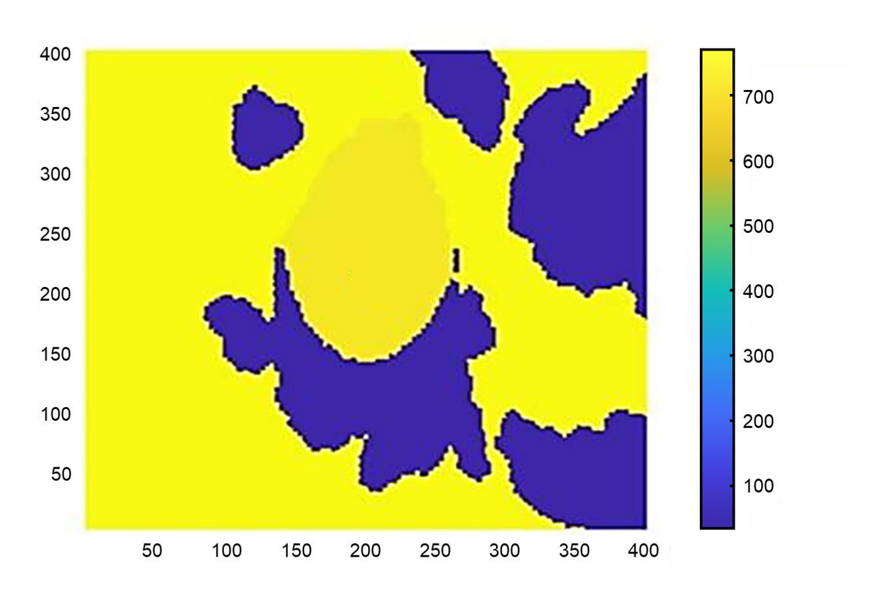
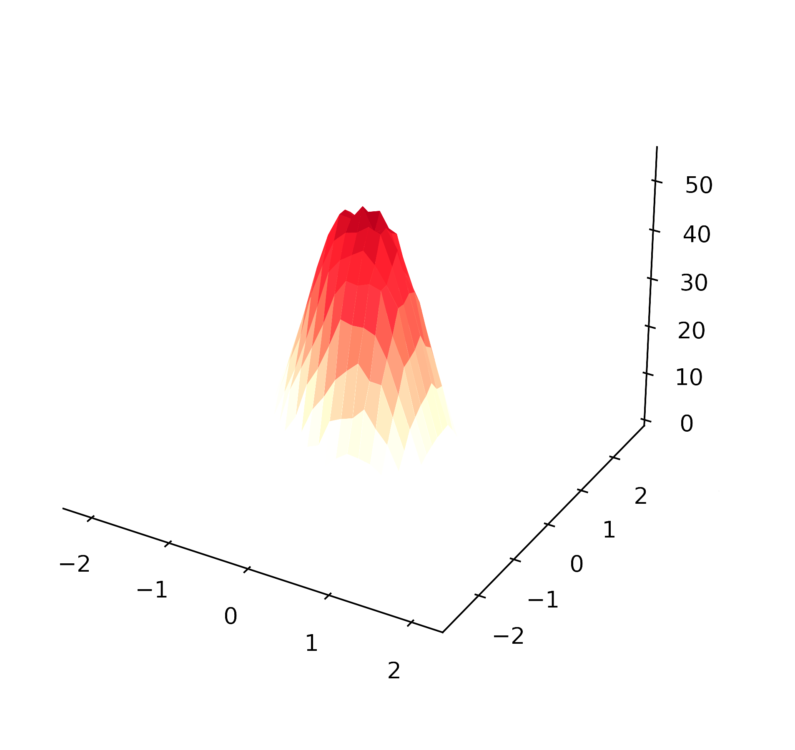
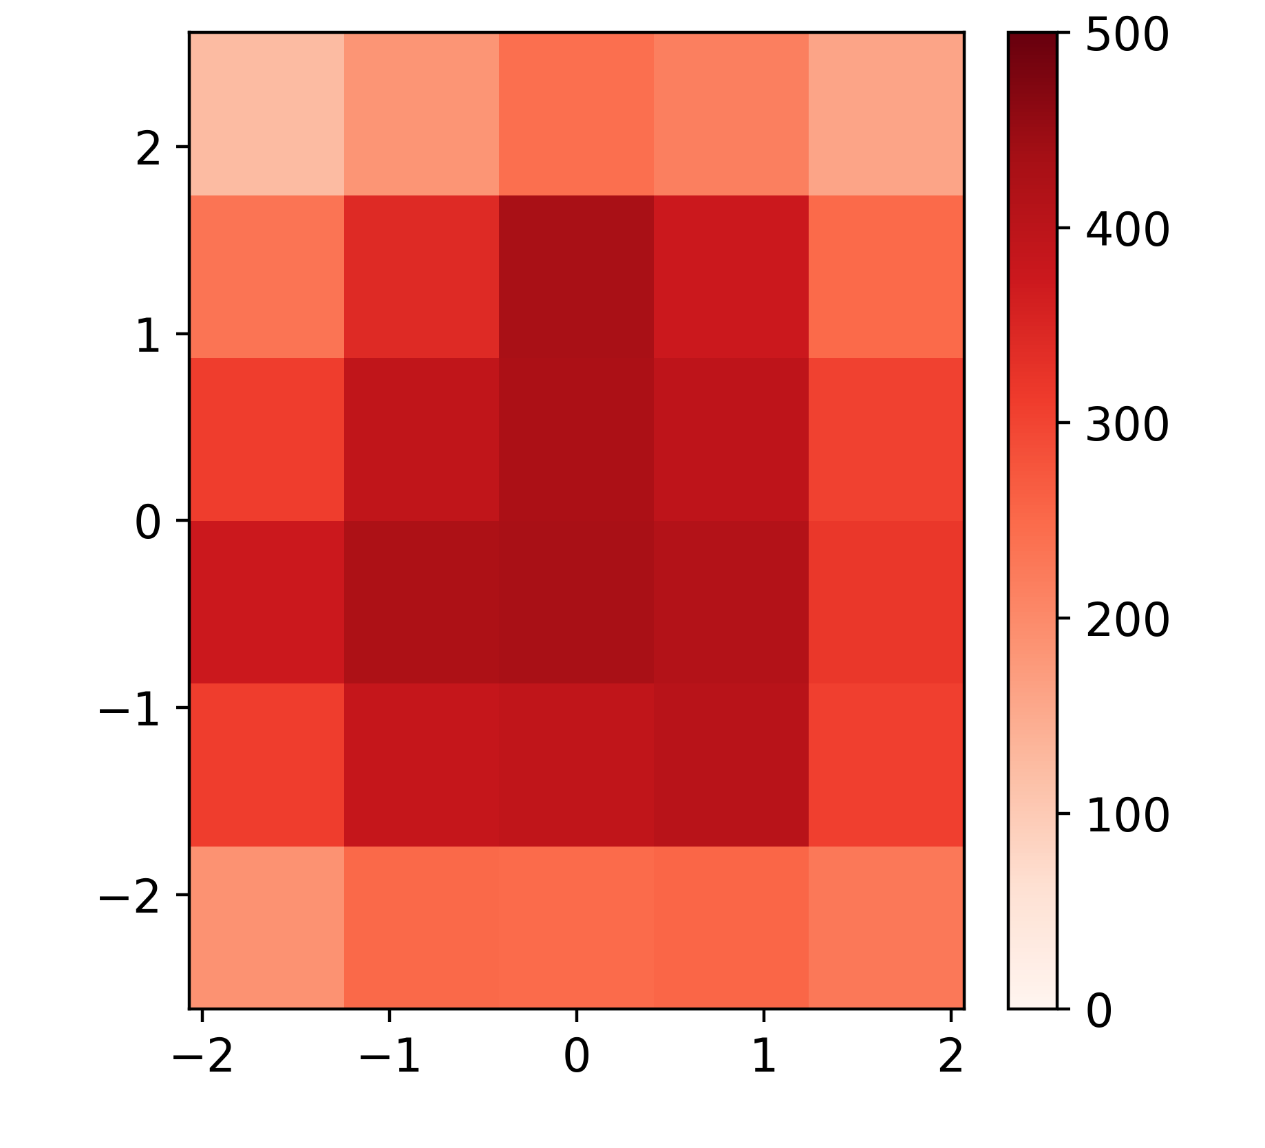
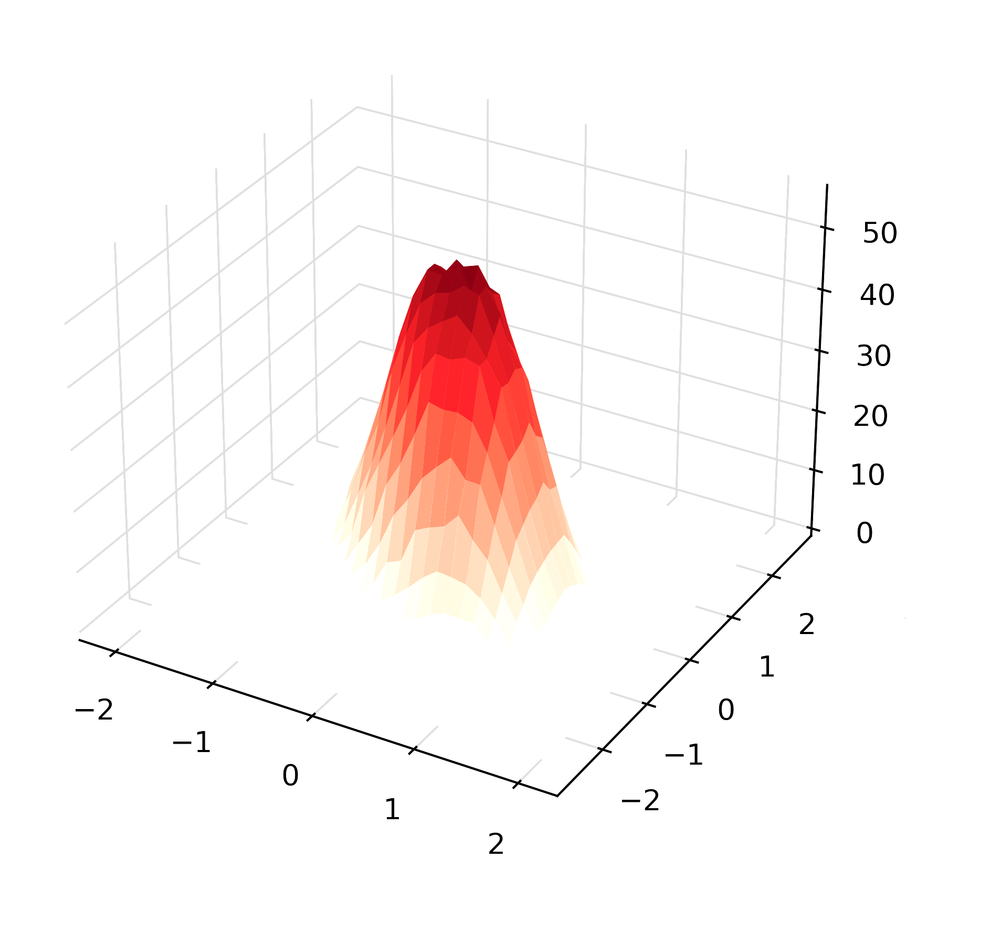
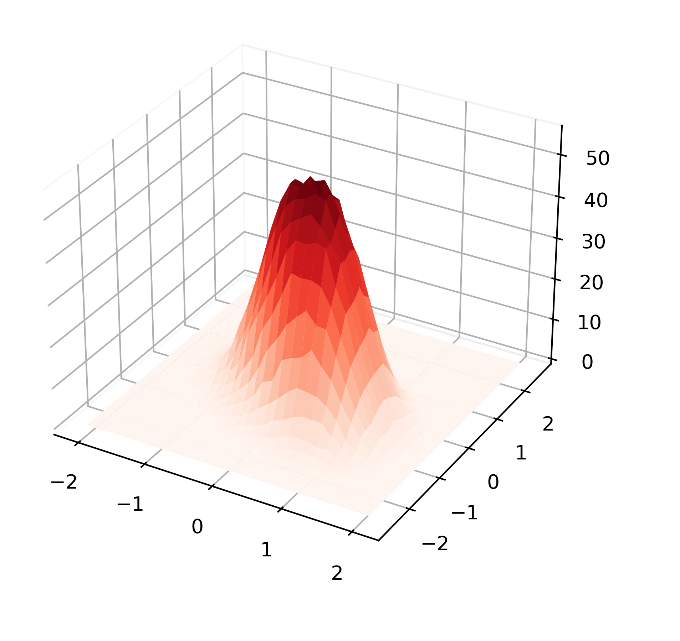
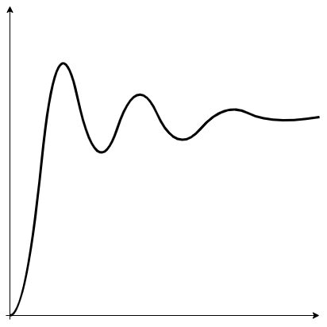
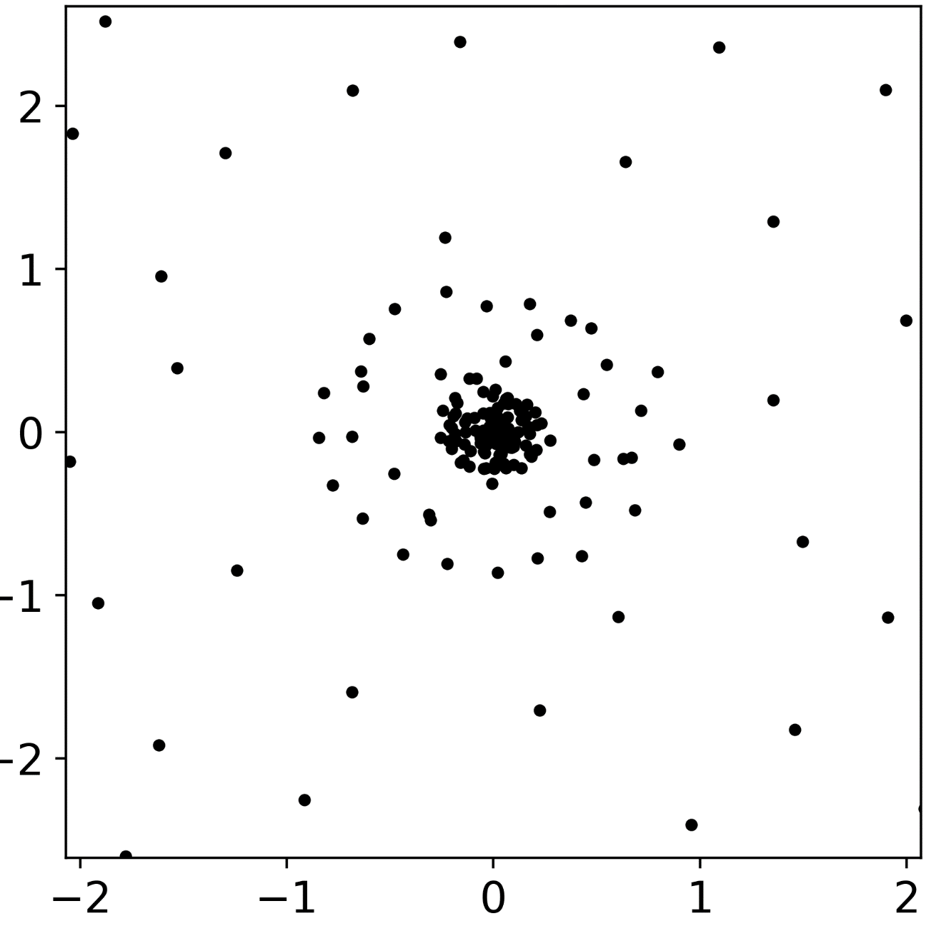
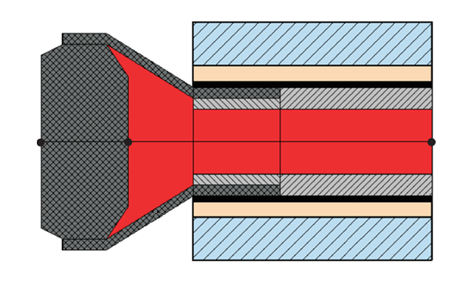
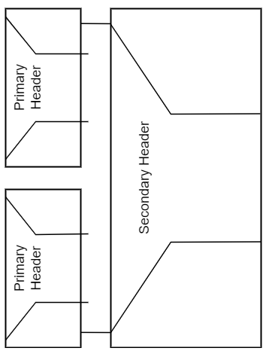
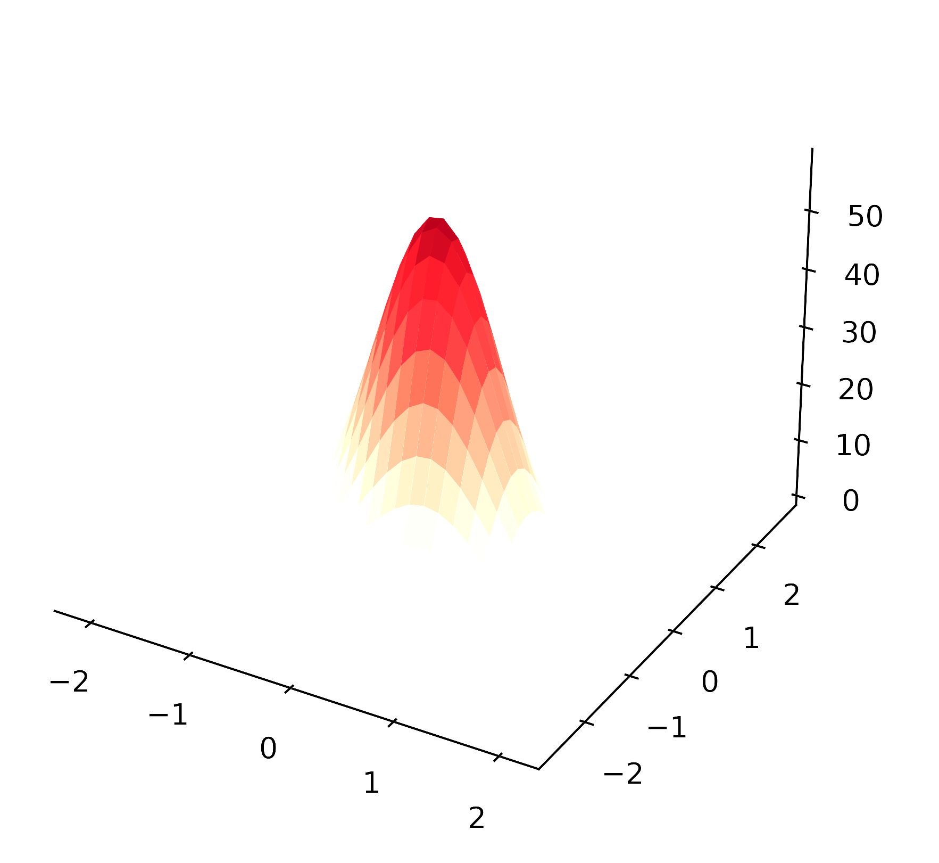
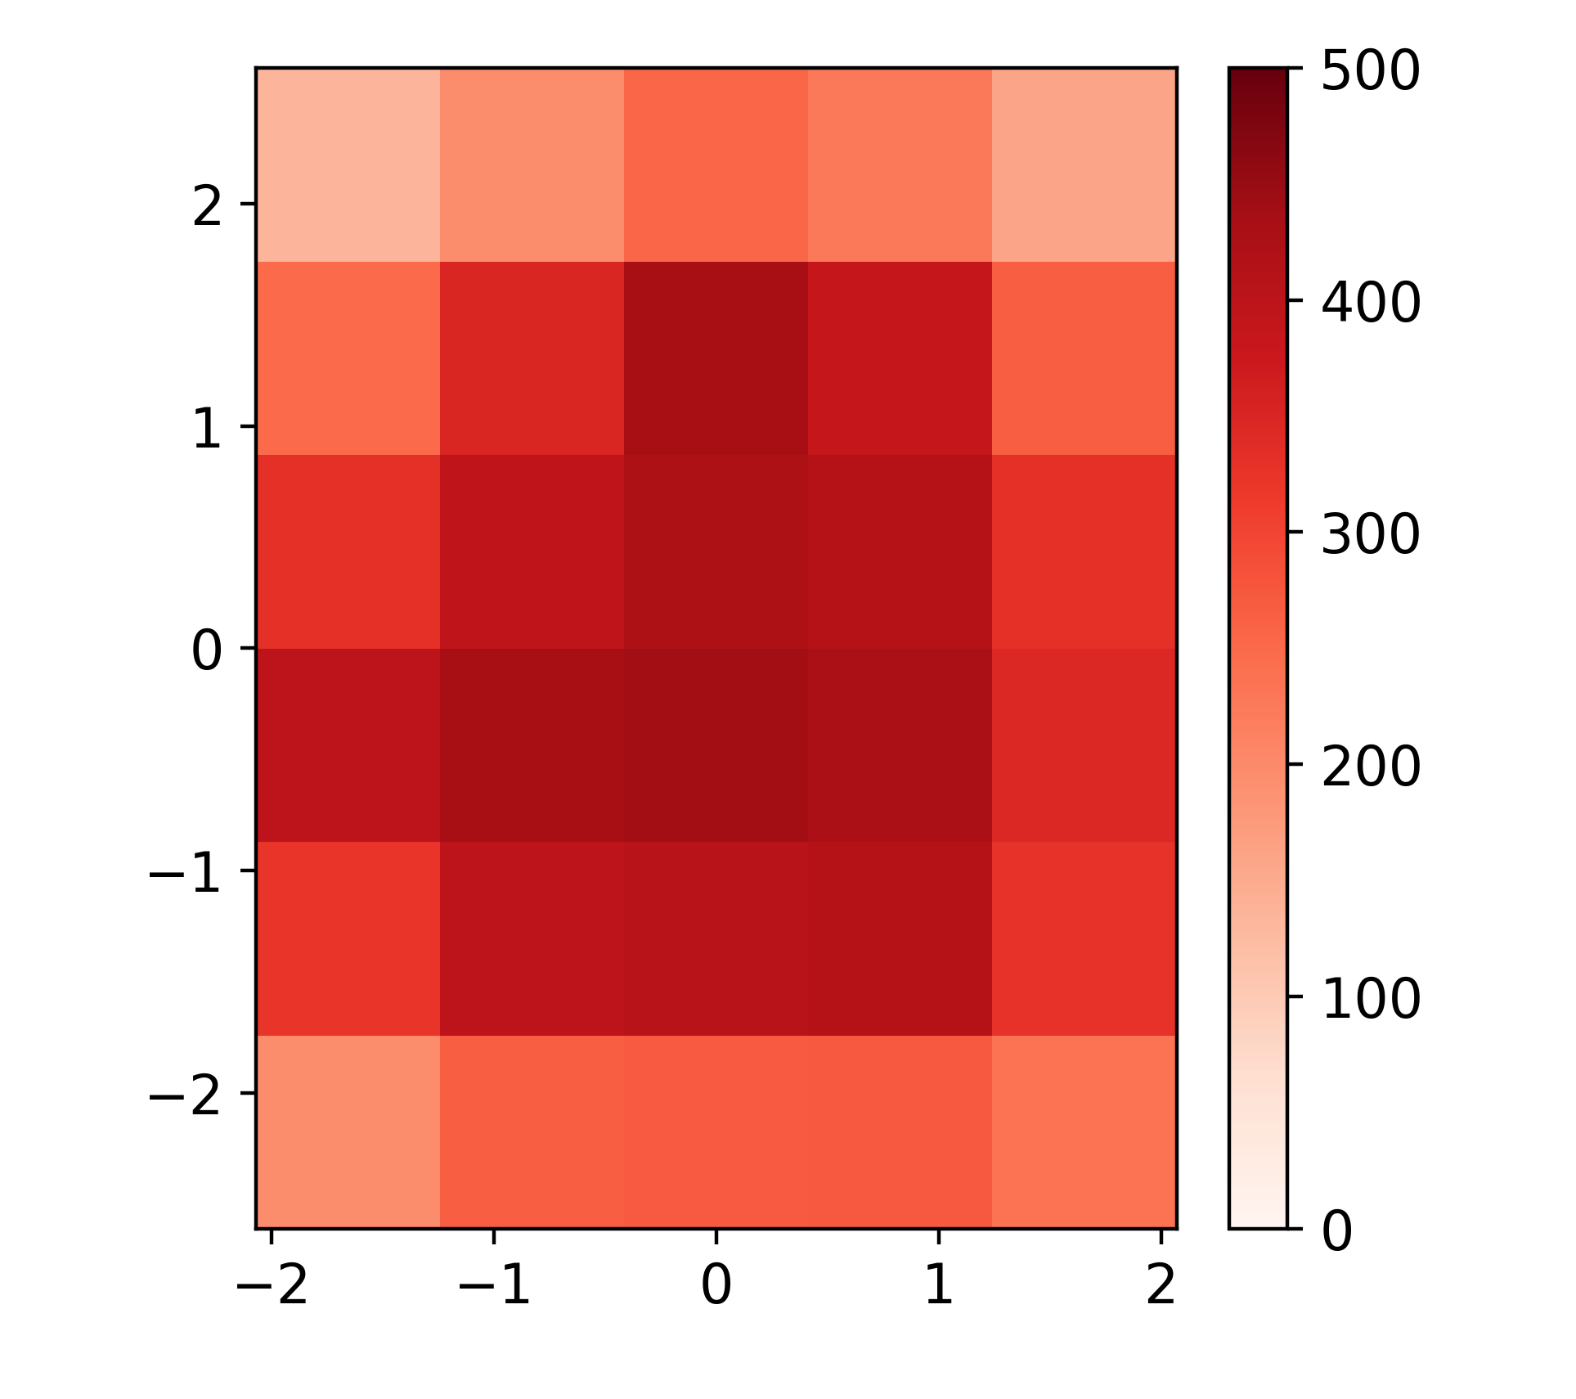
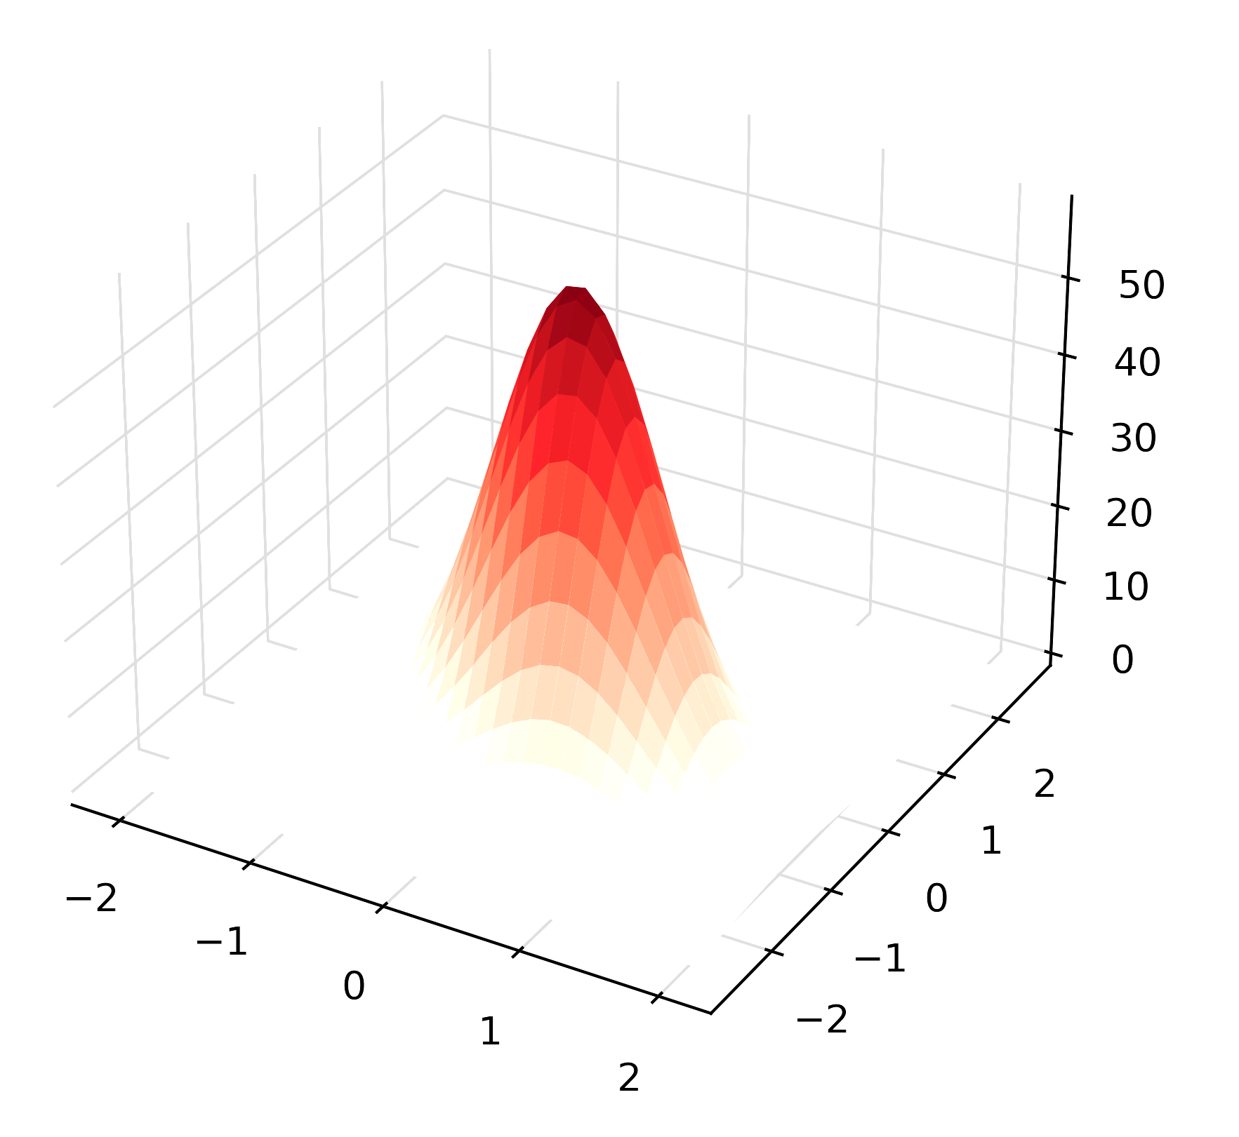
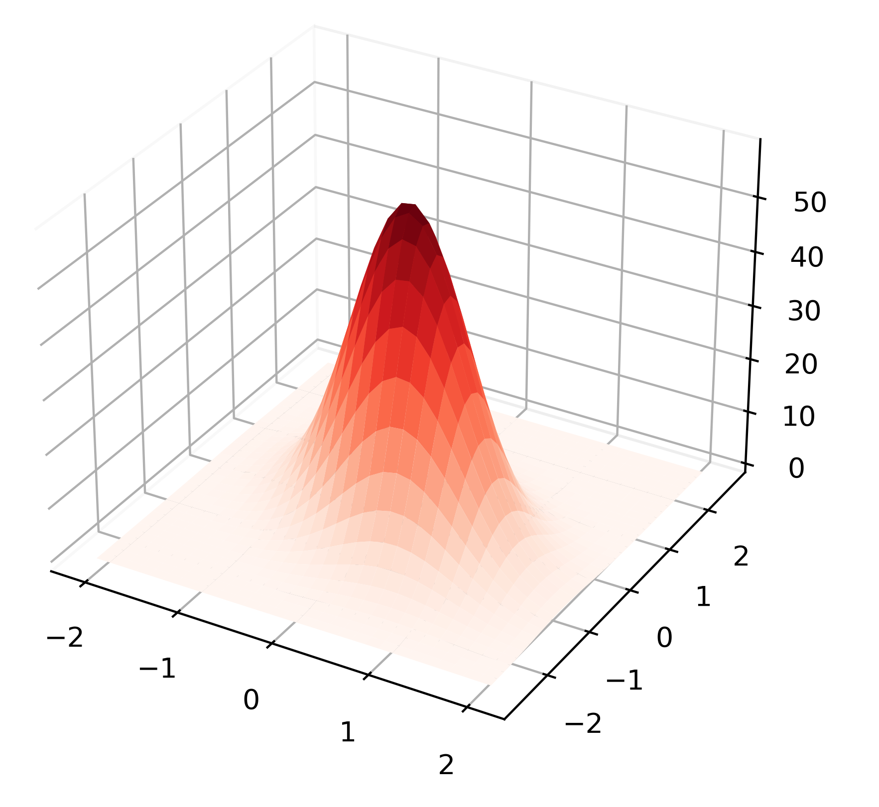



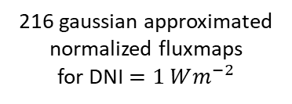









DNI nowcasting
resolution $20m×20m$
Setpoint$u_{setpoint}$
optical models
thermal model
216 normalized fluxmaps from STRAL data for DNI $=1 Wm^{−2}$
$6×5$ fluxmap on receiver
Model for simulation
fan dynamics
216 representative aimpoints
4 primary and 1 secondary header
30 absorber cups
Flux $F$ for each cup
Receiver massflow $${\dot{m}}_{rec}$$
3 dispersion factors $κ_{1}, κ_{2}, κ_{3}$
$${\dot{H}}_{inlet,3}$$
$${\dot{H}}_{out}$$
216 gaussian approximated
normalized fluxmaps
for DNI $=1 Wm^{−2}$
$6×5$ fluxmap on receiver
Model for optimization
state measurements
$$T_{abs,front}$$
$$T_{abs,back}$$
$${\dot{m}}_{rec}$$
$${\ddot{m}}_{rec}$$

Slide 2
