Slide 1
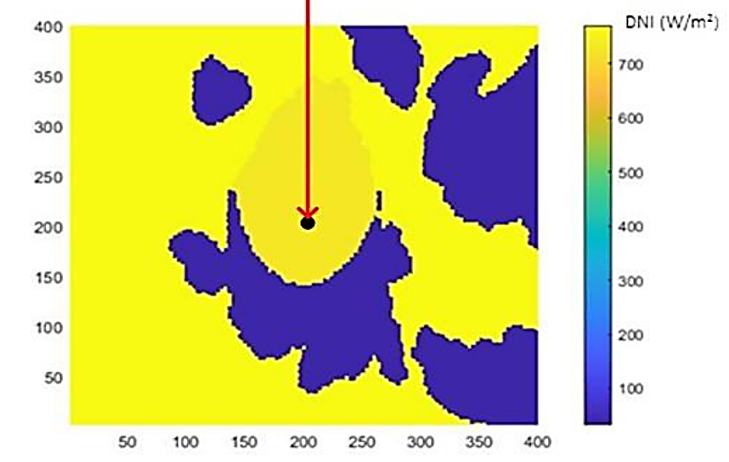
400
DNI (W/m²)
700
350
300
600
distance [px, 1px = 20m]
250
500
200
400
150
300
100
200
50
100
50
100
150
200
250
300
350
400
distance [px, 1px = 20m]

Slide 2
