Slide 1
CRIME SCENE
-DEATH OF LILY

Slide 2
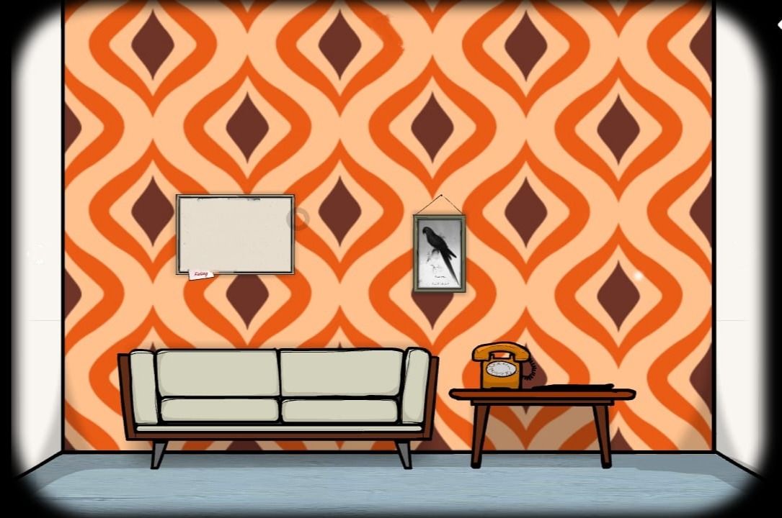

Find the Sum of Encrypted Integers - LeetCode
Notes:
HI MITHUN

Slide 3
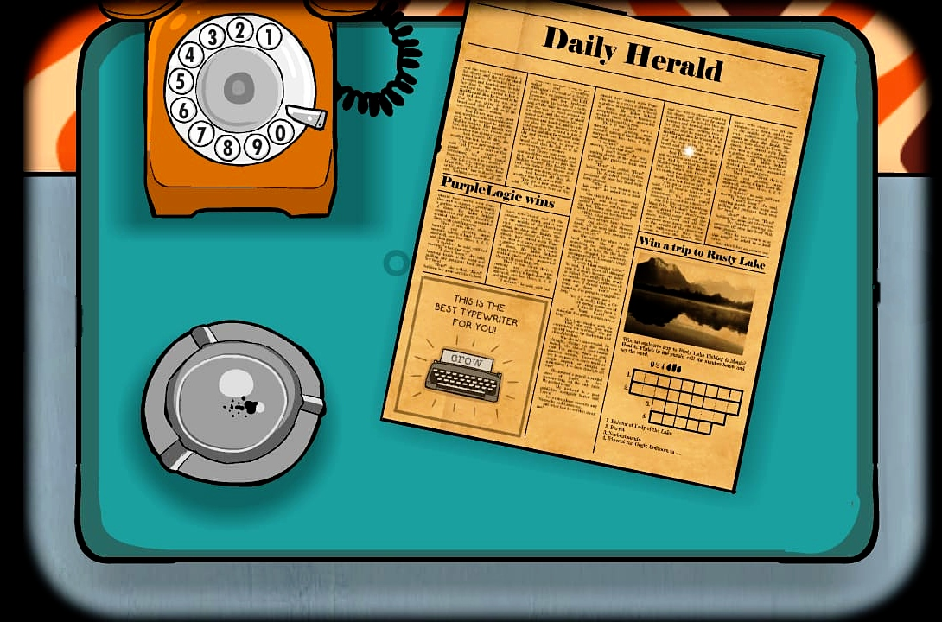

1

Slide 4
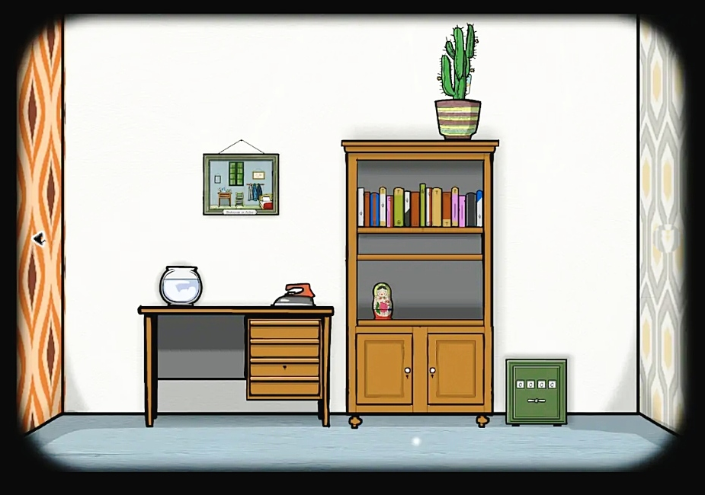


Slide 5
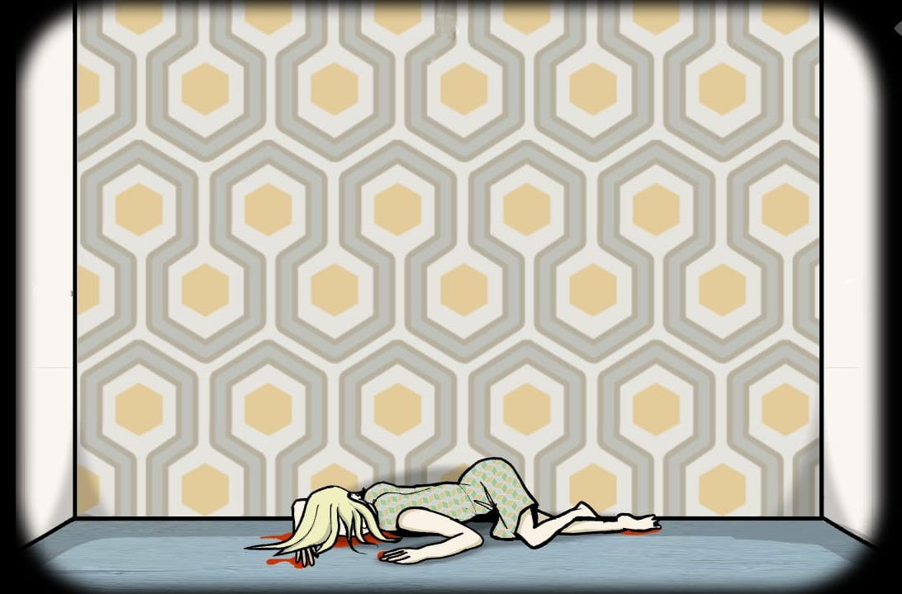

Slide 6
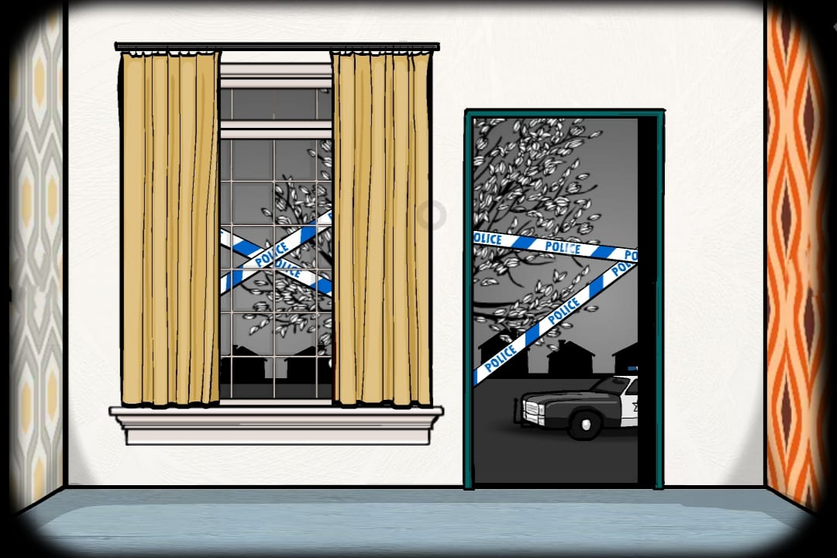


Slide 7
