Slide 1


Savoury Pancake Mixes

Slide 2

Why??
For too long, India and the world have accepted convenient breakfasts as nothing more than sugary cereals or the same old boring eggs. But what if savory pancakes could change how the world eats?
Slurrp Farm believes in a better-for-you, quick-fix format with the goodness of millets—available in flavors that actually excite children and encourage them to start their day without a glucose spike. With more and more experts speaking about how children shouldn't consume sugar at all, eliminating it from the first meal of the day gives parents more leeway to create better, balanced meals for the rest of the day.
Modern Indian parents simply don't have the time to prepare traditional, labor-intensive breakfasts like parathas or idlis. That's where these easy mix-and-dump breakfasts come in—no soaking grains the night before, no elaborate prep. Just wholesome nutrition that keeps kids full for longer thanks to the power of millets, while reshaping their expectations away from sugar-laden mornings.
The statistics speak for themselves: about 1 in 4 people skip breakfast in major metropolitan cities, and many school children go without a balanced morning meal. It's time to change that—one savory pancake at a time.

Slide 3
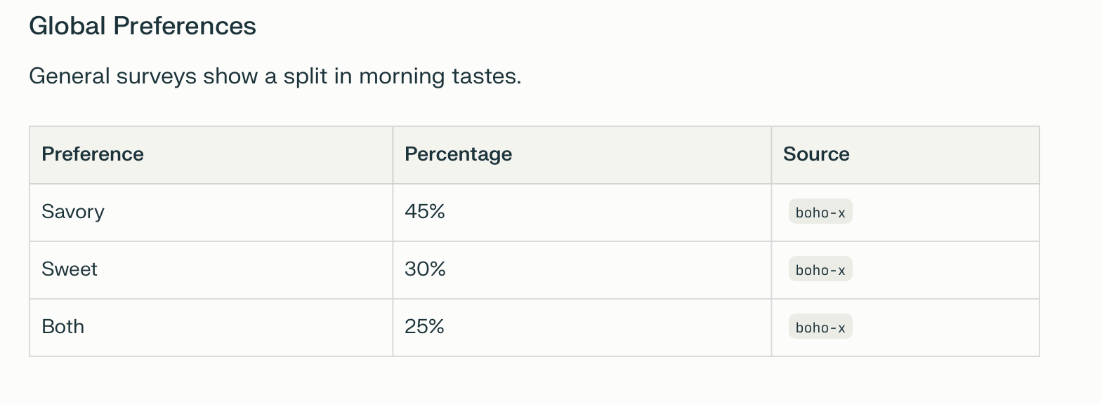
Why?

Slide 4
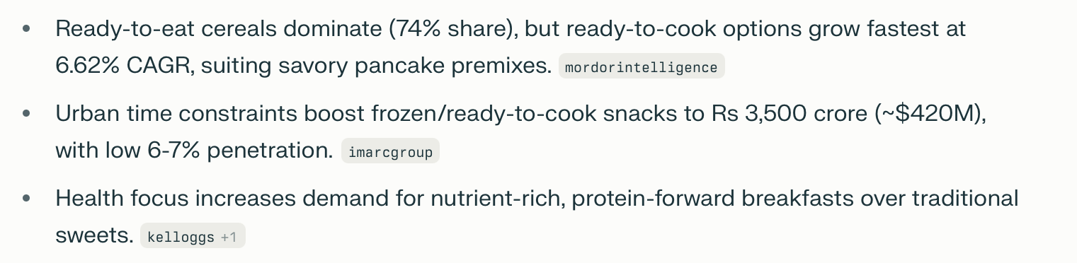
Why?

Slide 5
Why?

Slide 6
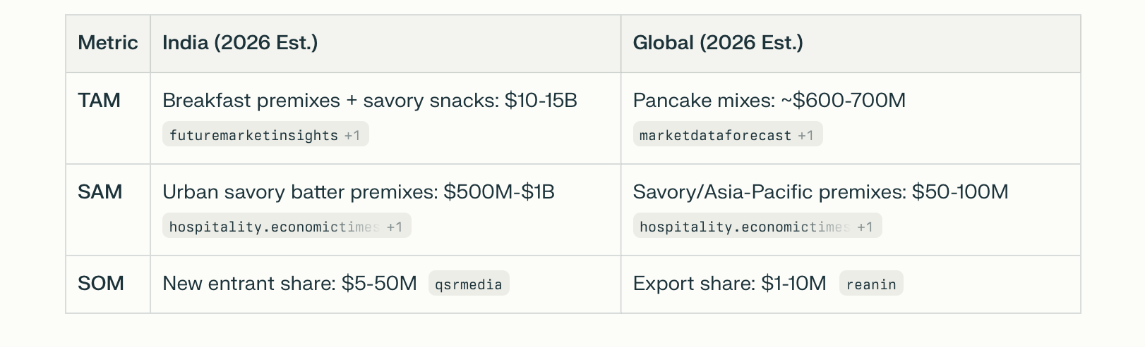
Why?

Slide 7
How does it add to the SF portfolio?
First-mover in savory millet pancakes differentiates from QSR (Uncle Peter's) and rivals, aligning with "zero junk" ethos amid millet promotion (Budget 2026 boosts).
Increases repeat buys (family packs for breakfast/snacks), lifts AOV 15-25% through bundles, and fuels influencer virality
(2,500+ partners).
TAP INTO THE LUNCHBOX SPACE WITH PANCAKES
These pancakes cook in 5-10 minutes using Slurrp's millet premix base (just add water/egg, fold in onions, spinach, or masala), yielding soft, stackable portions that stay moist without refrigeration. Parents slice them into fingers or rolls, pairing with ketchup or chutney for 2-3 hour portability—far better than soggy parathas.
Packed with ragi/jowar protein (10-12g per serving), hidden veggies curb picky eating while mimicking dosa/upma tastes 90% of Indian kids prefer over sweet pancakes.
Addresses lunch box monotony (common in urban India, where 70% parents seek variety), boosting consumption amid breakfast skipping trends.
Slurrp's "zero junk" branding reassures allergen-conscious moms, with examples like potato-spinach variants already tiffin-tested.​
This extends savory pancakes beyond breakfast, turning Slurrp packs into daily essentials for working parents

Slide 8
How does it add to the SF portfolio?
Kid-Parent Appeal Synergy
These flavors mimic popular snacks (pizza bites, nachos, corn cheese toast) that 80% of urban Indian kids aged 5-12 request, while Slurrp's millet base delivers 10-15g protein, hidden veggies, and zero maida per serving—addressing parents' top concerns like nutrition gaps and obesity (affecting 20% school kids). Parents get guilt-free convenience (prep under 10 mins), kids get familiar tastes without the "healthy" label turning them off.
Muffin Conversion Benefits
Appeal Expansion: Kids see them as "pizza bites" or "cheese pops," driving repeat buys; stack for lunch boxes or freeze for weekly batches.

Slide 9
A child says, “Momm, I want pizza for breakfast.” The instinctive response — “Who eats pizza in the morning?” And then someone barges in saying … why not?
Introducing Slurrp Farm Veggie Pizza Savory Pancakes — making kids’ favourite food the first thing they eat in the morning, without compromise. Same excitement. Better ingredients. A breakfast that feels like fun, not food rules.

