Slide 1


BVRIT HYDERABAD College of Engineering for Women Department of Computer Science & Engineering
Review 4
Bone Marrow Cancer Detection from Leukocytes using Neural Networks
29th April, 2023
Team No: 21
R. Shreya 19WH1A0578
M. Lekhya Sri 19WH1A0582
T. Mili Preethika 19WH1A0583
Under the Guidance of :
Name: Ms. A. Kranthi
Designation: Assistant Professor

Slide 2
Table of Contents
Abstract
Introduction
Literature Survey
Existing system
Objective
Proposed System
Advantages
Architecture
Methodology
Dataset
Evaluation Metrics
Conclusion
Future Work
Publications
References

Slide 3
ABSTRACT
Leukocytes, produced in the bone marrow, make up around one percent of all blood cells. Uncontrolled growth of these white blood cells leads to the birth of blood cancer Acute lymphoblastic leukemia (ALL) is a type of cancer where the bone marrow forms too many lymphocytes. On the other hand, Multiple myeloma (MM), a different kind of cancer, causes cancer cells to accumulate in the bone marrow rather than releasing them into the bloodstream. Our project is to predict where the cells are cancerous or normal using the neural networks.

Slide 4
INTRODUCTION
Cells that comprise the blood are three types: platelets, red blood cells, and white blood cells
Each of them is made continuously in the bone marrow and released timely in the bloodstream
The normal blood cell growth, hampered by the exponential growth of abnormal blood cells, is the main cause of blood cancer
Bone marrow is the infected area for a white blood cancer type cancer called Acute Lymphocytic Leukemia (ALL)
"Acute" indicates the fast progress of the disease, and if it does not get treated in the early stages, it might prove to be fatal within a short span

Slide 5
INTRODUCTION(cont..)
Deep Learning is known to demonstrate better functioning than accustomed Machine Learning for processing a large number of images
Convolution Neural Networks (CNNs) combine various multi-layer perceptron and display efficient results with a little pre-processing
CNN's themselves act as a feature extractor as each convolution layer of the network learns a new feature that is present in the images and hence produces a high activation
Our objective is to develop a automated classifier using neural networks to determine whether an individual is diagnosed with cancer or not

Slide 6
LITERATURE SURVEY
S.No | Title of the paper | Author(s) & Journal Details | Description/Interpretation
1 | Automated Diagnosis Of Leukemia: A Comprehensive Review | Afshan Shah , Syed Saud Naqvi , Khuram Naveed , Nema Salem , Mohammad A. U. Khan And Khurram S. Alimgeer , October 1, 2021 | Proposed Work : This paper presents a comprehensive review of the CAD systems for the detection of the various types of leukemia. Future Work :More efficient pre-processing and segmentation algorithms should be proposed for high density noisy images in order to achive higher accuracy.
2 | Automatic Detection Of White Blood Cancer From Bone Marrow Microscopic Images Using Convolutional Neural Networks | Deepika Kumar, Nikita Jain, Aayush Khurana, Sweta Mittal, Suresh Chandra Satapathy, Roman Senkerik And Jude D. Hemanth , IEEE August 14, 2020 | Proposed Work :The model was trained with the optimized Dense Convolutional neural network framework (DCNN) and finally predicting the type of cancer present in the cells. Future Work :A broader experimental study considering the dependence on the size of the databases should be performed.
3 | Automatic Diagnostic Tool For Predicting Cancer Grade In Bladder Cancer Patients Using Deep Learning | Rune Wetteland , Vebjørn Kvikstad , Trygve Eftestøl 1erlend Tøssebro, Melinda Lillesand , Emiel A. M. Janssen And Kjersti Engan ,IEEE, August 26, 2021 | Proposed Work : This paper proposed pipeline, called TRIgrade, that will identify diagnostic relevant regions in the whole-slide image (WSI) and collectively predict the grade of the current WSI. Future Work : preprocessing steps will be added to deal with color variations, blur, and the tissue segmentation model will be updated with a new class for blur, providing a more generalized system
4 | Feature Extraction Of White Blood Cells Using Cmykmoment Localization And Deep Learning In Acute Myeloid Leukemia Blood Smear Microscopic Images | Tusneem Ahmed M. Elhassan, Mohd Shafry Mohd Rahim, Tan Tian Swee, Siti Zaiton Mohd Hashim And Mahmoud Aljurf , IEEE, February 15, 2021 | Proposed Work : In this study, a new hybrid feature extraction method was developed using image processing and deep learning methods Future Work :. The proposed model could be further improved by hybridization and parallelization methods to reduce the computation time and increase model accuracy

Slide 7
LITERATURE SURVEY
S.No | Title of the paper | Author & Journal Details | Description/Interpretation
5 | Exploiting the Multiscale Information Fusion Capabilities for Aiding the Leukemia Diagnosis Through White Blood Cells Segmentation | Nadeem Akram, Sharjeel Adnan, Muhammad Asif, Syed Muhammad Ali Imran, Muhammad Naveed , IEEE, May 11, 2021 | Proposed Work : Manual WBC assessment methods are tedious, subjective, and less accurate. To overcome these problems, they proposed a multi-scale information fusion network (MIF-Net) for WBC segmentation. . Future Work :This paper further work on segmentaion of adjacent cells. In addition, we will also consider other types of cancers for computerassisted diagnosis.
6 | Short-Term Heart Rate Variability and Blood Biomarkers of Gastric Cancer Prognosis | Lili Wang, Bo Shi, Peng Li , Genxuan Zhang, Mulin Liu And Deli Chen , IEEE , January 27, 2020 | Proposed Work :Short-term HRV time-series were extracted from 61 patientswho were first diagnosed with Gastric cancer were enrolled . Future Work :This study is of of great significance for further improving the effects of therapy for Gastric Cancer.
7 | Identification Tool for Gastric Cancer Based on Integration of 33 Clinical Available Blood Indices Through Deep Learning | Bowen Zhang, Long Cheng, Yuzhen Niu, Aming Wang, Pengyi Zhang, Tiantian Shen, Dekui Zhangand Shuyan Li ,IEEE, October 11 , 2021 | Proposed Work : This study integrated a variety of blood biochemical indices and established an identification system by means of deep learning under the H2O framework method. Future Work :With the further collection and learning of blood test data, the performance of this diagnostic model can be further improved.
8 | Multiple Omics Analysis of the Rac3 Roles in Different Types of Human Cancer | Yipeng Song And Rongna Ma ,IEEE , September 9, 2022 | Proposed Work :This study performed multiple omics analysis to investigate the roles of Rac3 in differential expression, survival prognosis, mutative status, DNA methylation, functions, immune infiltration, and immunotherapy across 33 human cancer types. . Future Work :further studies are required to validate the paper findings before clinical application in various cancers.

Slide 8
LITERATURE SURVEY
S.No | Title of the paper | Author(s) & Journal Details | Description/Interpretation
9 | Dual-Illumination Ultrasound/ Photoacoustic System for Cervical Cancer Imaging | Maryam Basji, Andrei Karpiouk, Ira Winer, Stanislav Emelianov, And Mohammad, IEEE , February1, 2021 | Proposed Work :A small ultrasound and photoacoustic endoscopic device has been created in the earlier work to image the cervical tissue through the cervical canal. The dual-mode illumination system can provide more realistic information. . Future Work : Further research is required to evaluate the system performance on human cervical tissue.
10 | Non-Invasive Assessment of the Spatial and Temporal Distributions of Interstitial Fluid Pressure, Fluid Velocity and Fluid Flow in Cancers In Vivo | Md Tauhidul Islam, Songyuan Tang, Ennio Tasciotti, And Raffaella Righetti IEEE, June 29, 2021 | Proposed Work : This study demonstrated the connection between these calculated values and the underlying IFP, IFV, fluid flow, and other factors within the tumors. Using finite element and ultrasound simulations for a variety of simulated phantoms the techniques were validated. Future Work : The use of non-invasive poro elastography methods will be of great clinical significance for diagnosis, prognosis and treatment of cancers
11 | A Systematic Review on Recent Advancements in Deep and Machine Learning Based Detection and Classification of Acute Lymphoblastic Leukemia | Pradeep Kumar Das, Diya V A, Sukadev Meher, Rutuparna Panda And Ajith Abraham , IEEE , August 9, 2022 | Proposed Work :The favoured method for an early identification of leukaemia is microscopic analysis of WBCs because it is less invasive and expensive. Here, multiple AI-based ALL detection methods are systematically evaluated with respect to their benefits and drawbacks. . . Future Work : Further research can be carried out to efficiently classify benign and malignant (ALL) as well as classify ALL into its subtypes: L1, L2, and L3, which results in more accurate disease diagnosis.
12 | A Review on Traditional Machine Learning and Deep Learning Models for WBCs Classification in Blood Smear Images | SiRaj Khan, Muhammad Sajjad, Tanveer Hussain, Amin Ullah And Ali Shariq Imran ,IEEE , January 20, 2021 | Proposed Work :Traditional machine learning (TML) and deep learning (DL) algorithms have considerably advanced medical image analysis (MIA). These techniques significantly enhanced the automatic diagnosis of brain tumours and leukemia/blood cancers and can the help haematologists Future Work : In future these techniques will have tremendous contributions in the development of medical imaging, natural language processing and speech analysis.

Slide 9
EXISTING SYSTEM
For the purpose of analyzing the malignant cells, it uses a CNN, SVM and RandomForest classifiers to distinguish between the white blood cells.
The existing model follows a generic approach to predict the type of cancer on a small dataset
Some of the non affected malignant cells are also predicted as cancerous

Slide 10
OBJECTIVE
Early detection and diagnosis are key to a good change for a cure. In order to reach a decisive conclusion for the diagnosis of the disease and the degree of progression, it is of paramount importance to identify malignant cells with high accuracy. Our motive is to propose a classifier that has best computational power.

Slide 11
PROPOSED SYSTEM
With the use of neural networks like ResNet50 and MobileNet, the system analyses the
malignant cells to classify whether they are cancerous or not. We can improve the
performance of this new system and the model is trained on the larger dataset compared to
that of the existing one

Slide 12
ADVANTAGES
Good performance
Increased efficiency
Higher effectiveness

Slide 13
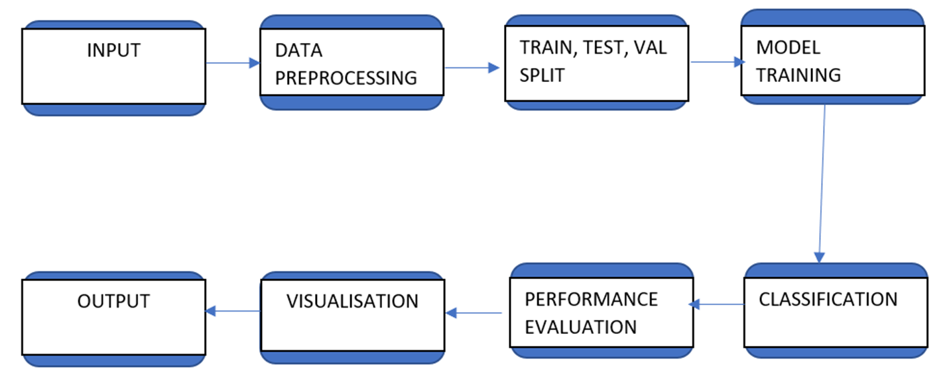
ARCHITECTURE

Slide 14
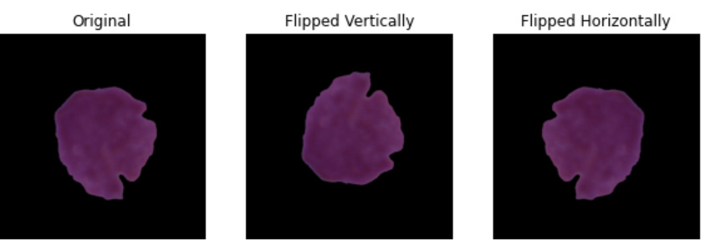
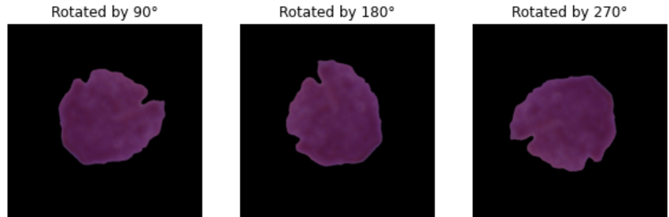
METHODOLOGY
Data Augmentation
Architecture

Slide 15
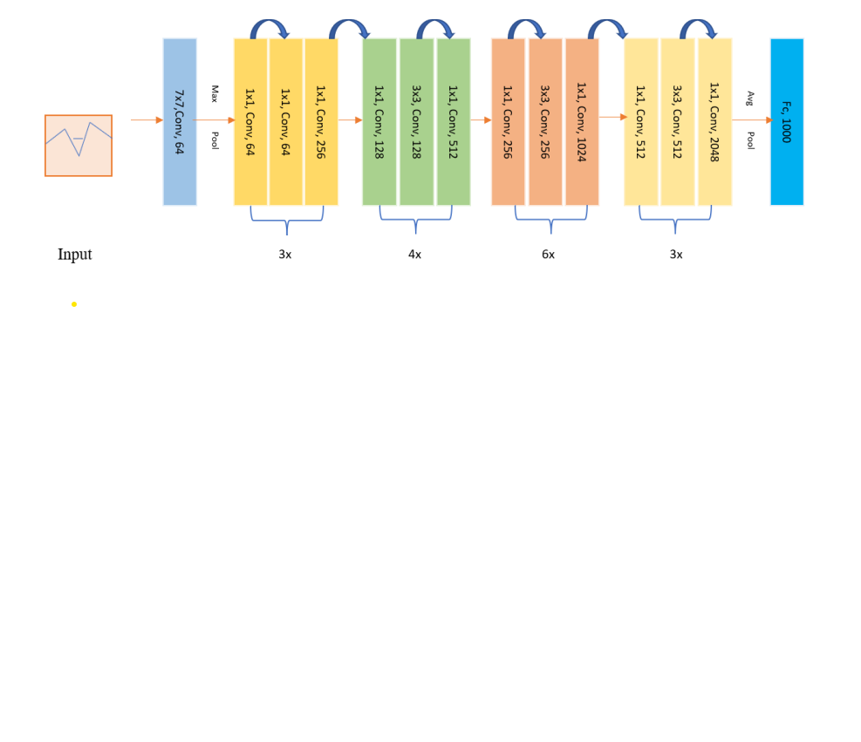
METHODOLOGY(Cont..)
ResNet-50 Architecture

Slide 16
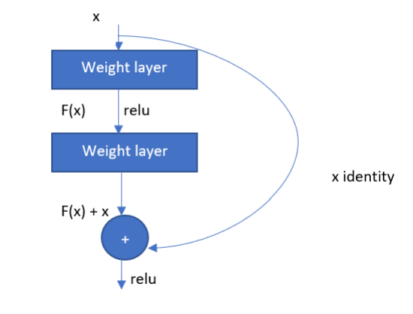
METHODOLOGY(Cont..)
Skip Connection

Slide 17
METHODOLOGY(Cont..)
ResNet-50 is a convolutional neural network that is 50 layers deep
The 50-layer ResNet architecture: 7×7 kernel convolution alongside 64 other kernels with a 2-sized stride. A max pooling layer with a 2-sized stride. 9 more layers—3×3,64 kernel convolution, another with 1×1,64 kernels, and a third with 1×1,256 kernels

Slide 18
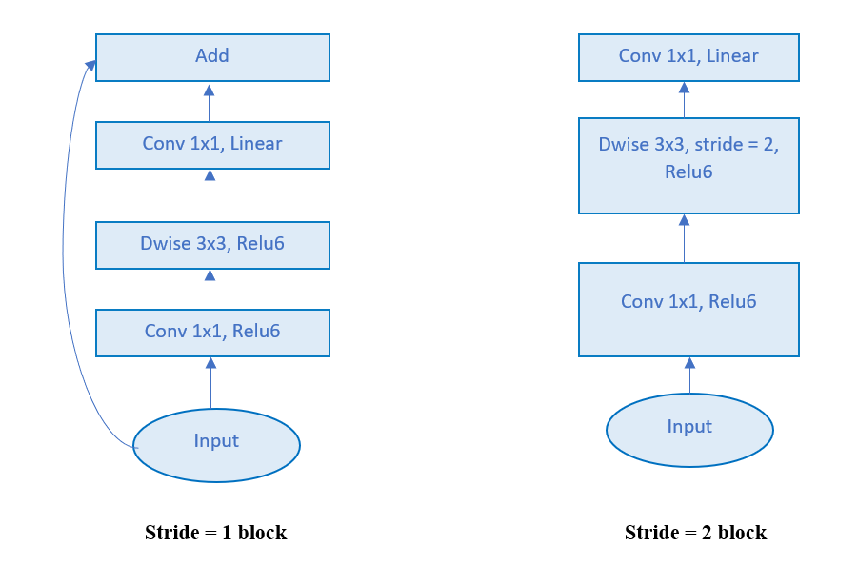
METHODOLOGY(Cont..)
MobileNetV2 Architecture

Slide 19
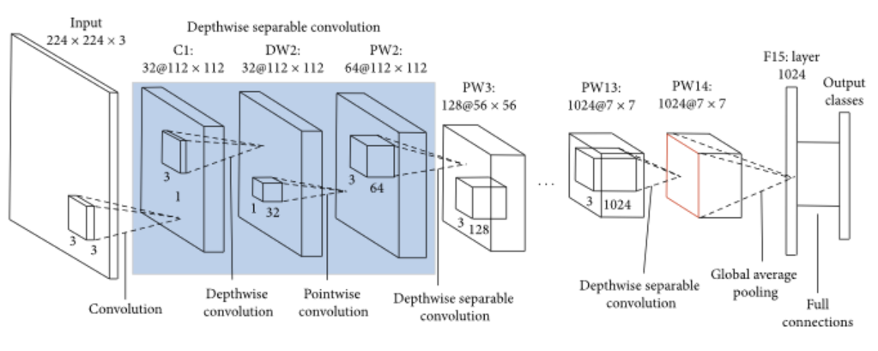
METHODOLOGY(Cont..)

Slide 20
METHODOLOGY(Cont..)
MobileNet is a streamlined architecture that uses depth wise separable convolutions to construct lightweight deep convolutional neural networks
MobileNet uses depth wise separable convolutions. It significantly reduces the number of parameters when compared to the network with regular convolutions with the same depth in the nets

Slide 21
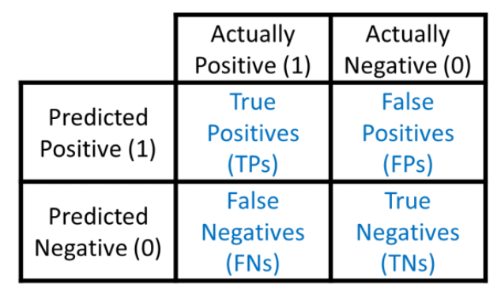
EVALUATION METRICS
CONFUSION MATRIX
TN + TP
ACCURACY =
TN + FP + TN + FN

Slide 22
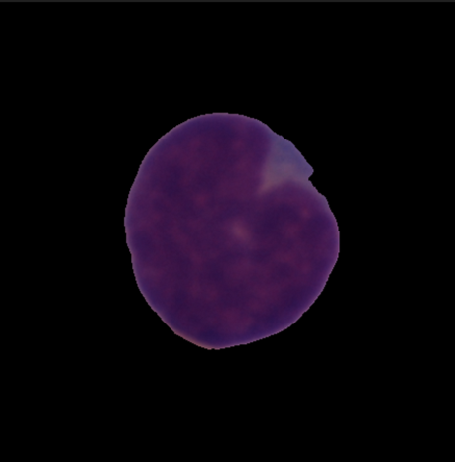
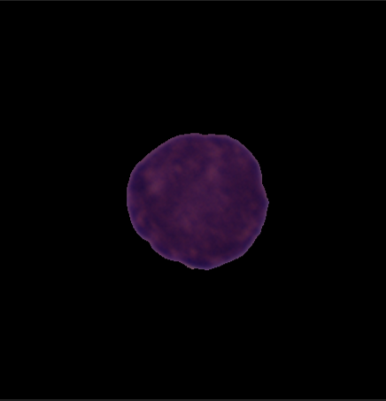
DATASET
Number of images: 10662
Dataset link:https://www.kaggle.com/datasets/avk256/cnmc-leukemia
Cancer Normal
Sample Images

Slide 23
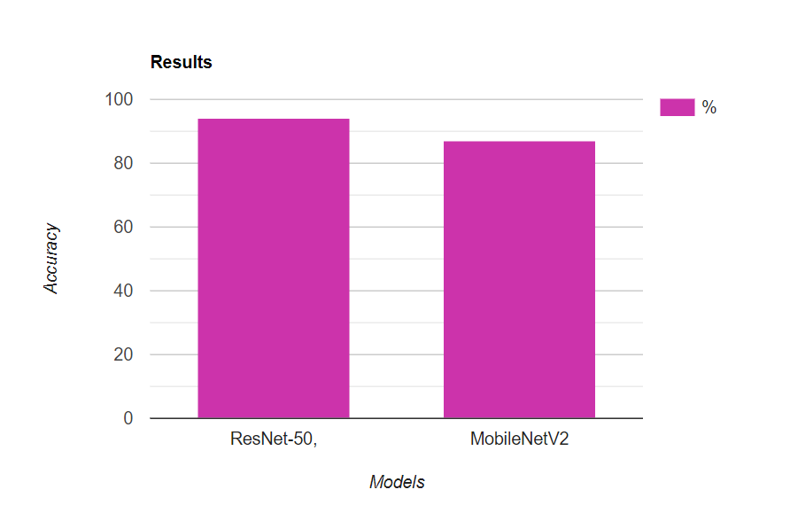
RESULTS

Slide 24
CONCLUSION
In this effort, a new approach to classify the cancer is developed. For this we are using ResNet50 and MobileNet neural networks for improving the accuracy and better prediction. The dataset used in this is also larger.

Slide 25
FUTURE WORK
Further division of cancers from leukocytes

Slide 26
PUBLICATION
Ms Shanmuga Sundari mam, Ms A Kranthi mam, Maturi Lekhya Sri, Tenali Mili Preethika, Ronda Shreya presented a paper " Bone Marrow Cancer Detection from Leukocytes using Neural Networks " on 8th International Conference on Computing, Communication and Security (ICCCS-2023) organized by Baba Farid College of Engineering and Technology Bathinda, Punjab (India), March 03-04, 2023
Publication will be in reputed Scopus/ESCI/SCIE Indexed Journals

Slide 27
REFERENCES
[1] K. Kessenbrock, V. Plaks, and Z. Werb, ``Matrix metalloproteinases: Regulators of the tumor microenvironment,'' Cell, vol. 141, no. 1, pp. 5267, Apr. 2010.
[2] A. Rehman, N. Abbas, T. Saba, S. I. U. Rahman, Z. Mehmood, and H. Kolivand, ``Classication of acute lymphoblastic leukemia using deep learning,'' Microsc. Res. Techn., vol. 81, no. 11, pp. 13101317, Nov. 2018.
[3] S. Shaque and S. Tehsin, ``Acute lymphoblastic leukemia detection and classication of its subtypes using pretrained deep convolutional neural networks,'' Technol. Cancer Res. Treatment, vol. 17, Jan. 2018, Art. no. 153303381880278.
[4] M. Hallek, P. Leif Bergsagel, and K. C. Anderson, ``Multiple myeloma: Increasing evidence for a multistep transformation process,'' Blood, vol. 91, no. 1, pp. 321, Jan. 1998.
[5] J. G. Kelton, A. R. Giles, P. B. Neame, P. Powers, N. Hageman, and J. Hirsch, ``Comparison of two direct assays for platelet-associated IGG (Paigg) in assessement of immune and nonimmune thrombocytopenia,‘’ Blood, vol. 55, no. 3, p424429, 1980.
[6] M. Perkonigg, J. Hofmanninger, B. Menze, M.-A. Weber, and G. Langs, ``Detecting bone lesions in multiple myeloma patients using transfer learning,'' in Data Driven Treatment Response Assessment and Preterm, Perinatal, and Paediatric Image Analysis. Cham, Switzerland: Springer, 2018, pp. 2230.
[7] A. Jemal, R. Siegel, E. Ward, Y. Hao, J. Xu, and M. J. Thun, ``Cancer statistics, 2009,'' CA, A Cancer J. Clin., vol. 59, no. 4, pp. 225249, Jul. 2009.

Slide 28
REFERENCES
[8] Y. Liu and F. Long, ``Acute lymphoblastic leukemia cells image analysis with deep bagging ensemble learning,'' in CNMC Challenge: Classication in Cancer Cell Imaging. Singapore: Springer, 2019, pp. 113121.
[9] A. B. Kul'chyns'kyi, V. M. Kyjenko, W. Zukow, and I. L. Popovych, ``Causal neuro-immune relationships at patients with chronic pyelonephritis and cholecystitis. Correlations between parameters EEG, HRV and white blood cell count,'' Open Med., vol. 12, no. 1, pp. 201213, Jul. 2017.
[10] S. Kant, ``Leukonet: Dct-based cnn architecture for the classication of normal versus leukemic blasts in b-all cancer,'' 2018, arXiv:1810.07961.
[11] I. Arel, D. C. Rose, and T. P. Karnowski, ``Deep machine learningA new frontier in articial intelligence research,'' IEEE Comput. Intell. Mag., vol. 5, no. 4, pp. 1318, Nov. 2010.
[12] J. Zhao, M. Zhang, Z. Zhou, J. Chu, and F. Cao, ``Automatic detection and classication of leukocytes using convolutional neural networks,'' Med.Biol. Eng. Comput., vol. 55, no. 8, pp. 12871301, Aug. 2017.
[13] L. Zhang, L. Lu, I. Nogues, R. M. Summers, S. Liu, and J. Yao, ``Deep-Pap: Deep convolutional networks for cervical cell classication,'' IEEE J. Biomed. Health Informat., vol. 21, no. 6, pp. 16331643, Nov. 2017.
[14] R. Duggal, A. Gupta, R. Gupta, and P. Mallick, ``Sd-layer: Stain deconvolutional layer for CNNs in medical microscopic imaging,'' in Proc. Int. Conf. Med. Image Comput. Comput.-Assist. Intervent. Cham, Switzerland:
Springer, 2017, pp. 435443.
[15] D. J. Foran, D. Comaniciu, P. Meer, and L. A. Goodell, ``Computerassisted discrimination among malignant lymphomas and leukemia using immunophenotyping, intelligent image repositories, and telemicroscopy,''
IEEE Trans. Inf. Technol. Biomed., vol. 4, no. 4, pp. 265273, 2000.

Slide 29
THANK YOU

