Slide 1


BVRIT HYDERABAD College of Engineering for Women Department of Computer Science and Engineering
Comparative Analysis of Algorithm for identifying false news
Under the guidance of:
Name: Mrs B.Nagaveni
Designation: Assistant Professor
Team No: 16
D. Mounika 19WH1A05A0
Sree Aiswarya . T 19WH1A0584
Shaik Maseera Firdose 19WH1A0589

Slide 2
TABLE OF CONTENT
Abstract
Introduction
Literature Survey
Existing system
Drawbacks
Objective
Proposed System
Methodology
Evaluation Metrics
Tools and Technology
Societal impact
Dataset
ResultsConclusion
Future work
References

Slide 3
ABSTRACT
The rapid development of different social media and content-sharing platforms has been largely exploited to spread misinformation and fake news, that make people believing in harmful stories, which allow to influence public opinion, and could cause panic and chaos among population.
We are trying to build a model using various machine learning algorithms to detect fake news and evaluate these algorithms based on their results.

Slide 4
INTRODUCTION
Social media are taking an increasing part in our lives, many people tend to search and consume news.
Due to the massive propagation of news on social networks, users rarely check the accuracy of the information they share.
It is therefore common to see false and manipulated information that are circulating on social media such as hoaxes, rumors, urban legends, and fake news.
This massive dissemination of false information ,could cause a serious negative impact on individuals and society.
One approach to detecting fake news involves fact-checking by humans and computer algorithms.

Slide 5
CONT…
Human fact-checkers often perform research, analyse sources, and inspect supporting documentation to confirm the truth of news pieces.
Automated algorithms, on the other hand, utilise methods for natural language processing (NLP) to examine the content of papers.
ML algorithms can quickly analyse large datasets of known fake news stories and identify patterns indicative of falsehoods, such as emotive language, sensational headlines, and lack of credible sources.
Once trained, the algorithm can classify new news stories as real or fake and help identify the sources of fake news and how it spreads online.
ML is a powerful tool in the fight against misinformation, and it is increasingly being used by media outlets and fact-checking organizations.

Slide 6
LITERATURE SURVEY
S.No | Title of the paper | Author(s) & Journal Details | Description/ Interpretation
1 | Supervised Learning for Fake News Detection | Julio C. S. Reis; André Correia; Fabrício Murai; Adriano Veloso; Fabrício Benevenuto | Measures the prediction performance of current learning on the usefulness and importance of features for detecting false news.
2 | Detecting fake news over online social media via domain reputations and content understanding | Kuai Xu; Feng Wang; Haiyan Wang; Bo Yang | This paper characterizes hundreds of popular fake and real news measured by shares, reactions, and comments on domain reputations and content understanding.
3 | A Hybrid Linguistic and Knowledge-Based Analysis Approach for Fake News Detection on Social Media | Noureddine Seddari; Abdelouahid Derhab; Mohamed Belaoued; Waleed Halboob | In this paper, the sentiment analysis focuses on the extraction of opinion, which involves examining written texts and evaluations using analytical techniques.
4 | OPCNN-FAKE: Optimized Convolutional Neural Network for Fake News Detection | Hager Saleh; Abdullah Alharbi; Saeed Hamood Alsamhi | This paper proposes novel approaches based on Machine Learning (ML) and Deep Learning (DL) for the fake news detection system to address this phenomenon or main aim of this paper is to find the optimal model that obtains high accuracy performance.

Slide 7
LITERATURE SURVEY
S.No | Title of the paper | Author(s) & Journal Details | Description/ Interpretation
5 | A Taxonomy of Fake News Classification Techniques: Survey and Implementation Aspects | Dhiren Rohera; Harshal Shethna; Keyur Patel; Urvish Thakker; Sudeep Tanwar | A systematic analysis and study are carried out as part of the paper’s research method to provide a comprehensive analysis of the field of fake news identification using AI techniques or main aim is to explore and analyze the state-of-the-art techniques for the tangled task of fake news classification.
6 | All Your Fake Detector are Belong to Us: Evaluating Adversarial Robustness of Fake-News Detectors Under Black-Box Settings | Hassan Ali; Muhammad Suleman Khan; Amer Alghadhban; Meshari Alazmi | The main goal of this study is to answer the following key questions about the robustness of fake-news detectors under several engineering choices, we analyze the robustness of fake-news detectors to black-box adversarial attacks.
7 | Selective Feature Sets Based Fake News Detection for COVID-19 to Manage Infodemic | Manideep Narra; Muhammad Umer; Saima Sadiq; Ala’ Abdulmajid Eshmawi | This study works on the detection of COVID-19 fake news detection. Experiments in this work are carried out using feature extraction and feature selection techniques in combination with several machine learning and deep learning models.
8 | A Novel Stacking Approach for Accurate Detection of Fake News | Tao Jiang; Jian Ping Li; Amin Ul Haq; Abdus Saboor; Amjad Ali | In this paper, we evaluated five machine learning models and three deep learning models on two fake news datasets of different size in terms of accuracy, precision, recall, F1-score.

Slide 8
EXISTING SYSTEM
In this system author used early-based techniques to systematically characterize the websites and reputations of publishers of the fake and real news articles on their registration pattern, website age, domain ranking, domain popularity

Slide 9
DRAWBACKS
Model based on domain ranking which is not reliable.
The difference on topics and word embedding shows little difference between fake and real news.
Lack of transparency.

Slide 10
OBJECTIVE
The objective of this project is to accurately identify the fake news. Our study explores different textual properties that can be used to distinguish fake content from real. By using those properties, we train a combination of different machine learning algorithms and evaluate their performance on a real-world dataset.

Slide 11
PROPOSED SYSTEM
By observing a comparative review of several machine learning techniques, the suggested methodology seeks to advance the field of fake news detection.
So we made the proposed system based on system's results that will help identify the most effective algorithm for detecting false news and provide insights in this area.

Slide 12









ARCHITECTURE
Text
Vectorization
Data Collection
Data Cleaning
Data Preprocessing
Training Data
Testing Data
Model Training
Trained Model
Model Evaluation

Slide 13
METHODOLOGIES
Methodologies:
SVM
Decision Trees
Random Forest
Logistic Regression
KNN
Multinomial NB

Slide 14
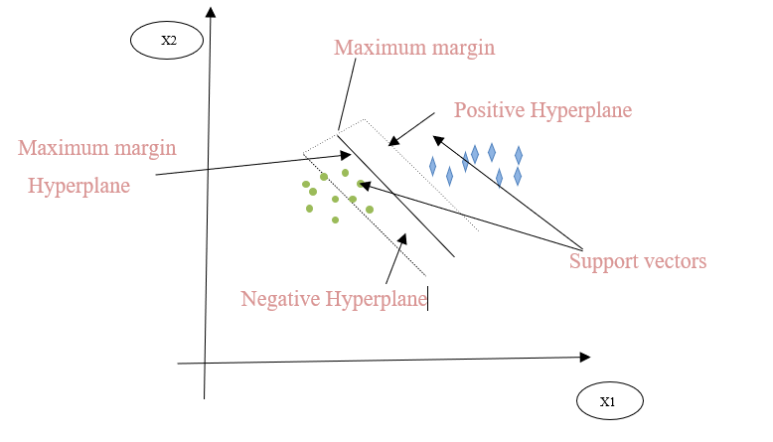
CONT…
Support Vector Machines:
SVMs are a well-known machine learning method for recognising fake news. SVMs are effective at handling high-dimensional data, making them suitable for analysing textual data. SVMs operate by identifying the hyperplane that best divides data into various classes. Real and fake news would be the classes in the fake news detection scenario.
During training, the SVM algorithm learns the optimal hyperplane that separates the real and fake news samples. Once trained, the SVM model may be used to categorise new samples as either true or fake news.

Slide 15
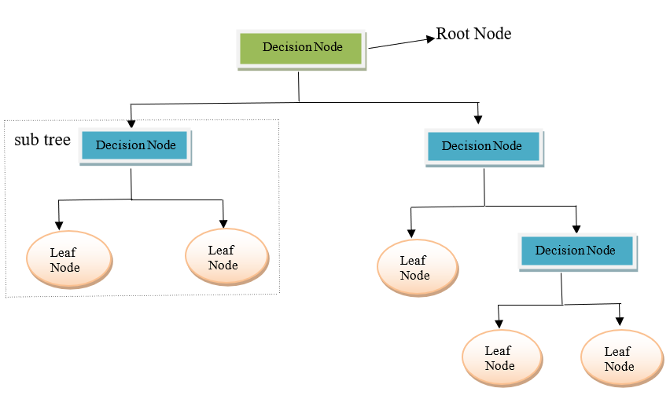
CONT…
Decision Trees:
Popular machine learning algorithms include decision trees, which is widely used for classification problems. Decision trees are implemented in the context of detecting fake news to pinpoint the essential traits or characteristics that support the genuineness of news stories. The decision tree algorithm works by recursively splitting the dataset based on the most informative feature, creating a tree-like structure of decisions that leads to a final prediction.
The final decision is based on the leaf node of the tree, which indicates whether the news article is real or fake. The advantage of decision tree algorithm for fake news detection is its interpretability, as the tree structure provides insights into the key features that distinguish between real and fake news.

Slide 16
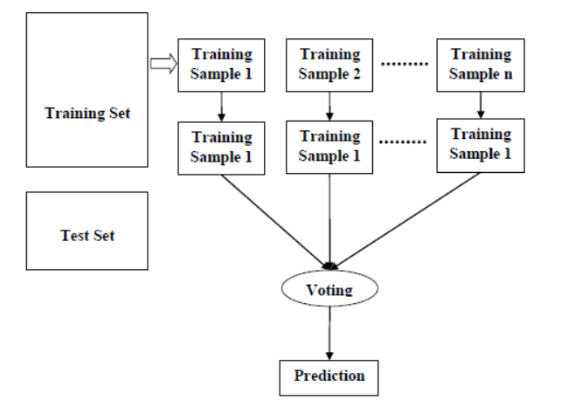
CONT…
Random Forest:
With the help of the machine learning technique known as Random Forest, the model's accuracy and robustness are increased. Multiple decision trees are built utilising various subsets of the training data and features by the Random Forest algorithm. The final classification is based on the consensus of all the decision trees, each of which is trained on a different random sample of the data and features. This enhances the model's capacity for generalisation while reducing overfitting. It can provide insights into the importance of different features in the classification process, which can be useful for understanding the underlying factors that contribute to fake news.

Slide 17
CONT…
Logistic Regression:
In binary classification situations, where the objective is to predict the probability of a binary outcome such as(yes/no), logistic regression is a statistical model that is frequently utilised. The news article being fake or authentic can be predicted, in the context of fake news identification using a collection of features taken from the article.
The input features are converted by the logistic regression model into a probability value between 0 and 1, with values closer to 1 indicating a higher likelihood that the article is a forgery and values closer to 1 indicating that the article is true.

Slide 18
CONT…
K Nearest Neighbours:
KNN is a popular algorithm used in machine learning for classification problems. In the context of fake news detection, KNN works by measuring the similarity between a news article and other articles in a training set. The value of K is typically determined using cross-validation techniques. It does not require any assumptions about the distribution of the data and can handle nonlinear decision boundaries.
Multinomial NB:
Natural language processing (NLP) and text classification tasks, such as fake news identification, use the classification technique known as Multinomial Naive Bayes (MNB). It is a subtype of Naive Bayes algorithm , it performs well with features like word frequencies in text data that have discrete and multinomial distributions. The algorithm works by first training a model on a labelled dataset of news articles. The model then calculates the probabilities of each word appearing in fake and real news articles, which are used to classify new, unseen articles based on their word frequencies. The article is classified as fake or real based on which label has a higher probability given its word frequencies.

Slide 19
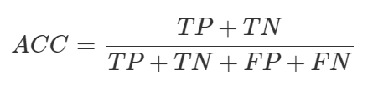

EVALUATION METRICS
To evaluate the performance of our system, we used several evaluation metrics, which are: Accuracy (ACC ), Recall (REC ), and F1-score (F1 ) .
Accuracy:(ACC)
It is a measure of the proportion of correct predictions of the model, and is defined as the number of true predictions divided by the total number of analyzed items.
Recall:(REC)
It corresponds to the ratio of the number of correctly classified positive items to the number of actual positive items.

Slide 20
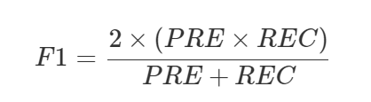
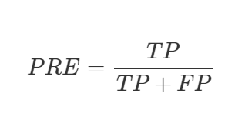
CONT..
F1- Score: (F1)
It relates precision (PRE ) and recall (REC ) metrics to obtain a quality measure that balances the relative importance of these two metrics.
Where :
Precision refers to the amount of information that is conveyed by a number in terms of its digits; it shows the closeness of two or more measurements to each other.

Slide 21
TOOLS AND TECHNOLOGIES
Jupyter Notebook
Libraries:
NumPy
Pandas
Matplotlib
Seaborn
NLTK
Sci-kit Learn

Slide 22
SOCIETAL IMPACT
Fake news has a significant negative impact on society, including political polarization, social division, and erosion of trust in institutions.
The development of effective fake news detection methods can help mitigate these negative impacts by preventing false information from spreading.
Improved fake news detection can lead to increased trust in media and institutions, as well as a more informed and active citizens.
It is important to strike a balance between the advantages of detecting fake news and worries about censorship and privacy.
Collaboration between researchers, journalists, and social media companies can help ensure that effective fake news detection methods are developed and implemented responsibly.

Slide 23
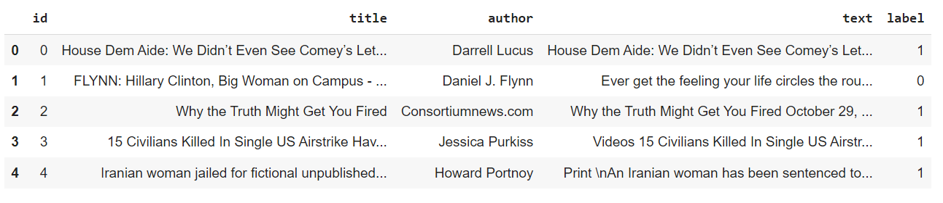
DATASET
Dataset: https://www.kaggle.com/c/fake-news/data.
No. of attributes: 5
Size: Test- 5,200 Train- 20,800
Classes : 2 (Fake-1, Real-0)

Slide 24
RESULTS
Based on the accuracy achieved by each algorithm we try to find out the best approach to find fake news.
S.NO | ALGORITHM | ACCURACY | PRECISION | RECALL | F1-SCORE
1 | SVM | 98 | 98 | 98 | 98
2 | Decision Tree | 96 | 96 | 96 | 96
3 | Random Forest | 93 | 93 | 93 | 93
4 | Logistic Regression | 96 | 96 | 96 | 96
5 | KNN | 86 | 87 | 86 | 86
6 | Multinomial NB | 83 | 87 | 84 | 83

Slide 25
CONT…

Slide 26
CONCLUSION
We made summaries of six different research studies that aim to develop automated methods for detecting fake news.
The studies all recognise the challenges posed by the prevalence of fake news on social media, and they all attempt to use machine learning techniques to identify and classify false information.
The studies evaluate the performance of their models against various criteria, such as accuracy, recall, f1-score and precision.

Slide 27
FUTURE WORK
Future work for fake news detection could involve developing more sophisticated algorithms using advanced machine learning techniques such as deep learning and reinforcement learning.
The integration of natural language processing (NLP) techniques could also improve the accuracy of fake news detection.
Additionally, social network analysis could be used to track the spread of fake news across social media platforms, and collaboration between researchers, journalists, and social media companies could play a critical role in developing more effective detection methods and strategies.

Slide 28
REFERENCES
[1] D. Rohera et al., "A Taxonomy of Fake News Classification Techniques: Survey and Implementation Aspects," in IEEE Access, vol. 10, pp. 30367-30394, 2022, doi: 10.1109/ACCESS.2022.3159651.
[2] H. Ali et al., "All Your Fake Detector are Belong to Us: Evaluating Adversarial Robustness of Fake-News Detectors Under Black-Box Settings," in IEEE Access, vol. 9, pp. 81678-81692, 2021, doi: 10.1109/ACCESS.2021.3085875.
[3] H. Saleh, A. Alharbi and S. H. Alsamhi, "OPCNN-FAKE: Optimized Convolutional Neural Network for Fake News Detection," in IEEE Access, vol. 9, pp. 129471-129489, 2021, doi: 10.1109/ACCESS.2021.3112806.
[4] K. Xu, F. Wang, H. Wang and B. Yang, "Detecting fake news over online social media via domain reputations and content understanding," in Tsinghua Science and Technology, vol. 25, no. 1, pp. 20-27, Feb. 2020, doi: 10.26599/TST.2018.9010139.
[5] T. Jiang, J. P. Li, A. U. Haq, A. Saboor and A. Ali, "A Novel Stacking Approach for Accurate Detection of Fake News," in IEEE Access, vol. 9, pp. 22626-22639, 2021, doi: 10.1109/ACCESS.2021.3056079.

Slide 29
[6] M. Umer, Z. Imtiaz, S. Ullah, A. Mehmood, G. S. Choi and B. -W. On, "Fake News Stance Detection Using Deep Learning Architecture (CNN-LSTM)," in IEEE Access, vol. 8, pp. 156695-156706, 2020, doi: 10.1109/ACCESS.2020.3019735.
[7] M. F. Mridha, A. J. Keya, M. A. Hamid, M. M. Monowar and M. S. Rahman, "A Comprehensive Review on Fake News Detection With Deep Learning," in IEEE Access, vol. 9, pp. 156151-156170, 2021, doi: 10.1109/ACCESS.2021.3129329.
[8] H. Hammouchi and M. Ghogho, "Evidence-Aware Multilingual Fake News Detection," in IEEE Access, vol. 10, pp. 116808-116818, 2022, doi: 10.1109/ACCESS.2022.3220690.
[9] D. Li, H. Guo, Z. Wang and Z. Zheng, "Unsupervised Fake News Detection Based on Autoencoder," in IEEE Access, vol. 9, pp. 29356-29365, 2021, doi: 10.1109/ACCESS.2021.3058809.
[10] K. Yoshikawa, T. Awa, R. Kusano, H. Sato, M. Ichino and H. Yoshiura, "A Fake News Dissemination Model Based on Updating Reliability and Doubt among Individuals," 2020 11th International Conference on Awareness Science and Technology (iCAST), Qingdao, China, 2020, pp. 1-8, doi: 10.1109/iCAST51195.2020.9319485.
[11] N. Seddari, A. Derhab, M. Belaoued, W. Halboob, J. Al-Muhtadi and A. Bouras, "A Hybrid Linguistic and Knowledge-Based Analysis Approach for Fake News Detection on Social Media," in IEEE Access, vol. 10, pp. 62097-62109, 2022, doi: 10.1109/ACCESS.2022.3181184.

Slide 30
THANK YOU

