Slide 1
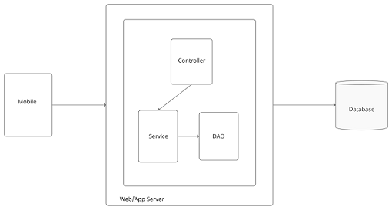
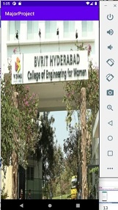
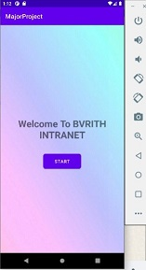
BVRITH INTRANET MOBILE APP
AIM
The aim of this project is to develop a complete, integrated android based mobile application to provide students with information regarding college administration details, Departmental details, Placement activities, Library books details, Hostel details, Transportation details, and so on.
ARCHITECTURE
RESULTS
INTRODUCTION
Intranet is a real time application that can be installed on any Android devices and improve interactivity, accessibility and convenience in the learning process.
Students, faculty, and administration all will use this mobile application. In the previous system, all information is viewed on the website. At the same time, it is very difficult to access information and it takes a long time to search in a specific website. Hence, in order to overcome this problem a smart phone based mobile application using Android can be used to make this process easier, secure and less error prone.
REFERENCES
Shilpi, Taneja., Goel, Anita. (2015). Mobile Applications in Educational Institutions. Computational Intelligence Communication Technology (CICT), 2015 IEEE International Conference on. IEEE, 2015.
Nikhlil Jadhav1 , Bhupesh Singh2 , Kunal Lunge3 , Gopi Mali 4 , Nilesh Patil, Android Application for College Management System, in IJESC Volume 6 Issue No. 12 , 2016.
CONCLUSION
We propose an architecture that makes use of existing infrastructure to offer information to the students via apps. To accommodate the varying demands of students and university departments, the design is robust, durable, and scalable.
SARA FATIMA - 18WH1A0542 ,CH.SRIPRIYA - 18WH1A0557, NISHA - 19WH5A0505, Guide - Mr. K. NARESH

