Slide 1

The Zen of C++
Adnan Zejnilovic
Chapter 6
Functions

Slide 2
What is a Function?
Top-Down Design
Stepwise refinement
Divide and Conquer
Built-in (Predefined) Functions
Programmer defined functions

Slide 3
Benefits of Using Functions
Eliminate repetitive statements
Make code modular
Easier to read/understand the code
Easier to isolate software defects if there are any

Slide 4
Some “Rules”
Function Calls
Function Body
Function Definition
Function Header
Function Prototype/Declaration
“Caller” Program

Slide 5
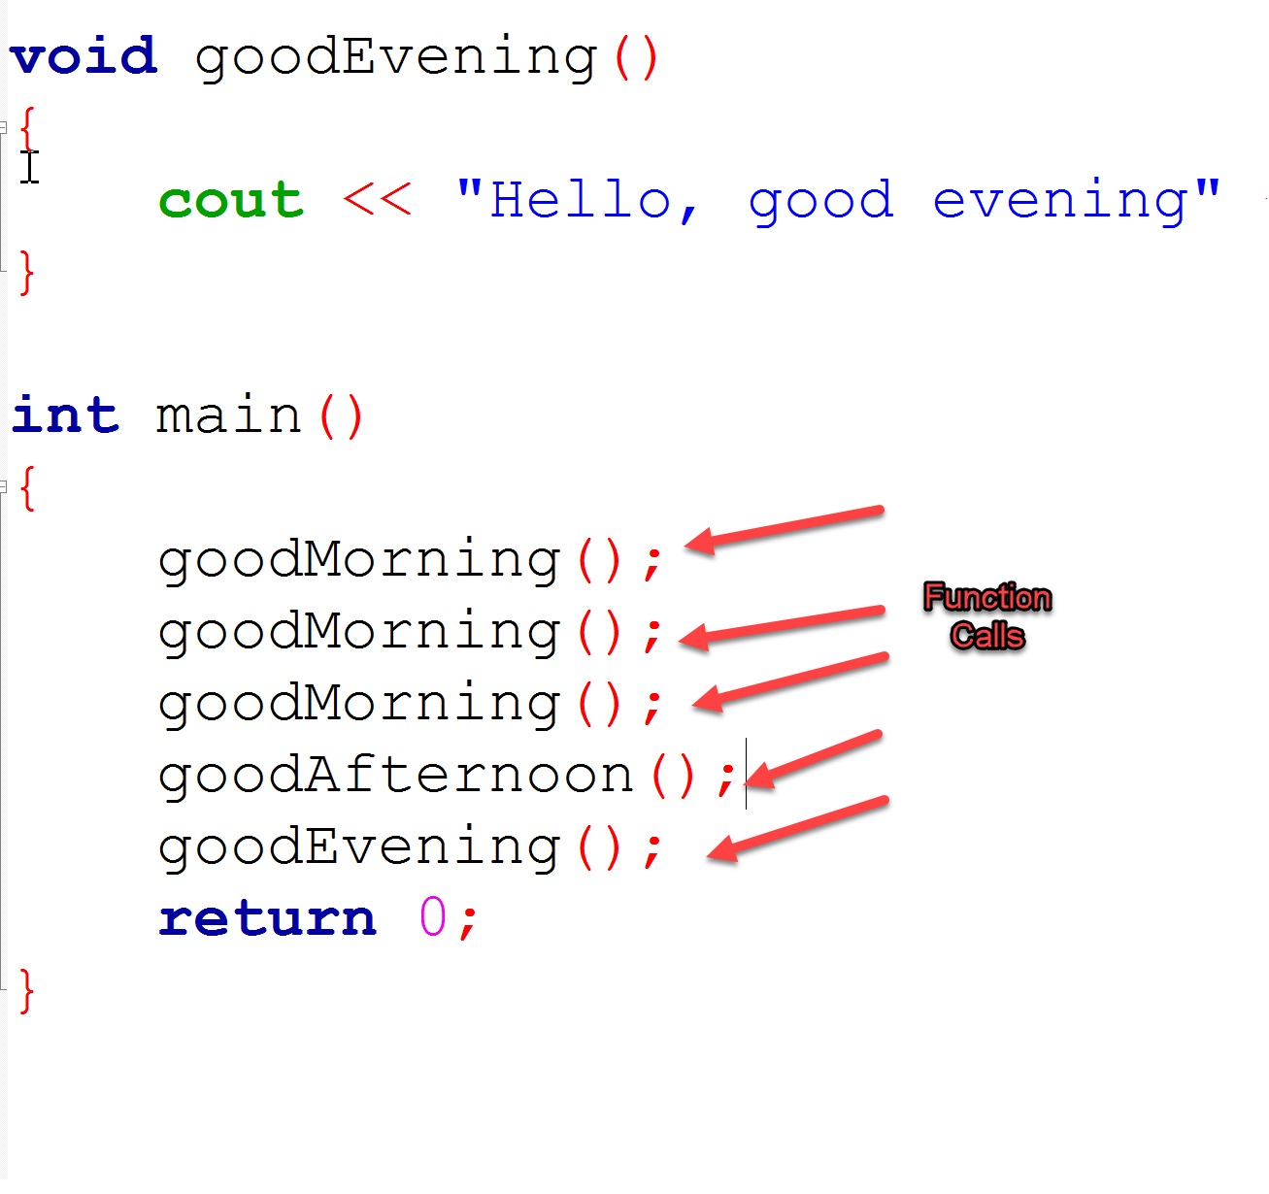
Function Calls

Slide 6
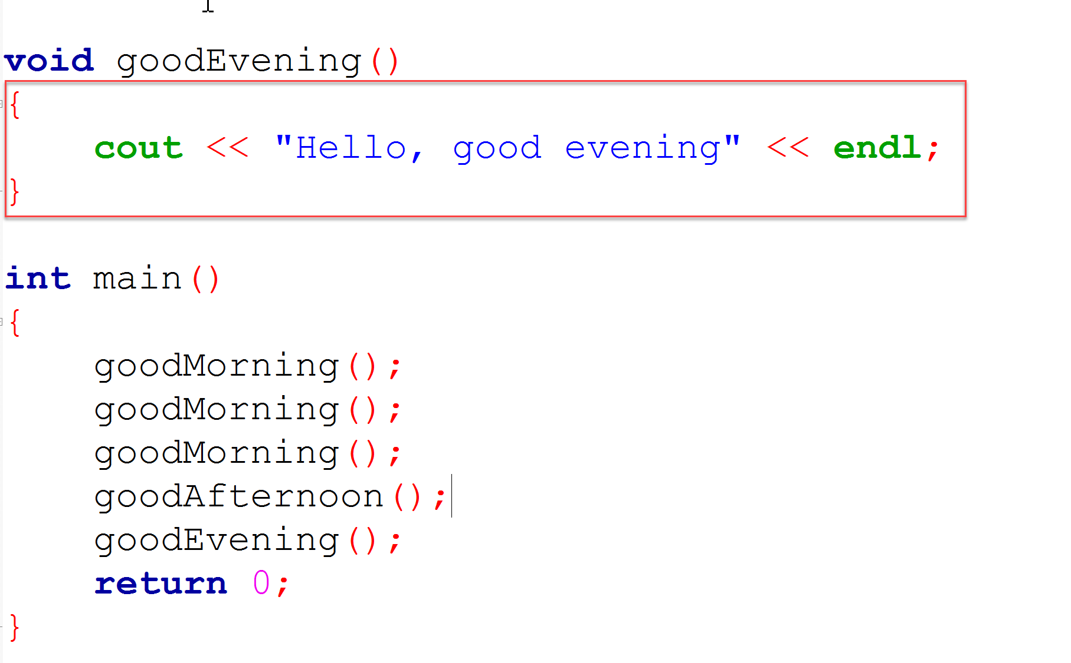
Function Body
Starts with {
Ends with a }

Slide 7
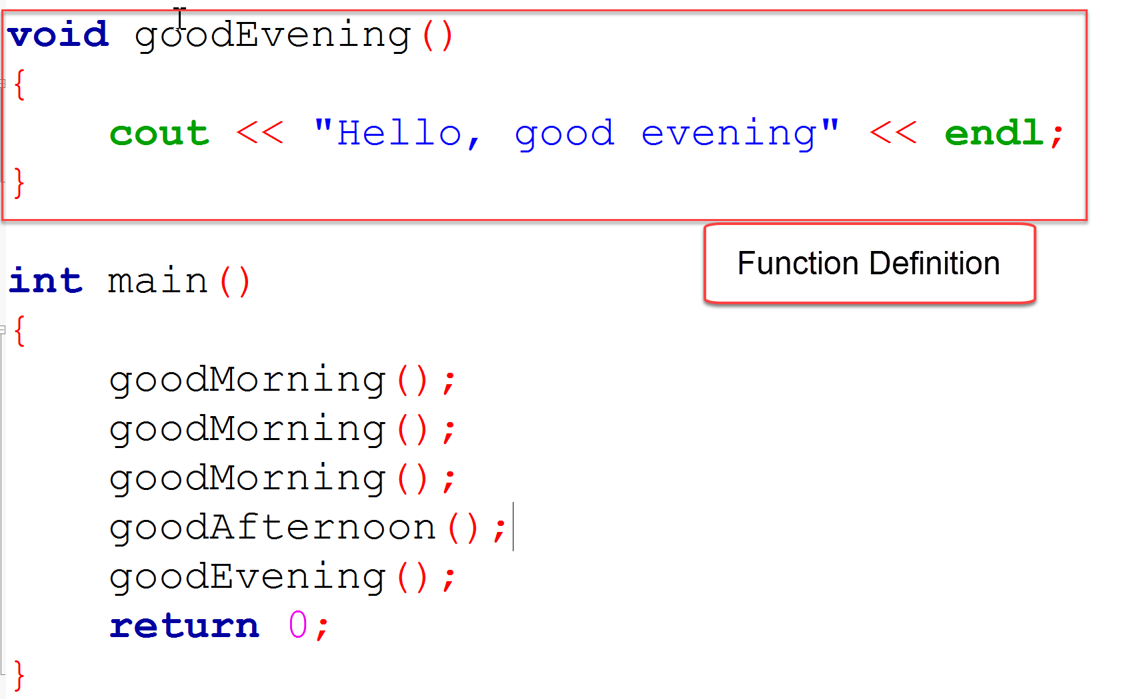
Function Definition

Slide 8
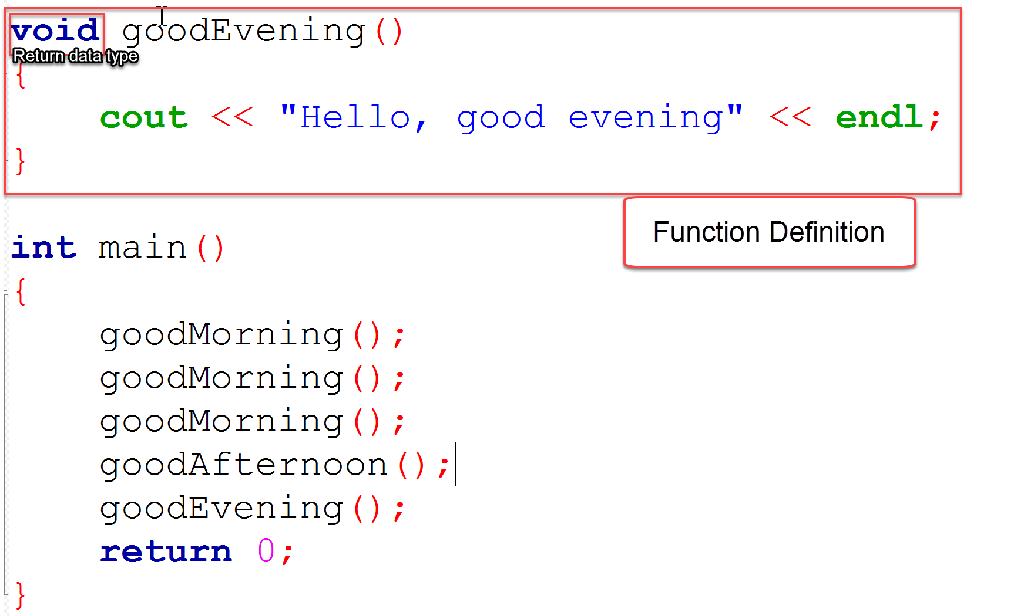
Function Definition
Function definition consists of:
Function return data type
“void”
Function name
Parameter List

Slide 9
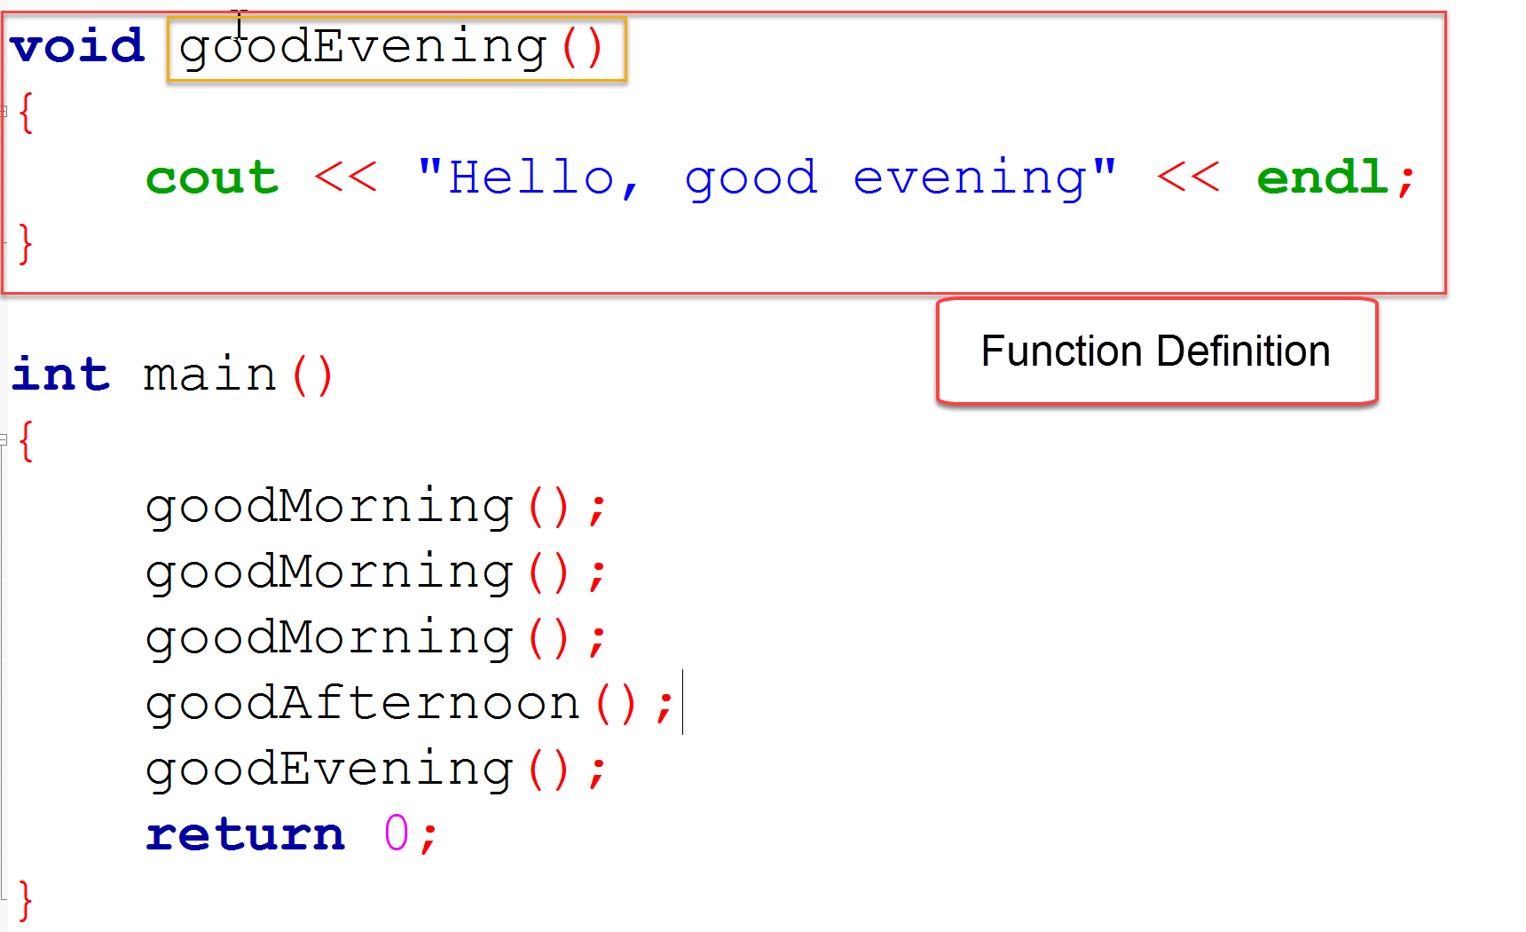
Function Definition
Function definition consists of:
Function return data type
Function name “goodEvening”
Parameter List

Slide 10
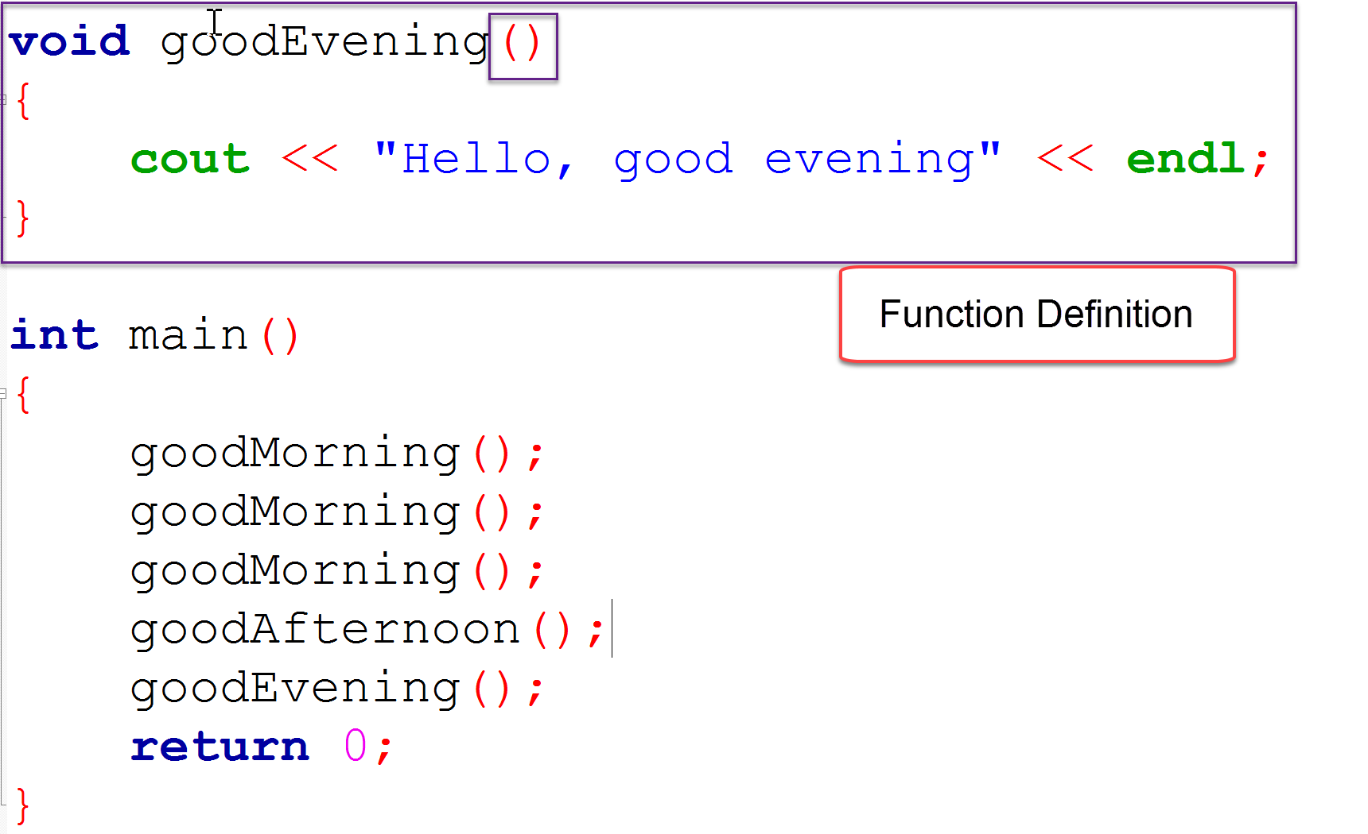
Function Definition
Function definition consists of:
Function return data type
Function name
Parameter List
In this case, the list is empty
Hence nothing in parenthesis
“Empty” parameter list

Slide 11
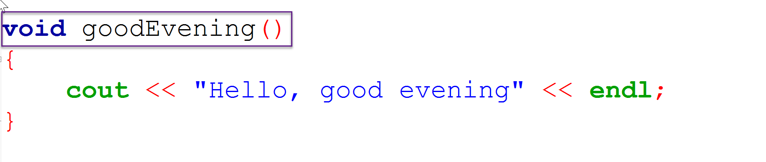
Function Header
Function Header contains:
Function return data type
Function name
Parameter list

Slide 12
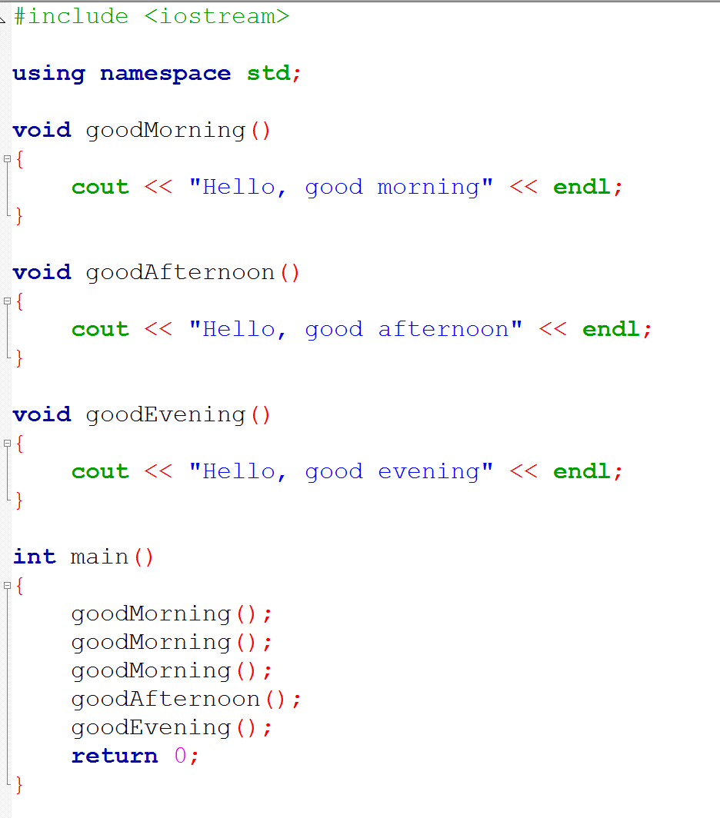
Write Functions Before the int main()

Slide 13
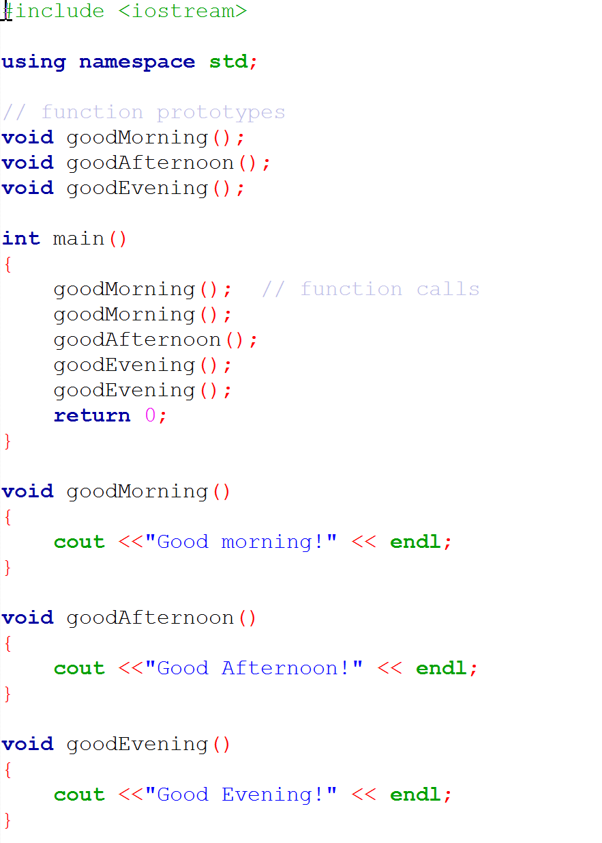
Write Functions after the int main()
In this case, declare function prototypes
Let the compiler know (forward declaration)
No difference between two approaches
Using prototypes is the preferred approach
More complex programs are split into
Header files (prototypes)
Implementation files

Slide 15
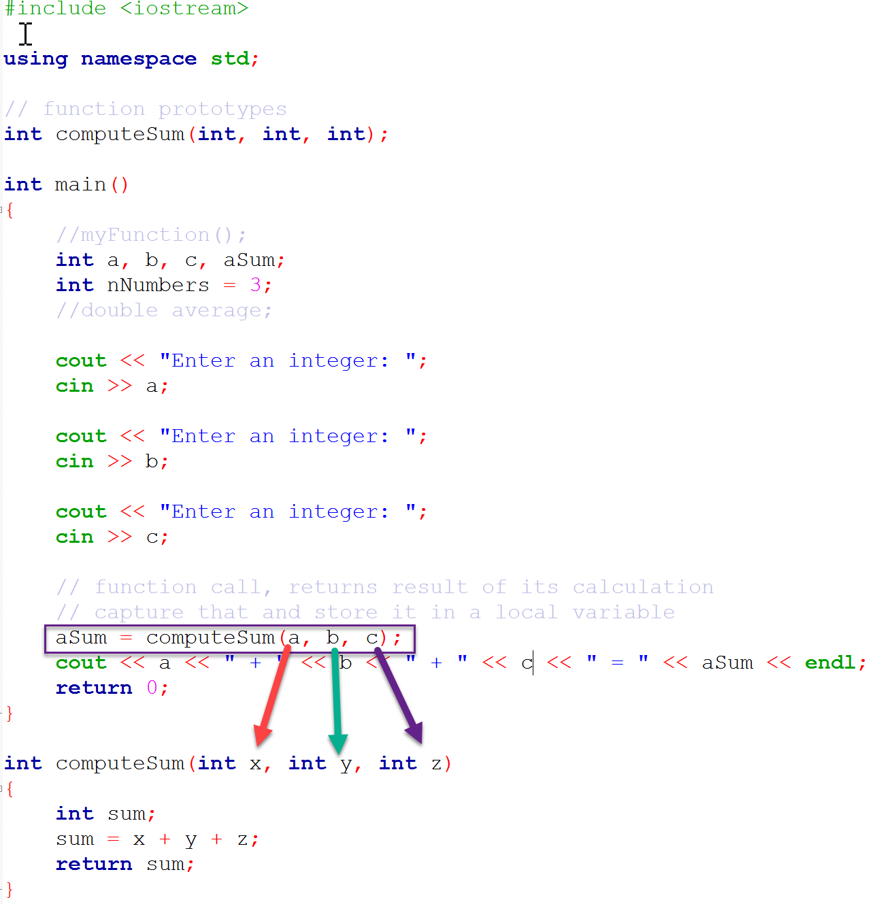
Passing by Value
Functions receive data through parameters
Parameters are local (to the function) variables designed to receive data from a caller program
Distinguish between an argument and a parameter
a, b, and c are arguments
x, y, and z are parameters

Slide 16
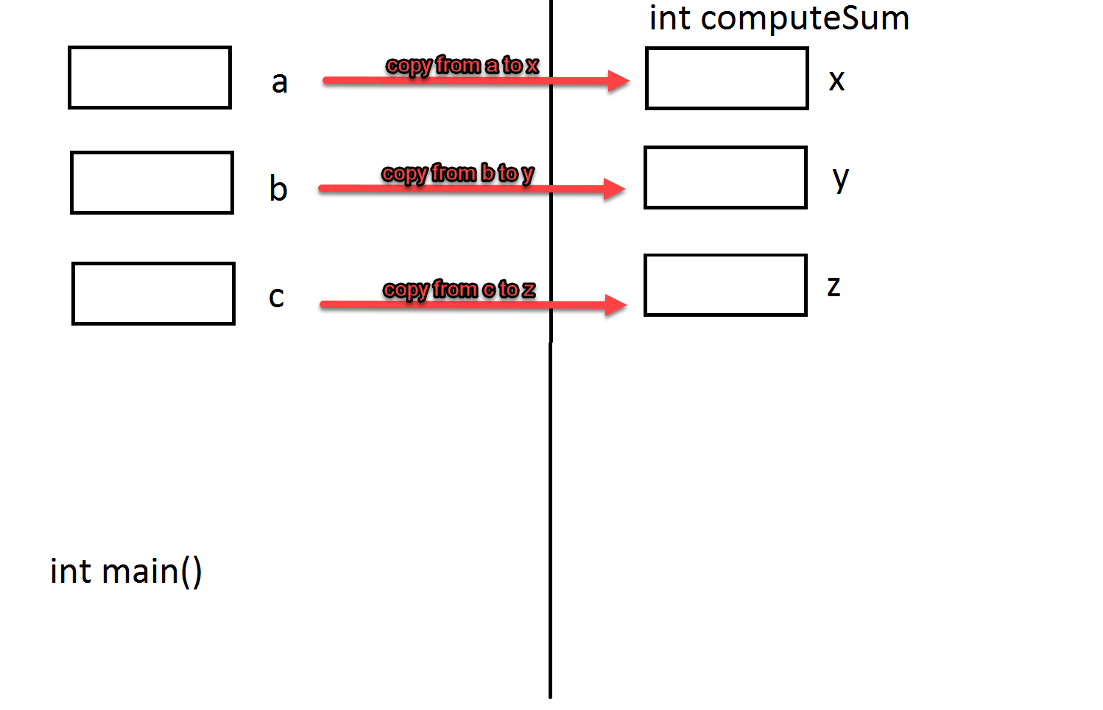
Passing by Value – Order Matters!
Contents of a are copied to x
Contents of b are copied to y
Contents of c are copied to z

Slide 17
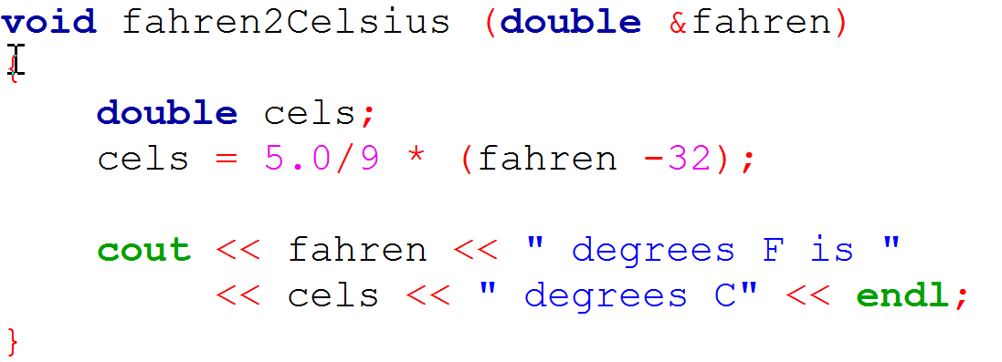
Pass by Reference
A reference parameter is denoted by an “&”
When passing by reference the data is NOT copied from arguments to parameters
Instead, the function parameter is given the address of the data
Note the “&” in front of the fahren parameter

Slide 18
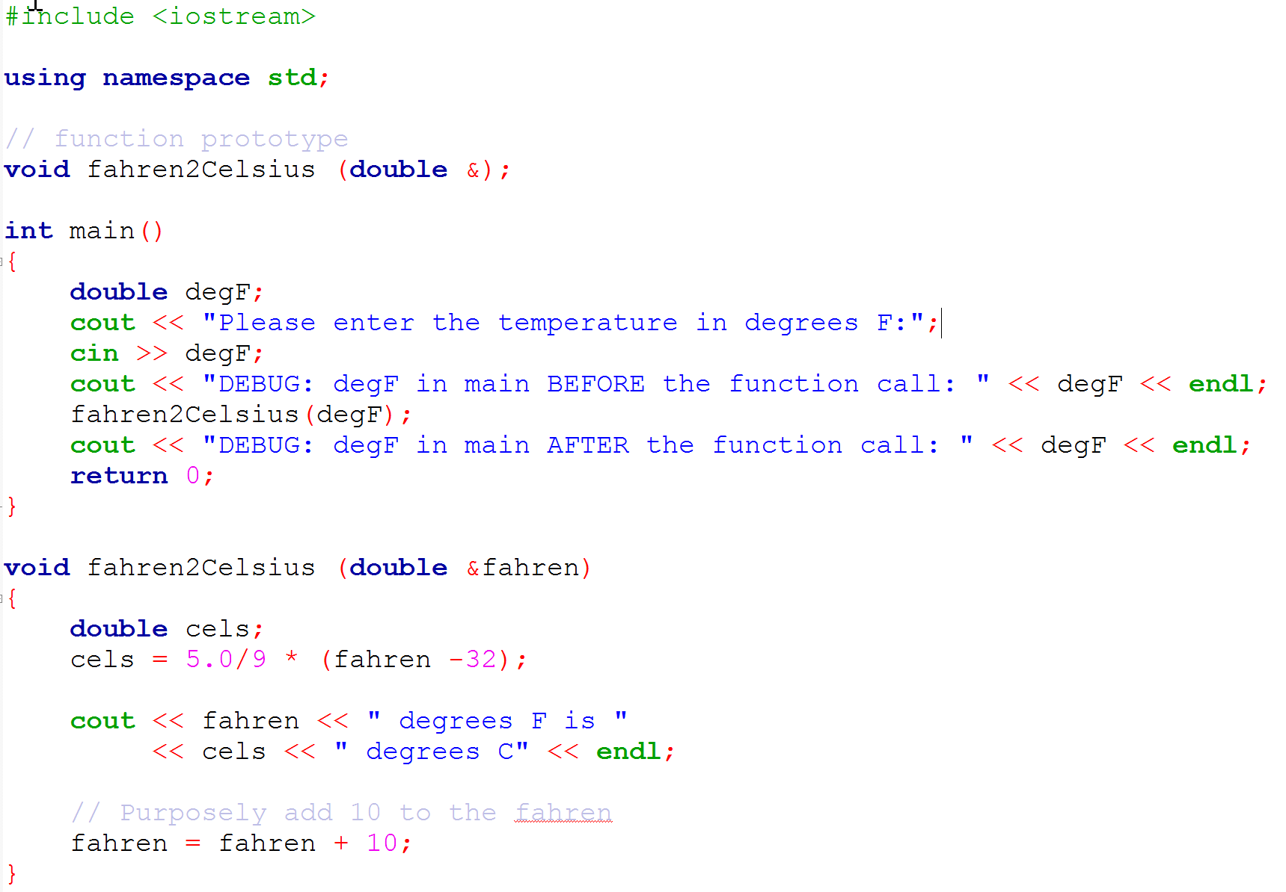
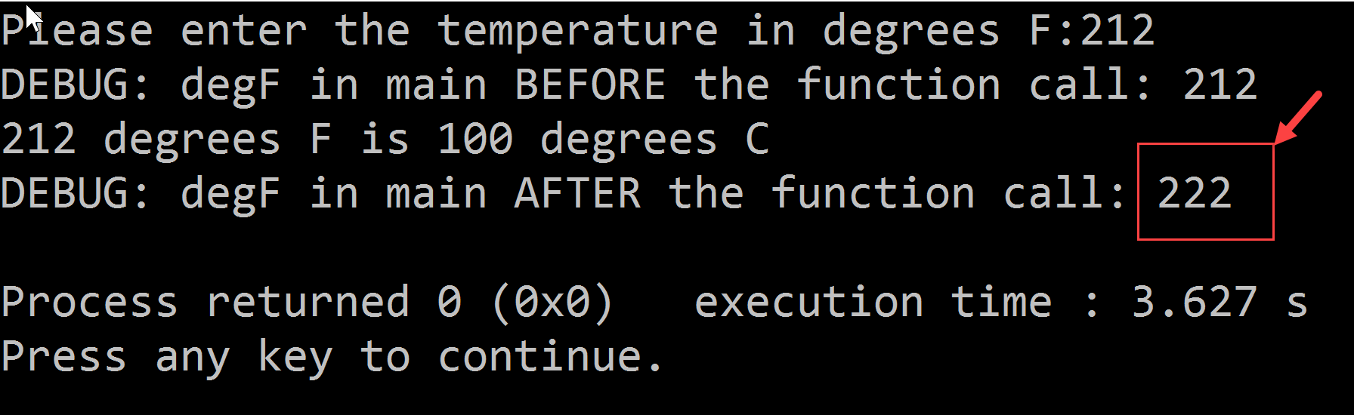
Pass by Reference
Run this program
What happened ?
Why did degF get changed?

Slide 19

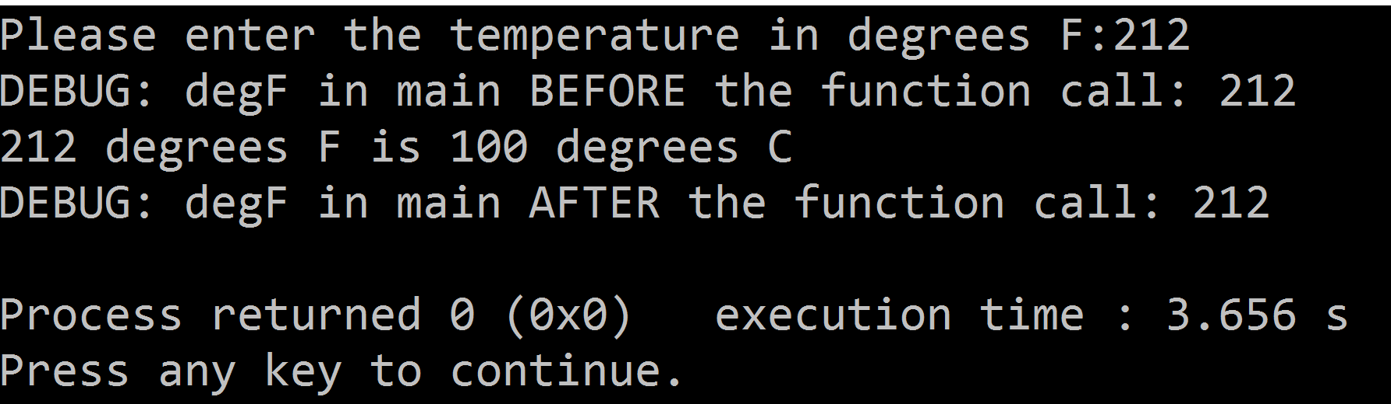
Pass by Value
Let’s examine identical function that uses “pass by value” and its output
The argument(degF) was not affected by the change in the fahren2Celsius function

Slide 20
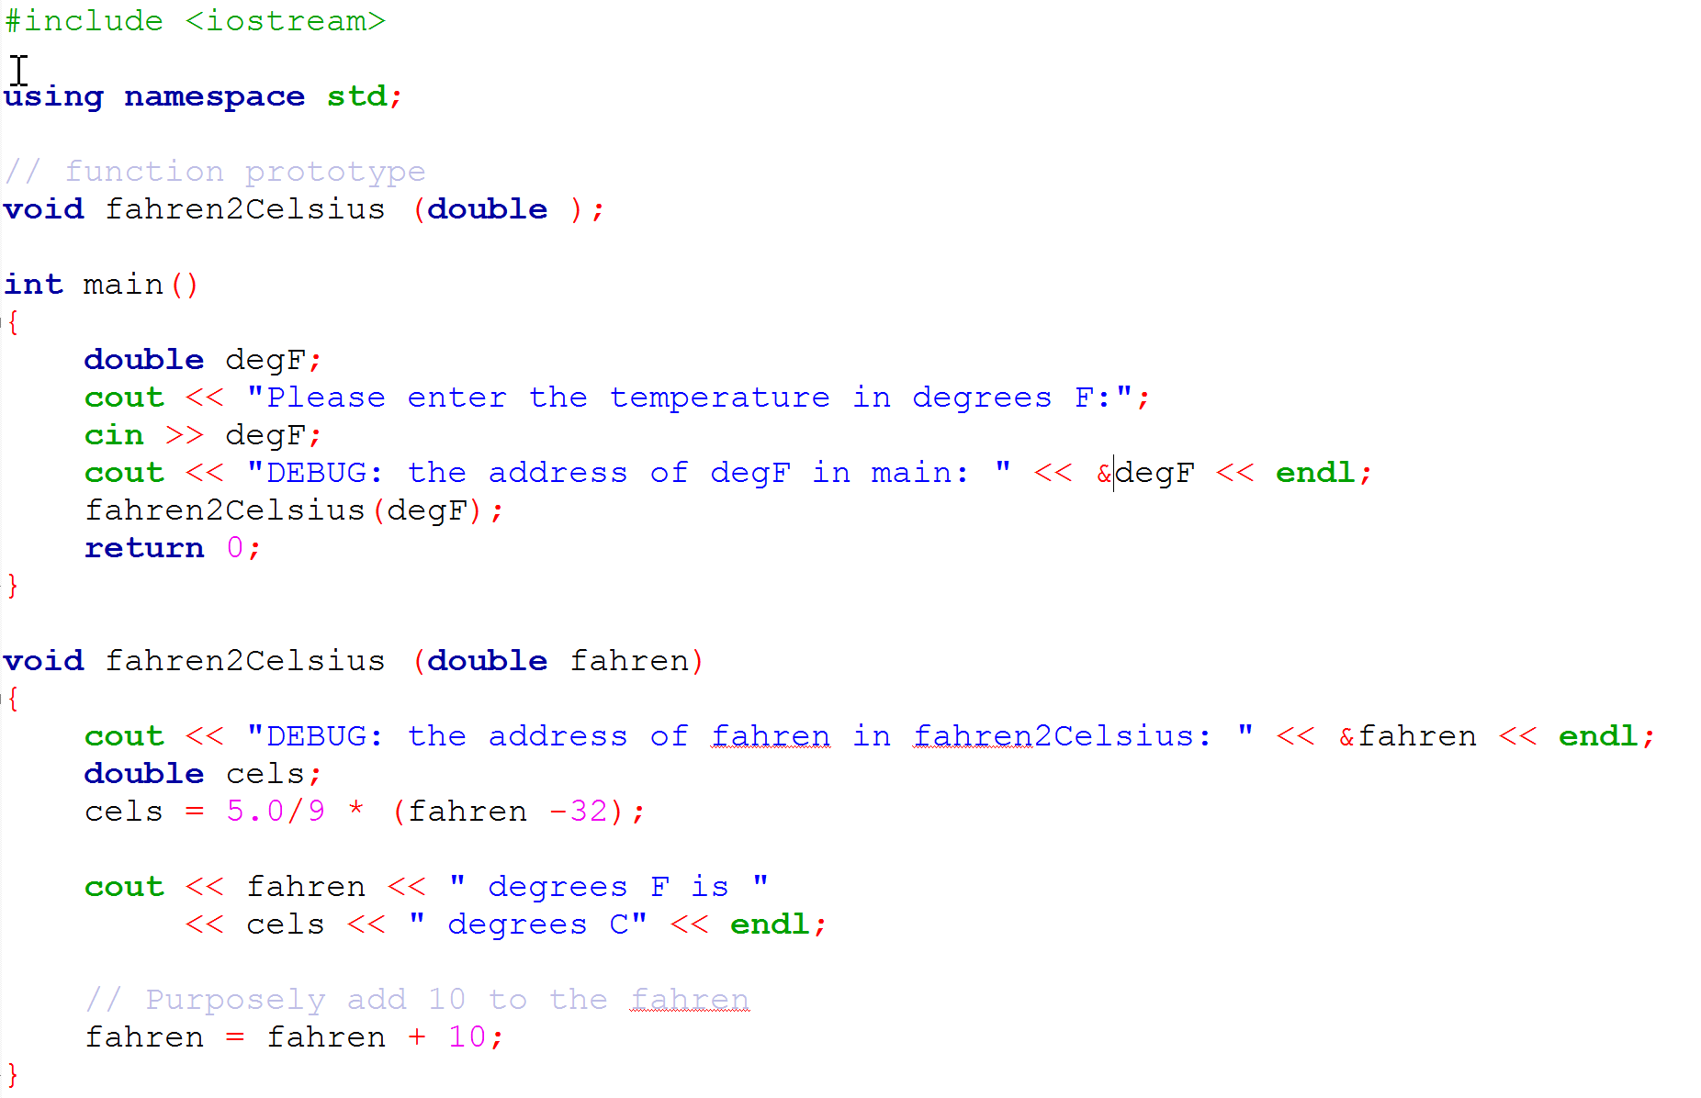
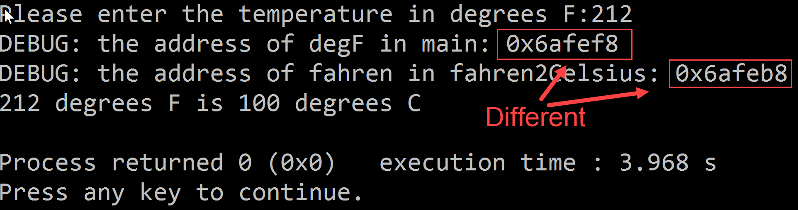
Pass by Value
Let’s look at the variable addresses:
They are different which confirms that the argument is in a different memory location

Slide 21
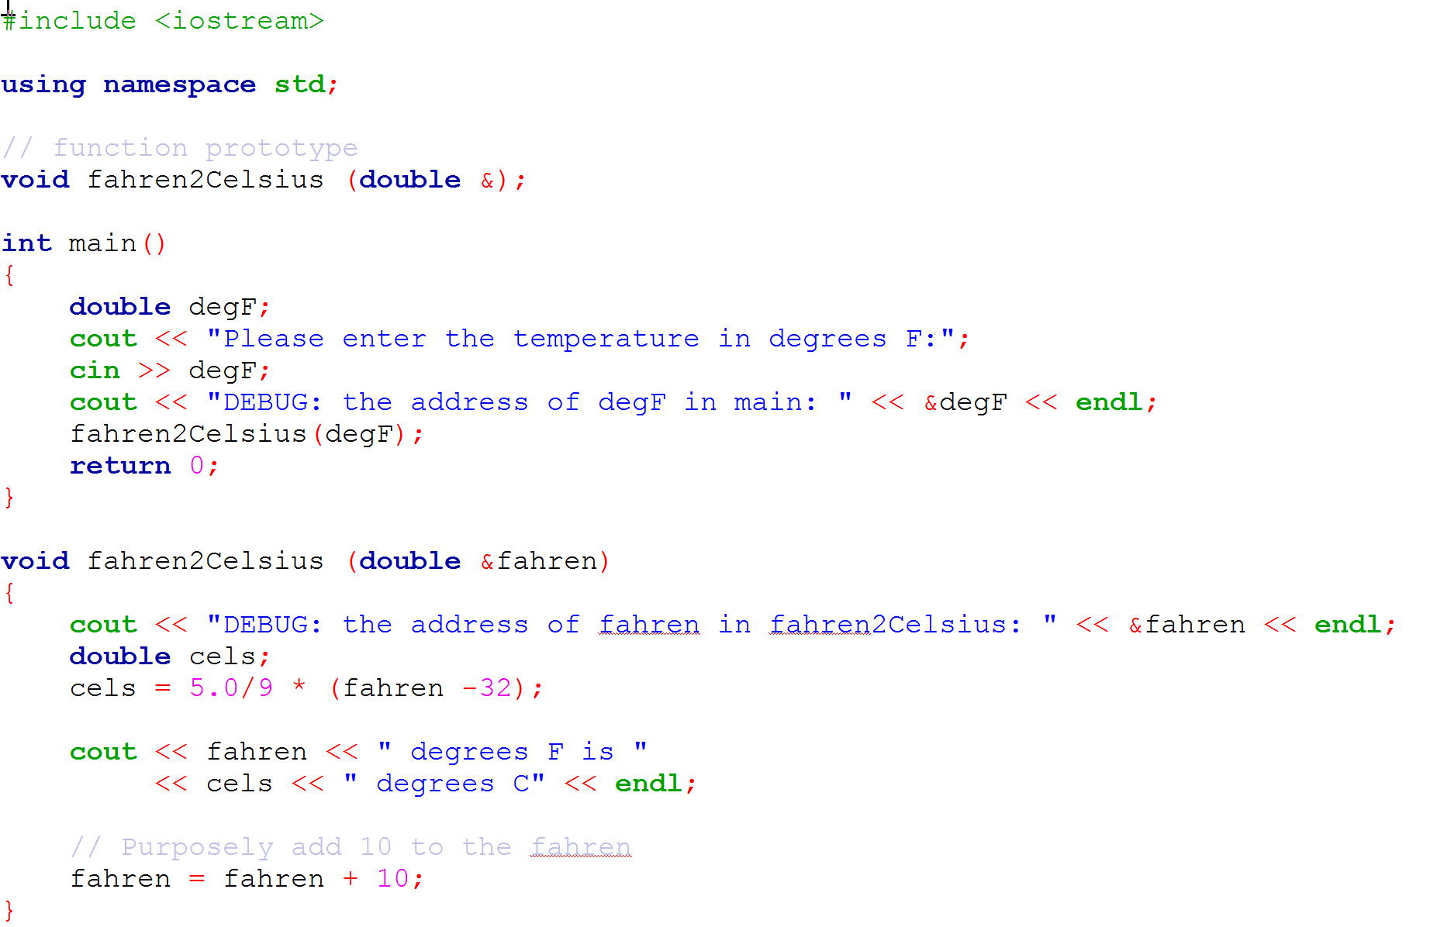
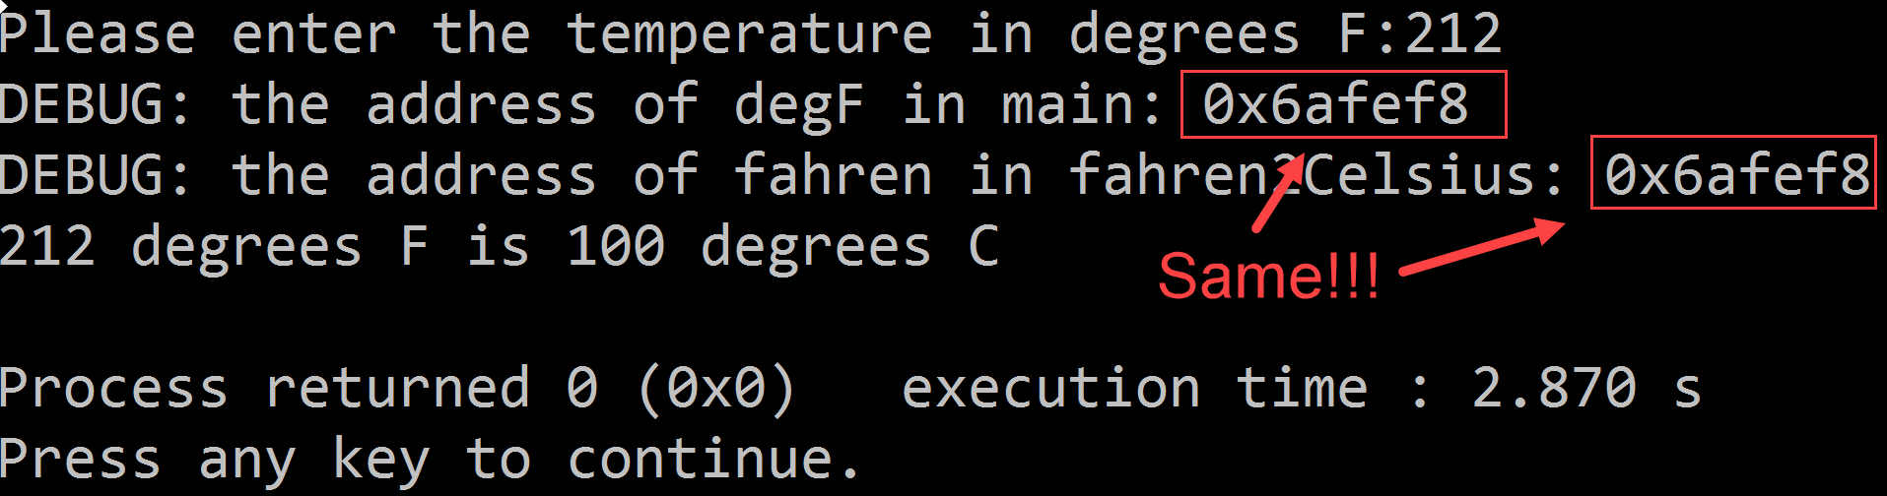
Pass by Reference
Let’s look at the variable addresses when passing by reference
The addresses of degF and fahren are the same:
Which proves that fahren is an “alias” for degF as they are the same memory location

Slide 22
Pass by Constant Reference
Passing by reference is faster as we are only passing the address
This is especially true if we were to pass a large object
Making a copy of it would be time consuming
Passing by reference is passing only the address of the argument variable
However, the value of the argument variable can be changed in the function so it is dangerous
What if we wanted to pass by reference and prevent the function from changing the value of the argument?
The answer is pass by constant reference

Slide 23
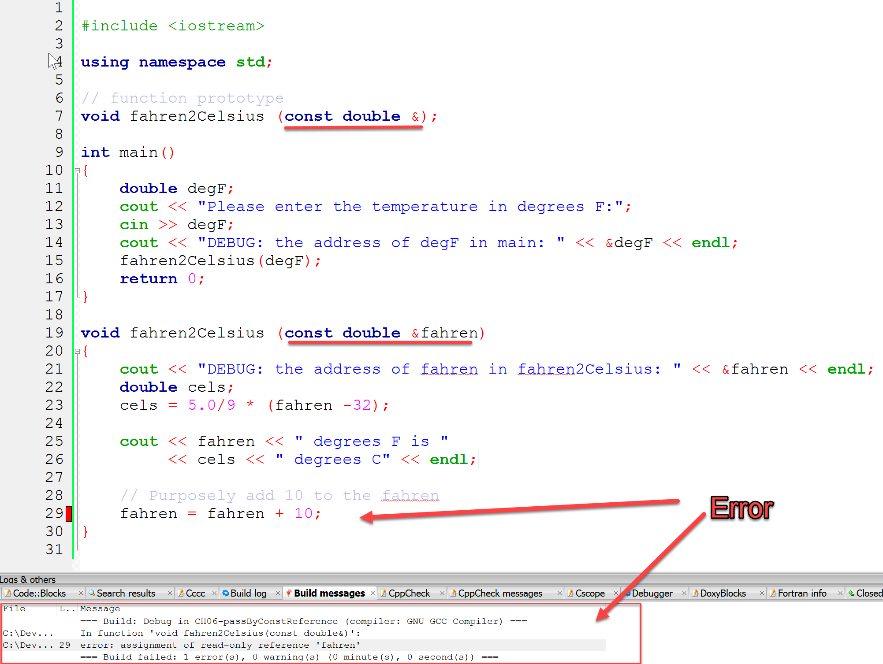
Pass by Constant Reference
When passing by const reference, any attempt to modify the parameter inside the function would result in an error

Slide 24
void Functions and the return Statement
void functions do not return any values
It is possible to place a “return” statement in a void function
The moment the return statement executes, the program control is transferred to the caller program
Any statements after the return statement are not going to execute as the function immediately goes out of scope following the execution of the return statement
Avoid using return statements in void functions
Instead use value returning functions that return bool or some other value

Slide 25
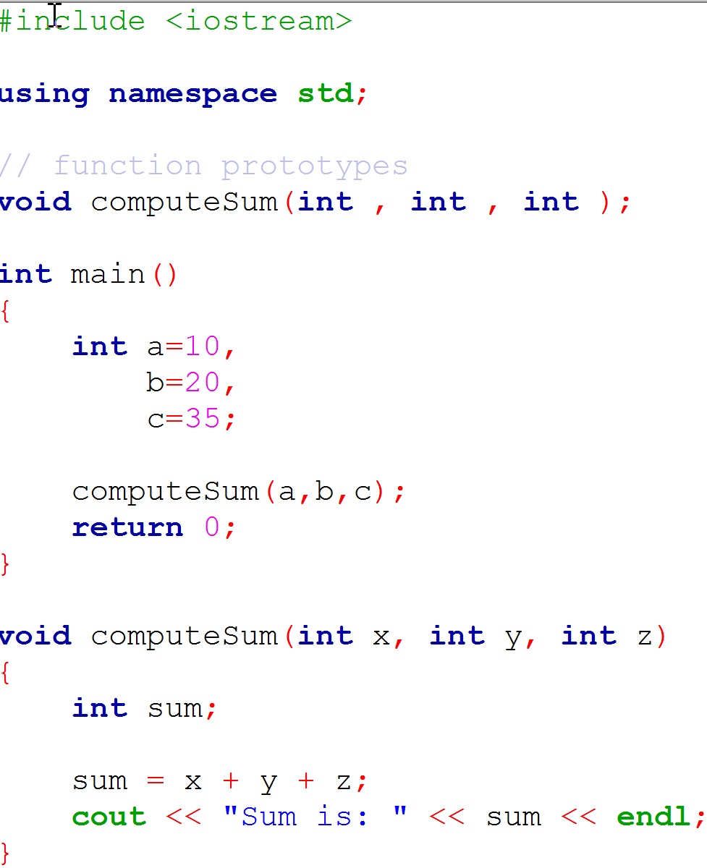
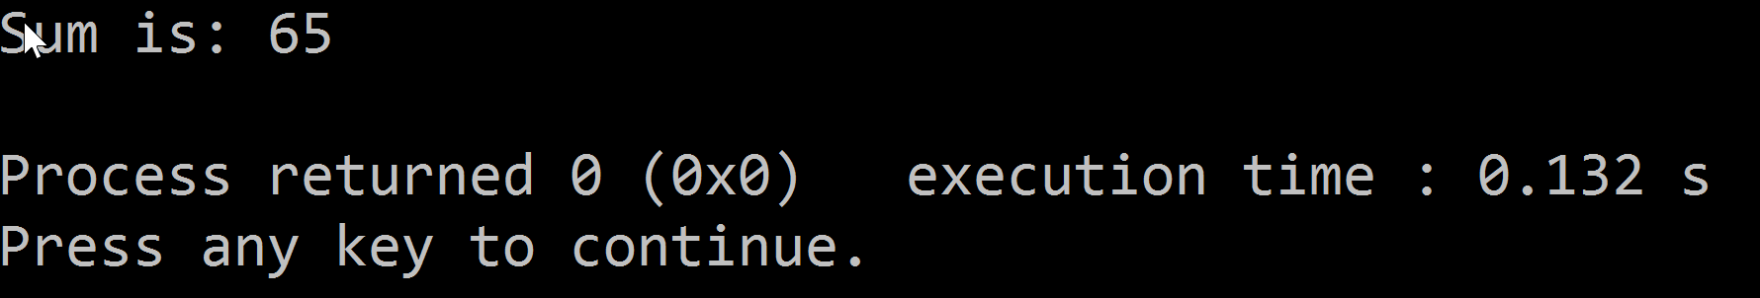
void Functions and the return Statement

Slide 26
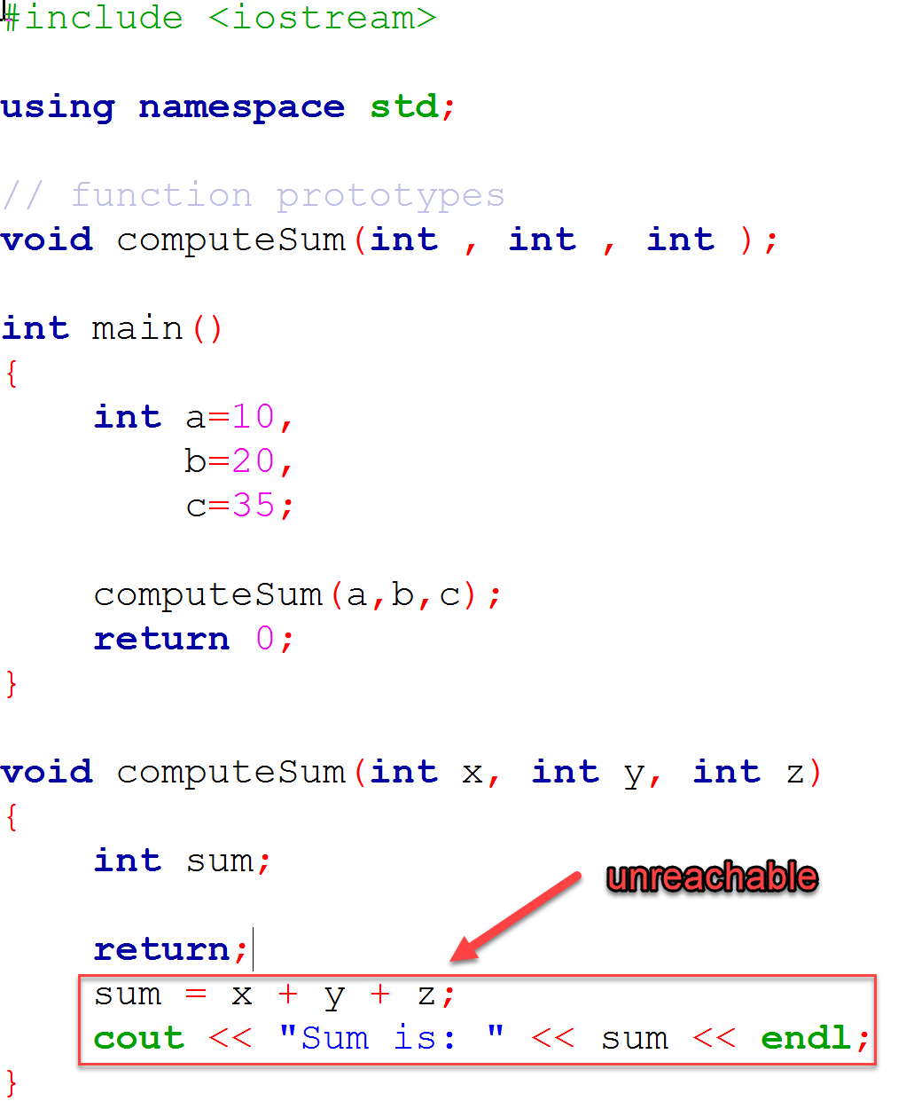
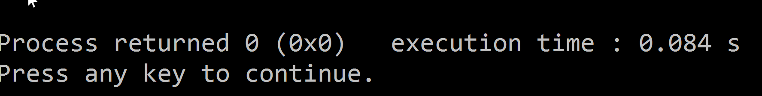
void Functions and the return Statement
Placing a “return” statement in a void function will return the control to the caller program
Statements after the return statement are not going to execute
In fact, the function will go out of scope following successful return to the caller program
Below is the output of the program run
sum is never computed nor displayed

Slide 27
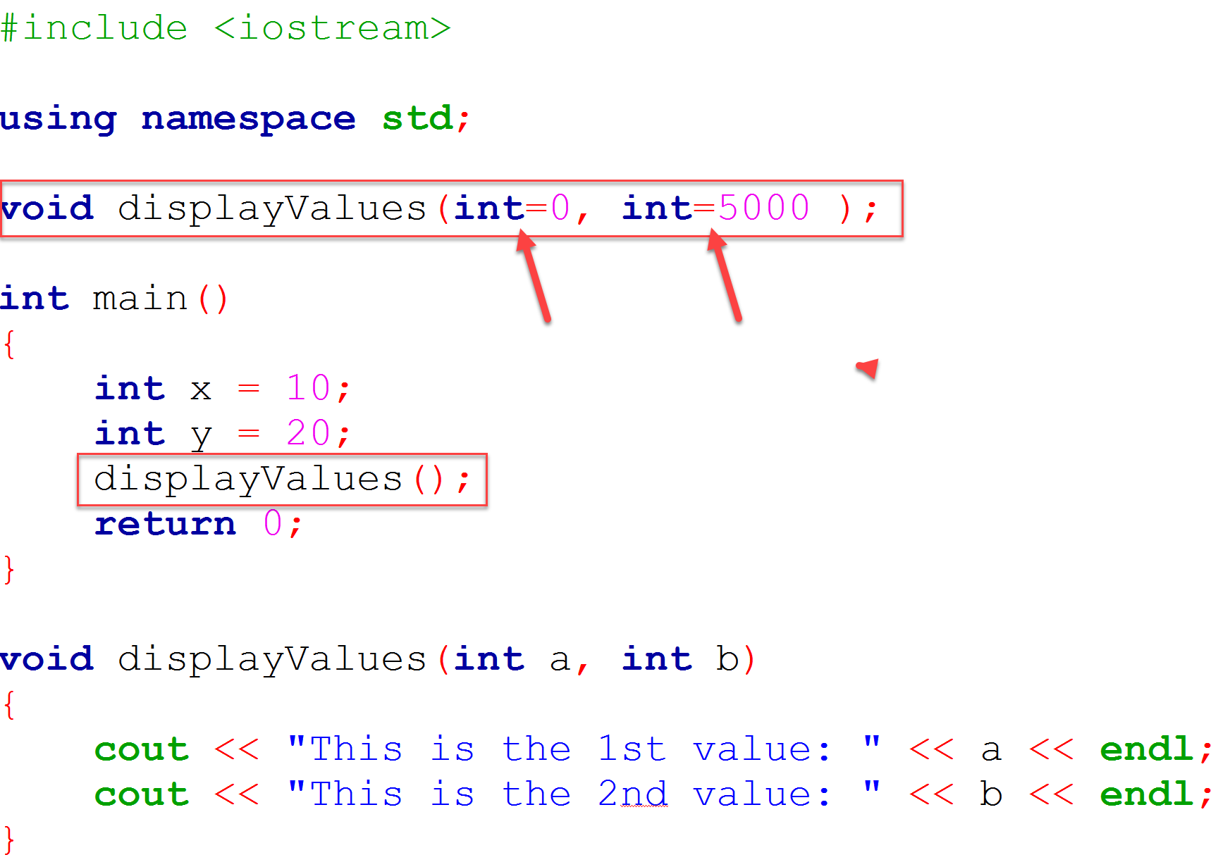
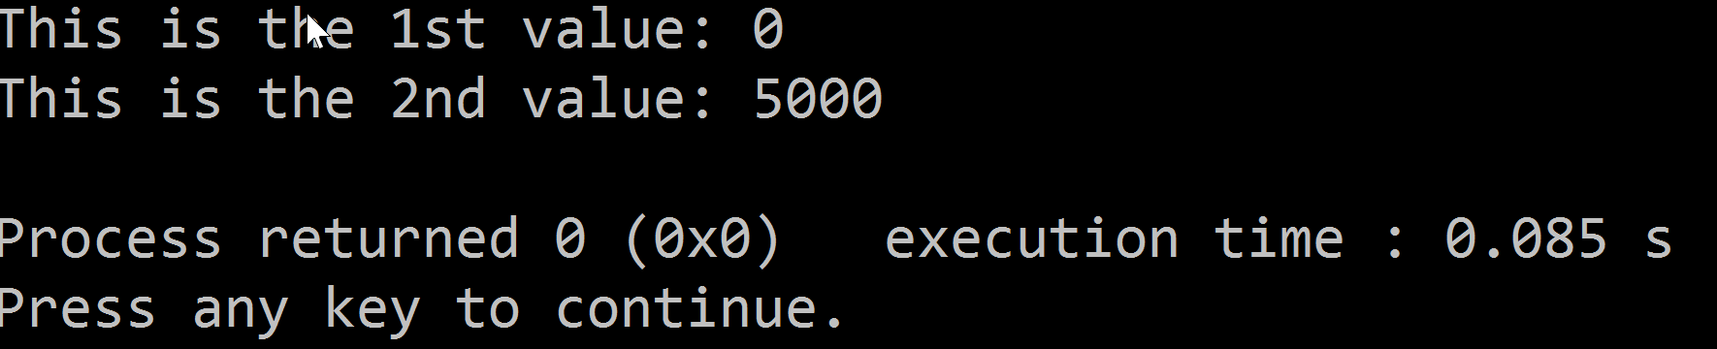
Default Arguments
Note the function prototype – both parameters have default values
Syntax: datatype = value
Should a programmer forget to pass an argument (or both as is the case in this example) when calling the function, the default argument will be assigned
Following is the output of the program run:
Note the function call was made without any parameters and default arguments were assigned

Slide 28

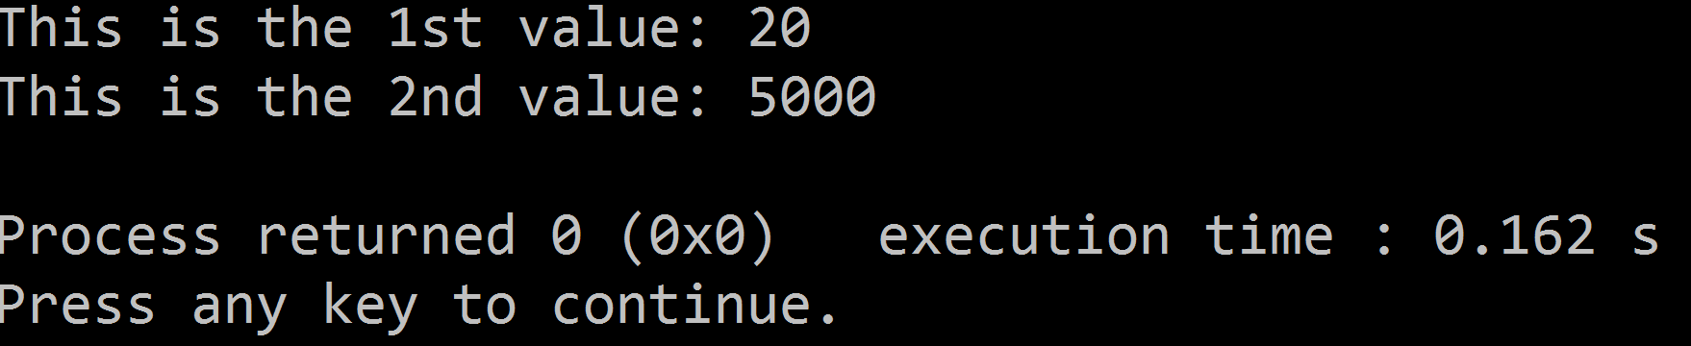
Default Arguments
The function was called with only one argument “y”
Following is the output of program run:
Notice that the passed argument’s value was copied to the first parameter and the second parameter got its value from the default argument
When skipping default arguments, you cannot skip arguments on the left
For example, if there are three default arguments, if the function is called with only two arguments, then 1st and 2nd parameters will receive the values and the 3rd (skipped) argument will receive the default parameter
displayValues(a); is correct
displayValues(, b); is incorrect

Slide 29
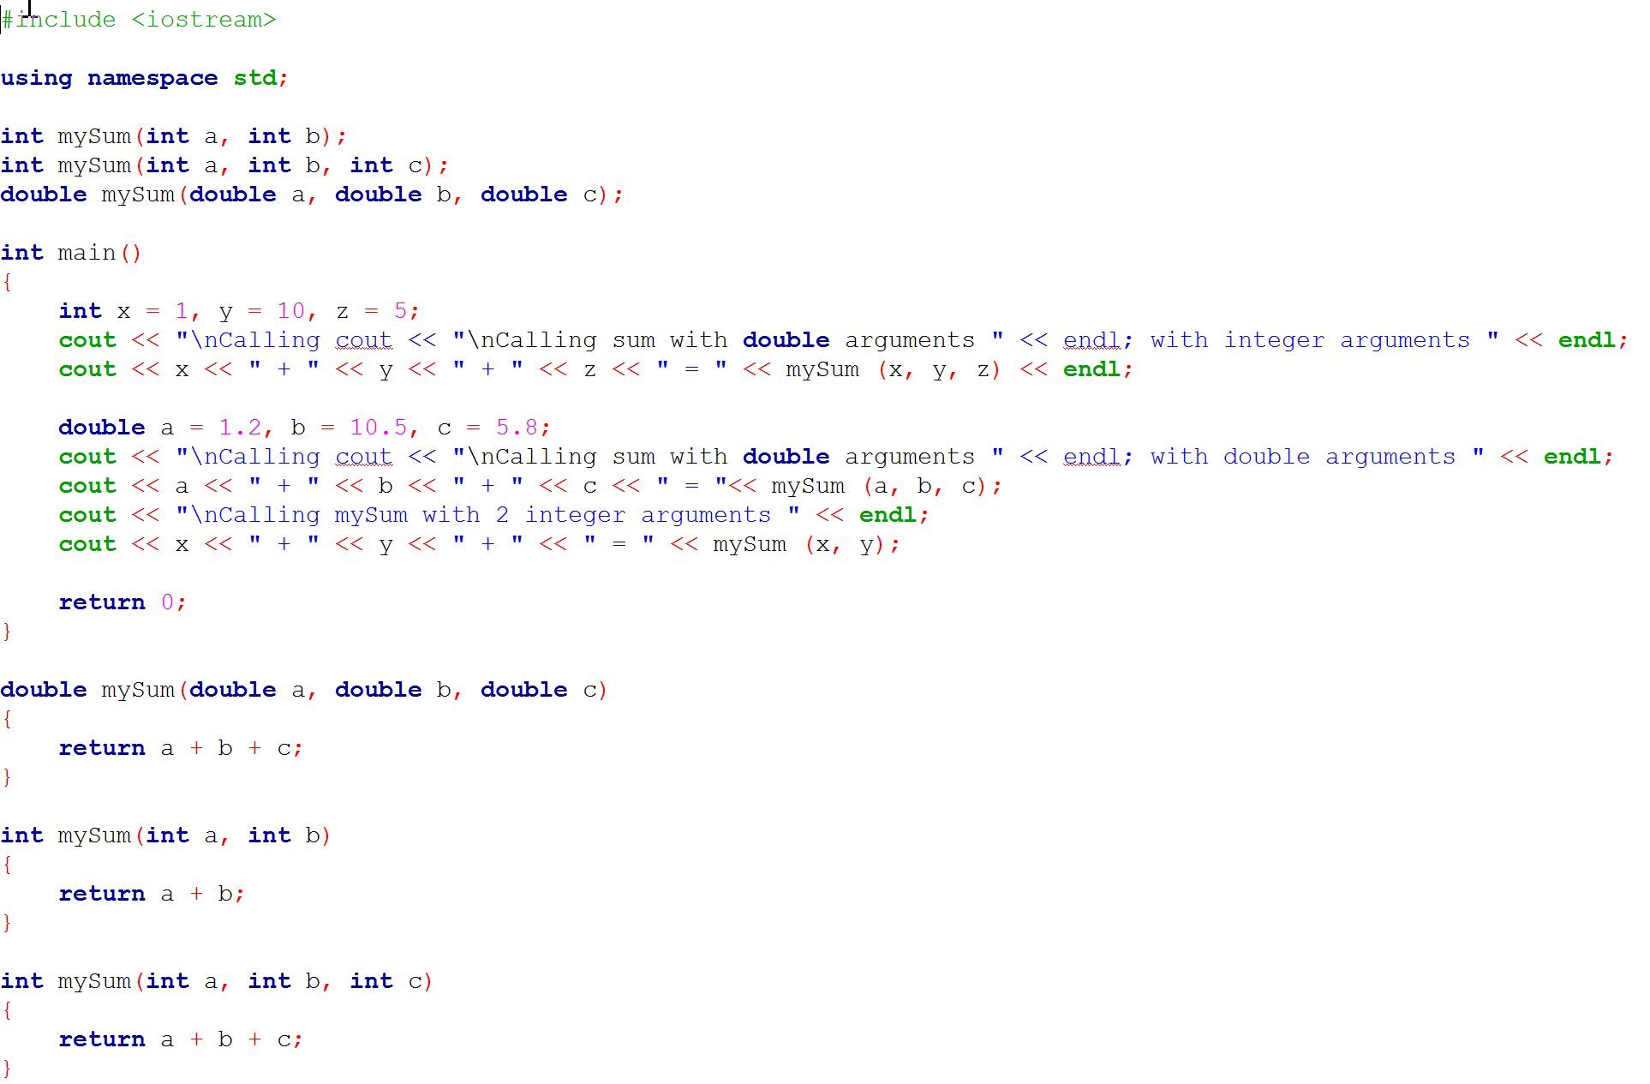
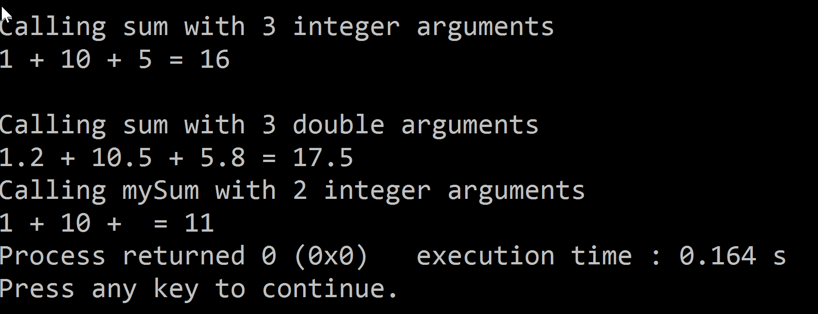
Overloading Functions
Great feature of the language
Simplifies source code
Functions have the same name but different “signature”
Function signature
Number of parameters and their data types

Slide 30
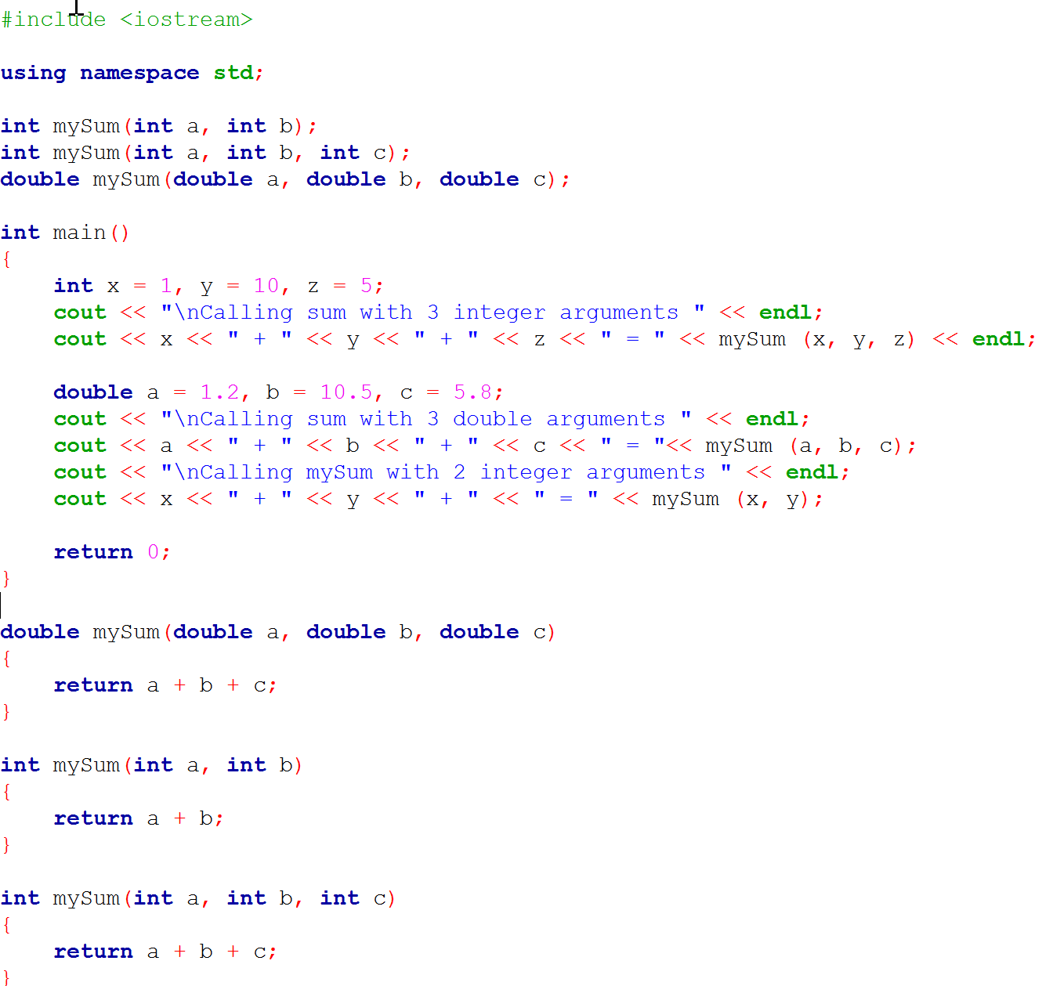
Overloading Functions - Example

Slide 31
Scope
“Lifetime” of a variable
Declared
Initialized
Operations performed on it – i.e. Incremented/decremented
Destroyed
Also it is important to note where in the program a variable has been declared
This determines the scope (“visibility”) of a variable
A variable is in scope after its declaration
Block scope
Variable declared inside a block of code
In scope only for that block of code
Global Scope vs Local Scope
Function Prototype Scope
Refers to the scope of function parameters
When the function returns to the caller, all of its parameters go out of scope

Slide 32
Global Variables / Global Constants
Global variables are in scope throughout the entire program
If not initialized, the compiler will set them to default values – i.e. set an int to zero
No need to pass them into functions
However, global variables are a very bad programming practice
Code portability is affected as functions that rely on global variables cannot be ported to another program
Any function can change global variable
The question is, which function changed it?
In order to control your code, you should always pass data to functions

Slide 33
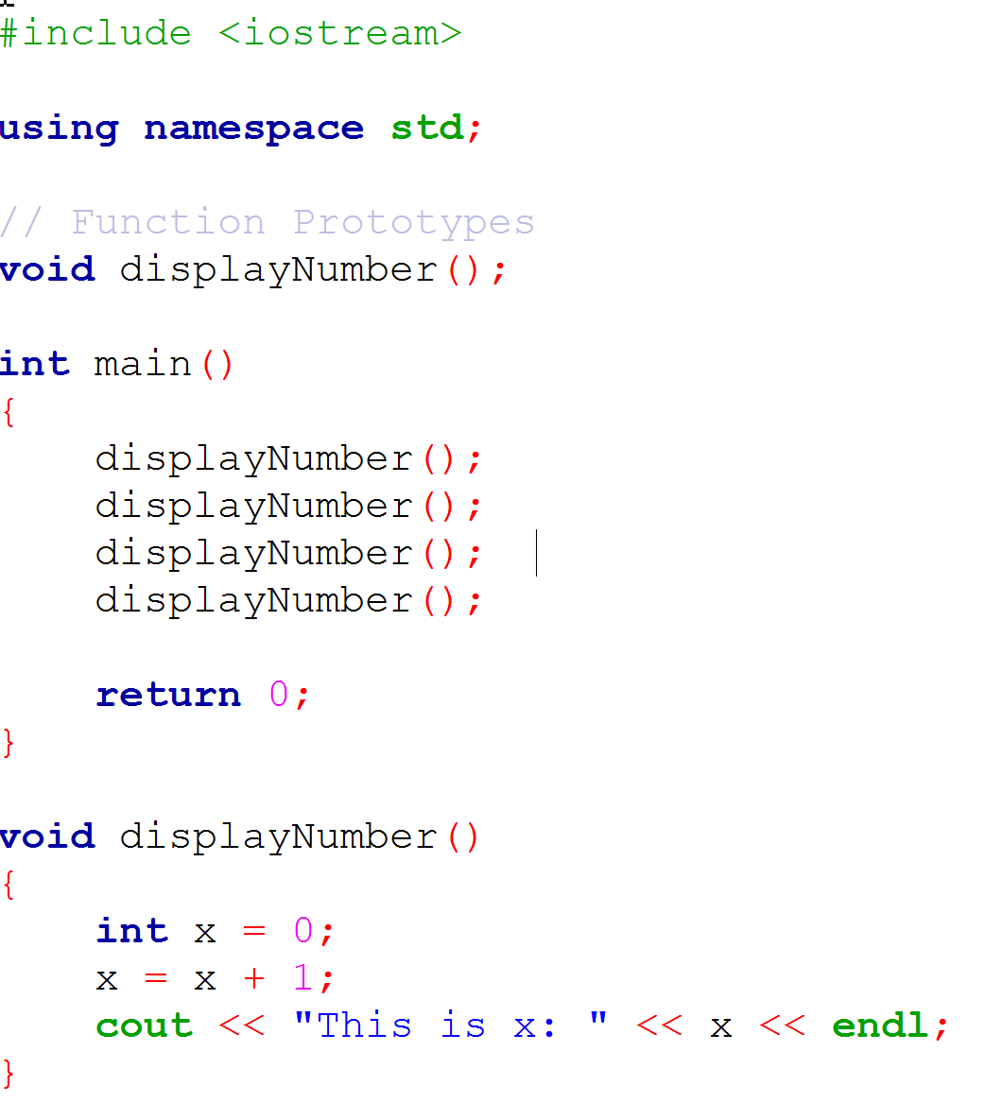
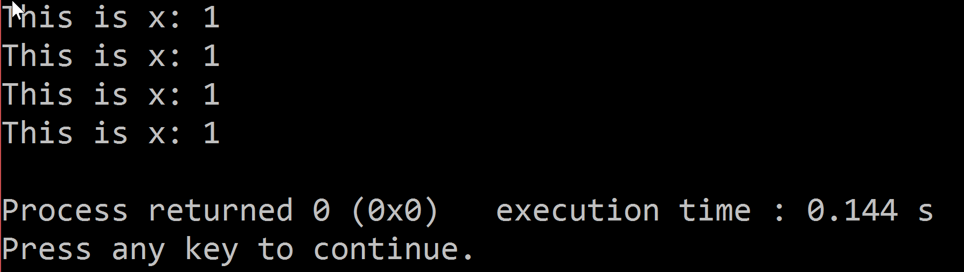
Local Variables
Local variables are in scope for the lifetime of a function
When the function returns to the caller program, all of its local variables are destroyed along with the data in them
Notice the output of the code sample?
Each time the function is called, variable x is allocated, initialized, and incremented.
Each time the function returns to int main, x (local variable in displayNumber) is destroyed
Good for program portability
Good for debugging as they are confined to the function not entire program

Slide 34
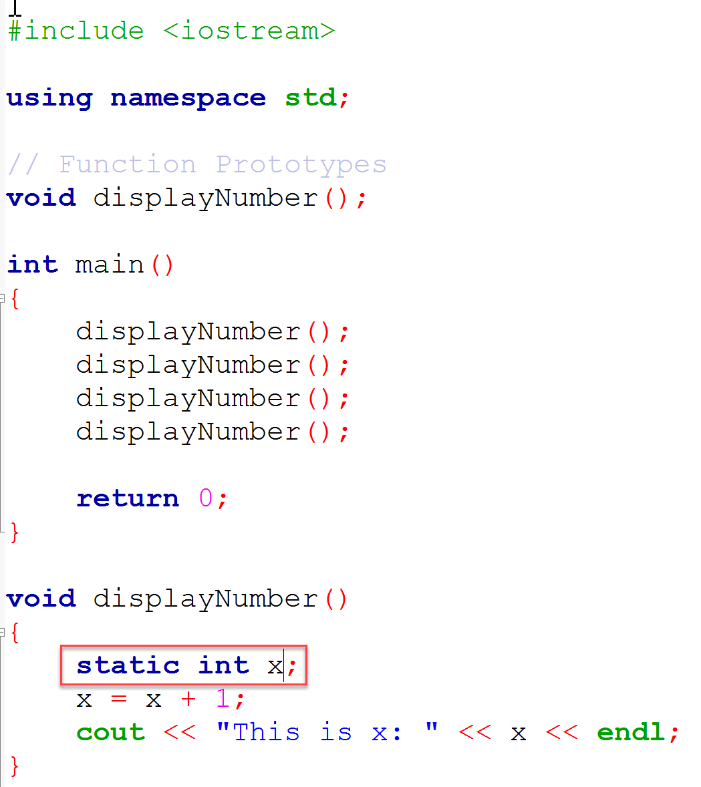
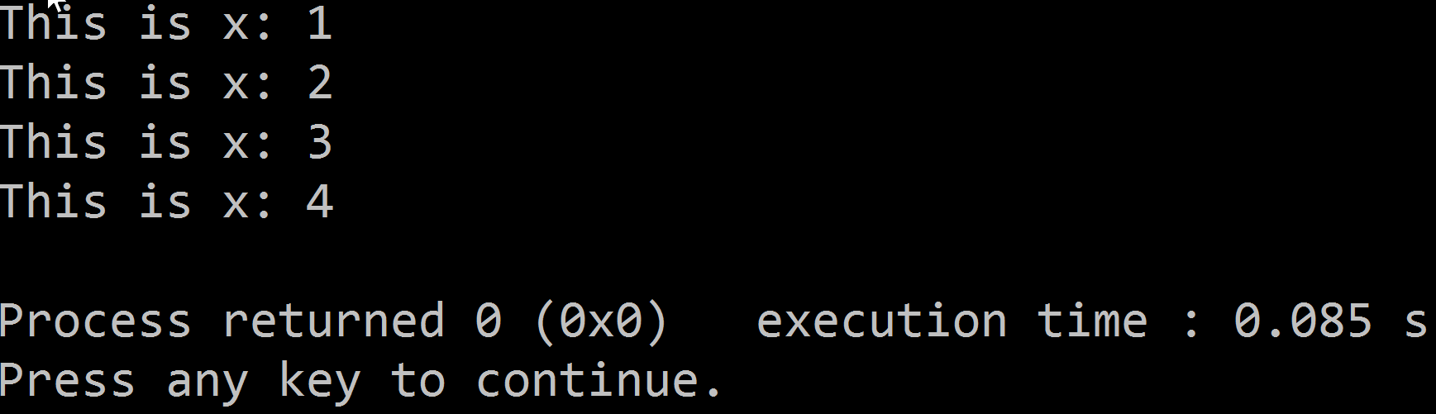
Static Local Variables
They behave like the global variables
The compiler will initialize them if not initialized
Notice that x was never initialized?
Yet they are local in scope
Hint: try printing x in main
Static local variables keep their values between function calls

Slide 35
Stubs & Drivers
Using stubs and drivers is a very good programming practice when working with functions
Tests values (data types) passed into a function
Driver program (usually int main) “drives” the program
Calls functions
Users get an idea of the program flow

