Slide 1
MATLAB ile Görüntü İşleme
Part - II
Temel İşlemler
Yoğunluk Dönüşüm Fonksiyonları
Filtreler
Histogram İşleme
Örnekler

Slide 2
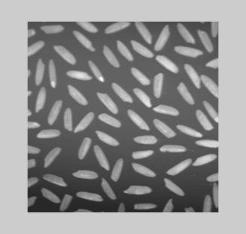
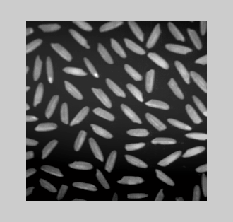
Temel İşlemler - I
1) Resmin okunması ve boyutlarının alınması :
r1 = imread('rice.tif');
[M, N] = size(r1);
display(M); %256
display(N); % 256
figure,imshow(r1);
2) Resmin Görüntülenmesi
% imshow(f,G);
% f is an image array
% G is the number of intensity levels
% imshow(f,[low high]);
% displays as black all values <= low
% displays as white all values >= high
imshow(r1, [64 256] );

Slide 3
Temel İşlemler - II
Filename: [1x44 char]
FileModDate: [1x20 char]
FileSize: 65966
Format: 'tif'
FormatVersion: []
Width: 256
Height: 256
BitDepth: 8
ColorType: 'grayscale'
FormatSignature: [73 73 42 0]
ByteOrder: 'little-endian'
NewSubfileType: 0
BitsPerSample: 8
Compression: 'Uncompressed'
PhotometricInterpretation: 'BlackIsZero'
StripOffsets: [8x1 double]
SamplesPerPixel: 1
RowsPerStrip: 32
StripByteCounts: [8x1 double]
XResolution: 72
YResolution: 72
ResolutionUnit: 'Inch'
Colormap: []
PlanarConfiguration: 'Chunky'
TileWidth: []
TileLength: []
TileOffsets: []
TileByteCounts: []
Orientation: 1
FillOrder: 1
GrayResponseUnit: 0.0100
MaxSampleValue: 255
MinSampleValue: 0
Thresholding: 1
ImageDescription: [1x166 char]
3) Resmin yazılması ve bilgilerinin alınması
imfinfo rice.tif
f = imread('rice.tif');
imwrite(f,'ricev01.tif');
imwrite(f,'ricev02.jpg','quality',0);
r2 = imread('ricev02.jpg');
figure,imshow(r2);
imfinfo ricev02.jpg
Filename: 'ricev02.jpg'
FileModDate: '31-Oct-2006 16:32:04'
FileSize: 1514
Format: 'jpg'
FormatVersion: ''
Width: 256
Height: 256
BitDepth: 8
ColorType: 'grayscale'
FormatSignature: ''
Comment: {}

Slide 4
Temel İşlemler - III
4) Sıkıştırma Oranı Hesaplama :
imwrite(f,'ricev02.jpg','quality',10);
K = imfinfo('ricev02.jpg');
display(K.FileSize);
image_bytes = K.Width*K.Height*K.BitDepth/8;
compressed_bytes = K.FileSize;
compression_ratio = image_bytes/compressed_bytes;
display(compression_ratio);
ans =
2989
compression_ratio =
21.9257

Slide 5


Temel İşlemler - IV
5) Binary Images
r = zeros(50,50);
r(5:44,13:25) = 1;
imshow(r);
B = logical(r); %%%
6) Intensity Images
% uint8 [0 256]
% uint16 [0 65535]
% double [0.0 1.0]
for i=1:50
for j=1:50
r(i,j) = i/100.0+j/100.0;
end
end
imshow(r);

Slide 6
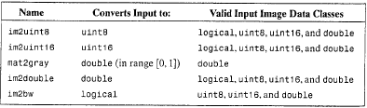
Resim Sınıfları ve Türleri Arasında Dönüşüm
Converting Between Image Classes and Types
A =
Columns 1 through 10
5 8 10 13 15 18 20 23 25 28
8 10 13 15 18 20 23 26 28 31
10 13 15 18 20 23 26 28 31 33
13 15 18 20 23 26 28 31 33 36
15 18 20 23 26 28 31 33 36 38
……………………………….
Columns 41 through 50
……………………………….
224 227 229 232 235 237 240 242 245 247
227 229 232 235 237 240 242 245 247 250
229 232 235 237 240 242 245 247 250 252
232 235 237 240 242 245 247 250 252 255
7) Yoğunluk değerlerini tamsayıya dönüştürmek :
A = im2uint8(r);
display(A);

Slide 7
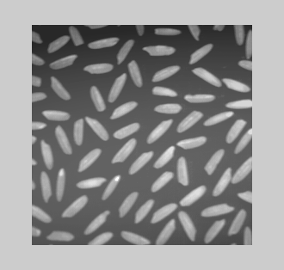
Temel İşlemler - V
8) Satır Toplamları Hesaplama :
for i=1:50
rowsum(i) = sum(r(i,:));
end
display(rowsum);
9) Resmi Dikey Ters Çevirme
(Flip Vertically)
r1 = imread('rice.tif');
figure,imshow(r1);
fp=r1(end:-1:1,:);
figure,imshow(fp);

Slide 8

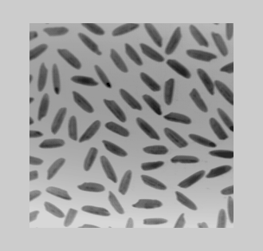
Temel İşlemler - VI
10) Subsampling
(Seyreltme, Altörnekleme)
r1 = imread('rice.tif');
figure,imshow(r1);
fp=r1(1:2:end,1:2:end);
figure,imshow(fp);
11) Resmin Negatifini Elde Etme
r2 = imcomplement(r1);
figure,imshow(r2);
veya
r2 = imadjust(r1,[0 1], [1 0]);
figure,imshow(r2);
Diğer?

Slide 9
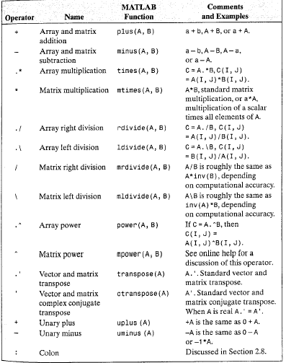
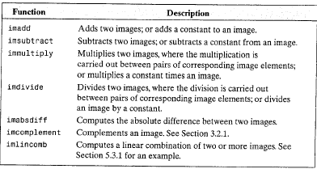
Aritmetik Operatörler
Resimler için aritmetik operatörler
Dizi ve Matrisler için aritmetik operatörler

Slide 10
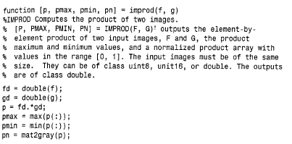

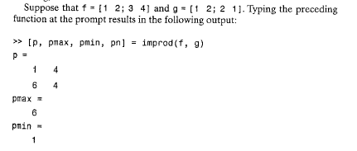
İki resmi çarpan matlab fonksiyonu yazmak

Slide 11
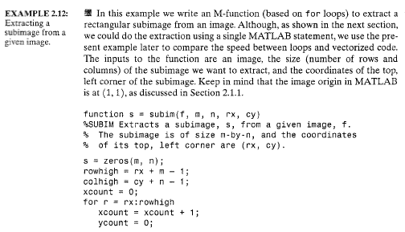

Extracting a subimage from a given image

Slide 12
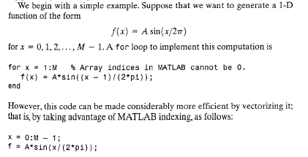
Vectorizing Loops

Slide 13
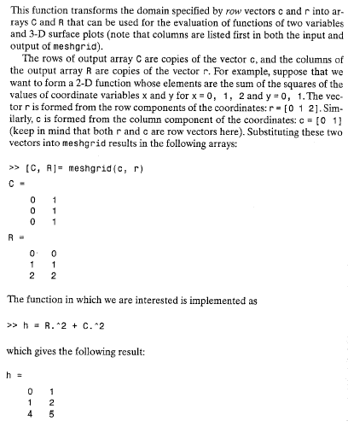
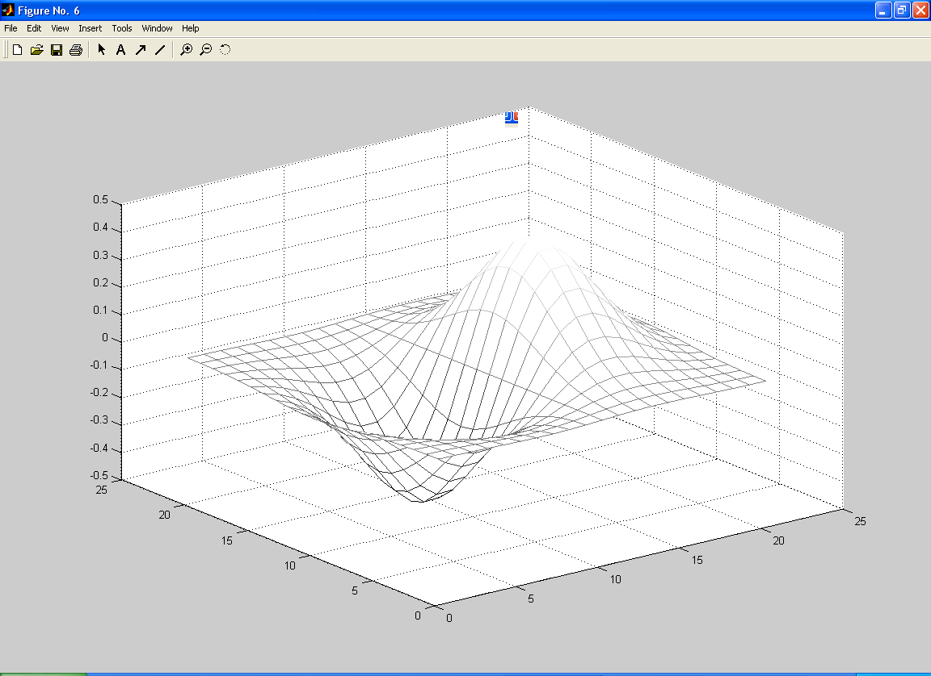
Meshgrid fonksiyonu
[X,Y] = MESHGRID(x,y) transforms the domain specified by vectors x and y into arrays X and Y that can be used for the evaluation of functions of two variables and 3-D surface plots.
The rows of the output array X are copies of the vector x and the columns of the output array Y are copies of the vector y.
[X,Y] = meshgrid(-2:.2:2, -2:.2:2);
Z = X .* exp(-X.^2 - Y.^2);
mesh(Z)

Slide 14
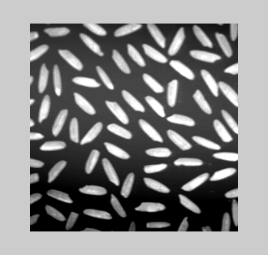
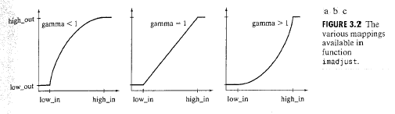

Yoğunluk Dönüşüm Fonksiyonları
Intensity Transformation Functions
r2 = imadjust(r1,[0.25 0.75], [0 1]);
figure,imshow(r2);

Slide 15
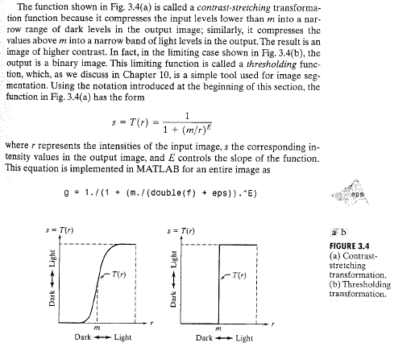
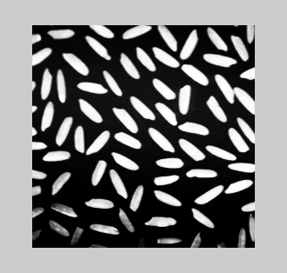
Contrast Stretching Transformation
m=127; E=10;
g=1./(1+(m./double(r1)+eps).^E);
figure,imshow(g);

Slide 16
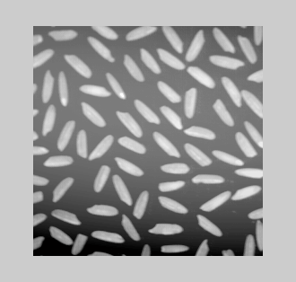
Logarithmic Transformations
g=im2uint8(mat2gray(log(1+double(r1))));
figure,imshow(g);
log, log2, log10

Slide 17
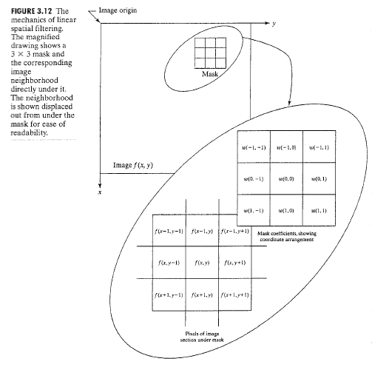
Filtreler
f = im2double(imread('rice.tif'));
imshow(f);
w1=ones(3);
g1=imfilter(f,w1,'replicate');
figure, imshow(g1,[]);
w2=ones(10);
g2=imfilter(f,w2,'replicate');
figure, imshow(g2,[]);
IMSHOW(I,[LOW HIGH])
If you use an empty matrix
([]) for [LOW HIGH], IMSHOW uses [min(I(:)) max(I(:))]; the
minimum value in I displays as black, and the maximum value
displays as white.
Filter, mask, kernel, window
Çarpımlar toplamı hesaplanır, sum of products
komşu pikseller dikkate alınır

Slide 18
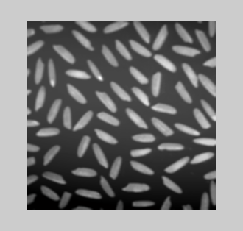
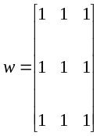
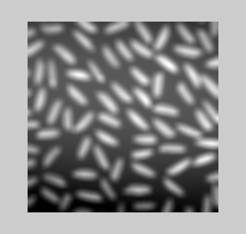
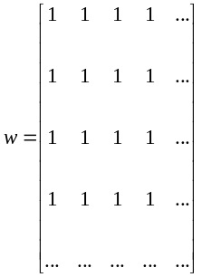
Filtreler
3x3
10x10

Slide 19
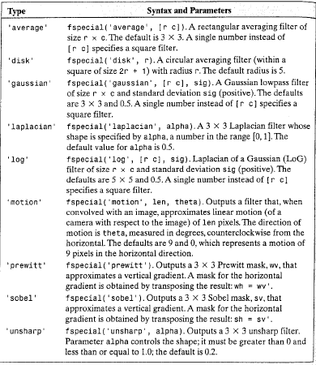
1. Standard Linear Spatial Filters
Doğrusal Uzaysal Filtreler

Slide 20
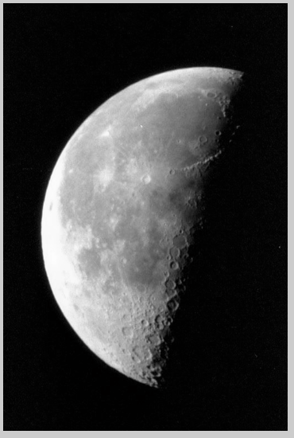
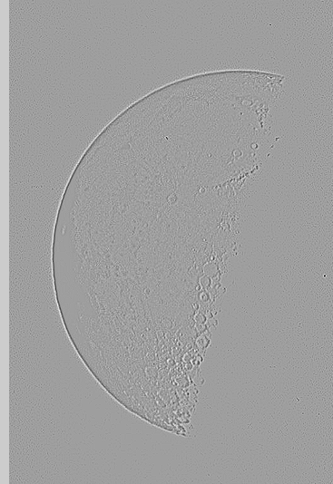
Laplacian Filter
f=imread('c:\\moon.tiff');
w4=fspecial('laplacian',0);
f=im2double(f);
g4=imfilter(f,w4,'replicate');
figure,imshow(g4,[]);

Slide 21


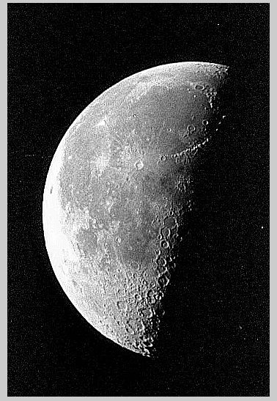
f=imread('c:\\moon.tiff');
w4=fspecial('laplacian',0);
w8 = [1 1 1; 1 -8 1; 1 1 1];
f=im2double(f);
g4=f-imfilter(f,w4,'replicate');
g8=f-imfilter(f,w8,'replicate');
imshow(f);
figure,imshow(g4);
figure,imshow(g8);

Slide 22
2. Standard Nonlinear Spatial Filters order statistic filters or rank filters
Min filter
Max Filter
Median Filter

Slide 23
Histogram İşleme
Histogram Processing

Slide 24
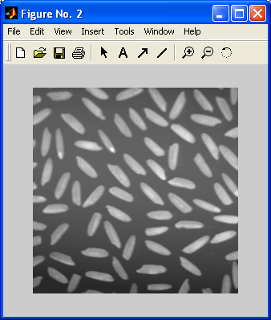
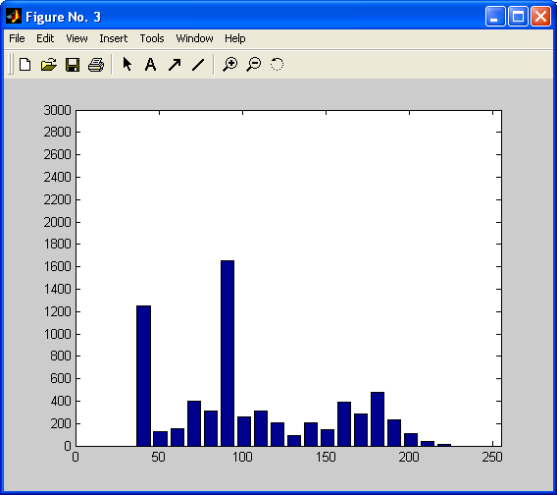
Örnek 1 : Resim Histogramları : Generating and Plotting Image Histograms
f=imread('rice.tif');
h=imhist(f);
h1=h(1:10:256);
horz=1:10:256;
bar(horz,h1);
axis([0 255 0 3000]);
set(gca,'xtick',0:50:255);
set(gca,'ytick',0:200:3000);

Slide 25
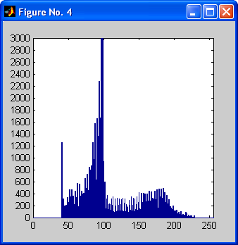
Tüm Yoğunluk Değerleri İçin
f=imread('rice.tif');
h=imhist(f);
h1=h(1:256);
horz=1:256;
bar(horz,h1);
axis([0 255 0 3000]);
set(gca,'xtick',0:50:255);
set(gca,'ytick',0:200:3000);

Slide 26
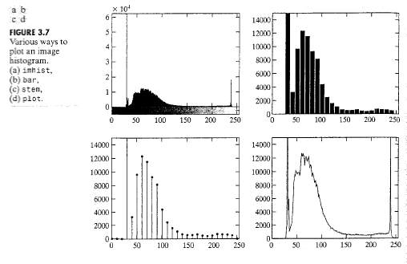
Değişik Histogram Çizdirme Yolları

Slide 27
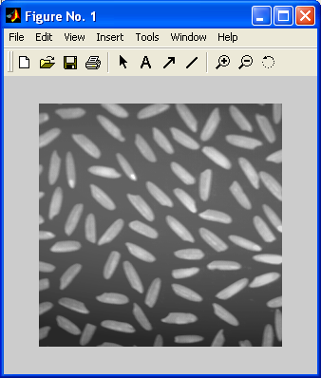
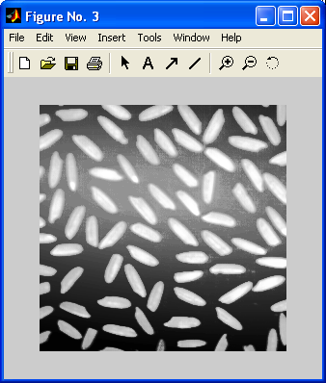
Örnek 2 : Histogram Eşitleme (Histogram Equalization) - I
Orijinal resim
Eşitlemeden sonra
f=imread('rice.tif');
figure,imshow(f);
figure;imhist(f);
ylim('auto');
g=histeq(f,256);
figure,imshow(g);
figure;imhist(g);
ylim('auto');

Slide 28
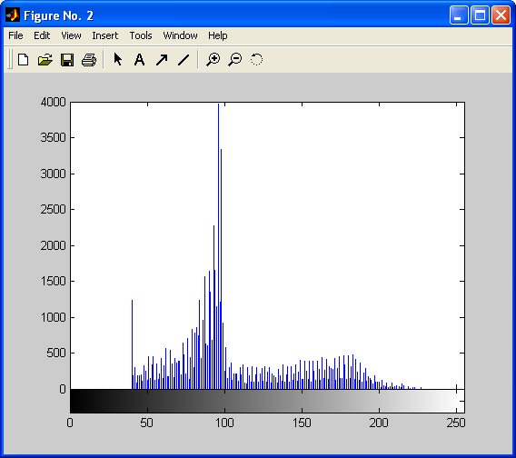
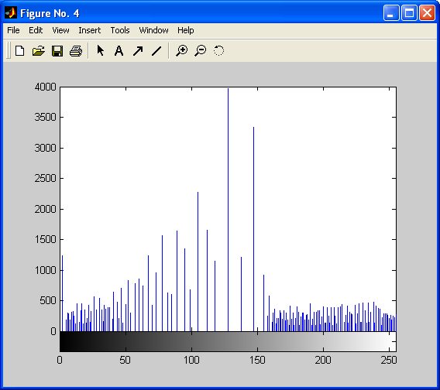
Örnek 2 : Histogram Eşitleme (Histogram Equalization) - II
Orijinal frekanslar
Eşitlemeden sonra

Slide 29
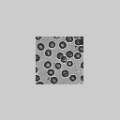
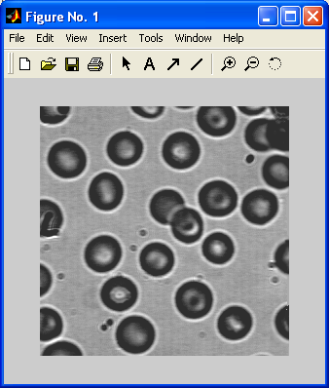
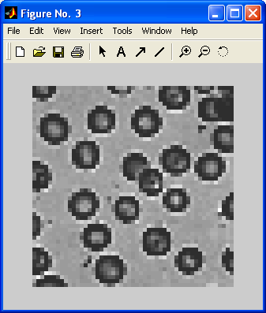
Örnek 3 : Downsampling
f=imread('blood1.tif');
f=ind2gray(f,gray(256));
f=f(1:256,1:256);
f1=imresize(f,0.2); % Downsample to a 1/5th of the size
f2=imresize(f1,5); % Go back to original size
figure; imshow(f);
figure; imshow(f1);
figure; imshow(f2);

Slide 30
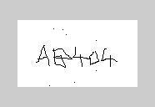
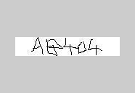
Örnek 4 : Karakter Boyu Bulma
r1 = imread('c:\\plaka2.jpg');
imshow(r1);
K = imfinfo('c:\\plaka2.jpg');
for i=1:K.Height
satir_toplam(i)=sum(r1(i,:));
end
display(K.Height); display(K.Width);
display(satir_toplam);
for i=K.Height/2:-1:1
if(satir_toplam(1)-satir_toplam(i)<2500)
break;
end;
end
low = i;
display(low);
for i=K.Height/2:1:K.Height
if(satir_toplam(1)-satir_toplam(i)<2500)
break;
end;
end
high = i;
display(high);
r2 = imcrop(r1,[1 low K.Width high-low]);
figure, imshow(r2);

Slide 31
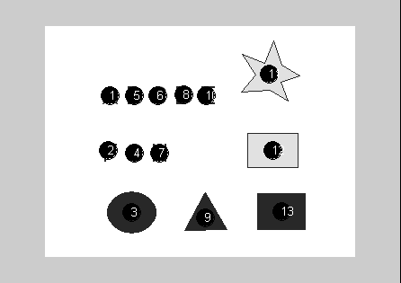
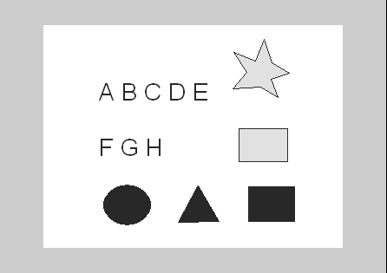
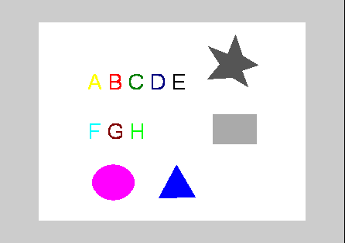
Örnek 5: Bir Resimdeki Nesneleri Bulma

Slide 32
Örnek 5: Bir Resimdeki Nesneleri Bulma
f=imread('c:\\Sekiller.gif');
imshow(f);
f=imcomplement(f);
[L,n]=bwlabel(f);
hold on % So later plotting commands plot on
% top of the image display(n); display(L([50:60],:));
for k=1:n
[r,c] = find(L==k);
rbar = mean(r);
cbar = mean(c);
plot(cbar, rbar, 'Marker', 'O', 'MarkerEdgeColor', 'k', ...
'MarkerFaceColor', 'k', 'MarkerSize', 15);
text(cbar, rbar, num2str(k),'Color','w','FontSize',10);
end
% Farklı Renk Verme
colored = label2rgb(L);
figure, imshow(colored);

