Slide 1
Image Processing #3
Computing with Images

Slide 2
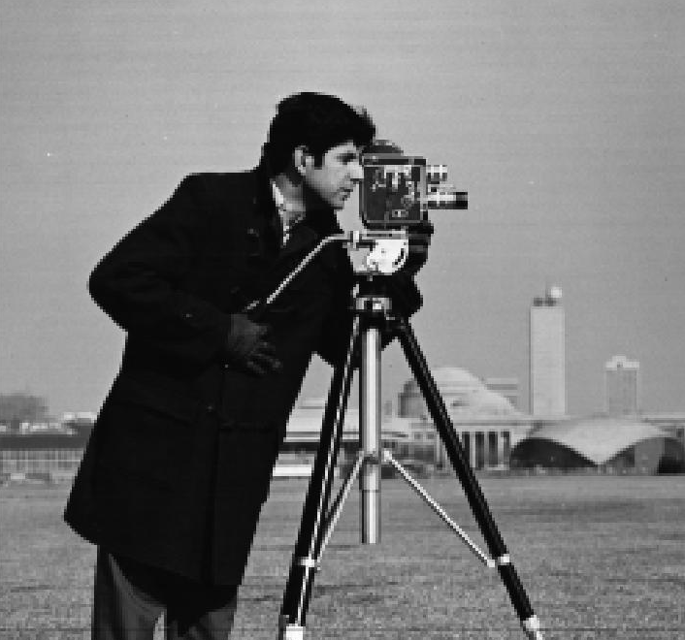
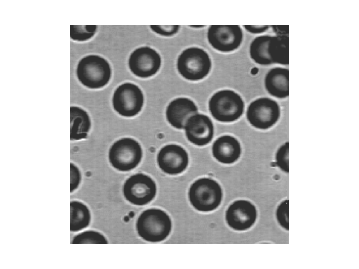
Agenda
Computing with image
  An image ”calculator”
How is it done?
What can we use it for?
+
= ??
- 142 = ??

Slide 3
Computing with Images
Arithmetic: An image calculator: + - / etc.
Logic operations (the math. inside the CPU…)
Image computation is done pixel-wise
For example:
a1
a2
…
b1
b2
…
a1 +b1
a2 +b2
a3
a4
…
+
b3
b4
…
=
a3 +b3
a4 +b4
…
…
…
…
…
…
a1
a2
…
a1 +10
a2 +10
a3
a4
…
+
10
=
a3 +10
a4 +10
…
…
…

Slide 4
Computing with Images
The size of the output image
Sometimes a program requires the images to have the same sizes
+
=

Slide 5
Computing with Images: Caution!!
Undesired effects may happen, when computing with images: Overflow / Underflow
Example: Two Gray value images I₁, I₂ with pixel ranges: [0,255]. Their Pixel sum may be larger than 255!! For example: 124+202=326!
Subtraction results may be smaller than 0!!
For example: 124-202=-78!!

Slide 6
Solution to the Overflow/Underflow Problem
Use an intermediate image:
  Pixel values are float values (32 bits / 4 bytes)
  Can store almost any number
Write computation results into intermediate image
Rescale intermediate image to values 0…255 and write results into normal Gray value image.

Slide 7
Gray Value Scaling and Shifting
Intermediate float image
… | -1 | … | 0 | … | 1 | … | min | … | max | …
Gray value image
0 | 1 | … | … | 255 | 256 | … | … | … | …
Does this algorithm look familiar?
Same algorithm as used in histogram stretching!
(show:2D_gel add 2D_gel, med/uden 32-bit. Forklar forskel)

Slide 8
Computing with Images
In ImageJ
  Involving two images:
  Process => Image Calculator
  Involving an image and a constant:
  Process => Math
+
=
+
10
=

Slide 9
Computing with Images
Operators in ImageJ
  Arithmetic: +, - , x, /
  Logic: AND, OR, NOT, XOR
  Others: Min, Max, Average, Difference
Let us have a closer look…

Slide 10
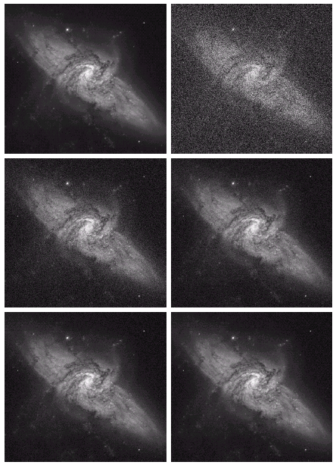
Computing with Images: Arithmetic
Original
Noise added
Arithmetic: +, - , x, /
Example: Addition (+)
  Remove noise
Assume noise has zero mean
The noise tends to cancel out if we average a number of images
Example: real value: 100.
Value in different images: 103, 109, 98, 87, 95, 112.
Average = (I₁ + I₂ + I₃ + I₄ + I₅ + I₆ ) / 6 = 104
The more images the better
Requirement: nothing is moving (changing) in the scene!
8
16
64
128

Slide 11


Computing with Images: Arithmetic
Arithmetic: +, - , x, /
Example: Addition (+)
  Used when adding text etc. to your images
  Mixing two images by averaging (show: 2D_gel and alphabet)
  But what if we want to put more weight on one image?
    Go from one image to another…
  Alpha blending (or weighted averaging):
  If then this operation is std. averaging
  (show: 2D_gel and alphabet for different alpha)
  Many programs (CV+CG) support alpha blending
    Image representation: RGBA (4 bytes) per pixel
    Each pixel can have its own alpha value!
      E.g. transparency of an object

Slide 12
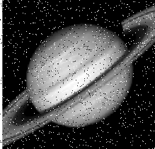
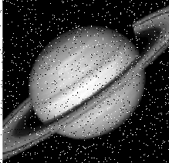
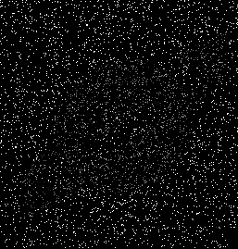
Computing with Images: Arithmetic
Arithmetic: +, - , x, /
Example: Subtraction (-)
  Subtract two images of the same scene at different time instances => Noise in scene
  Help you to judge the nature of the noise in your setup
Before
After
Error
( ShowEyesweb demo )
-
=
-
=

Slide 13
Computing with Images: Arithmetic
Subtraction (-)
  Background subtraction
Image containing object - Background image = Object
More on this later on…
Image w. Obj.
Background
Object
-
=
-
=

Slide 14
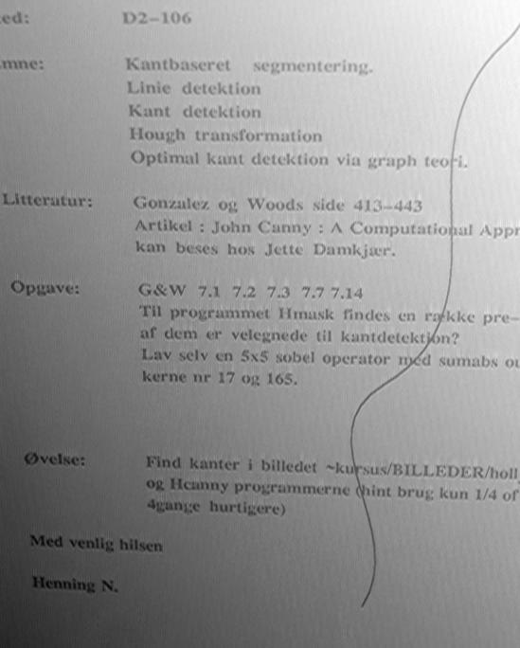
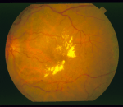
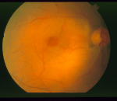
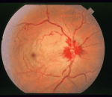
Computing with Images: Arithmetic
Arithmetic: +, - , x, /
Subtraction (-)
Improve segmentation
Uneven illumination
  Within an image
  Between images
Solution
  “Remove background”
  Algorithm: g(x,y) = f(x,y) – f(x,y), f(x,y) = mean
  Use a big kernel for f(x,y), e.g., 10-50

Slide 15
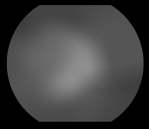
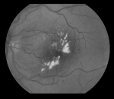
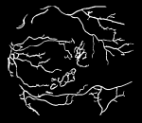
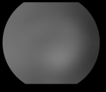
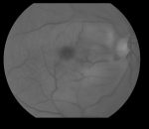
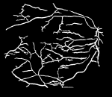

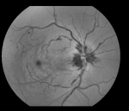
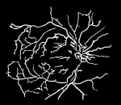
Computing with Images: Arithmetic
Input f(x,y)
Mean f(x,y)
  f(x,y) – f(x,y)
Edges

Slide 16




Computing with Images: Logic
Logic operations: AND, OR, NOT, XOR
  AND: & , &&
  OR: | , ||
  0=False=black, 1=True=white. Sometimes everything > 0 is True
Truth table (sandheds tabel)
AND
0
1
AND
=
0
0
0
1
0
1
OR
0
1
OR
=
0
0
1
1
1
1

Slide 17

Computing with Images: Logic
NOT: ! Means inverting the image
NOT
=
XOR
0
1
XOR
=
0
0
1
1
1
0

Slide 18
Logic: Examples
Two methods to find
objects in the image
  Color thresholding
  Background subtraction
Just one method has to be correct
Both methods have to be correct
= OR: The object is here
= AND: The object is here

Slide 19
Logic: Examples
Measure the degree of overlap between two images: I₁ and I₂
I₄=I₁ AND I₂
= dark grey
I₁
I₂
I₃=I₁ OR I₂
A is the number of pixels in I₁
B is the number of pixels (dark grey) in I₄
Degree of overlap is given as B/A
[0,1] 0 is no overlap and 1 is perfect overlap
What if I₂ is completely black?
Disagreement is found as C/D
C is the number of non-dark grey pixels (light grey + black) in I₄ :
I₃ - I₄ = I₁ XOR I₂
D is the number of pixels in I₃
[0,1] 1 is no overlap and 0 is perfect overlap

Slide 20

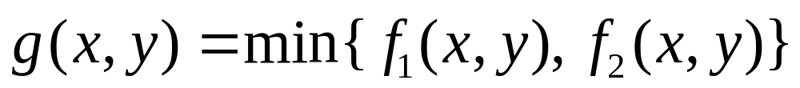
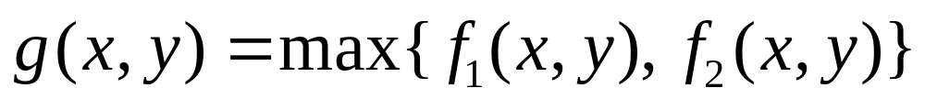
Computing with Images
Other operations: Min, Max, Average, Difference
  Average: Normalised addition: (I₁ + I₂ ) / 2
  Difference: The absolute value of image subtraction
    Abs (I₁ - I₂ )
    Abs(-2)=2. Written as |-2| = 2 Math: abs(Z) =
    Code: If (Z<0) then Z = -1 x Z
    I₁ - I₂ will be in [-255 , 255]. | I₁ - I₂ | will be in [0 , 255]
  Min:
  Max:
  (show: 2D_gel:max 100)

Slide 21
What to remember
Arithmetic: An image calculator
Logic: “Computer math.”
Pixel-wise operation
Either two images, or an image and a scalar
Caution: overflow and underflow
Operations:
  Basic: +, - , x, /
  Logic: AND, OR, NOT, XOR
  Others: Min, Max, Average, Difference

Slide 22
Exercises (1/5)
Discuss the PE-questions
Play around with the image computing tools in ImageJ
Find an image and add noise. Try to remove the noise by the method from OH 10
  ImageJ: Process => Noise
Draw: Abs(y), where y=x+1
How would you do alpha-blending with three images?

Slide 23
Exercises (2/5)
Samme opgave som sidst
  Men nu har i en metode
  som kan hjælpe jer ☺
  NB: ImageJ:
    Mean: Process => Filters => Mean

Slide 24
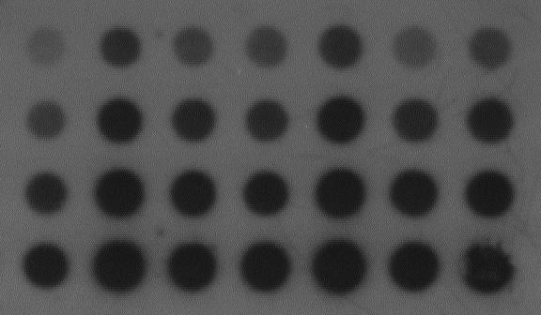
Exercises (3/5)
Samme opgave som sidst
  Men nu har i en metode som kan hjælpe jer ☺
  NB: ImageJ: Mean: Process => Filters => Mean

Slide 25
Exercises (4/5)
Chroma-keying
  Use Image Processing to combine the weather-girl and the graphics (only in theory)
  Assume the green rectangle and the graphical map of DK overlap 100%
Input image: A
Graphics: B

Slide 26



Exercises (5/5)
Given two images: A and B
  How kan logic be used to create the following images?
C
D
E
A
F
G
H
B

