Slide 1
Graph-based Algorithms for Segmentation
Speaker : Sema Candemir
Course : Algoritmalar ve Teorisi Alanında Özel Konular
Date : 27/05/2005

Slide 2
Presentation Plan
Introduction
Last Week
Segmentation
  Graph Based Clustering
  Energy Minimization with Graph Cuts
References

Slide 3
Introduction
Graph algorithms are abundant and give good results on many computer vision problems.
There have been a number of interesting results in computer vision in the past few years that make use of graph algorithms.

Slide 4
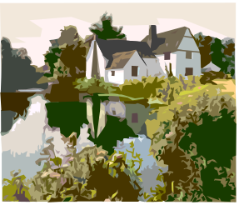
What is Computer Vision ?
2-D Images
Preprocessing
Modelling
Recognition

Slide 5
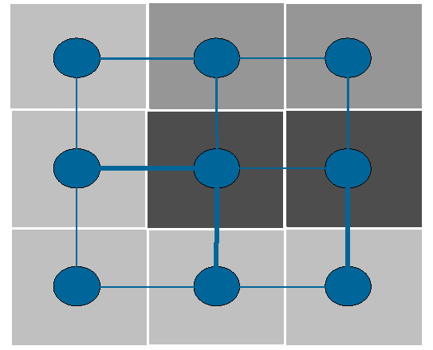
From Pixels to Graphs
A two-dimensional digital image is usually given by a rectangular array of picture elements called pixels.
Each vertex represents a pixel.
Edge weights are proportional to the difference in pixel intensities.

Slide 6
Object Recognition
We are given a set of features describing the scene
S={f1, f2, ...}
And a second set describing the model
M={F1,F2,...}
The task of the object recognition step is to find a global correspondence, i.e.
{(f1,F1), (f2,F2),... }
To find this pairings, researchers have used different techniques like generalized Hough transform, graph matching, relaxation labeling and constrained tree search.

Slide 7
Graph Matching
Image model is given as graphs
gm={Vm, Em} where
(for example, gm is an aspect graph)
    Vm is a set of vertices
    Em set of arcs
gd={Vd,Ed} is a graph derived from an observed image of a scene.
We want to know whether the scene contains the object desribed by gm.
Image based Measurement System, Obect Recognition and Parameter Estimation, Ferdinand van der Heijden, John Wiley & Sons,1994 ISBN: 0 471 950629

Slide 8
Aspect graphs
An aspect of a polyhedron is the set of visible faces.
If the number of polyhedron types in a scene is limited, then the recognition of an object can be done by storing all possible aspect graphs in a database.

Slide 9
Graph Matching
Matching problems can be formulated as largest isomorphic subgraph or largest isomorphic subtree problems
The problem is the question whether gd is, or contains, gm. If so we call this graph as isomorphic graphs.
d4
m2
m3
d3
gm
d2
gd
m1
d1
gm is an isomorphic subgraph of gd

Slide 10
Problems at Aspect Graph Solution
The aspect of graph of a polyhedron is certainly not unique. Other polyhedrons may have the same aspect graph.
An object in the foreground may occlude an object in the background. Of course this will affect the aspect graph.
Noise will affect the aspect graph

Slide 11
Solution to this problems
Attributes can be appended to the nodes so as to add information to the image of the faces.
Shadow can be utilised to improve the robustness.
Polygon
4 vertices
2 vanishing points
Radu Horaud and Humberto Sossa, Polyhedral Object Recognition by Indexing Pattern Recognition [5]

Slide 12
2 - Segmentation
  Minimum Spanning Tree
  Graph based Clustering
  Energy Minimization with Graph Cuts

Slide 13
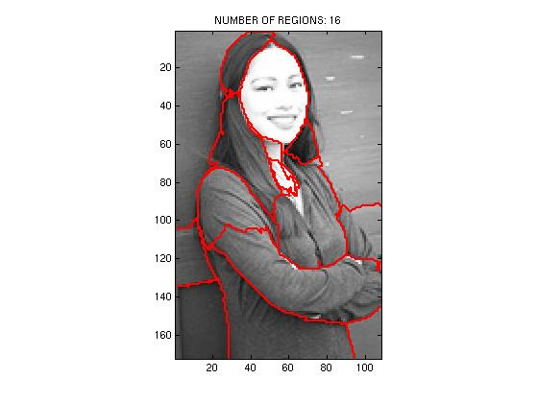
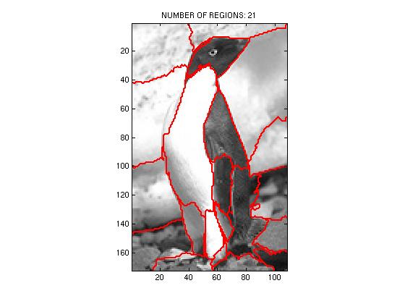
What is Segmentation ?
Segmentation: given an image, partition it into a number of regions, so that each region corresponds to an object. (intensity, color, texture ...)
İmages from Hrishikesh Deshpande, Image segmentation for digital cameras

Slide 14
Graph theoretic approaches have been widely used for performing segmentation.
Such interesting graph algorithms used in
segmentation
  Minimum Spanning Tree
  Graph Cut

Slide 15
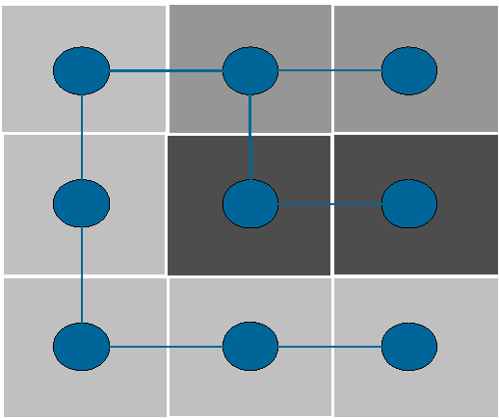
The minimum spanning tree (MST)
MST’s are used in segmentation.
The minimum spanning tree of an edge-weighted graph is a tree that spans all nodes of the graph and of minimum total weight among all such trees.
Yakov Keselmen, Some Applications of Graph Algorithms in Computer Vision

Slide 16
The minimum spanning tree (MST)
Add one edge at a time, of a minimum weight, that connects two different disconnected components.

Slide 17
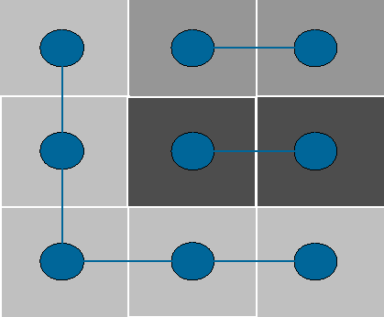
The minimum spanning tree (MST)
Go on until the difference between adjacent components becomes too large (the value is determined by a parameter)
MST’s are also used in clustering
Yakov Keselmen, Some Applications of Graph Algorithms in Computer Vision

Slide 18
Segmentation by Graph Theoretic Clustering
One natural view of segmentation is that we are attempting to determine which components of a data set naturally “belong together”
This is a problem known as clustering.
There are different techniques to solve clustering problem. One of them is Graph based approach.

Slide 19


Associate each data item with a vertex in a weighted graph, where the weights on the edges between elements are large if the elements are “similar” and small if they are not.
Image are taken from Davi Geiger, Image segmentation

Slide 20
Finding the Minimal Cuts:
Spectral Clustering Overview
Data
Similarities
Block-Detection
This slide from Dan Klein, Sep Kamvar, Chris Manning, Natural Language Group Stanford University

Slide 21
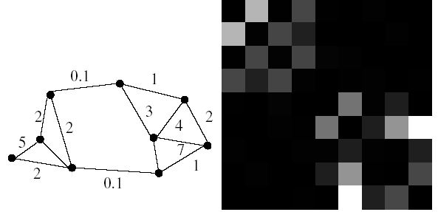
Construct an edge from every element to every other
Associate with this edge a weight representing the extent to which the elements are similar.

Slide 22
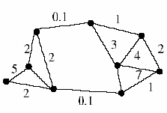
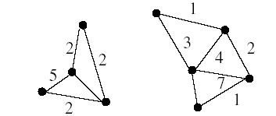
Cut the graph into connected components with relatively large interior weights “which correspond to clusters” by cutting edges with relatively low weights.
The weights of the within-component edges will be large compared to the across-component edges.
As a result, image segmentation problem becomes a graph cut problem.

Slide 23
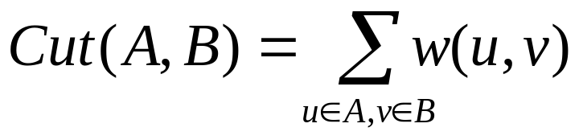
Graph Cut
A graph G=(V,E) can be partitioned into two disjoint sets
A, B, A U B = V , A ∩ B = Ø
by simply removing edges connecting the two parts.
The degree of dissimilarity between these two pieces can be computed as total weight of the edges that have been removed. In graph theoretic language, it is called the cut:
Notes:
Might need a picture here.

Slide 24
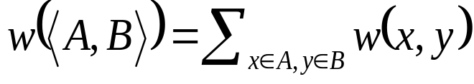
Minimum Cut
A cut of a graph G is the set of
edges S such that removal of
S from G disconnects G.
Minimum cut is the cut of minimum weight, where weight of cut <A,B> is given as
* From Khurram Hassan-Shafique CAP5415 Computer Vision 2003

Slide 25
Finding the Minimal Cuts:
Spectral Clustering Overview
Data
Similarities
Block-Detection
P. Perona and W. T. Freeman. A factorization approach to grouping 1998
This slide from Dan Klein, Sep Kamvar, Chris Manning, Natural Language Group Stanford University

Slide 26
If such an affinity matrix is block-diagonalized, the summation of the weights of those off-diagonal block matrices is minimized, or the summation of those diagonal block matrices is maximized.
Similarities
Block-Detection
Ying Wu, ECE432-Advanced Computer Vision Notes Series 5,
Segmentation: Clustering, Graph Cut and EM

Slide 27
* Slides from Dan Klein, Sep Kamvar, Chris Manning, Natural Language Group Stanford University

Slide 28
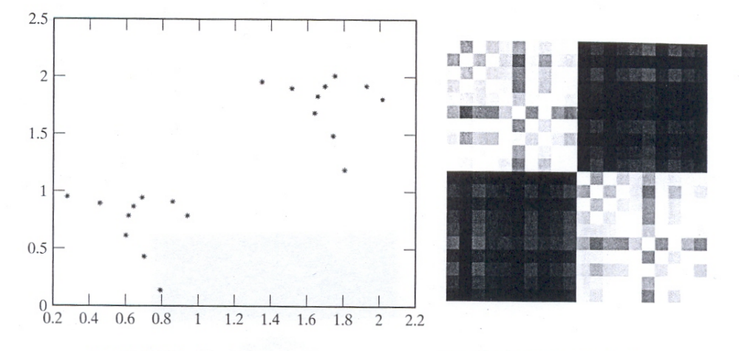
On the left, a set of points on the plane. On the right, the affinity matrix for these points, where large values are light and small values are dark.
The blocks correspond to links internal to the two obvious clusters, and the off diagonal blocks correspond to links between these clusters.
The nodes of the graph are the points in the feature space

Slide 29
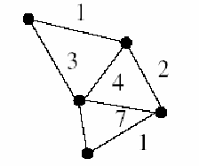
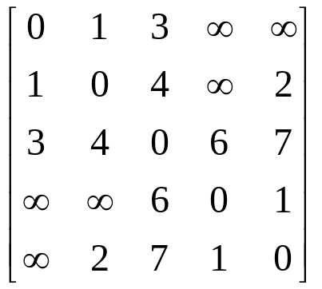

We can represent an image (i = 1,...,N pixels) by a NxN matrix, which is called Affinity matrix:
Affinity Matrix
which means that a larger Aij indicates the i-th and the j-th pixels are more similar.
Ying Wu, ECE432-Advanced Computer Vision Notes Series 5,
Segmentation: Clustering, Graph Cut and EM

Slide 30
Affinity Measures
When we viewed segmentation as simple clustering, we needed to supply some measure of how similar clusters were.
The affinity measure depends on the problem at hand. [3]
  Affinity by Distance
  Affinity by Intensity
  Affinity by Color
  Affinity by Texture
  Affinity by Motion

Slide 31
Affinity by Distance
Affinity should go down quite sharply with distance, once the distance is over some threshold.
where σ is a parameter which will be large if quite distant points should be grouped and small if only very nearby points should be grouped.

Slide 32
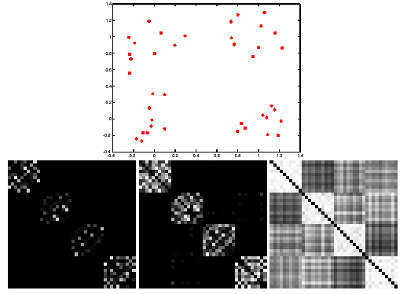

Scale affects affinity
* From Marc Pollefeys COMP 256 2003
Notes:
This is figure 14.18

Slide 33
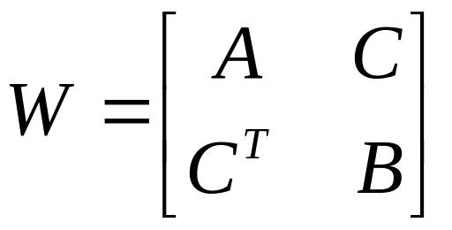
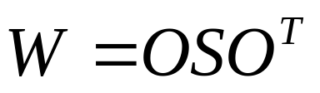
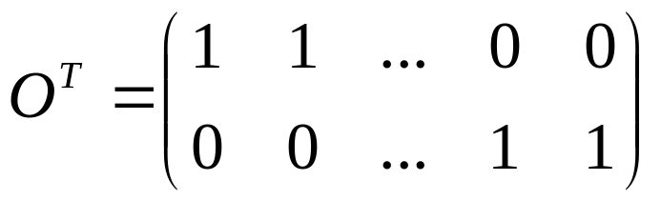
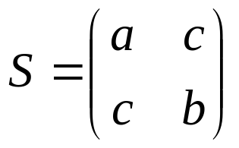
Diagonalization
A & B would be constant and C would be 0. Then W can be decomposed as

Slide 34

Assume that there are k elements and c clusters.
We can represent a cluster by a vector with k components.
The intention is that if a component in a particular vector has a small value, then it is weakly associated with the cluster, and if it has a large value, then it is strongly associated with a cluster.
A good cluster is one where elements that are strongly associated with the cluster also have large values in the affinity matrix.
w^{T} A w

Slide 35
Graph Eigenvector Segmentation
Construct an affinity matrix
Compute the eigenvalues and eigenvectors of the affinity matrix
Until all the elements are clustered
  Take the eigenvector corresponding to the largest unprocessed eigenvalue
  Zero all elements that have already been clustered
  Threshold the remaining elements to determine which elements belong to this cluster

Slide 36
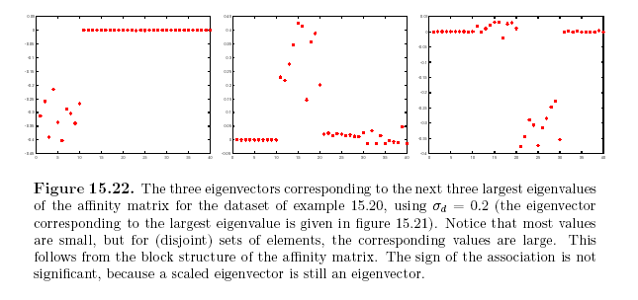

Slide 37
Drawbacks of Minimum Cut
Weight of cut is directly proportional to the number of edges in the cut.
Cuts with
lesser weight
than the
ideal cut
Ideal Cut
* Slide from Khurram Hassan-Shafique CAP5415 Computer Vision 2003

Slide 38
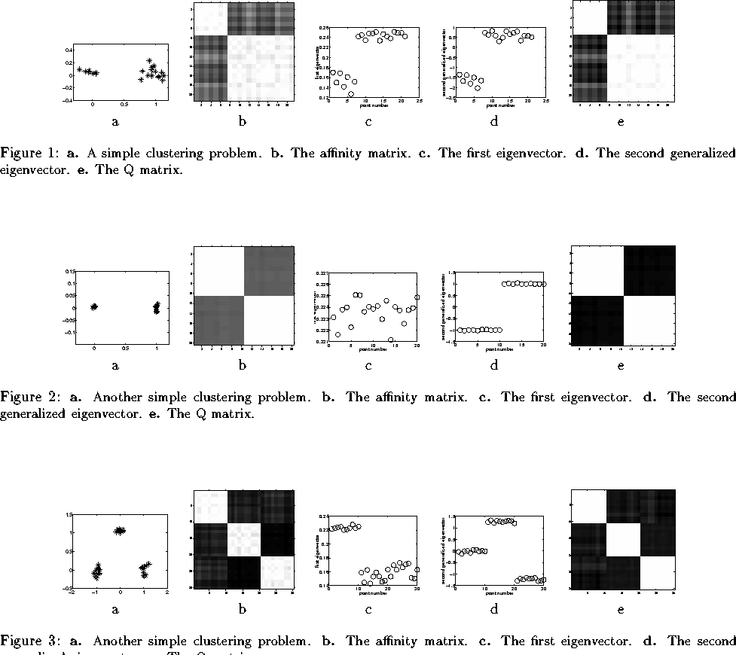
Affinity Matrix Perona/Freeman Shi/Malik Scott/Lon.Higg
1st eigenv. 2nd gen. eigenv. Q matrix
Affinity Matrix Perona/Freeman Shi/Malik Scott/Lon.Higg
1st eigenv. 2nd gen. eigenv. Q matrix
Affinity Matrix Perona/Freeman Shi/Malik Scott/Lon.Higg
1st eigenv. 2nd gen. eigenv. Q matrix

Slide 39
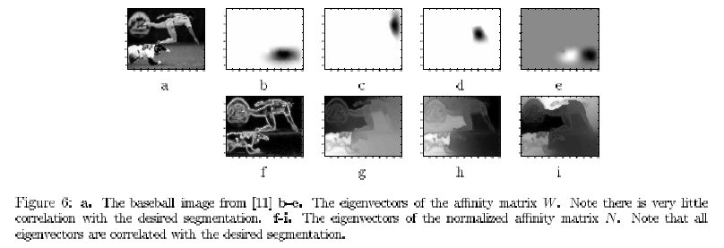
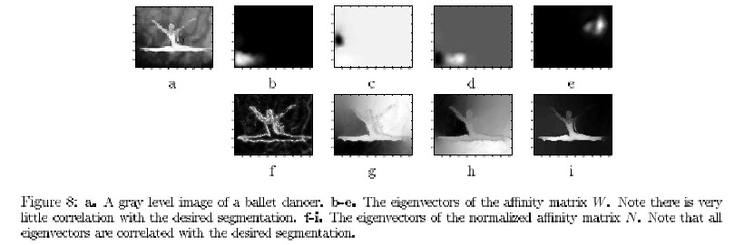

Slide 40
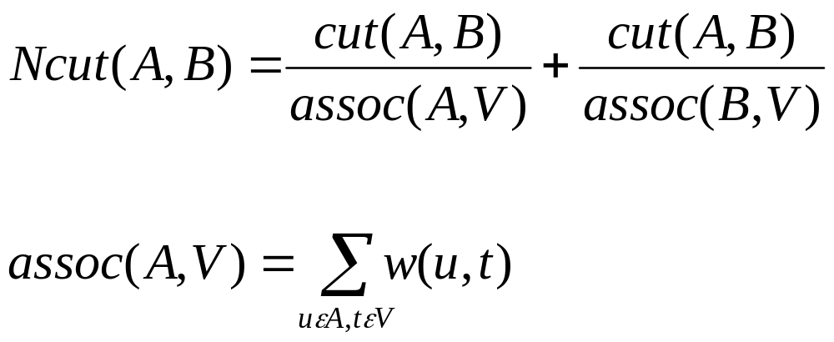
Normalized Cut
The result of a more sophisticated version of the eigenvector segmentation algorithm is called normalized graph cut algorithm (Shi &Malik 97).
Computes the cut cost as a fraction of the total edge connections to all the nodes in the graph. We call this disassociation measure the normalized cut (Ncut):
Normalized Cuts and Image Segmentation Jianbo Shi and Jitendra Malik, Member, IEEE TRANSACTIONS ON PAMI, VOL. 22, NO. 8, AUGUST 2000

Slide 42
References
J. Shi and J. Malik. Normalized cuts and image segmentation In Proc. IEEE Conf. Computer Vision and Pattern Recognition, pages 731-737,1997.
Weiss et al. Segmentation using eigenvectors: a unifying view
Computer Vision, A Modern Approach, Prentice Hall 2002
P. Perona and W. T. Freeman. A factorization approach to grouping In H. Burkardt and B. Neumann, editors, Proc ECCV, pages 655-670, 1998.
Radu Horaud Humberto Sossa Polyhedral Object Recognition by Indexing Pattern Recognition number 12 volume 28 pages 1855-1870 December 1995
Ali Shokoufandeh and Sven Dickinson, Graph-theoretical methods in computer vision, Pages: 148 - 174 Lecture Notes In Computer Science; Vol. 2292 Year of Publication: 2002 ISBN:3-540-43328-7
Ferdinand van der Heijden, Image based Measurement System, Obect Recognition and Parameter Estimation, John Wiley & Sons,1994 ISBN: 0 471 950629

