Slide 1

Green Pace
Security Policy Presentation
Developer: Edwin Jones

Slide 2

OVERVIEW: DEFENSE IN DEPTH
Aligns with defense-in-depth strategy
Formalizes team security best practices
Applies across SDLC: Design → Deploy

Slide 3
THREATS MATRIX
Likely STD-002-CPP STD-004-CPP STD-005-CPP STD-009-CPP | Priority STD-006-CPP STD-008-CPP STD-010-CPP
Low priority STD-003-CPP STD-007-CPP | Unlikely STD-001-CPP

Slide 4
10 PRINCIPLES
1. Validate Input Data Applies to: STD-001, 002, 003, 004, 008, 009
2. Heed Compiler Warnings Applies to: All Standards
3. Architect and Design for Security Applies to: STD-010
4. Keep It Simple Applies to: STD-001, 003, 010
5. Default Deny Applies to: STD-005
6. Least Privilege Applies to: Triple-A Policy
7. Sanitize Data Sent to Other Systems Applies to: STD-004
8. Practice Defense in Depth Applies to: STD-002, 006, 007
9. Use Effective Quality Assurance Techniques Applies to: STD-005, 006, 007, 008, 009
10. Adopt a Secure Coding Standard Applies to: All Standards

Slide 5
CODING STANDARDS
Ranking Factors:
Severity
Likelihood
Remediation cost
Exploit potential
Top Priority Standards
STD-002: Null pointer dereference
STD-004: Format string misuse
STD-005: Memory mismanagement
Medium Priority Standards
STD-003: String null-termination
STD-006: Exceptions
STD-008: Iterator misuse
STD-010: One-definition rule
Low Priority Standards
STD-007: Throwing from destructors
STD-009: Unsafe string access
STD-001: Integer conversion

Slide 6
ENCRYPTION POLICIES
Encryption at Rest
AES-256 required for storage, backups, and databases
Encryption in Flight
TLS 1.3 for all internal and external communication
Encryption in Use
Memory isolation and secure enclave support for sensitive data

Slide 7
TRIPLE-A POLICIES
Authentication
MFA required for all users
Authorization
Role-Based Access Control (RBAC)
Enforced least privilege
Accounting
Immutable logs for logins, access, and changes
Logs retained for 1+ year and reviewed regularly

Slide 8
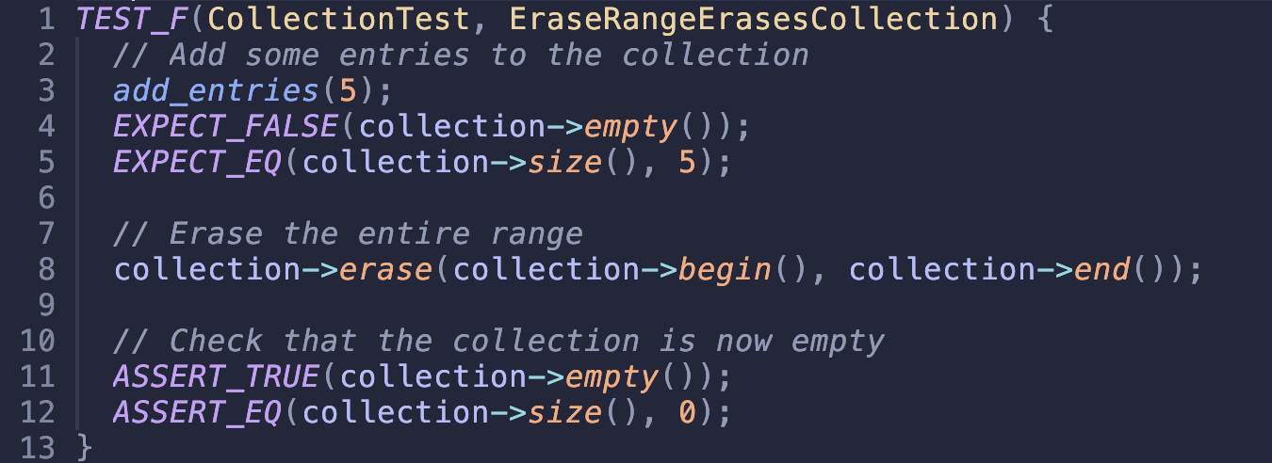
Does erasing a valid iterator range leave the container empty?
Coding Vulnerability: Unsafe iterator use (STD-008)

Slide 9
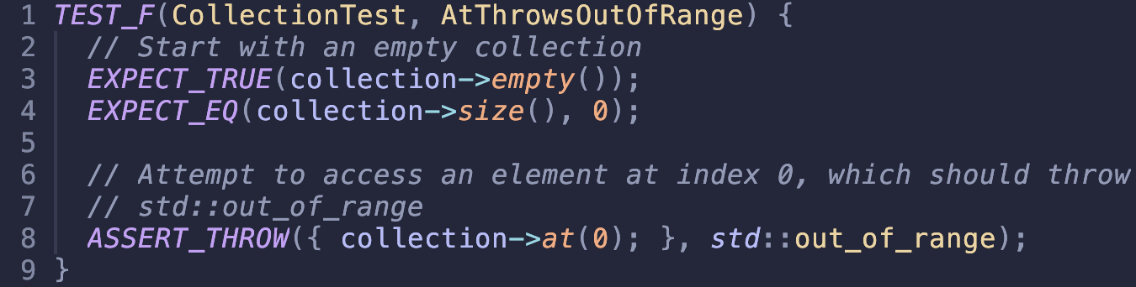
Does accessing an empty vector with .at() throw an exception?
Coding Vulnerability: Unsafe index access (STD-009)

Slide 10
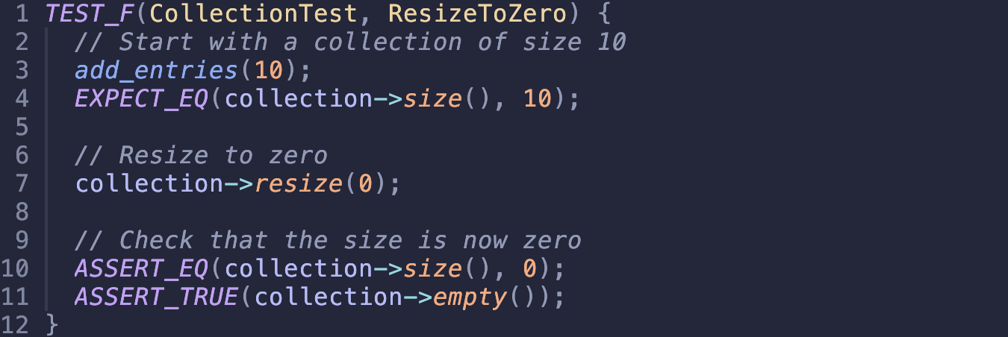
Can we safely resize a filled container to zero?
Coding Vulnerability: Improper memory management (STD-005)

Slide 11
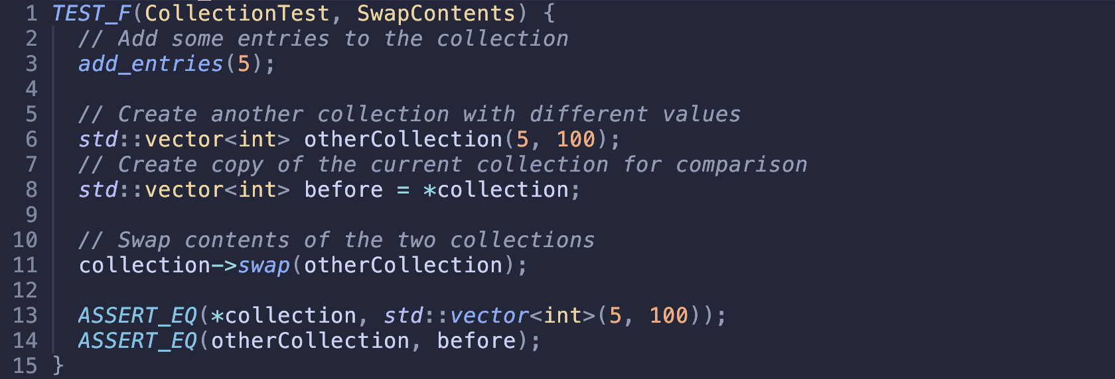
Does swapping two containers preserve their contents?
Coding Vulnerability: Inconsistent state after operation (QA Principle)

Slide 12
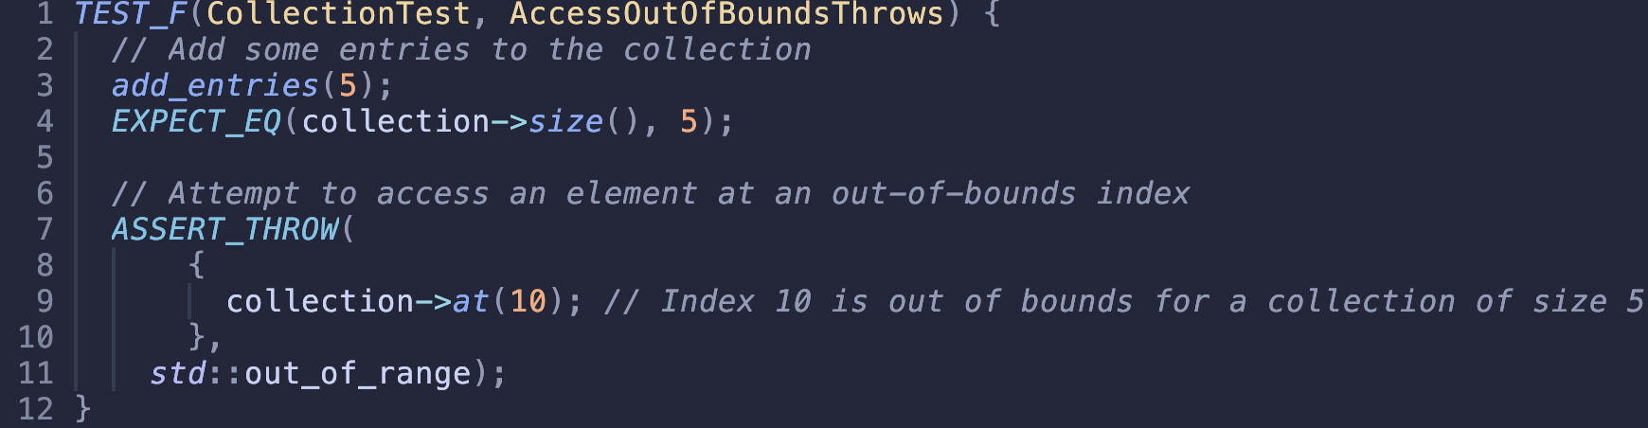
Does accessing index 10 in a 5-element vector throw an exception?
Coding Vulnerability: Out-of-bounds access (cross-cutting concern)

Slide 13

AUTOMATION SUMMARY

Slide 14
TOOLS
DevSecOps Pipeline:
Security integrated from design to deployment
Automation Tools:
Clang Static Analyzer, CppCheck, Parasoft C/C++test – static analysis during build
Valgrind – dynamic memory analysis during test/verify
Polyspace Bug Finder, SonarQube – post-build static code quality enforcement

Slide 15
RISKS AND BENEFITS
Problems:
Delayed integration of testing and security tools
Secure coding standards not enforced automatically
Vulnerabilities may go undetected
Solutions:
Adopt automated security tools now
Enforce policy compliance in CI/CD
Make testing and analysis part of every build
Risks of Waiting:
Vulnerabilities persist longer
Costs rise with delayed fixes
Missed opportunities for early prevention
Benefits of Acting Now:
Earlier detection of issues
Easier compliance and enforcement
Stronger, more secure software over time

Slide 16
RECOMMENDATIONS
Current Gaps:
No runtime monitoring or alerting
Limited boundary and negative test coverage
Static analysis not enforced across all projects
No consistent post-deployment validation
Real-World Example:
Heartbleed (2014): could have been caught with enforced static and dynamic analysis (Black Duck Editorial Staff, 2014)

Slide 17
CONCLUSIONS
Next Steps:
Add runtime analysis and monitoring tools
Enforce static analysis in all CI/CD pipelines
Expand test coverage, including boundary and error cases
Introduce fuzz testing for input robustness
Conduct quarterly policy audits
Recommended Standards:
CERT C++ MEM51-CPP – secure memory handling
MISRA C++ – safety-critical guidance
OWASP ASVS – secure application development baseline

Slide 18
REFERENCES
OpenSSL “Heartbleed” vulnerability (CVE-2014-0160) | CISA. (2016, October 5). Cybersecurity and Infrastructure Security Agency CISA. https://www.cisa.gov/news-events/alerts/2014/04/08/openssl-heartbleed-vulnerability-cve-2014-0160
Black Duck Editorial Staff. (2014, April 7). Heartbleed vulnerability: What should you do? Black Duck. https://www.blackduck.com/blog/heartbleed-vulnerability.html

