Slide 1
Adding OpenCL Support to Vortex GPGPU
Blaise Tine, Fares Elsabbagh

Slide 2
Open-Source OpenCL Implementations
There are a few open-source OpenCL implementations
Most of them are vendor driven
Most of them only support vendor specific device targets
Only POCL supports a wider range of device targets
Name | Version | Targets | Status | URL
Intel Beignet | 2.0 | x86 | Closed | https://cgit.freedesktop.org/beignet
Intel Neo | 2.1 | X86 | Active | https://01.org/compute-runtime
POCL | 1.2 | x86, ARM, AMD, TCE, PTX | Stable | https://github.com/pocl/pocl
ROCm | 1.2 | AMD | Stable | https://github.com/RadeonOpenCompute
TI-OpenCL | 1.1 | TI | Closed | https://git.ti.com/opencl/ti-opencl
Shamrock | 1.2 | TI | Active | https://git.linaro.org/gpgpu/shamrock.git
libclc | 1.2 | AMD, PTX | Closed | https://libclc.llvm.org/
Clover | 1.1 | AMD | Closed | https://people.freedesktop.org/~steckdenis/clover/

Slide 3
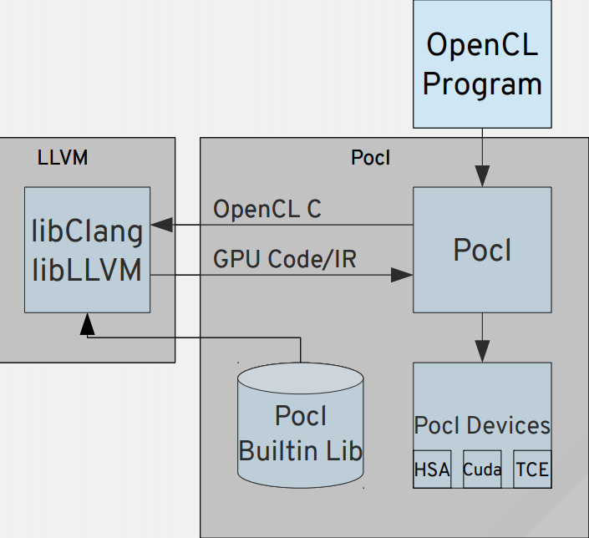
POCL: A Performance Portable OpenCL Implementation
Key Insights:
Use target-specific execution model
SIMT -> GPUs
MIND, SIMD -> CPUs
Target-specific compiler transformations
Using LLVM
Key Features:
A single interface with multiple target devices
Support HSAIL export
Support PTEX export
Custom accelerator support via TCE*
Support SPIR import
POCL Software Stack
* TTA-based Co-design Environment - http://openasip.org/

Slide 4
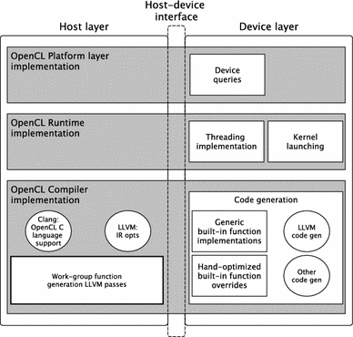
POCL Software Stack
Host-device Interface
Routes device-specific function calls
Host Layer
Interfaces with user application
Devices query API
OpenCL runtime implementation
OpenCL compiler implementation
Device Layer
Command queue management
Kernel loading and execution
Device properties query
Target-specific kernel compilation passes
Built-in/hand-optimized routines
* TTA-based Co-design Environment - http://openasip.org/

Slide 5
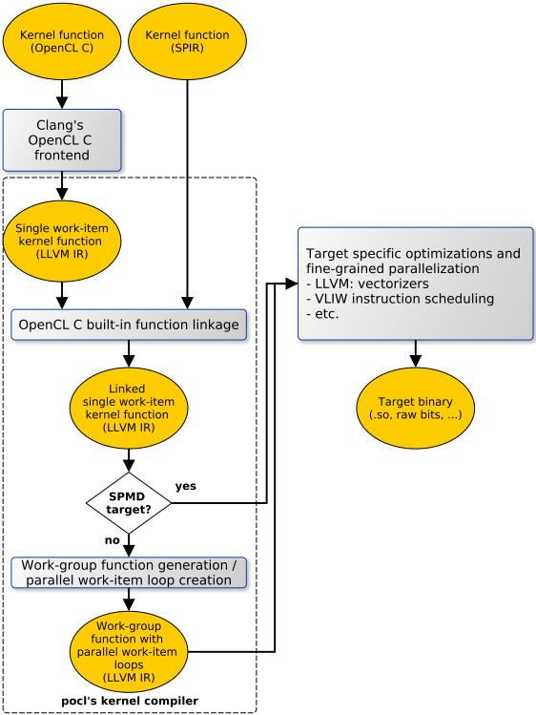
POCL Compilation Chain
Input User Program
OpenCL kernel
Use Clang to generate LLVM IR
SPIR program
Direct conversion to LLVM IR
Kernel Compilation
Generate single work-item function
Link target-specific build-in functions (sin, cos, sqrt, etc..)
Generate work-group function for non-SPMD
Target-specific optimizations
Fine-grained parallelization
* TTA-based Co-design Environment - http://openasip.org/

Slide 6
Vortex Unique Architecture
Vortex is a RiscV SIMT processor
Configurable 1-32 compute nodes (Warps)
Configurable 1-32 threads per warp
ISA Extension
Minimal RiscV ISA modification
Increases portability
New instructions for Warps/Threads
wspawn, clone, tmc, split, join, barrier
Execution Model
In-place execution (no-offloading)
Use ‘fork’ to partition work across warps/threads
Limitations
No OS support
Warp
Scheduler
PC
TM
PC
TM
RegisterFile
RegisterFile
I-Cache
Fetch
Decode
Execute
PC
TM
PC
TM
RegisterFile
RegisterFile
D-Cache
memory
Writeback

Slide 7
POCL Support for RiscV CPUs
There is currently no official support for RiscV
Adding support for RiscV with limited changes
Clone the existing ARM backend implementation
Enable POCL cross-compilation for LLVM-RiscV
Disable device-specific functions
Disable device-specific optimizations
Requirements
Linux environment with pthread library
Limitations
Offline kernel compilation only
Offline Compilation
OpenCLKernel
POCL Compiler
Kernel
Binary
RISCV-V CPU
OpenCL Application
POCL Runtime
pthread
Kernel
Linux Kernel

Slide 8
POCL Support for Vortex
NewLib BSP
A barebone std C++ libraries without OS dependency
Implement NewLib stub functions for Vortex emulator
Memory allocator, File IO and console output
POCL Runtime
Remove linux & pthread dependencies to use NewLib
Modify kernel compilation to use load from static library
Modify kernel invocation to use Vortex spawn instr.
Modify linker to generate runtime as static library
POCL Compiler
Enable cross-compilation for RiscV CPU targets
Implement registration API for static kernels (RegLib)
Cross-compile kernel to static library
Offline Compilation
OpenCLKernel
POCL Compiler
Kernel
Object
RegLib
Kernel
GCC Linker
Kernel
Binary
Vortex CPU
OpenCL Application
POCL Runtime
Vortex Lib
Kernel
NewLib

Slide 9
POCL Support for Vortex (2)
Kernel Compilation Changes
Work-group lowering
Work-item lowering
Control-flow divergence
Built-in Library Support
cos, sin, sqrt, etc..
Native implementations
Unique Codegen Optimizations?
TDB*
Offline Compilation
OpenCLKernel
POCL Compiler
Kernel
Object
RegLib
Kernel
GCC Linker
Kernel
Binary
Vortex CPU
OpenCL Application
POCL Runtime
Vortex Lib
Kernel
NewLib

Slide 10
POCL Support for Vortex (3)
Hardware Support for POCL
Native Barriers Support
Currently implemented in software
HW support greatly simplifies codegen
HW support greatly improves performance
Design complexity: medium
Floating-point Extension
Needed for running OpenCL benchmarks
Use existing Verilog IP for FP processors
Need to modify Vortex pipeline
New floating-point register file
New floating-point control/status registers
Floating-point exception handling
Floating-point to integer conversion
Design complexity: high

Slide 11
Work Items Status
Current Status
Test LLVM support for RiscV
Test POCL compilation on X86
Test POCL cross-compilation for ARM
POCL Cross-compilation for RiscV
Kernel registration API
POCL support for NewLib RiscV CPUs
Vortex emulation update to match RTL
NewLib Support on Vortex
POCL running on Vortex
Test vecadd on Vortex
Port rodinia benchmark to Vortex

