Slide 1
Vortex RISC-V GPGPU System: Extending the ISA, Synthesizing the Microarchitecture, and Modeling the Software Stack
Fares Elsabbagh, Bahar Asgari, Hyesoon Kim, Sudhakar Yalamanchili
Notes:
<number>

Slide 2
Motivation
General-Purpose GPUs (GPGPUs) are widely used in parallel applications such as AI and Machine Learning
Execution model is flexible and provides substantial speedups
GPGPUs could be achieved with a low hardware cost
Not enough research has explored GPGPUs with RISC-V
Wanted to contribute to the community by providing an open-source, lightweight, and configurable GPGPU system
<number>

Slide 3
Terminology
Single Instruction, Multiple Threads (SIMT)
Single Instruction, Multiple Data (SIMD) not exposed to the programmer
Hardware Warp
A group of hardware threads that share the same PC and follow the same execution path with minimal divergence
Control Divergence
When threads in a warp want to follow different execution paths
Possible control divergence at conditional branches
Immediate post-dominator (IPDOM) stack is a hardware binary tree representation with each leaf corresponding to a branch target
<number>

Slide 4
What is Vortex GPGPU System?
RISC-V ISA Extension
5 new instructions to the ISA to control hardware warps, hardware threads within a warp, and control divergence
Synthesizable Microarchitecture
Synthesized {1,2,4,8,16,32} hardware warps and threads per warp Vortex configurations
Written in Verilog
Software Model
A runtime kernel that implements our execution model
Vortex matrix library
<number>

Slide 5
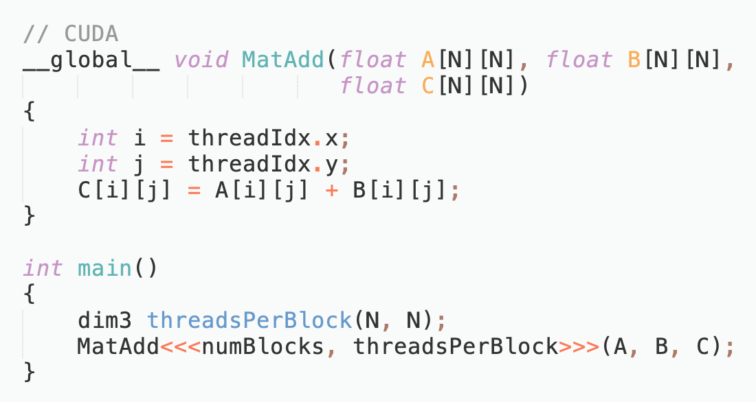
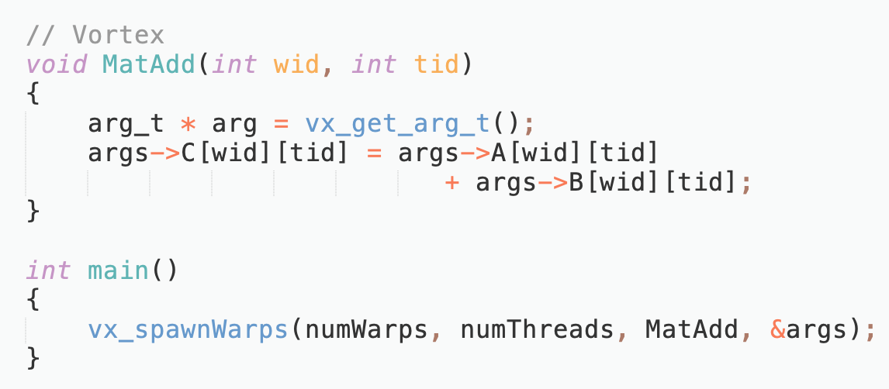
CUDA VS. Vortex
CUDA® is a parallel computing platform and programming model developed by NVIDIA for general computing on graphical processing units (GPUs)
<number>
Notes:
<number>

Slide 6
CUDA VS. Vortex
CUDA Programming Model | Vortex Programming Model
Kernel invocation from the CPU | Kernel invocation from the GPU (no host)
Multi-dimensional blocks exposed to the programmer | One-dimensional warps exposed to the programmer
Block IDs and Thread IDs are special hardware registers | Software Warp IDs and Thread IDs are stored in the general-purpose registers
<number>
Notes:
<number>

Slide 7
Hardware Warp Representation
A warp PC register
32 general-purpose registers per thread
In a 16 threads per warp configuration, each warp will have 512 registers
A thread-mask register
One bit for each thread in the configuration to show whether the thread is active
An immediate post-dominator (IPDOM) stack
Handles control divergence
<number>
Notes:
Add Figure for a warp
<number>

Slide 8
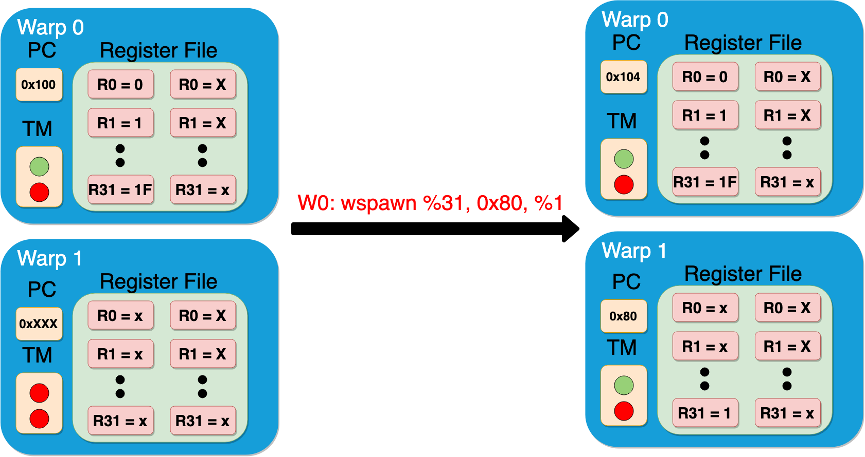
ISA Extension: Warp Control
WSPAWN %dest, PC, %src
Spawns a hardware warp at a specific PC and copies %src contents to %dest of the new warp
WHALT
Halts warp execution
Deactivates all threads
TM=Thread Mask register
<number>

Slide 9
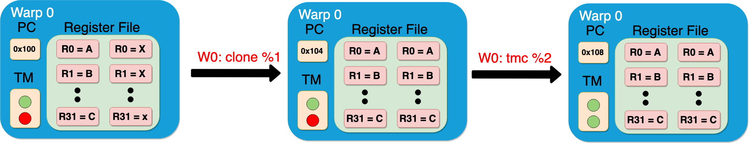
ISA Extension: Thread Control
clone %threadNum
Copies the 32 general-purpose registers of thread 0 to the registers of thread %threadNum
tmc %numThreads
Controls the thread-mask register by activating the first %numThreads threads
TM=Thread Mask register
<number>

Slide 10
ISA Extension: Control Divergence
Split %predicate
Pushes original thread mask as a fall-through entry to the IPDOM stack
Pushes threads that evaluate %predicate as false with PC+4
Sets the current thread mask to activate the threads that evaluate %predicated to be true
Join
Pops out an entry from the IPDOM stack
Sets current thread mask to the popped entry's thread mask
If entry is fall-through, continue normal execution
Otherwise, jump to the entry's PC value
<number>

Slide 11
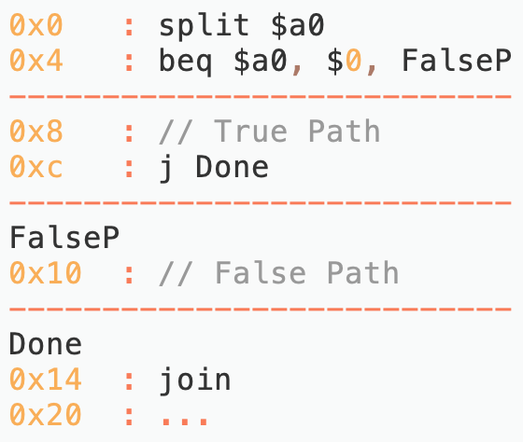
Control Divergence Example
Phase | Current PC | Current TM
split | 0x0 | 1111
beq | 0x4 | 1100
True Path | 0x8
 | 0xc
join | 0x14
beq | 0x4 | 0011
False Path | 0x10
join | 0x14
- | 0x20 | 1111
IPDOM Stack:
TM | PC | F
- | - | -
TM | PC | F
1111 | - | Y
0011 | 0x4 | N
TM | PC | F
1111 | - | Y
TM | PC | F
- | - | -
TM = Thread Mask
F = Fall-through entry
<number>
Notes:
Series of Figures??
<number>

Slide 12
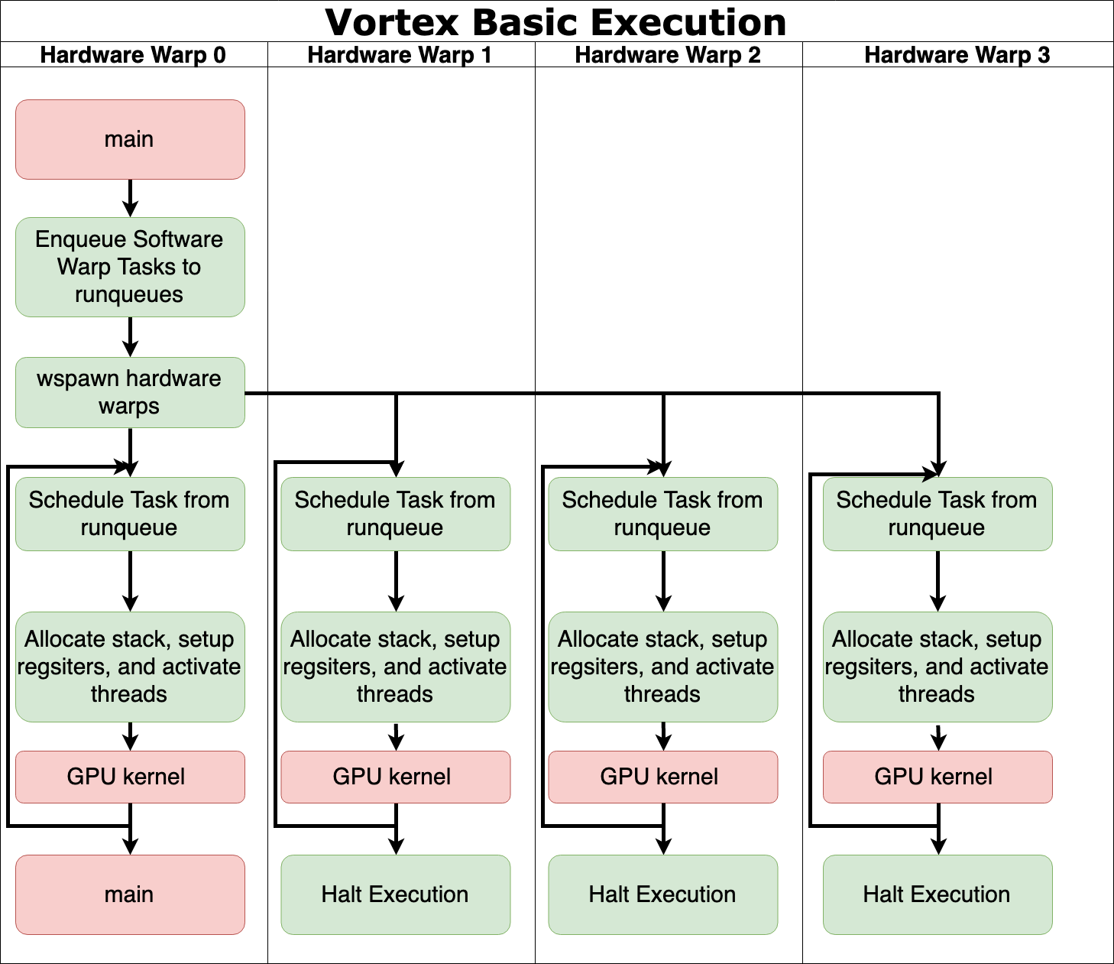
Execution Model
Basic Execution
Stand-alone Execution
Hardware warp 0 schedules GPU kernels onto other hardware warps to accelerate its workload
Example: Main program is requesting 1024 warps each with 64 threads to execute a GPU kernel on a Vortex configuration of 4 hardware warps and 32 hardware threads per warp
<number>

Slide 13
Runtime Kernel
Supports Vortex execution model
Includes concepts such as software warps, which could be scheduled and preempted
Provides synchronization between software warps
Provides communication channels between warps
Does not require any compiler modifications
Implemented as an intrinsic library
<number>

Slide 14
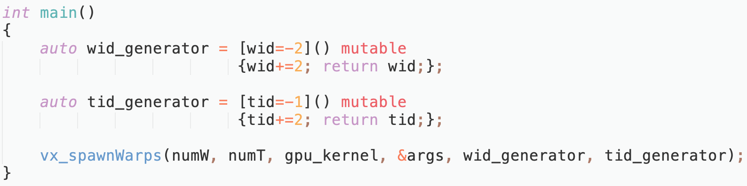
Complex Control Flow
Some algorithms might benefit from a non-standard series of WIDs and TIDs
A number generator could be passed to the runtime kernel to generate non-standard series of WIDs and TIDs
E.g. Passing in two stateful lambdas that return only even and odd numbers as an argument to the kernel would cause the WIDs to be even and the TIDs to be odd.
<number>

Slide 15
Vortex Library
Implements matrix operations
Illustrates how Vortex could easily be used to accelerate workloads
Optimizes the number of warps and threads per warp to spawn and whether to copy data to shared memory based on the configuration and the algorithm
Guarantees no shared memory bank conflicts
<number>

Slide 16
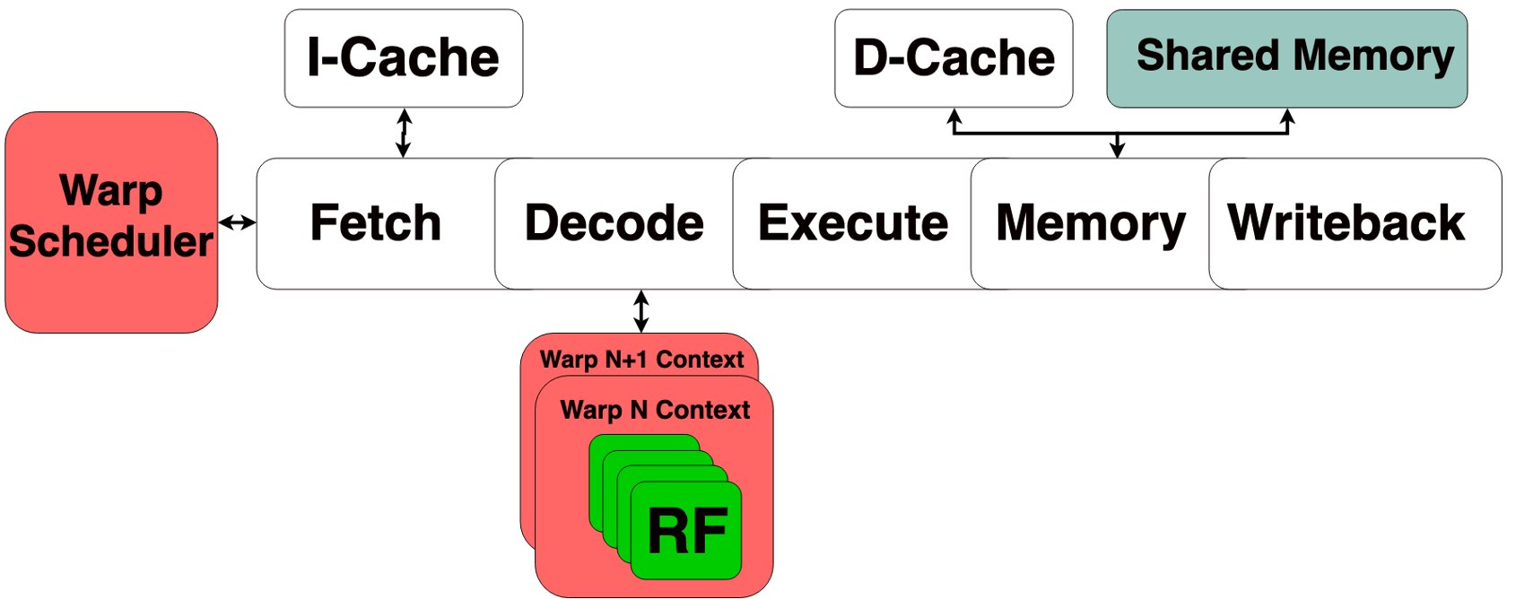
Microarchitecture Implementation
<number>

Slide 17
Microarchitecture Implementation (Cont.)
Warp Scheduler
Chooses the next warp to fetch an instruction
Fine-grain scheduler
Contains the PC, thread mask, and IPDOM stack for each warp
Handles wspawn, whalt, clone, and split instructions
Warp context
Contains the general-purpose registers for each thread in the warp
Each hardware warp is assigned a warp context
Handles clone and wspawn instructions
<number>

Slide 18
Memory
Cache
Configurable by size, number of ways, and line sizes
Only one thread can access the cache module per cycle
In a 32 threads per warp configuration, a memory instruction would take 32 cycles in MEM stage
Future implementations will increase the number of cache ports
Shared Memory
Banked by the number of threads in a configuration
Mapped to a physical address space and managed by the kernel
In a 32 threads per warp configuration, a memory instruction could take only 1 cycle if there are no bank conflicts
<number>

Slide 19
System Evaluation Methodology
Benchmark:
A 32x32 matrix-matrix multiplication
Configurations:
{1,2,4,8,16,32} hardware warps and threads per warp
Number of execution units kept equal to the number of threads in a configuration
Number of shared memory banks equal to the number of threads in a configuration
Platform
Arria© 10 FPGA using Quartus 18.0
<number>

Slide 20
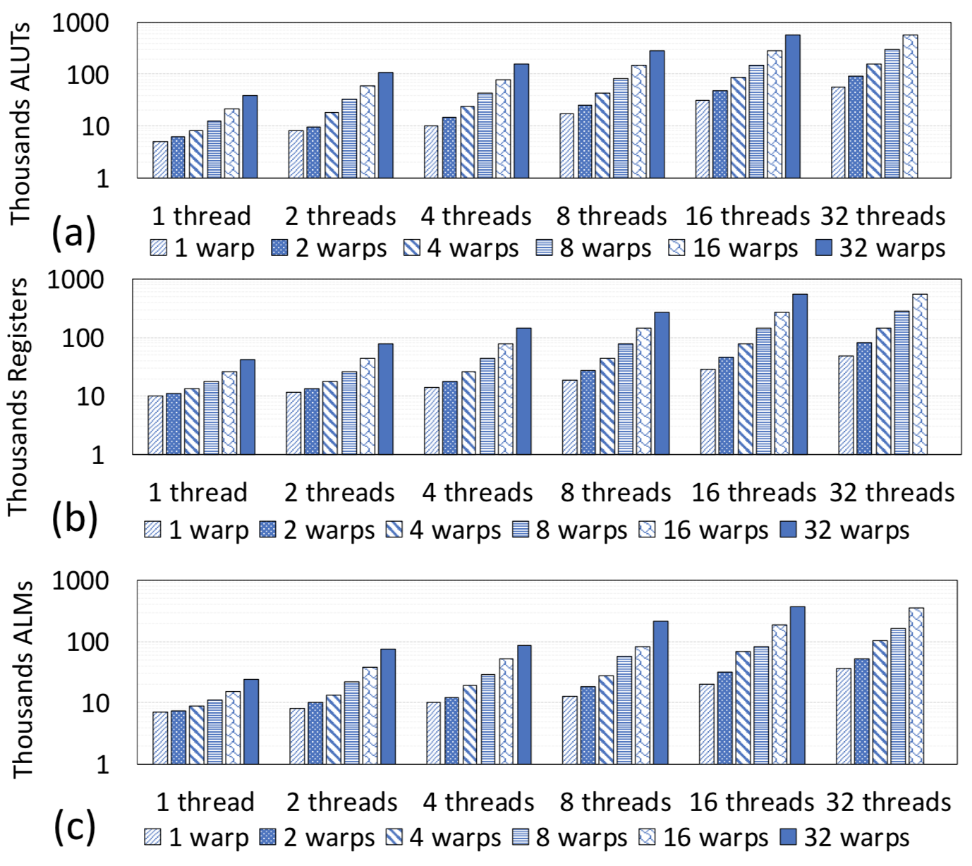
Hardware Resource Utilization
Increasing number of warps yields same register increase as number of threads
Increasing threads per warp increases ALM and ALUT utilization more than increasing the number of warps
This is because each thread has a private execution unit
<number>

Slide 21
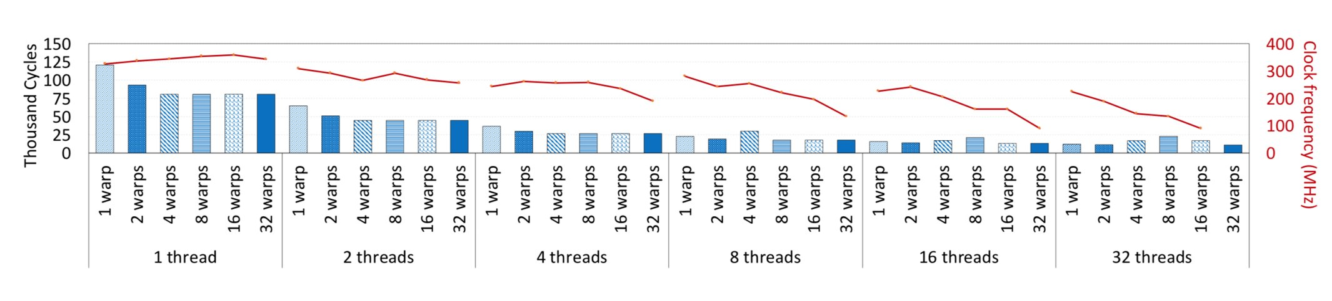
Performance Evaluation
Increasing the number of threads yields less cycles up to 8 threads
Kernel overhead when initializing the threads
Increasing the number of warps does not yield better performance after 4 warps
The warp scheduler does not provide the pipeline utilization that could be achieved
Increasing the number of threads per warp affects the clock frequency more than the number of warps
<number>

Slide 22
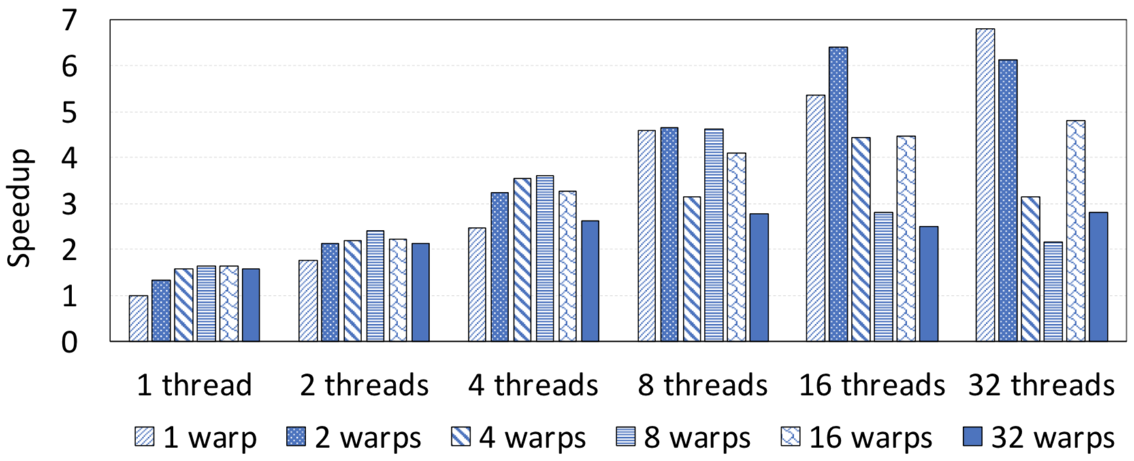
Overall speedup
Vortex configuration with 1 warp and 32 threads yields the best speedup
This is mainly due limitations in the warp scheduler
A configuration with the number of execution units not equal to the number of threads per warp could yield better speedup
<number>

Slide 23
Future Work
Hardware:
Improve the warp scheduler for better pipeline utilization
Implement a cache module with more ports
Software
Improve ISA extension to reduce kernel overhead when spawning warps and initializing threads
Extending the runtime kernel to support popular libraries like OpenCV
<number>

Slide 24
Conclusions
Explored building a GPGPU machine using RISC-V
Introduced 5 new instructions to the ISA
Synthesized the microarchitecture for up to 32 warps and threads per warp configurations
Implemented a runtime kernel that supports our execution model
Achieved up-to 7x speedups for matrix multiplication benchmark
<number>

Slide 25
Questions?
<number>

Slide 26
Vortex Extensions
Software Extension:
ISA Extension
5 new instructions that fit into one opcode
A thread-mask register and an immediate post-dominator (IPDOM) stack that introduced to the ISA state
Runtime Kernel
Supports stand-alone execution
Schedules and creates contexts for software warps
Hardware Extension:
Supports Single Instruction-Multiple Threads (SIMT) execution model
Executes programs on hardware warps, a group of hardware threads executing the same PC
Implements a thread mask register and an IPDOM stack to allow control divergence
Focuses on data throughput with a shared memory module
<number>

Slide 27
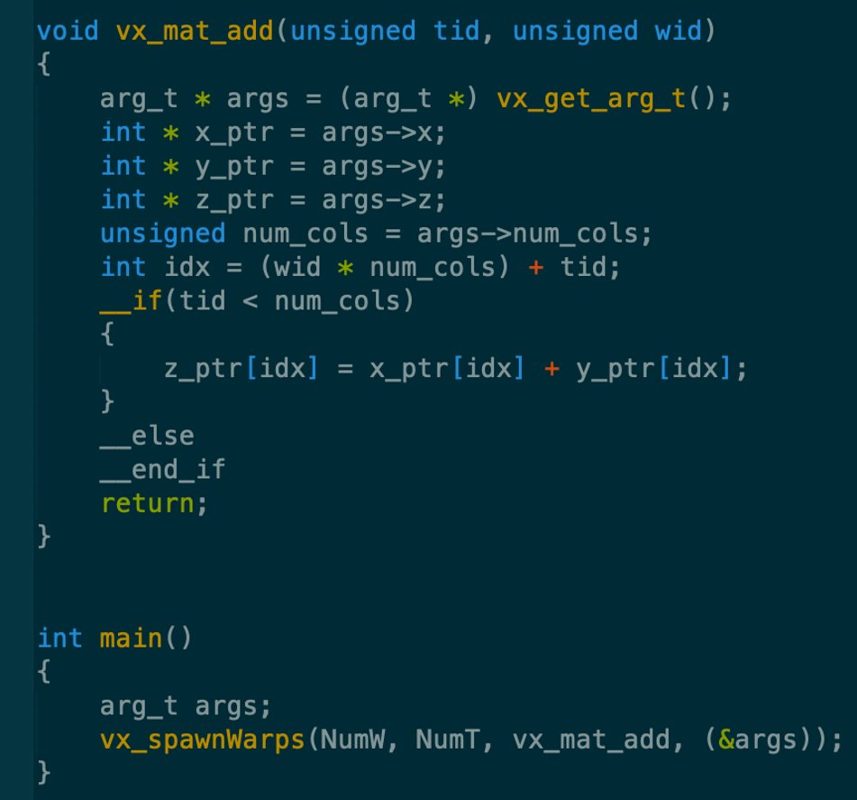
Execution Model
Basic Execution
Hardware warp 0 schedules GPU kernels onto other hardware warps to accelerate its execution
<number>

Slide 28
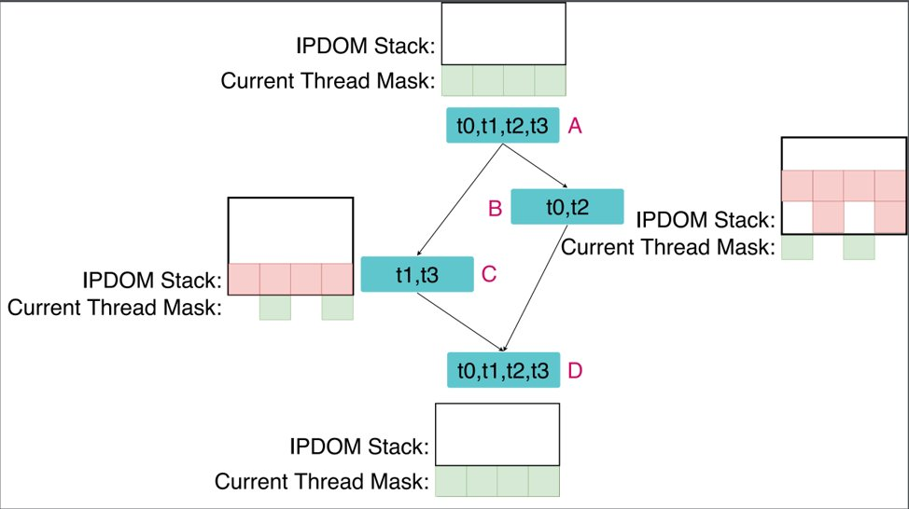
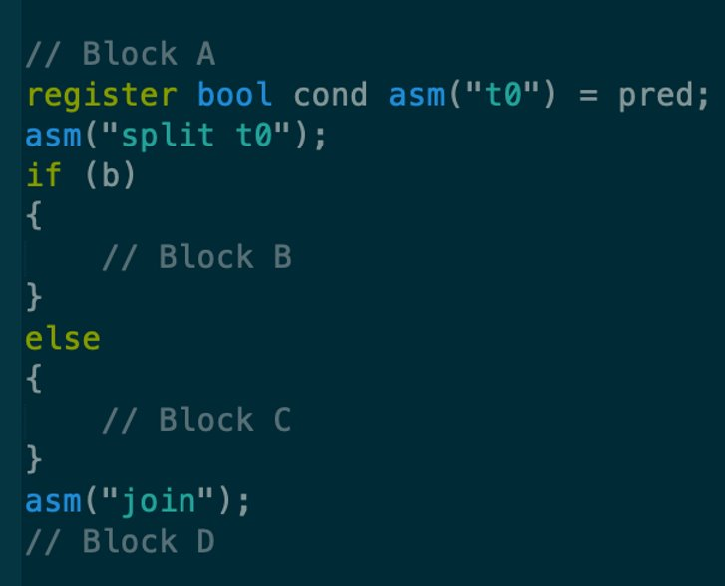
Control Divergence
Split %predicate
Pushes into the IPDOM Stack
Join
Pops out of the IPDOM
Stack
<number>

Slide 29
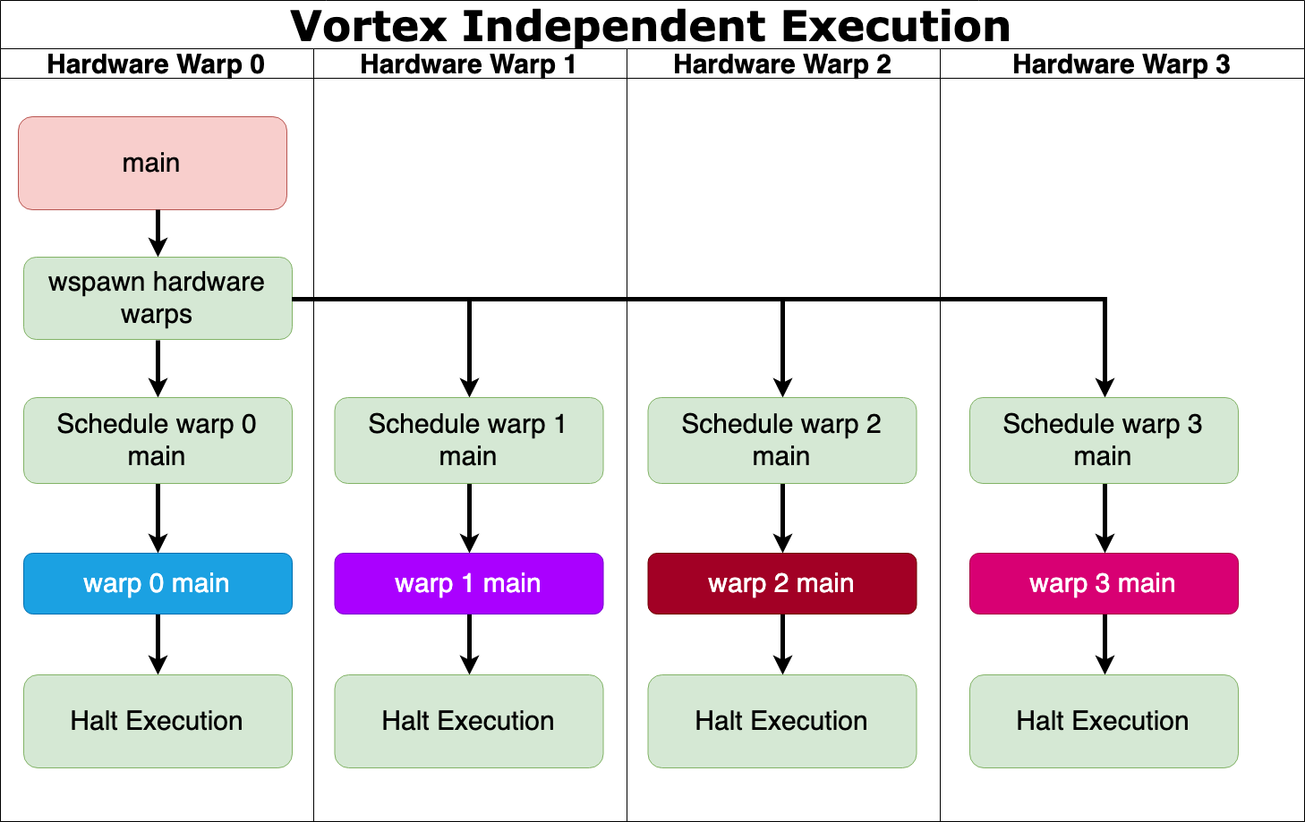
Execution Model (Cont.) (REMOVE)
Independent Execution
Each hardware warp is executing a different GPU kernel
Multi-program execution
Comparable to CPU execution model but with warps instead of threads
Includes multiple programs, each with multiple software warps, are being scheduled by the runtime kernel on all hardware warps.
Uses first-come-first-serve scheduling
<number>

Slide 30
Vortex VS. CUDA Programming Model
Cuda
GPU kernel invocation is from the CPU
Uses blocks with multiple dimensions
Block IDs and thread IDs are special registers
Vortex
GPU kernel invocation is from the GPU
Spawns software warps that are one-dimensional group of software threads
Software-warp IDs and thread IDs are passed in as normal arguments
<number>
Notes:
NumW and NumT refer to the number of software warps and software threads and are not constraint by the number of hardware warps and threads per warp
Vortex supports exceptions and interrupts
<number>

