Slide 1

Smart Health Monitoring
Internet of Things
Artificial Intelligence and Data Engineering
Students
Mohsin Ali
Andrea Zanin
Professors
Giuseppe Anastasi
Francesca Righetti
Carlo Vallati

Slide 2
System Overview and Use Case
The project introduces a clinical IoT framework designed for a Smart Health hospital ward.
Patients wear wireless sensor nodes to monitor their heart rate (BPM) in real time.
The system uses edge intelligence (TinyML) to predict cardiovascular disease risk by combining live BPM with static clinical features of the patient.
If an anomaly is detected, a local alarm (red LED) triggers, requiring a physical and manual intervention by a nurse to clear it, thereby ensuring medical safety.
Smart Health Monitoring 2

Slide 3
5-Layer System Architecture
Edge layer: nRF52840 nodes running Contiki-NG for data collection and local TinyML inference
Wireless mesh layer: IEEE 802.15.4/MAC network operating with RPL-Lite routing
Gateway layer: An nRF52840 Border Router acting as a bridge between the wireless network and IP via a SLIP tunnel
Middleware & DB layer: A Mosquitto MQTT broker for routing, a Python backend for logic execution, and a MySQL database for historical storage
Presentation layer: Grafana dashboard server for real-time telemetry visualization
Smart Health Monitoring 3

Slide 4
Protocols: MQTT vs. CoAP
Integrating both protocols is a core design requirement of the system
MQTT (TCP): utilizes a publish-subscribe pattern to ensure reliable, continuous upstream streaming of telemetry from nodes to the backend
CoAP (UDP): utilizes a request-response model to manage downstream actuations (e.g., LED latching)
CoAP eliminates the overhead of persistent TCP sockets, making it highly efficient and low-latency for battery-constrained devices
Smart Health Monitoring 4

Slide 5
Edge Diagnostics and TinyML
The system employs a Random Forest classifier trained on the Kaggle "Heart Disease" dataset (75% accuracy)
The model analyzes 6 features: Age, Sex, Resting Blood Pressure, Cholesterol, Fasting Blood Sugar, and MaxHR (dynamically mapped to live BPM)
To optimize execution on nRF52840 nodes, the generated C code was adapted by casting variables to single-precision float
This leverages the hardware floating-point unit (FPU), reducing inference time to microseconds and ensuring RTOS stability
Smart Health Monitoring 5

Slide 6
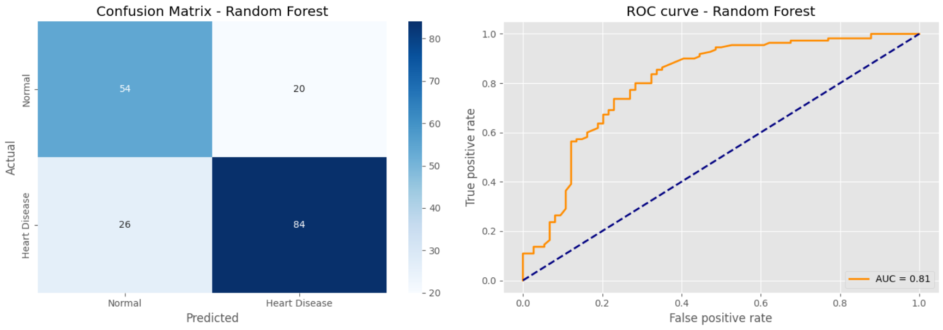
Patient Profiling and Performance
To simulate a realistic ward, nodes dynamically load specific clinical profiles at boot based on their MAC address suffix
This validates the edge intelligence paradigm: identical heart rates yield completely different risk assessments depending on the patient's profile (e.g., clinically fragile vs. healthy)
Model evaluation shows a solid recall (0.76) for the "Disease" class
Smart Health Monitoring 6

Slide 7
Firmware and IPv6 Address
The firmware is built on Contiki-NG's event-driven protothread model
Client nodes manage both an MQTT client for upstream telemetry and a CoAP server to receive incoming commands
Devices autoconfigure their IPv6 addresses dynamically via SLAAC
The Python backend resolves addresses by dynamically scraping the border router's HTTP routing table or applying a deterministic mathematical mapping as a fallback
Smart Health Monitoring 7

Slide 8
Logical Workflow and Closed-Loop Control
Deployment & boot: FPU-optimized firmware boots up, loads specific patient profiles, and registers on the MQTT broker
Edge intelligence: every 5 seconds, the node computes the heart rate, runs the local Random Forest inference, and transmits the data
Automated actuation: if an anomaly is flagged, the backend asynchronously dispatches a CoAP command to latch the node's red LED on
This critical alarm state persists indefinitely until medical personnel manually clear it via a long 3-second button press on the sensor
Smart Health Monitoring 8

Slide 9
Stress Testing and Network Jamming
Under baseline conditions, CoAP latency (RTT) remains low (30-120 ms) with a 100% MQTT Packet Delivery Ratio (PDR)
To evaluate resilience, a "Spammer Node" was introduced to flood the network with 500 UDP packets per second on Channel 26
This aggressive flood causes CSMA/CA MAC-layer collisions, drastically spiking CoAP response times to 400-600 ms, with timeout peaks up to 2000 ms
Smart Health Monitoring 9

Slide 10
Adaptive Mitigation Strategies
Edge adaptation (rate backoff): upon local anomaly classification, the node throttles its transmission rate (from 5s to 20s) to reduce its RF channel footprint, albeit sacrificing temporal resolution
Gateway adaptation (deadband filter): if the backend detects CoAP latency exceeding 300 ms, it sends a command to all nodes to suppress redundant telemetry (filtering up to 80% of traffic)
Tests prove that MQTT PDR remains artificially stable at 100% due to TCP automatic retransmissions, proving that CoAP UDP latency is a vastly superior metric for detecting physical RF congestion
Smart Health Monitoring 10

Slide 11
Conclusions and Future Work
The project successfully demonstrates an integrated IoT pipeline combining constrained-device edge ML inference with cloud-side closed-loop network adaptation
The dual MQTT/CoAP architecture effectively balances reliability and low-latency control
Future work: Scalability evaluation across a larger number of concurrent patient nodes, Over-the-Air retraining for TinyML models, and dynamic modulation of CoAP polling frequencies
Smart Health Monitoring 11

