Slide 1
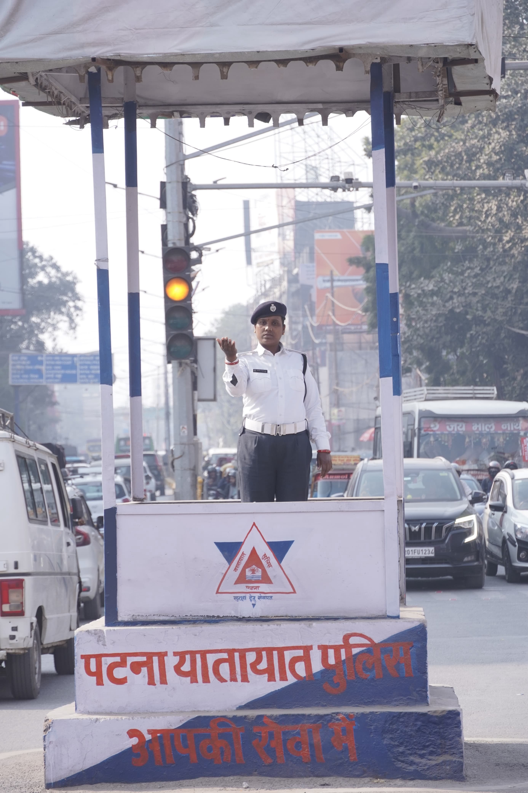
Parking & Traffic Management
Issues and Challenges
A Session for City Managers • Patna
Session by
Pourush Agarwal
DySP, Patna Traffic Police

Slide 2
Session Agenda
2
• Why parking & traffic matter for a city
• The scale of the problem in Patna
• Key parking issues & the role of sign boards
• Traffic management challenges
• Special situations: VIP movement & metro diversion
• Root causes and their impact
• Solutions — smarter parking, signage & real-time updates
• Smart technology in traffic management
• Case study: Pune parking reform
• Action roadmap for Patna

Slide 3
Why Parking & Traffic Matter
3
• Traffic reflects a city's quality of life & governance
• Poor parking eats into scarce public road space
• Congestion means lost productivity, fuel and time
• It directly affects safety, emergency access & emissions
• Well-managed mobility builds public trust & attracts investment

Slide 4
The Scale of the Problem in Patna
4
12.5 L+
62%+
~8%
798
vehicles on Patna roads
new vehicles are 2-wheelers
city area is road (vs 25% ideal)
traffic cops for the whole city
Vehicles have grown roughly threefold in a decade, while road space and enforcement staff have not kept pace — the core of Patna's congestion.
Sources: Times of India (Patna) reports; NIUA public perception study.

Slide 5
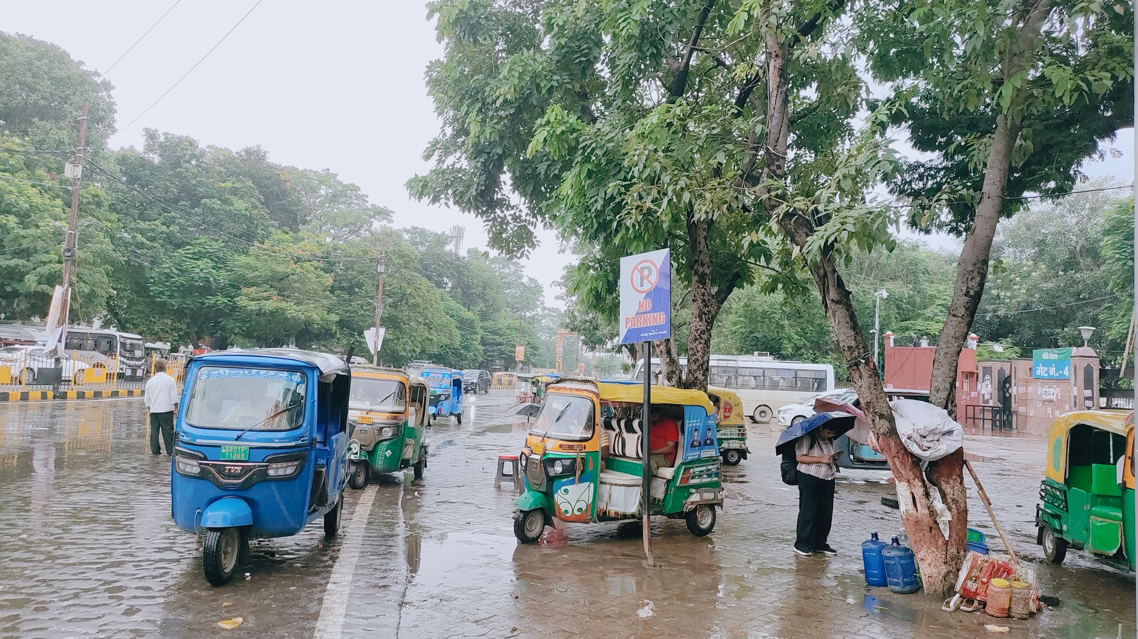
Key Parking Issues in Patna
5
• Illegal roadside parking on both sides of arterial roads
• Vehicles ignore signage — parking right under 'No Parking' boards
• Footpaths & carriageways encroached by parked vehicles
• Autos & e-rickshaws halt anywhere near stations & markets
• Very little organised, paid off-street parking
• Weak deterrence — sign boards alone don't ensure compliance
Autos parked right under a 'No Parking' board — Patna

Slide 6
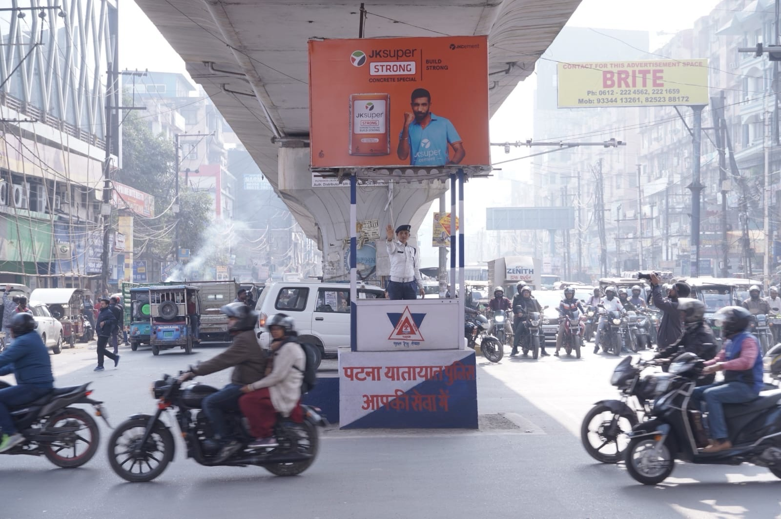
Traffic Management Challenges
6
• Mixed traffic — cars, 2-wheelers, autos, e-rickshaws, carts
• Only ~8% of city area is road (well below the 25% norm)
• Manual regulation at junctions with severe manpower shortage
• Frequent VIP movement disrupts normal traffic flow
• Metro construction forces route diversions & lane closures
• Encroachment & construction shrink usable road width
Patna Traffic Police regulating a busy junction

Slide 7
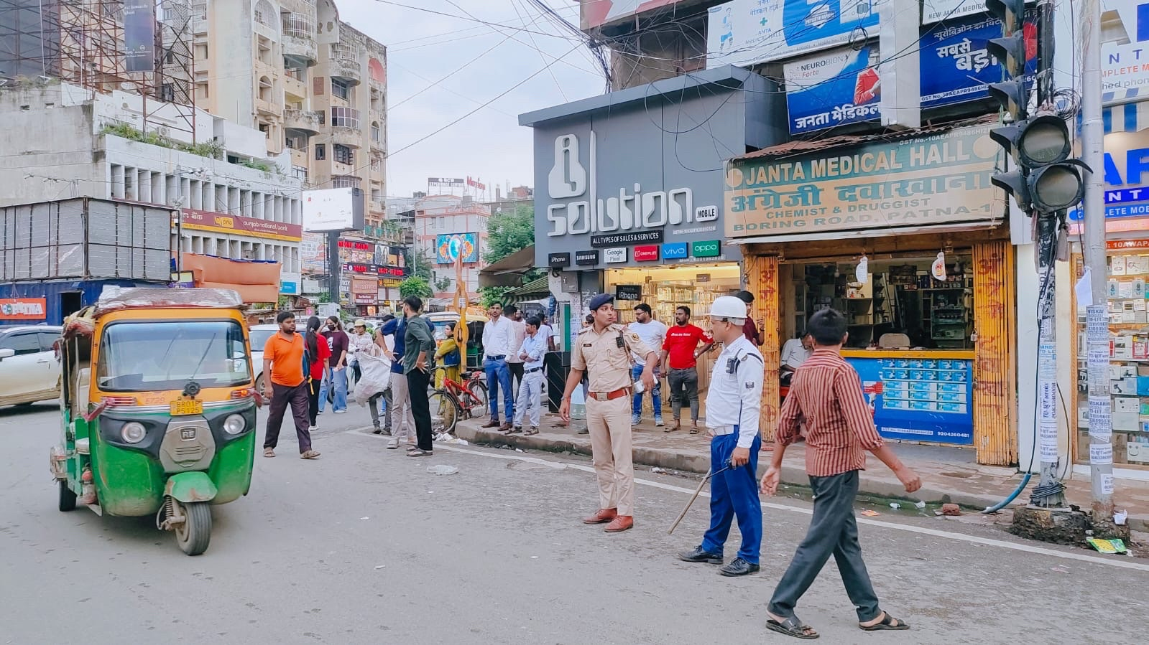
Special Traffic Situations
7
VIP Movement
Metro Diversion
• Route clearance & holding of traffic during transit
• Advance planning with escort & pilot coordination
• Minimise public inconvenience with timed, short holds
• Lane closures around metro construction sites
• Planned diversions on key corridors & junctions
• Clear signage + advance public communication needed
On-ground regulation at Boring Road crossing, Patna

Slide 8
Root Causes Behind the Chaos
8
Rapid Motorisation
Weak Enforcement
No Parking Policy
Vehicle ownership rising faster than infra
Low penalties, poor signage compliance
Parking treated as free & unlimited
Land-use Mismatch
Weak Public Transport
Fragmented Governance
Dense commercial zones, no parking norms
Few reliable last-mile options
Multiple agencies, unclear ownership

Slide 9
Impact of Poor Management
9
Economic
Environmental
Social & Safety
• Lost man-hours in jams
• Higher fuel & logistics cost
• Reduced business footfall
• Higher vehicular emissions
• Idling pollution & noise
• Poor air quality (AQI)
• More accidents & fatalities
• Blocked emergency vehicles
• Stress & road rage

Slide 10
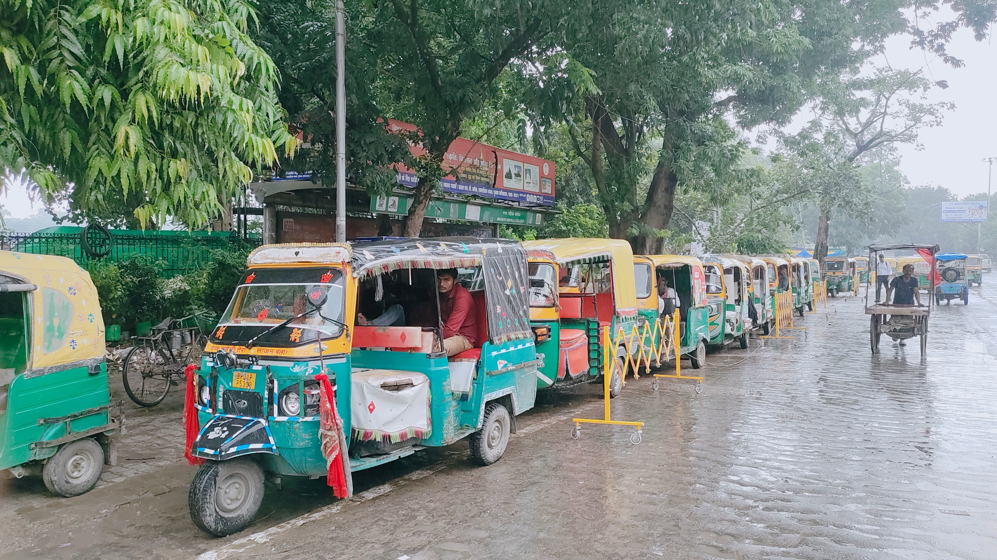
Solutions: Smarter Parking
10
• Priced, demand-based on-street parking (pay-and-park)
• Clearly marked bays with barricades & discipline
• Multi-level & organised off-street parking
• Designated auto/e-rickshaw stands near hubs
• Strict enforcement: towing, fines, CCTV
• Parking norms in building bye-laws for new projects
Organised auto stand with barricades — Patna

Slide 11
Solutions: Traffic Management
11
• Clear, well-placed sign boards + strict enforcement of signage
• Real-time updates to public — social media, apps, FM & alerts
• Advance communication for VIP movement & metro diversions
• Adaptive / synchronised signals on key corridors (ITS)
• Dedicated lanes for buses & non-motorised transport
• Decongest by removing encroachments at choke points
• Strengthen public transport & last-mile connectivity

Slide 12
The Role of Smart Technology
12
Smart Sensors
Digital Sign Boards
ANPR Cameras
Detect free/occupied parking bays in real time
Dynamic messages for diversions & warnings
Automatic number-plate enforcement
Adaptive Signals
Real-time Updates
Cashless Payment
AI-based signal timing on live traffic flow
Live traffic & diversion info to citizens
Transparent, leak-proof parking revenue

Slide 13
Case Study: Pune Parking Reform
13
Pune's on-street parking management (with ITDP India)
• Adopted a city parking policy — parking priced, not free
• Demand-based pricing: higher rates in busy zones & peak hours
• Clearly demarcated, managed on-street bays with signage
• Cashless, self-paying system for transparent revenue
• Freed footpaths & road space for people and buses
• Result: reduced haphazard parking & smoother flow on key roads
– Lesson: policy + pricing + enforcement + technology together works

Slide 14
Action Roadmap for Patna
14
Short Term (0-6 m)
Medium (6-18 m)
Long Term (18 m+)
• Fix hotspots (Boring Rd, Station Rd)
• Demarcate bays + clear signage
• Clear encroachments
• Enforcement drive + towing
• Adopt a city parking policy
• Pay-and-park + app
• Real-time updates channel
• Metro diversion planning
• Multi-level parking
• City-wide ITS & CCTV
• Integrated mobility plan
• Data-driven governance
Already begun: In late 2025 Patna traffic police banned car/auto parking on Income Tax Golambar–Dak Bungalow & Budh Marg–GPO Golambar to decongest key stretches.

Slide 15
Key Takeaways
• Parking is a policy problem, not just an infrastructure one
• Sign boards must be backed by real enforcement
• Plan ahead for VIP movement & metro diversions
• Real-time updates keep citizens informed & reduce chaos
• Technology + pricing + enforcement must go together
• Patna can adapt proven models like Pune's reform

Slide 16
Thank You
Questions & Discussion
Session by Pourush Agarwal, DySP, Patna Traffic Police
Let's build a well-managed, people-friendly Patna

