Slide 1
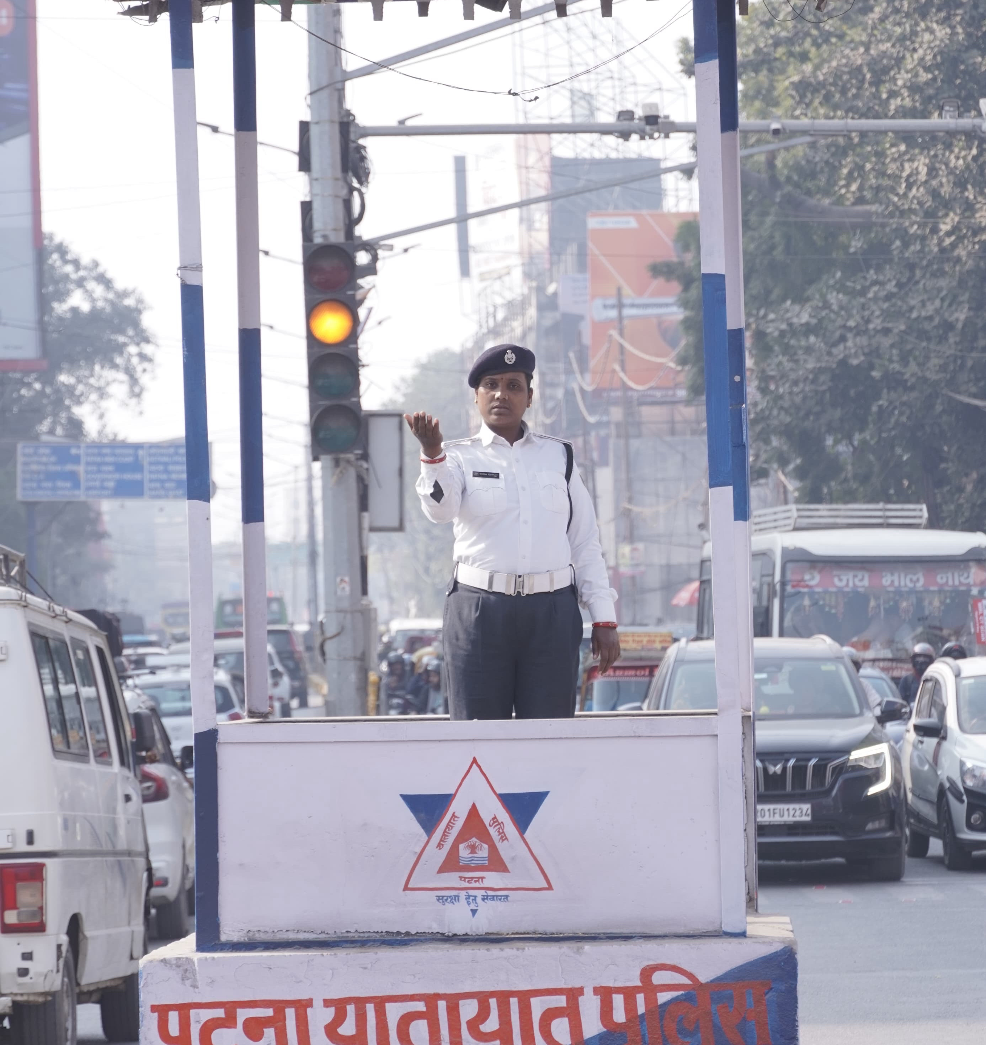
Parking & Traffic Management
Issues and Challenges
Session by
Pourush Agarwal
DySP Traffic Patna

Slide 2
Session Agenda
2
• Why parking & traffic matter for a city
• Key parking issues & the role of sign boards
• Traffic management challenges
• Special situations: VIP movement & metro diversion
• Root causes and their impact
• Solutions — smarter parking, signage & real-time updates
• Smart technology in traffic management
• Case study: Pune parking reform
• Action roadmap for Patna

Slide 3
Why Parking & Traffic Matter
3
• Traffic reflects a city's quality of life & governance
• Poor parking eats into scarce public road space
• Congestion means lost productivity, fuel and time
• It directly affects safety, emergency access & emissions
• Well-managed mobility builds public trust & attracts investment
• Orderly streets improve pedestrian safety and business footfall

Slide 4
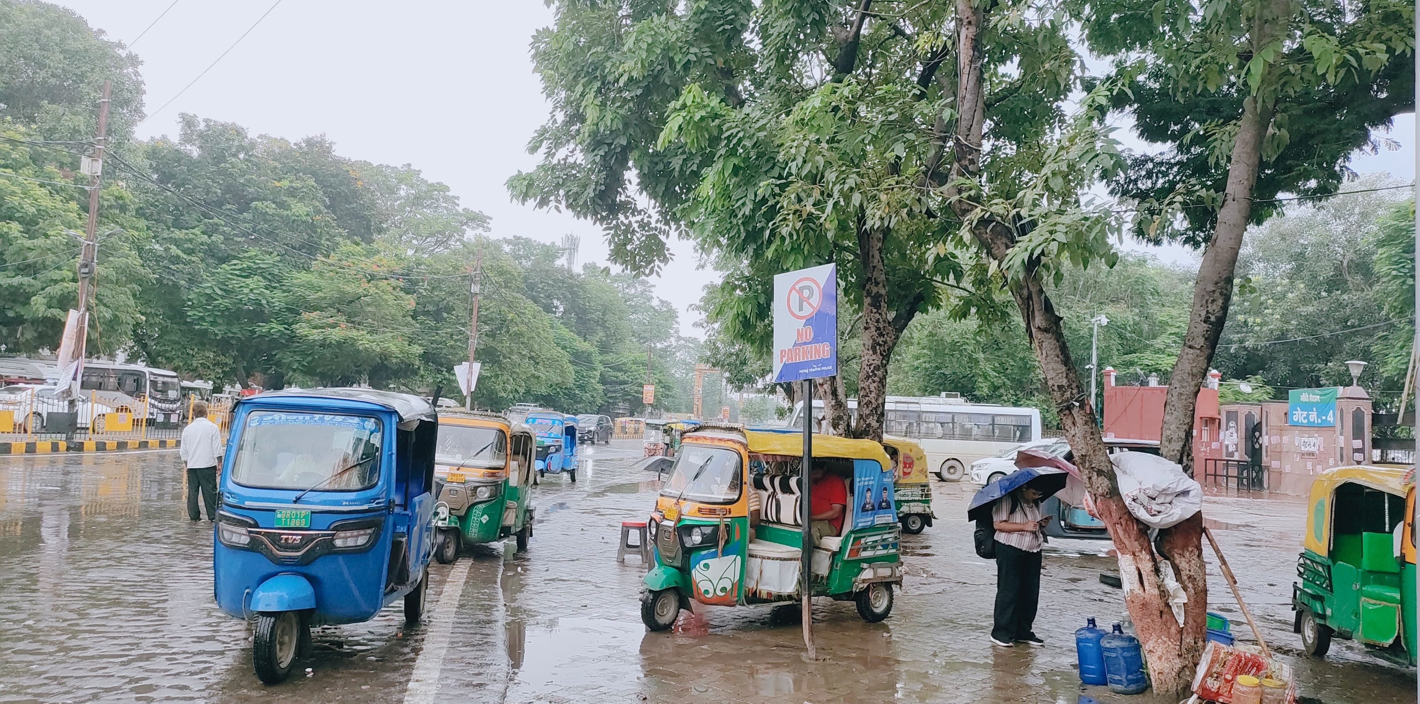
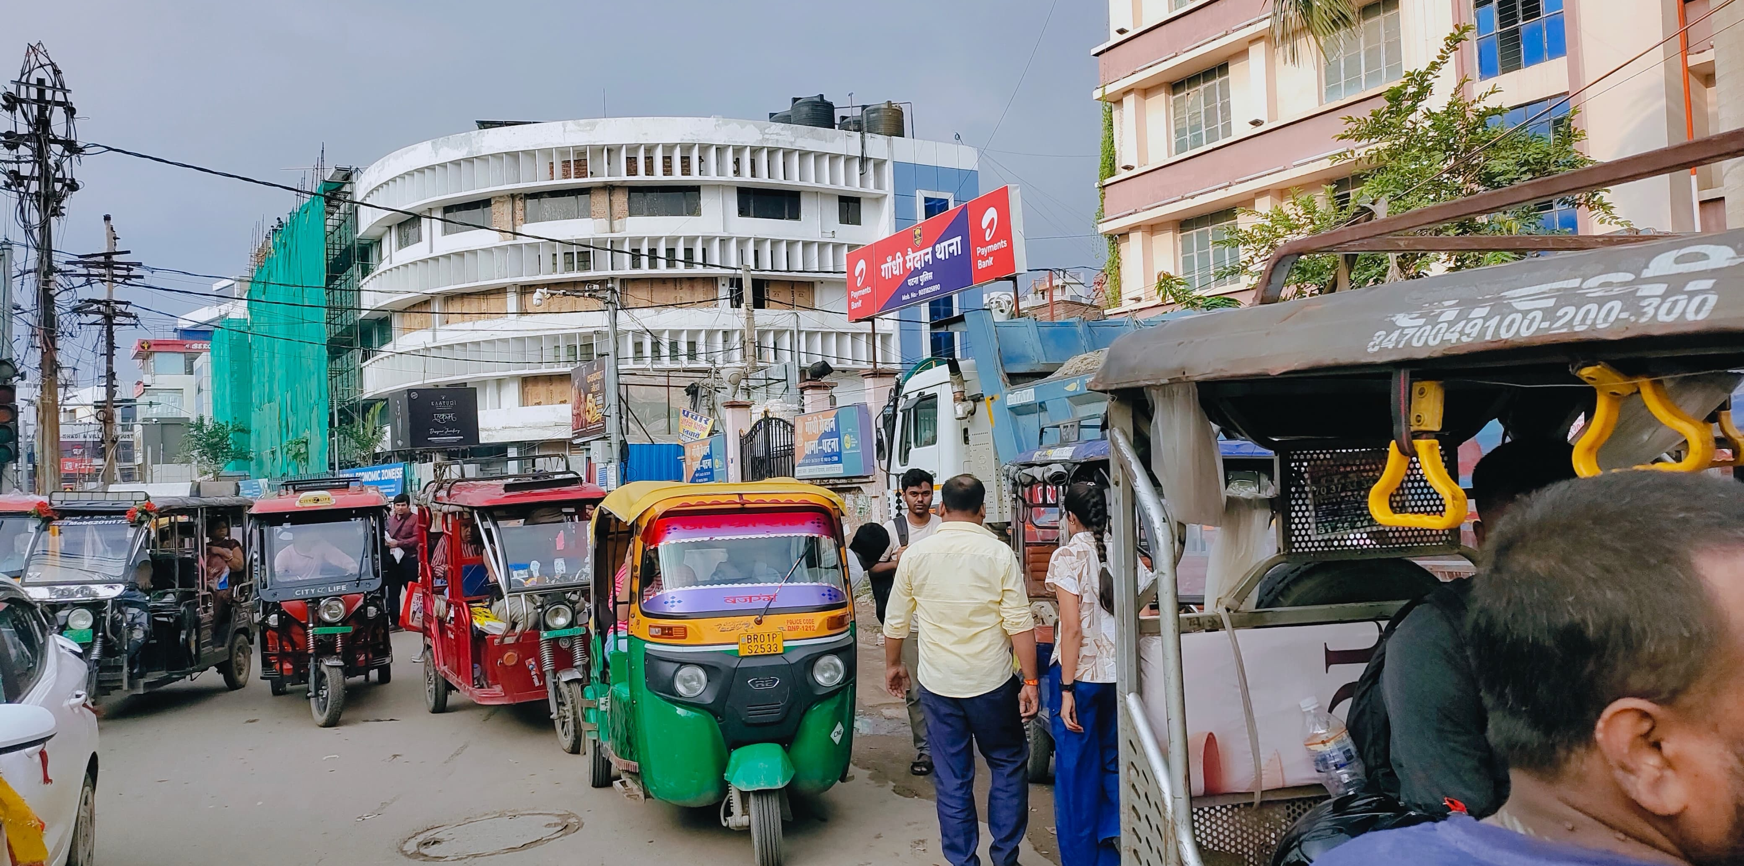
Key Parking Issues in Patna
4
• Illegal roadside parking on both sides of arterial roads
• Haphazard parking chokes market roads, as seen in Wakarganj
• Vehicles ignore signage — parking right under 'No Parking' boards
• Autos & e-rickshaws halt anywhere near stations & markets
• Very little organised, paid off-street parking
Parking right under a 'No Parking' board
Haphazard parking in Wakarganj

Slide 5
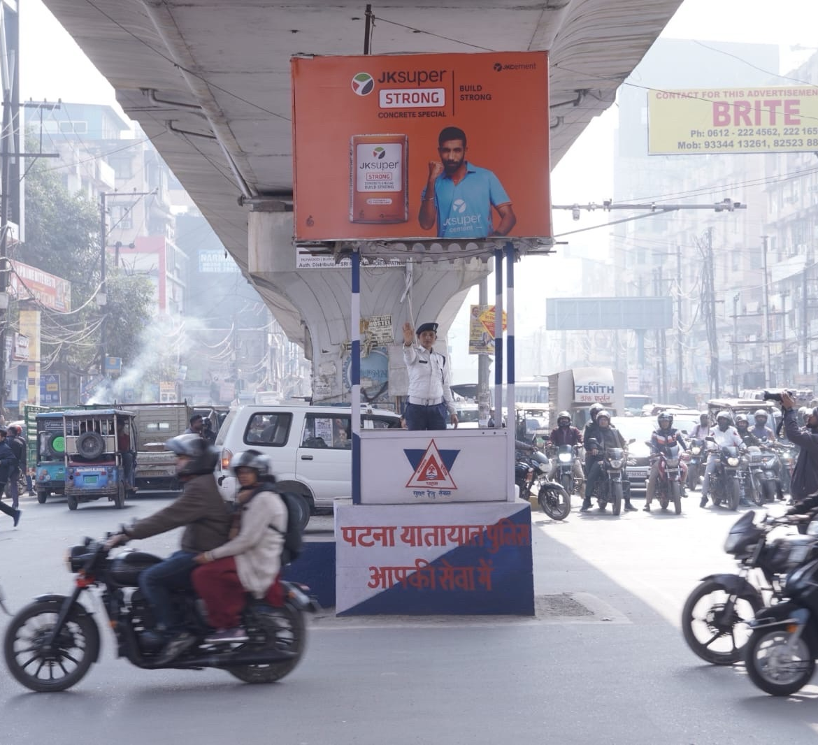
Traffic Management Challenges
5
• Mixed traffic — cars, 2-wheelers, autos, e-rickshaws, carts
• Traffic peaks during school and office hours at key locations
• Severe manpower shortage
• Weak public transport pushes people to private vehicles
• Only ~8% of city area is road (well below the 25% norm)
• Frequent VIP movement disrupts normal traffic flow
• Metro construction forces route diversions & lane closures
• Encroachment & construction shrink usable road width
Patna Traffic Police regulating a busy junction

Slide 6
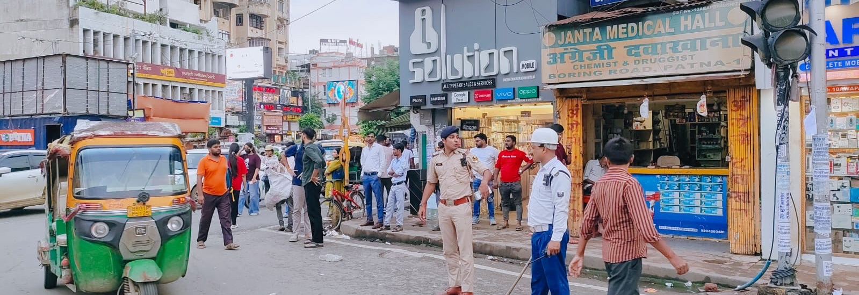
Special Traffic Situations
6
VIP Movement
Metro Diversion
• Route clearance & holding of traffic during transit
• Advance planning with escort & pilot coordination
• Lane closures around metro construction sites
• Clear signage + advance public communication
On-ground regulation at Boring Road crossing, Patna

Slide 7
Root Causes Behind the Chaos
7
Rapid Motorisation
Weak Enforcement
No Parking Policy
Vehicle ownership rising faster than infrastructure
Low penalties and poor signage compliance
Parking treated as free & unlimited
Land-use Mismatch
Weak Public Transport
Fragmented Governance
Dense commercial zones with no parking norms
Few reliable last-mile options
Multiple agencies, unclear ownership

Slide 8
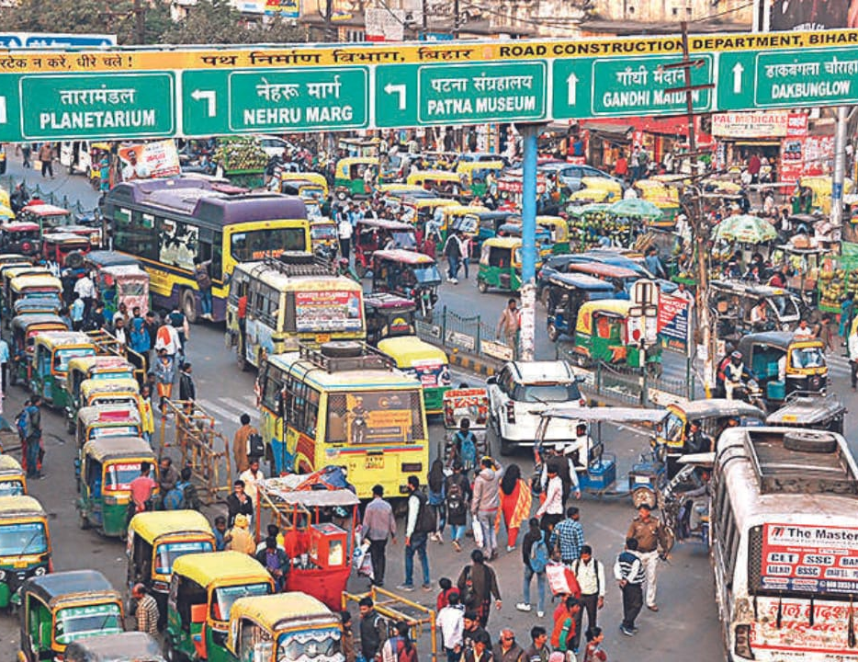
Impact of Poor Management
8
Economic
Environmental
Social & Safety
• Lost man-hours in jams
• Higher fuel & logistics cost
• Reduced business footfall
• Higher vehicular emissions
• Idling pollution & noise
• Poor air quality (AQI)
• More accidents & fatalities
• Blocked emergency vehicles
• Stress & road rage
Congestion on a Patna arterial road

Slide 9
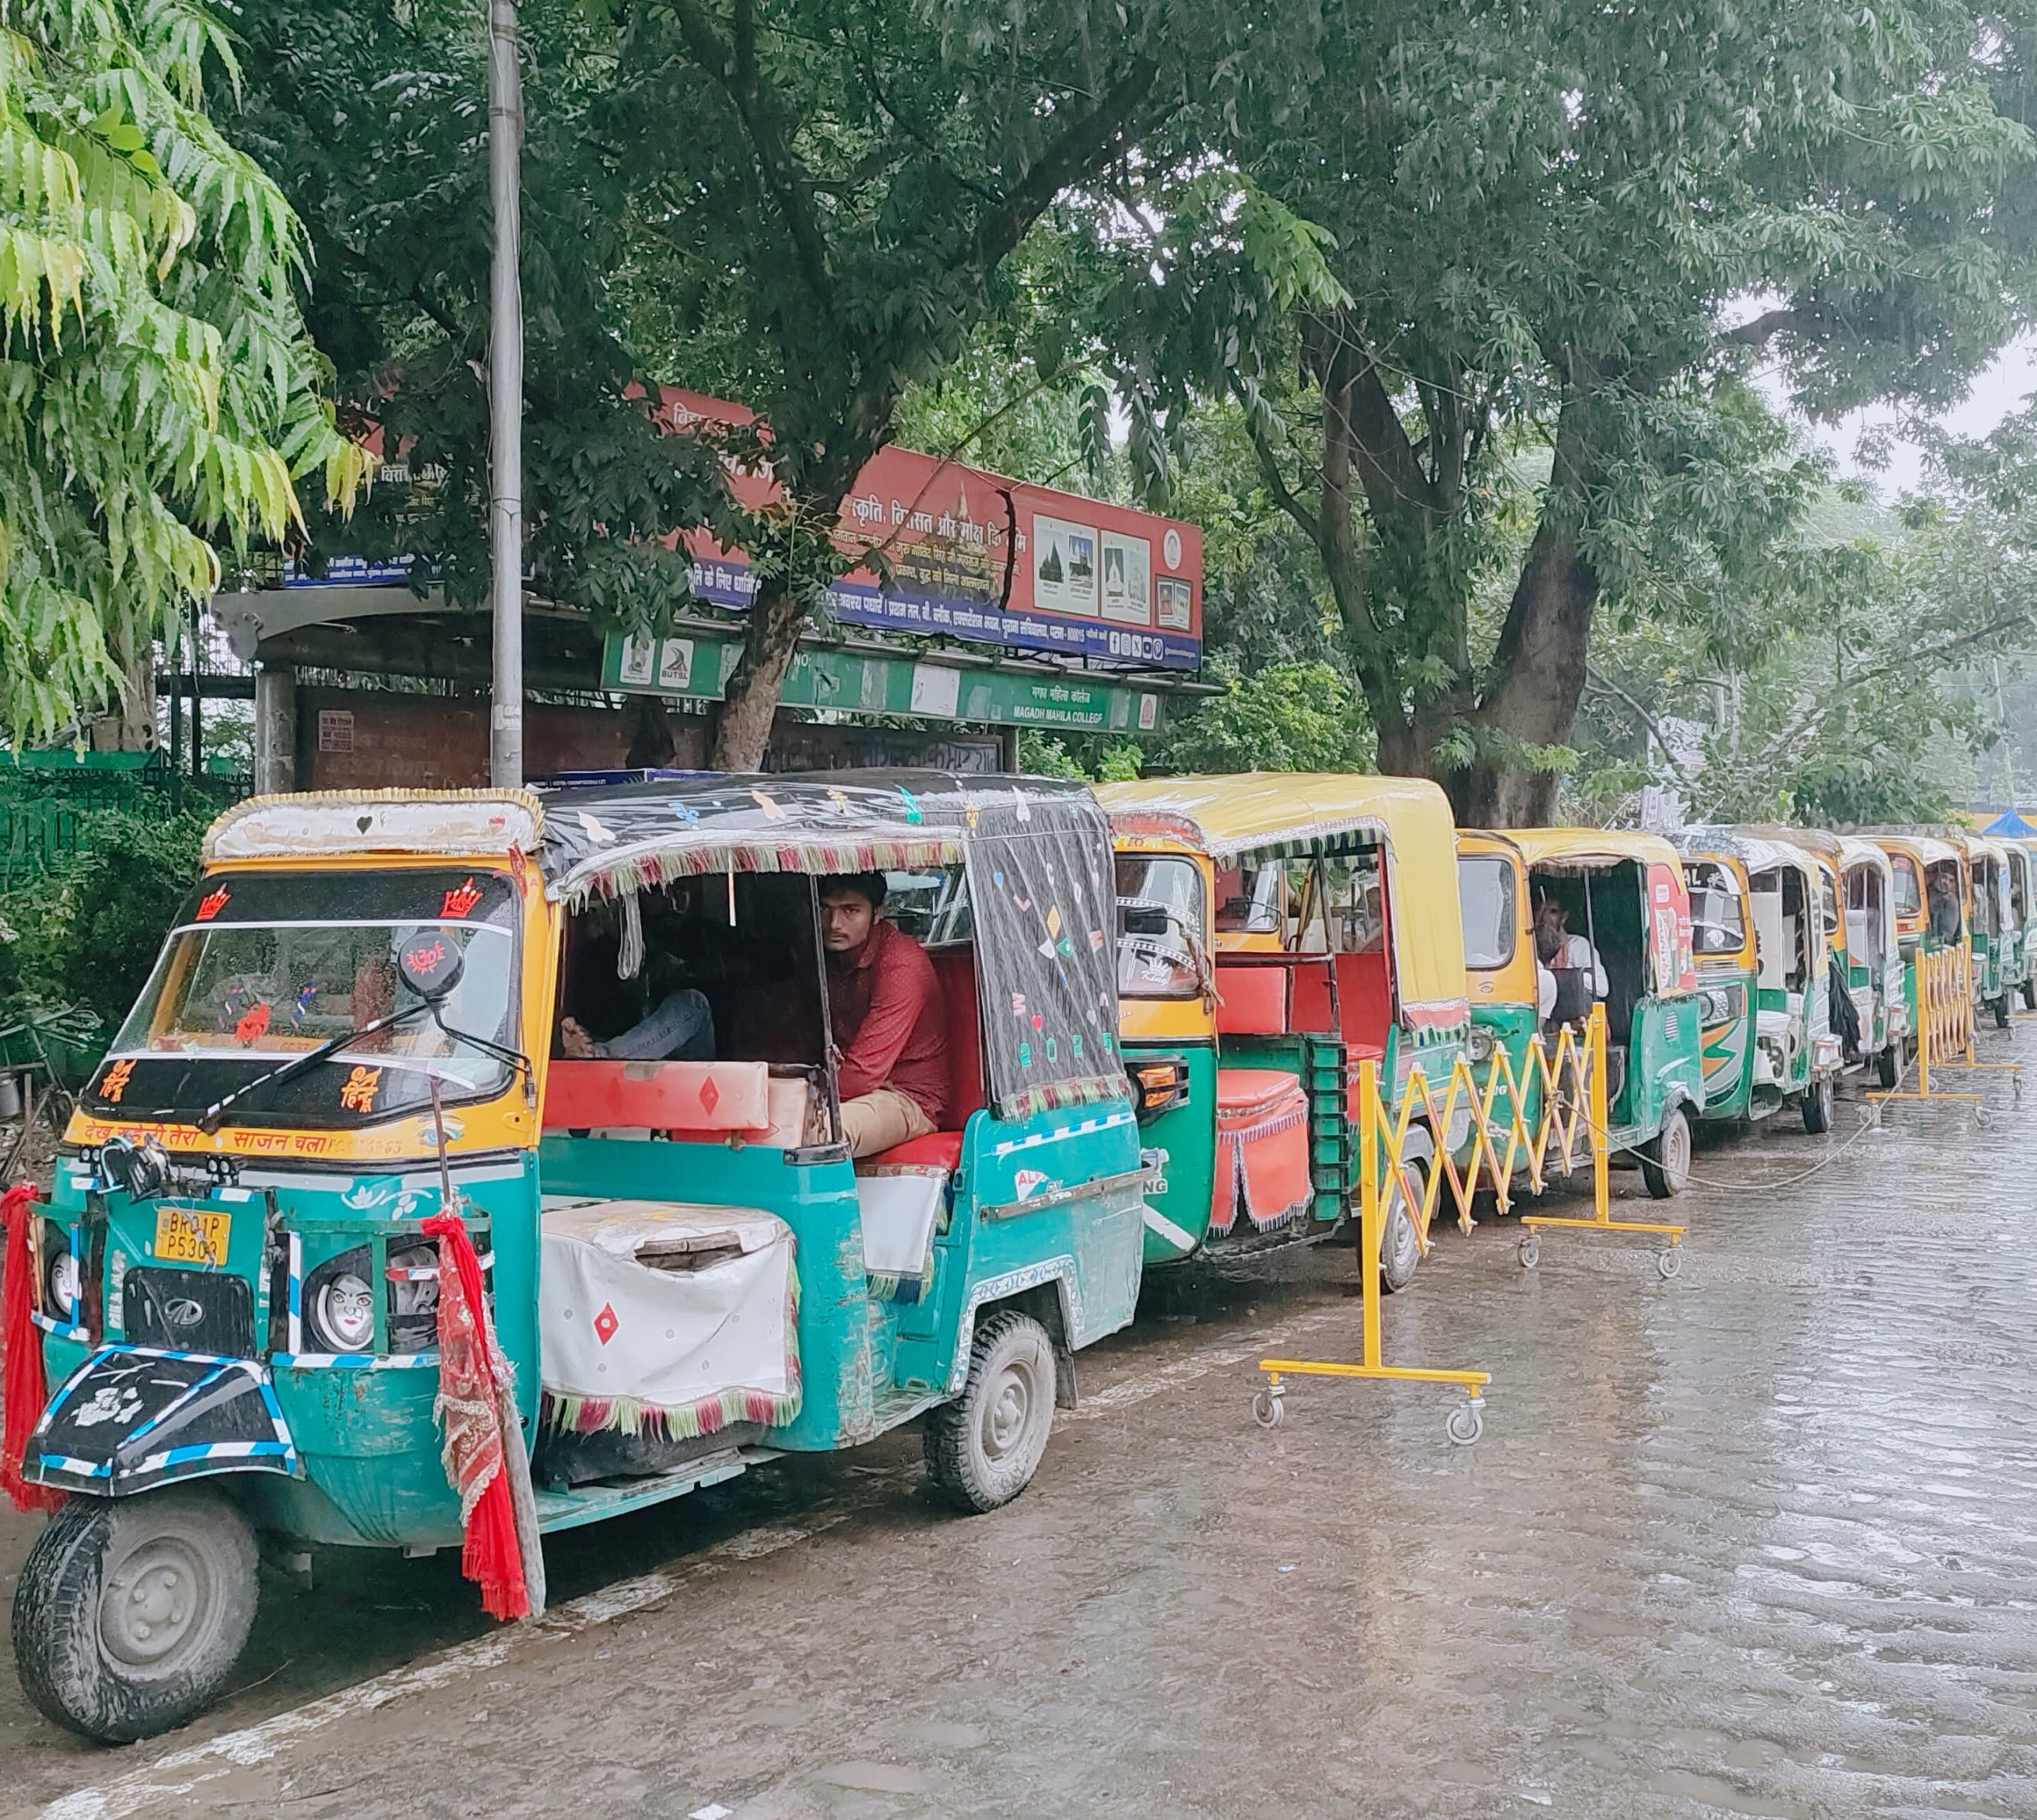
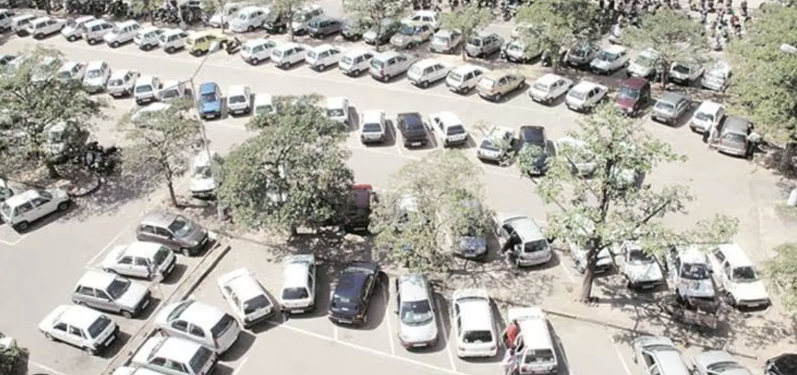
Solutions: Smarter Parking
9
• Priced, demand-based on-street parking (pay-and-park)
• Clearly marked bays with barricades & discipline
• Multi-level & organised off-street parking
• Designated auto and e-rickshaw stands near hubs
• Strict enforcement: towing, fines and CCTV
• Parking norms in building bye-laws for new projects
Organised auto stand with barricades — Patna

Slide 10
Solutions: Traffic Management
10
• Clear, well-placed sign boards with strict enforcement
• Real-time updates to public — social media, apps & alerts
• Advance communication for VIP movement & metro diversions
• Adaptive / synchronised signals on key corridors (ITS)
• Dedicated lanes for buses & non-motorised transport
• Community awareness by NCC
• Joint and coordinated anti-encroachment drives
• Elevated corridors and flyovers
– Karbigahiya–Mithapur Flyover
– Mithapur–Sipara Elevated Road
• Ring road development
• Smart management : ICCC
• Strengthen public transport & last-mile connectivity

Slide 11
The Role of Smart Technology
11
Smart Sensors
Digital Sign Boards
ANPR Cameras
Detect free and occupied parking bays in real time
Dynamic messages for diversions & warnings
Automatic number-plate based enforcement
Adaptive Signals
Real-time Updates
Cashless Payment
Signal timing based on live traffic flow
Live traffic & diversion information to citizens
Transparent, leak-proof parking revenue

Slide 12
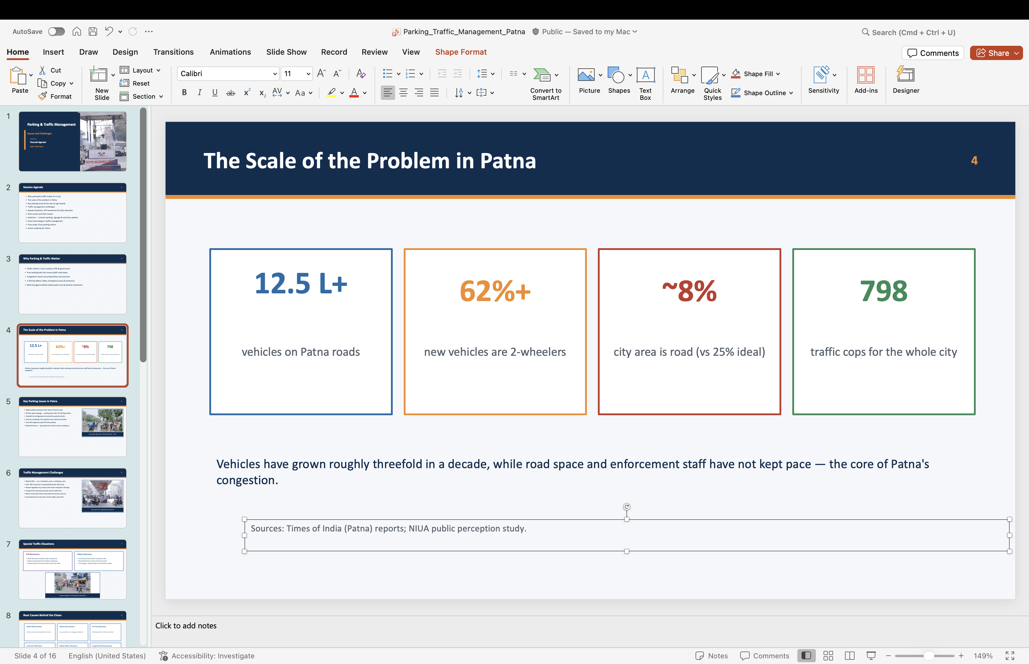
Case Study: Pune Parking Reform
12
Pune's on-street parking management (with ITDP India)
• City parking policy adopted — parking priced, not free
• Demand-based pricing in busy zones & peak hours
• New no-parking zones
• Metro–parking integration — app-based booking and discount for ticket holders
• Cashless, self-paying system for transparent revenue
• Result: less haphazard parking & smoother flow
Integrated parking & transit facility

Slide 13
Action Roadmap for Patna
13
Short Term (0-6 months)
Medium Term (6-18 months)
Long Term (18 months +)
• Fix hotspots — Boring Road, Station Road
• Demarcate bays with clear signage
• Clear encroachments
• Enforcement drive and towing
• Adopt a city parking policy
• Pay-and-park with mobile app
• Real-time updates channel
• Metro diversion planning
• Multi-level parking
• City-wide ITS and CCTV
• Integrated mobility plan
• Data-driven governance
Already begun: In late 2025 Patna traffic police banned car and auto parking on Income Tax Golambar–Dak Bungalow and Budh Marg–GPO Golambar.

Slide 14
Key Takeaways
• Parking is a policy problem, not just an infrastructure one
• Sign boards must be backed by real enforcement
• Plan ahead for VIP movement and metro diversions
• Real-time updates keep citizens informed and reduce chaos
• Joint and coordinated efforts by all stakeholders
• Holistic approach by city managers
• Patna can adapt proven models like Pune's reform

Slide 15
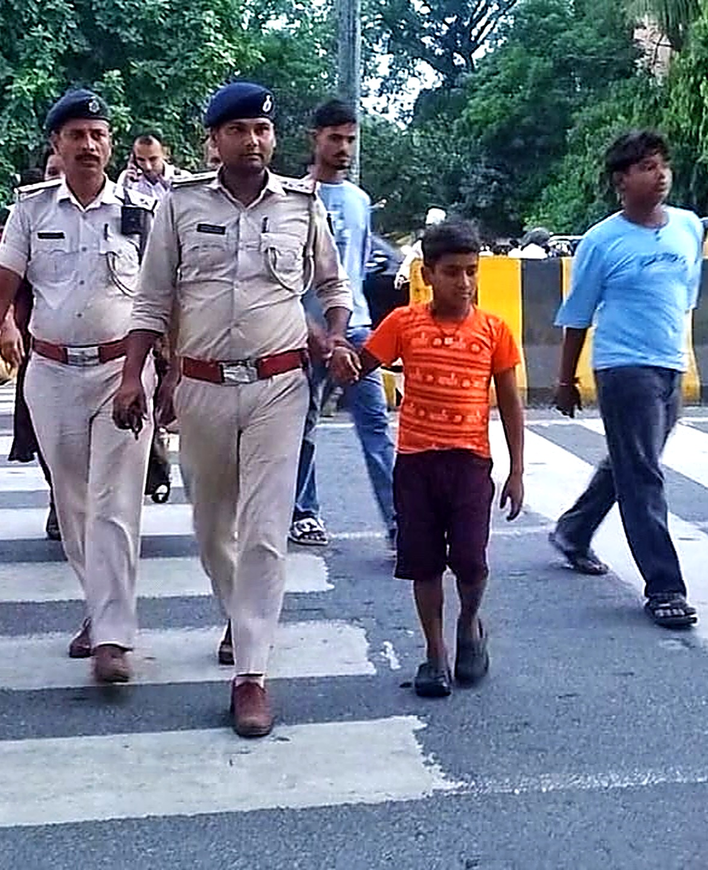
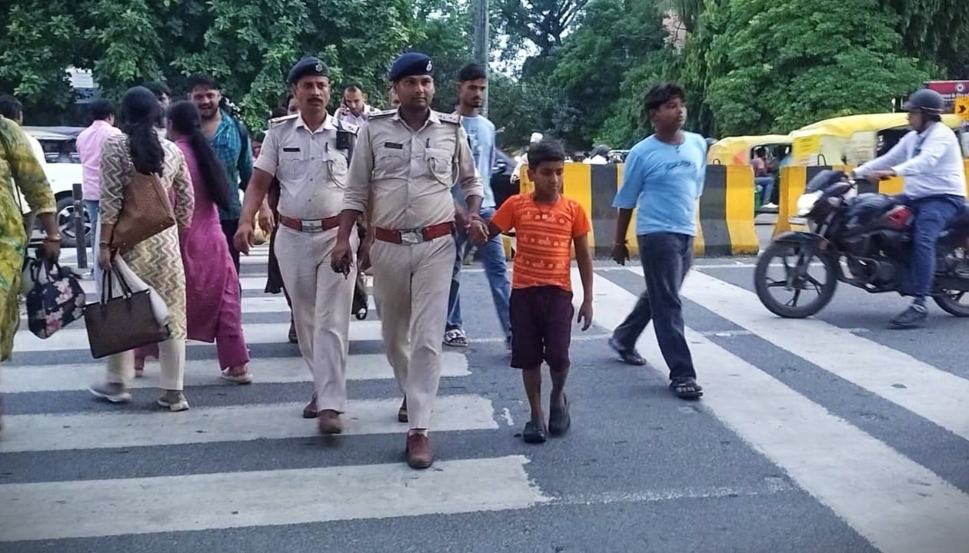
Thank You
Questions & Discussion
Session by
Pourush Agarwal
DySP Traffic Patna

