Slide 1


BVRIT HYDERABAD College of Engineering for Women Department of Computer Science and Engineering
Comparison of various algorithms for fake review detection on
E-Commerce websites
Date : 22/12/2022
Review - 2
Under the guidance of:
Name: Mrs. K. Hema
Designation:
Assistant Professor
Team No: 12
Names with roll numbers:
G. Suvidha - 19WH1A0579
K. Akshaya - 19WH1A0568
B. Akshitha - 19WH1A0563

Slide 2
AGENDA
Abstract
Introduction
Objective
Literature Survey
Existing system
Drawbacks
Proposed system
Advantages
Architecture
Methodology
Datasets
Code
Evaluation Metrics
Tools and Technology
Societal impact
Conclusion
References

Slide 3
ABSTRACT
In recent years, fake review detection has attracted significant attention from both businesses and the research community.
For reviews to reflect genuine user experiences and opinions, detecting fake reviews is an important problem.

Slide 4
INTRODUCTION
Many of e-commerce sites provide a review option for client feedback.
People generally make purchasing decisions based on customer reviews.
Some website owners may employ spammers to write false reviews in order to boost product sales and also decrease the sales of their competitors.

Slide 5
OBJECTIVE
Many approaches have been proposed by researchers in the past to detect fraudulent reviews.
However, there is a critical need to identify and analyze the best machine learning algorithm to detect fraudulent reviews.

Slide 6
LITERATURE SURVEY
S.No | Title of the paper | Author(s) & Journal Details | Description/ Interpretation
1 | Fake Reviews Detection: A Survey | Rami Mohawesh; Shuxiang Xu; Son N. Tran; Robert Ollington; Matthew Springer, Yaser Jararweh, Sumbal Maqsood | Deep learning algorithms such as C-LSTM, HAN, convolutional HAN, and char-level C-LSTM,Bert, DistilBert and Roberta were compared on different paramenters. Overall Roberta performed the best.
2 | Detecting and Analysing Fake Opinions Using Artificial Intelligence Algorithms | Mosleh Hmoud Al-Adhaileh1 Fawaz Waselallah Alsaade2 | These models are BiLSTM and CNN. The BiLSTM model provided higher accuracy for detecting fake reviews than the CNN model in many aspects. Only In terms of speed CNN is faster.
3 | Using Boosting Approaches to Detect Spam Review | Sifat Ahmed, Faisal Muhammad Shah | Boosting algorithms have been used to improve the accuracy. Up to 93% accuracy has been achieved where traditional machine learning algorithms achieve an accuracy of up to 89%.XGBoost, AdaBoost and the Gradient Boosting Machine (GBM) were used on feature selection methods out of which XGBoost on Chi2 has given the accuracy of 95.8%.
4 | Detection of Fake User Reviews with Deep Learning | Kenan Taşağal, Özlem Uçar | CNN-LSTM model from LSTM, BILLSTM and CNN-LSTM models with an accuracy of 87% yielded better results than other models.

Slide 7
EXISTING SYSTEM
DOMAIN : ​
NATURAL LANGUAGE PROCESSING​.
PROJECT :​
Creating and detecting fake reviews of online product ​.
Fake review creation and detection of amazon website using Open AI(Open Artificial Intelligence), NBSVM(Support Vector Machine with Naïve Bayes features) and ROBERTa.
ROBERTa has given the maximum accuracy out of all.

Slide 8
DISADVANTAGES
Restricted to NLP domain.
May or may not be the best algorithms for fake review detection

Slide 9
PROPOSED SYSTEM
DOMAIN :
NLP and DEEP Learning
Compare
LSTM
Roberta
Boosting Classifiers on algorithms
Based on various measures and come out with the best one which detects the fake reviews

Slide 10
ADVANTAGES
Including algorithms from both NLP and DEEP learning.
Development of user friendly interface for fake review detection.

Slide 11
ARCHITECTURE(LSTM)
Import Dataset
Data preprocessing
One hot representation
LSTM
Embedding layer
Padding
Dense Layer
Model Training
Evaluation

Slide 12
METHODOLOGY
LSTM stands for Long Short-Term Memory and is a type of Recurrent Neural Network (RNN).
With LSTM, you can easily process sequential data such as video, text, speech, etc.
LSTM modules consist of gate layers that act as key drivers to control information in neural networks.

Slide 13
DATASETS
Fake reviews dataset
4 columns
Tuples - 40433
Size - 14955KB

Slide 14
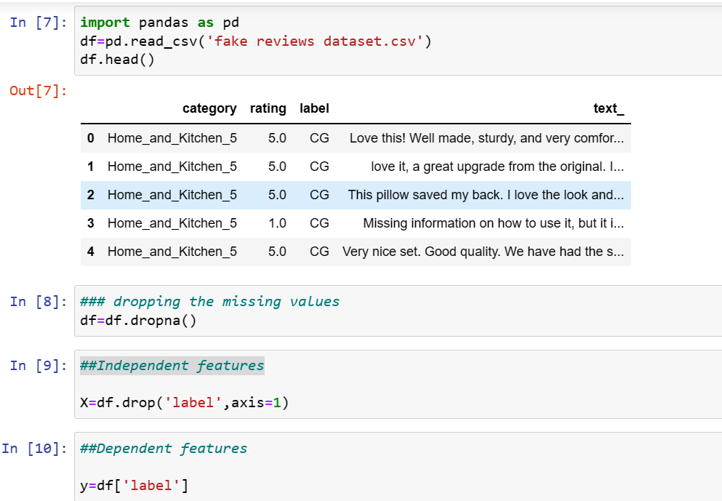
CODE

Slide 15
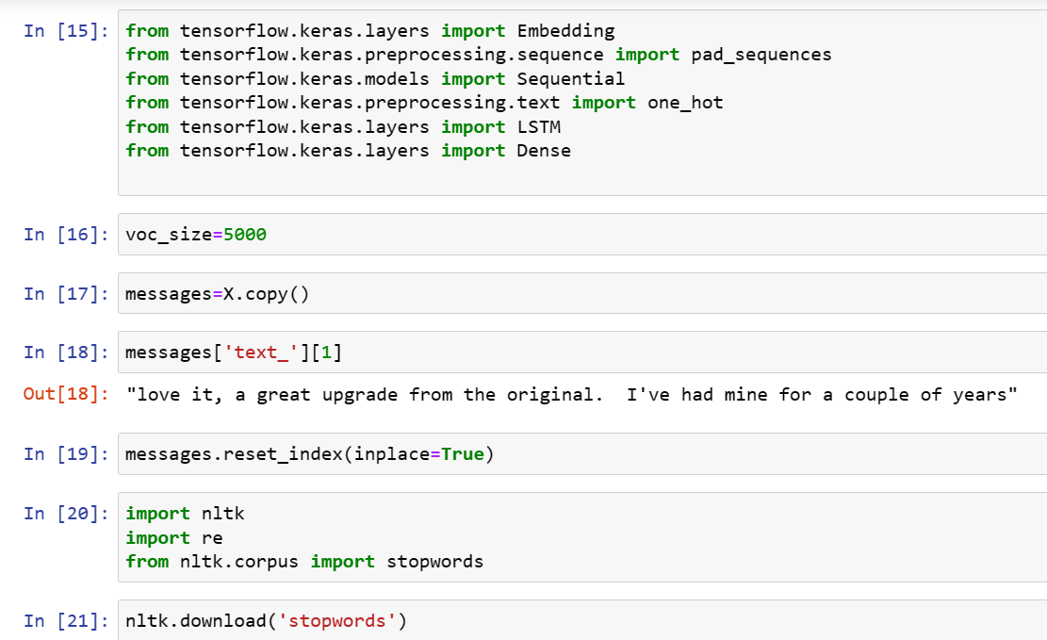

Slide 16
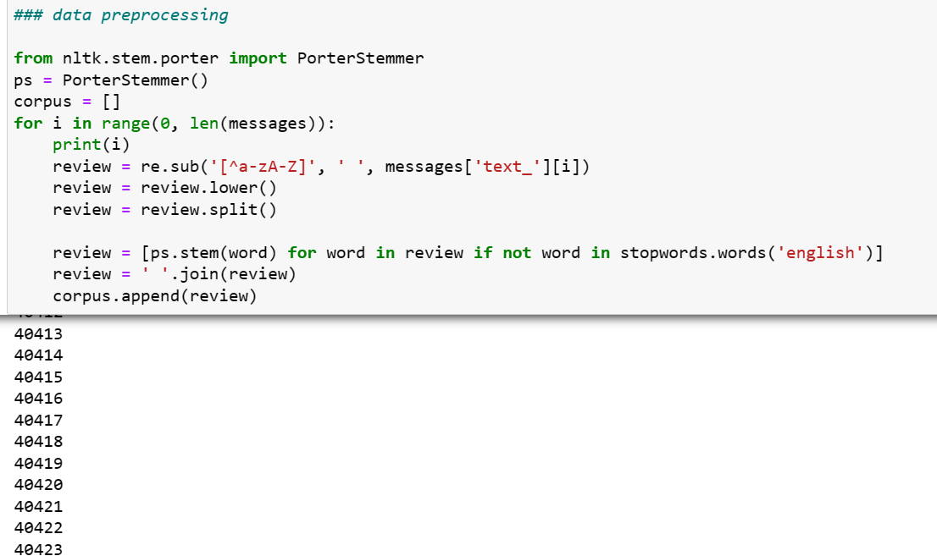

Slide 17
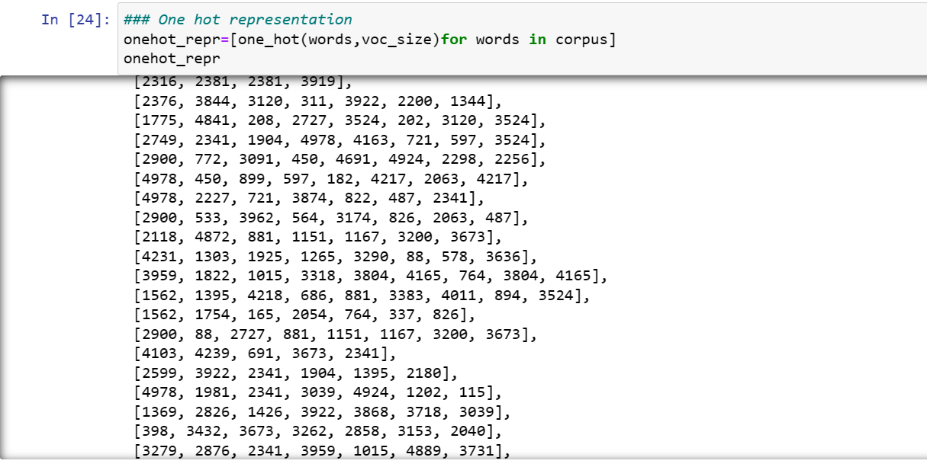

Slide 18
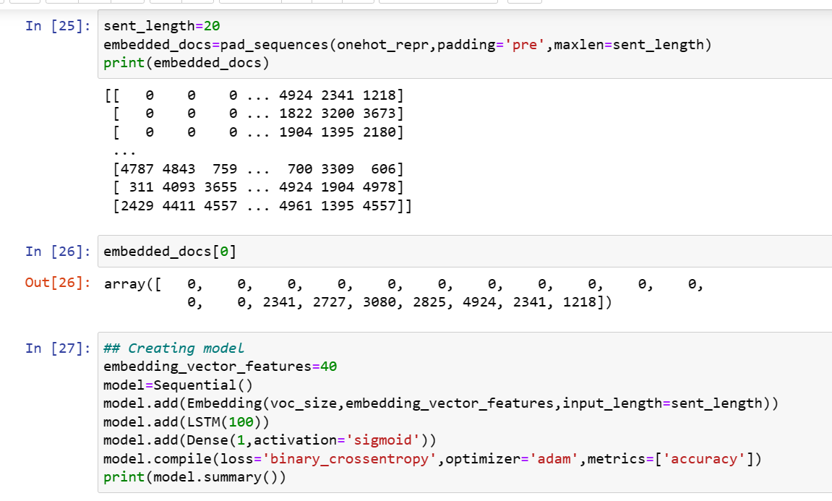

Slide 19
EVALUATION METRICS
Accuracy
Precision
Recall

Slide 20





TOOLS AND TECHNOLOGIES

Slide 21
SOCIETAL IMPACT
Almost all (88%) shoppers use ratings and reviews to evaluate or
learn more about product
Will avoid using that brand again
Leave a negative review
Wouldn’t purchase from the website
Will post [negatively] about the brand on social media
Decrease in revenue for the brand

Slide 22
CONCLUSION
To summarize fake review detection is one of the useful tools we require now days.
The dataset consists of fake and real reviews from amazon dataset.
We intend to compare algorithms from NLP and deep learning to find the best one.

Slide 23
REFERENCES
[1] Mohawesh, R., Xu, S., Tran, S. N., Ollington, R., Springer, M., Jararweh, Y., & Maqsood, S. (2021). Fake
reviews detection: A survey. IEEE Access, 9, 65771-65802.
[2]Al-Adhaileh, M. H., & Alsaade, F. W. (2022). Detecting and Analysing Fake Opinions Using Artificial
Intelligence Algorithms. INTELLIGENT AUTOMATION AND SOFT COMPUTING, 32(1), 643-655.
[3]Ahmed, S., & Muhammad, F. (2019, May). Using Boosting Approaches to Detect Spam Reviews.
In 2019 1st International Conference on Advances in Science, Engineering and Robotics Technology
(ICASERT) (pp. 1-6). IEEE.
[4]Taşağal, K., & Uçar, Ö. (2018). Detection of Fake User Reviews with Deep Learning. International
Journal of Research in Engineering and Applied Sciences (IJREAS), 8(12).
[5]Tang, H., Cao, H., & Li, J. (2021, September). A Study On Detection Of Fake Commodity Reviews Based
On ERNIE-BiLSTM Model. In 2021 International Conference on Computer Information Science and
Artificial Intelligence (CISAI) (pp. 1-5). IEEE.

Slide 24
THANK YOU

