Slide 1


BVRIT HYDERABAD College of Engineering for Women Department of Computer Science and Engineering
Comparison of various algorithms for fake review detection on
E-Commerce websites
Date : 25/3/2023
Phase 2 Review - 1
Under the guidance of:
Name: Mrs. K. Hema
Designation:
Assistant Professor
Team No: 12
Names with roll numbers:
G. Suvidha - 19WH1A0579
K. Akshaya - 19WH1A0568
B. Akshitha - 19WH1A0563

Slide 2
AGENDA
Abstract
Introduction
Problem Statement
Existing system
Proposed system
Architecture
Methodology
Datasets
Code
Evaluation Metrics
Tools and Technology
Societal impact
Conclusion
References

Slide 3
ABSTRACT
In recent years, fake review detection has attracted significant attention from both businesses and the research community.
For reviews to reflect genuine user experiences and opinions, detecting fake reviews is an important problem.

Slide 4
INTRODUCTION
Many of e-commerce sites provide a review option for client feedback.
People generally make purchasing decisions based on customer reviews.
Some website owners may employ spammers to write false reviews in order to boost product sales and also decrease the sales of their competitors.

Slide 5
PROBLEM STATEMENT
Many approaches have been proposed by researchers in the past to detect fraudulent reviews.
However, there is a critical need to identify and analyze the best machine learning algorithm to detect fraudulent reviews.
In this research, we aim to compare various NLP and DEEP LEARNING models to distinguish between spam and non-spam reviews and decide the best model.

Slide 6
EXISTING SYSTEM
DOMAIN : ​
NATURAL LANGUAGE PROCESSING​.
PROJECT :​
Creating and detecting fake reviews of online product ​.
Fake review creation and detection of amazon website using Open AI(Open Artificial Intelligence), NBSVM(Support Vector Machine with Naïve Bayes features) and ROBERTa.
ROBERTa has given the maximum accuracy out of all.

Slide 7
PROPOSED SYSTEM
DOMAIN :
NLP and DEEP Learning
Compare
LSTM
Roberta
BiLSTM
Boosting Classifiers on algorithms
Based on various measures and come out with the best one which detects the fake reviews

Slide 8
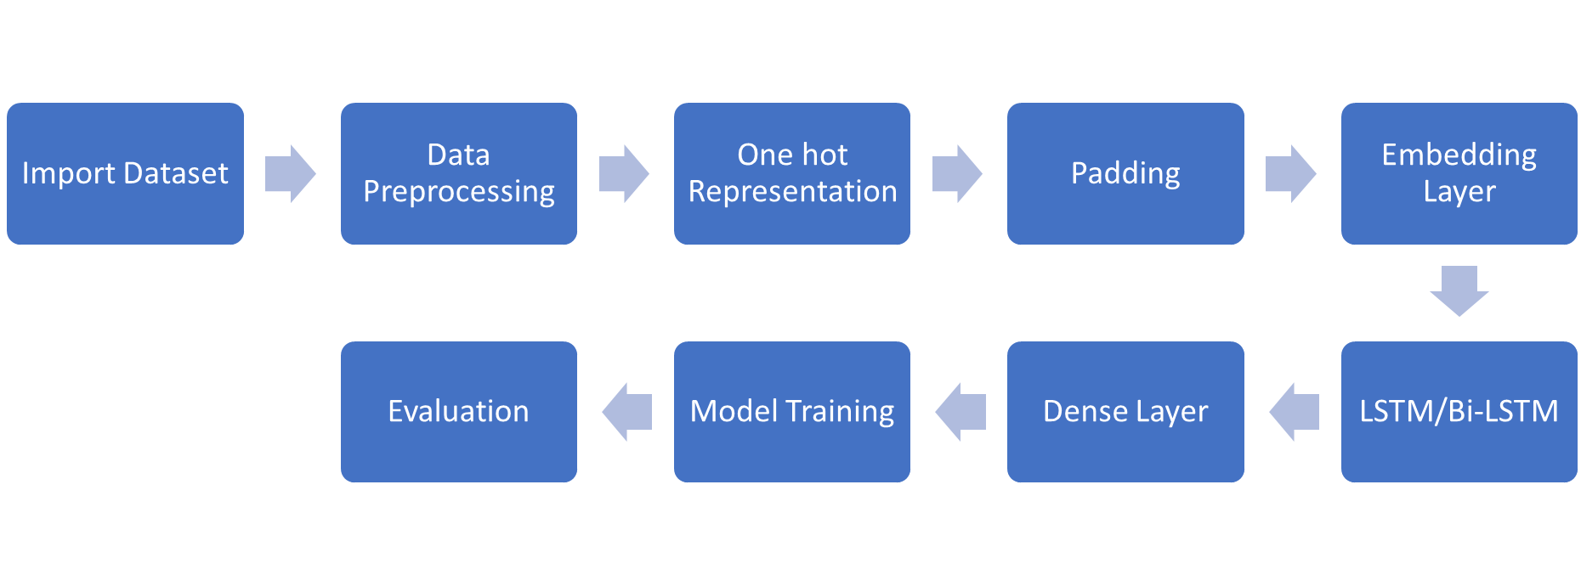
ARCHITECTURE(LSTM/BiLSTM)

Slide 9
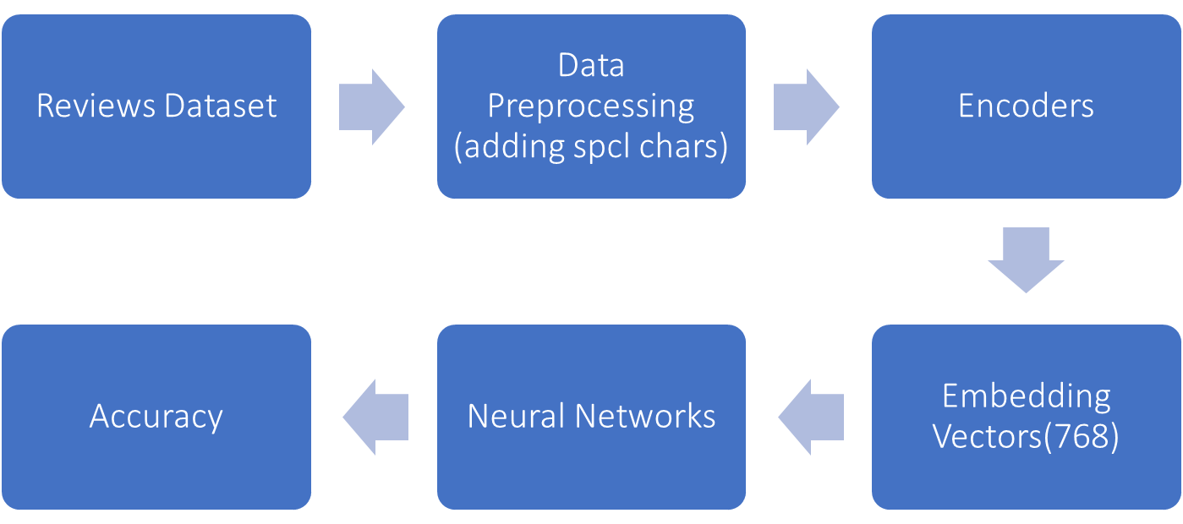
ARCHITECTURE(ROBERTa)

Slide 10
METHODOLOGY
LSTM stands for Long Short-Term Memory and is a type of Recurrent Neural Network (RNN).
With LSTM, you can easily process sequential data such as video, text, speech, etc.
A Bidirectional LSTM, or biLSTM, is a sequence processing model that consists of two LSTMs: one taking the input in a forward direction, and the other in a backwards direction.
BiLSTMs effectively increase the amount of information available to the network, improving the context available to the algorithm

Slide 11
RoBERTa (short for “Robustly Optimized BERT Approach”) is a variant of the BERT model.
RoBERTa is a transformer-based language model that uses self-attention to process input sequences and generate contextualized representations of words in a sentence.

Slide 12
DATASETS
Fake reviews dataset
4 columns (Category,label,Rating,text)
Tuples – 40433
Original – 20216
Fake – 20217
Size - 14955KB

Slide 13
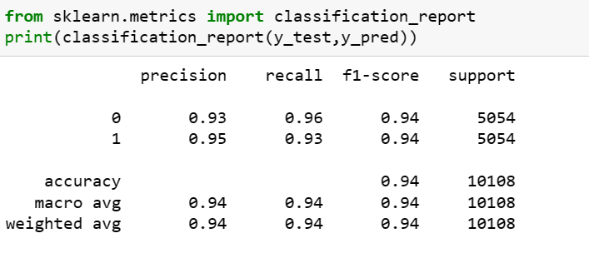

EVALUATION METRICS
Roberta
LSTM

Slide 14
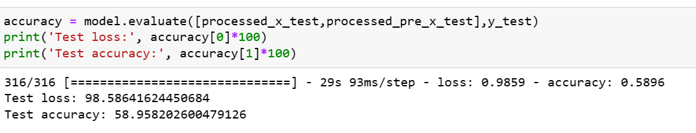
EVALUATION METRICS
BILSTM

Slide 15



TOOLS AND TECHNOLOGIES

Slide 16
CONCLUSION
To summarize fake review detection is one of the useful tools we require now days.
The dataset consists of fake and real reviews from amazon dataset.
We intend to compare algorithms from NLP and deep learning to find the best one.

Slide 17
REFERENCES
[1] Mohawesh, R., Xu, S., Tran, S. N., Ollington, R., Springer, M., Jararweh, Y., & Maqsood, S. (2021). Fake
reviews detection: A survey. IEEE Access, 9, 65771-65802.
[2]Al-Adhaileh, M. H., & Alsaade, F. W. (2022). Detecting and Analysing Fake Opinions Using Artificial
Intelligence Algorithms. INTELLIGENT AUTOMATION AND SOFT COMPUTING, 32(1), 643-655.
[3]Ahmed, S., & Muhammad, F. (2019, May). Using Boosting Approaches to Detect Spam Reviews.
In 2019 1st International Conference on Advances in Science, Engineering and Robotics Technology
(ICASERT) (pp. 1-6). IEEE.
[4]Taşağal, K., & Uçar, Ö. (2018). Detection of Fake User Reviews with Deep Learning. International
Journal of Research in Engineering and Applied Sciences (IJREAS), 8(12).
[5]Tang, H., Cao, H., & Li, J. (2021, September). A Study On Detection Of Fake Commodity Reviews Based
On ERNIE-BiLSTM Model. In 2021 International Conference on Computer Information Science and
Artificial Intelligence (CISAI) (pp. 1-5). IEEE.

Slide 18
THANK YOU

