Slide 1


BVRIT HYDERABAD College of Engineering for Women Department of Computer Science and Engineering
Comparison of various algorithms for fake review detection on
E-Commerce websites
Date : 06/05/2023
Phase 2 - Review - 2
Under the guidance of:
Name: Mrs. K. Hema
Designation:
Assistant Professor
Team No: 12
Names with roll numbers:
G. Suvidha - 19WH1A0579
K. Akshaya - 19WH1A0568
B. Akshitha - 19WH1A0563

Slide 2
AGENDA
Abstract
Introduction
Objective
Literature Survey
Existing system
Disadvantages
Proposed system
Advantages
Architecture
Methodology
Datasets
Evaluation Metrics
Conclusion
References

Slide 3
ABSTRACT
In recent years, fake review detection has attracted significant attention from both businesses and the research community.
For reviews to reflect genuine user experiences and opinions, detecting fake reviews is an important problem.

Slide 4
INTRODUCTION
Many of e-commerce sites provide a review option for client feedback.
People generally make purchasing decisions based on customer reviews.
Some website owners may employ spammers to write false reviews in order to boost product sales and also decrease the sales of their competitors.

Slide 5
PROBLEM STATEMENT
Many approaches have been proposed by researchers in the past to detect fraudulent reviews.
However, there is a critical need to identify and analyze the best machine learning algorithm to detect fraudulent reviews.
In this research, we aim to compare various NLP and DEEP LEARNING models to distinguish between spam and non-spam reviews and decide the best model.

Slide 6
EXISTING SYSTEM
DOMAIN : ​
NATURAL LANGUAGE PROCESSING​
PROJECT :​
Creating and detecting fake reviews of online product ​.
Fake review creation and detection of amazon website using Open AI(Open Artificial Intelligence), NBSVM(Support Vector Machine with Naïve Bayes features) and ROBERTa.

Slide 7
DISADVANTAGES
Restricted to NLP domain.
May or may not be the best algorithms for fake review detection

Slide 8
LITERATURE SURVEY
S.No | Title of the paper | Author(s) & Journal Details | Description/ Interpretation
1 | Leveraging transfer learning techniques | P Gupta, S Gandhi, BR Chakravarthi | ,Bert, DistilBert, albert and Roberta were compared on different paramenters. Overall Roberta performed the best.
2 | Detecting and Analysing Fake Opinions Using Artificial Intelligence Algorithms | Mosleh Hmoud Al-Adhaileh1 Fawaz Waselallah Alsaade2 | These models are BiLSTM and CNN. The BiLSTM model provided higher accuracy for detecting fake reviews than the CNN model in many aspects. Only In terms of speed CNN is faster.
3 | Using Boosting Approaches to Detect Spam Review | Sifat Ahmed, Faisal Muhammad Shah | Boosting algorithms have been used to improve the accuracy. Up to 93% accuracy has been achieved where traditional machine learning algorithms achieve an accuracy of up to 89%.XGBoost, AdaBoost and the Gradient Boosting Machine (GBM) were used on feature selection methods out of which XGBoost on Chi2 has given the accuracy of 95.8%.
4 | Detection of Fake User Reviews with Deep Learning. | Kenan Taşağal, Özlem Uçar | CNN-LSTM model from LSTM, BILLSTM and CNN-LSTM models with an accuracy of 87% yielded better results than other models.

Slide 9
PROPOSED SYSTEM
DOMAIN :
NLP and DEEP Learning
Compare
LSTM
NB-Logistic Regression
Roberta
Bi-LSTM
Based on various measures and come out with the best one which detects the fake reviews

Slide 10

ADVANTAGES
Including algorithms from both NLP and DEEP learning.
Predicting the reviews if they are fake or no.
Improving the existing algorithms.

Slide 11
ARCHITECTURE(ROBERTa)
Import Dataset
Splitting the dataset
Pre-processing
defining the model
With pretrained roberta
Training the Model
Validating the model
Evaluation

Slide 12
ARCHITECTURE(LSTM)
Import dataset
Pre-processing
Splitting the dataset
Defining the model layers
Evaluation
Compiling and fitting the model

Slide 13
ARCHITECTURE(Bi-LSTM)
Import dataset
Pre-processing
Splitting the dataset
Defining the model’s 2 Layers
Evaluation
Compiling and fitting the model

Slide 14
ARCHITECTURE(NB-Logistic Regression)
Import Dataset
Splitting the dataset
Evaluation
Pre-Processing
Defining a LR model with NB feature

Slide 15
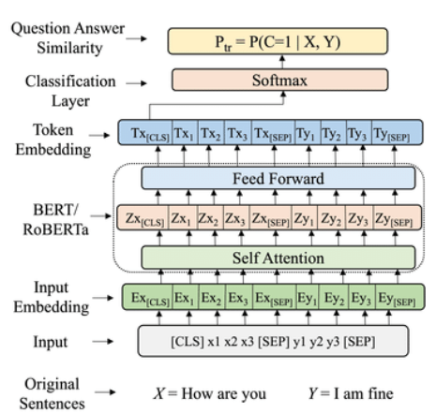
METHODOLOGY
RoBERTa (Robustly Optimized BERT Pretrained Approach)

Slide 16
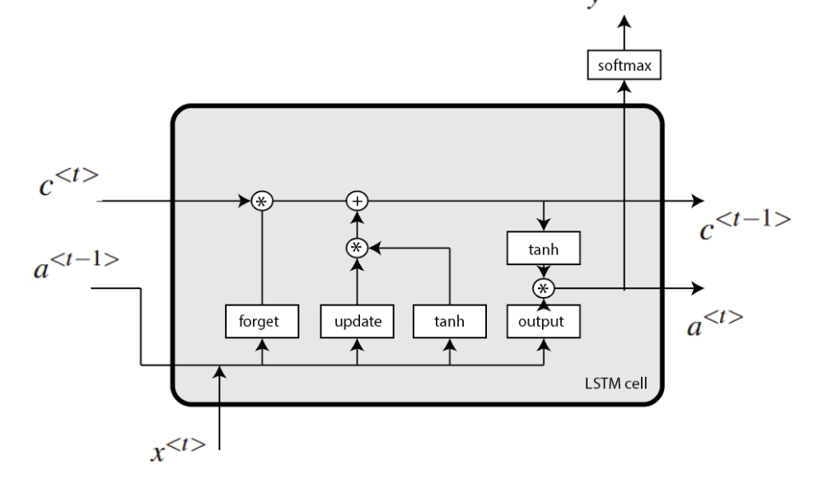
LSTM (Long Short-Term Memory)

Slide 17
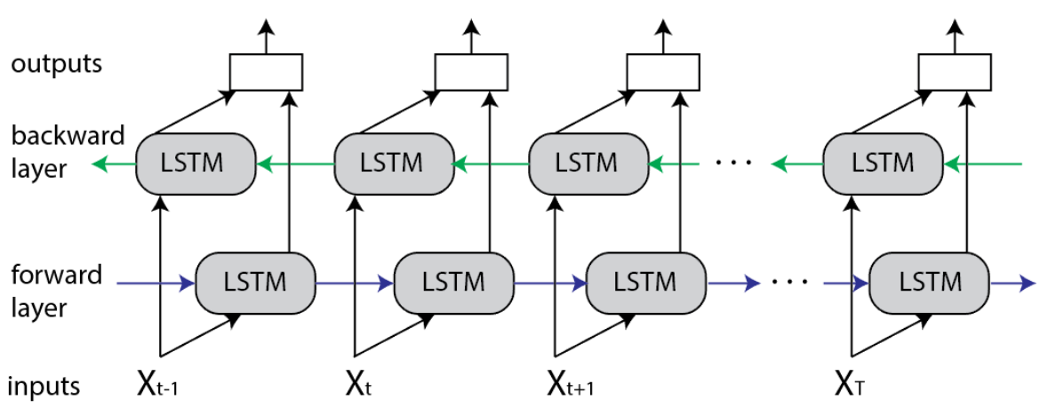
BiLSTM (Bidirectional Long Short-Term Memory)

Slide 18
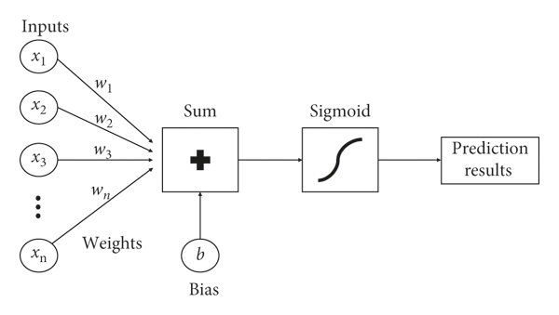
NB Logistic Regression
Log Count ratio

Slide 19
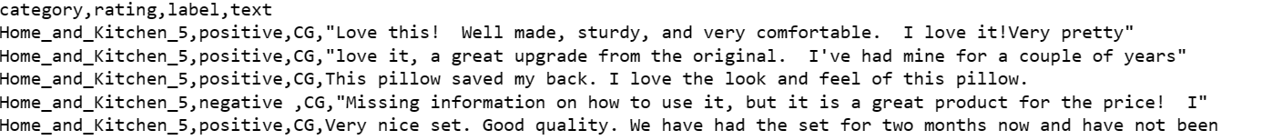
DATASETS
Fake reviews dataset
4 columns (Category, label, Rating, text)
Tuples – 40433
Original – 20216
Fake – 20217
Size - 14955KB
Fake reviews dataset.csv

Slide 20
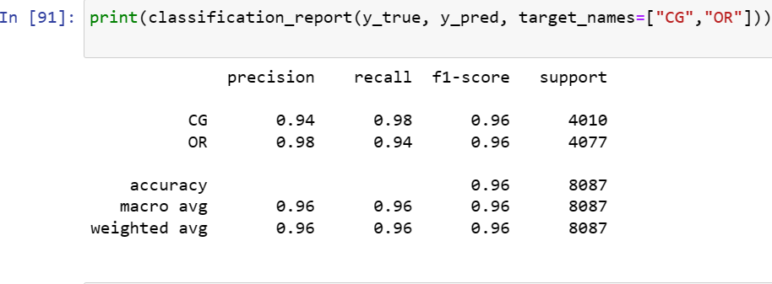
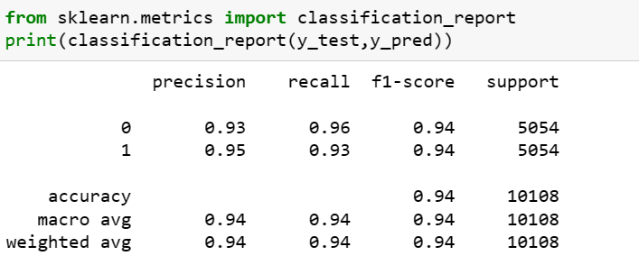
EVALUATION METRICS
Roberta LSTM

Slide 21
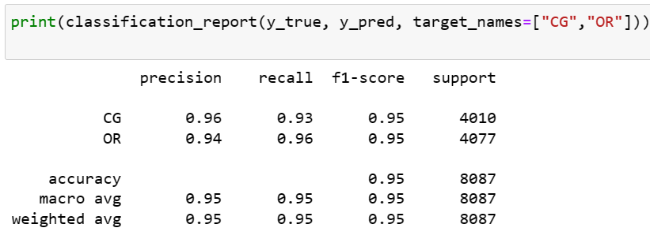
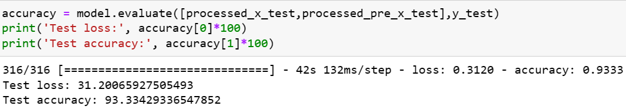
NB-Logistic Regression
BILSTM

Slide 22
CONCLUSION
To summarize fake review detection is one of the useful tools we require now days.
The dataset consists of fake and real reviews from amazon dataset.
We intend to compare algorithms from NLP and deep learning to find the best one.
In our study we conclude that the Roberta has outreached other alogrithms.

Slide 23
REFERENCES
[1] Mohawesh, R., Xu, S., Tran, S. N., Ollington, R., Springer, M., Jararweh, Y., & Maqsood, S. (2021). Fake
reviews detection: A survey. IEEE Access, 9, 65771-65802.
[2]Al-Adhaileh, M. H., & Alsaade, F. W. (2022). Detecting and Analysing Fake Opinions Using Artificial
Intelligence Algorithms. INTELLIGENT AUTOMATION AND SOFT COMPUTING, 32(1), 643-655.
[3]Ahmed, S., & Muhammad, F. (2019, May). Using Boosting Approaches to Detect Spam Reviews.
In 2019 1st International Conference on Advances in Science, Engineering and Robotics Technology
(ICASERT) (pp. 1-6). IEEE.
[4]Taşağal, K., & Uçar, Ö. (2018). Detection of Fake User Reviews with Deep Learning. International
Journal of Research in Engineering and Applied Sciences (IJREAS), 8(12).
[5]Tang, H., Cao, H., & Li, J. (2021, September). A Study On Detection Of Fake Commodity Reviews Based
On ERNIE-BiLSTM Model. In 2021 International Conference on Computer Information Science and
Artificial Intelligence (CISAI) (pp. 1-5). IEEE.

Slide 24
THANK YOU

