Slide 1


SMART SHOE for HEALTH FITNESS USING IoT
BVRIT HYDERABAD College of Engineering for Women
Department of Information Technology
Team- 8
C. Neha Reddy(1262)
K. Deekshita(1273)
S. Sravani(1280)
B. Sai likhitha(1298)
Under the Guidance of
Guide Name: Ms. K.S.Niraja
Assistant Professor

Slide 2
Contents
Summary
Architecture
Modules
Implementation of Modules
Conclusion

Slide 3
Nb Summary
Cancer is a group of diseases characterized by the uncontrolled growth and spread of abnormal cells. If the spread is not controlled, it can result in death. Lung cancer was the most common cancer in worldwide, contributing 2,093,876 of the total number of new cases diagnosed in 2018.
The incidence rate has been declining since the mid- 1980s in men, but only since the mid-2000s in women, because of gender differences in historical patterns of smoking uptake and cessation.
Cigarette smoking is by far the most important risk factor for lung cancer; 80% of lung cancer deaths in the US are still caused by smoking.
The project had designed in such a way that anyone who do running or walking by wearing these uniquely designed shoe they will get to know how many steps they have walked and if the person sits ideal for sometime then he’ll get a warm up message and if he do over exercise(walking or running) then he will get a rest for a while notification. And there will be also a water remainder to help the user to avoid dehydration.

Slide 4
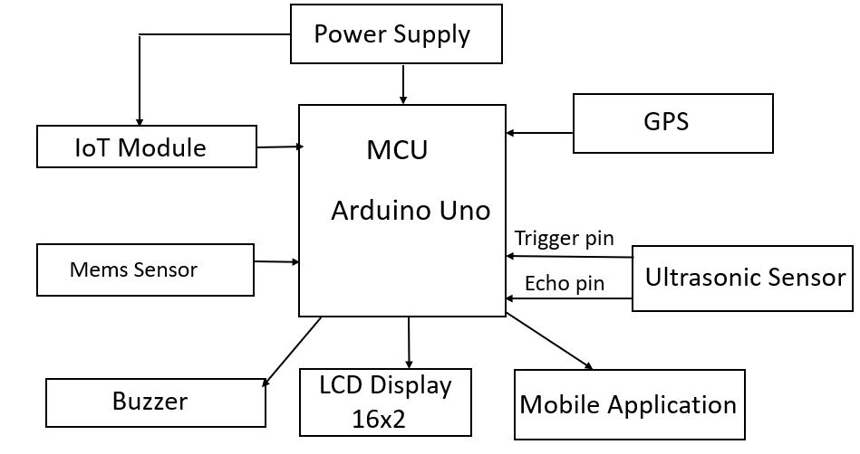
Implementation System Architecture

Slide 5
Modules
Movement Detection
Calculating Step Count
Calculating Time
Buzzer
GPS

Slide 6
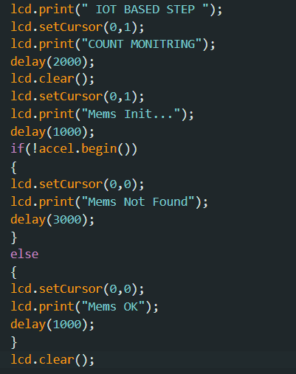
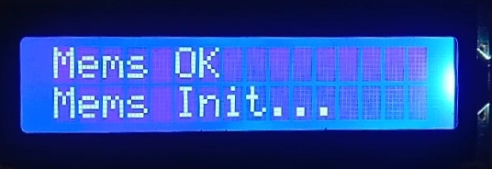
Movement Detection

Slide 7
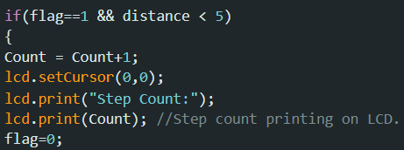
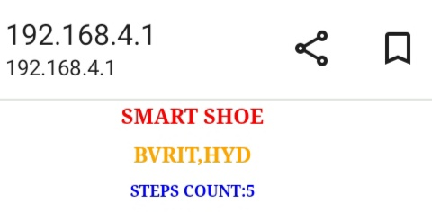
Calculating Step Count

Slide 8
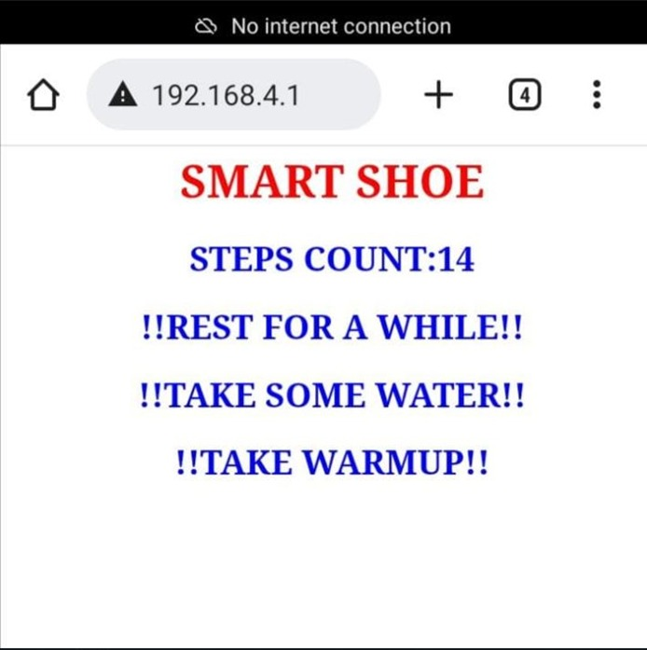
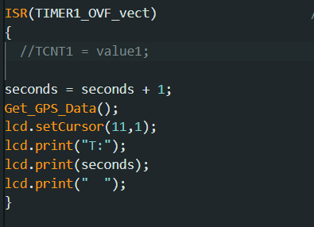
Calculating Time

Slide 9
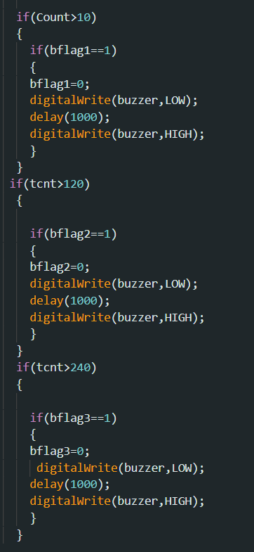
Buzzer

Slide 10
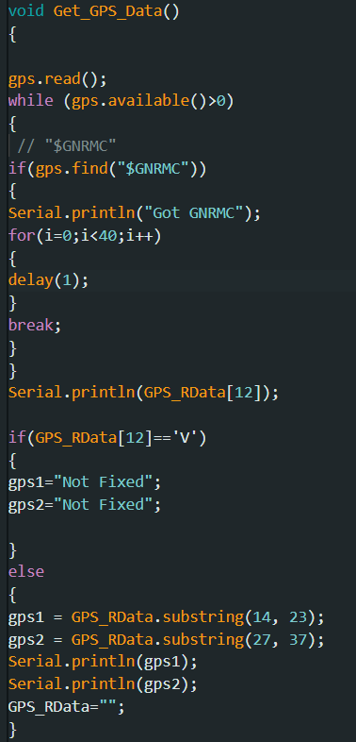
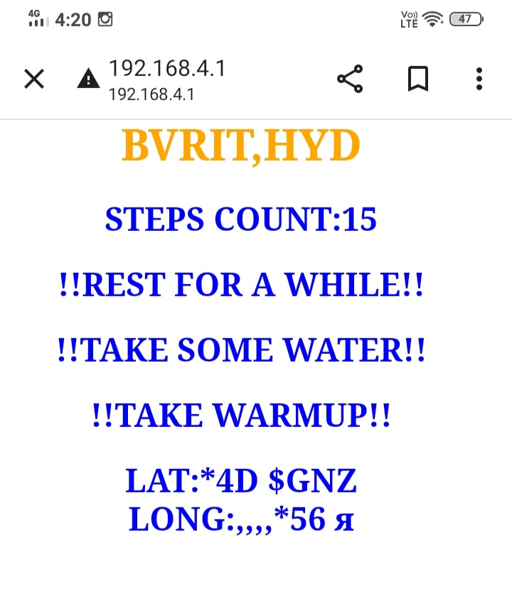
GPS

Slide 11
Conclusion
Calculating number of steps taken, calculating time for water remainder and to print warm up message, preventing over exercise based on step count and buzzer for every message has been done. And working on GPS.

Slide 12
Thank You

