Slide 1

An Autonomous Institution Affiliated to Visvesvaraya Technological University. Approved by UGC/AICTE/Govt. of Karnataka, Accredited by NAAC (Grade 'A+') Bangalore-560064, Karnataka, INDIA
3D Stratigraphic Modelling of
The Dutch Sector
Aditya K – 1NT22CS015
Aditya Parthiban – 1NT22CS016
Advaith V – 1NT22CS017
Akarshak Sharma– 1NT22CS020

Slide 2
Contents
Abstract
Introduction
Objectives
Literature survey
Dataset used

Slide 3
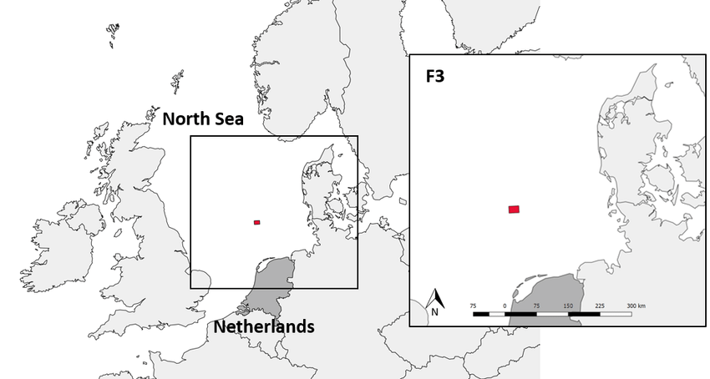
Abstract
In this project, we aim to construct a comprehensive 3D stratigraphic model using the F3 dataset acquired in the Netherlands. Leveraging seismic data stored in SEG-Y format, our objective is to unravel the intricate geological structures and properties hidden beneath the Earth's surface.
Through systematic pre-processing, interpretation, and modelling, we aim to contribute to our understanding of subsurface geology and support various applications in geoscience, petroleum engineering, and environmental research.

Slide 4
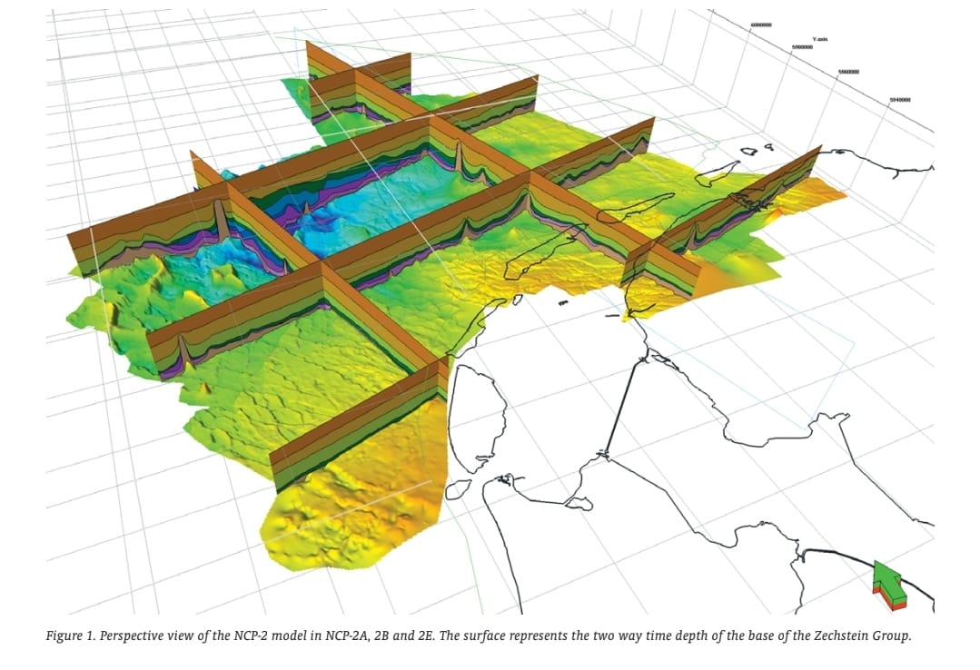
Introduction
The exploration of subsurface geological structures and properties plays a crucial role in understanding Earth's history and supporting various applications such as resource exploration and geological hazard mitigation. The F3 dataset, acquired in the Netherlands and rich in seismic data stored in
SEG-Y format, offers an invaluable opportunity to delve into the depths of the Earth's crust.
In this project, we embark on a journey to construct a comprehensive 3D stratigraphic model that captures the complex geological architecture of the study area. By systematically pre-processing seismic data, interpreting reflections, and modelling stratigraphic units, we aim to advance our understanding of subsurface geology and its implications.

Slide 5
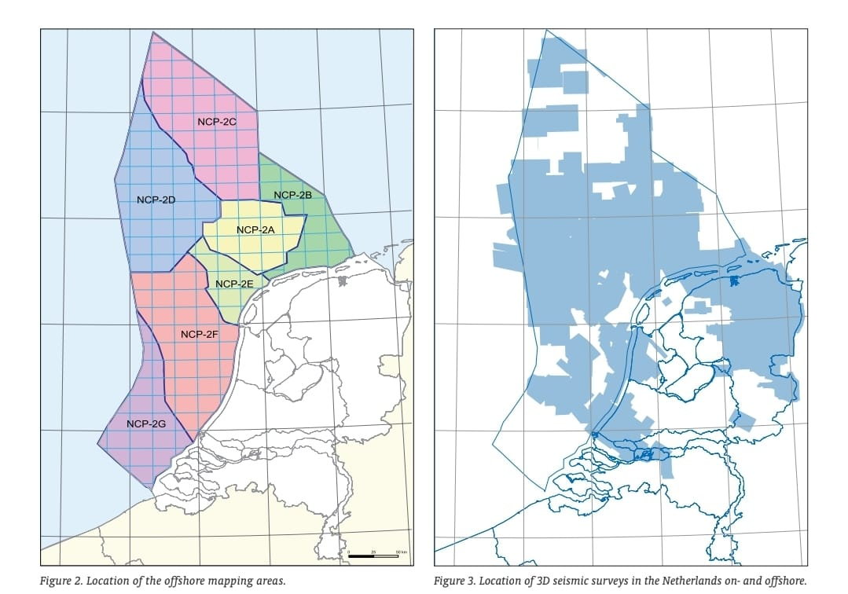
Objectives
Pre-process the seismic data from the F3 dataset to enhance quality and clarity.
Interpret seismic reflections to identify stratigraphic boundaries and geological formations.
Track horizons across the seismic volume to extract and visualize the spatial distribution of stratigraphic units.
Construct a 3D stratigraphic model integrating seismic interpretation techniques with advanced visualization methods.
Contribute to the advancement of geoscience, petroleum engineering, and environmental research through insights gained from the constructed model.

Slide 6
Literature Survey
Previous Research Papers:
ResearchGate Paper: This study explores the use of seismic attributes and Wheeler transformations for geomorphological interpretation of stratigraphic surfaces in the F3 Block of the Dutch Offshore Sector, North Sea.
https://www.researchgate.net/publication/323422270_The_Application_of_Seismic_Attributes_and_Wheeler_Transformations_for_the_Geomorphological_Interpretation_of_Stratigraphic_Surfaces_A_Case_Study_of_the_F3_Block_Dutch_Offshore_Sector_North_Sea
Cambridge Core Paper: This paper provides a revised Upper Cenozoic stratigraphy for the Dutch sector of the North Sea Basin, integrating lithostratigraphic, seismostratigraphic, and allostratigraphic approaches.
https://www.cambridge.org/core/services/aop-cambridge-core/content/view/C5CBBFE87C086E11C56A648415E4A304/S0016774600023015a.pdf/revised_upper_cenozoic_stratigraphy_of_the_dutch_sector_of_the_north_sea_basin_towards_an_integrated_lithostratigraphic_seismostratigraphic_and_allostratigraphic_approach.pdf
TNO Report: This report discusses advanced methodologies and technologies for 3D stratigraphic modeling in the Dutch North Sea, focusing on integrating various geological data sources.
https://www.tno.nl/media/2632/information20-art4.pdf

Slide 7

Dataset Used
F3 Dataset Sliced
Available On: Kaggle
https://www.kaggle.com/datasets/gustavoscholze/f3-dataset
Dataset Details:
F3 is a block in the Dutch sector of the North Sea. The block is covered by 3D seismic that was acquired to explore for oil and gas.
Dataset Specifications:
Format: .sgy (SEG-Y)
Size: 699 MB
Owner: Gustavo Pretto Scholze
License: CC BY-SA 3.0

Slide 8
Methodology – High Level Descriptive Algorithm
Step #1 – Data Preprocessing and EDA:
Import the dataset using Open3D, Pyvista, Trimesh, Plotly
Clean the data to remove any noise or errors.
Normalize the data for consistency.
Step #2 – Seismic Interpretation:
Identify and pick horizons and faults within the seismic volume.
Use manual picking or automated horizon tracking algorithms.
Step #3 – Well Log Interpretation
Import well logs and correlate them with the seismic data.
Identify key stratigraphic units and lithologies.
Step #4 – Horizon & Fault Modelling
Import well logs and correlate them with the seismic data.
Identify key stratigraphic units and lithologies.
Step #5 – Grid Construction
Define a 3D grid that covers the entire area of interest.
Discretize the grid based on the resolution required.
Step #6 – Property Modelling:
Populate the grid cells with properties such as lithology, porosity, and permeability using well log data and seismic attributes.
Use geostatistical methods like Kriging or Sequential Gaussian Simulation.
Step #7 – Model Calibration
Calibrate the model using well data and production history (if available).
Adjust the model to match observed data as closely as possible.
Step #8 – Visualization & Analysis
Visualize the 3D model.
Analyse the model for geological features, reservoir properties, and potential hydrocarbon traps.

Slide 9
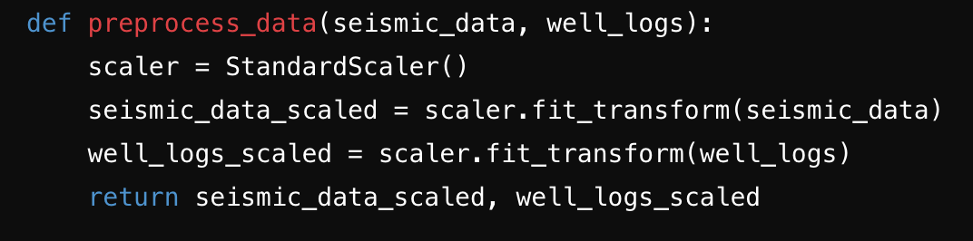
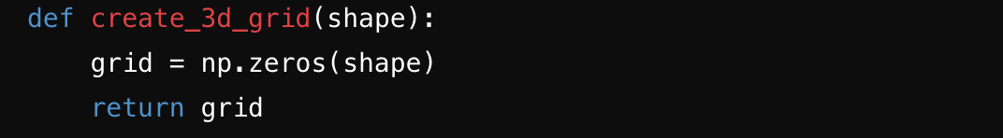
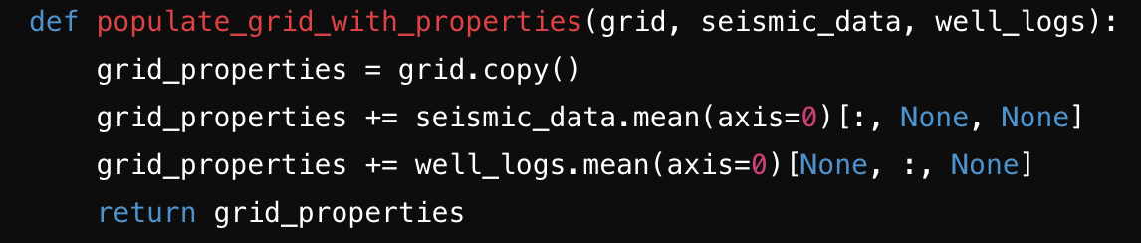
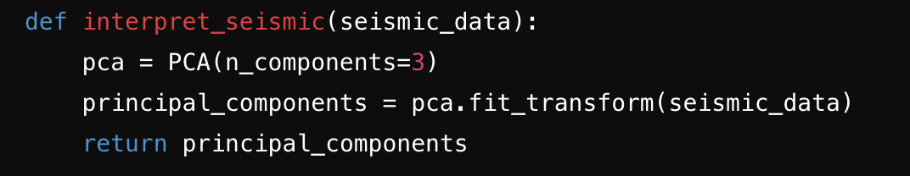
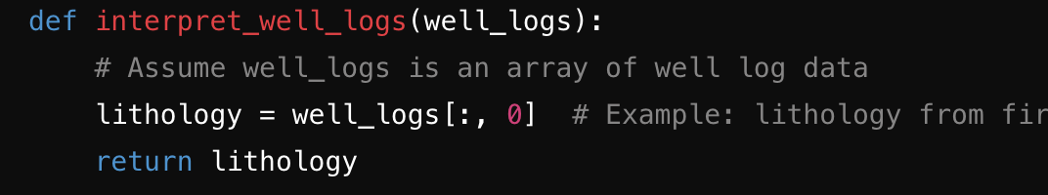
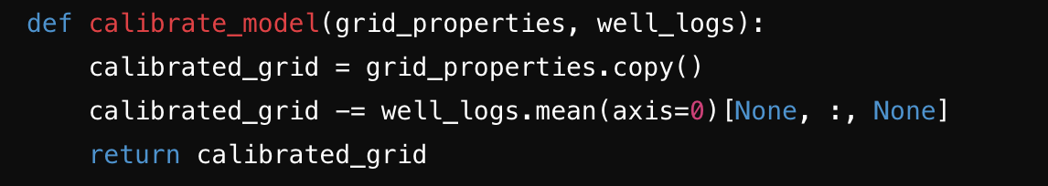
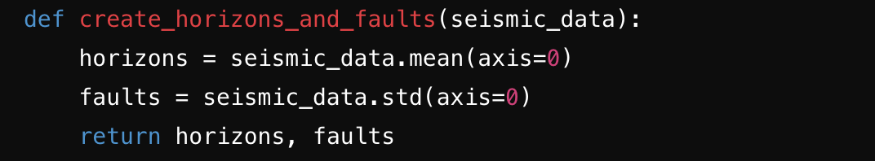
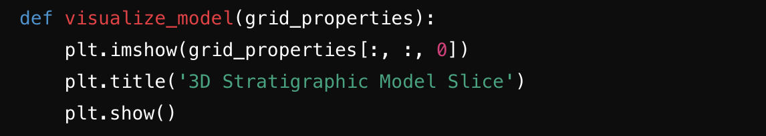
Methodology – Low Level Pseudocode Algorithm
Step #1 – Data Preprocessing
Step #5 – Grid Construction
Step #6 – Property Modelling
Step #2 – Seismic Interpreation
Step #3 – Well Log Interpretation
Step #7 – Model Calibration
Step #4 – Horizion & Fault Modelling
Step #8 – Visualisation & Analysis

Slide 10
Block Diagram
Data Processing
Grid Construction
Seismic Interpreation
Property Modelling
Well Log Interpretation
Model Calibration
Horizion & Fault Modelling
Visualisation & Analysis

Slide 11
THANK YOU

