Slide 1
SPENDSMART-ML · REAL-DATA MODEL REPORT
Personalized Spending Recommender
Trained & Benchmarked on Real Data
Every model trained on real public datasets — measured on less vs. more data.
1,308,352
1,927
2
4
real transactions
real users
public datasets combined
ML models

Slide 2
DATA & METHOD
Real datasets, honest coverage, a like-for-like test
Credit-card transactions (Kaggle)
1.30M txns · 983 users · 18 months — the rich per-category expense backbone.
Personal-finance tracker (Kaggle)
944 users — adds real monthly income, housing, financial (loan/investment) & utilities.
Coverage fix
Combined panel now carries income + all expense categories (subscriptions stay label-only).
Metric fix
Forecaster reported with WAPE (robust to $0-spend months); MAPE dropped as misleading.
Experiment
Each model trained on a SMALL slice vs the FULL data to show the effect of more data.

Slide 3
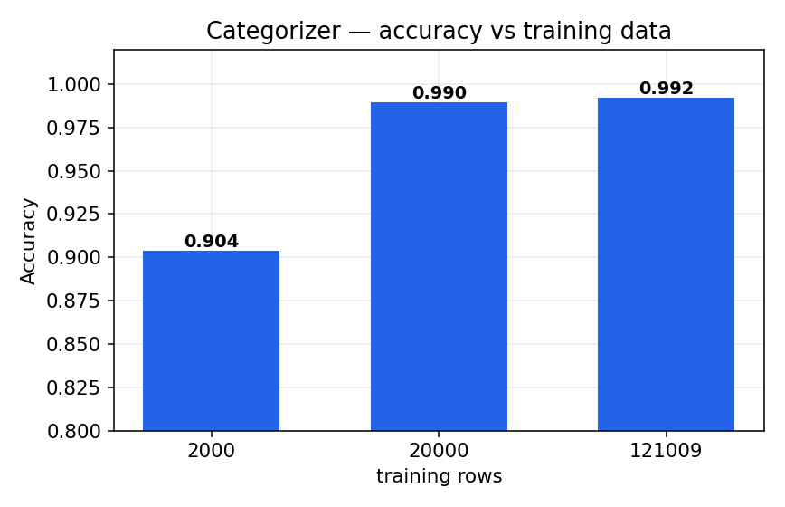
MODEL 1 · CATEGORIZER
Transaction categorizer (TF-IDF → Logistic Regression)
LESS DATA → MORE DATA
0.74 → 0.97
macro-F1 (2k → 121k rows)
90.4% → 99.2%
accuracy on held-out real test
More labeled data barely moves top-line accuracy but sharply improves macro-F1 — the model gets much better on the rarer categories.

Slide 4
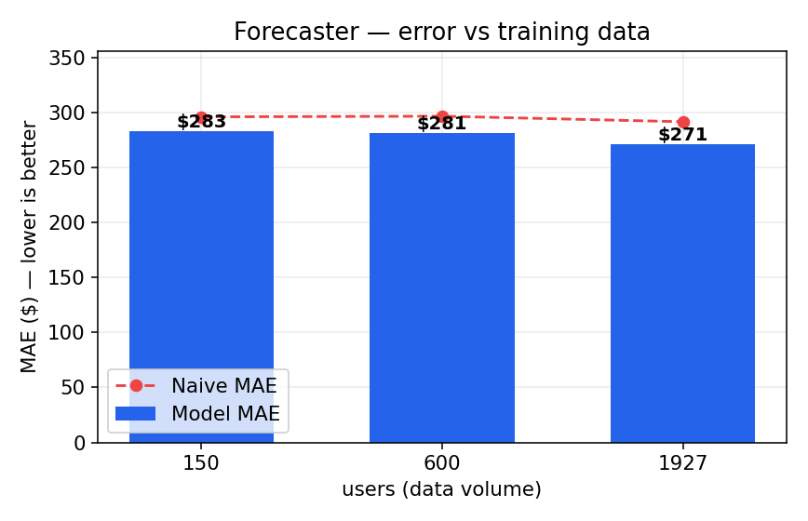
MODEL 2 · FORECASTER
Personalized forecaster (per-category gradient boosting)
LESS DATA → MORE DATA
$283 → $271
MAE (lower is better)
+4% → +7%
skill vs. naive baseline
With more users the personalized model pulls further ahead of the naive 'same-as-last-month' baseline. Reported as WAPE, robust to $0 months.

Slide 5
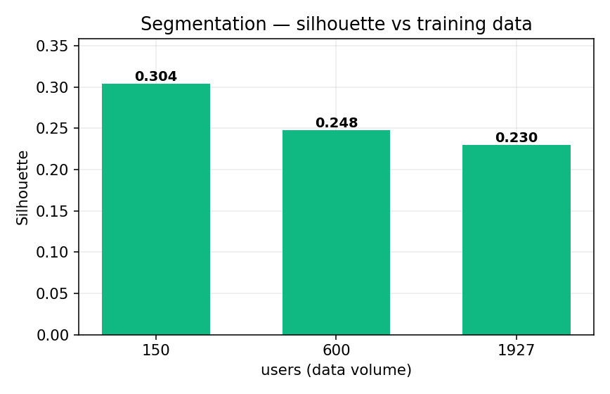
MODEL 3 · SEGMENTATION
User segmentation (KMeans cohorts)
LESS DATA → MORE DATA
0.30 → 0.23
silhouette (cluster quality)
1,927
real users clustered into 6 cohorts
Silhouette dips slightly as more — and more varied — real users join: expected when the population grows heterogeneous. Cohorts stay clearly separated (>0.2) and peer comparisons fair.

Slide 6
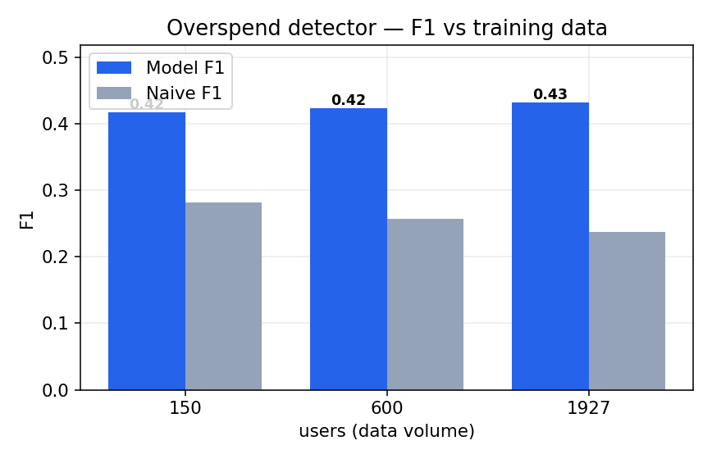
MODEL 4 · OVERSPEND DETECTOR
Overspend detector (forecast-driven alerts)
LESS DATA → MORE DATA
0.42 → 0.43
F1 (model)
0.24
naive baseline F1 at full data
The detector consistently beats the naive baseline; more data lifts F1 and keeps it well above the naive line.

Slide 7
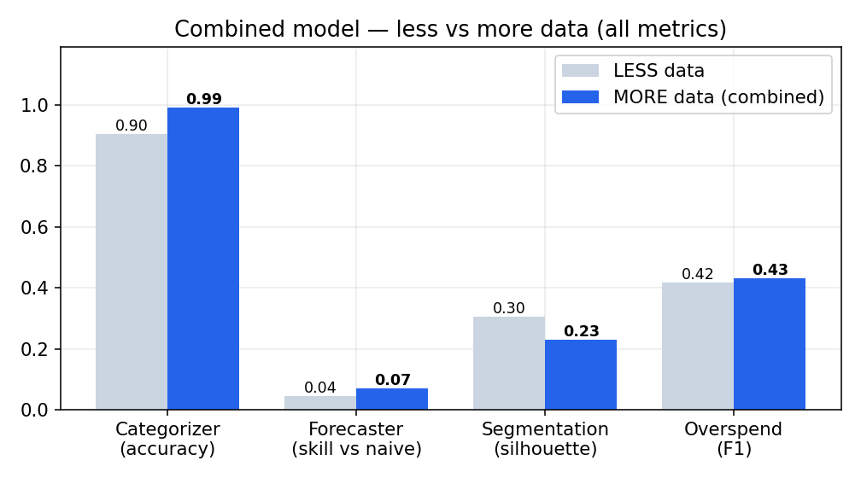
FINAL · COMBINED MODEL (ALL REAL DATA)
The full pipeline on every real dataset
99.2%
0.23
categorizer accuracy
segmentation silhouette
$271
0.43
forecaster MAE
overspend F1
LIVE PERSONALIZED RECOMMENDATION
1. [overspend] Groceries trending above your usual
2. [overspend] Miscellaneous trending above your usual
All figures from real public data · income now real for 944 users (median $4,008/mo, 23% saved) · subscriptions remain label-only.

