Slide 1

Hacettepe University
Faculty of Engineering
Deparment of Geomatics Engineering
WEB GIS
(GMT458)
Final-Presentation
Name/Surname: Arca Aldıkaçtı
Student ID: 2210674053

Slide 2
Purpose of the Project
Problem: Student’s access to course notes on campus is not collected in a spesific place and is also uncontrolled and library occupancy can not be learned by a provider.
Solution: Developing and authorization based Web-GIS platform that combines spatial and verbal data
Aim: Visualize the library location and status on the map. Digitizing resource sharing among students.

Slide 3
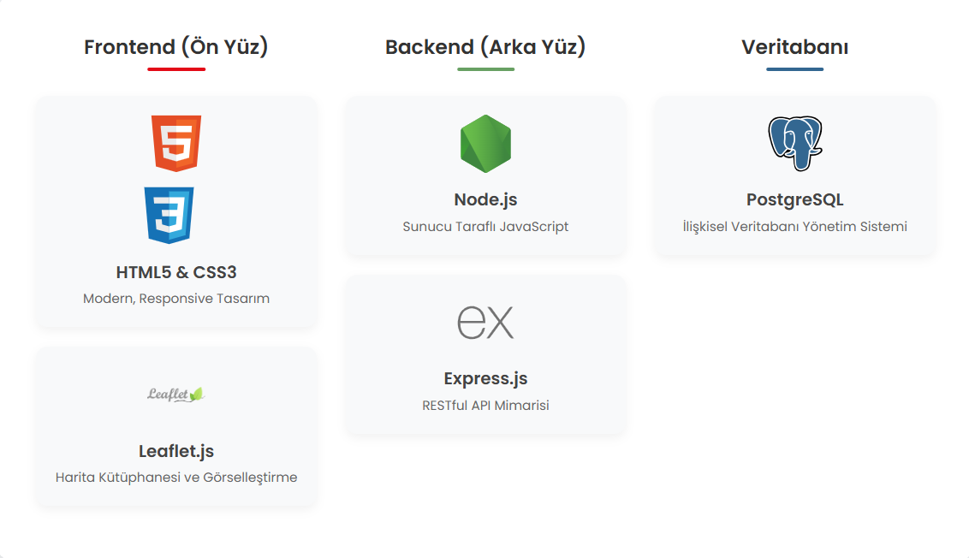
Tech Stack

Slide 4
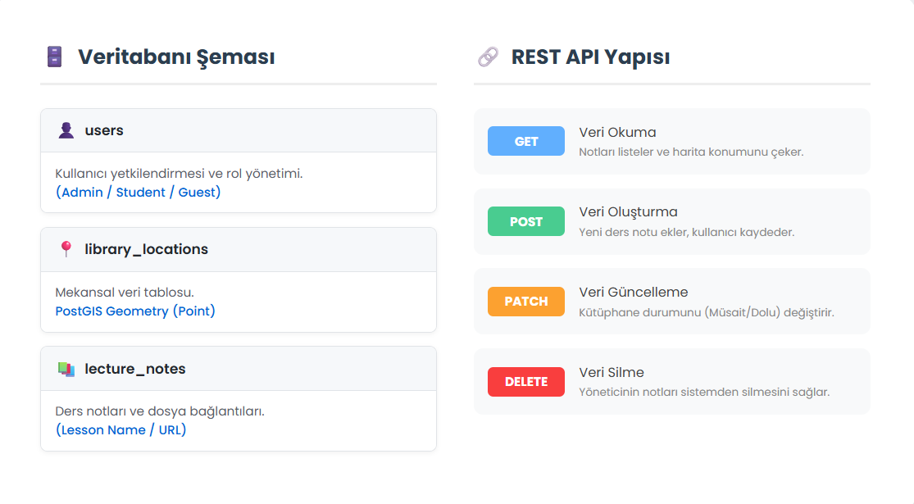
System Architecture and Database Design

Slide 5
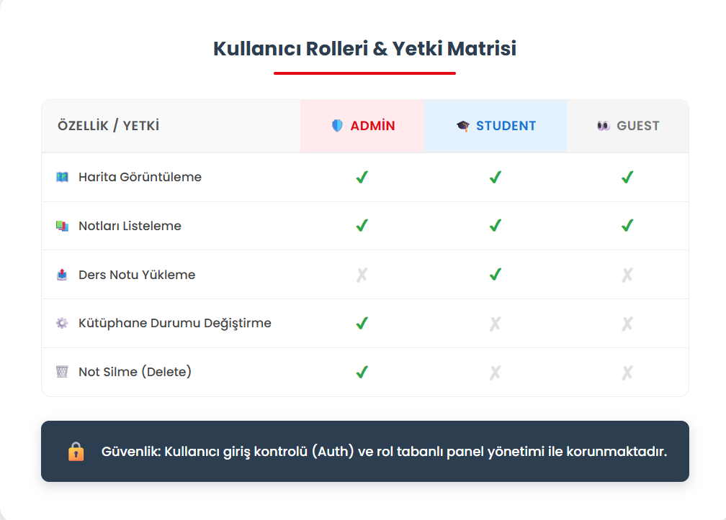
Authentication

Slide 6
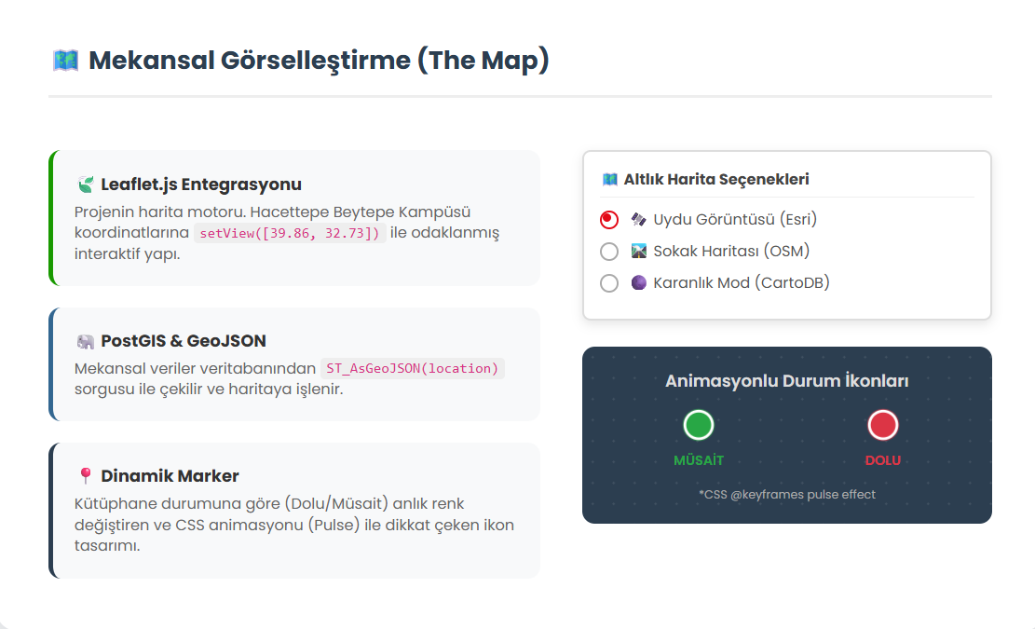
Visualizing Spatial Data

Slide 7
Process of CRUD
Create: Students add new lecture notes.
Read: All users see instant library situation and notes.
Update: Admin updates the library occupancy status.(Available/Full)
Delete: Admin deletes inappropriate or old notes from the system.

Slide 8
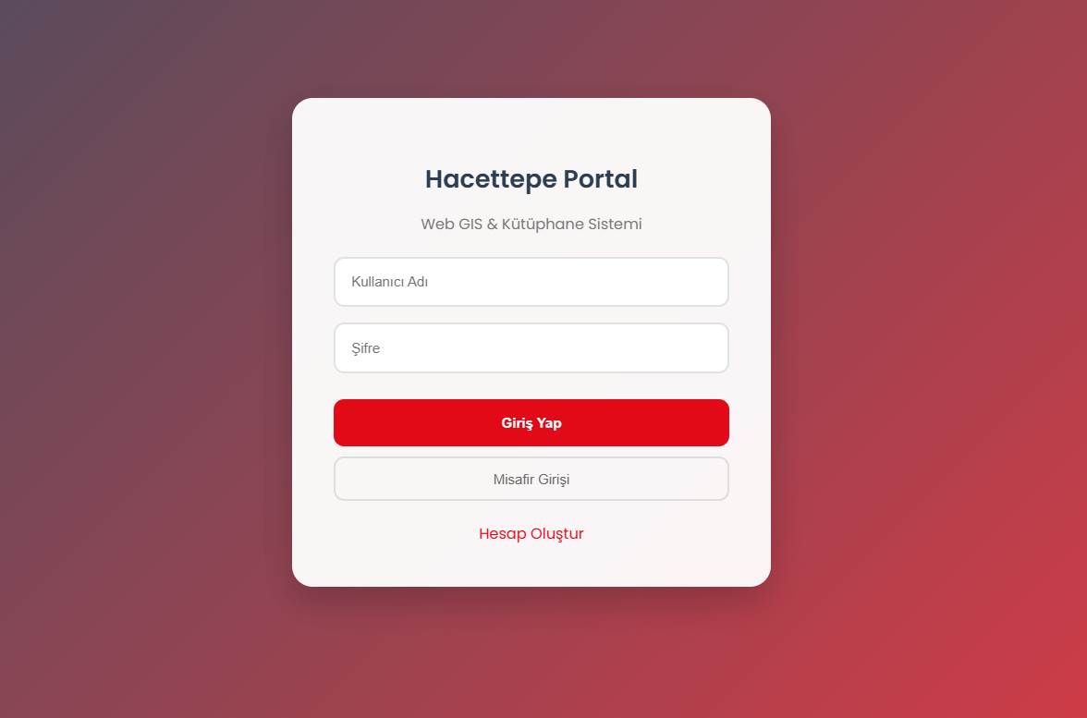
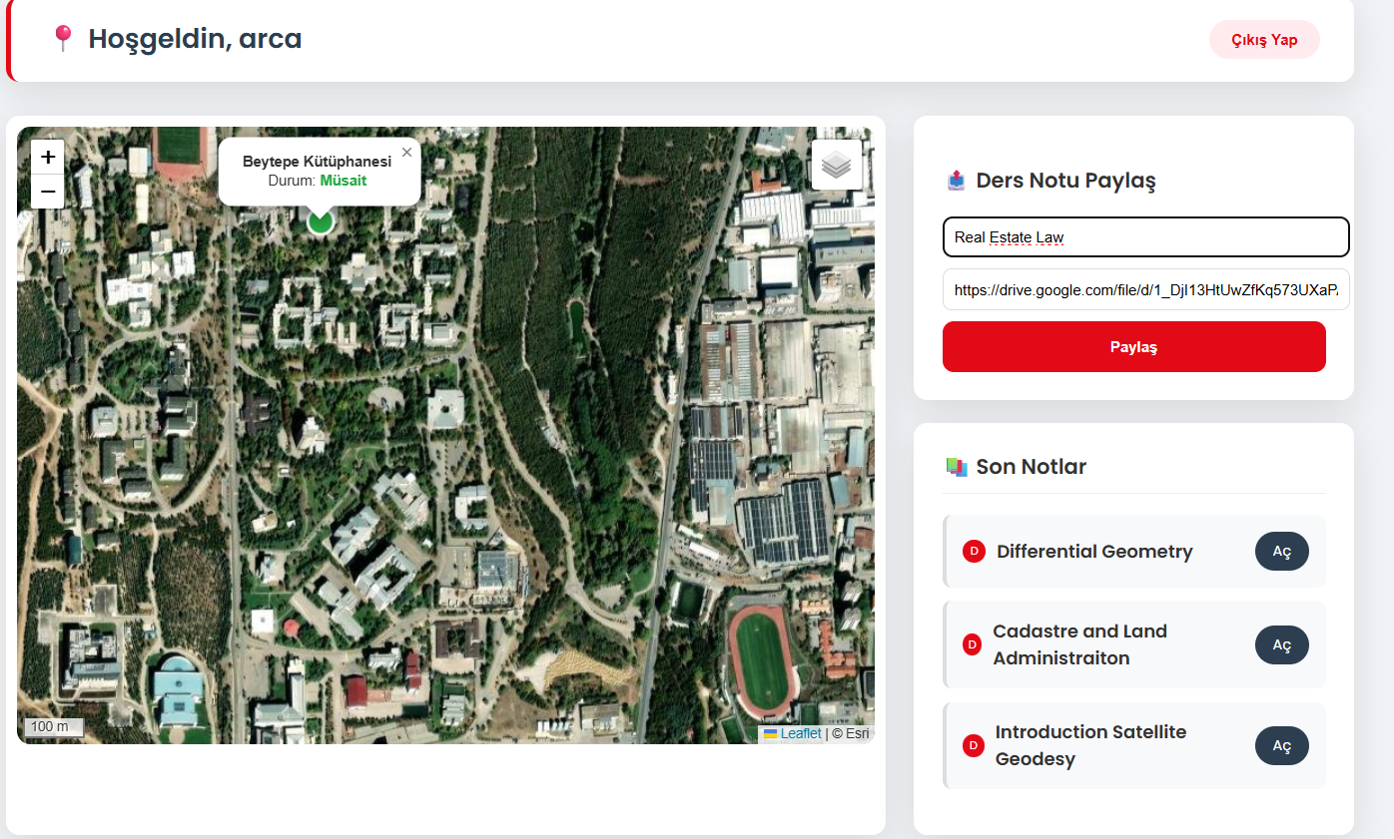
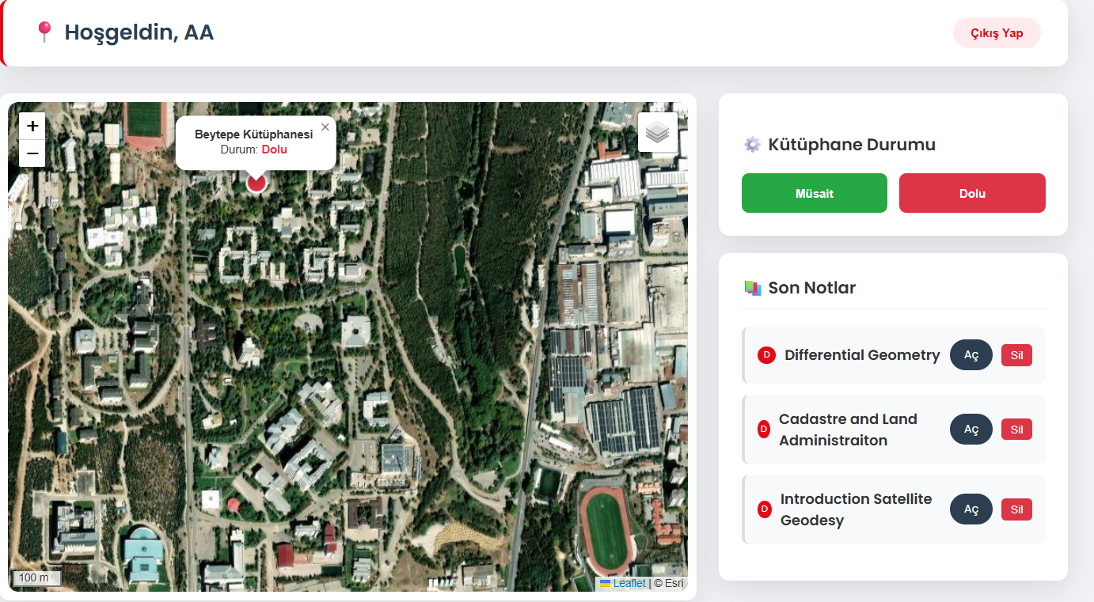
Application ScreenShots

Slide 9
Conclusion
A full-stack Web-GIS Project was developed from start to finish.
PostGIS enabled spatial data to be presented on the web.
Experience was gained in authorization and API management.
Future Studies: We can learn which table and seat is empty or occupied in the library, Also It can be supported with data such as what percentage of the library is full or empty.

Slide 10
THANK YOU FOR LISTENING
TO ME!

