Slide 1








DRDO
Fine-Tuning
BY : Arjun Pandey
Date:01/10/2024

Slide 2
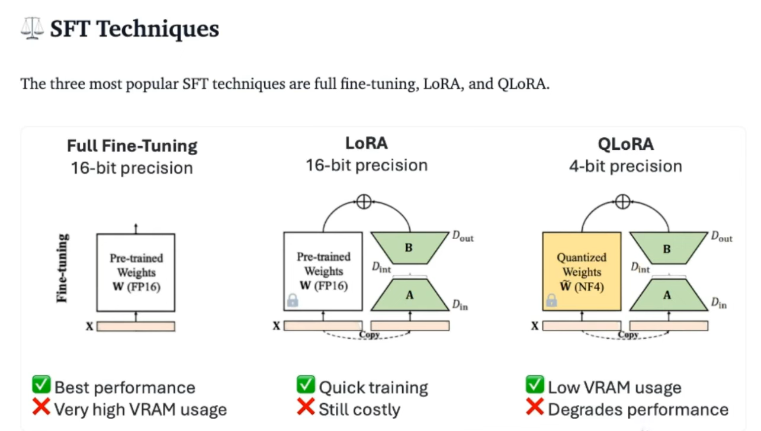

Slide 3
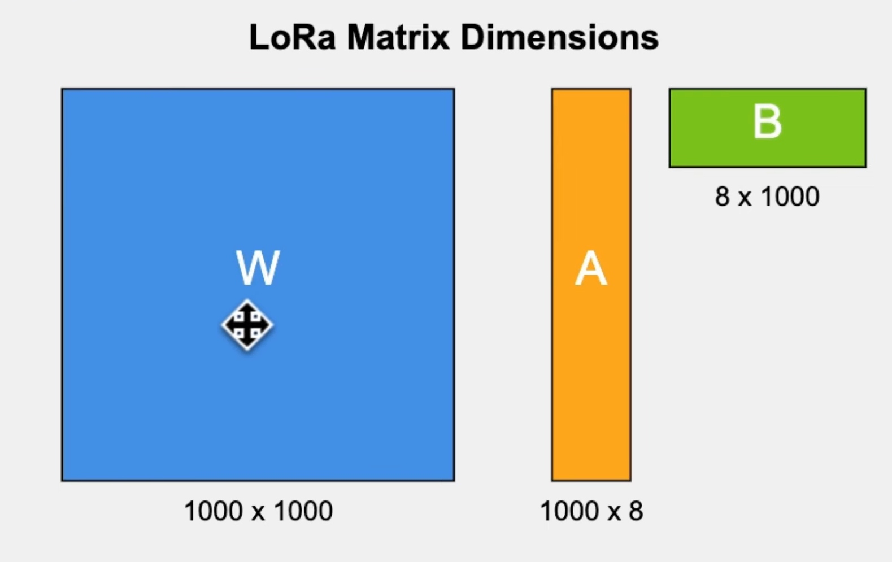



Rank : 8

Slide 4
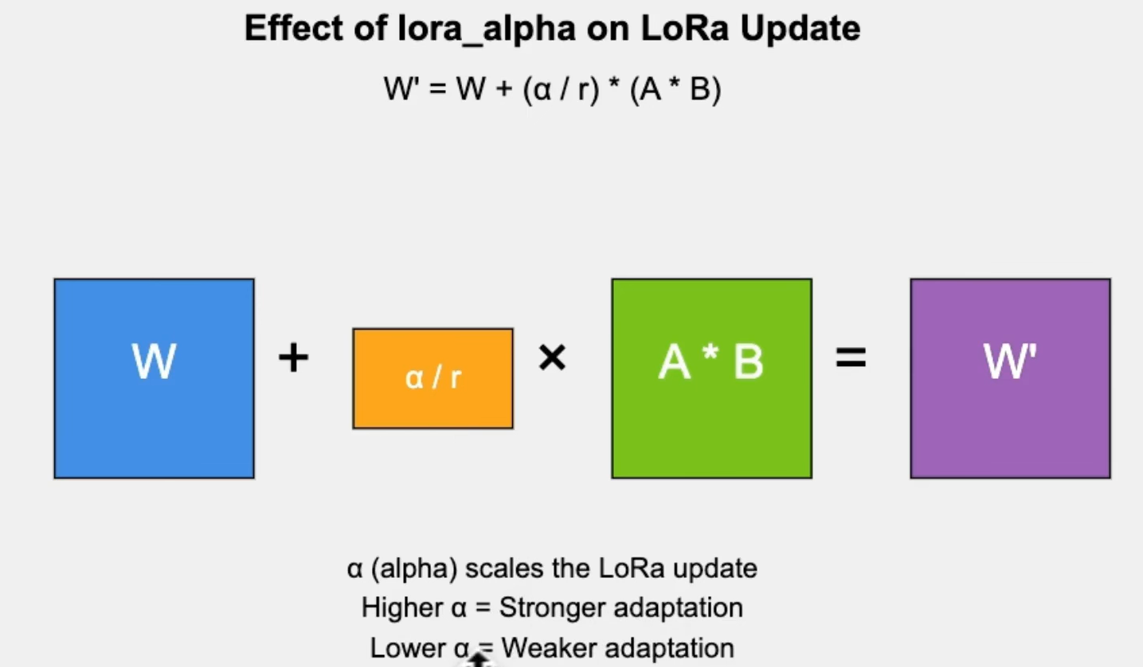

Slide 5


DYSL-LAB intern
THANKS FOR WATCHING
BY : Arjun Pandey
Date:01/10/2024

