Slide 1
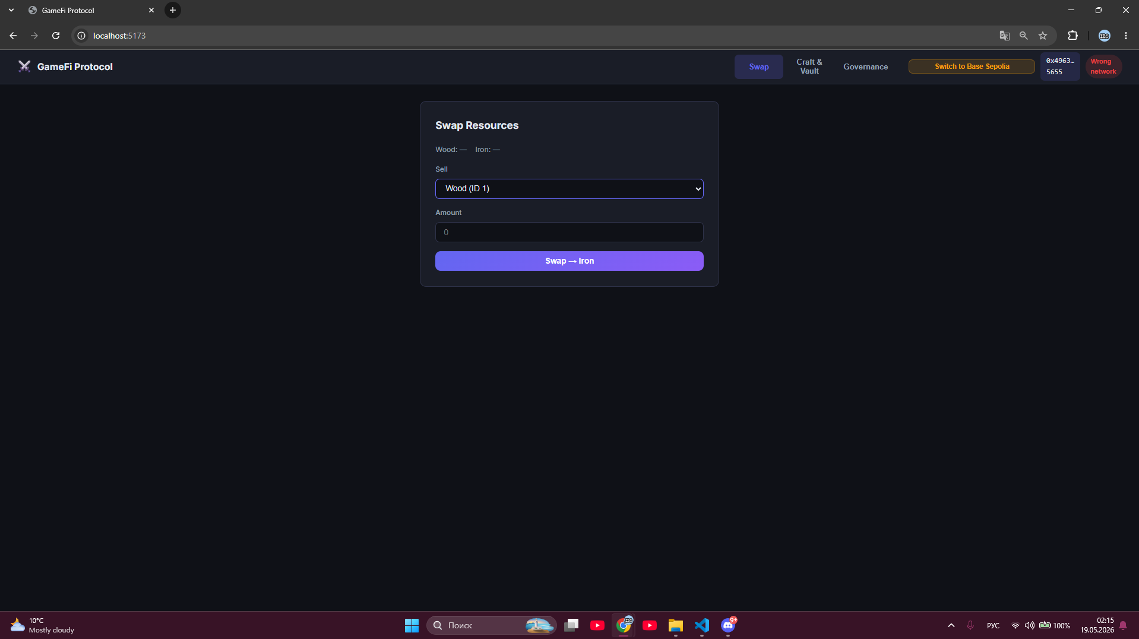
GameFi Economy Protocol
On-chain economy layer for blockchain games
Option B: GameFi Economy
Arbitrum Sepolia
React + Foundry + The Graph
? ERC1155 resources and crafted items
? Custom constant-product AMM for resource swaps
? UUPS-upgradeable crafting and ERC4626 vault
? DAO governance with Governor + Timelock
GameFi Economy Protocol | Arbitrum Sepolia demo
Blockchain Technologies 2

Slide 2
Problem & Scope
A reusable economy layer, not a full game client
Game economies need
Our protocol provides
Demo focus
? transparent ownership
? player-driven markets
? secure item lifecycle
? upgrade path after launch
? fungible and non-fungible game assets
? AMM trading for resources
? crafting progression
? governed parameters
? live wallet connection
? network detection
? resource swap
? crafting transaction
GameFi Economy Protocol | Arbitrum Sepolia demo
Blockchain Technologies 2

Slide 3
Architecture
Contract modules and external infrastructure
Frontend
Economy Core
Token & Vault
Governance
Infra
React/Vite dApp MetaMask + ethers.js
GameItems ERC1155 ResourceAMM x*y=k Crafting UUPS proxy
GameToken ERC20Votes/Permit GameVault ERC4626
GameGovernor TimelockController GameTreasury
Chainlink oracle / VRF flow The Graph subgraph CREATE2 factory
?
?
?
?
GameFi Economy Protocol | Arbitrum Sepolia demo
Blockchain Technologies 2

Slide 4
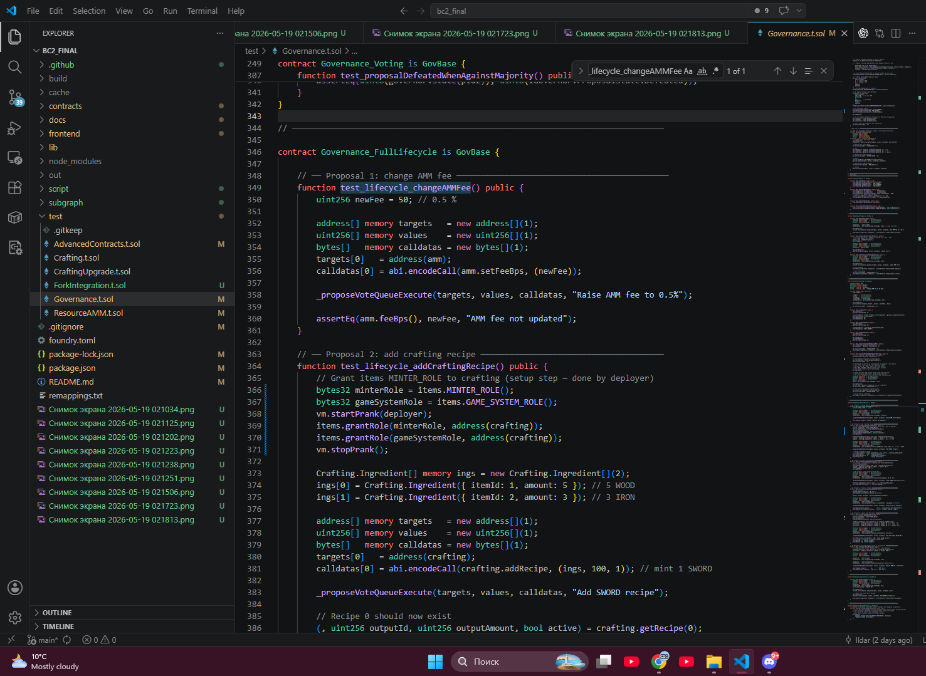
Core Contracts
Standards and responsibilities
? GameToken: ERC20Votes + ERC20Permit governance token
? GameItems: ERC1155 resources (WOOD, IRON, CRYSTAL) and crafted items
? GameVault: ERC4626 deposit/share accounting for GAME
? ResourceAMM: custom x*y=k ERC1155 AMM with 0.3% fee and slippage guard
? Crafting: UUPS upgradeable recipe system behind ERC1967Proxy
GameFi Economy Protocol | Arbitrum Sepolia demo
Blockchain Technologies 2

Slide 5
AMM & Crafting Flow
Live demo path
Swap flow
1. User approves ResourceAMM as ERC1155 operator
2. swap(tokenIn, amountIn, minOut) executes
3. AMM applies fee and updates reserves
4. User receives opposite resource
Craft flow
Recipe #0: 3 WOOD + 2 IRON -> 1 SWORD
GameFi Economy Protocol | Arbitrum Sepolia demo
Blockchain Technologies 2

Slide 6
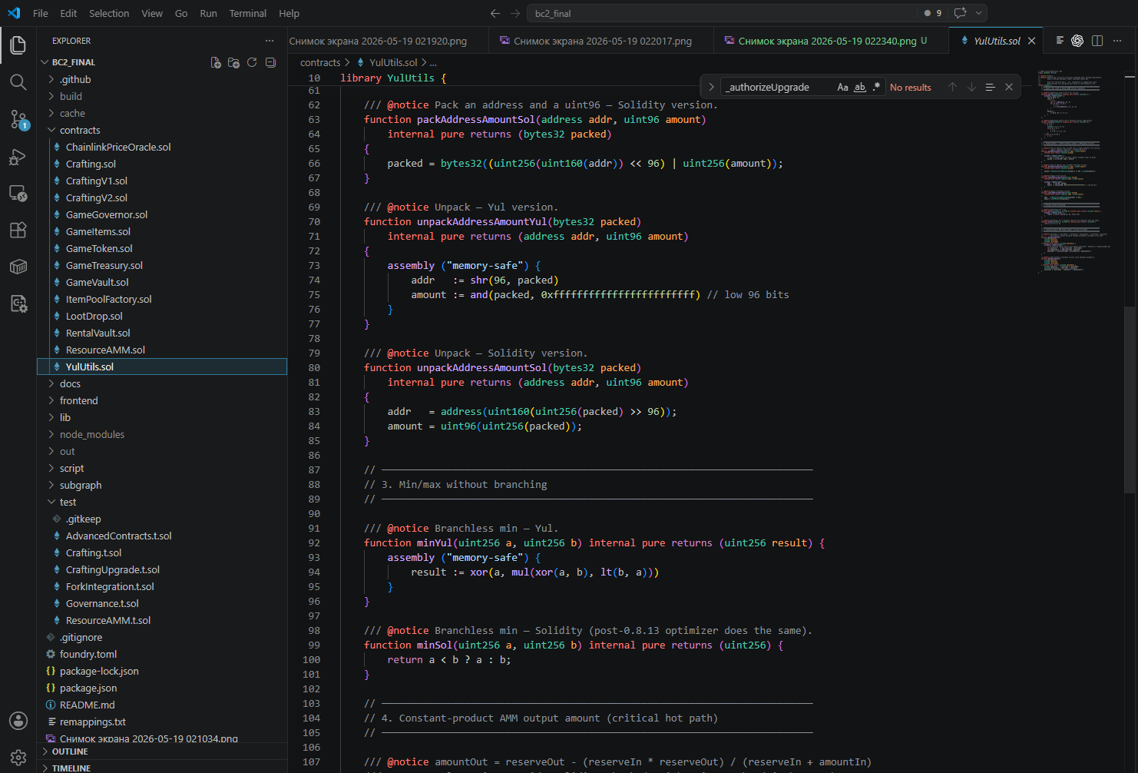
DAO Governance
Governor + TimelockController
? Voting token: GAME with ERC20Votes checkpoints
? Voting delay: 7,200 blocks, about 1 day
? Voting period: 50,400 blocks, about 1 week
? Quorum: 4%; proposal threshold: 1%
? Timelock delay: 2 days before execution
Propose -> Vote -> Queue -> Execute Timelock owns treasury actions and delayed parameter changes.
GameFi Economy Protocol | Arbitrum Sepolia demo
Blockchain Technologies 2

Slide 7
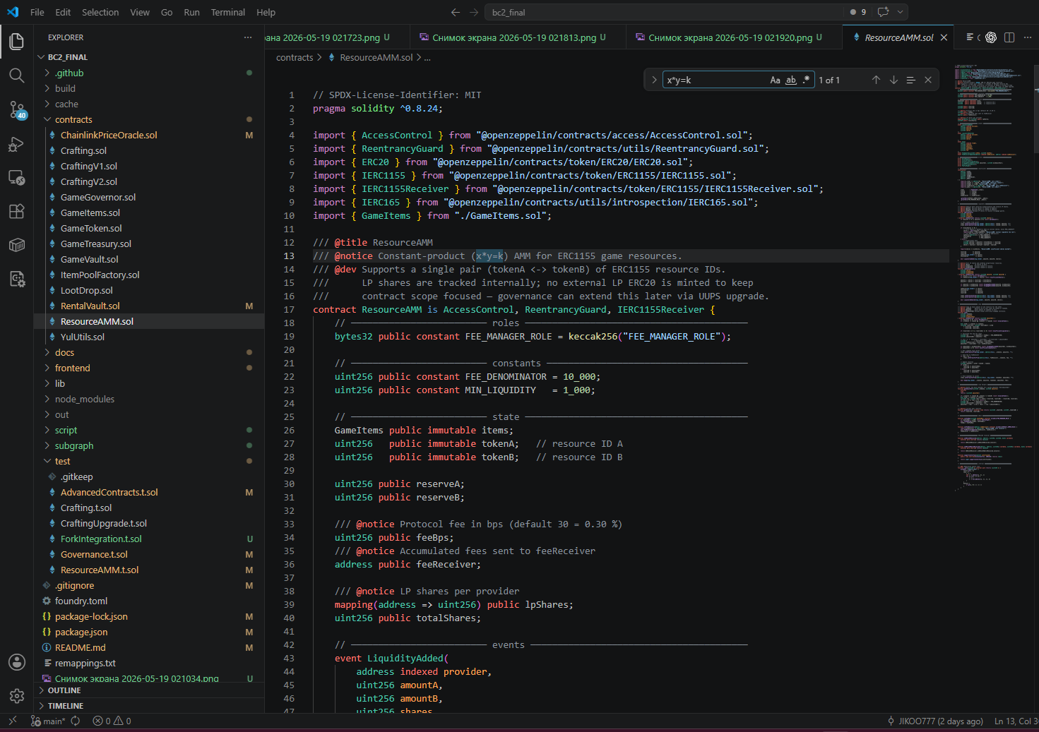
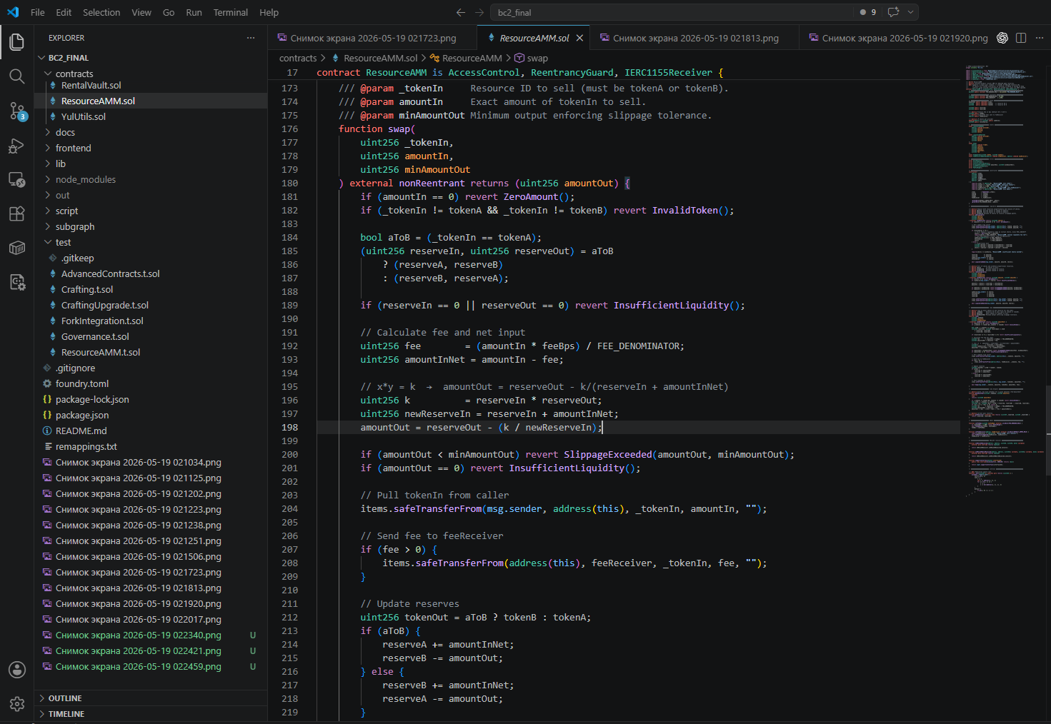
Advanced Requirements
Mandatory course components covered
UUPS proxy
CraftingV1 -> CraftingV2 upgrade path
CREATE / CREATE2
ItemPoolFactory standard and deterministic pool deployment
Yul assembly
YulUtils and AMM sqrt math
Chainlink
Price feed wrapper with staleness checks; VRF-compatible loot flow
The Graph
Subgraph schema for swaps, crafting, rentals, loot and governance
GameFi Economy Protocol | Arbitrum Sepolia demo
Blockchain Technologies 2

Slide 8
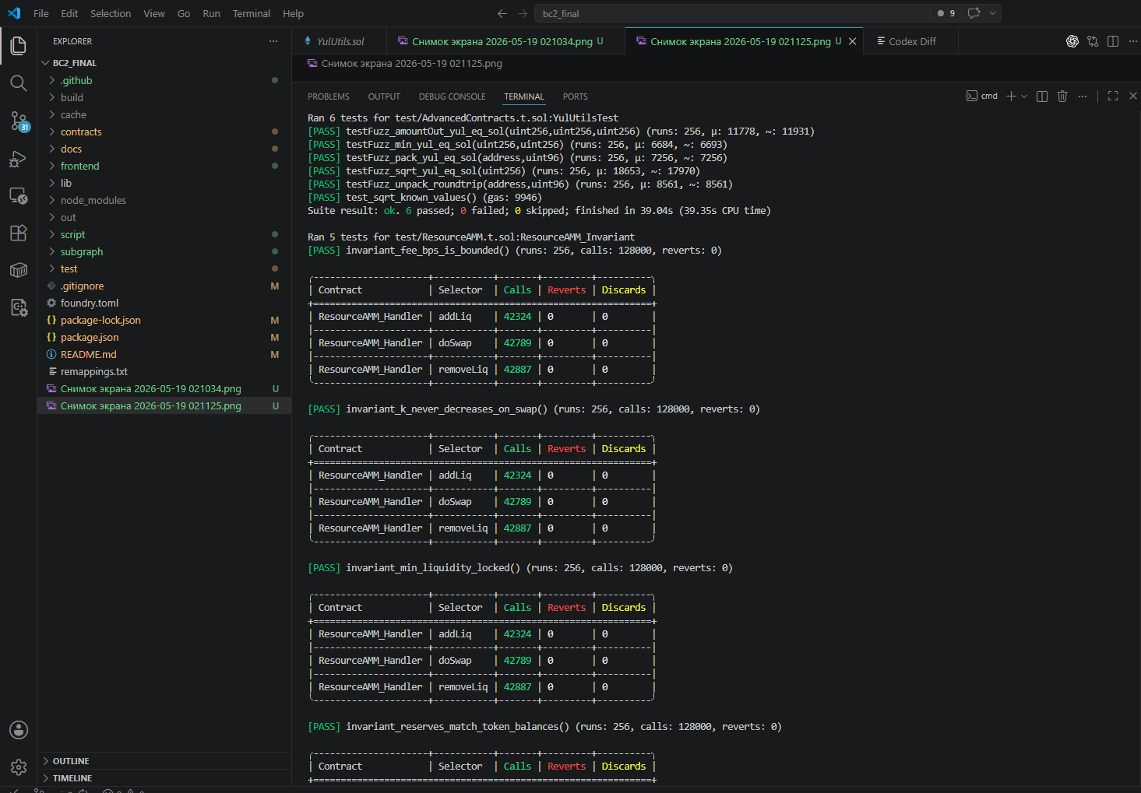
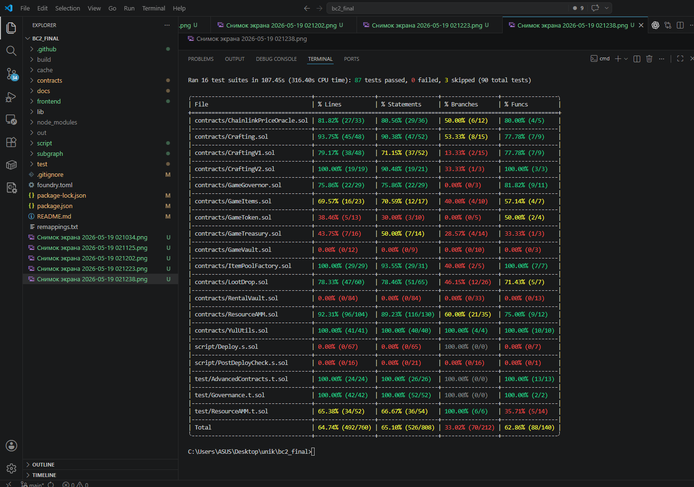
Testing & Verification
Foundry, frontend, subgraph and security tooling
? Unit, fuzz, invariant and optional fork tests
? Current local snapshot: 87 passed, 0 failed, 3 skipped
? Frontend build passes with React/Vite
? Subgraph build passes with generated ABIs and mappings
? Slither high-severity gate included in CI
GameFi Economy Protocol | Arbitrum Sepolia demo
Blockchain Technologies 2

Slide 9
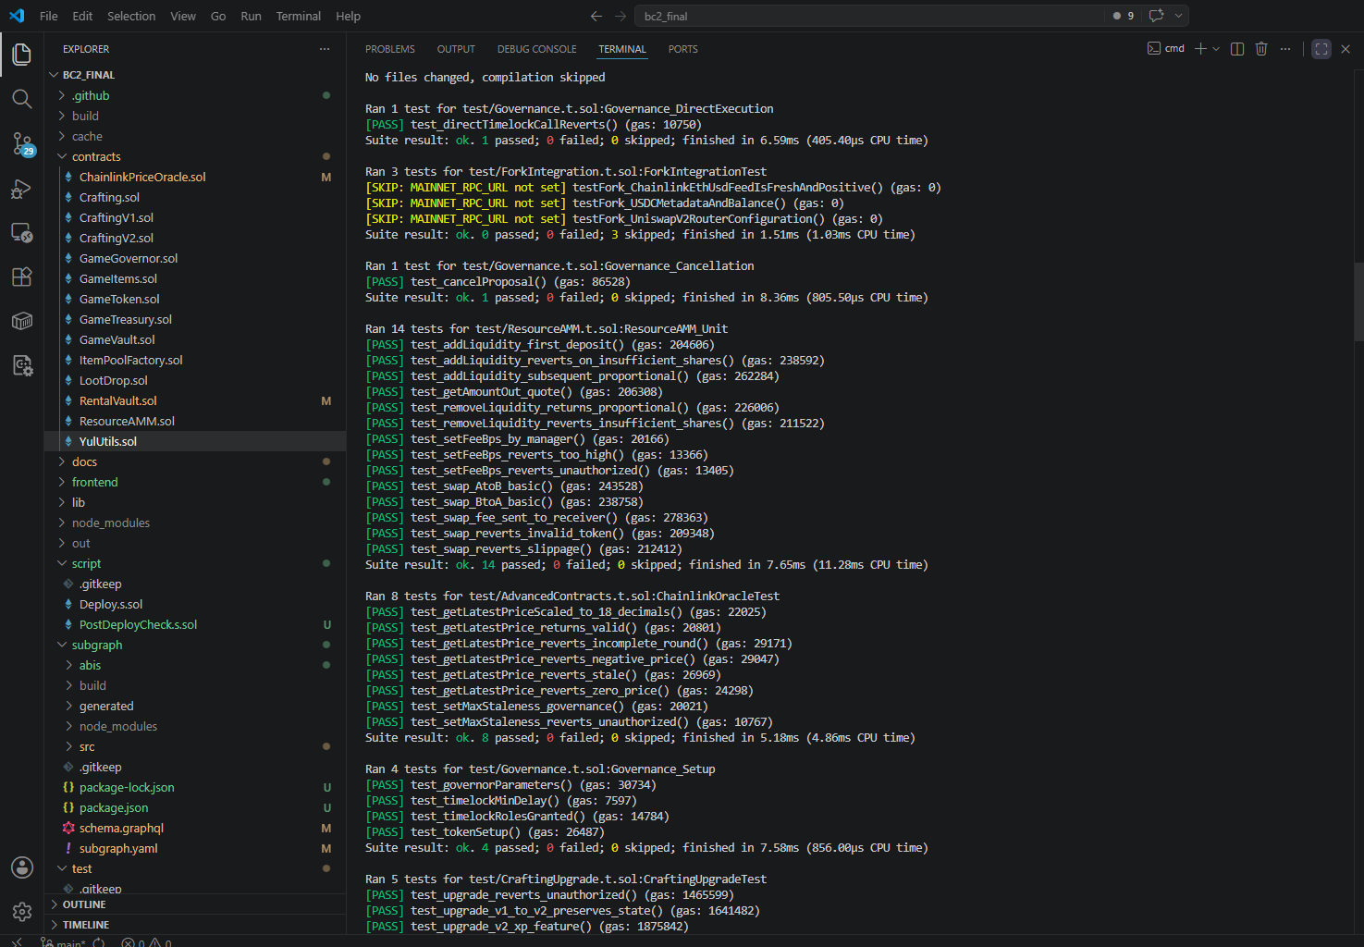
Deployment
Foundry broadcast output and frontend wiring
Network
Arbitrum Sepolia Chain ID: 421614 ResourceAMM: 0x69e951e9cf90c8d116b59276b3b68ae548fa9920 Crafting proxy: 0x9d2b2608cd9cb1abfe026f5800d5f0f6f5cf427b GameItems: 0x044b55374010b4b06cb39afdc88f8c7444258f87
? Addresses copied from run-latest.json
? Frontend checks chain and prompts switch
? DemoSetup seeded resources, AMM liquidity and recipe #0
GameFi Economy Protocol | Arbitrum Sepolia demo
Blockchain Technologies 2

Slide 10
Frontend Demo
MetaMask + deployed contracts
Live demo checklist
1. Connect MetaMask
2. Switch to Arbitrum Sepolia
3. Read WOOD/IRON balances and pool reserves
4. Swap a small amount: 1 or 2
5. Open Crafting and craft recipe #0
Avoid Vault unless the demo wallet has GAME tokens.
GameFi Economy Protocol | Arbitrum Sepolia demo
Blockchain Technologies 2

Slide 11
Team Presentation Split
3 speakers, clean responsibility boundaries
Speaker 1
Speaker 2
Speaker 3
Smart Contracts / Architecture
Governance / Advanced / Tests
Frontend / Live Demo
? GameToken, GameItems, GameVault
? ResourceAMM and Crafting UUPS
? Explain protocol modules
? Governor + Timelock
? CREATE2, Yul, Chainlink, subgraph
? Test and security snapshot
? MetaMask and network detection
? contracts.ts deployment addresses
? Swap + Craft live flow
GameFi Economy Protocol | Arbitrum Sepolia demo
Blockchain Technologies 2

Slide 12
Summary
What the live demo proves
? Contracts are deployed on an L2 testnet and wired into the frontend
? The dApp reads real ERC1155 balances and AMM reserves
? Swap and crafting execute as wallet-confirmed transactions
? Architecture covers required standards, governance, oracles, indexing and advanced Solidity
? Remaining production work: verification links, real VRF subscription, stronger vault/rental coverage
Q&A
Be ready to explain each module at architecture level.
GameFi Economy Protocol | Arbitrum Sepolia demo
Blockchain Technologies 2

Slide 13
Appendix: Screenshots
Code, tests, UI and repository evidence
Screenshot 1
Screenshot 3
Screenshot 6
Screenshot 7
Screenshot 10
Screenshot 13
GameFi Economy Protocol | Arbitrum Sepolia demo
Blockchain Technologies 2

