Slide 1
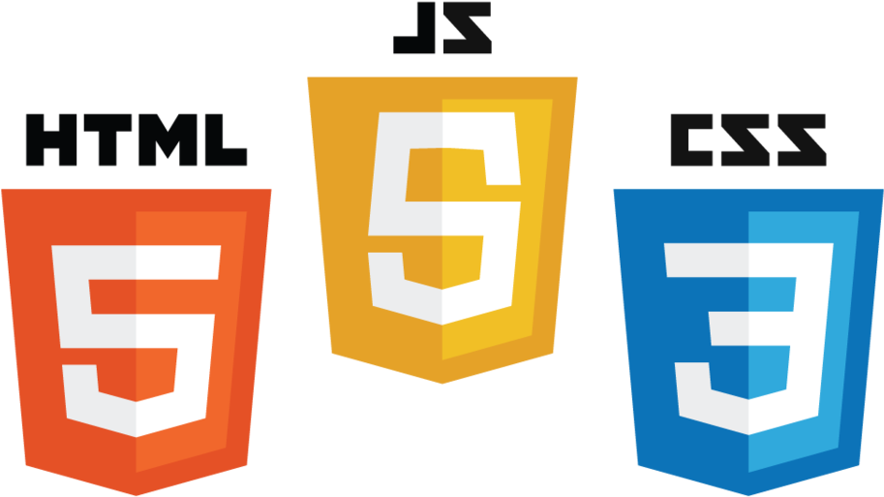

AB
Abdullah Baleid
SWE363 · WEB ENGINEERING
Personal Portfolio Web App
A modern, responsive portfolio built with vanilla web technologies, GSAP, and three live APIs.
عبــدالله بلعيــد
HTML5
CSS3
JavaScript
GSAP
KFUPM · Software Engineering
● ABDULLAH-BALEID-PORTFOLIO.VERCEL.APP
01 / 06
Notes:
Hello, I'm Abdullah Baleid, presenting my personal portfolio web application for SWE363.

Slide 2
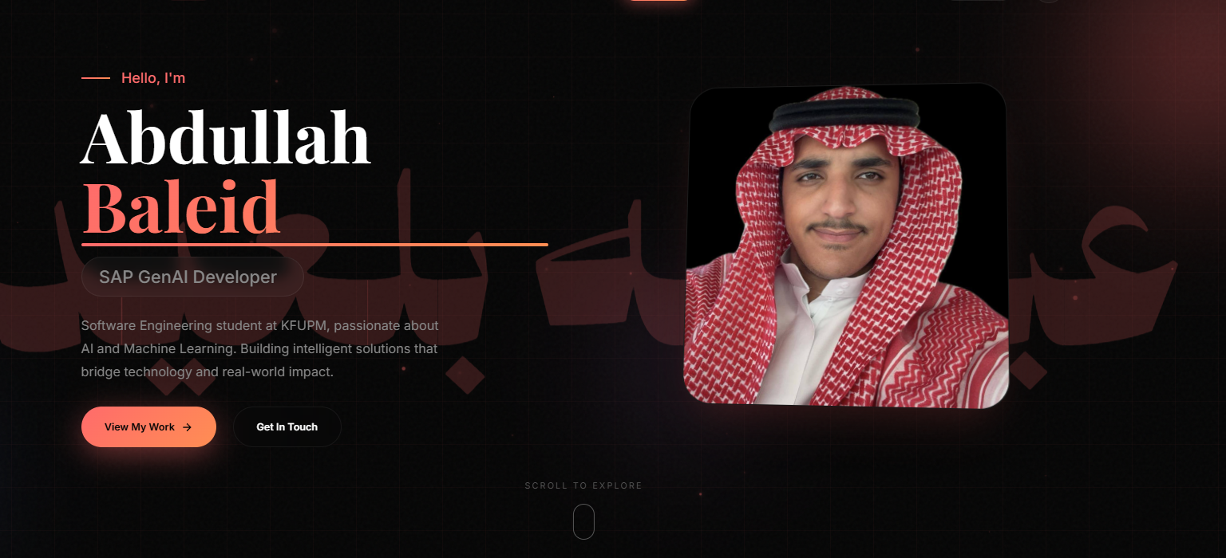
01 / OVERVIEW
Project Overview
A complete personal portfolio that showcases experience, projects, and live data, designed for recruiters and built end-to-end by vibe coding techniques.
01
Modern, responsive design
03
Three live API integrations
Mobile-first layout with smooth section transitions and a persistent dark/light theme toggle.
GitHub for repositories, OMDb for movies, and RAWG for games, all rendered live.
02
Vanilla web stack + GSAP
04
Innovation features
HTML5, CSS3, and JavaScript, animations powered by GSAP and ScrollTrigger.
Particle cursor, confetti on form submit, and a Konami-code easter egg.
● OVERVIEW
02 / 06
Notes:
I built a professional portfolio using vanilla web technologies with GSAP animations and three external APIs. Let me show you.

Slide 3
02 / WALKTHROUGH
Live Demo
Switching to the live site — here is the path I will walk through, end to end.
→ STEP 01
→ STEP 02
→ STEP 03
Hero
About
Journey
Typing effect, particle cursor, dark/light theme toggle.
Animated stat counters scroll into view.
Click an experience card to open a detail modal.
~ 30 sec
~ 30 sec
→ STEP 04
→ STEP 05
→ STEP 06
Projects
GitHub Repos
Fun Zone
Filter by AI/ML, sort A–Z, open a project card.
Live GitHub API data with language colors.
Search a movie via OMDb and a game via RAWG.
~ 45 sec
→ STEP 07
→ STEP 08
→ STEP 09
Contact
Easter Egg
Responsive
Trigger validation errors, then submit for confetti.
Konami code: ↑ ↑ ↓ ↓ ← → ← → B A.
DevTools mobile view to show breakpoints.
03 / 06
Notes:
Now I'll switch to the live website and walk through each section. I'll demo the hero with typing effect and theme toggle, animated stat counters in About, the Journey modal, project filtering and sorting, live GitHub repos, the Fun Zone with movie and game search, contact form validation with confetti, the Konami code easter egg, and finally responsive mobile view.

Slide 4






03 / STACK
Tech Stack & AI Tools
Vanilla web technologies for the build. AI assistants for acceleration, all output reviewed and modified.
// TECH STACK
// AI TOOLS USED
HTML, CSS, JavaScript
vanilla
Claude / Claude Code
· API integration · debugging
· Code completion
GSAP + ScrollTrigger
animations
All output reviewed & modified
human in the loop
GitHub · OMDb · RAWG
3 live APIs
localStorage / sessionStorage
state
● STACK & AI
04 / 06
Notes:
Built with vanilla web tech and GSAP. I used Claude for API integration and debugging, and Copilot for code completion. All AI output was reviewed and modified.

Slide 5
04 / REFLECTION
Challenges & Lessons
What broke, how I fixed it, and what stuck.
01
Challenges Solved
02
What I Learned
PROBLEM → FIX
SKILL
API rate limits → retry button + graceful fallback.
Async/await patterns for clean API code.
PROBLEM → FIX
SKILL
Theme persistence → localStorage on toggle.
State management without a framework.
PROBLEM → FIX
SKILL
Mobile responsiveness → breakpoint-driven layout.
Cross-browser testing & defensive CSS.
● CHALLENGES & LESSONS
05 / 06
Notes:
I solved API rate limits with a retry button, theme persistence with localStorage, and mobile responsiveness with breakpoints. Along the way I deepened my understanding of async/await patterns, state management, and cross-browser testing.

Slide 6
05 / WRAP-UP
Conclusion & Future Work
A complete, professional portfolio, ready for recruiters today, with a clear path forward.
▸ LIVE URL
// STATUS
abdullah-baleid-portfolio .vercel.app
Complete, professional portfolio — live and shareable.
// FUTURE WORK
Blog with MDX content
Real email backend for contact form
Accessibility audit & ARIA improvements
● ABDULLAH BALEID · SWE363
06 / 06
Notes:
I've built a complete portfolio ready to share. Future plans include a blog, a real email backend, and improved accessibility. Thank you!

