Slide 1
Vigilane
Henry Wang, Jackson Parrack, Jimmy Macdonald,
Aleksandre Khvadagadze

Slide 2
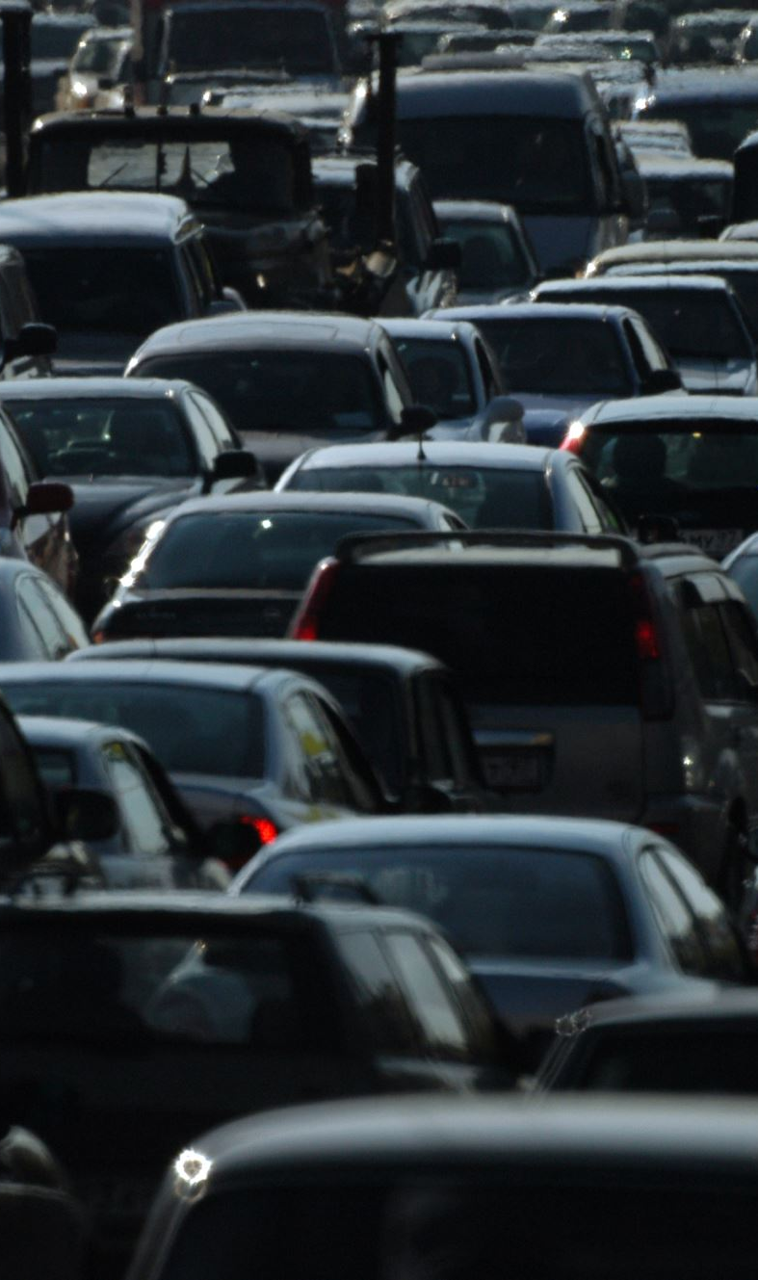
Problem
Potholes are often unreported
Municipal reporting is slow
Drivers lack real-time awareness
No centralized live hazard map

Slide 3
Core Idea
Run AI model on dashcam feed
1
Detect potholes in real time
2
Confirm via voice (optional)
3
Auto-report to cloud database
4
Display alerts in mobile app
5

Slide 4
AI & Detection Layer
Real-time object detection
Configurable confidence threshold
Webcam or dashcam input
Headless reporting mode
Optimized for live inference

Slide 5
Smart Confirmation
TTS Alert
Prevents false positives
Improves report accuracy

Slide 6
Backend
Session management
Hazard reporting endpoints
Firebase ID token auth
Secure request validation

Slide 7
Cloud
Firestore (NoSQL DB)
Firebase Auth (Google Sign-In)
Secure cloud storage
Real-time data sync

Slide 8
Mobile Application
Live hazard dashboard
Incident history browsing
User authentication
Cross-platform architecture

Slide 9
System Architecture
Dashcam -> YOLOv8 detection
Confirmed hazard -> Flask API
API -> Firestore storage
Mobile app -> Fetch & display alerts

Slide 10
Tech Stack
Frontend: React Native, Expo Router, TypeScript
Backend: Python, Flask
AI: YOLOv8, OpenCV
Cloud: Firebase Firestore, Firebase Auth

Slide 11
Team Roles
Jackson Parrack – Frontend
Henry Wang - Backend
Jimmy Macdonald – AI
Aleksandre Khvadagadze - Database

Slide 12
Why Care?
Reduces road damage reporting delay
Enables crowdsourced hazard mapping
Improves road safety
Scalable cloud-first design
Real-world AI application

Slide 13

Future Features
GPS Clustering of hazards
Severity classification
City dashboard for municipalities
Heatmap visualization
Edge device deployment

